Slide 1
UNIVERSITY OF ISRA
Bank Fraud
Detection System
✓
A Machine Learning Approach for Detecting
Suspicious Banking Transactions
GRADUATION PROJECT
BANK TRANSACTION
Supervisor
•••• 4821
Eng. Suleiman Al-Masri
SECURE • ML MONITORED
Bilal Massad
Sabeel Abu Shamlah
Data Analysis & EDA
Machine Learning Models
تحليل البيانات الأولية، وفهم خصائصها، وتحديد توزيع الفئات، والمساهمة في تجهيز البيانات للتحليل.
العمل على نماذج التصنيف، وتجهيز تجارب التدريب، ومقارنة الخوارزميات المستخدمة في المشروع.
FRAUD RISK
DETECTED
Nourhan Shahadeh
Sami Ismail
Project Coordination, Data Balancing, Evaluation & System Integration
Research & Technical Documentation
تنسيق العمل ومراجعة الملفات ودمج مكونات المشروع، ومعالجة عدم توازن البيانات وتقييم النماذج وربطها بواجهة Flask.
البحث العلمي وإعداد التوثيق الفني للمشروع.
AI Graduation Project • 25-minute presentation
01

Slide 2
Why Does Banking Fraud Need Better Detection?
The challenge is not only finding fraud — it is finding it accurately.
The problem
Why machine learning?
Project question
Fraudulent transactions are rare, while legitimate transactions dominate the data. This creates a strong class-imbalance challenge.
ML can learn transaction patterns and combine many signals such as time, location, device trust and transaction behavior.
Can a supervised ML pipeline distinguish legitimate and fraudulent transactions with high recall and precision?
PROJECT FOCUS
• Build a complete fraud-detection pipeline from raw data to prediction.
• Compare multiple machine learning models using the same evaluation criteria.
• Expose the selected model through a Flask-based web service.
Sami Ismail • 1:30
2/12

Slide 3
Objectives and Project Scope
A focused end-to-end system: data → model → API → web prediction.
01 Understand the data
02 Build the model
03 Deliver a usable prototype
Explore distributions, fraud rates, feature relationships and possible risk signals.
Prepare the data, handle class imbalance, train ML models and select the best performer.
Deploy the trained model behind Flask and connect it to a simple web interface.
INPUT
Transaction features
MODEL
Fraud / Legitimate
OUTPUT
Prediction + score
Sami Ismail • 2:00
3/12

Slide 4
System Architecture
The solution connects data science with a lightweight deployment layer.
Transaction Data
Preprocessing
Balancing
ML Models
Data → Decision
Evaluation
Flask API
Web Interface
Each stage has a clear input and output.
Nourhan Shahadeh • 2:00
4/12

Slide 5
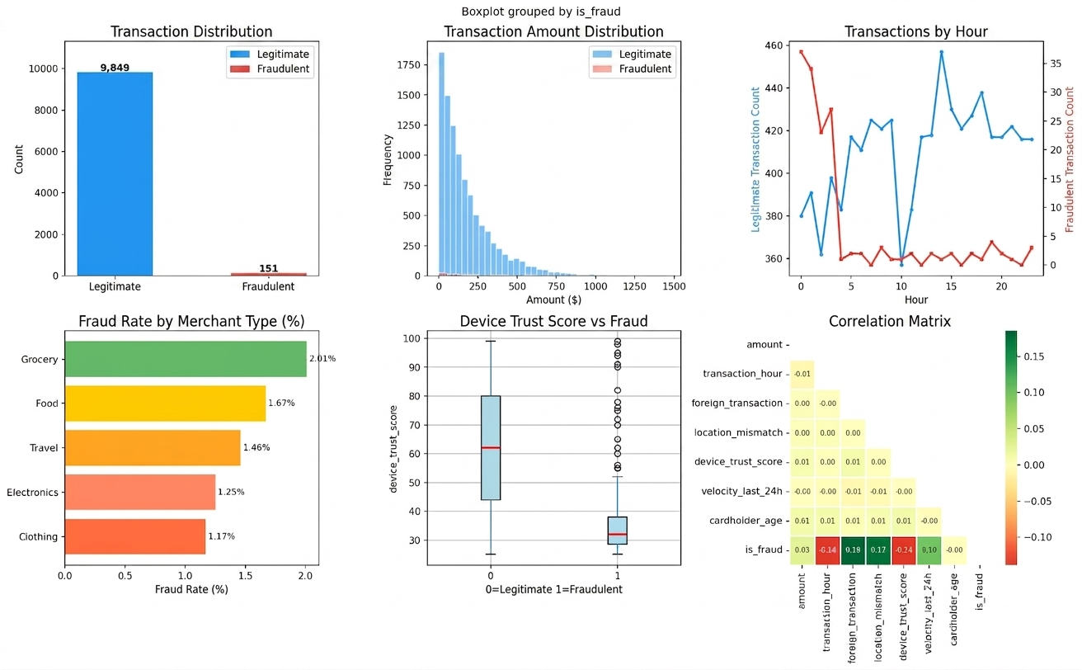
Dataset Snapshot and Exploratory Analysis
EDA was used to understand imbalance, feature behavior and fraud patterns.
10,000
9,849
151
transactions
legitimate
fraudulent
• Fraud represents only about 1.5% of the transactions.
• Transaction amounts are concentrated at lower values.
• Fraud patterns vary across time, merchant type and device trust.
Bilal Massad • 1:30
5/12

Slide 6
What Did the EDA Reveal?
The strongest visual signals were related to timing, device trust and transaction context.
Imbalance
Legitimate transactions dominate the raw data, so accuracy alone is not enough.
Device trust
Fraudulent cases show a much lower device-trust distribution.
Merchant / time
Fraud rates differ across merchant categories and transaction hours.
Bilal Massad • 2:00
6/12

Slide 7
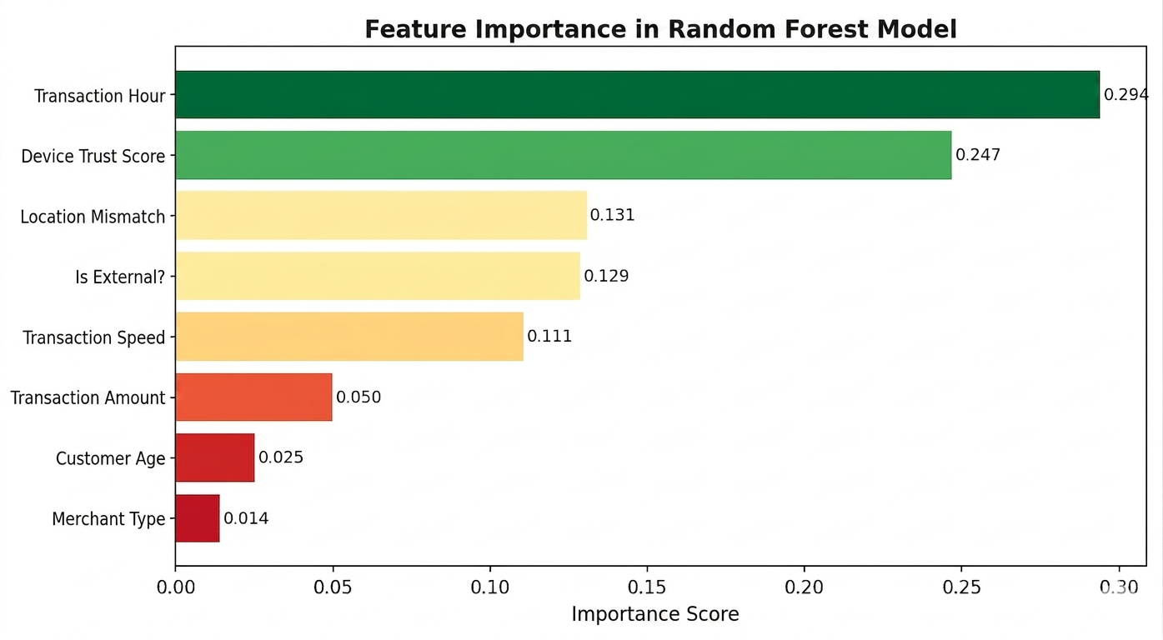
Feature Preparation and Risk Signals
The model becomes more useful when the input features reflect meaningful transaction behavior.
TOP SIGNALS
• Transaction Hour — 0.294
• Device Trust Score — 0.247
• Location Mismatch — 0.131
• External Transaction — 0.129
• Transaction Speed — 0.111
Data balancing
The training data was balanced to reduce bias toward the majority class and improve fraud detection.
Nourhan Shahadeh • 2:00
7/12

Slide 8
Machine Learning Models and Training
Three models were trained and compared using the same prepared dataset.
Logistic Regression
Decision Tree
Random Forest
Baseline linear classifier
Rule-based nonlinear classifier
Ensemble of decision trees
TRAINING FLOW
Cleaned data
Balanced data
Train models
Validate
Evaluation focuses on accuracy, precision, recall, F1-score and AUC.
Sabeel Abu Shamlah • 2:00
8/12

Slide 9
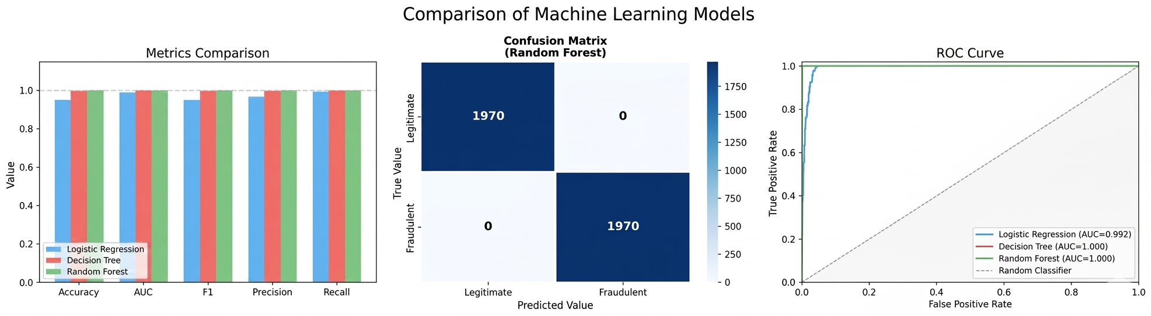
Model Evaluation Results
Random Forest achieved the strongest results on the displayed evaluation set.
1.000
1.000
Random Forest AUC
Accuracy
1970 / 1970
Correct cases in confusion matrix
Academic note
The result is excellent, but strong results should be re-checked on new unseen data before real banking use.
Sabeel Abu Shamlah • 2:30
9/12

Slide 10
Deployment with Flask
Flask connects the trained model to a simple prediction endpoint.
Web Form
Flask API
ML Model
Prediction
Request
Processing
Response
User submits transaction features through the web form.
Flask loads the trained model, prepares inputs and returns a prediction.
The interface shows the predicted class and a risk score / message.
Goal: make the ML model usable by a non-technical user.
Nourhan Shahadeh • 2:00
10/12

Slide 11
Web Interface and Live Demo Flow
The demo should be simple: enter features → submit → receive a clear fraud decision.
Fraud Detection Web App
Step 1
Transaction details
Enter the transaction features.
Transaction Amount
Device Trust Score
$ 250
32
Step 2
Click Predict and send the request to Flask.
Transaction Hour
Location Mismatch
14
Yes
Step 3
Predict Transaction
Result: FRAUDULENT
Show the prediction returned by the model.
Example interface — use the actual project UI during the live demo.
Nourhan Shahadeh • 3:30
11/12

Slide 12
Conclusion
From data analysis to a usable fraud-detection prototype
VALUE ADDED
LIMITATIONS
NEXT STEPS
Complete pipeline from EDA to deployment.
Meaningful risk signals guide the model.
Results depend on the dataset.
High scores should be validated on new unseen data.
Larger datasets + explainability.
Stronger API security and monitoring.
TAKEAWAY
An accurate model becomes valuable when it supports
clear and actionable fraud decisions.
Thank you
Questions & Discussion
Sami Ismail • 3:00
12/12

