Slide 1
Company Research summary:
OLIST
Prepared by Nourhan Amro · HVIA-AI Internship · 2026
Real Data. Real Business. Real Impact.

Slide 2
Company Snapshot
2015
Tiago Dalvi
$1.5B
$320M+
$70B+
45,000+
Who Olist is today, at a glance
Founded as Olist, headquartered in Curitiba, Brazil
Valuation reached with the Series E round (Dec 2021)
Founder & CEO — still leading the company today
Raised across six funding rounds to date
Gross merchandise volume processed per year (2026)
Active sellers running their business on Olist

Slide 3
Olist Has Reinvented Itself Before
Four rescopes in ~15 years — each time chasing the seller's next real pain point
2007
2008
2011
2014
Artisan fair-trade shop (Solidarium)
Pivots to retail distributor
Solidarium becomes an online marketplace
Near-collapse — 500 Startups rescue
Olist's core skill was never “selling on marketplaces” — it's re-scoping the business around whatever pain the seller has next.
2015
2019–26
Reborn as Olist: multi-marketplace listing
2019–26
Ecosystem: ERP + logistics + creditI

Slide 4
One Seller, Three Ways Olist Makes Money
COMMERCE | LOGISTICS | CAPITAL
Olist Store — listing across 15+ marketplaces Olist Shops — own branded online store Revenue: take-rate + SaaS fees | Olist Pax — fulfillment network Envios — AI-driven shipping (8x growth) Revenue: shipping & fulfillment fees | Olist Credit — merchant lending Olist Pay — payment processing Revenue: lending margin + processing fees

Slide 5
50,000+
6.5M+
2.5M+
Small and medium Brazilian merchants, plus a growing base of digitally native brands who can't justify building direct integrations with 15+ individual marketplaces themselves.
active sellers
Olist gives them one dashboard for listings, orders, payments, and increasingly logistics and credit too.
products listed
end consumers reached

Slide 6
customers!
Small and medium Brazilian merchants who can't justify building direct API integrations with 15+ individual marketplaces themselves, plus a growing segment of digitally-native brands. The three stats (50K+ sellers, 6.5M+ products, 2.5M+ end consumers).

Slide 7
Pain Points to Validate in the Data
Hypotheses from company research — to be tested against the 2016–2018 order data
1
Logistics complexity
Delivery time and freight cost likely vary hugely by Brazilian region.
2
Fragmented seller quality
A long tail of small sellers can mean inconsistent reviews and service.
3
Credit & payment risk
Olist Credit now underwrites merchant loans — exposure worth understanding.
4
Competitive pressure
Mirakl, Marketplacer, and regional players compete for the same sellers.
5
AI-native execution
Dalvi's own 2026 challenge: becoming AI-native at scale, not just AI-assisted.

Slide 8
Dataset understanding

Slide 9
Nine Tables, Grouped by Role
Four rescopes in ~15 years — each time chasing the seller's next real pain point
CORE TRANSACTION
PARTIES
CATALOG & GEO
orders :the hub (99,441 rows)
order_items : items per order (112,650)
order_payments :how paid (103,886)
order_reviews :1–5 score (99,224)
customers :buyer + zip (99,441)
sellers :merchant + zip (3,095)
customer_unique_id :links repeat buyers across order-level customer_id
products :category + specs (32,951)
Category_name_translation:
PT→EN lookup (71)
geolocation : zip → lat/lng (1,000,163)

Slide 10
Data Quality: Verified, Not Assumed
0
112,650
13
1.14
18.5%
6.8%
Results from the integration notebook's referential-integrity and cardinality checks
Orphaned foreign keys across every table join — checked, not assumed
Rows in the final order-item-grain master table (matches order_items exactly)
Notebooks built: 9 profiling + integration + RFM + sales/delivery + seller analysis
Average items per order (max 21)
of customer_ids collapse when grouped by the real customer_unique_id
of delivered orders arrive later than promised — the seed of Finding 1

Slide 11
The Business Story
What the numbers actually say, once you dig past the schema

Slide 12
A Healthy Aggregate, Two Measurable Leaks
Olist's core model thousands of small sellers reaching customers across a huge, uneven country is fundamentally healthy in aggregate.
No region, seller, or category is large enough to sink the business alone.
But underneath that healthy aggregate, two specific, quantifiable problems are quietly costing satisfaction and revenue quality
both are exactly the kind of problem analytics and AI exist to fix.

Slide 13
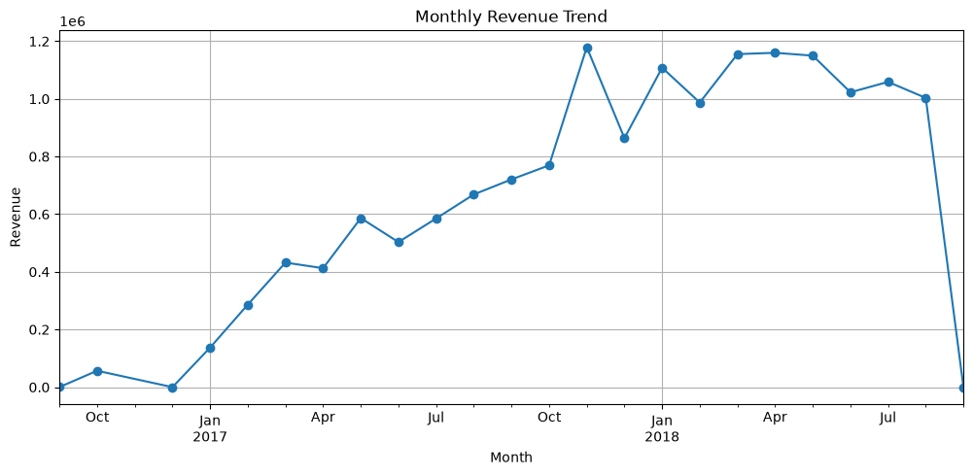
Where the Revenue Comes From
What the numbers actually say, once you dig past the schema
Notebook 12 — Sales & Delivery “Monthly Revenue Trend”

Slide 14
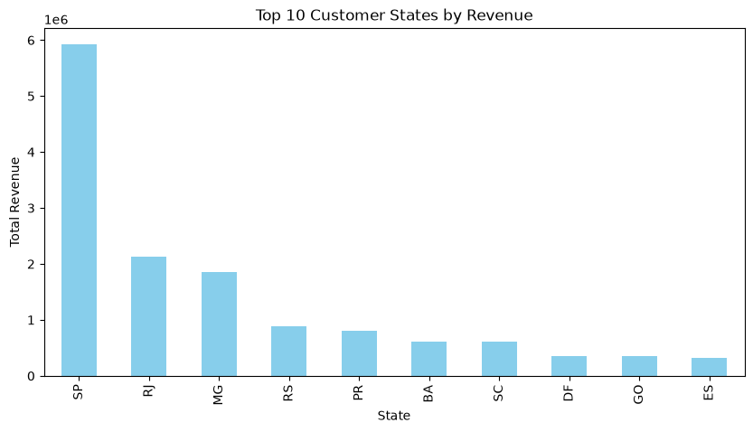
Where the Revenue Comes From
What the numbers actually say, once you dig past the schema
Notebook 12 — Sales & Delivery “Top 10 Customer States by Revenue

Slide 15
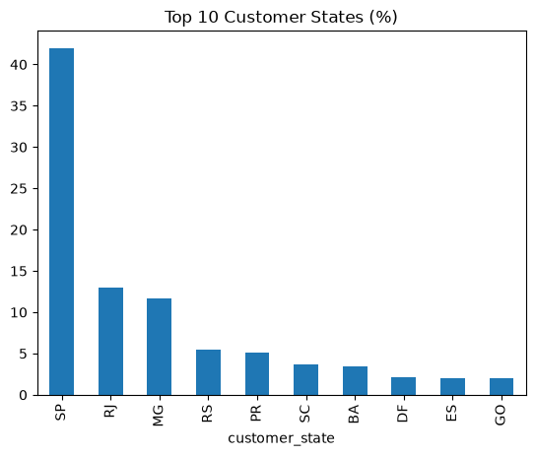
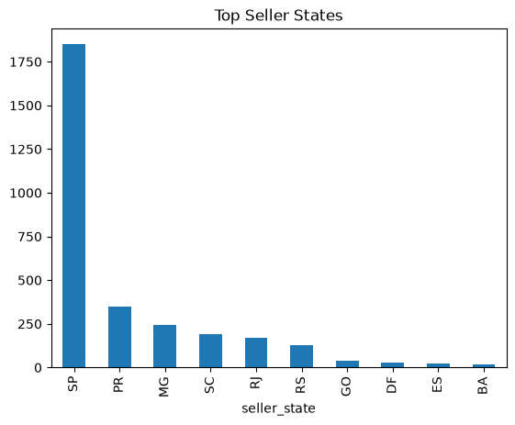
Where Customers & Sellers Concentrate
Both sides of the marketplace cluster in the same handful of states
Notebook 01 — Customers “Top 10 Customer States (%)”
Notebook 01 — Customers “Top 10 Customer States (%)”

Slide 16
Finding 1 :Delivery Performance & Its Cost
12.1 vs 23.4
6.8%
15–21%
4.29 → 2.27
−0.27
1 shot
Confirmed hypothesis: logistics complexity is real, and it's geographically concentrated
Avg. actual vs. estimated delivery days — Olist under-promises by design
of delivered orders arrive late overall
late-delivery rate in AL, MA, SE — far from the SP/RJ core
Average items per order (max 21)
correlation between delay length and review score
most customers never buy from Olist again — a late order may be their only impression

Slide 17
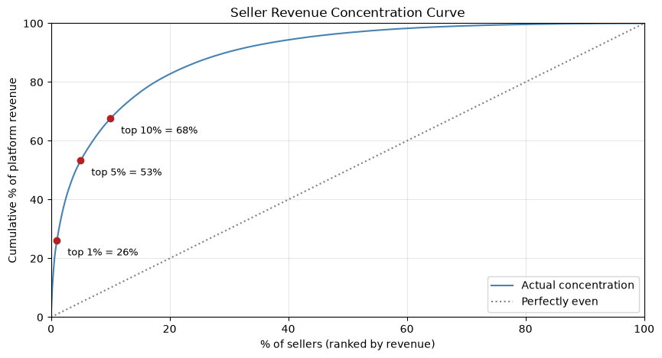
Finding 2 : Revenue Concentration Among Sellers
Long tail, not a monopoly: top 1% of sellers hold 26% of revenue, no seller exceeds 1.7%
Notebook 13 — Seller Analysis “Seller Revenue Concentration Curve”

Slide 18
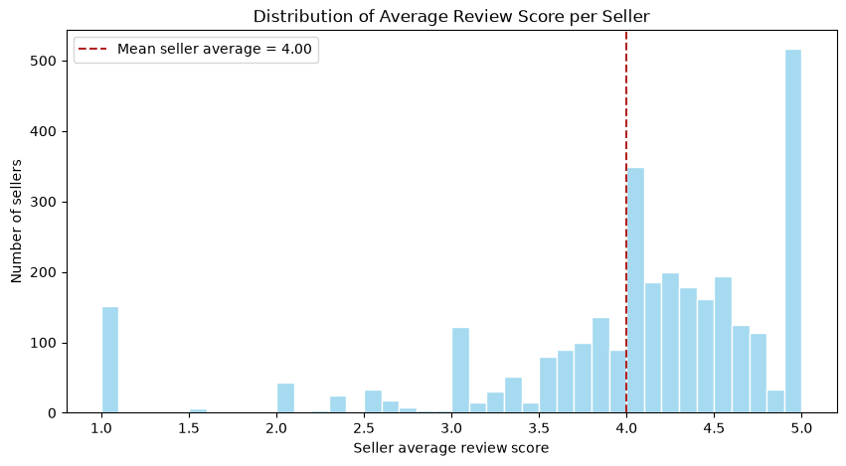
Is the Low Score Signal or Noise?
9.9% of sellers average below 3.0 — but is that a real pattern?
Notebook 13 — Seller Analysis “Distribution of Average Review Score per Seller”

Slide 19
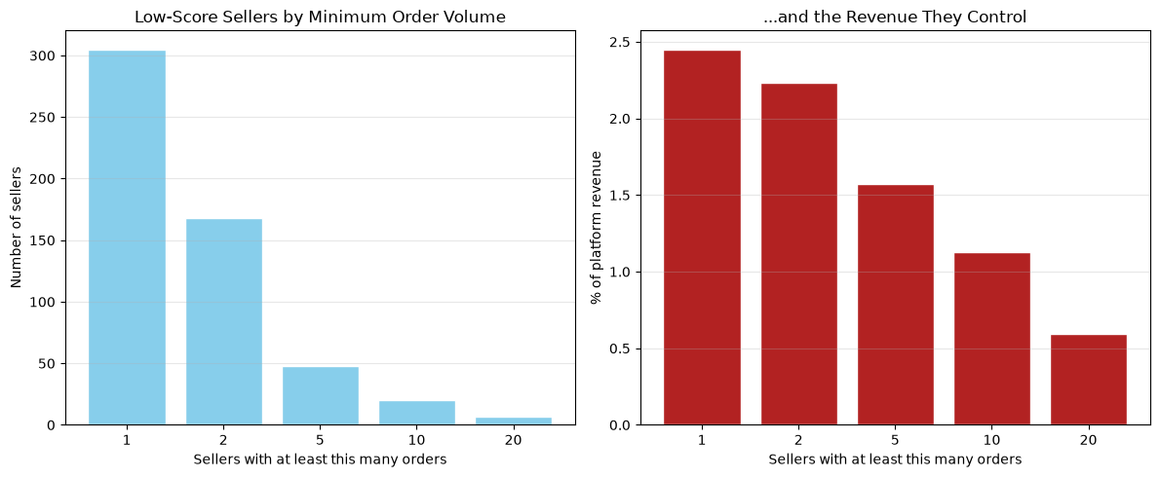
One Bad Review vs. a Real Pattern
Re-cutting low scorers by genuine order volume separates noise from a sustained problem
Notebook 13 — Seller Analysis“Low-Score Sellers by Minimum Order Volume” +“…and the Revenue They Control”

Slide 20
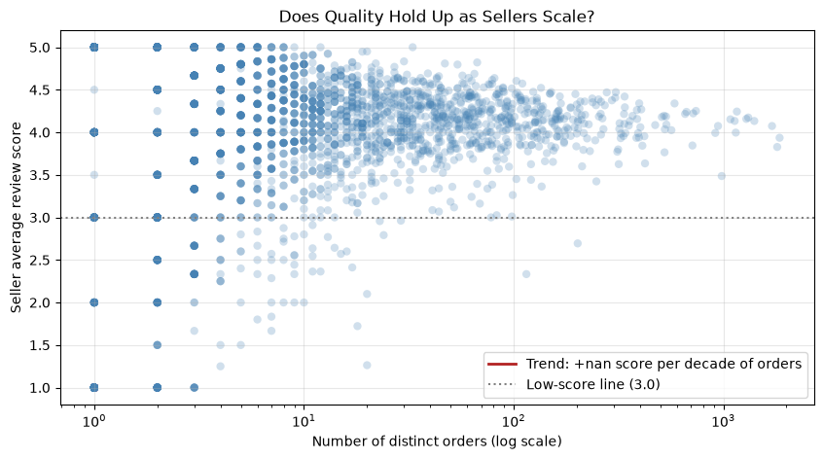
Does Quality Hold Up at Scale?
Order volume vs. average review score : quality does not degrade as sellers grow
Notebook 13 — Seller Analysis “Does Quality Hold Up as Sellers Scale?”

Slide 21
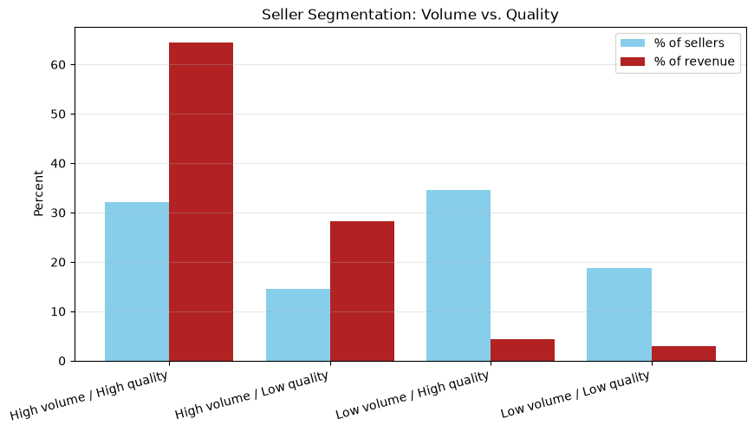
The Segment That Matters
451
28.2%
30,693
451 sellers (14.6%) combine above-median volume with below-average quality
high-volume / low-quality sellers
of platform revenue sits with them
orders run through this segment
Notebook 13 — Seller Analysis “Seller Segmentation: Volume vs. Quality”

Slide 22
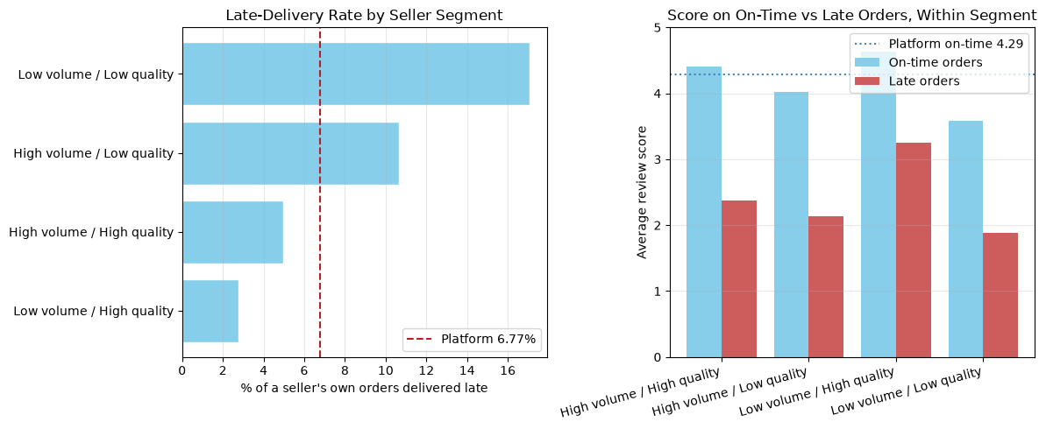
Tested directly : the risk segment's own on-time orders still underperform
45% / 55%
41%
88 sellers
Tested directly — the risk segment's own on-time orders still underperform
of the segment's score gap is delivery-driven vs. genuinely seller-driven
of all late orders platform-wide come from this one segment
in the segment have a 0% late rate and still score below average
Notebook 13 — Seller Analysis (validation section)
“Late-Delivery Rate by Seller Segment” +
“Score on On-Time vs Late Orders, Within Segment

Slide 23
The Throughline
Two specific, measurable operational leaks sit inside an otherwise healthy business:
a geographically concentrated delivery failure punishing already-underserved regions, and a defined high
volume seller segment whose quality gap is real ,not a logistics illusion , and puts over a quarter of platform revenue at quiet risk.
Neither requires a strategic pivot to fix. Both are exactly what targeted analytics and prediction exist to solve.
Scope limitation: the fifth hypothesis credit & payment risk is not testable with this dataset. It records payment method and installments, but no repayment, default, or chargeback outcomes. Stated plainly rather than approximated.

Slide 24
The Solution Proposal

Slide 25
Introducing the Order & Seller Risk Score
DELIVERY-RISK COMPONENT
SELLER-RISK COMPONENT
Predicts at order-time whether this shipment is likely late, based on the confirmed regional pattern (state, seller, season).
Flags whether this order's seller sits in the confirmed high-volume / low-quality segment.
Attribution matters because the data proved it has to: this segment alone generates 41% of platform wide late orders while holding a genuine, delivery-independent quality gap collapsing both into one number would mis-rank the real cause.

Slide 26
Dual-Track Action, Mapped to HVIA's Capabilities
LOGISTICS TRACK
(~45% of the gap)
Carrier prioritization for at-risk routes
Honest, region-adjusted delivery estimates
Proactive delay notifications to customers
QUALITY TRACK
(~55% of the gap)
Account-management outreach to flagged sellers
Listing-quality review and coaching
Response-time support, not a shipping fix

Slide 27

The Outreach

Slide 28
The Outreach Message
Hi [Name],
I've been digging into Olist's public order dataset as part of a data analysis project, and one pattern stood out: about 15% of sellers account for over 40% of all late deliveries platform-wide, while holding roughly 28% of total revenue. Looking closer, it's not simply a shipping issue — some of it traces back to delivery timing, but most of the quality gap holds up even on their on-time orders.
That's the kind of pattern a seller-level risk score could catch early — flagging whether a seller's risk is logistics-driven or service-driven before it shows up in reviews, so the right team can act on the right cause.
I'd love to share the full analysis and hear whether this lines up with something your team is already looking at. Would you be open to a short 15-minute call in the next couple of weeks?
Best,
Nourhan
AI Intern, HVIA Data & AI Solutions
LinkedIn — addressed to Olist's Head of Data / Operations / Seller Experience

Slide 29
Thanks!

