Slide 1
FINAL DATA ANALYTICS PROJECT
CMS Synthetic Healthcare
Claims & Insurance Analytics
Team 3
NTI (Advanced Data Analytics)
/ Eng. Shimaa Daowd
5-9-2026
Nourhan, Malak -> Power BI
Basnt -> Tableau
Dareen, Clara -> Python

Slide 2
AGENDA
What we'll walk you through
01
Business Problem & Objectives
05
Power BI / Tableau Dashboards
02
Dataset & Data Sources
06
Python Analysis & Predictive Modeling
03
Data Cleaning & Preparation
07
Key Insights & Recommendations
04
Data Modeling — Star Schema
08
Limitations & Next Steps
CMS Synthetic Healthcare Analytics | Final Project
2

Slide 3
SECTION 01
Business Problem & Objectives
Business Question
How do clinical encounter types, high-cost drugs, and demographics drive $16.81M in healthcare costs, and how can ML models classify patient risk and forecast expenses to relieve facility strain?
Stakeholders
Healthcare Analytics, Clinical Risk Management, Hospital Operations, and Financial Actuarial Teams.
Decisions Supported
Financial: Reduce $4.35M in uncovered costs by adjusting payer coverage strategies.
Clinical: Automate risk triage (High/Medium/Low) for severe cases (e.g., fractures, embolisms).
Operations: Balance provider workload and hospital capacity based on predicted demand and patient age stays
Success Criteria
Predictive Accuracy: High Accuracy in classification model & NLP.
Financial Impact: Actionable feature importance metrics to reduce $4.35M in uncovered expenses.
BI Synergy: Full integration across Python modeling, Power BI financial KPIs, and Tableau operational dashboards.
Reminder: CMS data here is synthetic — findings must not be used for real clinical conclusions.
CMS Synthetic Healthcare Analytics | Final Project
3

Slide 4
SECTION 02
Dataset & Data Sources
medications.csv
encounters.csv
claims_transactions.csv
careplans.csv
Prescription (Part D) Events
procedures.csv
conditions.csv
payers.csv
claims.csv
[# records, key fields — drug codes, days supply, cost]
patients.csv
providers.csv
immunizations.csv
Source Data
Dataset Link : https://synthetichealth.github.io/downloads.html
CMS Synthetic Healthcare Analytics | Final Project
4

Slide 5
SECTION 03
Data Cleaning & Preparation
Missing Values
Duplicates
Data Types
Invalid Dates
Text Inconsistencies
Outliers
CMS Synthetic Healthcare Analytics | Final Project
5

Slide 6
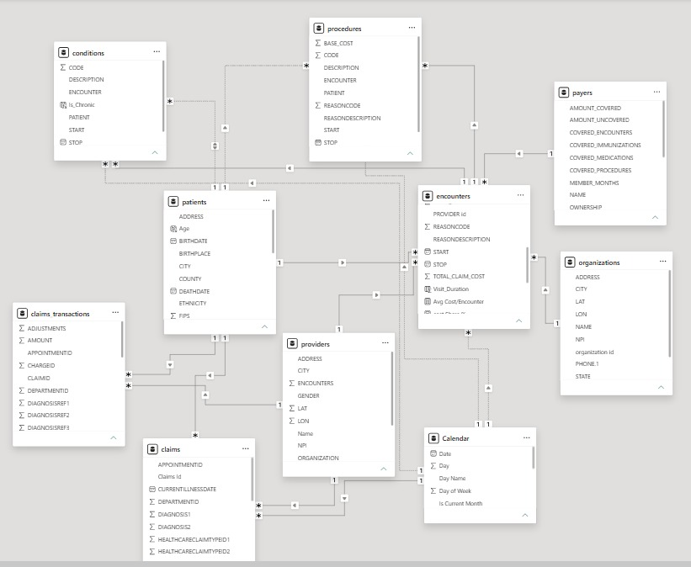
SECTION 04
Data Modeling — Star Schema
Fact & Dimension Classification
Fact Tables
Fact_encounters
Fact_claim
Fact_claims trascations
Fact_conditions
Dimension / Lookup Tables
Dim_patients
Dim_providers
Dim_organizations
Dim_procedures
Dim_payers
Calender (Date Dimension)
CMS Synthetic Healthcare Analytics | Final Project
6

Slide 7

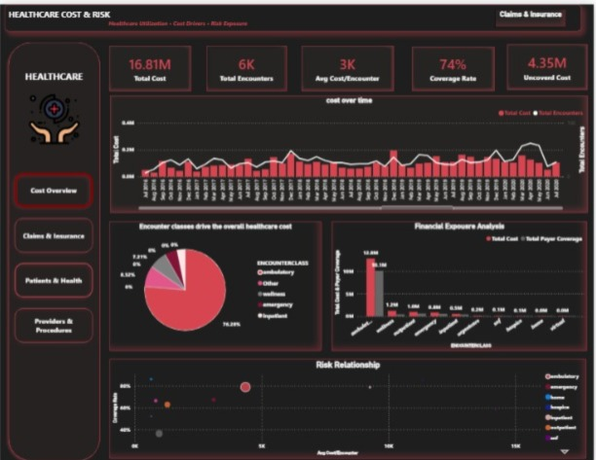
SECTION 05
Dashboard Walkthrough — Pages 1 & 2
[Dashboard Page 1 screenshot]
[e.g., Executive Overview — KPIs, YTD/MTD, trend]
[Dashboard Page 2 screenshot]
[e.g., Claims Cost Deep-Dive]
CMS Synthetic Healthcare Analytics | Final Project
7

Slide 8
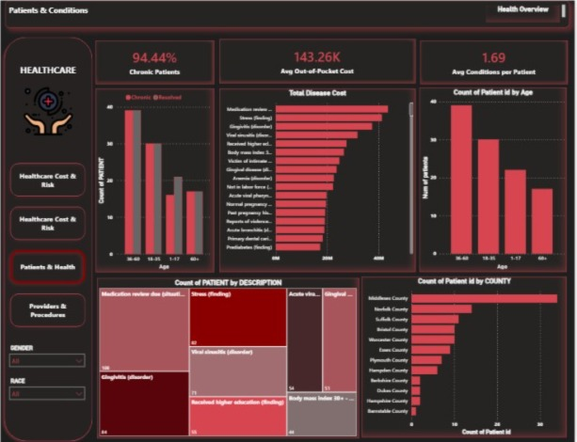
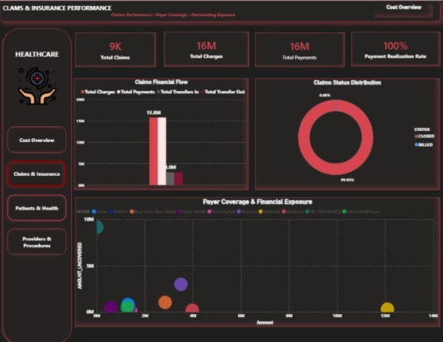
SECTION 05
Dashboard Walkthrough — Pages 3 & 4
[Dashboard Page 3 screenshot]
[e.g., Provider / Beneficiary Segmentation]
[Dashboard Page 4 screenshot]
[Detail / drill-through page]
[One-line insight callout for Page 3]
[One-line insight callout for Page 4]
CMS Synthetic Healthcare Analytics | Final Project
8

Slide 9
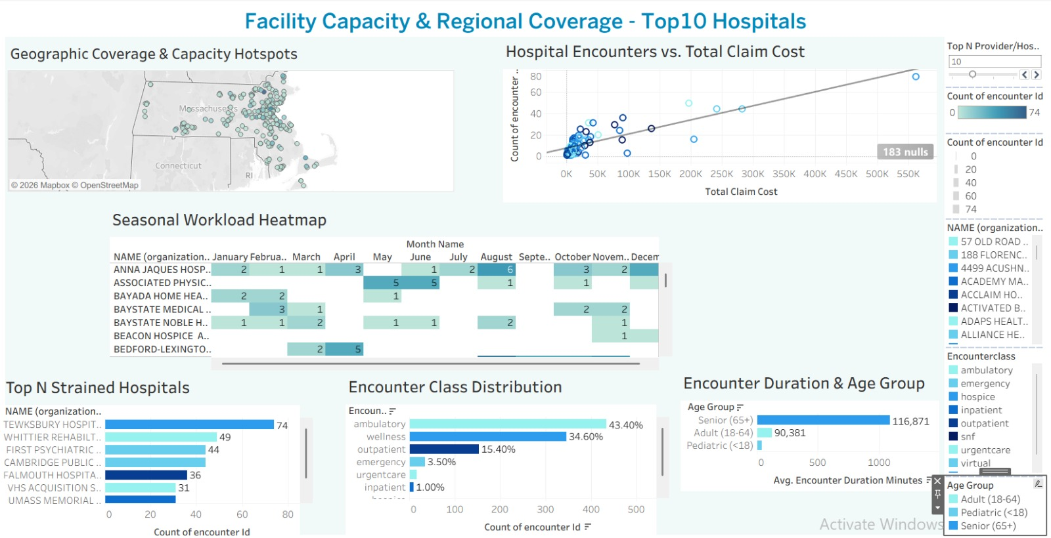
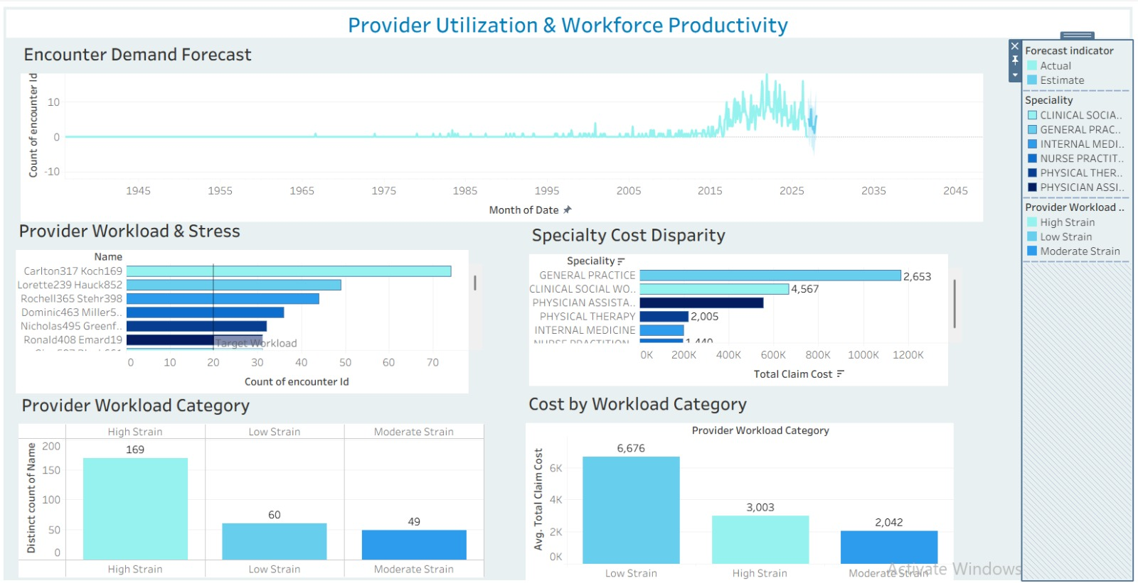
SECTION 05
Dashboard Walkthrough — Pages 1 & 2
[Dashboard Page 4 screenshot]
[Detail / drill-through page]
CMS Synthetic Healthcare Analytics | Final Project
8

Slide 10
SECTION 05
BI Interactivity Highlights
Drill-down & drill-through to detail page
Slicers & report-page tooltips
1
2
Navigation buttons & bookmarks
Q&A visual
3
4
Dynamic titles / KPI icons via DAX
Parameter-driven views (Tableau: Top N / Measure / Year selector)
5
6
[Mark which items your team implemented, and where to see each one in the dashboard]
CMS Synthetic Healthcare Analytics | Final Project
9

Slide 11
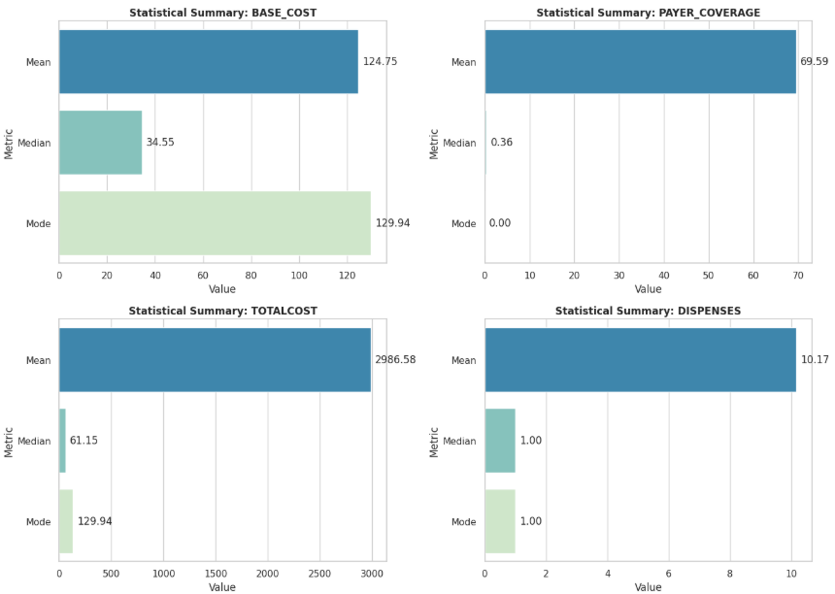
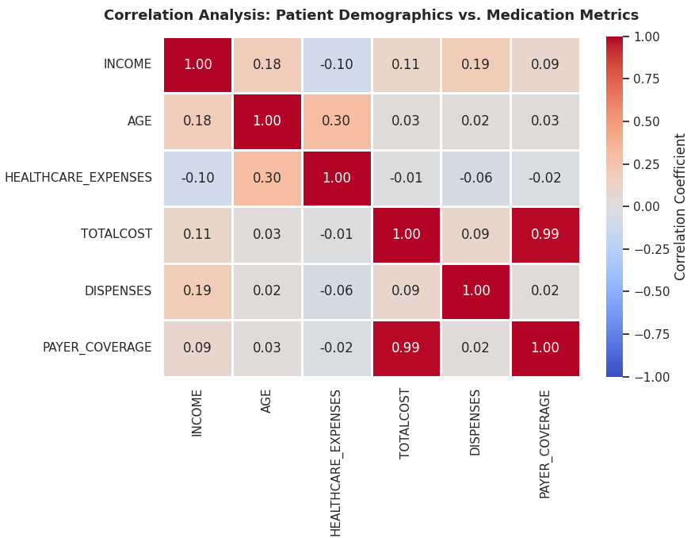
SECTION 06
Python Analysis — Descriptive & Correlation
[Chart: descriptive statistics —
e.g., distribution of claim costs by type]
[Chart: correlation heatmap —
claim cost vs. chronic conditions / length of stay]
CMS Synthetic Healthcare Analytics | Final Project
10

Slide 12
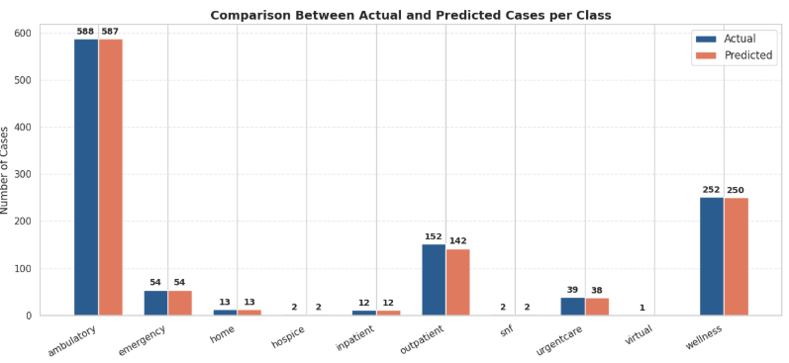
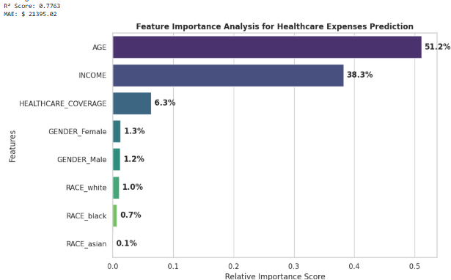
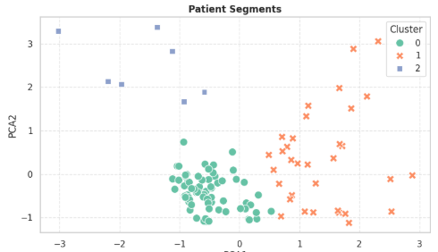
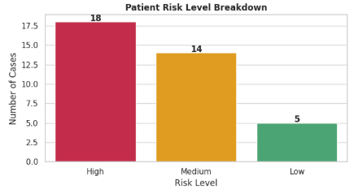
SECTION 06
Python Analysis — ML models and NLP
[Task type: classification of high-cost beneficiaries / regression on claim cost / clustering of provider risk profiles]
[Model output visual — confusion matrix,
feature importance, or predicted vs. actual plot]
Classification
Model : Random Forest
Dataset: encounters.csv (Label : ‘ENCOUNTERCLASS’)
Accuracy: 0.98
Regression
Model : Random Forest
Dataset: Patient.csv (Label : ‘HEALTHCARE_EXPENSES’)
Accuracy: 0.74
Clustering
Model : KMeans
Dataset: Patient.csv
Clusters : 0, 1, 2
NLP
Dataset: careplans.csv
Risk_Level: High, Medium, Low
CMS Synthetic Healthcare Analytics | Final Project
11

Slide 13
SECTION 07
Key Insights & Recommendations
Insights
Recommendations
1
High-Cost Exposure: Healthcare expenses total $16.81M across 6K encounters, with $4.35M left uncovered due to cost disparities in specific encounter classes like Ambulatory (76.28% volume).
1
Revenue Cycle & Portfolio Risk Mitigation:
Renegotiate payer contracts and adjust coverage thresholds for high-volume segments (like Ambulatory care) to directly recapture the $4.35M uncovered cost exposure and protect profit margins.
2
Operational Strain & Bottlenecks: Provider utilization is heavily imbalanced, where high-strain facilities experience disproportionately high claim costs and senior patients ($65+$) demand longer stay durations.
2
Capacity Optimization & Cost-Containment:
Implement predictive staff scheduling and patient load-balancing based on demand forecasts to reduce high-strain provider overtime, prevent clinician burnout, and eliminate defensive over-testing costs.
3
Predictive Drivers & Risk: Clinical risk is driven by critical diagnoses (fractures, embolisms) and high-cost medications (e.g., Alteplase), where HEALTHCARE_COVERAGE and AGE serve as top predictors in cost modeling.
CMS Synthetic Healthcare Analytics | Final Project
12

Slide 14
SECTION 08
Limitations & Next Steps
Limitations
Next Steps
Synthetic Data Scope: Generated data may not fully capture real-world patient behavior or complex clinical edge cases.
Unstructured Diagnosis Text: Diagnostic descriptions (REASONDESCRIPTION) lack full clinical detail and standardized ICD codes.
Data Cleaning Challenges: High noise and missing values in specific fields
Incorporate Real EMR & Claims Data: Validate models using authentic hospital Electronic Medical Records and actual insurance claim logs.
Advanced Model Tuning & Deep Learning: Fine-tune BioBERT for multi-label risk classification and test XGBoost/LightGBM algorithms to boost cost regression R^2.
Real-Time BI Dashboard Integration: Add interactive risk-scoring calculators and automated forecasting alerts into Power BI and Tableau.
CMS Synthetic Healthcare Analytics | Final Project
13

Slide 15
TEAM
Team Members & Roles
Nourhan Ahmed
Malak Youssif
Basnt Ibrahim
Dareen Elsayed
cleaning & modeling
&2 Dashboards using Power BI&
cleaning & modeling
&2 Dashboards using Power BI
cleaning & modeling
& 2 Dashboards using Tableau
& One story
Python Anylsis (Statistics & Correlation & Clustering & Classification & NLP )
Clara Ehab
Python Analysis (Time-Series Forecating & Regression & Describtive Analysis )
CMS Synthetic Healthcare Analytics | Final Project
14

Slide 16
Thank You
Questions & Discussion
Project Link : https://drive.google.com/drive/folders/1UEkG6xG5FK3Xfu8pjYVLxdS6njnGtDOf?usp=sharing
NTI (Advanced Data Analytics)
5-9-2026

