Slide 1







Insurance Performance Analysis Project
Excel
Python
SQL
Power BI
Tableau
Supervised by
DR. Amal Mahmoud

Slide 2



Nourhan Elboraey
Team Lead
Bachelor of Commerce
Taha Mohammed
FCAI-CU Student
Radwa Sayed
Bachelor of BIDT

Slide 3
OVERVIEW
Table of Contents
1
Why This Project
7
Python — Cleaning, EDA & Features
Slide 13
2
Dataset Overview
8
Python — Risk Factor Analysis
Slide 4
Slides 14–17
3
Challenges & Limitations
9
Power BI — Executive View
Slide 5
Slides 18–22
4
The Analytics Tools
10
Tableau — Exploratory View
Slide 6
Slides 23–26
5
Excel — Data Modeling & Dashboards
11
Key Insights & Recommendations
Slides 7–9
Slides 27–28
6
SQL — Modeling & KPI Queries
12
Conclusion
Slides 10–12
Slide 29

Slide 4
WHY THIS PROJECT
Project Objective
Identify Cost Drivers
This project analyzes over 100,000 medical insurance records to understand the factors affecting healthcare costs and insurance profitability. The analysis helps identify cost drivers, segment customer risk, and support better pricing and business decisions through interactive dashboards..
Which demographic & health factors most affect claims cost
Segment Risk
Group patients/plans by risk profile for targeted action
Enable Self-Serve Insight
Interactive dashboards for non-technical stakeholders
DEPI Capstone — Medical Insurance Analytics
2

Slide 5
THE RAW MATERIAL
Dataset Overview We worked with a dataset containing over 100,000 insurance records collected from Kaggle
100,000
4
Demographics
Kaggle
Insurance Records
Data Groups
Health · Usage · Plan
Public Source Dataset
Field groups used across the pipeline:
Demographics
Health Indicators
age, gender, region, income band
BMI, smoker status, chronic conditions
Healthcare Usage
Insurance Plan
visits, hospitalizations, prior claims
plan type, premium, coverage, tenure
These variables allowed us to analyze both customer behavior and medical costs
3

Slide 6
BEING UPFRONT
Challenges & Limitations
Data Challenges
Project Limitations
The Age column contained invalid values ranging from 0 to 200, resulting in unrealistic patient records and affecting data quality. values were cleaned and validated using predefined business rules to ensure consistency. Minor data quality issues, such as missing and inconsistent values, were also corrected during the preprocessing stage.
The analysis was based on a static historical dataset .
Results depend on the quality of the available data after preprocessing.
The project focused on descriptive analytics and dashboard reporting rather than predictive modeling.
DEPI Capstone — Medical Insurance Analytics
13

Slide 7
The Analytics Tools
Excel
Python
SQL
Power BI
Tableau
4

Slide 8
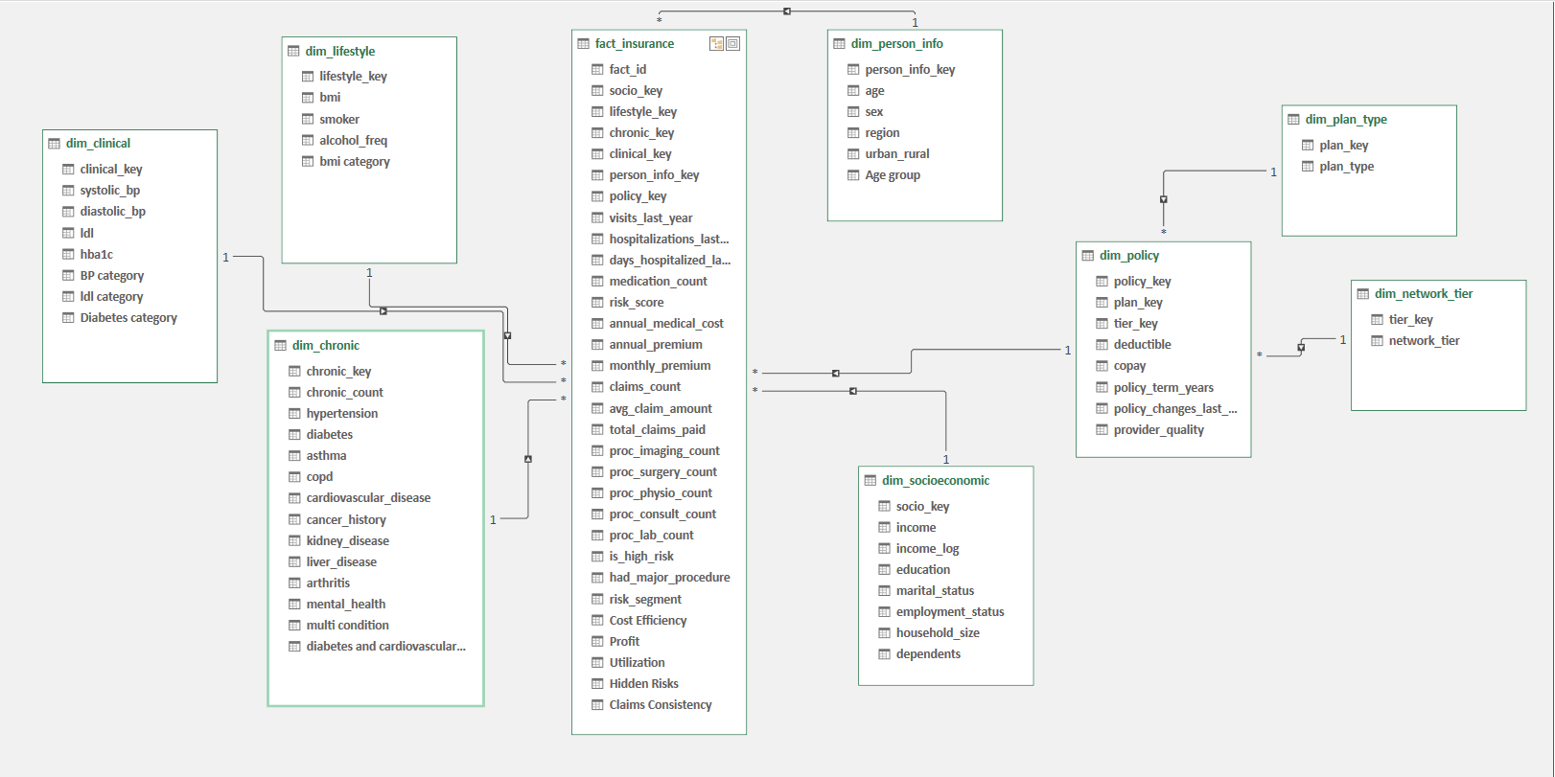
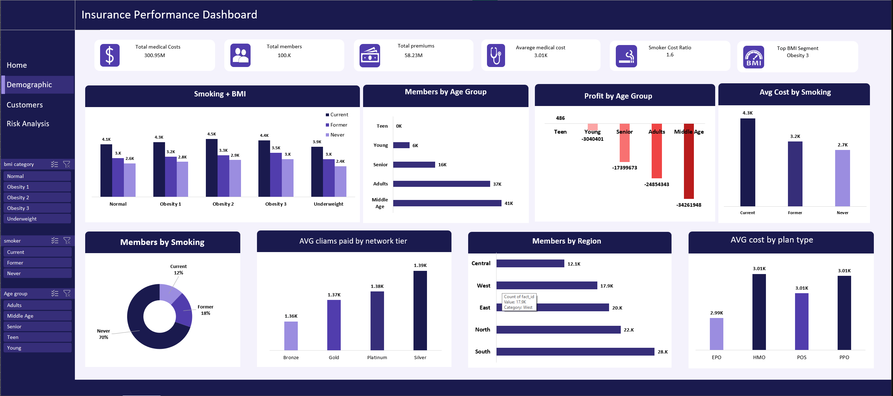
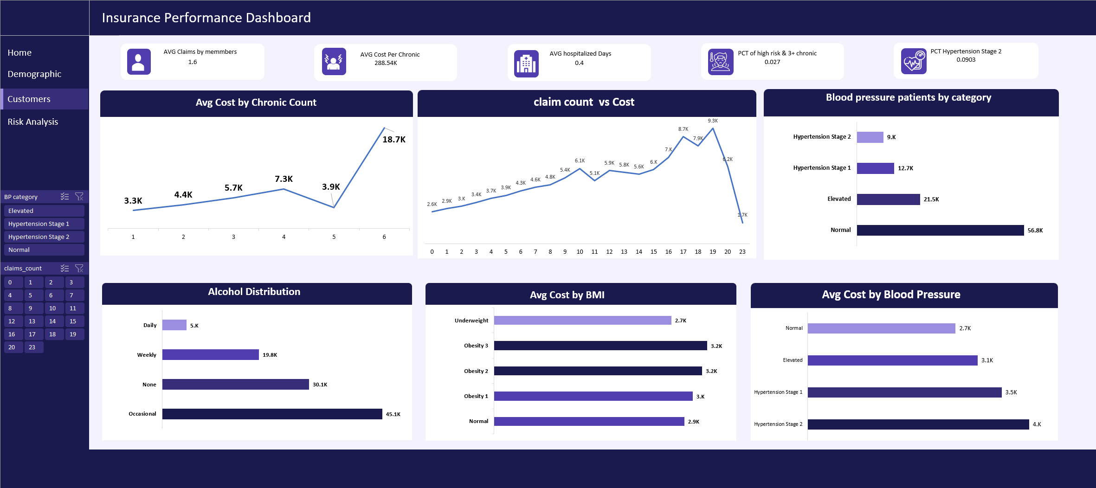
FIRST LOOK AT THE DATA
Excel—Data Modeling
We started with Excel to understand the raw dataset
1
Data Import
Load the dataset and verify rows, columns, and data types
2
Build Relationships
Create relationships between related tables using primary and foreign keys
3
Validate the Mode
Verify table connections to ensure accurate analysis and reporting.
DEPI Capstone — Medical Insurance Analytics
5

Slide 9
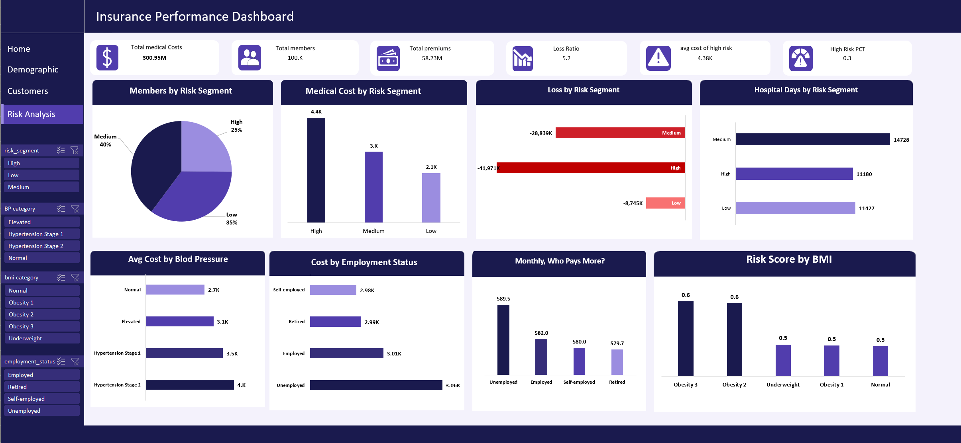
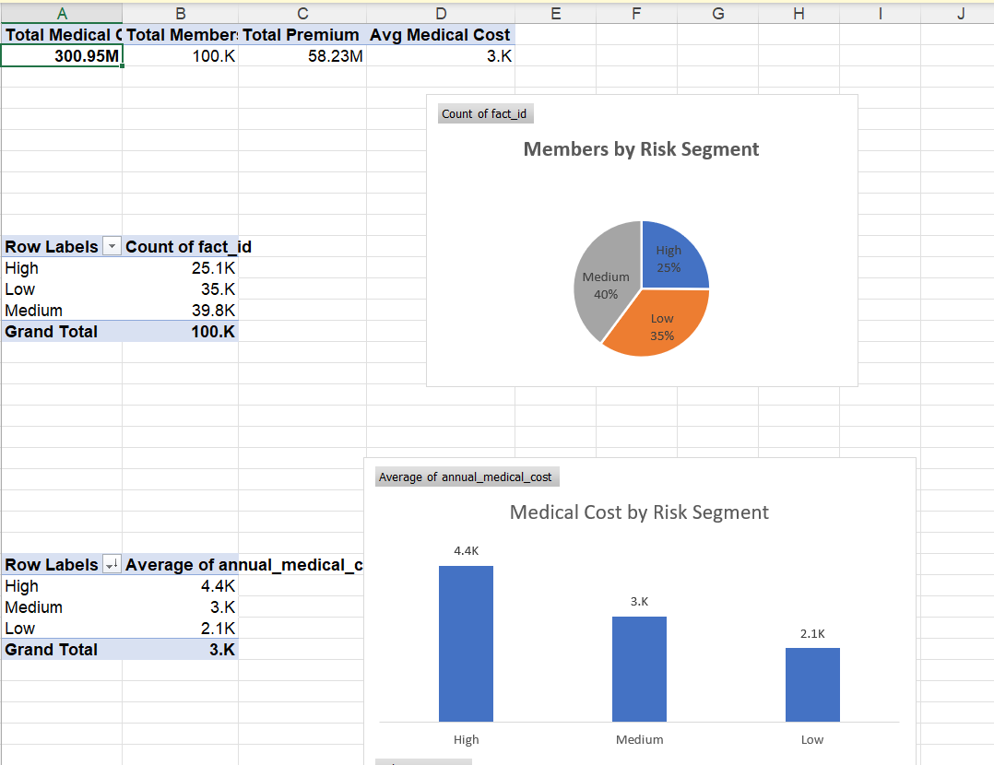
FIRST LOOK AT THE DATA
Excel— Analysis using the Model
1
Interactive Dashboard
Build dashboards using Pivot Charts and Slicers.
2
Dynamic Filtering
Allow users to filter data by region, age, plan, and risk level
3
Decision Support
Present business insights for faster decision-making.
DEPI Capstone — Medical Insurance Analytics
5

Slide 10

FIRST LOOK AT THE DATA
Excel— Dashboard
1
Interactive Dashboard
Row/column counts, data types, obvious gaps
2
Pivot Tables
Quick cuts by region, plan type, age band
3
Spot-Checks
Flag nulls, duplicates, and outlier values before scripting
DEPI Capstone — Medical Insurance Analytics
5

Slide 11
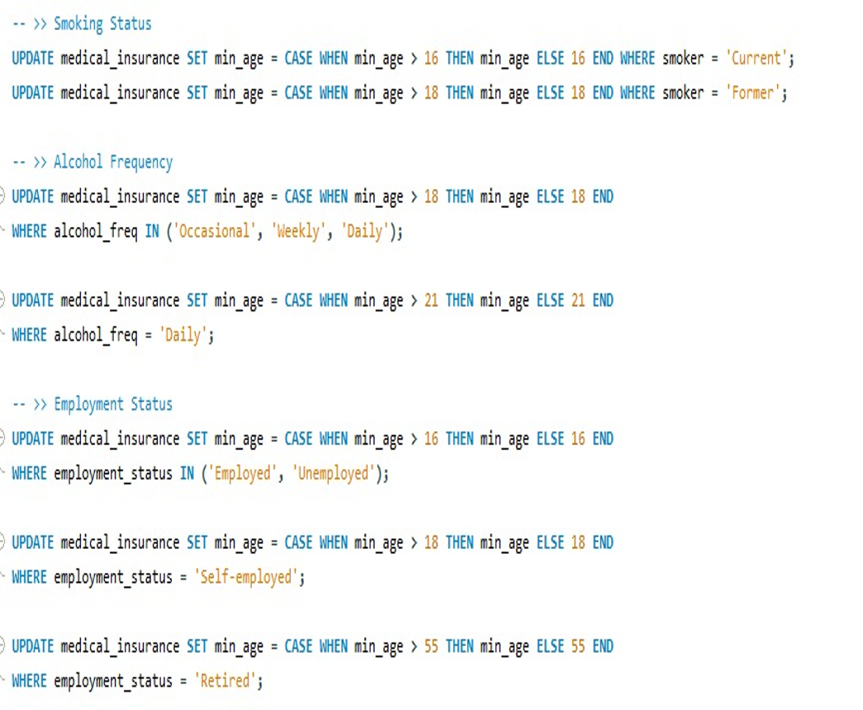
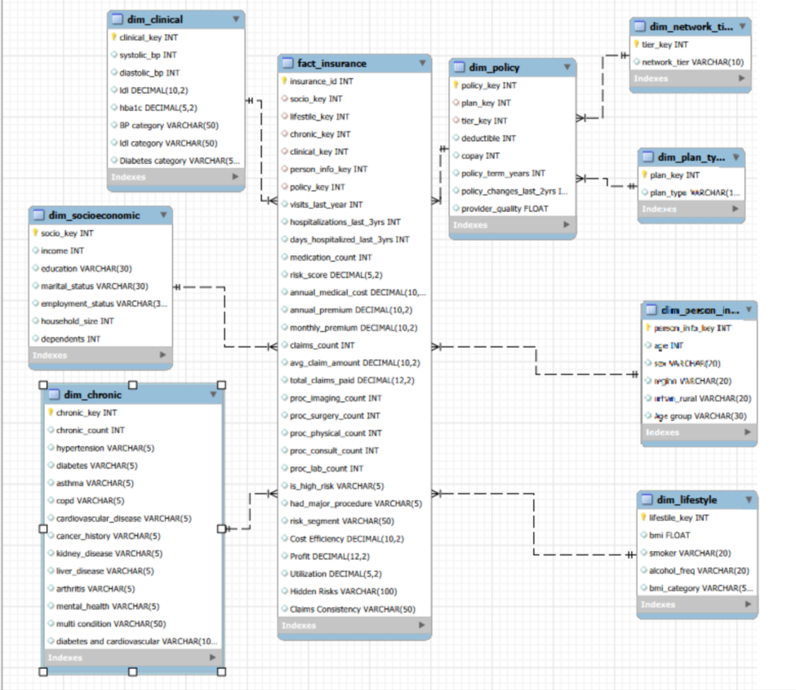
MODELING & KPI QUERIES
SQL— cleaning
Data Cleaning Process
Prepared the medical insurance dataset by identifying and correcting data quality issues to ensure reliable analysis and reporting.
Cleaning Tasks
Removed duplicate records.
Handled missing values.
Corrected invalid data entries.
Standardized data formats and categories.
Validated data consistency across related fields.
Outcome
A clean, consistent, and analysis-ready dataset used for SQL modeling, Python analysis, and Power BI dashboards.
DEPI Capstone — Medical Insurance Analytics
8
 | Role
fact_claims | Grain: one claim per row
dim_patient
dim_plan | Plan type, premium, coverage
dim_date | Time attributes for trending

Slide 12
MODELING & KPI QUERIES
SQL— Modeiling
Star Schema
Table | Role
fact_claims | Grain: one claim per row
dim_patient | Demographics & health indicators
dim_plan | Plan type, premium, coverage
dim_date | Time attributes for trending
Sample KPI Queries
Avg. claim cost by region & plan type
High-risk segment share of total cost
Utilization rate by age band
DEPI Capstone — Medical Insurance Analytics
8

Slide 13
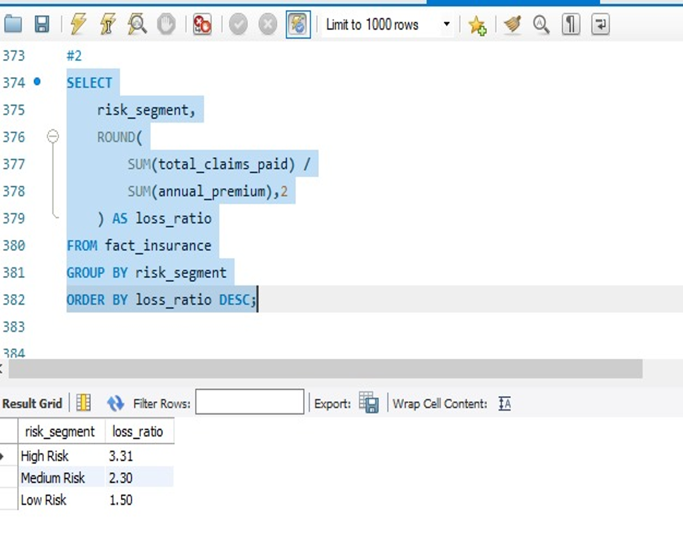
MODELING & KPI QUERIES
SQL— Analysis
Analysis Purpose
Analyze the cleaned insurance dataset to uncover trends, patterns, and key business insights that support ata-driven decisions
Key Analysis
Identified cost distribution across different patient groups.
Compared medical expenses by demographic and health factors.
Analyzed claim and premium trends.
Measured the impact of chronic diseases and lifestyle habits.
Generated business insights for reporting and dashboard design.
Outcome
Provided meaningful insights that guided the development of KPIs and interactive dashboards.
DEPI Capstone — Medical Insurance Analytics
8

Slide 14
CLEANING, EDA & FEATURES
Python
Data Cleaning
Exploratory Analysis
Feature Engineering
Handle nulls & duplicates
Standardize categories
Treat outliers
Distributions by age/region
Correlation of cost drivers
Class balance checks
Risk score / BMI bands
Utilization ratios
Encode categoricals
DEPI Capstone — Medical Insurance Analytics
6

Slide 15
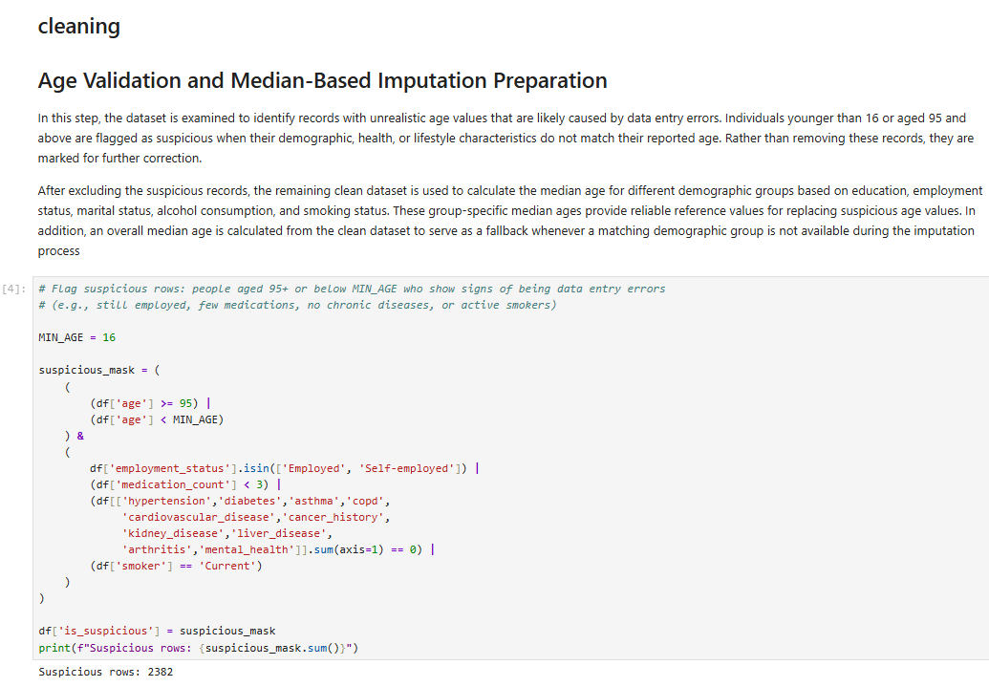
RISK FACTOR ANALYSIS
Python — Data Cleaning
1. Data Cleaning
Handle missing values, duplicates, and inconsistent records.
2. Feature Engineering
Create new variables such as BMI Category, Age Group, and Risk Score.
3. Data Preparation
Prepare the dataset for exploratory analysis and visualization
DEPI Capstone — Medical Insurance Analytics
7

Slide 16
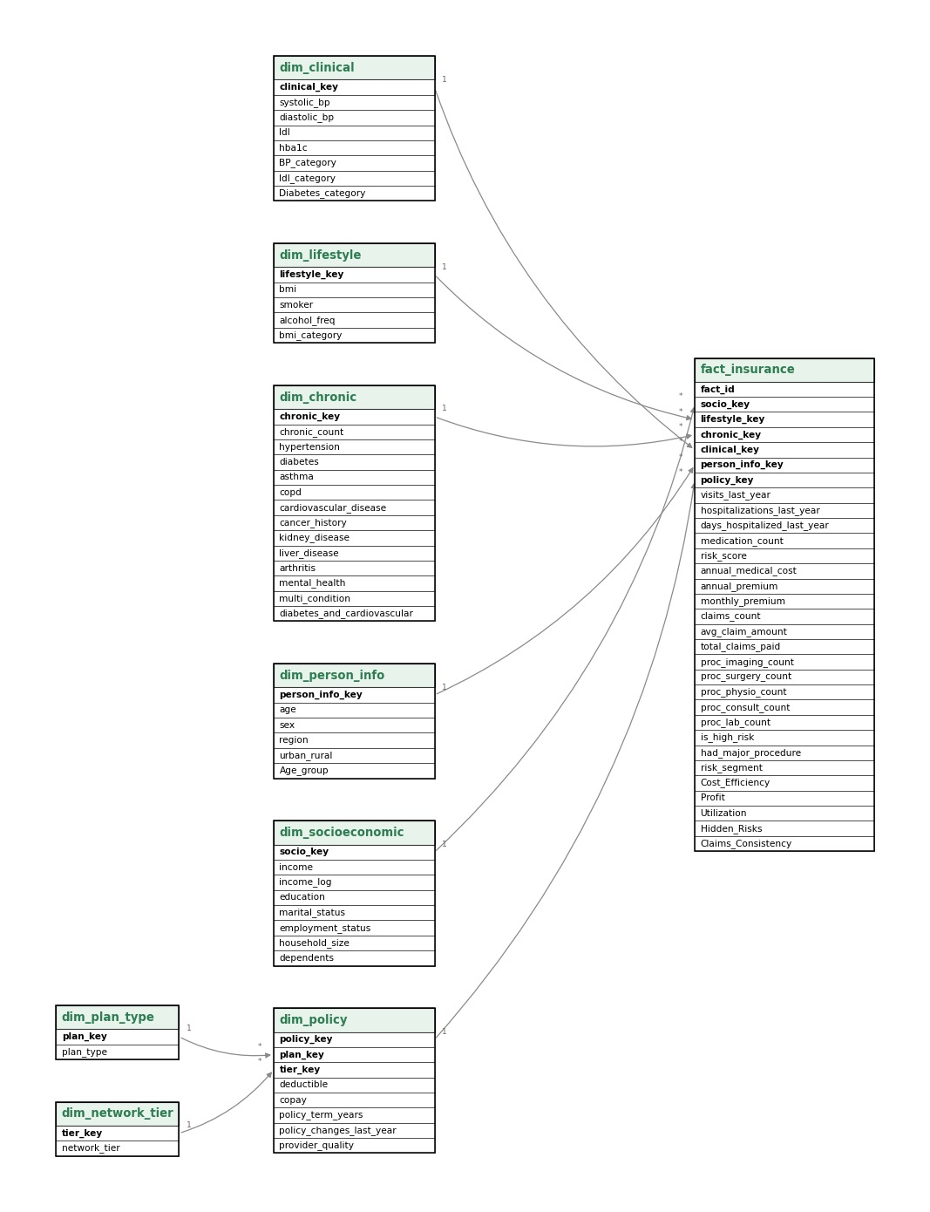
RISK FACTOR ANALYSIS
Python — Data Model
1. Data Structure
Organize the dataset into fact and dimension tables.
2. Feature Relationships
Define relationships between customer, policy, clinical, and lifestyle data.
3. Analytical Model
Build a model that supports efficient analysis and reporting.
DEPI Capstone — Medical Insurance Analytics
7

Slide 17
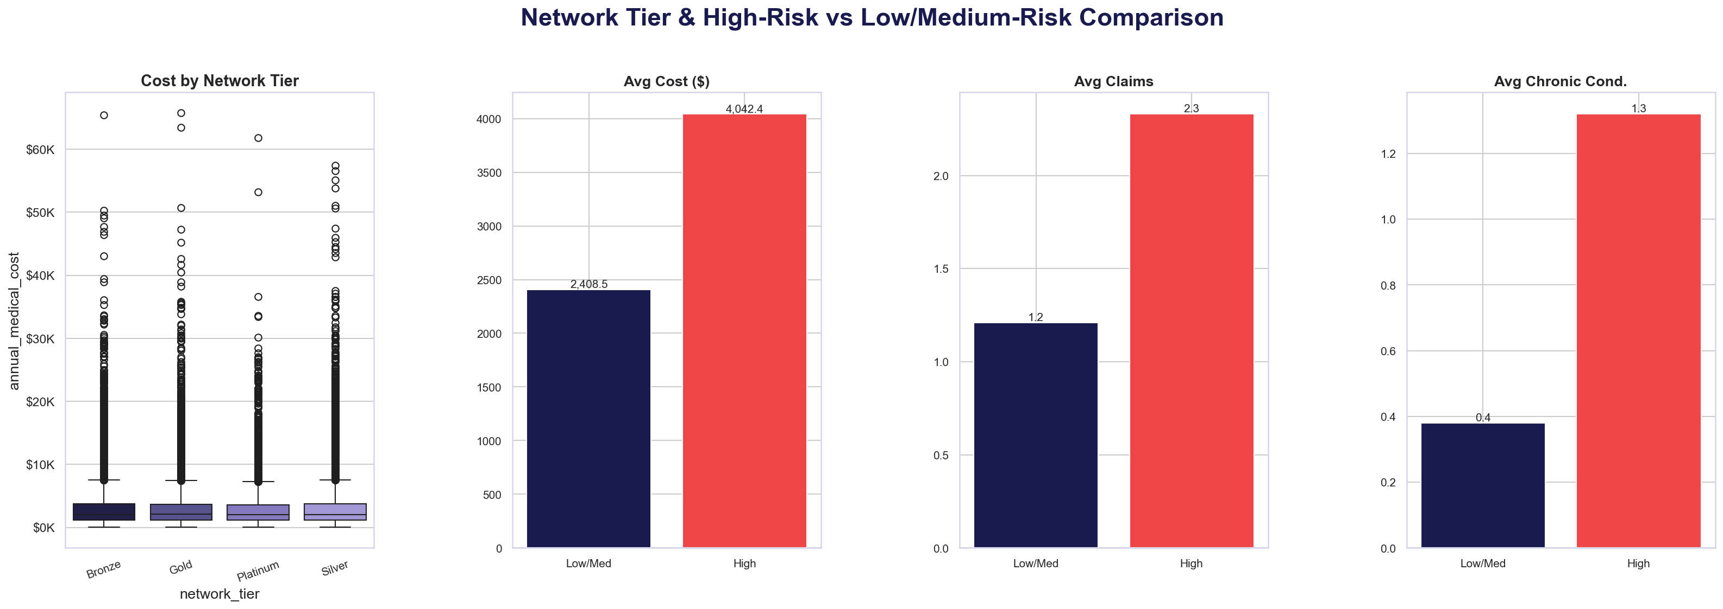
RISK FACTOR ANALYSIS
Python — Analysis and Risk Factors
1. Risk Factor Analysis
Explore how smoking, BMI, and chronic diseases affect medical costs.
2. Exploratory Insights
Identify trends and patterns using descriptive statistics and visualizations.
3. Key Findings
Detect the strongest factors associated with higher healthcare expenses.
DEPI Capstone — Medical Insurance Analytics
7

Slide 18
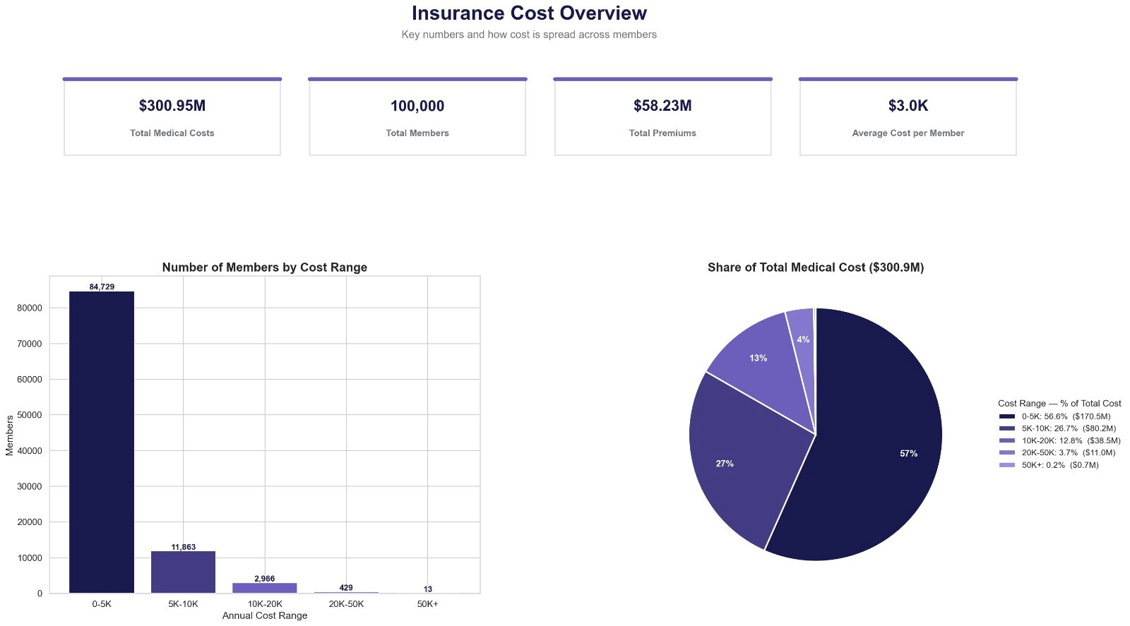
RISK FACTOR ANALYSIS
Python — Dashboard
Overview
This dashboard provides a comprehensive view of medical insurance costs by combining financial metrics, health indicators, and risk analysis into a single interactive report.
Key Dashboard Insights
Monitors medical insurance costs through interactive KPIs.
Compares healthcare expenses across insurance plan types.
Identifies relationships between health conditions and medical costs.
Highlights chronic diseases associated with higher healthcare expenses.
Supports risk segmentation for better insurance decision-making.
Key Visuals
Enables users to quickly identify cost patterns, compare health risks, and support informed business decisions.
DEPI Capstone — Medical Insurance Analytics
7

Slide 19
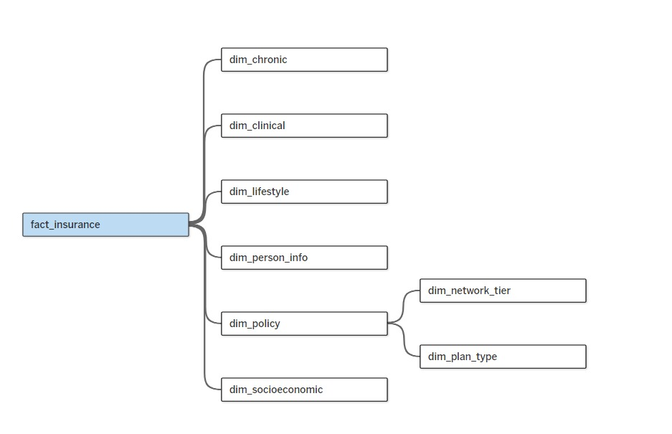
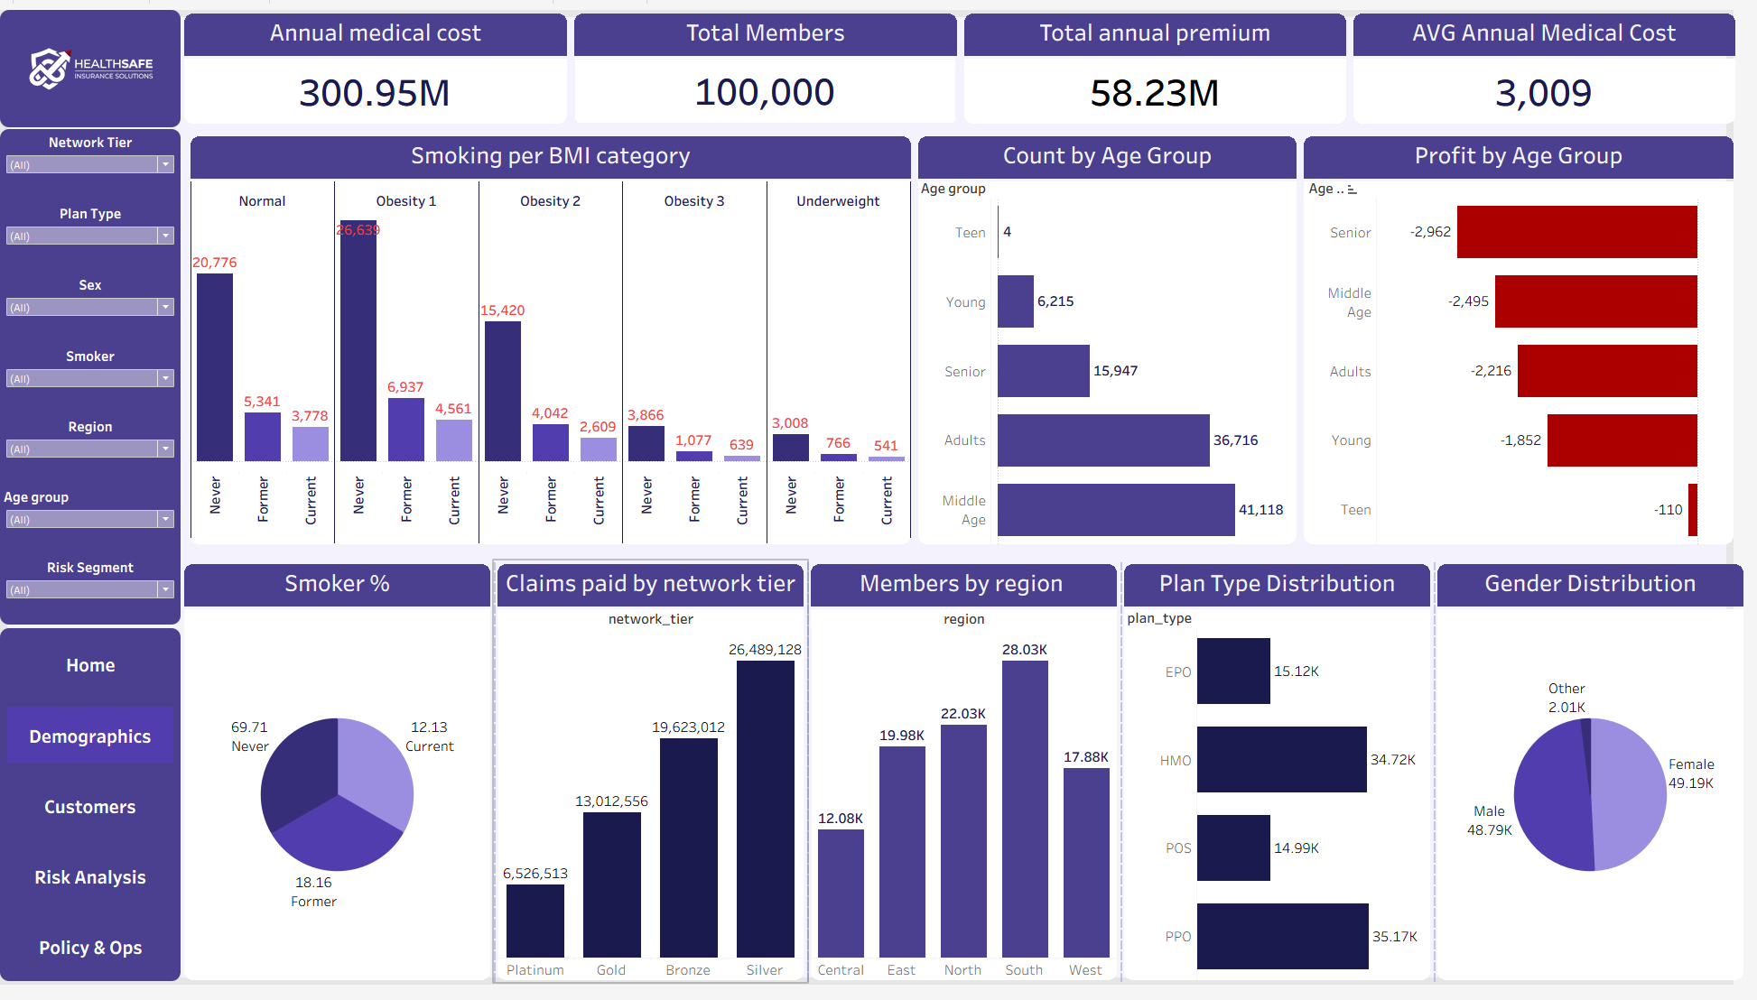
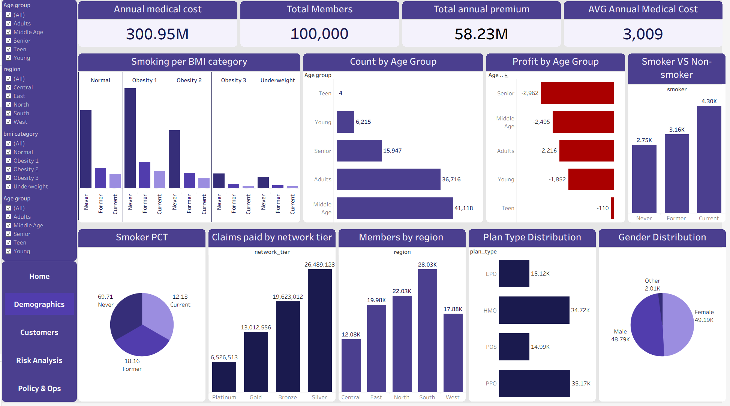
EXPLORATORY VIEW
Tableau —Data Modeling
Model Overview
the data model was designed using a Star Schema structure, where a central fact table stores insurance measures and connects to multiple dimension tables containing demographic, clinical, policy, and plan information.
Why This Model?
Improves query performance.
Reduces data redundancy.
Simplifies dashboard creation.
Supports accurate filtering and analysis.
Main Components
Fact Table: Insurance transactions and measures.
Dimension Tables: Person, Clinical, Policy, Plan Type, Network Tier, Chronic, and Socioeconomic data.
10

Slide 20
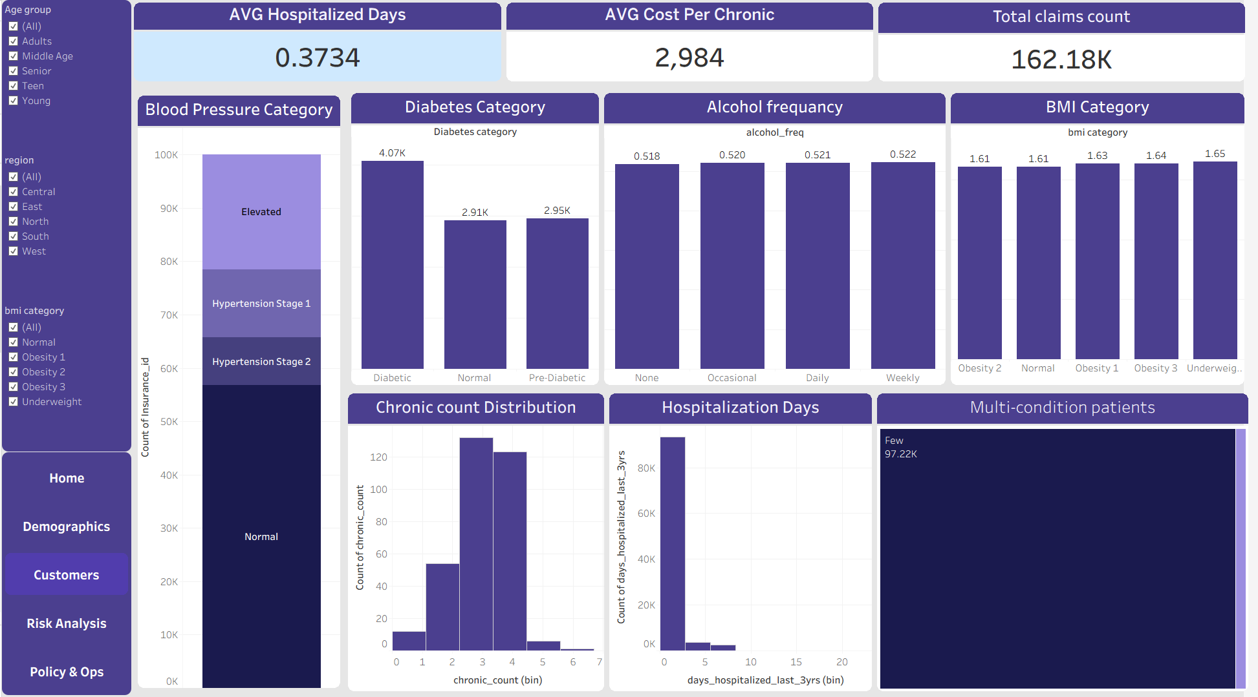
EXPLORATORY VIEW
Tableau —Demographics Dashboard
Answers
How do medical costs, premiums, and member characteristics vary across different customer segments
Audience
Business Analysts, Insurance Managers, and Decision Makers
Key Visuals
Annual Medical Cost & Total Premium KPIs
Medical Cost by BMI Category
Members & Profit by Age Group
Claims Paid by Network Tier
Members by Region
Plan Type Distribution
Smoker vs Non-Smoker Comparison
Gender Distribution
10

Slide 21
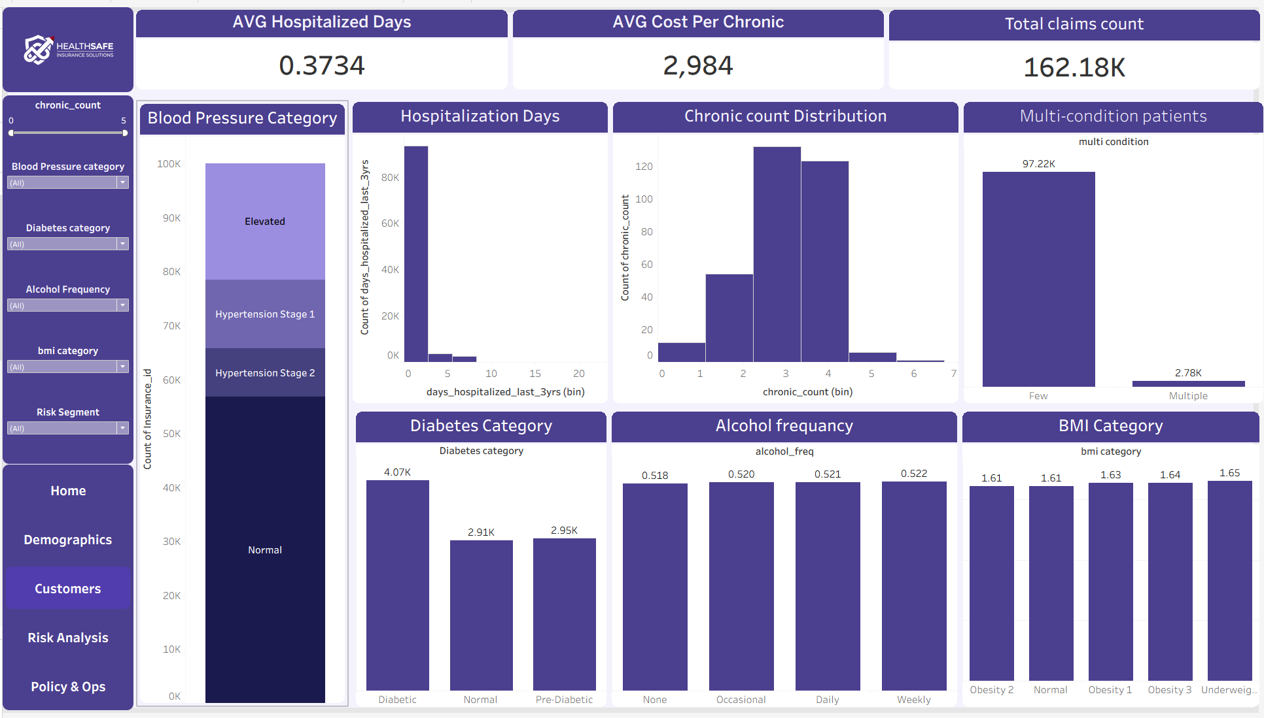
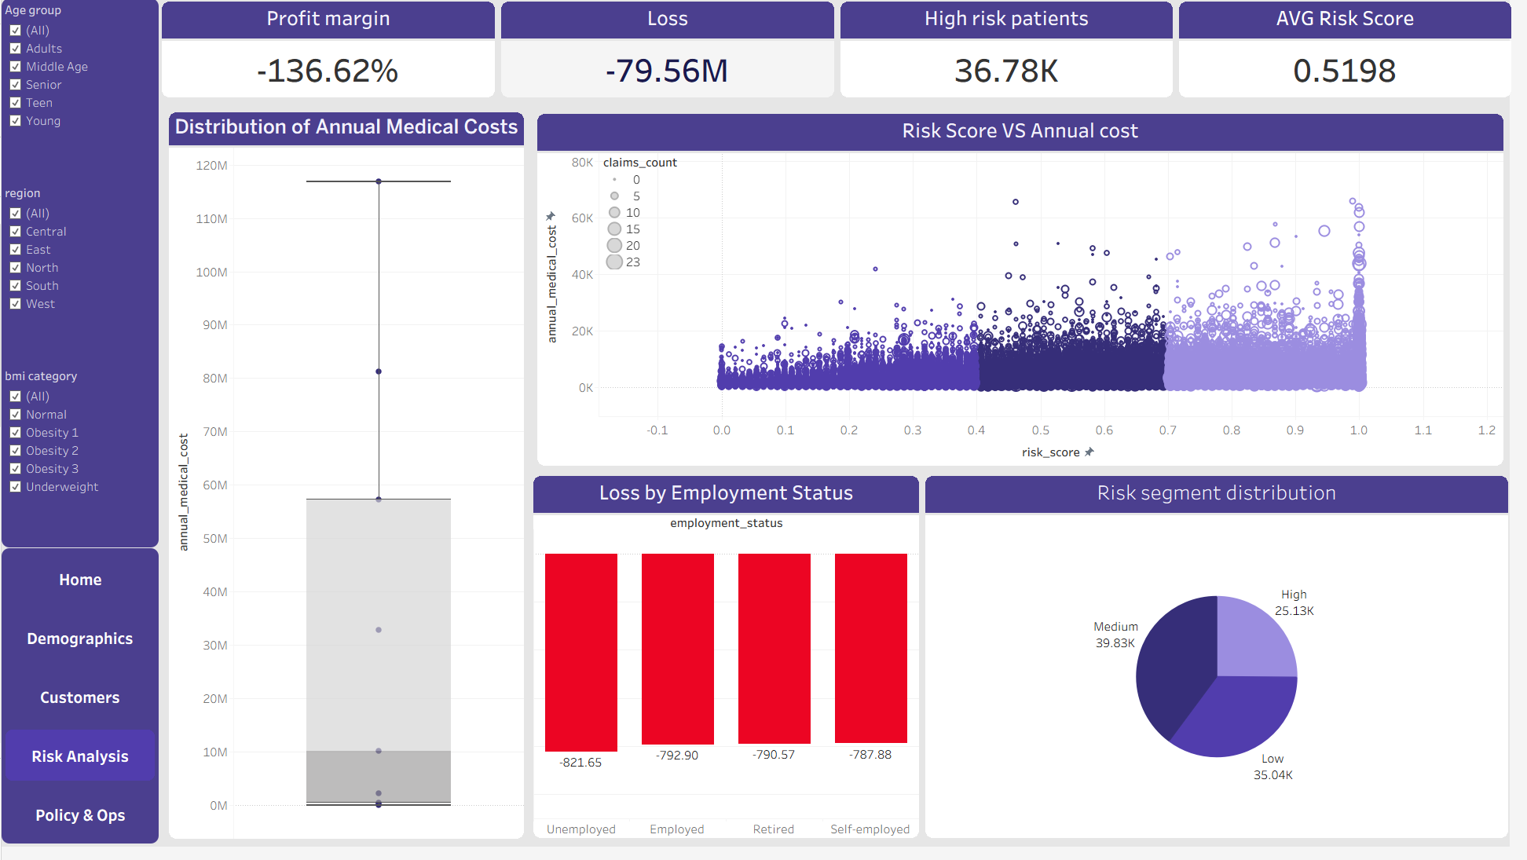
EXPLORATORY VIEW
Tableau — Customers Dashboard
Answers
"How do chronic conditions, hospitalization, and health indicators affect healthcare utilization and claims?
Audience
Healthcare Analysts, Insurance Managers, and Risk Teams
Key Visuals
Average Hospitalized Days
Average Cost per Chronic Condition
Total Claims Count
Blood Pressure Category Distribution
Hospitalization Days Analysis
Chronic Condition Distribution
Multi-condition Patients
Diabetes Category
Alcohol Frequency
BMI Category
10

Slide 22
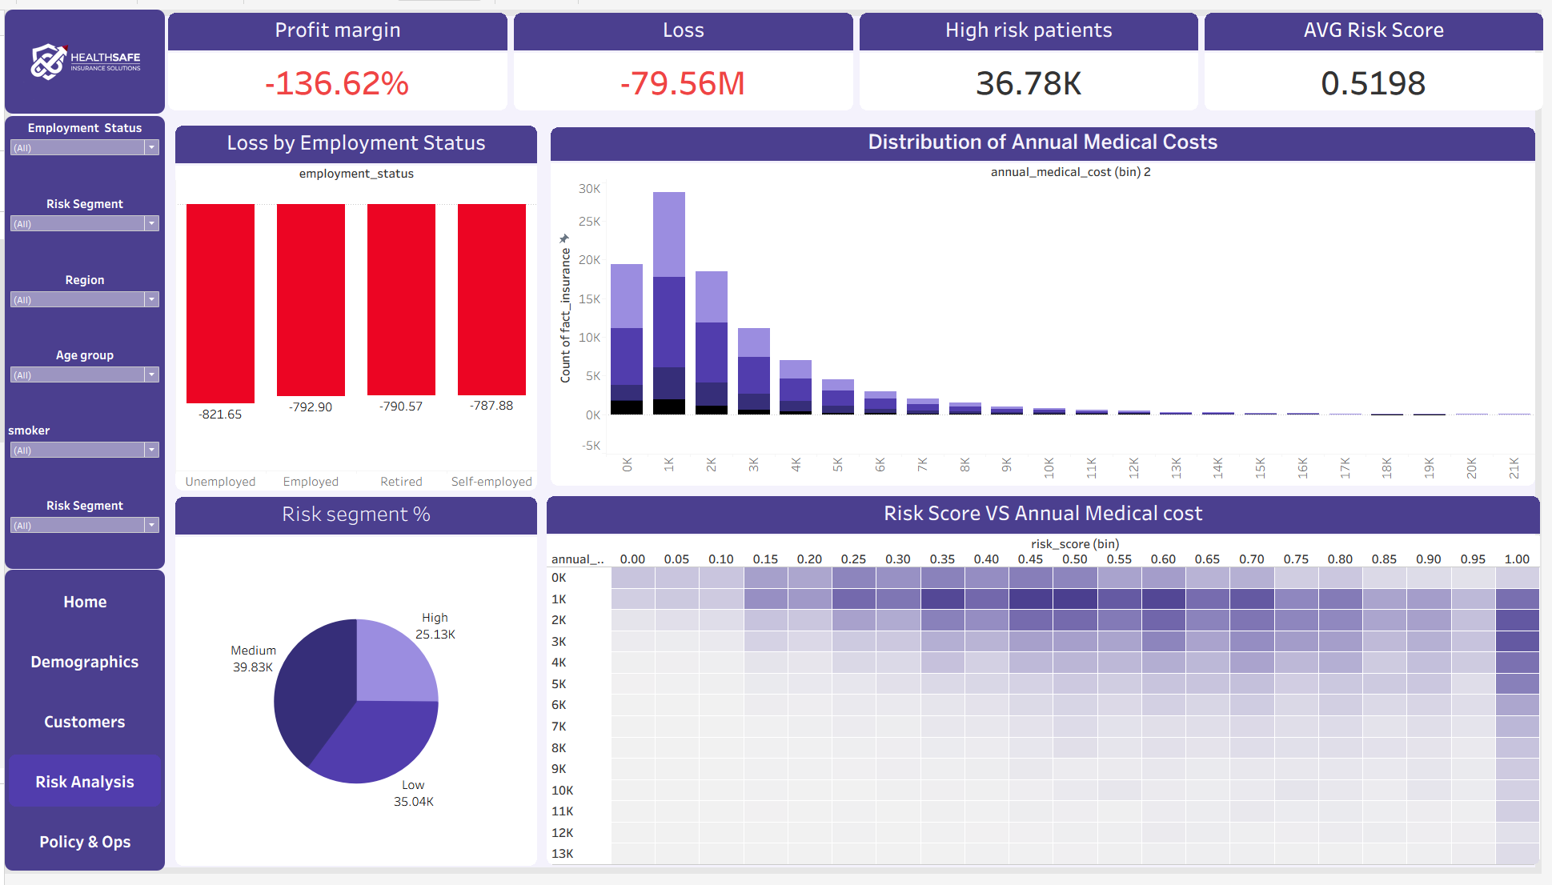
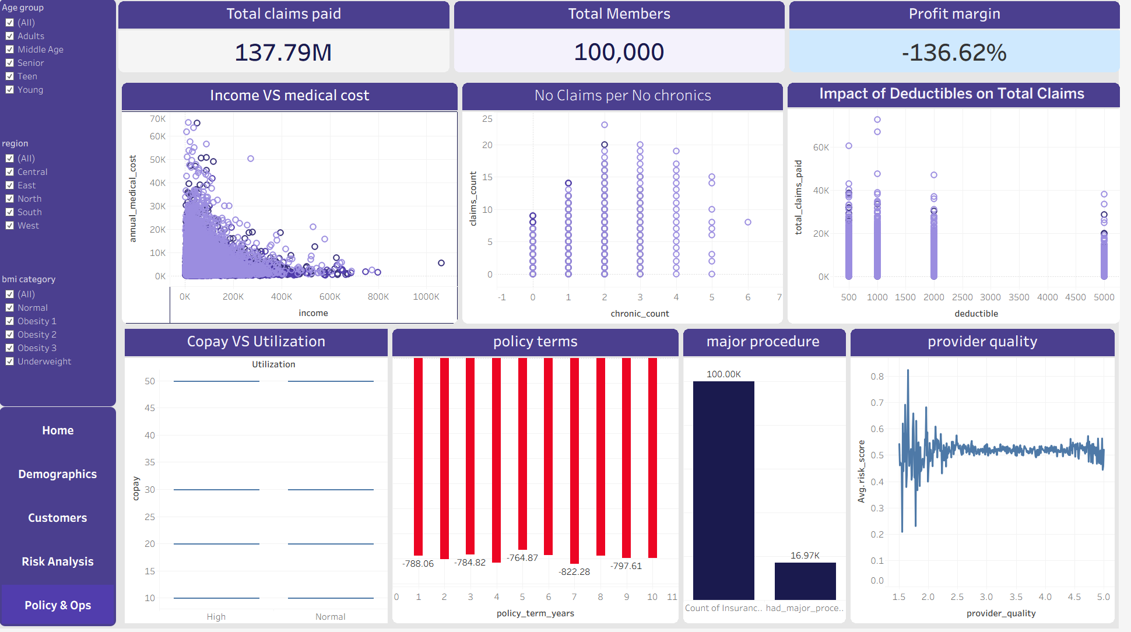
EXPLORATORY VIEW
Tableau —Risk analysis Dashboard
Answers
"How do risk levels and medical costs impact insurance profitability and financial performance?"
Audience
Risk Analysts, Insurance Managers, and Executive Decision Makers
Key Visuals
Profit Margin & Loss KPIs
High-Risk Patients
Average Risk Score
Loss by Employment Status
Annual Medical Cost Distribution
Risk Segment Distribution
Risk Score vs Annual Medical Cost
10

Slide 23
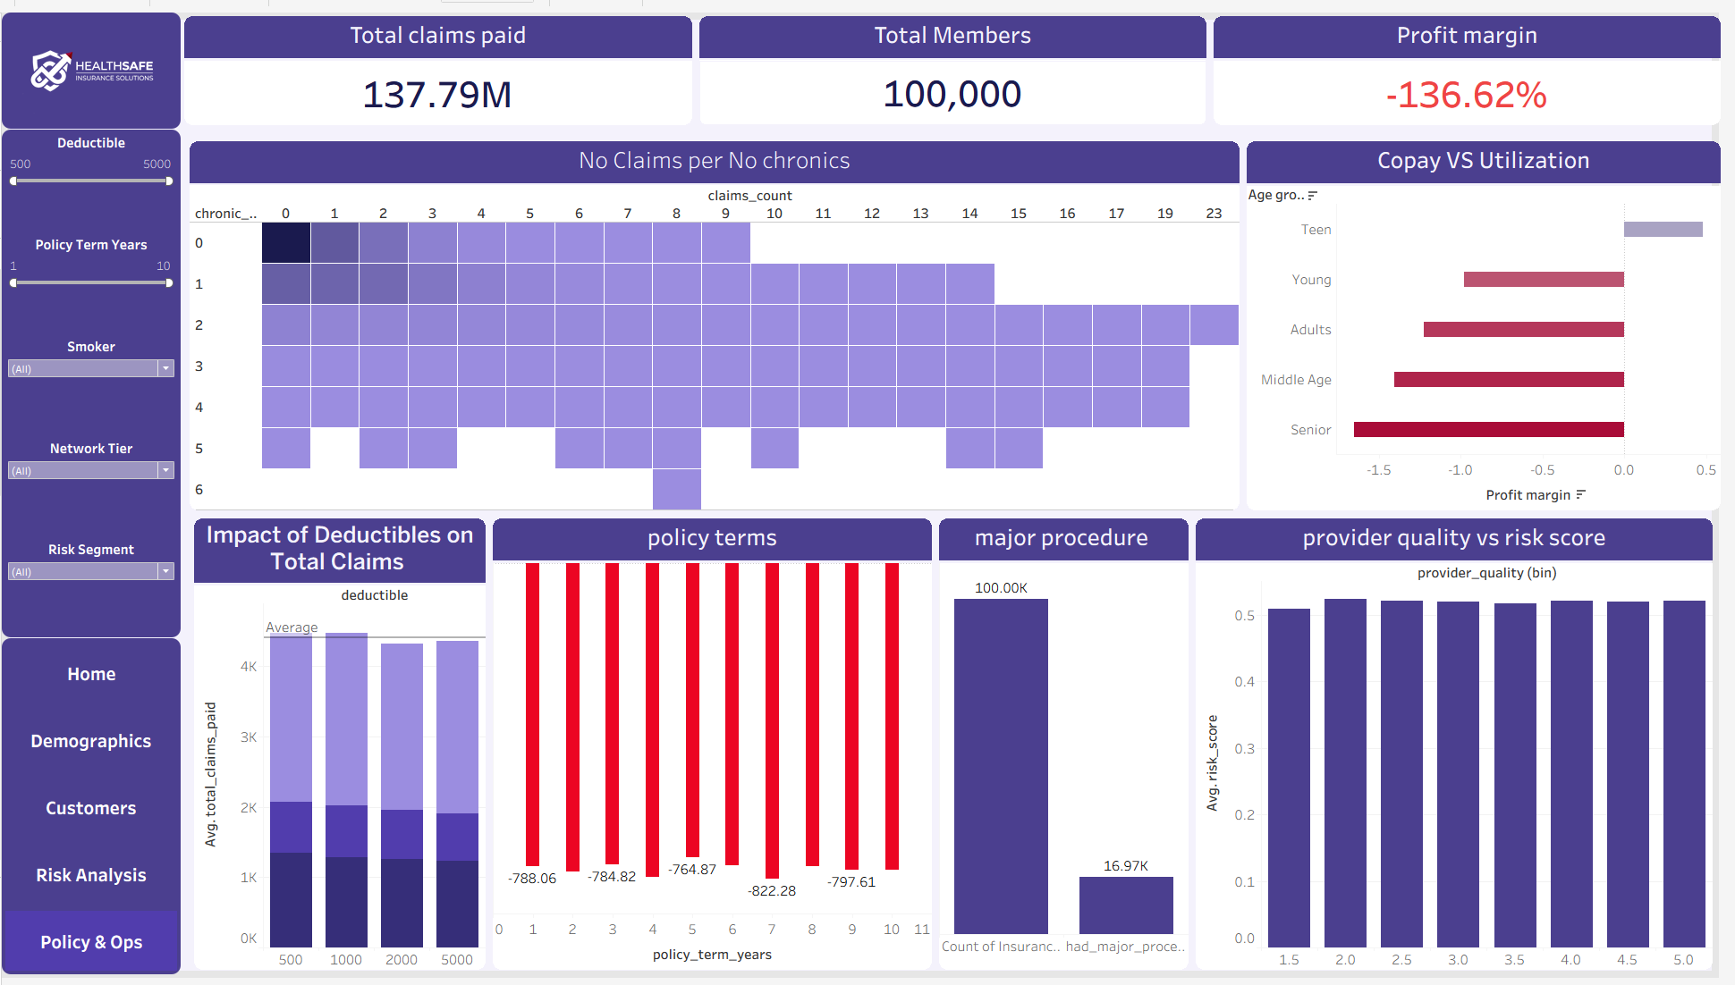
EXPLORATORY VIEW
Tableau — Policy & Operations Dashboard
Answers
"How do policy features and operational factors influence claims, utilization, and insurance profitability?"
Audience
Operations Managers, Policy Managers, and Insurance Executive
Key Visuals
Total Claims Paid
Total Members
Profit Margin
Claims vs. Chronic Conditions
Copay vs. Utilization
Deductible Impact on Claims
Policy Term Analysis
Major Procedure Distribution
Provider Quality vs. Risk Score
10

Slide 24
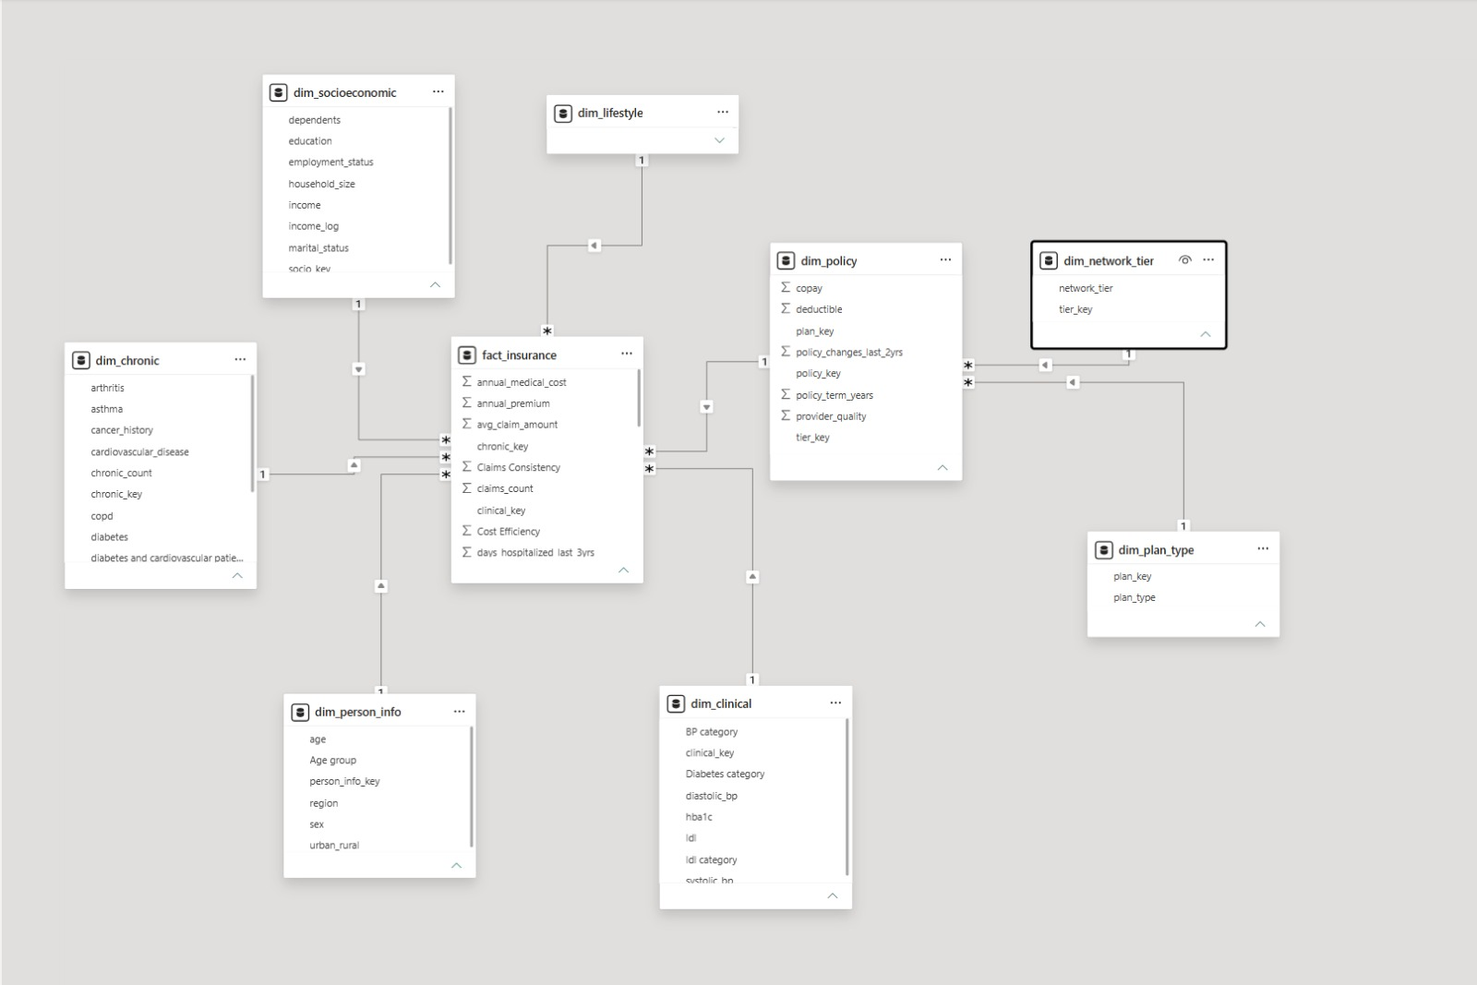
EXECUTIVE VIEW
Power BI Dashboard—Data Modeling.
Data Model Design
A Star Schema data model was built to organize insurance data into one central fact table connected to multiple dimension tables. This structure ensures efficient analysis, consistent calculations, and scalable dashboard development.
Core Tables
Fact Insurance
Person
Clinical
Policy
Plan Type
Network Tier
Chronic
Socioeconomic
Benefits
Faster data retrieval
Better analytical performance
Simplified relationships
Improved dashboard scalability
9

Slide 25
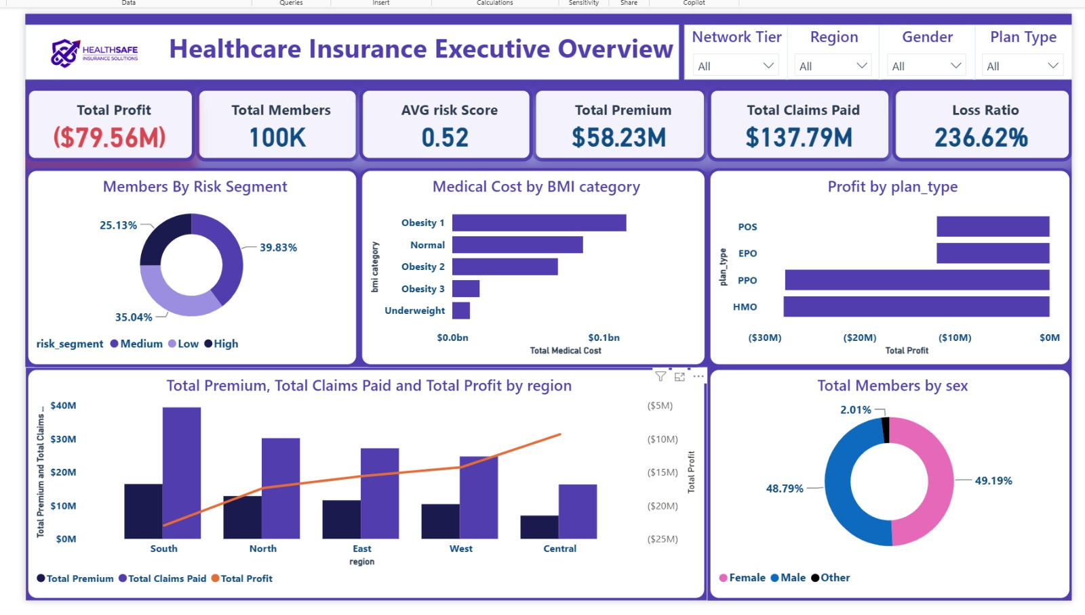
EXECUTIVE VIEW
Power BI Dashboard— Healthcare Insurance Executive Overview
Answers
"Where is claims cost concentrated, and by whom?"
Audience
Managers & underwriters — high-level, filterable
Key Visuals
Premium vs. claims vs. profit by region, risk donut
9

Slide 26
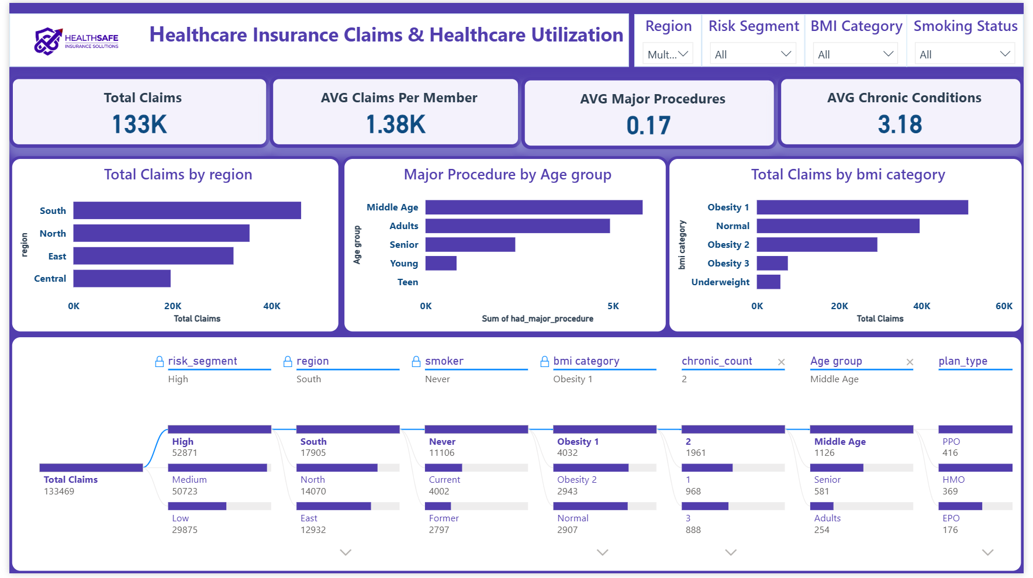
EXECUTIVE VIEW
Power BI Dashboard— Claims & Healthcare Utilization
Answers
"Where is claims cost concentrated, and by whom?"
Audience
Managers & underwriters — high-level, filterable
Key Visuals
Premium vs. claims vs. profit by region, risk donut
9

Slide 27
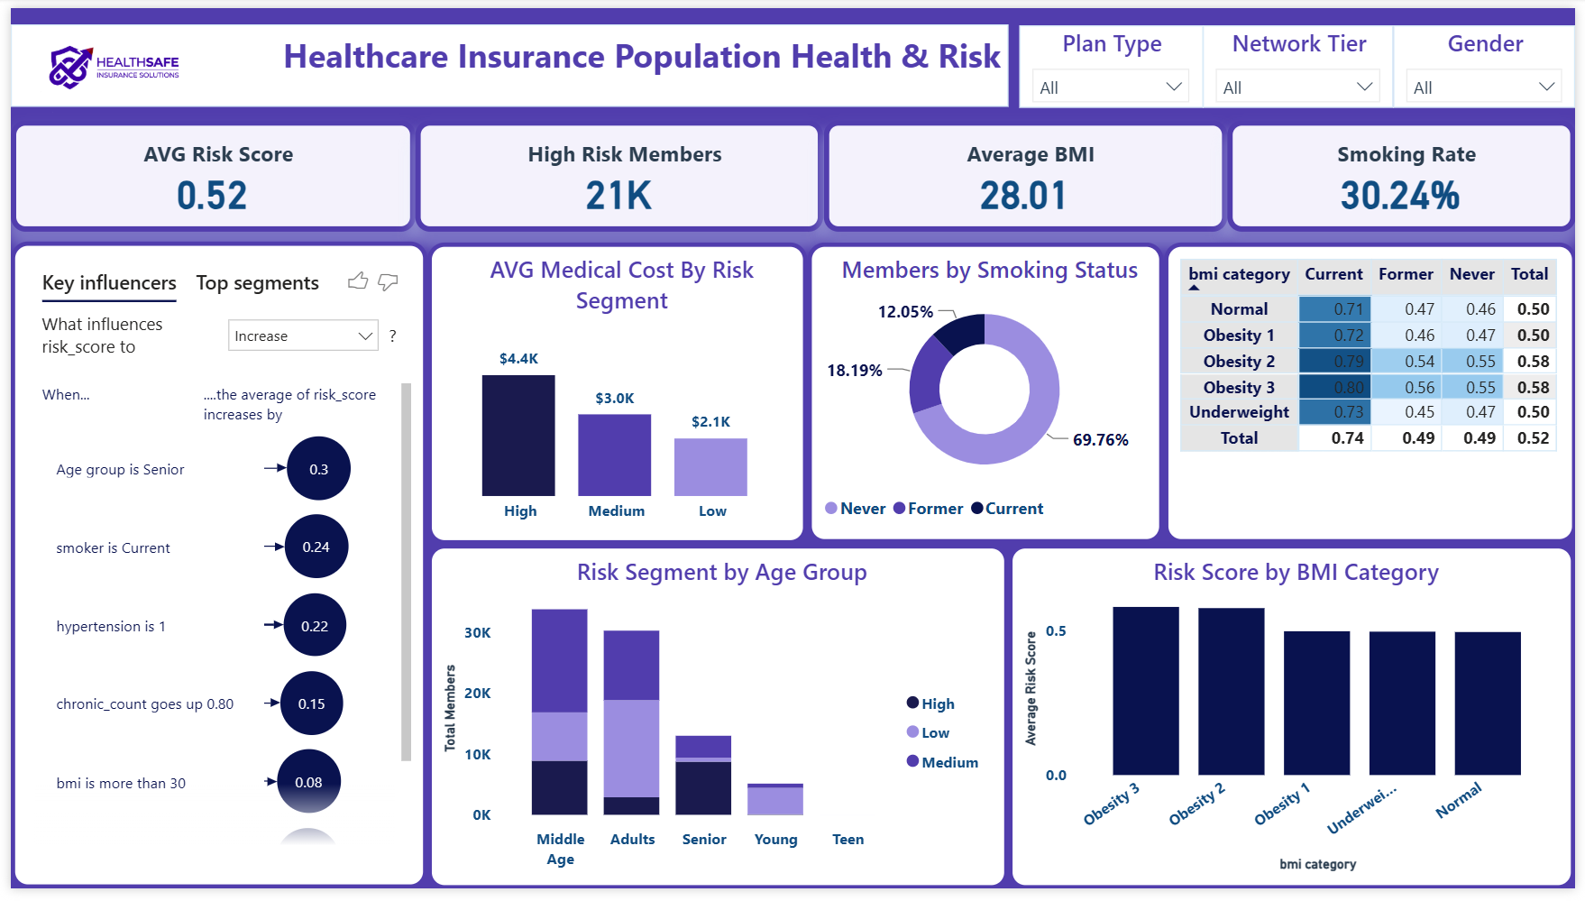
EXECUTIVE VIEW
Power BI Dashboard— Population Health & Risk Analysis
Answers
"Where is claims cost concentrated, and by whom?"
Audience
Managers & underwriters — high-level, filterable
Key Visuals
Premium vs. claims vs. profit by region, risk donut
9

Slide 28
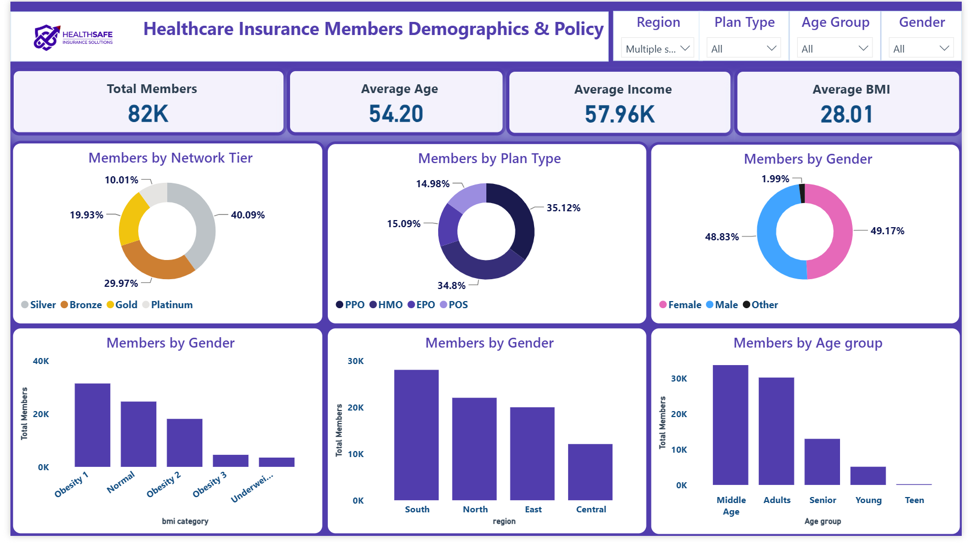
EXECUTIVE VIEW
Power BI Dashboard— Members Demographics & Policy Insights
Answers
"Where is claims cost concentrated, and by whom?"
Audience
Managers & underwriters — high-level, filterable
Key Visuals
Premium vs. claims vs. profit by region, risk donut
9

Slide 29
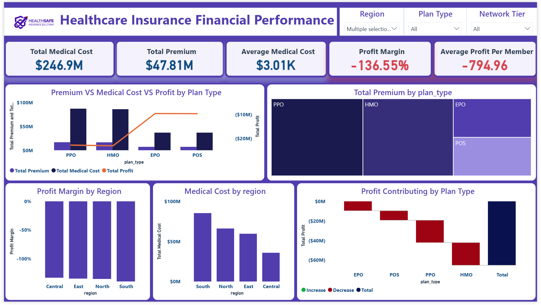
EXECUTIVE VIEW
Power BI Dashboard— Financial Performance Analysis
Answers
"Where is claims cost concentrated, and by whom?"
Audience
Managers & underwriters — high-level, filterable
Key Visuals
Premium vs. claims vs. profit by region, risk donut
9

Slide 30
WHAT THE DATA SHOWS
Key Insights
1
2
Book Is Underwater
Risk Is Concentrated
Loss ratio of 236.62% — $137.79M in claims against $58.23M in premium drives a $79.56M loss
36.78K members (~37%) are flagged high-risk, pulling the average risk score to 0.52
3
4
Smoking Is a Multiplier
Scale of Exposure
Only 12.1% of members smoke, but smoking combined with Obesity BMI bands drives the sharpest cost jumps
100K members generate $300.95M in annual medical cost — ~$3,009 average cost per member
DEPI Capstone — Medical Insurance Analytics
11

Slide 31
TURNING INSIGHT INTO ACTION
Recommendations
✓
Reprice the Loss-Making Segments
A 236.62% loss ratio means premiums need repricing for high-cost BMI/smoking bands
✓
Flag High-Risk Early
Use the 0.52 avg risk score to trigger proactive case management for the 36.78K high-risk members
✓
Target Smoking + BMI Jointly
Price and intervene on the combination, not each factor alone — that's where cost spikes
✓
Monitor Monthly
Operationalize the Power BI dashboard for monthly loss-ratio and risk-score reviews
DEPI Capstone — Medical Insurance Analytics
12

Slide 32
CONCLUSION
One dataset, five tools,
one coherent story
Excel validated the raw data, Python and SQL turned it into a trustworthy model, and Power BI / Tableau made the findings usable by the business — end to end, from spreadsheet to decision.
Thank you

