Slide 1
Auto BOM

Slide 2
Project Overview
User will need to enter the parts name, quantity, and budget they want.
Our program will scrape through www.newark.com to help them to find whatever they want.
We will provide them with the least cost options for all parts.
The output of the program will be in an excel sheet
GUI guides the user through the inputs, any errors, and states the final output file name and budget restrictions.
Further/More detailed specifications of the architecture are written in ProjectDocumentation

Slide 3
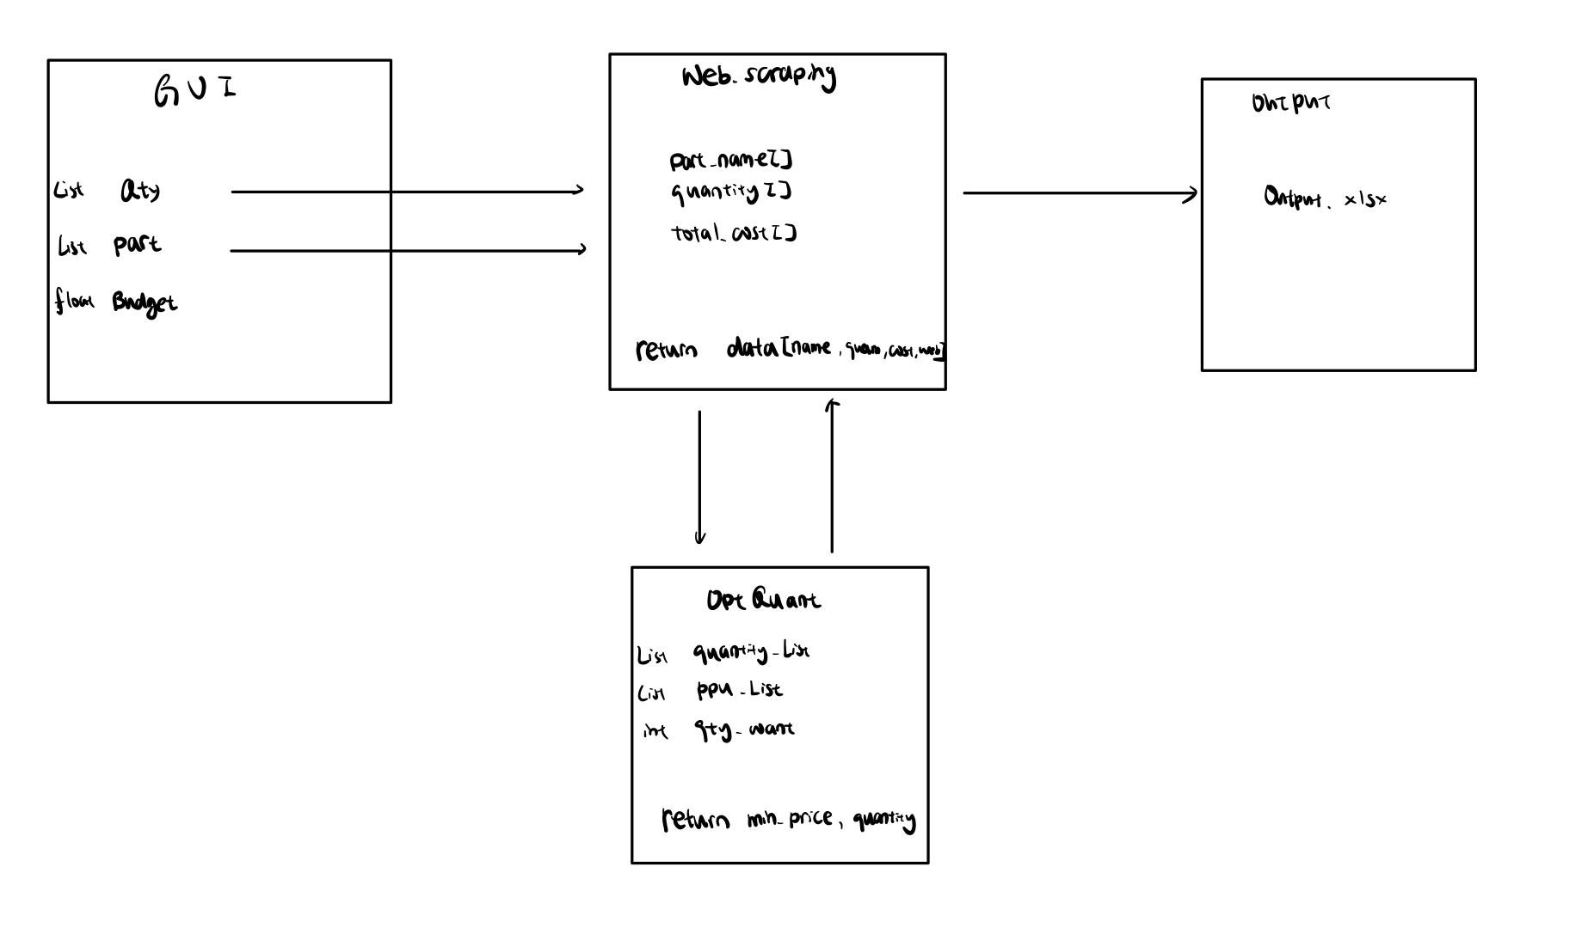
Overall project

Slide 4
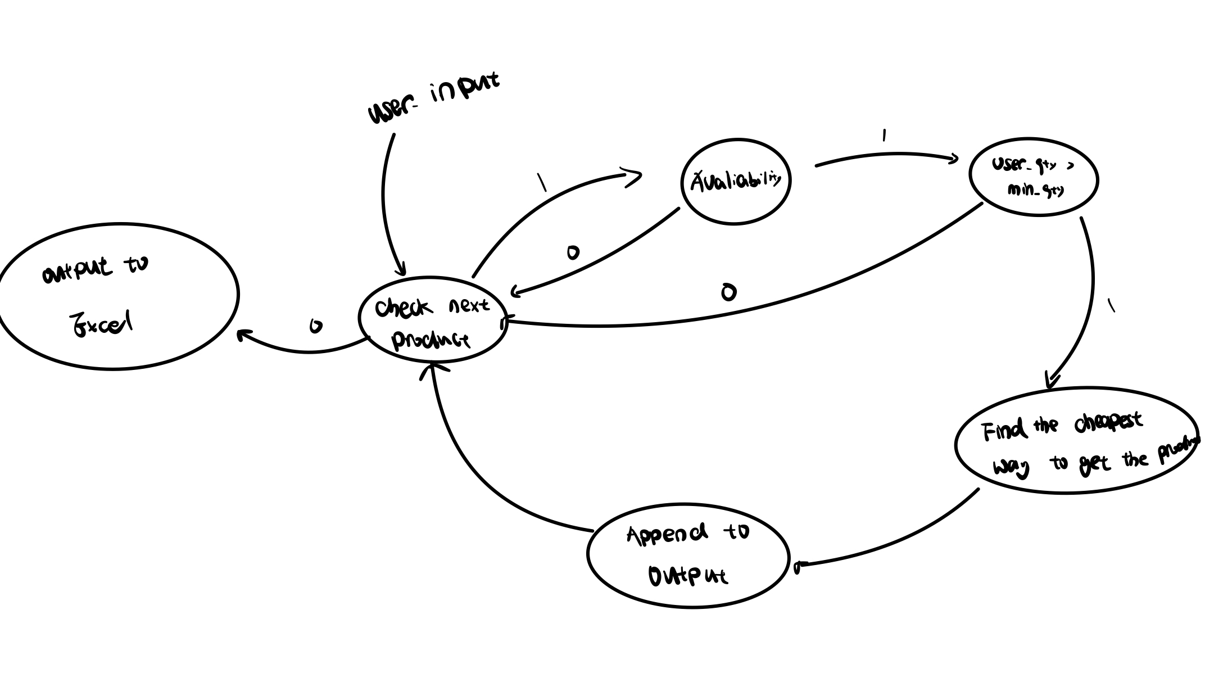
Web-scraping State Diagram

Slide 5
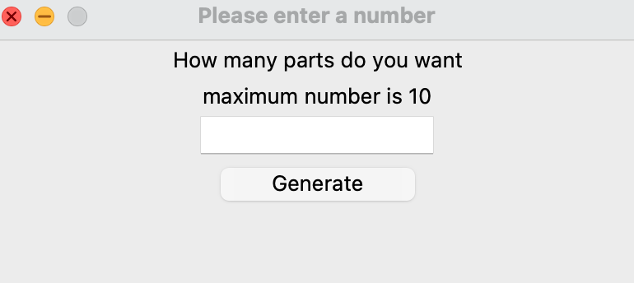
User Input for number of parts they want to get
Only 10 or less part can be entered, if user enters a number larger than 10, it will urge user to enter 10 parts

Slide 6
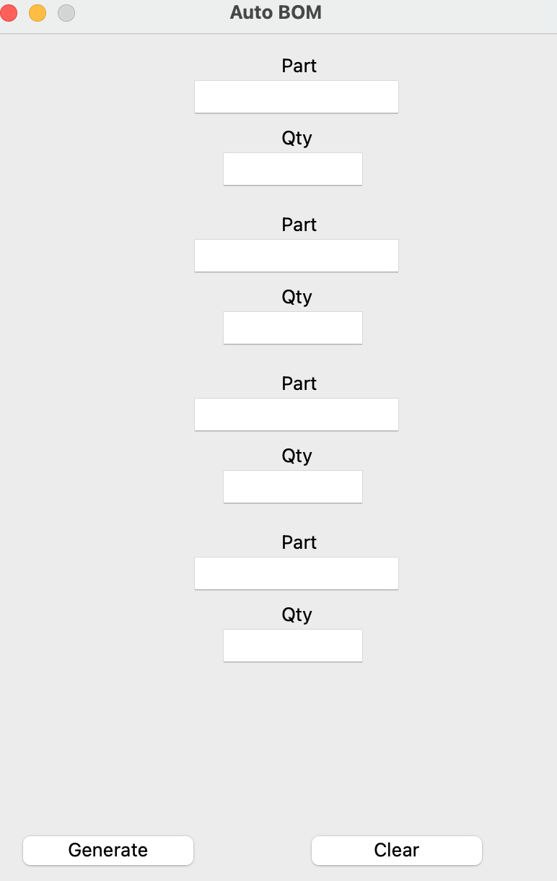
User Input
User will input their part number in part, and quantity they want in qty
By pressing “Generate”, the program will scrape through the product and generate the final BOM
By pressing “clear”, all the entries will be cleared and user can re-enter again.

Slide 7
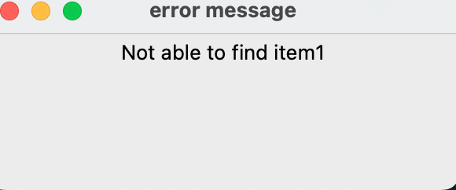
Error Message
An error message will pop up, if the program is not able to find any products that user entered

Slide 8
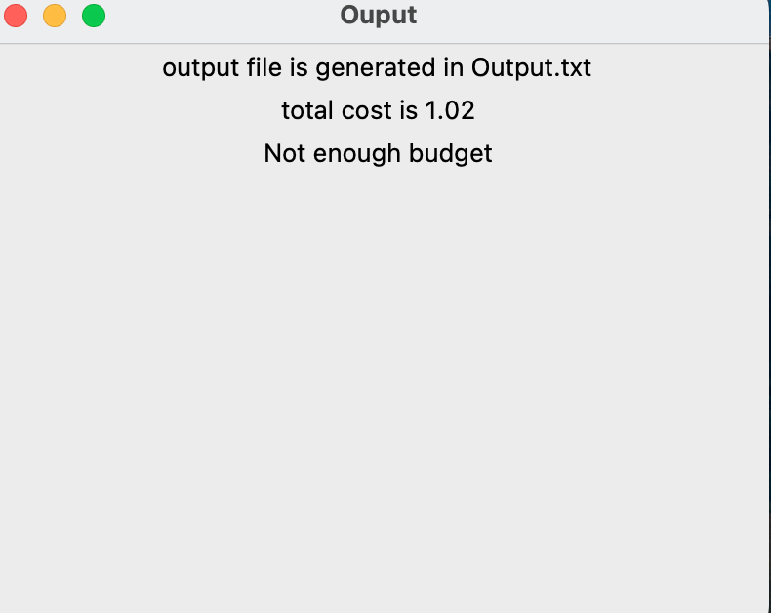
Output: Not enough budget

Slide 9
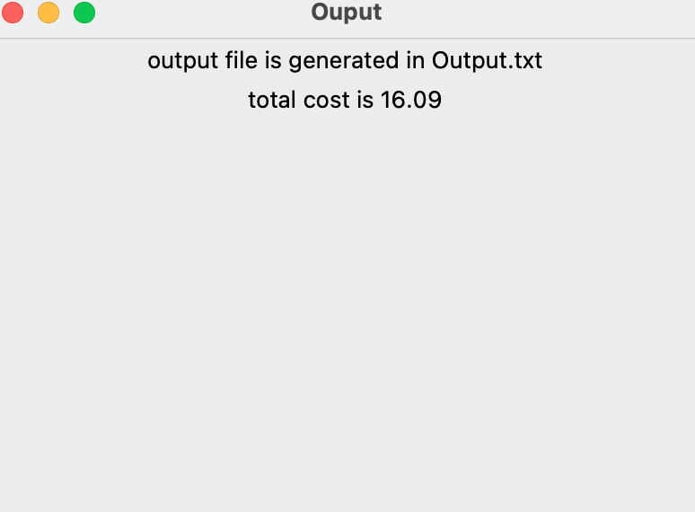
Output: Enough Budget

Slide 10
Output in excel

