Slide 1

MuseWardrobe - AI Fashion Website
PROJECT WORK
SIXTH SEMESTER
B.VOC - SOFTWARE DEVELOPMENT
Presented by :
Ayisha Nourin P
FKAWBVW010
BVOC SD
Guided by :
Mrs. Fathima kunhimuhammed
Asst. Professor
Department of Software Development
Farook college (Autonomous)

Slide 2
Contents
Introduction
Literature Survey
System architecture
Module description
Methodology
DFD

Slide 3
Introduction
MuseWardrobe combines outfit generation, AI fashion chatbot and style management in one platform.
Users can enter style prefernces, get personalized outfit suggestions and save favorite looks.
Includes product search links and dashboard to track saved outfits.
provides instant AI advice through the chatbot for style guidance.
Designed with clean, user-friendly interface for easy navigation
Aims to promote personalized styling, fashion exploration, and convenience for users.

Slide 4
Literature Survey
Various fashion platforms like Fashwell, StitchFix, and Zalando help users discover outfits and get fashion recommendations.
Fashwell focuses on AI-based clothing recognition and product suggestions.
StitchFix personalizes fashion choices using style quizzes and subscription boxes.
Zalando offers curated recommendations based on user browsing and purchase history.
Most existing platforms suggest individual products, not complete outfits or integrated style advice.
Users often need multiple platforms for outfit ideas, shopping, and style guidance.
Studies show that integrated AI-powered fashion platforms improve user engagement, personalization, and overall styling experience.

Slide 5
System architecture
Frontend (Client Side)
Developed using Next.js and Tailwind CSS for responsive web design and smooth user experience.
Includes UI screens like Home, Login/Signup, Outfit Generator, Outfit Detail, Fashion Chatbot, User Dashboard, and About/Help.
Handles animations, AI-generated outputs, product links, and responsive layout across devices.

Slide 6
System architecture
Stores user profiles, saved outfits, and style preferences.
Real-time sync support for live updates.
Ensures data consistency, integrity, and security.
Additional Components
Authentication: Firebase Auth for user login and signup.
Storage: Firebase Firestore / Realtime Database to store outfits, dashboard data, and user preferences.

Slide 7
Module description
1.User Authentication Module
Handles sign-up, login, logout
Stores user credentials securely using Firebase Auth.
Enables session management for personalized experience.
2. Outfit Generator Module
Allows users to enter preferences(fabric, color, occasion, body type, style).
Generates AI-based outfit suggestions.
Includes product search links and option to save favorites.

Slide 8
Module description
3. Fashion Chatbot Module
Let users ask style questions and get instant AI advice.
Helps users make better fashion choices based on AI suggestions.
4. User Dashboard Module
Central screen showing saved outfits and personal style profile.
Gives a snapshot of favorite looks and past AI suggestions.

Slide 9
Module description
5. User Profile Module
Allow users to manage personal style preferences.
Display saved outfits, AI suggestions, and dashboard summary.

Slide 10
Development Methodology
Agile Development Model is used for building MuseWardrobe.
Focuses on iterative and incremental development.
The project is divided into small, manageable modules (like outfit generator, fashion chatbot, dashboard etc.).
Each module is developed, tested, and refined in short cycles (sprints).
Allows early detection of bugs and reduces development risks.
Ensures smooth collaboration and tracking of progress.
Suitable for apps with evolving AI features and user personalization, like MuseWardrobe.

Slide 11

DFD Level 0
Data Flows:
User → Website: Inputs preferences (fabric, color, occasion, body type, style) / asks fashion queries
Website → Database (Firebase): Store user data (profile, saved outfits, chat history)
Database → Website: Retrieve saved outfits, user profile, past recommendations
Website → User: Provides AI outfit suggestions, chatbot responses, style insights, notifications

Slide 12
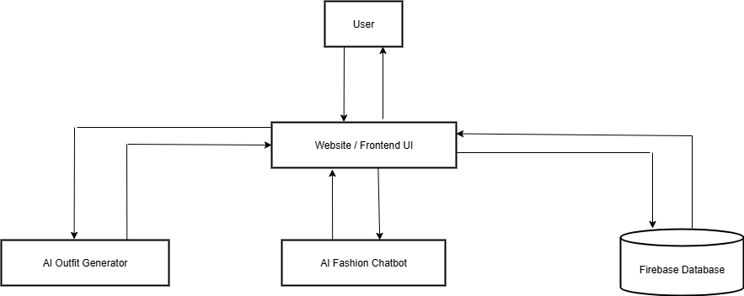
DFD Level 1

Slide 13
Next.js
A React-based framework for building fast and scalable web applications.
Helps create dynamic pages and manage routing easily.
Supports server-side rendering for better performance.

Slide 14
Tailwind CSS
It is a utility-first CSS framework.
Proivdes ready-to-use classes for styling.
Helps build modern, responsive UIs faster.
Removes the need to write custom CSS for everything.

Slide 15
Firebase
It is a cloud based platform by Google.
Provides backend services for web & mobile apps.
Helps developers build apps faster without managing servers.
Supports real-time data, authentication, hosting, and more.

Slide 16
Challenges & Learnings
Learned UI design and state management using Next.js and Tailwind CSS.
Faced challenges in data storage and real-time updates → solved using Firebase.
Understood app architecture and state management concepts.
Improved debugging & problem-solving skills.

Slide 17
Q and A

Slide 18
thank you...

