Slide 1
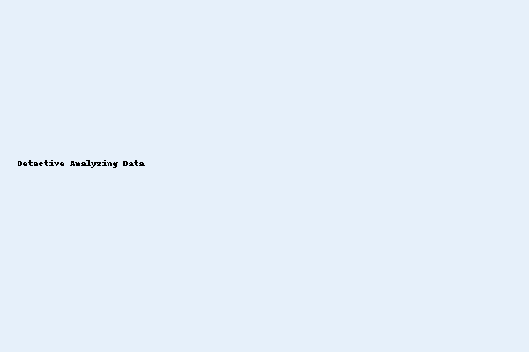
What is Data Analysis?
• Data analysis is about looking at information (data) to find useful things.
• It's like being a detective with numbers and facts.
• We try to understand what the data tells us.
• The goal is to make better decisions.
Notes:
Image Idea: A magnifying glass over a chart or a detective looking at data.

Slide 2

Why is Data Analysis Important?
• Understand the Past: See what happened before.
• See What's Happening Now: Know the current situation.
• Predict the Future: Guess what might happen next.
• Solve Problems: Find reasons for issues and solutions.
• Make Smart Choices: Help businesses and people make good decisions.
Notes:
Image Idea: Timeline with arrows pointing to past, present, and future. Or brain icon with data.

Slide 3

Where Do We Get Data?
• Surveys – Asking people questions.
• Sales Records – How many products were sold.
• Website Clicks – What people do on a website.
• Sensors – Information from machines (like weather data).
• Social Media – What people are saying online.
Notes:
Image Idea: Icons for clipboard, shopping cart, mouse cursor, weather, social media logos.

Slide 4

Simple Steps in Data Analysis
1. Collect Data – Gather all the information.
2. Clean Data – Fix mistakes and remove bad data.
3. Explore Data – Look at it to find patterns or trends.
4. Interpret Data – Understand what the patterns mean.
5. Share Findings – Tell others what you learned.
Notes:
Image Idea: Flow from messy data to clean data, chart, person presenting, lightbulb.

Slide 5

Tools for Data Analysis (Simple Examples)
• Spreadsheets – Microsoft Excel or Google Sheets.
• Charts and Graphs – Bar charts, pie charts, line graphs.
• Simple Math – Averages, percentages.
Notes:
Image Idea: Icons of spreadsheet, charts, calculator or math symbols.

Slide 6

Key Takeaways
• Data analysis helps us understand information.
• It's used everywhere to make better decisions.
• It involves collecting, cleaning, and looking at data.
• Simple tools like spreadsheets and charts are very useful.
• Making sense of data helps us learn and grow!
Notes:
Image Idea: Lightbulb, growing plant, or thought bubble with graph.

