Slide 1
Sub-event detection in news data stream

Slide 2
OUTLINE
Introduction
Tracking
New event detection
Sub event detection
challenges
dataset, evaluation and results
Notes:
ابتدا به طور خلاصه یه معرفی خواهم داشت از موضوع و در ادامه مفاهیم اصلی رو تعریف میکنم.
پروپوزال من روی تسک Tracking تعریف شده و توضیحی از این تسک ارایه میدم و بهترین راه حل هایی که تاحالا ارائه شده رو به کلی توضیح میدم خدمتتون.
در ادامه یه سری مسائل با تسک tracking داریم که به بیان مساله میپردازم و راه حل هایی که به نظر میتونه مسائل رو حل کنه عرض مکینم.
نهایتا به تعریف اصلی موضوع پروپوزال میپردازم ☺ و نهایتا روش ارزیابی و کاربردها رو در موردشون صحبت خواهم کرد.

Slide 3
introduction
TDT
Topic tracking
Story link detection
Topic detection
New event detection

Slide 4
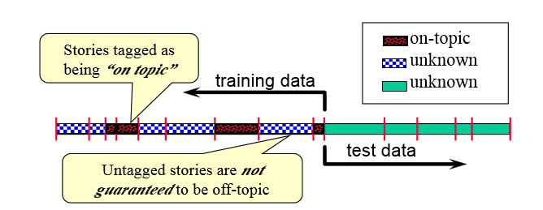

Topic tracking task
To detect the story that discuss the target topic, in
Multiple source stream.
training: given a stream of sample stories, with $N_{t}$ of them known as discuss a given target topic.
Test: Find all subsequent stories that discuss the target topic.

Slide 5
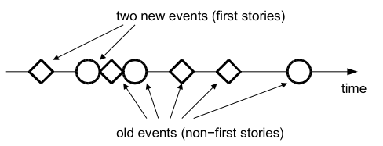
New Event Detection
New Event Detection is the task of detecting stories about previously unseen events in a stream of news stories.

Slide 6
problems:
Find all subsequent stories that discuss the target topic.
Duplicated document
Lexical variation
Unimportant document

Slide 7
Sub-event detection
events usually evolve (e.g., natural disasters, protests, etc.) and therefore, for most events, there is a set of sub-events nested within them.
Users generate novel data when a new sub- event occurs.
The content of the new data is different from the previous and it represents the current state of the event.

Slide 8
Sub-event detection challenges
Subevent definition
Novelty and redundancy definition
Very similar content
Named Entities
User generated data

Slide 9
Subevent definition
Subevents have been studied for event tracking applications. However, most current research is specifically related to social media applications, like Twitter, in terms of both its definition of subevents and methodologies. For example a subevent is defined as a topic that is discussed intensively in the Twitter stream for a short period of time before fading away. Accordingly, the subevent detection method relies on modeling the burstiness and cohesiveness properties of tweets in the stream. We instead aim to provide a more general definition of subevents as well as present a method for identifying subevent at the article level.

Slide 10

Novelty and redundancy
a new document $d^{t}$ arrives in the system, the previous N ones are already stored $(C).$
a novelty score $NS(d^{t},C)$ is computed, indicating the novelty of this document for the given corpus.
Notes:
بیان مشکل مفهوم جدید و قدیمی بود
البته خیلی روی مفهوم قدیمی بودن یا تکراری بودن یه خبر مشکلی نداریم اما در تشخیص جدید بودن خبر کمی دچار ابهام هستیم
بعضی وقتا خبر در حد 1 عدد نسبت به خبرهای قبلی جدید هست و واقعا خیلی برای کسی که تگ میزنه شاید محسوس نباشه این تغییر
به همین خاطر 5 تا تگ زدیم و اینترفیس و اینا

Slide 11


Very similar content
Cosine Similarity
old
$$θ_{2}$$
other features
(News Agency Match,
Time Diff,
Comments Similarity,
Tweets Similarity,
Named Entities,
…)
$$θ_{1}$$
new
Notes:
خب طبیعتا اینجا شباهت کسینوسی به تنهایی به هیچ وجه کارایی نداره. به همین خاطر تو نواحی خاصی مجبوریم یه کار دیگه انجام بدیم.
حالا مسئله خودم رو مطرح کن

Slide 12
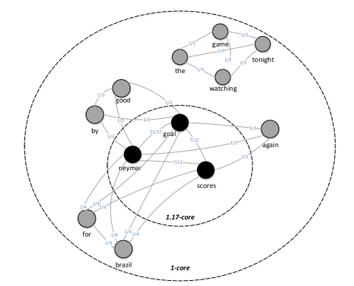
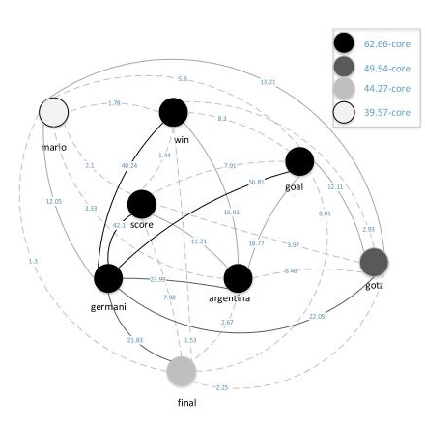
Comments (Tweets) Similarity
good goal by Neymar
goal! Neymar scores for brazil
goal !!! Neymar scores again
watching the game tonight

Slide 13
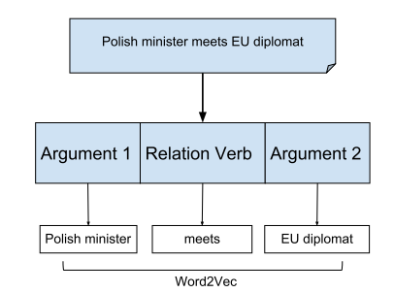
Named Entities

Slide 14
New Doc
Content Similarity
User generated data similarity
Other features
New
LSH
old
Nearest Neighbor

Slide 15
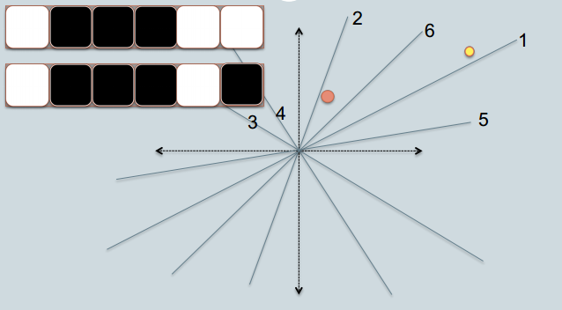
LSH

Slide 16
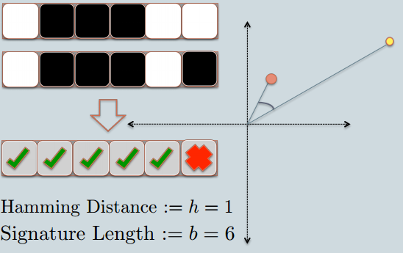
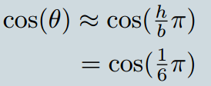
LSH

Slide 17
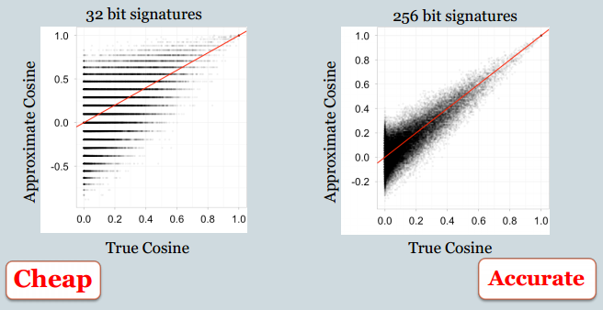
LSH

Slide 18
dataset
3 News Agency (3000 news article)
Tabnak
Khabaronline
FardaNews
Major Events
ترور دانشمند هسته ای
قتل روح الله داداشی
مذاکرات هسته ای
سهمه بندی بنزین
جام جهانی 2010
تحولات مصر

Slide 19
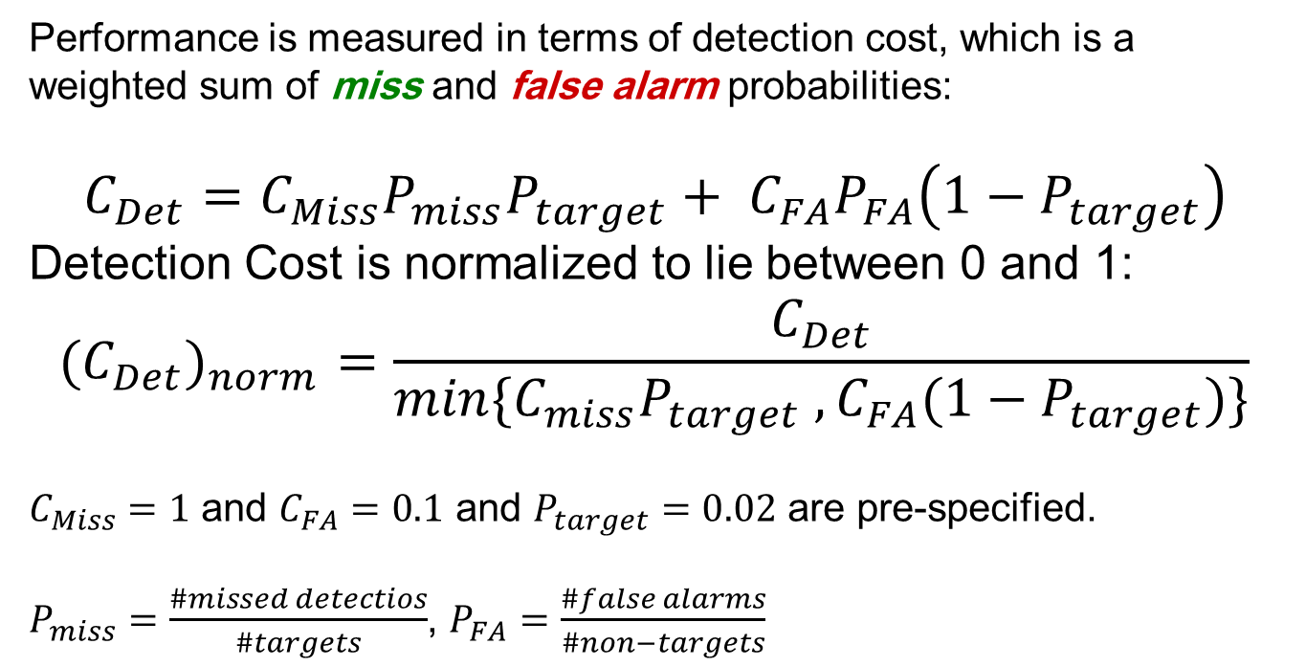
Evaluation Methodology
Performance is measured in terms of detection cost, which is a weighted sum of miss and false alarm probabilities:
$C_{Det}=C_{Miss}P_{miss}P_{target}+ C_{FA}P_{FA}\left(1−P_{target}\right)$
Detection Cost is normalized to lie between 0 and 1: $${{(C}_{Det})}_{norm}=\frac{C_{Det}}{min⁡\{C_{miss}P_{target} , C_{FA}(1−P_{target})\}}$$
$C_{Miss}=1$ and $C_{FA}=0.1$ and $P_{target}=0.02$ are pre-specified.
$P_{miss}=\frac{\#missed detectios}{\#targets}$, $P_{FA}=\frac{\#false alarms}{\#non−targets}$

Slide 20
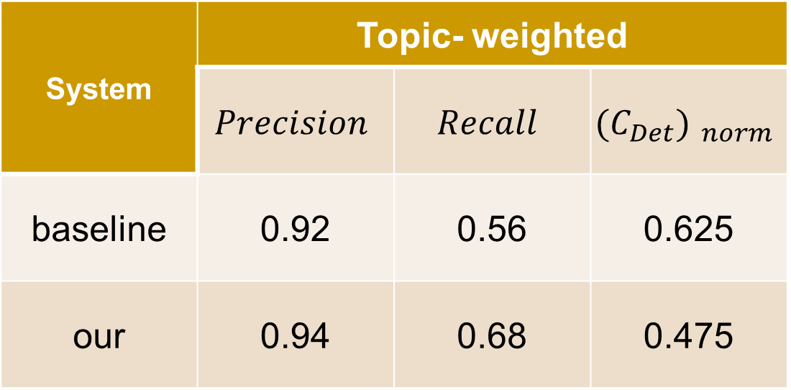
Results
System | Topic- weighted
 | $$Precision$$ | $$Recall$$ | $${(C_{Det}) }_{norm}$$
baseline | 0.92 | 0.56 | 0.625
our | 0.94 | 0.68 | 0.475

Slide 21
Thank You

Slide 22
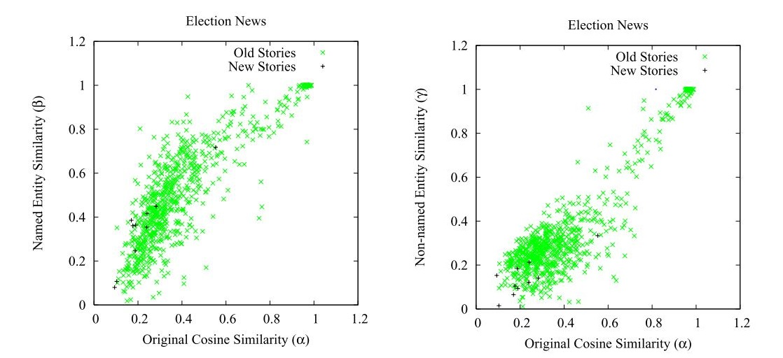
Notes:
اینجا فقط گاما اسکور مطرحه در حالیکه بتا اسکور پخش و پلاس

Slide 23
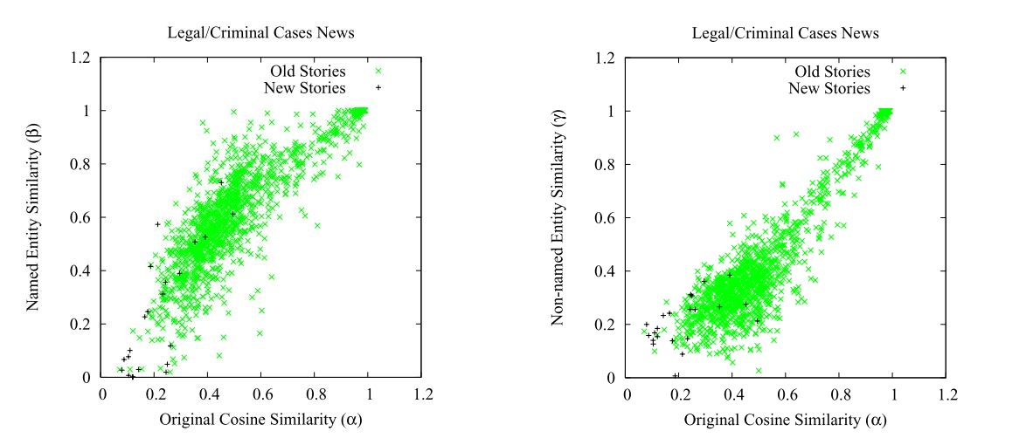
Notes:
اینجا هم بتا هم گاما زیر 0.4 میتونه تعداد زیادی از جدید ها رو کاراکترایز کنه
اما تعداد بیشتری هم old در گاما پیدا میشه

