Slide 1
New Event Detection Storyline Detection

Slide 2
New Event Detection
Dataset: TDT corpus (https://catalog.ldc.upenn.edu/LDC2005T16)
A major obstacle is the high degree of lexical variation in documents that cover the same event(Using paraphrases for improving first story detection in news and Twitter; Conference of the North American Chapter of the Association for Computational Linguistics: Human Language Technologies; HLT-NAACL;2012 )
Word embedding
کارهایی که برای بهبود پیچیدگی زمانی انجام شده عموما. مقاله های این مورد:
New event detection based on indexing-tree and named entity;sigir2007
On-line new event detection using time window strategy;icmlc;2011

Slide 3
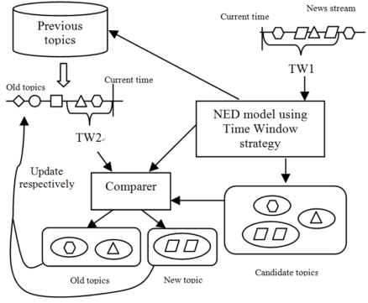

Slide 4
چالش:
نکته:
Individual comparison to each document in the history has been shown to be superior to a clustering approach where new documents are compared to the generated clusters(a system for NED;sigir2003)
ایده خام: نمایش جدیدی از خوشه ها(word embedding ?)

Slide 5
سه موضوع مطرح شده:
کپی تمام اخبار
کپی بخشی از خبر
روایت های مختلف از یک خبر
این ها در حوزه Topic Detection و نیز New Event Detection جای دارند.
چالش:
خبری در مورد یک رخداد قدیمی اما با اطلاعاتی جدید را به عنوان Event جدید شناسایی نکنیم.
در واقع Event جدیدی رخ نداده است اما اطلاعات جدیدی تولید شده است.
Storyline detection?

Slide 6
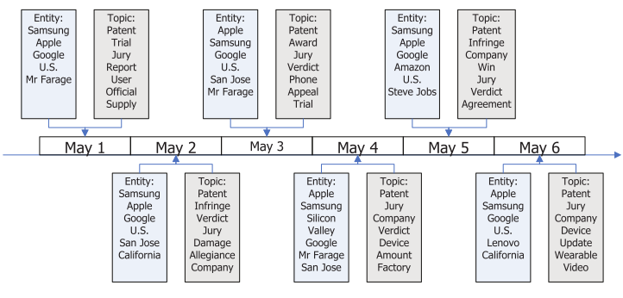
reveal the temporal structure of stories(Storyline Detection)
Storyline detection from news articles aims at summarizing events described under a certain news topic and revealing how those events evolve over time.
First: detection of events from news articles published in different time periods
Then: construction of storylines by linking events into coherent news stories
Generative Process
Parameter Estimation (Gibbs sampling)
An Unsupervised Bayesian Modelling Approach to Storyline Detection from News Articles;EMNLP;2015

Slide 7
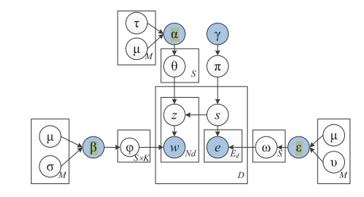
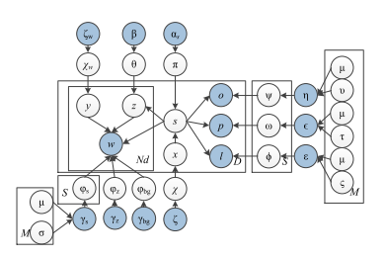
Storyline Detection
EMNLP 2015: Conference on Empirical Methods in Natural Language Processing
IJCAI 2016:International Joint Conference on Artificial Intelligence
Notes:
Storyline-topic-word
Storyline-topic
Storyline-entity

Slide 8
