Slide 1
NED

Slide 2


First Story Detection using Multiple Nearest Neighbors
normalized information gain is shown to be more effective than cosine similarity for the task of clustering news articles that are topically related.
The key idea for First Story Detection, is that acting on formed 3NN clusters rather than individual documents is less likely to return false positives.
Similar to the Single Linkage baseline, first stories are detected when a newly formed cluster core is dissimilar from news articles seen recently
a cluster core A is declared novel when the similarity between a news article d ∈ A and a news article n in the remainder of the collection C is below a threshold φ novelty.
sigir2016

Slide 3

cont.
add a threshold to filter out newly formed clusters that are less likely to be topically related to each other. Vuurens et al. show that news articles that have a high normalized information gain are rarely topically related.
In 3NN clustering, every node is assigned to its three nearest neighbors, not allowing links between nodes from the same news domain, and based on temporal proximity between publication dates which allows the clustering to be continuously updated in near real-time.
2-generate cluster cores are formed when three nodes each link to the other two as a one of its 3 nearest neighbors. These clusters contain information that is locally most central and therefore likely to be salient information [10].
sigir2016

Slide 4
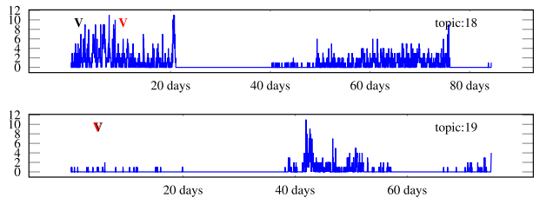
cont.
An inspection on the timeliness of the first stories detected reveals weaknesses in both approaches, and potentially an important aspect that should be taken into consideration in attempts to improve FSD. Timeliness of the detection is currently not addressed by the traditional evaluations that use a DET-curve and the tradeoff between recall and precision. To evaluate future work that addresses this issue, an additional metric to compare the timeliness of FSD approaches is required.

Slide 5
cont.
For this topic, the news slowly shifted over the cause of days from a focus on the election itself to the steadily increasing demonstrations. This gradual shift towards a new topic is relatively difficult to detect for the approaches used in this study.

Slide 6
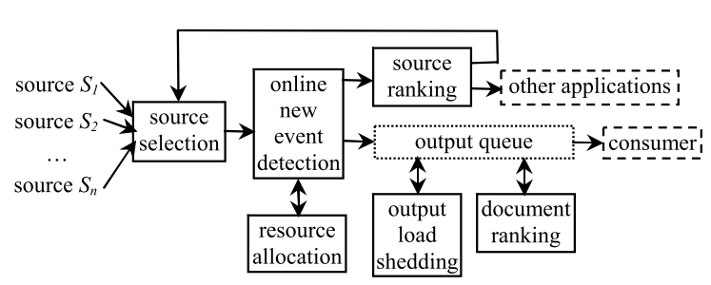
Resource-Adaptive Real-Time New Event Detection
SIGMOD 07

Slide 7
Sentence level
Retrieval and Novelty Detection at the Sentence Level; sigir2003
Novelty Detection: The TREC Experience; HTL 2005
Improving Novelty Detection for General Topics Using Sentence Level Information Patterns; CIKM 2006
A paper by Sobboroff and Harman[HLT 2005] reported the significant problem in evaluating such tasks, by highlighting problems in the construction of a ground truth dataset.

Slide 8


Enhancing First Story Detection using Word Embeddings
In this paper we show how word embeddings can be used to increase the effectiveness of a state-of-the art Locality Sensitive Hashing (LSH) based first story detection (FSD) system over a standard tweet corpus.
In particular, we propose to expand tweets with semantically related paraphrases identified via automatically mined word embeddings over a background tweet corpus.
The hash codes resulting from Equation (3) can be used to index the tweets into hash table buckets. Tweets colliding in the same bucket should have a high likelihood of being similar, i.e. discussing the same event.
sigir2016

Slide 9

Topic-conditioned Novelty Detection*
1. classifying documents into broad topics each of which consists of multiple events;
2. identifying Named Entities (NE’s), optimizing their weight relative to normal words for each topic, and computing a stopword list per topic;
3. measuring the novelty of a new document conditioned on the system-predicted topic for that document.
Since topical common words cause events in the same topic to be mutually confusing, and are a potential cause for a FSD system to miss the first story of a new event, a natural choice for us is to remove those words. We obtained a stopword list for each topic by thresholding on the training-set document frequency of a word:
KDD 2002; Jian Zhang, Jaime Carbonell

Slide 10
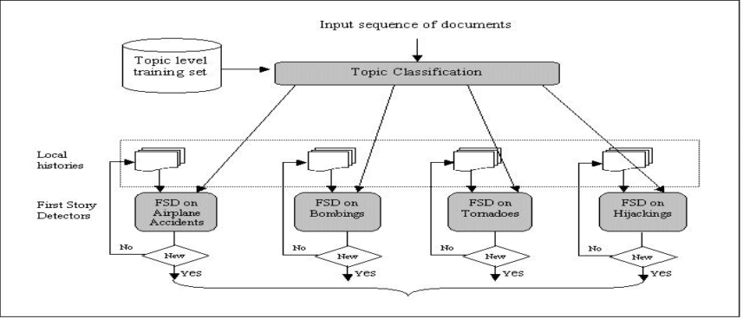
KDD 2002; Jian Zhang, Jaime Carbonell

Slide 11
dataset
For empirical examination, ideally, we would like to have a document collection with a large number of manually labeled topics and events, and with a reasonable number of documents for each event. In reality, such data sets are difficult to find. The TDT benchmark collections, for example, have over 300 manually defined events but broad topic labels are not available, unfortunately. We also found that the TDT events are often sparsely labeled for a given topic, e.g., only three bombing events were labeled among many bombing events actually reported in the TDT corpora. Those sparsely labeled events per topic do not allow us to thoroughly examine the power of our method in differentiating mutually confusable events. We therefore created our own data.
KDD 2002; Jian Zhang, Jaime Carbonell

Slide 12
FUTURE WORK
Automated hierarchical clustering: Instead of using human defined topics at the upper-level in our scheme, using system-generated clusters is another challenging problem.
Adaptive learning at the topic classification level: Substantial developments have been made recently in the adaptive filtering area of information retrieval[3], and investigating those new technique.es for novelty detection has not been done.
KDD 2002; Jian Zhang, Jaime Carbonell

Slide 13
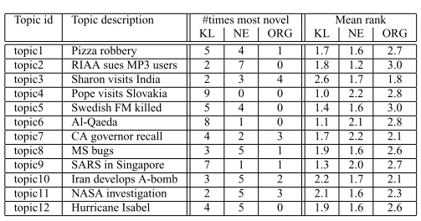

Newsjunkie: Providing Personalized Newsfeeds via Analysis of Information Novelty
$NE_{u}\left(R_{1},R_{2}\right)=\{e|e∈NE(R_{1})∩e∉NE(R_{2})\}$
$Dist NE\left(d,R\right)=\frac{NE_{u}\left(d,R\right)}{length\left(d\right)}$
www;2004; cited by 227

Slide 14
http://research.signalmedia.co/newsir16/
The First International Workshop on Recent Trends in News Information Retrieval will take place in Padua, Italy in conjunction with ECIR 2016

Slide 15
Detecting Controversial Events from Twitter; CIKM 2010
Extracting Social Events Based on Timeline and Sentiment Analysis in Twitter Corpus; NLDB 2012
Hotspots of News Articles: Joint Mining of News Text & Social Media to Discover Controversial Points in News; big data 2015
Earthquake Shakes Twitter Users : Real-time Event Detection by Social Sensors; www 2010; cited by ~2300

