Slide 1
Sub-event detection and summarization

Slide 2
Event Summarization using Tweets
This approach has the advantage of leveraging existing query matching technologies, and for simple one-shot events such as earthquakes it works well. However, for events that have “structure” or are long- running, and where users are likely to want a summary of all occurrences so far, this approach is often unsatisfactory.
We first design a modified Hidden Markov Model that can segment the event time-line, depending on both the burstiness of the tweet-stream and the word distribution used in tweets. Each such segment represents one distinct “sub-event”, a semantically distinct portion of the full event.
We then pick key tweets to describe each segment judged to be interesting enough, and combine them together to build the summary.
Challenge:
(1) Events are typically “bursty”: Some types of sub-events generate far more tweets per unit time than others. Our algorithm balances the number of tweets picked for the summary from low activity and bursty periods.
(2) Separate sub-events may not be temporally far apart: Our algorithm solves this problem by automatically learning language models for common types of sub-events. This allows it to separate different types of sub-events even when they are temporally close
ACM international conference on Intelligent User Interfaces;2012

Slide 3
Event Summarization using Tweets
Algorithms:
1) SUMMALLTEXT
each tweet as a vector.
cosine distance between them
select those tweets which are closest to all other tweets from the event.
2) SUMMTIMEINT
duration of the event into equal-time windows
durations of bursts can vary ☹
Multiple sub-events in the same burst ☹
a good segmentation should consider changes in language model along with changes in tweet volume. ☺
HMM; observation: Terms in Tweets, States: “touchdown”, “goal”,….
ACM international conference on Intelligent User Interfaces;2012

Slide 4
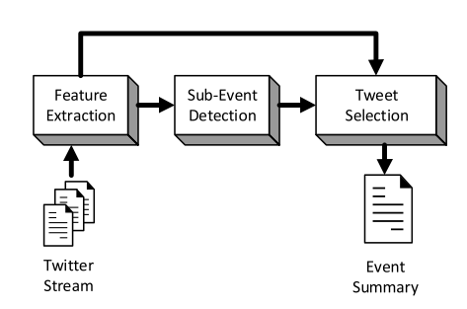
Degeneracy-Based Real-Time Sub-Event Detection in Twitter Stream
The detection of the important moments of an event is a topic that has not yet received much attention by the research community.
ICWSM;2015

Slide 5
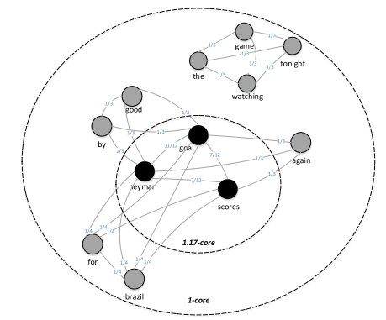
cont.

Slide 6
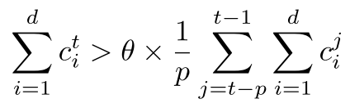
Sub-event detection
Detection based on tweeting rate ☹ (detection)
Detection based on tweeting weight☺ (sub event detection)
the system considers that an important moment occurred when the sum of the core numbers of the d terms belonging to the highest cores for the current time period increases by at least a predefined threshold θ from the average sum over the last p time periods.

