Slide 1
Code Force’s
BOYCOTT
CODE FOR QODS
Page 01

Slide 2
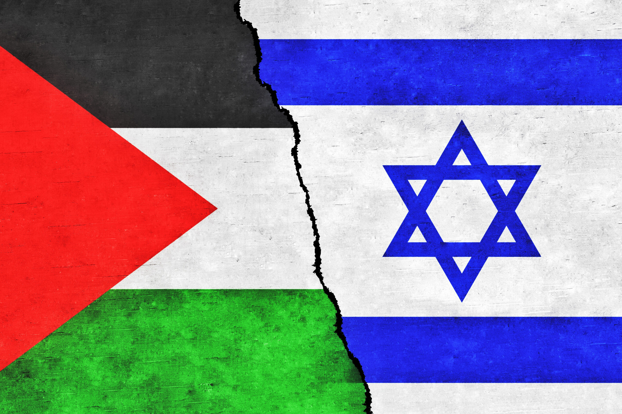
1967
This year initiated the establishment of settlements in Palestinian territories, resulting in tragic consequences. Incidents have included the loss of lives, including children and women, as well as extensive destruction, impacting homes and even trees. The vulnerability of Palestinians has been evident in the face of these actions.
What was taken by force, can only be regained by force
Page 02

Slide 3
TABLE OF CONTENTS
01
02
03
WHY BOYCOTTING!?
OUR IDEA
You can describe the topic of the section here
You can describe the topic of the section here
CONCLUSION
You can describe the topic of the section here
Page 03

Slide 4
WHY BOYCOTTING!?
01
Page 04

Slide 5
Reason
Many multinational and local Israeli brands serve as the essence of the Israeli military, as they are closely associated with its involvement in conflicts that lead to the heartbreaking loss of innocent lives, including women and children, on a daily basis.
Page 05

Slide 6
SOLUTION
So we though for a solution where we gonna boycotting these brands as the less thing that we can do for standing in solidarity with the Palestinians
Page 06

Slide 7
OUR IDEA
02
Page 04

Slide 8
In solidarity with the Palestinians, we have decided to create a website listing Israeli brands alongside their alternatives from other countries. Users simply need to specify their country and the product name, and they will be provided with the available alternatives.
Page 07

Slide 9
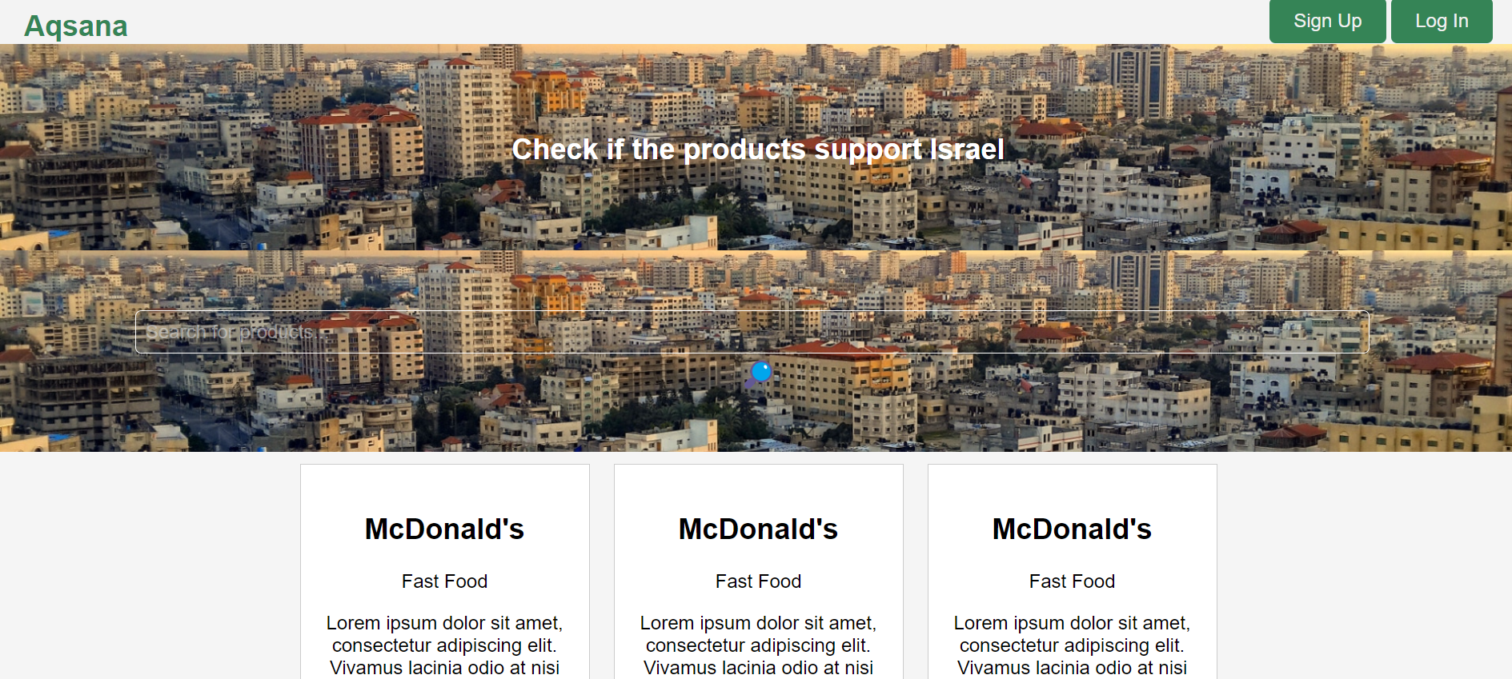
AQSANA
Aqsana is site where you can searsh for alternative brands and also you can suggest alternative and also boycoted brands

Slide 10
CONCLUSION
02
Page 04

Slide 11
Palestine its very Arabic and muslim matter we should
Do all what you can to save this matter cause every day
Thers a 100 of innocent who are dying.
Lets be all one hand.
Free Palestine 💓
Page 07

Slide 12


THANKS!
Please keep this slide for attribution

