Slide 1
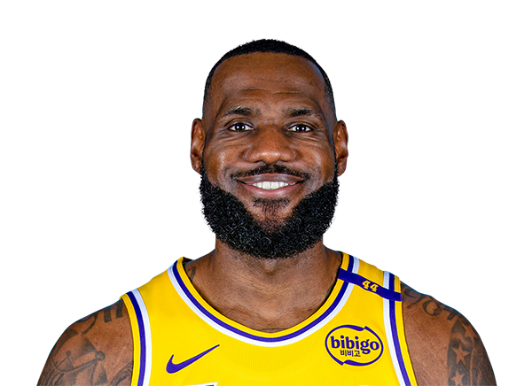
Lebron James
Backend Engineer
Summary of Professional Experience
Lebron James
Analyst
Deloitte Backend Developer
Email: LeJames@deloitte.com
I am a Backend Engineer with over 9 years of experience specializing in designing and delivering high-performance APIs for large-scale systems in the Middle East. Proficient in Java, Spring Boot, and Node.js, I have built secure, reliable, and well-documented APIs that power finance, healthcare, and e-commerce platforms. My expertise lies in architecting clean API contracts, optimizing request/response flows, and ensuring seamless integrations across services. With a strong foundation in database design and system performance tuning, I consistently deliver backend solutions that are scalable, maintainable, and aligned with business needs.
Key Skills
Relevant Experience
Business Skills:
Strategic Planning & Execution
Agile & Scrum Methodologies
Client Communication
Stakeholder Engagement
Problem-Solving
Product Mindset
Technology Skills:
Java / Spring Boot
Node.js / Express
RESTful & GraphQL API Design
SQL & NoSQL Databases
Microservices Architecture
Docker
Industry Experience:
Digital Marketing
Banking & Financial Services
E-commerce & Retail
Management Consultant, Nile Advisory Group (Jan 2021 – Present) Led large-scale transformation programs for hospitality and travel clients, achieving efficiency improvements of 25%+. Developed and embedded PMO frameworks to align project delivery with strategic goals. Directed digital transformation initiatives, including ERP rollouts and process automation, improving organizational responsiveness. Conducted executive workshops and training sessions on supply chain optimization, governance, and performance management.
Business Consultant, Delta Consulting Services (Jan 2013 – Dec 2020) Provided strategic advisory to clients in retail, financial services, and government, focusing on growth planning, restructuring, and competitive positioning. Guided organizational redesigns and market-entry strategies that strengthened client resilience and long-term performance.
Selected Clients
Education:
Bachelor’s degree in Computer Science, ASU
Languages:
Arabic
English
Dutch
Certifications:
AWS Certified Solutions Architect – Associate
Microsoft Certified: Azure Administrator
Kubernetes Certified Administrator (CKA)
Etisalat Misr — Orascom Development — Jumia Egypt — QNB Alahli — Palm Hills Developments

