Slide 1
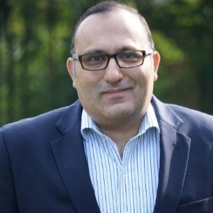
Daniel Ebeid
Backend Engineer
Summary of Professional Experience
Daniel Ebeid
Analyst
T&T, EAID, Customer As a Service / Operate
Email: debeid@deloitte.com
Cloud and DevOps engineer with 5+ years of experience in building, automating, and scaling infrastructure for high-availability systems. Proven expertise in designing CI/CD pipelines, container orchestration, and cloud-native applications across AWS, Azure, and GCP. Skilled in improving developer productivity, reducing deployment times, and enhancing system reliability through automation and monitoring solutions.
Relevant Experience
DevOps Engineer, CloudSphere Solutions (Apr 2023 – Present)
Built and optimized multi-cloud infrastructure (AWS + Azure) for enterprise clients.
Automated deployments with Terraform and Ansible, cutting manual effort by 60%.
Designed monitoring dashboards using Prometheus and Grafana.
Implemented CI/CD pipelines with GitHub Actions, reducing release cycle from 2 weeks to 3 days. System Administrator, LogiTech Transport (Sep 2018 – Dec 2020)
- Managed Linux-based servers and automated backup systems.
- Introduced Docker-based containerization for internal apps.
- Improved system reliability and reduced downtime by 30%.
Key Skills
Business Skills: - Project Planning & Execution
-Stakeholder Engagement
- Agile & Scrum
Technology Skills: -Cloud: AWS, Azure, GCP
-DevOps: Docker, Kubernetes, Terraform, Ansible
- Programming: Python, Go,
Industry Experience: - E-commerce
FinTech
Logistics & Supply Chain
Selected Clients
Education: - Bachelor’s degree in Computer Engineering, Ain Shams University
Languages: - Arabic - English
Certifications: - AWS Certified Solutions Architect – Associate
Microsoft Certified: Azure Administrator
Kubernetes Certified Administrator (CKA)
Amazon Egypt, Vodafone, Emirates Logistics

