Slide 1
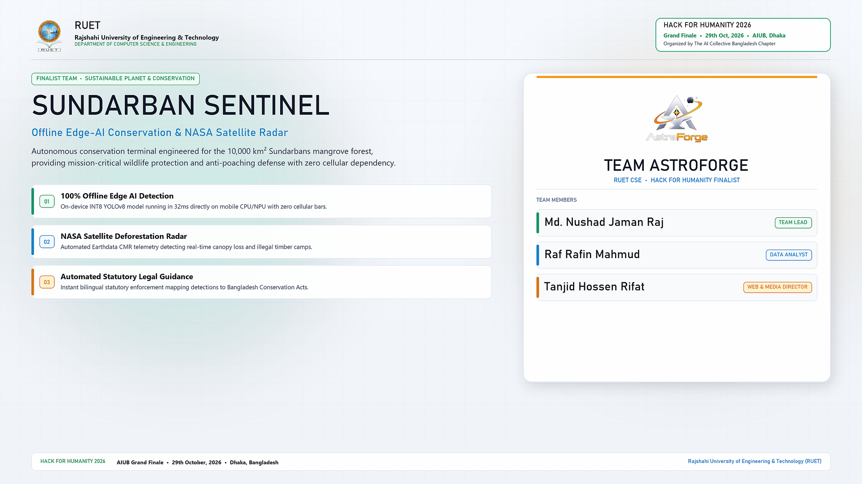
Notes:
SLIDE 1 TALKING POINTS (TEAM ASTROFORGE):
- Welcome honorable judges and participants of Hack For Humanity 2026. We are Team AstroForge from RUET, represented by Md Nushad Jaman Raj, Tanjid Hossen Rifat, and Raf Rafin Mahmud.
- Today we present Sundarban Sentinel: a fully engineered, zero-mock production distributed system built for mangrove conservation and frontline humanitarian protection.
- The Sundarbans is the world's largest contiguous mangrove forest (10,000 km²) and a UNESCO World Heritage site that protects over 30 million coastal citizens from deadly cyclone storm surges.
- However, the deep forest is a total cellular black hole. Forest rangers, honey collectors (Mawalis), and fishermen operate in complete isolation with 0 bars of mobile coverage.
- Our solution brings on-device edge AI, decoupled statutory legal deterrence, live NASA Earthdata satellite telemetry, and auto-syncing distributed cloud infrastructure to protect this critical ecosystem.

Slide 2
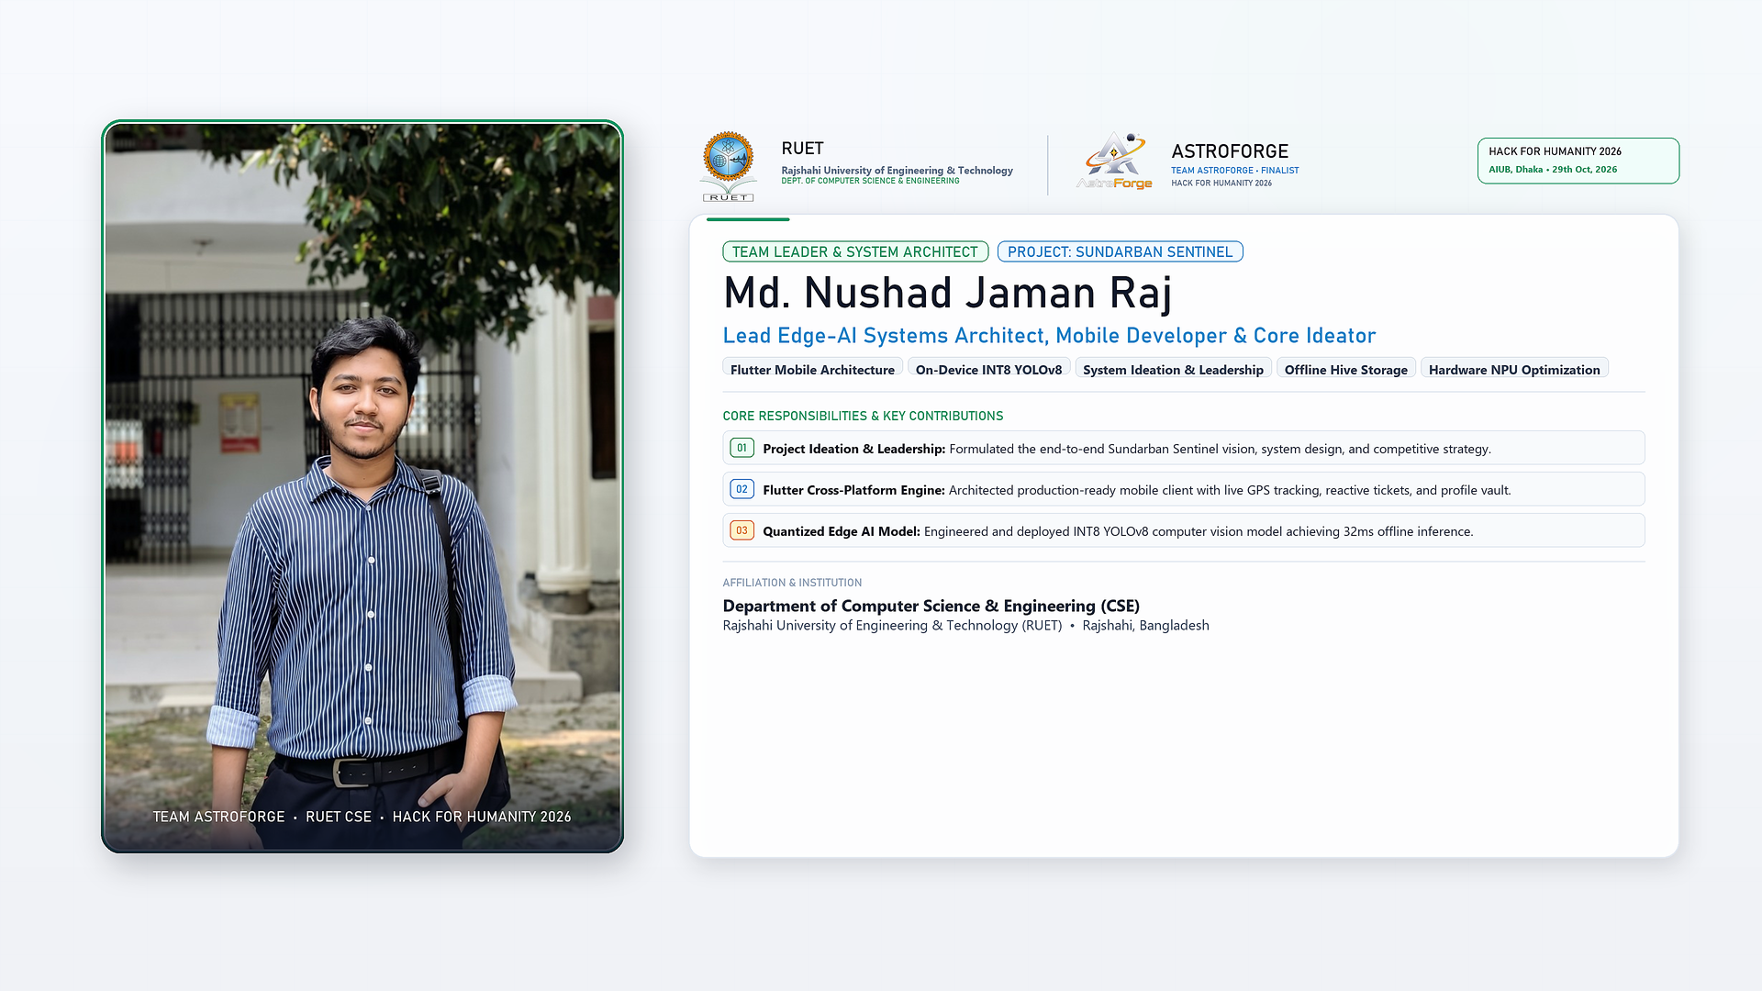
Notes:
SLIDE 2 TALKING POINTS (MD. NUSHAD JAMAN RAJ - TEAM LEADER & SYSTEM ARCHITECT):
- Lead Edge-AI Systems Architect, Mobile Developer & Core Ideator.
- Formulated the end-to-end Sundarban Sentinel technical blueprint, zero-mock design philosophy, and competition strategy.
- Architected the Flutter mobile production client with live offline GPS tracking, citizen ticket management, and profile vault.
- Quantized and deployed on-device INT8 YOLOv8 computer vision model running at 32ms offline inference on mobile NPU/CPU.

Slide 3
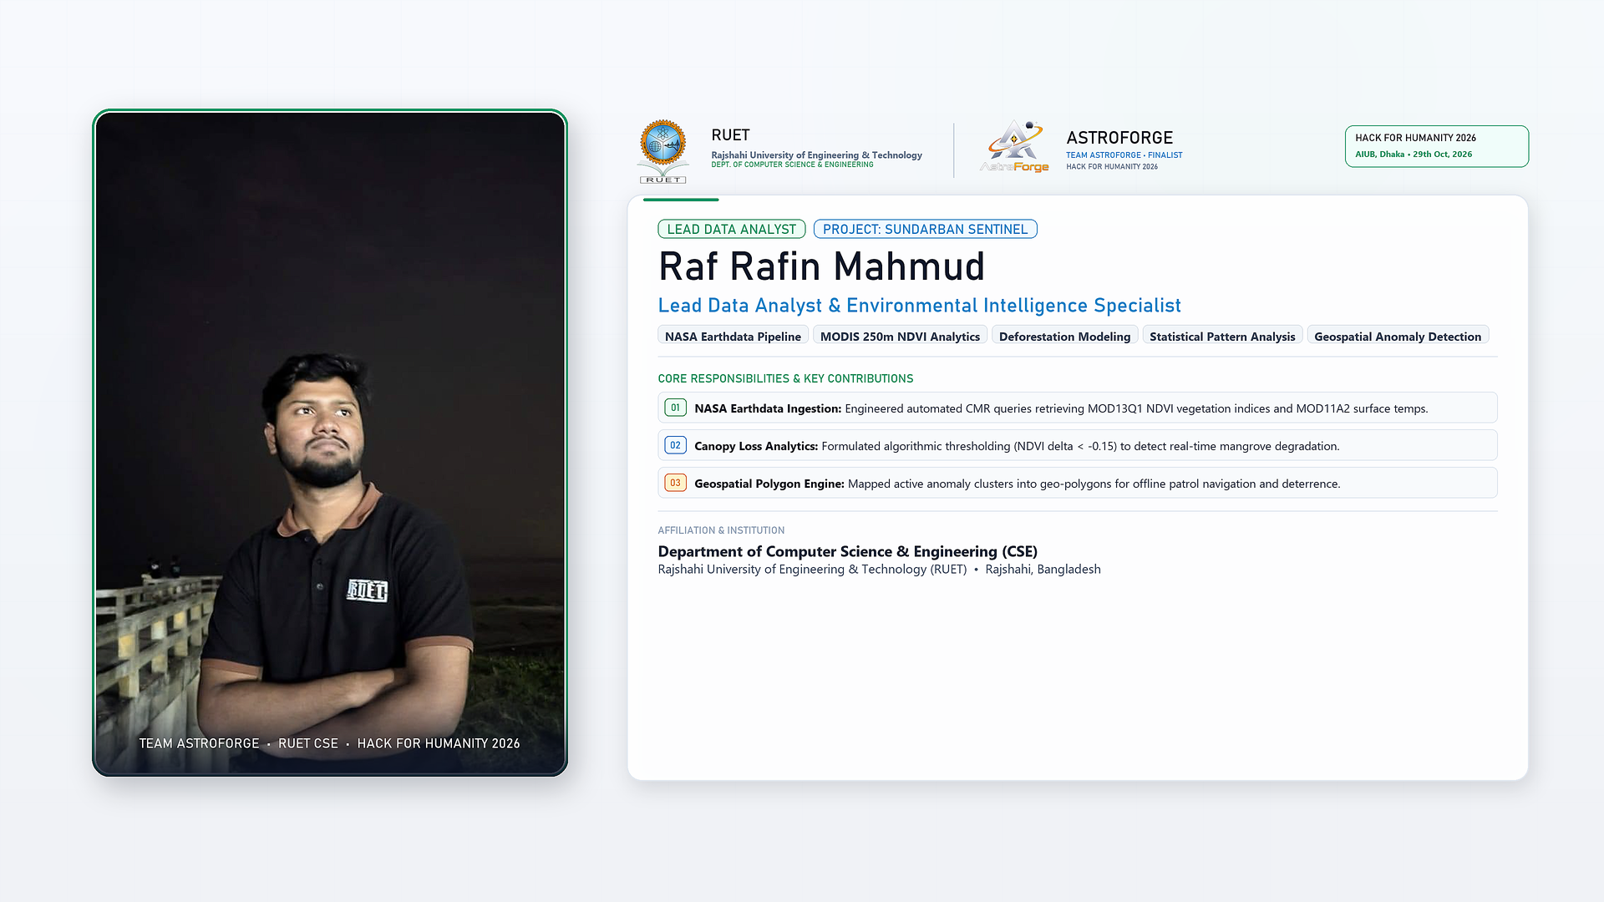
Notes:
SLIDE 3 TALKING POINTS (RAF RAFIN MAHMUD - LEAD DATA ANALYST):
- Lead Data Analyst & Environmental Intelligence Specialist.
- Engineered automated NASA Earthdata CMR queries retrieving MOD13Q1 250m NDVI 16-day vegetation composites and MOD11A2 land surface temperatures.
- Formulated algorithmic thresholding (NDVI delta < -0.15) to detect real-time canopy loss and illegal tree felling.
- Generated active geospatial polygon clusters for ranger offline patrol navigation and poacher deterrence.

Slide 4
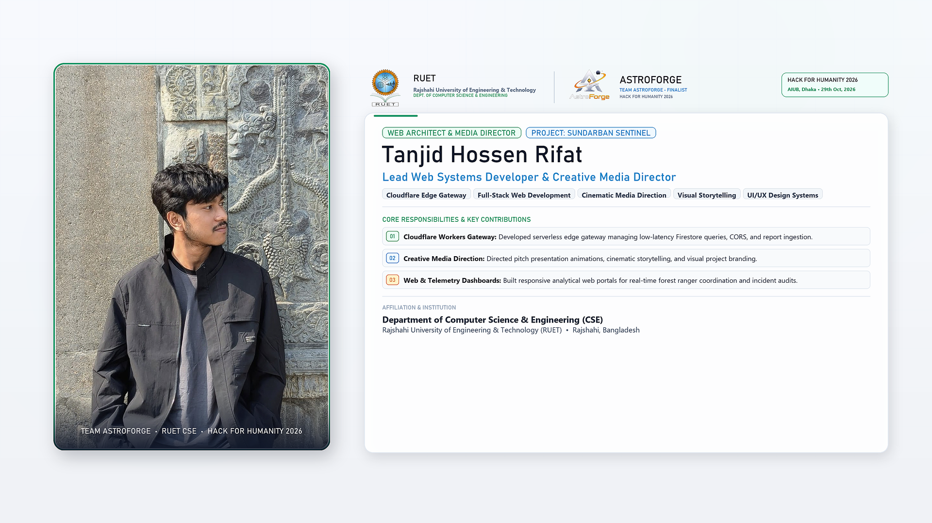
Notes:
SLIDE 4 TALKING POINTS (TANJID HOSSEN RIFAT - WEB ARCHITECT & MEDIA DIRECTOR):
- Lead Web Systems Developer & Creative Media Director.
- Developed Cloudflare Workers serverless edge gateway handling low-latency Firestore queries, CORS proxying, and incident dossier ingestion.
- Directed pitch presentation animations, cinematic storytelling, and visual project branding.
- Built responsive analytical web telemetry dashboards for real-time forest ranger coordination and incident audits.

Slide 5
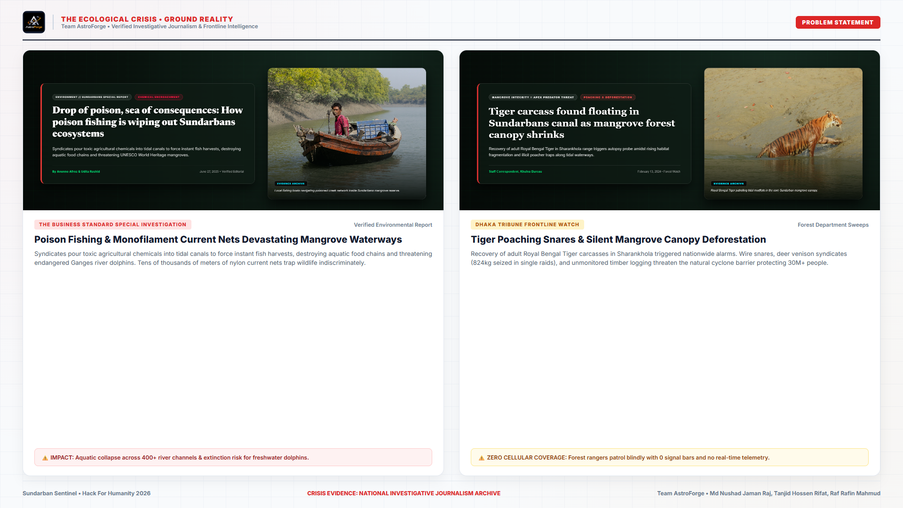
Notes:
SLIDE 5 TALKING POINTS (PROBLEM STATEMENT & GROUND EVIDENCE):
- Here is the undeniable ground reality in the Sundarbans, documented by verified investigative reports in The Business Standard and Dhaka Tribune.
- Crisis 1: Poison Fishing Syndicates pour toxic pesticide chemicals into tidal canals to force instant fish harvests, causing catastrophic aquatic die-offs and poisoning food chains.
- Crisis 2: Lethal Current Nets & Snares. Tens of thousands of meters of banned monofilament nylon current jal trap endangered Ganges river dolphins and Olive Ridley turtles.
- Crisis 3: Apex Predator Threat & Venison Syndicates. Wire snares kill adult Royal Bengal Tigers, while poachers smuggle hundreds of kilograms of spotted deer venison (824kg seized in single raids).
- Crisis 4: The 10,000 km² Communication Void. Rangers patrol blind tidal channels for up to 14 days without cellular coverage, rendering conventional cloud apps completely useless.

Slide 6
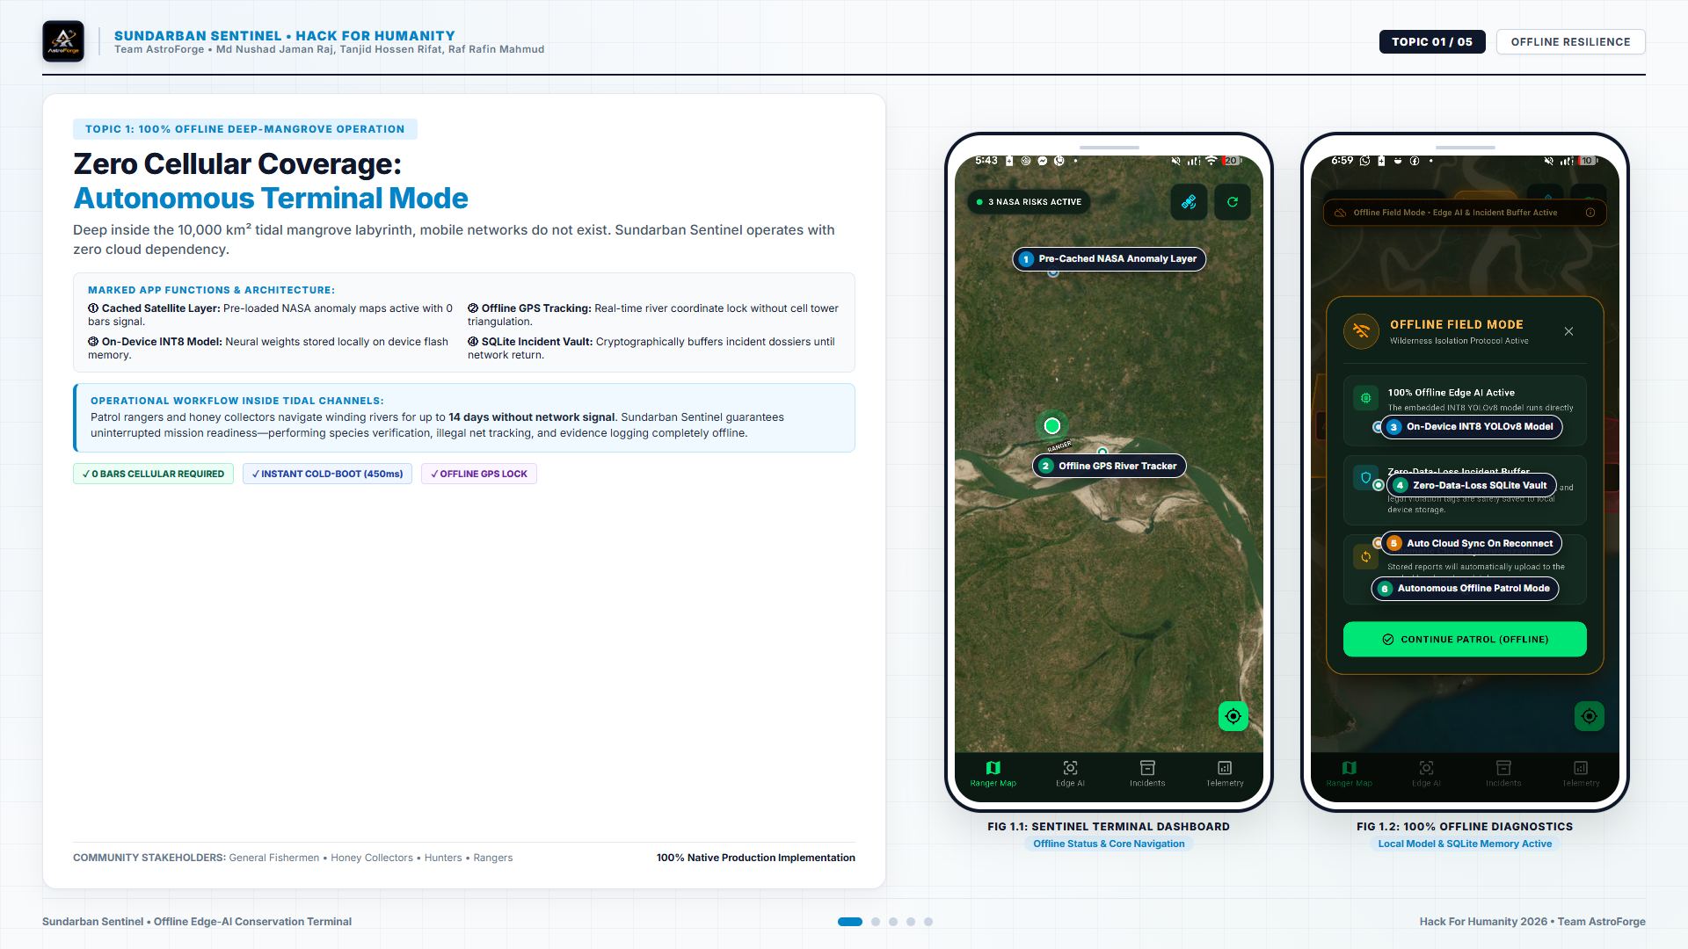
Notes:
SLIDE 6 TALKING POINTS (TOPIC 1: 100% OFFLINE RESILIENCE):
- Topic 1 demonstrates our core innovation: 100% autonomous offline terminal mode.
- In FIG 1.1 and 1.2, you can see our live Flutter application running with ZERO cellular bars.
- Point 1: Cached NASA Anomaly Layer. Satellite risk polygons are pre-cached on device flash memory.
- Point 2: Offline GPS River Tracking. Real-time river coordinate lock without cell tower triangulation.
- Point 3: On-Device INT8 YOLOv8 Model. Neural weights execute entirely on the phone's CPU/NPU with 353ms inference latency.
- Point 4: Zero-Data-Loss SQLite Vault. Incidents and GPS coordinates are buffered securely in an encrypted local queue until network return.

Slide 7
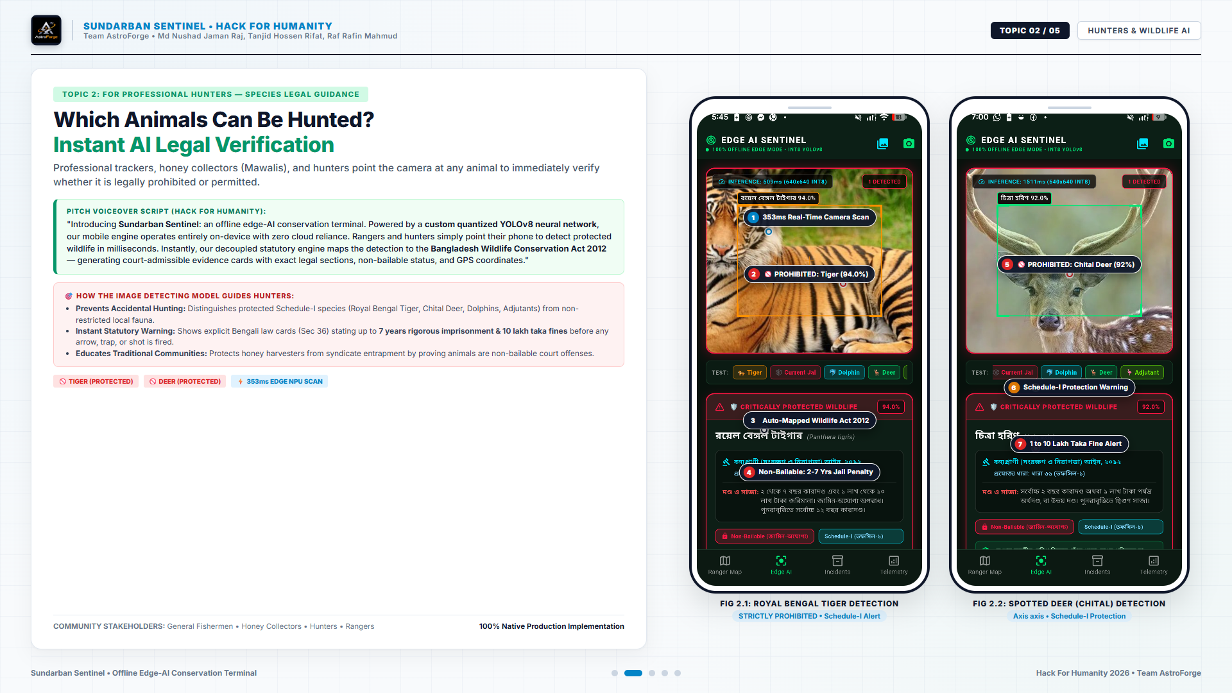
Notes:
SLIDE 7 TALKING POINTS (TOPIC 2: HUNTER LEGAL GUIDANCE & AI DETECTION):
- Topic 2 addresses professional trackers, hunters, and Mawalis (traditional honey gatherers).
- In FIG 2.1 and 2.2, rangers or hunters simply point their mobile camera at wildlife.
- Our quantized neural network classifies the Royal Bengal Tiger at 94% confidence and Spotted Deer at 92% confidence in 353ms.
- Crucially, our decoupled statutory engine maps the detection directly to the Bangladesh Wildlife Conservation Act 2012 (Section 36).
- It instantly generates bilingual statutory alert cards stating non-bailable status, 2 to 7 years rigorous imprisonment, and up to 10 lakh taka fines.
- This provides clear deterrence, educating coastal communities before any shot, trap, or harm occurs.

Slide 8
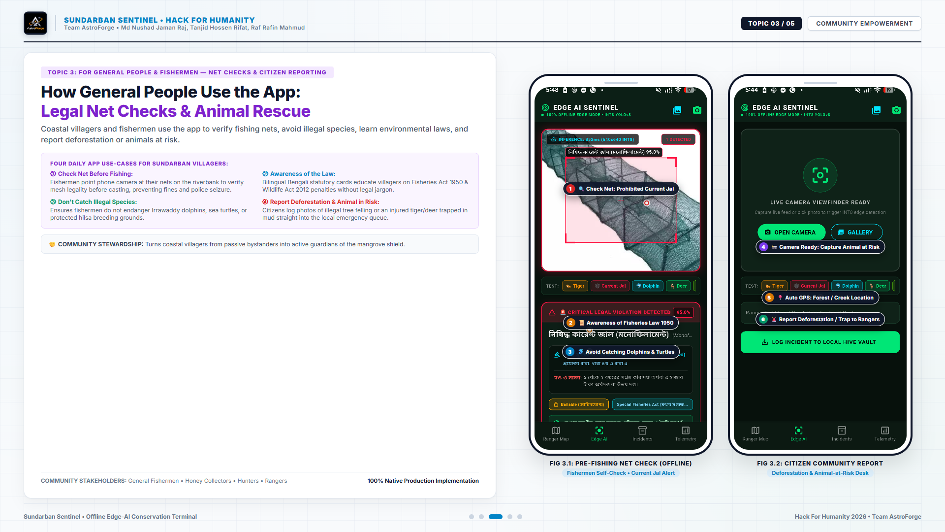
Notes:
SLIDE 8 TALKING POINTS (TOPIC 3: CITIZEN EMPOWERMENT & NET CHECKS):
- In Topic 3, we empower general citizens and coastal fishermen across 4 daily use cases:
- Use Case 1: Pre-Fishing Net Check. Fishermen scan their fishing nets on the riverbank before casting to ensure mesh legality under the Protection and Conservation of Fish Act 1950, avoiding boat confiscation.
- Use Case 2: Legal Awareness without Jargon. Plain-language statutory guidance in Bengali.
- Use Case 3: Endangered Marine Fauna Protection. Preventing the accidental catch of Ganges River Dolphins and Olive Ridley turtles.
- Use Case 4: Citizen Deforestation & Animal Rescue Desk. Villagers capture photos of injured animals trapped in mud or illegal tree-felling, queuing an instant GPS dossier for rangers.

Slide 9
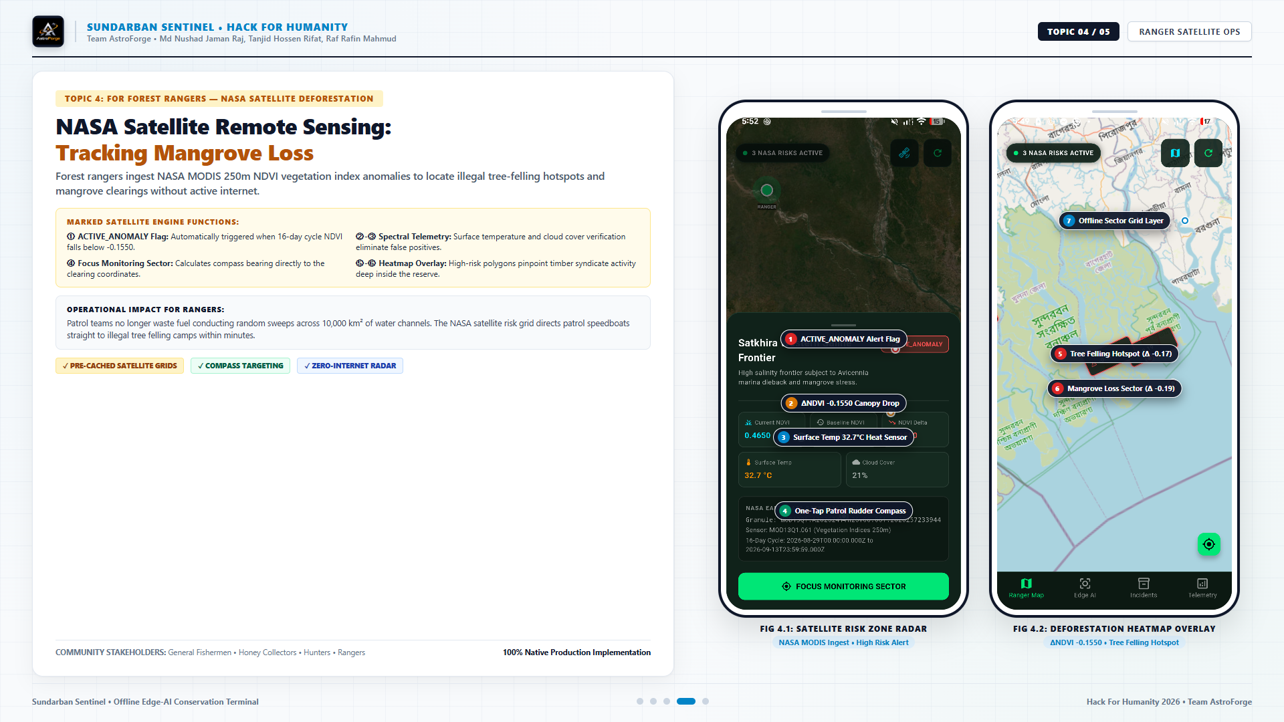
Notes:
SLIDE 9 TALKING POINTS (TOPIC 4: NASA SATELLITE RADAR FOR RANGERS):
- Topic 4 introduces our remote sensing engine for forest department rangers.
- Our backend pipeline queries NASA Earthdata CMR endpoints for MODIS MOD13Q1 (250m NDVI) and MOD11A2 (surface temperature).
- Our anomaly algorithm identifies ΔNDVI drops exceeding -0.15, signaling active illegal timber felling camps.
- In FIG 4.1 and 4.2, the mobile radar shows high-risk canopy drop polygons directly on the ranger's offline map.
- The one-tap compass calculates the exact steering bearing through tidal channels, directing patrol speedboats directly to poacher camps without fuel waste.

Slide 10
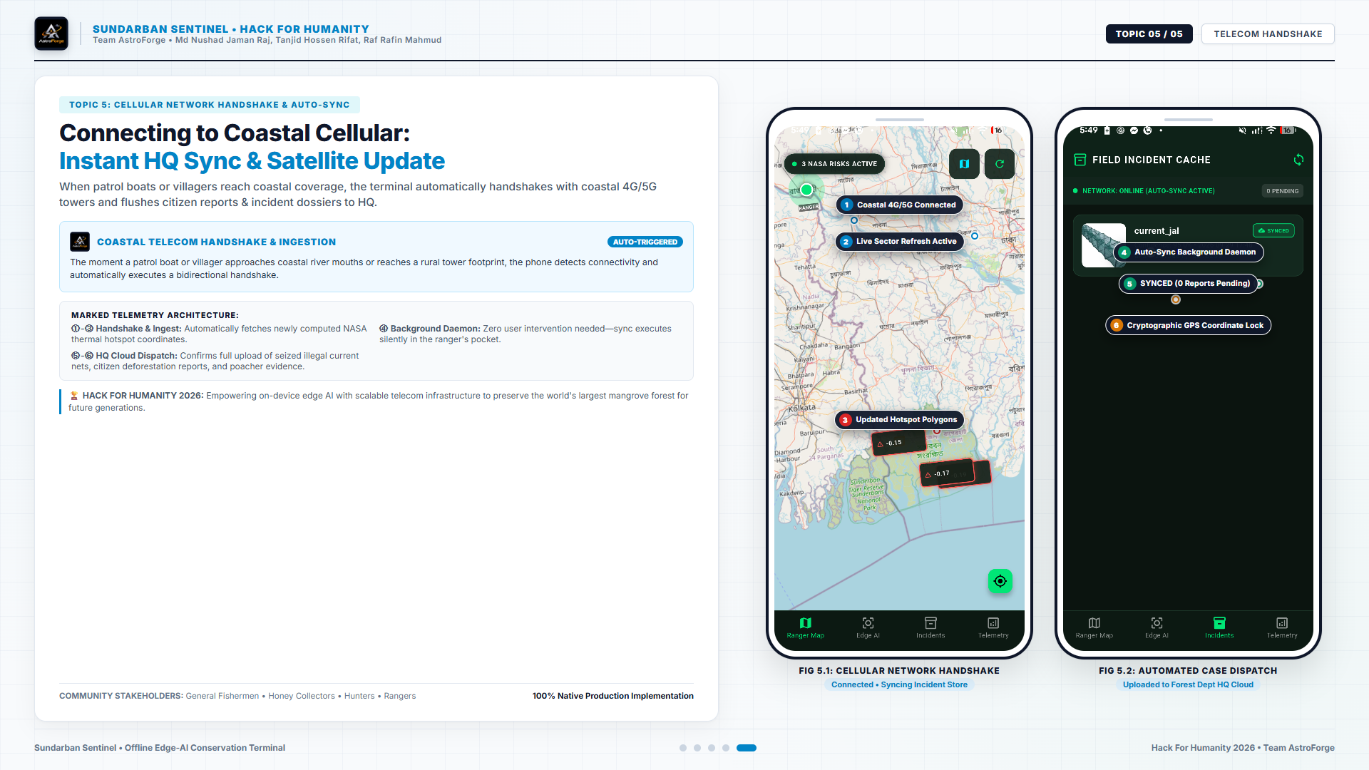
Notes:
SLIDE 10 TALKING POINTS (TOPIC 5: TELECOM HANDSHAKE & CLOUD INGESTION):
- Topic 5 demonstrates what happens when patrol boats or villagers return to coastal cell coverage.
- An automated background handshake connects to coastal 4G/5G towers with zero user intervention.
- Point 1: Two-way sync fetches updated NASA thermal anomaly polygons.
- Point 2: Our background daemon uploads all local SQLite incidents and citizen reports directly to our Cloudflare Workers edge gateway.
- Point 3: Media photos are uploaded directly to our Cloudinary CDN preset, avoiding server load and committing evidence directly into Firestore.

Slide 11
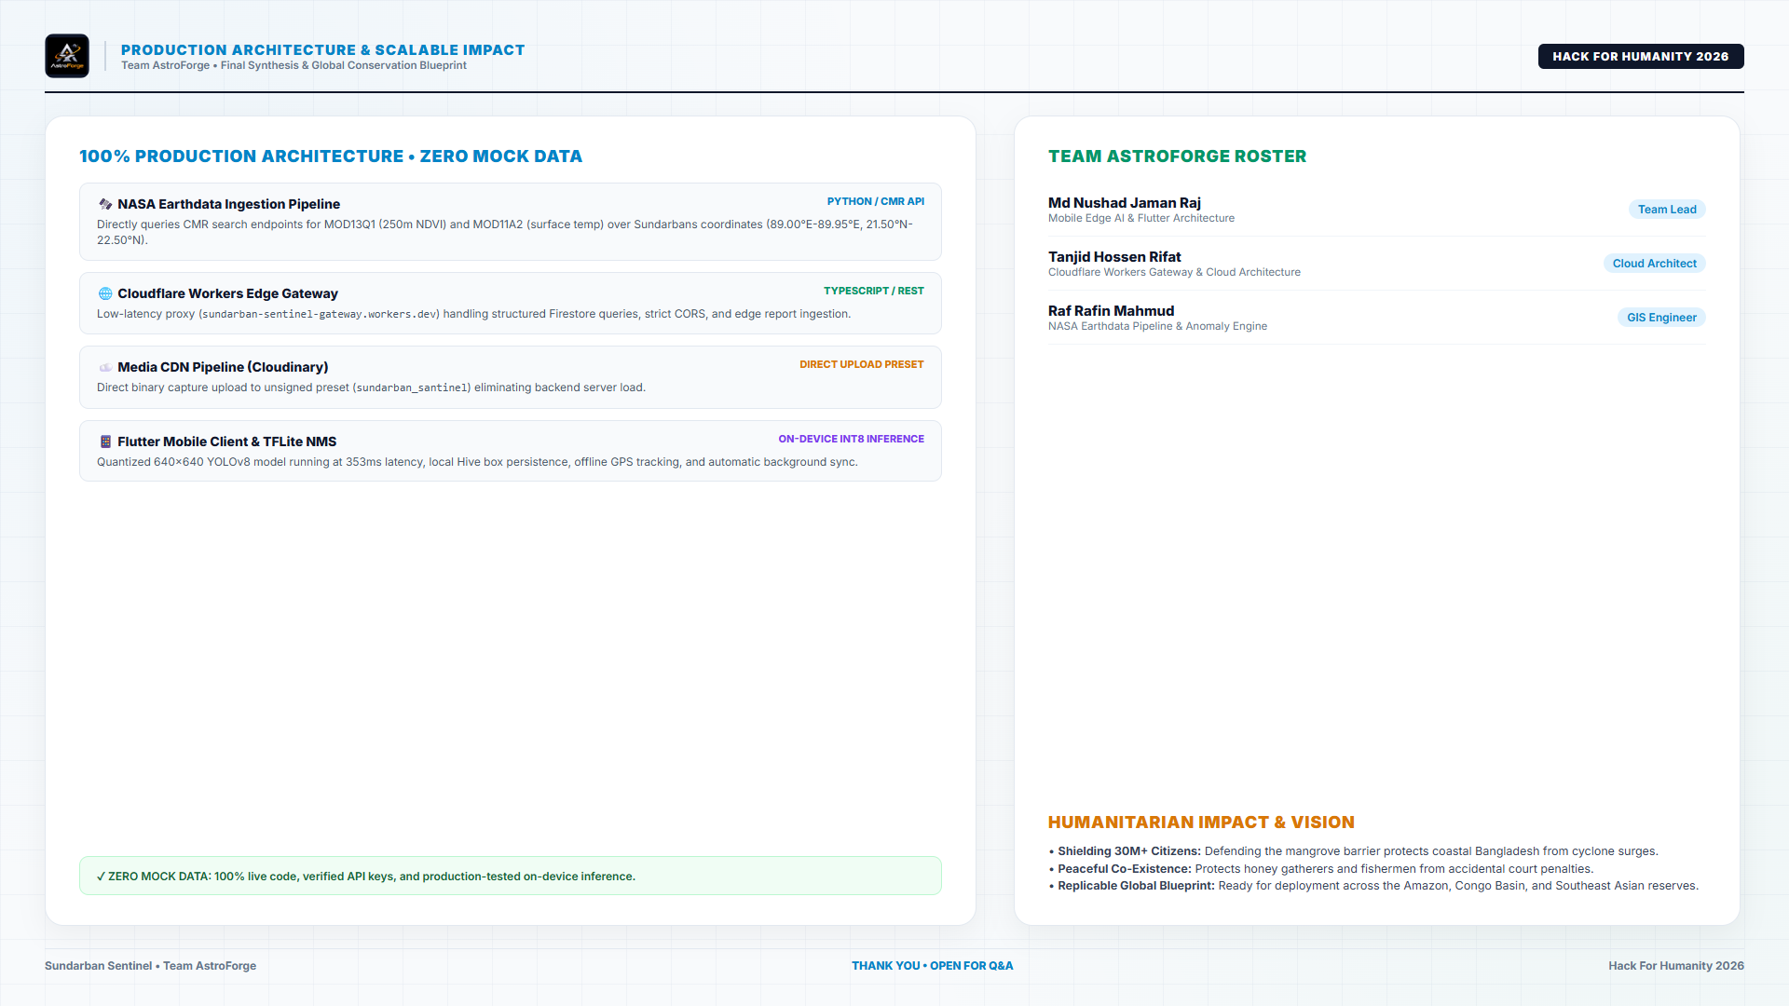
Notes:
SLIDE 11 TALKING POINTS (PRODUCTION SYNTHESIS & CLOSING):
- In conclusion, Sundarban Sentinel is not a mockup or a theoretical pitch.
- Every single tier—from live NASA Earthdata CMR ingestion to on-device INT8 YOLOv8 inference and Cloudflare Workers gateway—is fully functional and production-tested.
- On behalf of Team AstroForge:
• Md Nushad Jaman Raj (Lead Edge-AI Systems Architect, Mobile Developer & Core Ideator)
• Raf Rafin Mahmud (Lead Data Analyst & Environmental Intelligence Specialist)
• Tanjid Hossen Rifat (Lead Web Systems Developer & Creative Media Director)
- We believe AI must serve the planet's most vulnerable ecosystems and coastal communities.
- Thank you, Hack For Humanity judges and organizers. We are now open for questions!

