Slide 1


Asian University for Women
1 Aug 2026
An Empirical Evaluation of K-Means-Based Outlier Detection for Zero-Day Intrusion Detection in Industrial IoT Networks
PRESENTATION BY
Noushin Subah
220209
Nazhat Nashrah
220111
Sarah Azam Khan
241008

Slide 2
WHAT IS ZERO DAY?
A zero-day attack exploits a software or hardware vulnerability
There is no existing patch and no known signature for it.
How do we detect something "unseen"? ⟶ Zero Day Detection
Zero-day detection is the process of identifying malicious activity from such attacks without relying on prior labeled examples
We flag behavior that deviates from what a system has learned to recognize as "normal" or "known."
Must work on the assumption that the attack has never been seen before- rely on anomaly/outlier-based reasoning

Slide 3
SIGNIFICANCE
Signature-based IDSs are structurally incapable of catching zero-day attacks, they can only flag what they already know.
In IIoT environments specifically (manufacturing, energy, healthcare, utilities), a missed detection can cause physical damage, operational downtime, and disruption of critical infrastructure.
IIoT networks are structurally different ⟶ security tools built for conventional networks may create a persistent blind spot that attackers exploit
As attackers increasingly target industrial control systems, the cost of a delayed or missed zero-day detection scales from "inconvenient" to "catastrophic."

Slide 4
REAL WORLD INSTANCE
Stuxnet (2010)
a computer worm that exploited multiple zero-day vulnerabilities in Microsoft Windows to infiltrate and sabotage Siemens SCADA systems controlling centrifuges at an Iranian nuclear enrichment facility. It manipulated the centrifuges' speed controls to physically destroy them, while feeding false "normal operation" data to plant monitoring systems
a real case of a zero-day attack causing real-world physical damage to industrial infrastructure.1
Cyber Attacks on Maritime Assets and their Impacts on Health and Safety Aboard: A Holistic View, arXiv:2407.08406, 2024.

Slide 5
PROBLEM STATEMENT
Industrial IoT (IIoT) networks, spanning manufacturing, energy, healthcare, and utility infrastructure, are increasingly targeted by cyberattacks.
They remain protected largely by conventional IT-oriented security tools that don't account for their structural differences.
Signature-based IDSs, the most widely deployed defense mechanism, are fundamentally blind to zero-day attacks: threats that exploit previously unknown vulnerabilities with no existing signature to match against.

Slide 6
PROJECT OBJECTIVES & RESEARCH QUESTIONS
Main Objective: To systematically investigate how K-Means clustering configurations and centroid-distance thresholds affect Zero-Day Detection Rate (Z-DR) and False Positive Rate (FPR)
RQ1: How does the integration of centroid-distance-based outlier detection affect the Zero-Day Detection Rate (Z-DR) of a pre-trained deep learning classifier when identifying unseen malicious flows in a dynamic IIoT environment?
RQ2: How can the Z-DR\false-positive trade-off be balanced when based on distance threshold(d-min) and number of clusters (K), and therefore, what configuration best balances the two under a leave-one-class-out simulation on ToN-IoT?

Slide 7
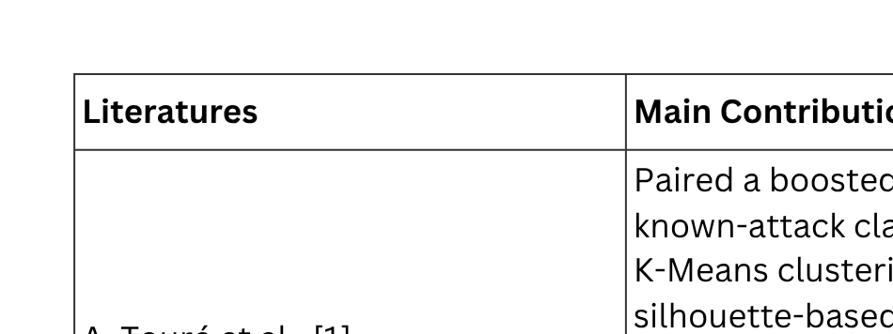
LITERATURE REVIEW & RESEARCH GAP

Slide 8
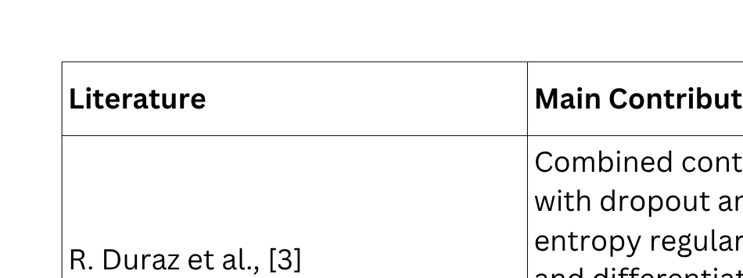
LITERATURE REVIEW & RESEARCH GAP

Slide 9
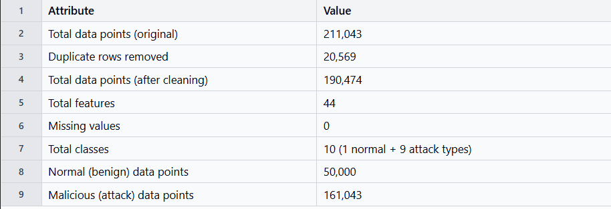
DATASET DESCRIPTION
Dataset Selection: Selected the ToN-IoT Network Dataset as the primary dataset because it contains diverse IIoT network attacks. (N. Moustafa et al. [1])
Dataset Preprocessing: Missing value check, duplicates removed, SMOTE

Slide 10
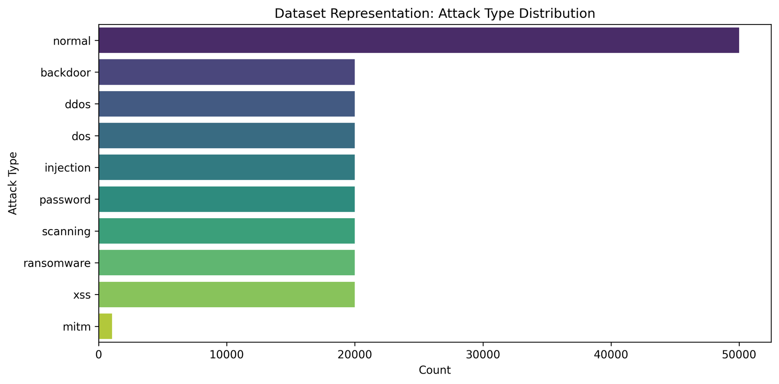
DATASET DESCRIPTION
Dataset Selection: Selected the ToN-IoT Network Dataset as the primary dataset because it contains diverse IIoT network attacks. (N. Moustafa et al. [1])

Slide 11
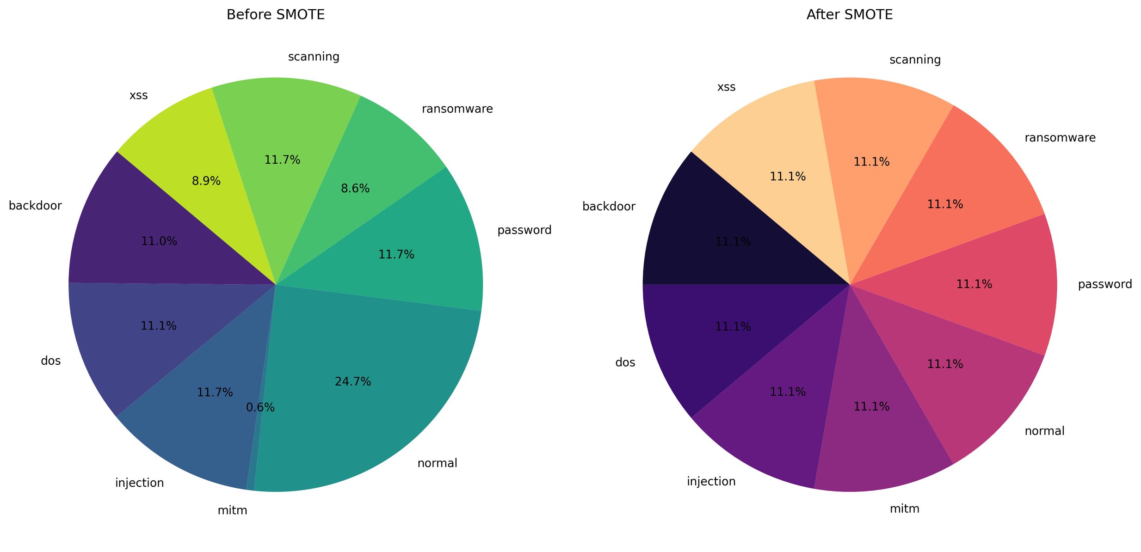
CLASS IMBALANCE HANDLING

Slide 12
LEAVE ONE CLASS OUT (LOCO)
Why LOCO?
LOCO is used to simulate a zero-day scenario.
one known attack class is deliberately withheld from training and validation, and treated as if it were an unseen, novel attack during testing.
How it works?
⟶ The chosen attack class is completely removed from the training and validation sets.
⟶ The remaining classes are split 80% training / 20% validation
⟶ The withheld class becomes the zero-day test pool, used only at evaluation time.
⟶ Both the ABi-GRU classifier and the K-Means clustering module are trained without ever seeing this class.
Which Classes?
⟶ DDoS
⟶ Ransomware

Slide 13
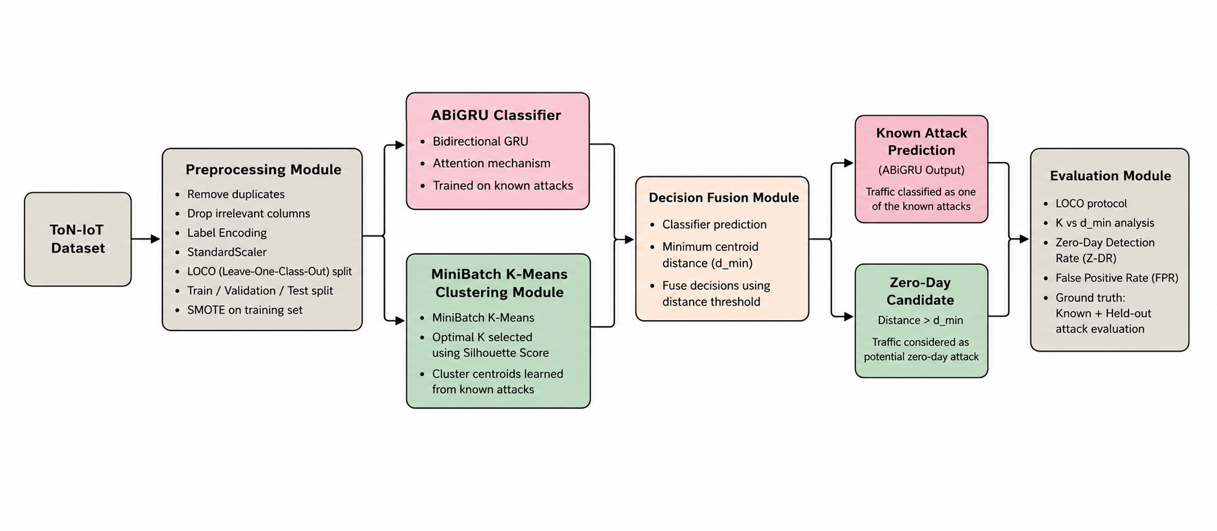
METHODOLOGY

Slide 14
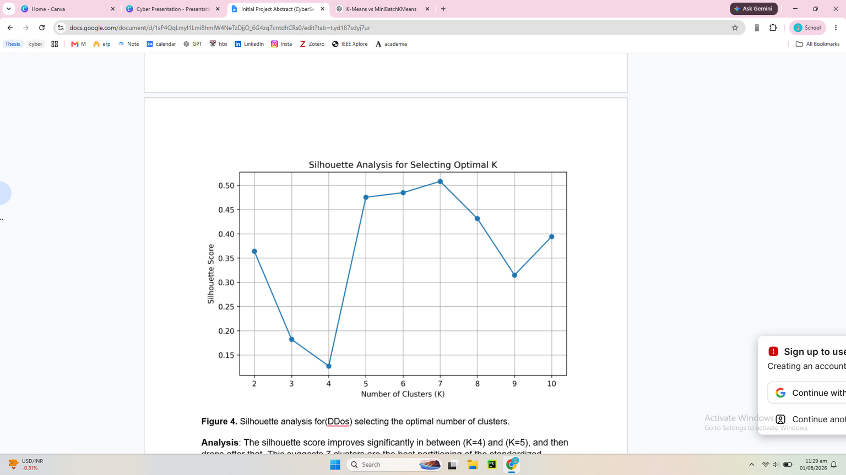
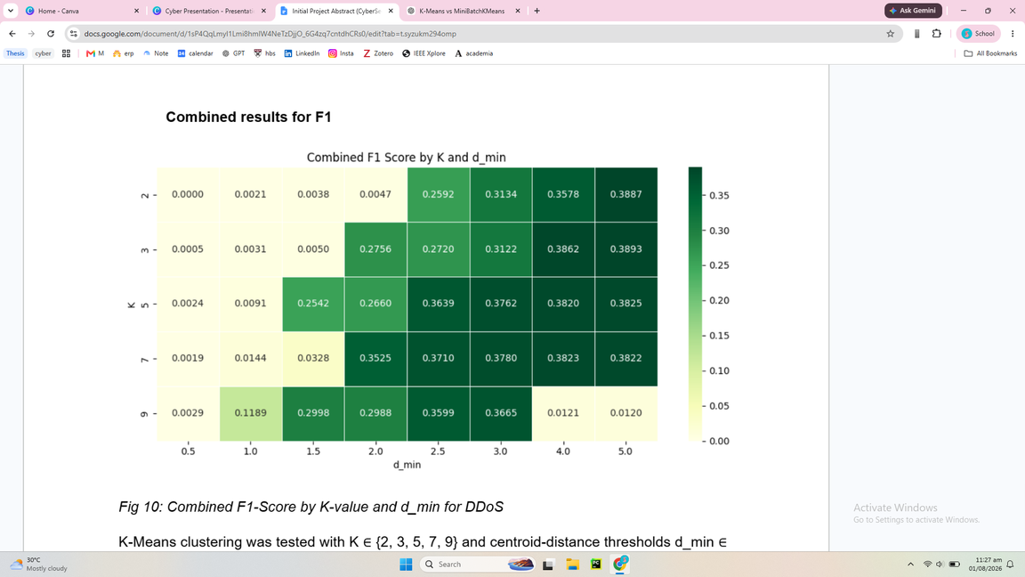
METHODOLOGY
Base Classifier (ABi-GRU): Implemented an Attention-based Bidirectional GRU (ABi-GRU) trained only on known attack classes. Used it to classify normal and known malicious network flows.
K-Means Outlier Detection: Trained K-Means on the balanced training data and selected the optimal K using the Silhouette Score [2-10]. Calculated Euclidean Distance from each flow to its nearest cluster centroid and compared it with the centroid-distance threshold (d_min). Classified flows exceeding d_min as Zero-Day attacks.
Parameter Optimization: Performed a parameter sweep by varying K and d_min. Compared different configurations to identify the optimal balance between detection performance and false alarms.

Slide 15
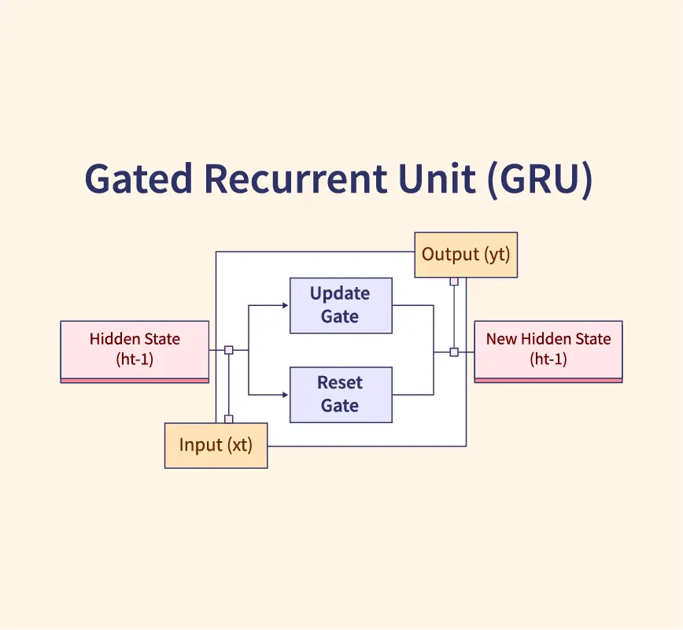
ABI-GRU CLASSIFIER
A: An attention mechanism that helps the model focus on the most important parts of the input instead of treating all features equally.
Bi – Bidirectional: The GRU processes the input sequence in both forward and backward directions. This allows the model to learn from both past and future context within the sequence.
GRU – Gated Recurrent Unit: A type of Recurrent Neural Network (RNN) designed to process sequential data. Uses gating mechanisms (update gate and reset gate) to remember important information and reduce the vanishing gradient problem.
It has fewer parameters than an LSTM, making it faster and more lightweight.
Implemented using PyTorch
Trained under LOCO protocol
Outputs attack probability
Probability forwarded to Decision Fusion

Slide 16
MINIBATCH K-MEANS
Standard K-Means Limitation
Computes distance from every sample to every centroid in each iteration.
Computationally expensive for large datasets.
Dataset Size
SMOTE-resampled training data (X_train_resampled) contains 302,688 instances.
Why MiniBatchKMeans?
Processes data in mini-batches (batch size = 1,000) instead of the full dataset.
Reduces computation time and memory usage.
Achieves much faster convergence.
Trade-off
Slightly lower clustering precision than standard K-Means.
Significant improvement in efficiency makes it suitable for large-scale datasets.

Slide 17
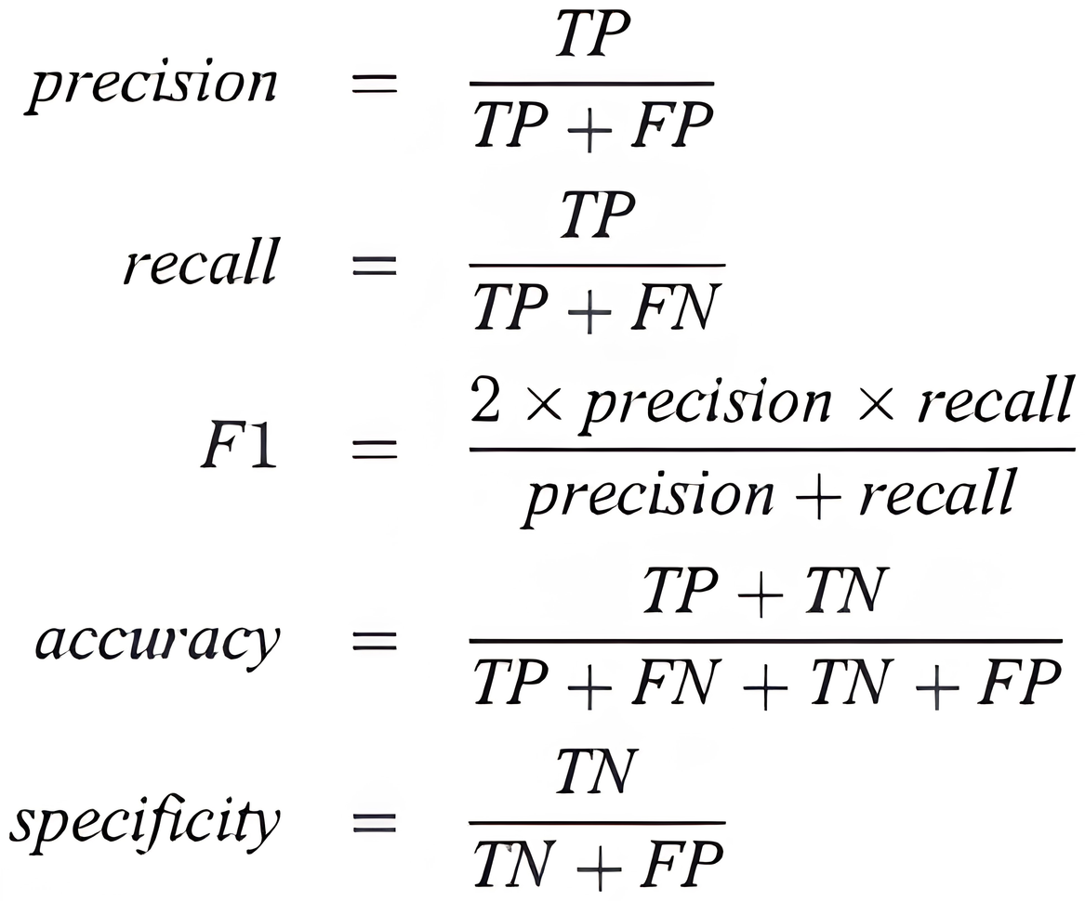
EVALUATION METRICS
Accuracy, Precision, Recall, and F1-score evaluate how well the ABi-GRU classifies known attacks.
Z-DR and FPR specifically evaluate Zero-Day detection, since unknown attacks cannot be measured using normal classification metrics.
Combined F1 helps select the best anomaly detection threshold by balancing detection capability and false alarms.

Slide 18
RESULT ANALYSIS
Research Questions, as aforementioned:
Parametric Variables
How does integrating centroid-distance-based outlier detection affect the Z-DR of a pre-trained deep learning classifier in dynamic IIoT environments?
01.
K values
d_min
Evaluation Metrics
How can the trade-off between Z-DR and FPR be optimized through the selection of the distance threshold (dmin​) and the number of clusters (K)?
02.
Z-DR
FPR
Combined F1
Notes:
Results & Analysis: This is the most important section. Do not just display numbers or
confusion matrices. Explain how your results answer each research question. Compare
your findings with your stated objectives and, where appropriate, with existing work from the literature. Discuss whether your results support or contradict your expectations.

Slide 19
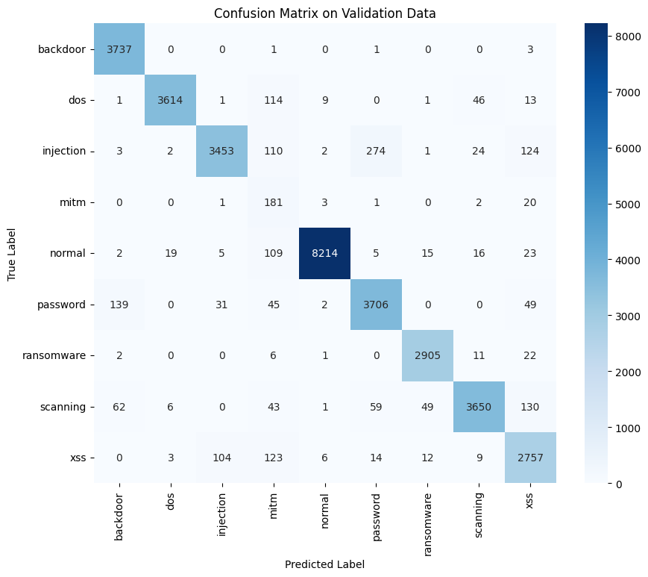
RESULT ANALYSIS
Known classes (backdoor, DoS, normal, and password traffic):
Overall accuracy of the classifier = 94%
Macro-average F1-score = 0.88
MITM being the worst class in both runs
Precision = 0.25
Recall = 0.87
F1 = 0.39
Notes:
ABi-GRU successfully learned to classify known attack types before zero-day began, MEANING that any failure on zero-day detection is due to the detection layer, not the base classifier

Slide 20
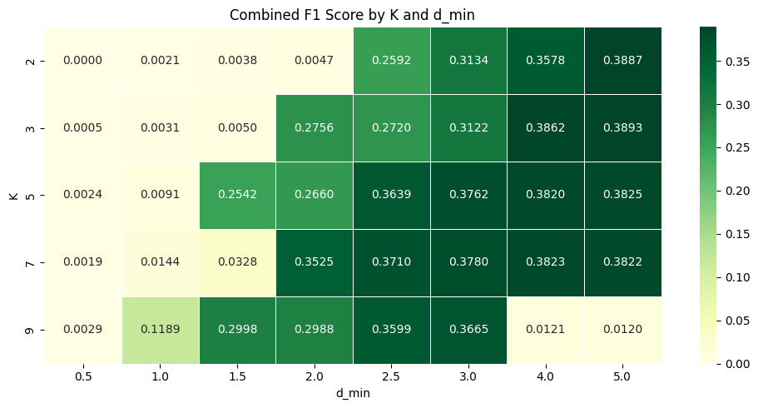
RESULT ANALYSIS
Alone, the base classifier cannot output detection as unknown
With clustering, at K=3 and d_min = 5.0, the pipeline flags 26.37% of DDoS
ABi-GRU ⟶ Misclassified
Notes:
ABi-GRU successfully learned to classify known attack types before zero-day began, MEANING that any failure on zero-day detection is due to the detection layer, not the base classifier

Slide 21
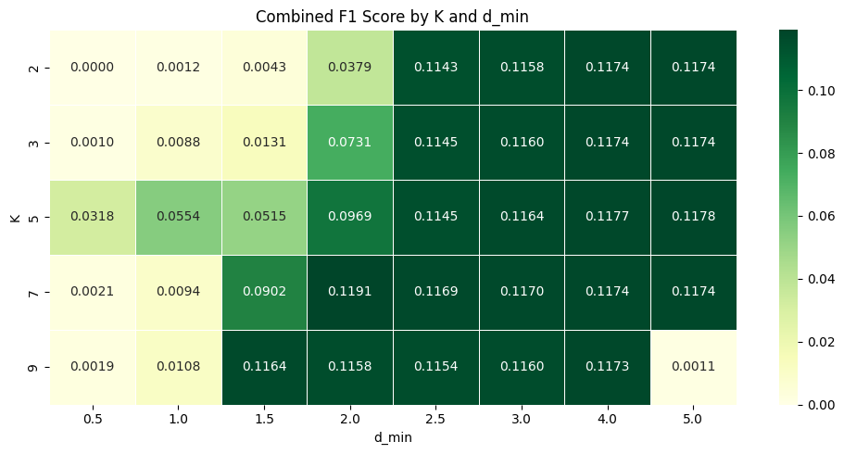
RESULT ANALYSIS
For ransomware:
Detected some as outliers
Z-DR low across all configurations
Notes:
ABi-GRU successfully learned to classify known attack types before zero-day began, MEANING that any failure on zero-day detection is due to the detection layer, not the base classifier

Slide 22
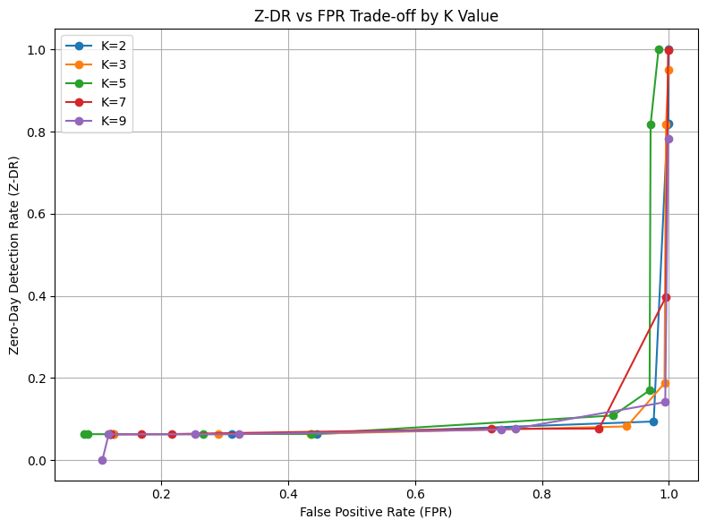
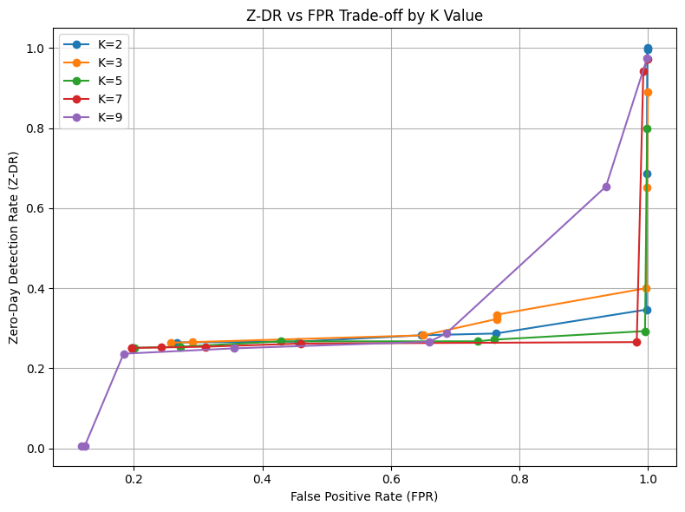
RESULT ANALYSIS
How does the K-value affect the Z-DR and FPR? ⟶ Effect depends greatly on the zero-day attack type
Ransomware
DDoS
Notes:
ABi-GRU successfully learned to classify known attack types before zero-day began, MEANING that any failure on zero-day detection is due to the detection layer, not the base classifier

Slide 23
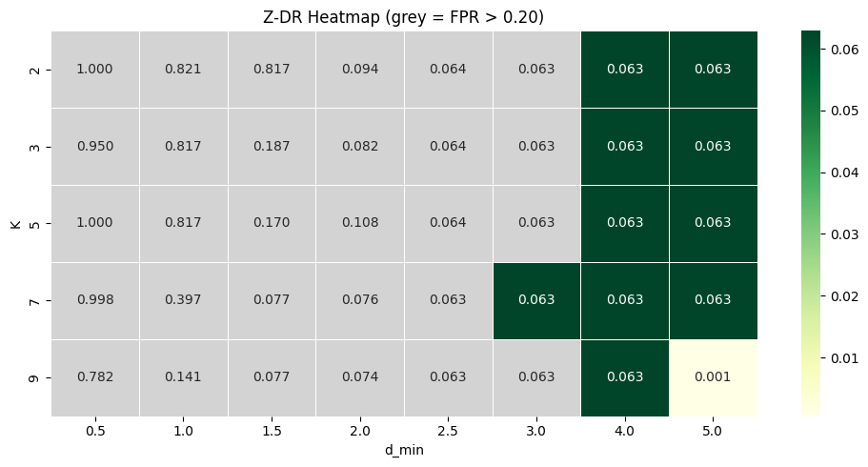
RESULT ANALYSIS
How does the d_min threshold affect the Z-DR and FPR?
As d_min increases:
Z-DR decreases
FPR increases
Ransomware
Notes:
ABi-GRU successfully learned to classify known attack types before zero-day began, MEANING that any failure on zero-day detection is due to the detection layer, not the base classifier

Slide 24
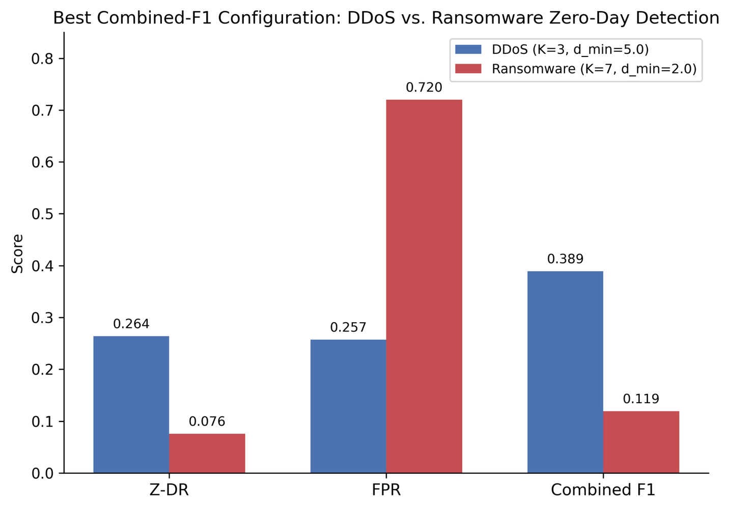
RESULT ANALYSIS
What is the best configuration found?
The values between ransomware and DDoS differ greatly
Reason mainly point to the feature overlapping of the dataset
Notes:
ABi-GRU successfully learned to classify known attack types before zero-day began, MEANING that any failure on zero-day detection is due to the detection layer, not the base classifier

Slide 25
LIMITATION AND FUTURE WORK
High dimensional feature space ⟶ distance concentration in clusters
The more the features, the lesser the difference between normal and zero-day flows
Only two LOCO splits were evaluated
Decision fusion module is not fully integrated
ToN-IoT is a simulated dataset
SMOTE in theory solves the data imbalance, however, it also raises confusion

Slide 26
DISCUSSION AND CONCLUSION
Problem: Standard, supervised classifiers cannot detect unknown attacks
Findings: With K-Means clustering, DDoS performed significantly better than ransomware, where the fundamental bottleneck for both is the overlap in the feature space, leading to no clean separation.
Centroid distance-based detection is attack-type dependent, so it is limited due to the high dimensionality of the dataset.
Proposed Solution: An empirical evaluation framework combining ABi-GRU with a MiniBatchKMeans centroid-distance-based outlier detection

Slide 27
REFERENCES
[1] A. Touré, Y. Imine, A. Semnont, T. Delot, and A. Gallais, "A framework for detecting zero-day exploits in network flows," Comput. Netw., vol. 248, Art. no. 110476, May 2024, doi: 10.1016/j.comnet.2024.110476
[2] M. Soltani, B. Ousat, M. J. Siavoshani, and A. H. Jahangir, “An adaptable deep learning-based intrusion detection system to zero-day attacks,” Journal of Information Security and Applications, vol. 76, p. 103516, Jun. 2023, doi: 10.1016/j.jisa.2023.103516.
[3] R. Duraz, D. Espes, J. Francq, and S. Vaton, “SECL: a Zero-Day attack detector and classifier based on contrastive learning and strong regularization,” ACM, pp. 1–12, Jul. 2024, doi: 10.1145/3664476.3664505.
[4] Sarhan, M., Layeghy, S., Gallagher, M. et al. From zero-shot machine learning to zero-day attack detection. Int. J. Inf. Secur. 22, 947–959 (2023). https://doi.org/10.1007/s10207-023-00676-0

Slide 28
Asian University for Women
1 Aug 2026
THANK YOU
ANY QUESTIONS?

