Slide 1
What Do We Mean When We Say Nothing At All?
Kate Gregory
kate@gregcons.com
@gregcons

Slide 2
Who Do We Write For?
The compiler?
A little
But compilers don’t care whether things are called Foo or UpdateOrders
Ourselves right now?
Sure
Ourselves later?
Definitely
Others later?
Whether we like it or not

Slide 3

Writing Code is a Form of Communication
We’re primarily communicating with the future
With ourselves, and with some strangers
We’re leaving what trail markers we can for those who follow us
It’s not enough for the code to compile
It’s not enough for the code to run without error
It has to be understood, by humans
Notes:
Now we are definitely writing code to solve a problem and we can’t forget that. But that’s not all we’re doing.
On trail marker pic, there is the big thing with the arrows but there are also small diamonds – a blue one on the left and a yellow canoe one closer to the sign

Slide 4
Reading Code
What the heck does this do?
Why is it doing that?
Are we sure this actually works?
What no-talent sad beginner wrote this?
Oh, right, me
I bet that silly goose never considered …

Slide 5
Well Written Code
Works
Works in other compilers and on other platforms
Has considered those questions and pre-answers them
Expressive
Transparent
Communicative
/*
orders.cpp
Purpose: Calculates the total of all orders Author: Jo Programmer
Last Modified: 4/10/06
*/
Notes:
No, not like this! (build)

Slide 6
Roger Orr’s Favourite Code Snippet
}
Notes:
I learned of this from Herb Sutter. You can find it at https://isocpp.org/wiki/faq/wg21#roger-orr

Slide 7
Introducing
Notes:
No really, that’s it. That’s what I want you to think about. The absence of keywords, punctuation, even whitespace. Just not having something in your file of code.

Slide 8
Saying Nothing Sometimes Means Nothing
class Holder
{
private:
int number;
public:
Holder(int i);
Holder();
void inc() { number++; }
int getNumber() { return number; }
std::string to_string();
};

Slide 9
Saying Nothing Sometimes Speaks Volumes
class Holder
{
private:
int number;
public:
explicit Holder(int i);
Holder();
void inc() { number++; }
int getNumber() const { return number; }
virtual std::string to_string() const;
};
Notes:
Ah, so before, when the one-arg constructor was not marked explicit, in a way it was marked implicit
getNumber and getStart are marked const which makes it clear that inc() is not const
getState is marked virtual which makes it clear that getNumber and inc are Dnot virtual
This non-virtualness and nonconstness was true on the previous slide, but wasn’t obvious, and even if you saw it and concluded it, you didn’t know if it was deliberate. Now you do.

Slide 10
Some things in C++ are paired with their opposites
Operators
+ -
* /
* &
Brackets
()
{}
[]
<>
Keywords
if else
noexcept noexcept(false)

Slide 11
Most things don’t really have opposites
break
continue
return
foo(x)
while, for, switch
Notes:
These don’t have and don’t need opposites. You just do them. You don’t try to decide between break and not break, if this is a place where the loop needs to stop looping, you stop looping

Slide 12
Let’s talk about these…
virtual, override
explicit
const
mutable? Not always
mutable
On a lambda
public, private
In a struct vs in a class
Ref-qualifiers on a function or on function parameters
New C++ 17 attributes
Notes:
The opposite of these is not saying anything at all.
The last three are C++ 17, covered in slides that follow. They control compiler WARNINGS not behaviour of your code

Slide 13
Fallthrough
switch (i)
{
case 1:
case 2:
msg += "case 1 or case 2. ";
break;
case 3:
msg += "case 3 or ";
case 4:
msg += "case 4.";
default:
break;
}
Notes:
Case 1 and 2 do the same thing. That’s super common. But when you run this code and i is 3, it does both the case 3 and case 4 stuff. It falls through. That’s legal. In fact, it’s the default if you don’t say break. But it’s not normal. In fact some compilers will warn if you do it, just as some will warn if you switch on an enum and don’t have a case for every value of the enum, etc.

Slide 14
Fallthrough
switch (i)
{
case 1:
case 2:
msg += "case 1 or case 2. ";
break;
case 3:
msg += "case 3 or ";
//fallthrough
case 4:
msg += "case 4.";
default:
break;
}
Notes:
Here a comment reassures the reader that this is deliberate.
Of course, the comment doesn’t make the compiler happy – and we don’t want compilers reading comments – and might be stale, might persist even if we don’t fall through

Slide 15
Fallthrough
switch (i)
{
case 1:
case 2:
msg += "case 1 or case 2. ";
break;
case 3:
msg += "case 3 or ";
[[fallthrough]];
case 4:
msg += "case 4.";
default:
break;
}
Notes:
So in C++ 17 we get this attribute, that doesn’t change anything about the way your code behaves, it just suppresses the warning by saying “I’m doing this on purpose.” And unlike the comment, if you use this attribute and then don’t fall through, you’ll get a warning.

Slide 16
Maybe Unused
int j = FunctionWithSideEffects();
assert(j > 0);
[[maybe_unused]] int j = FunctionWithSideEffects();
assert(j > 0);
Notes:
In release builds the assert disappears – turns into nothing! – and that makes j unused. You don’t want to move the call into the assert, you want the call to always happen. But now in a debug build you don’t have warnings, and in a release build you do. You could do some sort of ifdef so in a release build you just call the function and discard the return, but that’s not my first choice for how to handle this.

Slide 17
No Discard
int getNumber() { return 42; }
auto num = getNumber();
getNumber();
[[nodiscard]] int getNumber() { return 42; }
auto num = getNumber();
getNumber();
discarding return value of function with 'nodiscard' attribute
Notes:
You don’t have to use return values if you don’t want to. That’s why you can’t overload on return types. So that’s another nothing: not putting the return from getNumber into an expression or a variable. Is that ok to do? If it’s not, you can say it’s not and the compiler will give warnings if you discard it.
Now we have two nothings. We have the nothing on the last line, of not using the return value from getNumber. And in the rest of your code we have the nothing of not putting discard on functions whose return values are supposed to be used.
Can also put nodiscard on a type and then if any function returns that type, the return value being discarded will get you a warning.

Slide 18
How Can You Be Clearer About Intent?
Avoid defaults
In a class or struct, always include public: and private:
Yes, even in a two-element struct like Point
Add a return at the end of your void function
Use those optional things
Mark overrides of virtual functions with override
Use noexcept(false) if you’ve thought about it
Sure, they’re not needed, but using them carries meaning
Saves others guessing about whether you considered it
Notes:
So back to that list, things whose opposite is nothing, like virtual or const, how can you indicate to readers whether you’re leaving it out because you didn’t think about it either way, or because you thought about it and you don’t need it?

Slide 19
How Can You Be Clearer About Intent?
There is a limit to how verbose you can be
We do not have these keywords
implicit
const(false)
nonvirtual
ByVal
What should you do?
// I know what I’m doing, don’t change this
// note: passing by value
Notes:
Again, not like this
And really, this isn’t a ton better
If you must reach for a comment, at least explain why you’re doing whatever you’re doing

Slide 20
Context
Absence of a keyword means one of two things
I’ve thought about it and I don’t need keyword here
I have never heard of keyword, or at least haven’t considered whether or not to use it here
If you use it routinely and consistently throughout the codebase, readers can (possibly? With some certainty?) rule out that second option
Comments?
Only for cases that deceive
// I know this looks like it might be an override // of foo but it’s actually a different signature
Notes:
Certainly keywords like const and noexcept are very likely to be missing because nobody ever considered them

Slide 21
Optional Return Statements
void Thimbule(int robbit)
{
robbit ++;
if (robbit)
return;
robbit --;
}
void Sprial(int oob, int boo)
{
oob ++;
while (true)
{
if (++oob > boo)
return;
}
}
Notes:
Feel free to imagine these code snippets as being more complicated. As they are written they really don’t need to be functions, and could probably be optimized down to something simpler. That’s fine. They are placeholders for longer and more opaque code.
Thimbule may “fall out” of the bottom. If robbit, after being incremented, is anything other than zero, the function returns. But it might not be zero, in which case it will be decremented and then we return even though the statement isn’t there. Compare to Sprial: there’s a while true here, so the only way we’re getting out of this function is when oob finally manages to get larger than boo. If you always put that optional return at the bottom of functions like Thimbule, then the situation in Sprial would stand out better, I feel.

Slide 22
Ranged For
for (auto emp : department)
{
// ...
}
for (auto& emp : department)
{
// ...
}
for (auto const & emp : department)
{
// ...
}
Notes:
You probably didn’t think much of the first example until you saw the second. Then you realized oh, I guess an employee (or whatever department is a collection of) must be expensive to copy. Or maybe this loop is changing all the employees. Now you have to read it to see which. Now along comes the third one. Ah, this is just about the cost of the copy.
In that second case, if this is a developer who says const every chance they get, you know in the middle case the loop must change the employees. Because otherwise this developer would have said const.
And all the same things apply to function parameters as well – ref, const, all the alternatives to nothing.

Slide 23
Parameter Passing
Order createOrder(Customer c, OrderItem oi);
Are you sure?
Order createOrder(Customer& c, OrderItem oi);
Pass the order item by value, then move? Copy?
Order createOrder(Customer const & c, OrderItem oi);
Oh, Customer objects don’t know their orders?
Notes:
The ref, value combination gives me the most confidence that it’s been thought about tbh

Slide 24
Omitting Parameter Names
You can in the declaration
Compiler etc don’t care
Humans care, so don’t
You also can in the definition
If it’s an unused parameter
(virtual function, api drift, whatever)
Suppresses compiler warning
Big signal to humans
So, why not follow the same pattern in declaration?
int DetermineTotalTaxes(int, int, int);
int DetermineTotalTaxes(int ProvRate, int FedRate, int)
{
//whatever
return 42;
}
int DetermineTotalTaxes(int ProvRate, int FedRate, int);
Notes:
(The int this returns is a number of pennies, so don’t give me a hard time about the return type.)
How’s that for nothing sending a message?

Slide 25
What Other Choices Can Speak Volumes?
Notes:
So what other choices can communicate? Leaving off const, leaving off override, leaving off explicit, if those can tell people something, are there other choices that appear interchangeable but can actually tell people things?

Slide 26
Is A Raw Pointer Always A Non-owning Pointer?
Does this code use smart pointers?
Is there a lot of new and delete? Rule of 3 or 5?
Are there any destructors anywhere?
bool sendEmails(Employee* pe)
Message* sendEmails(Employee* pe)
Notes:
I have this function and without reading it, what does it do with that pointer when it’s done? Does it delete it? Who is responsible for the memory pe points to?
If I don’t see any smart pointers anywhere in this code, then that nothingness tells me something. There’s a good chance this pe is an owning pointer. Or the Message pointer that comes back from the second version of the function is maybe something I’m supposed to delete when I’m done with it?
On the other hand, if I don’t see any destructors, copy constructors, move constructors AT ALL in the code, then that nothingness tells me this is a Rule of Zero codebase and chances are any raw pointer I’m given is a sort of observer pointer, just for access to the object, and I don’t have to manage lifetime. If I don’t see any new or delete then I know all of that is being managed through library classes that are on the stack, whether they are smart pointers, vectors, whatever. I don’t need to see something wrapped up in observer_ptr or the like to know it’s safe to just use this pointer to access members and not worry about lifetime and memory management at all.
Mention observer pointer

Slide 27
What Does & Mean? *?
Is something passed by address or reference as non-const always changed?
Is there any meta-meaning to passing by address vs by reference?
Many style guides suggest pass-by-address to transfer ownership
This isn’t about what the compiler thinks
You have nothing in the code that mentions owning, yet maybe you’re speaking about owning anyway?

Slide 28
Is A Traditional for Loop Always Doing Something Odd?
Why did I choose that loop?
Does it touch every element?
Was there a reason not to use a ranged for?
Isn’t there an algorithm for that?
Is this something without a name we all know
find, count, all_of, sort, …
If you use algorithms when you can, then your choice of a loop gets my attention

Slide 29
Initializing
If a constructor doesn’t set a member variable after :, perhaps:
There’s a nonstatic member initializer that does
It gets set in the body
Why?
It was forgotten when the member was added to the class
Bonus points: forgotten in only one of the 5 constructors
What does it mean when I initialize something to its default value?
string s = "";
vector<Employee> department(0);
Notes:
We should all know that the best place to initialize member variables is in the initializing clause of the constructor, the part after the colon. So if you’re looking at a class with 7 member variables and one of them isn’t initialized there, what’s going on?
- well it’s not really true any more that that is the best place. A non static member initializer is a better choice when there’s a default value for a member variable and several constructors.
- or possibly the person who wrote this constructor initializes this in the body, once all the other variables are initialized. Sometimes there’s a good reason for this, other times it’s superstition.
- and of course there’s good old forgetting which happens remarkably often, so you’ve found a bug and you need to fix it
I’m often puzzled when I see initializations that add no information. Like if I just say string s, I’ll get an empty string. If I just say vector of Employee department, I’ll get one of size 0. Why is this person doing this? Do they not know? Do they think I don’t know? Did the code have a different literal before and this is just an artifact? What are you trying to tell me, previous person? This is one case where I think saying nothing would be better than being verbose. It’s possible this is an inconsistency on my part and I should be just as reassured and supported seeing these lines as seeing “private:” as the first thing in a class declaration, or seeing override on a function in a derived class, or seeing [[fallthrough]] in a switch. But I don’t right now, and I am not even sure that I should.

Slide 30
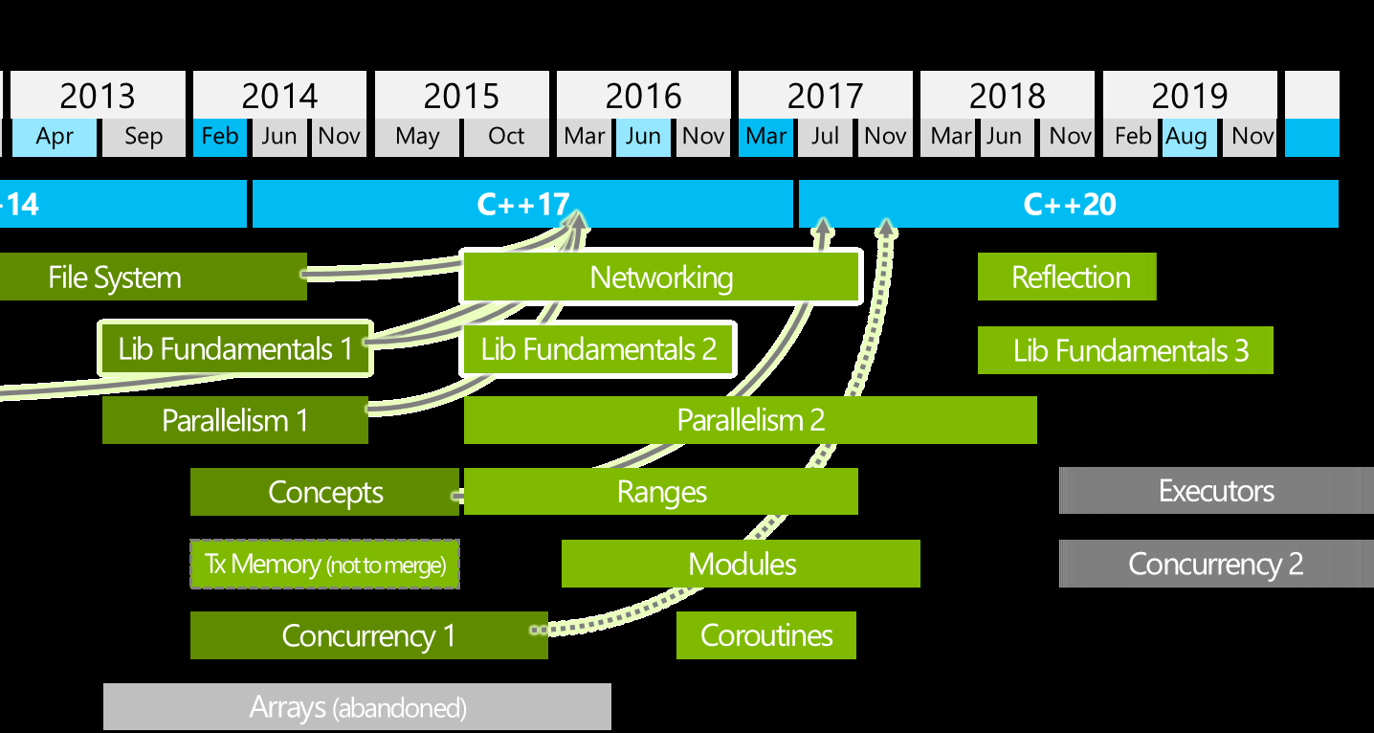
Could The Language Help Us?
Should we add keywords or attributes? Would you use them?
implicit
const(false)
nonvirtual
ByVal
Are you using fallthrough and maybe_unused?
Why not?
Notes:
Looks like we will have explicit(false) in C++ 20

Slide 31
Call To Action

Slide 32

Communicate
Clear code involves thinking about what you are telling the future reader
Show them why you did this
No puzzles or mysteries
No chance to think you were foolish or ill-informed
Notes:
Show them what you know. Show them what you considered.

Slide 33
What is Not in Your Code?
Think about what you’re not including or doing
The other ways you could have done this
The other choices you could have made
Can people learn from a seemingly arbitrary choice?
Notes:
In addition to what is on the screen, think about what is not on the screen

Slide 34
Nothingness
Can you express your choice without nothingness?
A little verbosity goes a long way
If the only way to express yourself is with nothingness, then fine, but make that nothingness speak
Context
Show your colours
Notes:
Show who you are, how you normally do things, what you know about, what you must have considered when you were writing this

Slide 35

Use Nothing In a Generous Way
Give that future reader all they need
Make sure your nothing speaks volumes
Ensure that they will understand
Notes:
… understand what you say, when you say nothing at all.

