Slide 1
RAPIDS: The SciDAC Institute for Computer Science and Data
Robert Ross
Lenny oliker
Institute Director
Mathematics and Computer Science Division
Argonne National Laboratory
rross@mcs.anl.gov
Deputy Director
Computational Research Division
Lawrence Berkeley National Laboratory
loliker@lbl.gov
Notes:
- Thanks for the opportunity to speak
- New SciDAC Institute just spinning up
- Tell you what RAPIDS is, how it's organized
- Through some examples of past work, how we plan to help DOE scientists to their work

Slide 2
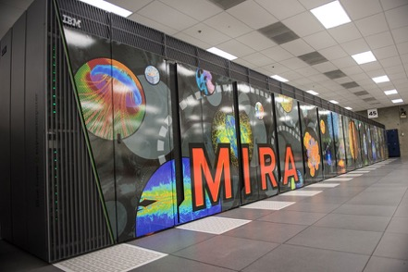
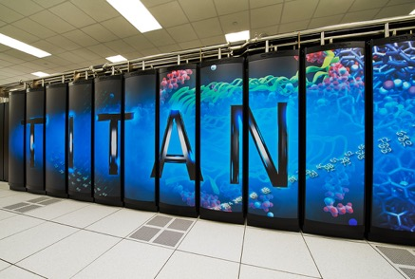
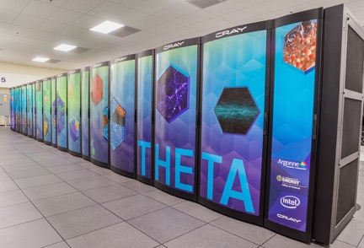
Diverse Science and Systems
Top image credit B. Helland (ASCR). Bottom left and right images credit ALCF. Bottom center image credit OLCF.
Notes:
- Interesting times for DOE science.
- Using computing in new ways, not just simulations but also data-intensive and learning applications
- At the same time, interesting new directions on the system side
- Together these bring lots of CS and Data challenges
- Important not just to bring this expertise to bear but to coordinate that effort

Slide 3
The RAPIDS Institute
Resource and Application Productivity through computation, Information, and Data Science
Objective: Solve computer science and data challenges for Office of Science application teams to achieve science breakthroughs on DOE platforms.
Application Engagement
Tiger Teams engage experts in multiple technology areas to work with science teams and codes
Outreach activities connect with broader community
Technology Focus Areas
Data Understanding – scalable methods, robust infrastructure, machine learning
Platform Readiness – hybrid programming, deep memory hierarchy, autotuning, correctness
Scientific Data Management – I/O libraries, coupling, knowledge management
Application Engagement & Community Outreach
Tiger Teams
Liaisons
Outreach
Data Understanding
Scientific Data Management
Platform Readiness
Notes:
- Solve CS and data problems for Office of Science teams
- Enable them to make best use of current and upcoming systems for this wide variety of problems and codes
- The way we do this, and I'll speak more to this, is through technical expertise in key areas coordinated by multiple engagement and outreach activities

Slide 4













The RAPIDS Team
Director
Deputy
Rob Ross
Lenny Oliker
Application Engagement
Data Understanding
Platform Readiness
Data Management
Outreach
Anshu Dubey
Sam Williams
Wes Bethel
P. Balaprakash
Jeff Vetter
Paul Hovland
Scott Klasky
John Wu
David Bernholdt
Notes:
- This is our team. Lenny Oliker is my deputy, he led the SUPER Institute for some time in SciDAC-3.
- Set of experts: ...

Slide 5
RAPIDS Focus Areas
Application Engagement & Community Outreach
Tiger Teams, Liaisons, and Outreach
Data Understanding
Scalable methods
Robust infrastructure
Machine learning
Platform Readiness
Roofline modeling
Hybrid programming
Deep mem. hierarchy
Autotuning
Correctness
Scientific Data Management
I/O libraries
Coupling
Knowledge management
Notes:
- Gives you a feel for the technical breadth of the project.
- I'm going to dive into these technology areas over the next few slides.

Slide 6
technologies

Slide 7
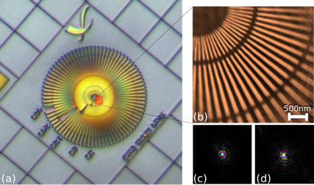
Data Understanding
Facilitate understanding of large and complex science data through robust and scalable analysis methods, including learning approaches.
Tools: AutoMOMML, DIY, GraphBLAS, Paraview and Catalyst, SENSEI, VisIt and Libsim, VTK
Advanced methods: Stochastic flow maps, Lagrangian coherent structures, topological methods
Scalable infrastructure: service-oriented data analysis and reduction, co-analysis with performance data
Learning approaches: domain-specific applications of deep learning, predictive performance models, data- and model-parallel training
(a) Optical image of target; (b) ptychographic image generated from APS data using GPU at rate exceeding data acquisition.
Contacts: Wes Bethel (LBNL) lead, Prasanna Balaprakash (ANL) co-lead
Notes:
- First technology focus area
- Technologies here help us extract knowledge from data via a variety of techniques
- Advanced methods: Techniques familiar with from their application in simulation-based science
- Infrastructure work designed to help couple science codes with analysis, scale to new platforms
- Set of activities to bring learning approaches to bear
- On the right is an example from a SciDAC-3 BES pilot activity
- optical microscope image on the left for orientation
- ptychographic ("tieko-graphic") reconstruction on the right
- activity employed new algorithms and GPUs to generate these images faster than data is acquired
---
It's an optical microscopy image of a gold resolution target, sometimes referred to as a Siemens star pattern. We imaged the area highlighted by the red square using hard x-rays and were able to resolve high resolution structures (30nm) that are not visible in the optical image. The analysis ran on a single GPU and was 88% faster than data acquisition, i.e. using a single GPU we could keep up with the X-ray imaging experiment, providing real-time feedback to APS users. The computation scales to multi-GPU systems almost linearly if datasets exceed GPU memory capacity.
Maybe Tom can find it, hint, it was in one of our highlight slides submitted to Lucy and Eliane. The optical image is a direct image, like any camera acquired image, and did not use x-rays or ptychography. It was just used as a reference to point out the part imaged with xray Ptychography. Yes, it was one of the first result of the ASCR/BES pilot project.

Slide 8
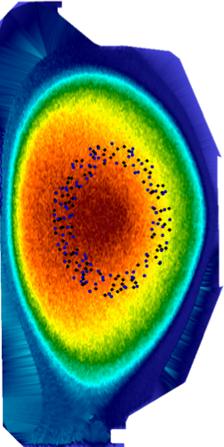
Increasing Temporal Fidelity of Data Analysis for XGC1
XGC1 fusion simulations use a particle representation, with many billions of particles in the largest simulations.
Transforming from particles into a vector field reduces data size while allowing for bounded error.
More timesteps can be captured, increasing temporal fidelity of analysis.
Poincarè plot generated from the binned vector field data exhibits approx. 1% error using 89 MBytes of vector field data, as opposed to 500 GBytes of particle data. Reduced data is shown in black, original resolution data is shown in blue.
Image credit James Kress (ORNL).
Notes:
- Another SciDAC-3 example, this time from fusion science
- This example highlights the value of transforming data from one representation to another
- In this case from hundreds of millions of particles, or more, into a vector field
- Dramatic data reduction, means more time steps can be retained for analysis
- Worked with the science team to understand and bound error
- Very special form of compression, something we're seeing more of in response to architectural change.
---
XGC1 fusion simulation code
Particle code, very large number of particles to achieve fidelity of computation.
(A) Boxplots of the differences in area of a Poincarè plot generated from full resolution particle data and a Poincarè plot generated from the binned vector field data for one studied mesh size. (B) The corresponding Poincarè plot for the test using 300M particles. Reduced data is shown in black, original resolution data is shown in blue. This test represents an error of approximately 1% represented in 89 MB, reduced from 500 GB of original particle data. (Image Credit James Kress)
---
In situ visualization is an enabling technique, but can cause challenges in environments with constrained resources. A typical use case with constrained resources is an in situ environment. Some visualization routines require very high temporal fidelity to produce correct results, posing a challenge depending on machine architecture and the simulation type. For our use case, XGC1, the simulation output is too large to be held in memory for long, meaning a visualization routine operating on this data every time step would cause the simulation to stall. To bypass this large data issue, we are working with data transformation and data precision techniques to reduce the size of the data needed to perform visualizations. This means that the simulation will be able to proceed while visualization algorithms will be given access to a greater temporal data fidelity. We study converting particle data to a vector representation to drastically reduce data size. To evaluate this transformation we utilize four different error metrics to allow us to bound the error coming from the representation change: Poincare contour error, Poincare center error, streamline end point error, and pathline end point error.
---
J. Kress, R. Michael Churchill, S. Klasky, M. Kim, H. Childs, D. Pugmire, In Situ Processing on Upcoming Supercomputers, Supercomputing Frontiers and Innovations, December 2016
Submitted: J. Kress, J. Choi, S. Klasky, R. Michael Churchill, H. Childs, D. Pugmire, Binning Based Data Reduction for Vector Field Data of a Particle-In-Cell Fusion Simulation, IEEE Symposium on Large Data Analysis and Visualization, 2017

Slide 9
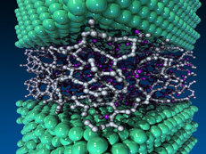
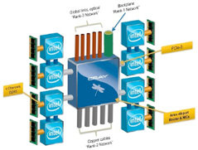
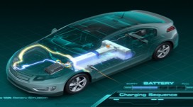
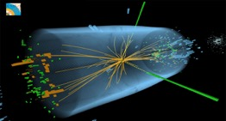
Learning Approaches for Scientific Discovery
Deep learning for object identification and image classification for LHC and APS
Iterative learning and model-based sampling for molecular dynamics simulations
Performance, power, energy modeling of novel HPC architectures
Machine learning for urban mobility planning and vehicle technology assessment
Notes:
- Machine learning and deep learning are hot topics
- This slide highlights some of our prior work in application of learning to science and engineering applications
- Includes
- object identification for LHC and APS users
- surrogate modeling in LAMMPS, for atomic-scale modeling
- performance and power prediction for applications on HPC systems
- ML approaches to accelerate design space exploration in vehicle technology contexts
---
Image data analysis for LHC and APS:
In this work, we are developing deep learning approaches for object identification and image classification for image datasets from ATLAS experiments from LHC and Advanced Photon Source at Argonne. In particular, we are adopting 2d and 3d convolutional neural nets and scaling them on leadership class machines for training and inference.
Molecular dynamics simulation:
Traditionally, atomic-scale materials models have taken years to develop, and researchers have had to rely largely on their own intuition to identify the parameters on which a model would be built. We are developing an iterative parallel algorithm that builds surrogate models for LAMMPS simulator. We tailor to our unique parallel environment an active learning heuristic popular in the literature on the sequential design of computer experiments in order to identify the MD simulations that will satisfy domain scientists constraints, whose evaluations have the best potential to improve the surrogate.
HPC:
We developed an automated, end-to-end modeling framework called AutoMOMML. It employs a pipeline of statistical approaches in a systematic way to automate the predictive modeling HPC such as modeling performance, power, and energy. The framework identifies the important variables, and selects and tunes the learning algorithms to model the required objectives based on hardware and application characteristics.
Urban mobility planning and vehicle technology assessment:
Distributed and parallel computing is one approach to accelerating simulation in vehicle technology assessment. Another approach is to use machine learning to reduce the number of simulations to be run and develop an algorithm to populate the complete vehicle technology database from a subset of simulations using predictive modeling. With Argonne’s Energy Systems researches, we are developing ML approaches to reduce the number of simulations. We are also extending ML approaches for traffic modeling and prediction.

Slide 10
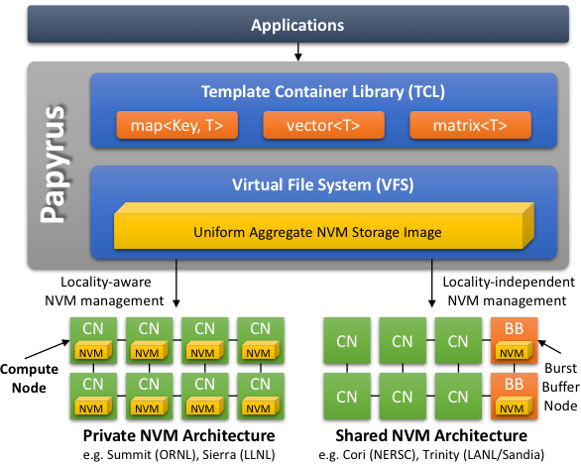
Platform Readiness
Preparing scientific codes for current and upcoming system through application of best-in-class expertise and tools.
Tools: CHiLL, CIVL, IMPACC compiler, Intel Advisor (Roofline), OpenARC, Orio, Papyrus, ROSE, SCR, TAU
Performance modeling and analysis for identifying optimization opportunities
Code generation and autotuning for computation and communication
Portable programming for heterogeneous and many-core systems, deep memory hierarchies
Correctness of programs (e.g., when moving to new platforms)
Papyrus provides abstractions for large shared data structures using map, vector, and matrix modalities
Contacts: Jeff Vetter (ORNL) lead, Paul Hovland (ANL) co-lead
Notes:
- Second technology focus area
- Here we're targeting productivity and correctness on current and upcoming platforms
- Recognizing that we have new users who will need assistance, and veterans who need help with particular hardware
- Performance modeling and analysis help us pinpoint opportunities
- Code generation and auto-tuning help codes more efficiently be adapted
- Portability options help build codes that are more nimble with respect to change of platforms
- Correctness work helps ensure that all these modifications still give us the right answers
- On the right is a depiction of Papyrus
- a system for providing a set of distributed container abstractions on top of a variety of different hardware classes
- provides some alternative ways of incorporating memory technologies into codes

Slide 11
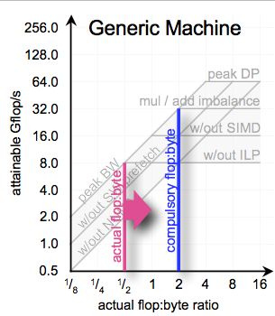
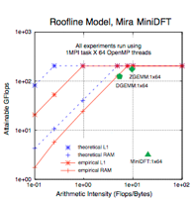
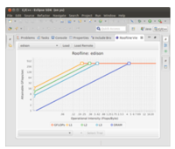
Roofline Performance Modeling
ASCR Base & LDRD
SciDAC3 Development
Outcome & Impact
Developed Roofline concept
2006-2011:
Easy-to-understand, visual performance model
Offers insights to programmers and architects on improving parallel software and hardware.
Roofline augmentation under SciDAC3 2013-2017:
Collaboration with FASTMath SciDAC Institute
Developed Empirical Roofline Toolkit (ERT) with public release 03/2015, with Roofline Visualizer
Created community tool for automatic hardware introspection and analysis
Roofline has become a broadly used performance modeling methodology across DOE
Intel has embraced the approach and integrated it into its production Intel® Advisor
Collaboration with NERSC to instrument and analyze execution of real applications on machines such as Edison and Cori
Automated Roofline code used to diagnose performance problems for DOE and SciDAC codes.
Proof of concept successfully applied to numerous computational kernels and emerging computing systems.
Snapshot of existing Intel Roofline tool in practice.
Notes:
- This slide highlights the roofline performance modeling technology
- Integrated into the Intel Advisor product
- Timeline view also highlights how many of these technologies transition from research to production
- Sometimes over very long timescales
- While we'll be employing Roofline to help codes, ...
- Will also be working to enhance modeling of GPUs, network, ML codes, etc.
---
Insightful visual performance modeling.
Also a good example of the pipeline that is being sustained under RAPIDS.
Prototype Roofline for GPUs
ERT already supports GPUs (machine characterization)
Initially leverage NVProf to capture application execution characterizations
Incorporate thread divergence and sub-warp effects into model
Include UVM thrashing
Extend Roofline to more accurately capture CPU cache effects
Extend Roofline to support non-FP codes (e.g. bio, graphs, etc…)
e.g. integer-heavy codes and corresponding throughput metrics
Evaluate feasibility of Roofline for ML codes (and other arch.)
Extend Roofline to the network (e.g. MPI)
Initially focus on P2P communication patterns
Assumes message concurrency is high enough that we are throughput limited
---
Contacts:
Sam Williams (swwilliams@lbl.gov) and Lenny Oliker (loliker@lbl.gov) LBNL
Roofline publications supported by SUPER funding:
* Taylor Barnes, Brandon Cook, Jack Deslippe, Douglas Doerfler, Brian Friesen, Yun (Helen) He, Thorsten Kurth, Tuomas Koskela, Mathieu Lobet, Tareq Malas, Leonid Oliker, Andrey Ovsyannikov, Abhinav Sarje, Jean-Luc Vay, Henri Vincenti, Samuel Williams, Pierre Carrier, Nathan Wichmann, Marcus Wagner, Paul Kent, Christopher Kerr, John Dennis, "Evaluating and Optimizing the NERSC Workload on Knights Landing", Performance Modeling, Benchmarking and Simulation of High Performance Computer Systems (PMBS), November 2016,
* Hasan Metin Aktulga, Md. Afibuzzaman, Samuel Williams, Aydın Buluc, Meiyue Shao, Chao Yang, Esmond G. Ng, Pieter Maris, James P. Vary, "A High Performance Block Eigensolver for Nuclear Configuration Interaction Calculations", IEEE Transactions on Parallel and Distributed Systems (TPDS), November 2016, doi: 10.1109/TPDS.2016.2630699
* Zhaoyi Meng, Alice Koniges, Yun (Helen) He, Samuel Williams, Thorsten Kurth, Brandon Cook, Jack Deslippe, and Andrea L. Bertozzi, "OpenMP Parallelization and Optimization of Graph-Based Machine Learning Algorithms",12th International Workshop on OpenMP (iWOMP), October 2016, doi: 10.1007/978-3-319-45550-1_2
* Douglas Doerfer, Jack Deslippe, Samuel Williams, Leonid Oliker, Brandon Cook, Thorsten Kurth, Mathieu Lobet, Tareq Malas, Jean-Luc Vay, and Henri Vincenti, "Applying the Roofline Performance Model to the Intel Xeon Phi Knights Landing Processor", Intel Xeon Phi User Group Workshop (IXPUG), June 2016,
* Alex Druinsky, Pieter Ghysels, Xiaoye S. Li, Osni Marques, Samuel Williams, Andrew Barker, Delyan Kalchev, Panayot Vassilevski, "Comparative Performance Analysis of Coarse Solvers for Algebraic Multigrid on Multicore and Manycore Architectures", International Conference on Parallel Processing and Applied Mathematics (PPAM),September 6, 2015, doi: 10.1007/978-3-319-32149-3_12
* Yu Jung Lo, Samuel Williams, Brian Van Straalen, Terry J. Ligocki, Matthew J. Cordery, Leonid Oliker, Mary W. Hall, "Roofline Model Toolkit: A Practical Tool for Architectural and Program Analysis", Performance Modeling, Benchmarking and Simulation of High Performance Computer Systems (PMBS), November 2014, doi: 10.1007/978-3-319-17248-4_7
* H. M. Aktulga, A. Buluc, S. Williams, C. Yang, "Optimizing Sparse Matrix-Multiple Vector Multiplication for Nuclear Configuration Interaction Calculations", International Parallel and Distributed Processing Symposium (IPDPS 2014),May 2014, doi: 10.1109/IPDPS.2014.125

Slide 12
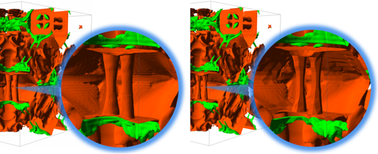
Scientific Data Management
Assist teams in storing, accessing, managing, and sharing large volumes of scientific data at DOE compute facilities.
Tools: ADIOS, Darshan, DataSpaces, FastBit, HDF5, Parallel netCDF, TAU
I/O libraries: Efficiently interfacing to complex and varied storage resources in HPC platforms
Coupling codes: Effective communication and data flow for (near-)real-time science workflows
Knowledge management: Capturing provenance of data, indexing and feature identification, facilitating sharing within and among teams
Polytropic gas simulation for modeling tokomak edge plasma. Data automatically translated from full resolution (left) to reduced resolution (right) to meet memory constraint.
Contacts: Scott Klasky (ORNL) lead, John Wu (LBNL) co-lead
Notes:
- Third technology area
- Addresses needs in storing, accessing, and managing large volumes of data
- Includes work on traditional I/O libraries such as HDF5, Parallel netCDF, and ADIOS
- Used by many scientific codes
- First time these three have been in a project together?
- Work on coupling codes together as an alternative to pushing data to/from external storage
- And work to capture provenance, help in feature detection, etc. under these common I/O libraries
- On the right is a compression example from fusion
- Showing isosurfaces here
- Entropy-based analysis to determine when data reduction should be applied
---
Accelerated the data-to-insights process by up to 75% for a large-scale AMR-based simulation-analytic workflow
Reduced overall data movement between the AMR-based simulation and in-situ analytics by 45%
Figure 6: Evaluation of application layer adaptation of the spatial resolution of the data using entropy based data down-sampling. (a) shows a simultaneous rendering of two isosurfaces of the full-resolution Polytropic Gas simulation data set. The surfaces are extracted from the density variable at the 60th time step, corresponding the isovalues 1.23 (red) and 4.18 (green), respectively. The right and left images show close up views of the two regions. (b) shows the result after the dynamic adaptation of its spatial resolution. The right region has its entropy value (at 5.14) that is lower than the specified threshold and thus is down-sampled at every 4th grid point. The left region has a higher entropy value (at 9.21) and its resolution is not changed.
T. Jin, F. Zhang, Q. Sun, H. Bui, M. Parashar, H. Yu, S. Klasky, N. Podhorszki, H. Abbasi, “Using Cross-Layer Adaptations for Dynamic Data Management in Large Scale Coupled Scientific Workflows”, SC 2013.

Slide 13
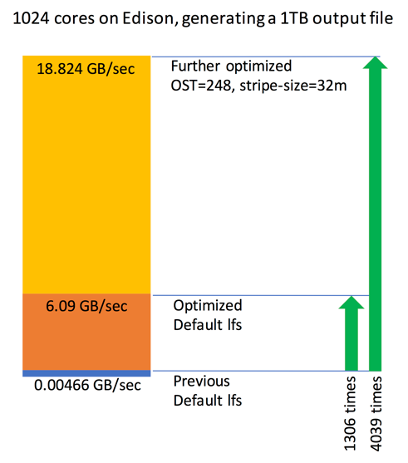
Accelerating I/O for WARP
WARP is an open-source particle-in-cell code designed to simulate charged particle beams with high space-charge intensity
Performs I/O using Python interface to HDF5
Initial performance in the MB/sec!
Analysis identified two points for improvement, type conversion and Lustre striping
18 GB/sec writes attained after optimization
I/O performance of WARP code after two rounds of improvements.
Notes:
- This example highlights how performance data and expertise in tools can have a significant impact on code performance.
- WARP uses HDF5 via a python interface, something we're seeing more of
- Initially performance was terrible
- leveraged I/O performance data from a tool called Darshan to narrow down issues
- Changes to address inefficiencies in type conversion
- Adjustments to how Lustre was used
- Many orders of magnitude performance improvement in I/O
---
Introduction
Warp is an extensively developed open-source particle-in-cell code designed to simulate charged particle beams with high space-charge intensity.
Parallel I/O performance of Warp to write to a HDF5 file was worse than writing sequential I/O, where aggregating , for some unknown reason
2016-2017
Solution:
Profiled Warp’s I/O performance using Darshan and custom instrumentation at large scales
Identified the bottleneck in type conversion and resolved to improve performance Warp’s I/O significantly.
Results and Achievements
Default I/O performance of Warp, was less than 0.005 GB/s in writing 1 TB data using 8K cores on Edison
After resolving the type conversion problem, I/O performance improved 1300X to 6 GB/s
Wither further tuning, by optimizing Lustre striping, performance improved 4000X to 18GB/s

Slide 14
Building on Success
MPAS-O
AMR Dycore
PISCEES
LibTensor
2x
12x
2x
150x
efficient use
of OpenMP
vectorized & autotuned
column solves
eliminated scalability
bottlenecks
was single node;
added MPI support
Institute for Sustained Performance, Energy, and Resilience (SUPER)
Performance Engineering
Autotuning
Performance Tools
Scalable Data Management, Analysis, and Visualization (SDAV) Institute
Data Management
Data Analysis and Visualization
FastMath Collaboration
Performance improvements in solvers and applications
Machine Leaning and Deep Learning
Applied to science domains
BGQ
GPU
KNL
BGQ
GPU
KNL
BGQ
GPU
KNL
BGQ
GPU
KNL
CGYRO
XGC1
XOLOTL init.
NWChem
3x
2x
>10⁴x
65x
LAPACK optimizations,
use of cuFFT
load balancing &
efficient OpenMP
efficient hashing
work pruning
OpenMP in lieu of
memory-limited flat MPI
BGQ
GPU
KNL
BGQ
GPU
KNL
BGQ
GPU
KNL
BGQ
GPU
KNC
MFDn
BIGSTICK
Geant4
ParaDis
1.8x
8x
12.6%
2x
efficient SpMM,
block eigensolver
load balancing &
efficient OpenMP
code optimization
algorithmic innovation
efficient use
of OpenMP
BGQ
GPU
KNL
BGQ
GPU
KNL
BGQ
GPU
KNL
BGQ
GPU
KNL
GTC
XGC1
PiconGPU
FireFOAM
35x
27x
25x
12x
ADIOS I/O
optimizations
ADIOS I/O
optimizations
ADIOS I/O
optimizations
ADIOS I/O
optimizations
BGQ
GPU
KNL
BGQ
GPU
KNL
BGQ
GPU
KNL
BGQ
GPU
KNL
BISICLES Calving
AMR Index Query
HDF5 writes
Power Grid
6x
500x
25x
200x
better graph
algorithms
new indexing
techniques
HDF5
autotuning
less data thru better
compression algorithm
BGQ
GPU
KNL
BGQ
GPU
KNL
BGQ
GPU
KNL
BGQ
GPU
KNL
Notes:
- The reason I'm able to provide all these examples of science impact is that the team has been doing this a long time.
- Many team members are coming out of the SUPER SciDAC that focused on performance and energy
- Many others coming from SDAV that focused on data management and analysis
- During SciDAC have had numerous collaborations with what is now FASTMath
- ... and have been applying learning algorithms to science too.
---
RAPIDS brings together key members of the SUPER and SDAV Institutes
Institute for Sustained Performance, Energy, and Resilience (SUPER)
Performance Engineering – experience with numerous SciDAC-3 SAPs, speedup improvements up to 1000x on SC supercomputers
Autotuning – advanced capabilities and tools to optimize SciDAC applications
Performance Tools – tuning and analysis tools, Roofline modeling & visualization
Scalable Data Management, Analysis, and Visualization (SDAV) Institute
Data Management – I/O libraries and frameworks, in situ processing and coupling, data compression, indexing
Data Analysis – topological & flow field, ensembles, feature driven exploration
Data Visualization – analysis frameworks, many-core, distributed viz. and analysis
FastMath Collaboration – performance improvements in solvers and applications
Machine Leaning and Deep Learning Thrust – Advance existing expertise to develop domain-specific adaptations targeted for SciDAC application data analysis

Slide 15
Building on Success
MPAS-O
AMR Dycore
PISCEES
LibTensor
2x
12x
2x
150x
efficient use
of OpenMP
vectorized & autotuned
column solves
eliminated scalability
bottlenecks
was single node;
added MPI support
Institute for Sustained Performance, Energy, and Resilience (SUPER)
Performance Engineering
Autotuning
Performance Tools
Scalable Data Management, Analysis, and Visualization (SDAV) Institute
Data Management
Data Analysis and Visualization
FastMath Collaboration
Performance improvements in solvers and applications
Machine Leaning and Deep Learning
Applied to science domains
BGQ
GPU
KNL
BGQ
GPU
KNL
BGQ
GPU
KNL
BGQ
GPU
KNL
CGYRO
XGC1
XOLOTL init.
NWChem
3x
2x
>10⁴x
65x
LAPACK optimizations,
use of cuFFT
load balancing &
efficient OpenMP
efficient hashing
work pruning
OpenMP in lieu of
memory-limited flat MPI
BGQ
GPU
KNL
BGQ
GPU
KNL
BGQ
GPU
KNL
BGQ
GPU
KNC
MFDn
BIGSTICK
Geant4
ParaDis
1.8x
8x
12.6%
2x
efficient SpMM,
block eigensolver
load balancing &
efficient OpenMP
code optimization
algorithmic innovation
efficient use
of OpenMP
BGQ
GPU
KNL
BGQ
GPU
KNL
BGQ
GPU
KNL
BGQ
GPU
KNL
GTC
XGC1
PiconGPU
FireFOAM
35x
27x
25x
12x
ADIOS I/O
optimizations
ADIOS I/O
optimizations
ADIOS I/O
optimizations
ADIOS I/O
optimizations
BGQ
GPU
KNL
BGQ
GPU
KNL
BGQ
GPU
KNL
BGQ
GPU
KNL
BISICLES Calving
AMR Index Query
HDF5 writes
Power Grid
6x
500x
25x
200x
better graph
algorithms
new indexing
techniques
HDF5
autotuning
less data thru better
compression algorithm
BGQ
GPU
KNL
BGQ
GPU
KNL
BGQ
GPU
KNL
BGQ
GPU
KNL
Notes:
- LibTensor - tensor contraction framework for QChem chemistry code.
- Under SUPER this was recast as a distributed memory framework using BLAS
- for big performance gains.
- Xolotl (“show-lot”) i- FES code, part of one of the SciDAC-3 SAPs.
- Accelerated comparisons and pruned redundant work
- 1,000x overall speedup
- MFDn - nuclear configuration interaction code, sparse matrices
- transformed the algorithm, for nearly 2x performance improvement on modern architectures
---
LibTensor: Libtensor is a tensor contraction framework for the QChem chemistry code. Originally, it was a highly-optimized, single-node, out-of-core implementation. Under the SAP partnership with CS/SUPER, the framework was extended to support the Cyclops Tensor Framework (CTF). CTF recasts tensor contractions into distributed memory operations that can be mapped onto MPI collectives and BLAS operations (the latter can be BGQ, KNL, or GPU accelerated). Thus, the collaboration allowed for both distributed memory execution and exploitation of emerging architectures. MFDn: MFDn is a nuclear configuration interaction code. At its core, it performs a Lanczos eigensolver using a giant, symmetric sparse matrix. In collaboration with SUPER and FastMath, LOBPCG was explored as an alternative to Lanczos. LOBPCG transforms SpMV into SpMM (sparse matrix times block vector), dot products into DGEMMs, and collectives on scalars into collectives on vectors. This created a number of performance challenges on xeon and KNL architectures for which we were able to attain a 1.8x speedup.
XOLOTL: Xolotl (“show-lot”) is an FES code (PSI SAP). Here, we accelerated comparisons and pruned redundant work in the reaction network initialization routine. On the Cray XC30 Eos at ORNL, this led to more than a 10,000× speedup in that routine (run time fell from nearly a day to 6 seconds) and an overall speedup of over 1,000×.

Slide 16
engagement

Slide 17
Community Engagement
Goal: Help application teams realize highest possible scientific impact.
Application Engagement (Anshu Dubey (ANL) lead, Sam Williams (LBNL) co-lead)
Direct assistance to application teams running on DOE compute platforms
Tiger teams with RAPIDS technology experts tackle challenges
Provide consultation for productivity issues
Community Outreach (David Bernholdt (ORNL) coordinating)
Educating and coordinating with broader DOE community, including SciDAC-4 Math Institute
Workshops, tutorials, and webinars
Facility Coordination (Kevin Harms (ANL), Oliver Rubel (LBNL), David Bernholdt (ORNL))
Ensure two-way communication with facilities
Coordinate software deployment, assist with technical challenges
Notes:
- We're thinking about engagement in three distinct ways
- Application engagement is direct, deep assistance
- Anshu and Sam have lots of experience with this and are coordinating these efforts
- Tutorials and workshops have a broader impact
- David Bernholdt is coordinating
- Plan to work with FASTMath
- Finally, coordination with the facilities is absolutely essential
- Both in terms of making sure that our tools are deployed and working at the sites
- ... and in terms of learning from the facilities about their perceived challenges
- All of these will help us adapt to changes in the community

Slide 18
Tiger Teams
Goal: Focused engagements to resolve specific application challenges
Engagement with one team for 3-6 months
Needed expertise drawn from all the focus areas as needed
Plan ahead for scope and resources
Clearly articulate expected outcomes
Three to four Tiger Team activities per year
Prioritization based on available expertise and potential impact on the application
Resources budgeted in RAPIDS appropriately.
Contacts: Anshu Dubey (ANL) lead, Sam Williams (LBNL) co-lead
Notes:
- Tiger teams are a model for application engagement
- Multi-disciplinary, deep, 3-6 month interactions
- Clear goal and plans: for example, accelerate a kernel, address I/O performance bottleneck

Slide 19
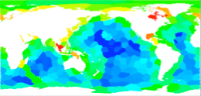
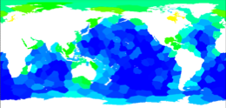
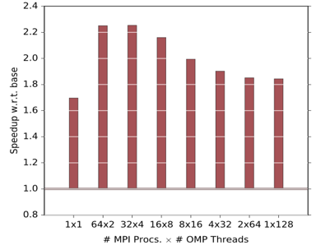
MPAS-Ocean Optimization for Emerging DOE Systems
Improved performance and energy of MPAS- Ocean, an unstructured mesh-based ocean modeling code, on leading DOE platforms using a variety of innovative approaches.
Multi-disciplinary optimization: SUPER, SDAV, and FASTMath personnel, VisIT and TAU tools
Implemented hybrid OpenMP/MPI version of code to target new node technologies
e.g., KNL, up to 2.2x speedup
Code also used as driver for other SUPER CS activities
Visualization of load imbalance using VisIT (left) leads to new partitioning scheme for improved load distribution (right)
Speedup on Knights Landing node using optimized, threaded version versus original flat MPI, showing up to 2.2x speedup
Notes:
- This is an example of the tiger team model in action, for an ocean code
- Brought together experts from all the SciDAC-3 Institutes, among others
- Code profiling and visualization to identify root causes
- Work to address load imbalance
- Threading to make better use of KNL nodes
---
This work highlights the valuable collaborative effort between the SUPER Institute and BER Application partnership (PI: William Collins) for the MPAS Ocean code, which uses a mesh based on Voronoi tessellations. Our work included detailed code profiling using a variety of methods include the TAU profiling tools and integration with the VisIT via a FASTMath collaboration. This allowed us to identify the load imbalance bottleneck and develop new methods to generate mesh partitioning with better load balance and reduced communication. Additionally we employed a number of optimization strategies to successfully implement a scalable hybrid (OpenMP/MPI) version that specifically targets the latest generation of DOE HPC systems such as Cori, where a 2.2x speedup was attained. The SUPER institute also leveraged this irregular computation to develop and validate energy-optimization strategies and associated tools. Many of these updates as being integrated into the MPAS development branch used by ACME.
Work was performed at Lawrence Berkeley National Laboratory, Argonne National Laboratory, Los Alamos National Laboratory, University of San Diego, University of Maryland, University Of Oregon, University of Utah
References
Taylor Barnes, Brandon Cook, Jack Deslippe, Douglas Doerfler, Brian Friesen, Yun (Helen) He, Thorsten Kurth, Tuomas Koskela, Mathieu Lobet, Tareq Malas, Leonid Oliker, Andrey Ovsyannikov, Abhinav Sarje, Jean-Luc Vay, Henri Vincenti, Samuel Williams, Pierre Carrier, Nathan Wichmann, Marcus Wagner, Paul Kent, Christopher Kerr, John Dennis, "Evaluating and Optimizing the NERSC Workload on Knights Landing", Performance Modeling, Benchmarking and Simulation of High Performance Computer Systems (PMBS), November 2016
Abhinav Sarje, Douglas W. Jacobsen, Samuel W. Williams, Todd Ringler, Leonid Oliker, "Exploiting Thread Parallelism for Ocean Modeling on Cray XC Supercomputers", Cray User Group (CUG), London, UK, May 2016,
Abhinav Sarje, Sukhyun Song, Douglas Jacobsen, Kevin Huck, Jeffrey Hollingsworth, Allen Malony, Samuel Williams, and Leonid Oliker, "Parallel Performance Optimizations on Unstructured Mesh-Based Simulations", Procedia Computer Science”, 1877-0509, June 2015, 51:2016-2025, doi: 10.1016/j.procs.2015.05.466
Kevin A. Huck, Kristin Potter, Doug W. Jacobsen, Hank Childs, Allen D. Malony, "Linking performance data into scientific visualization tools”, Proceedings of the First Workshop on Visual Performance Analysis. IEEE Press, Piscataway, NJ, USA. 2014

Slide 20
SciDAC-4 Partnership Connections
Title | PI | Prog. | RAPIDS Member(s)
Coupling Approaches for Next-Generation Architectures (CANGA) | P. Jones | BER | Peterka, Ross
Prob. Sea-Level Projections from Ice Sheet and Earth System Models | S. Price | BER | Patchett
Advancing Catalysis Modeling | M. H. Gordon | BES | Williams
AToM: Advanced Tokamak Modeling Environment | J. Candy | FES | Bernholdt
Plasma Surface Interactions: Predicting the Performance and Impact of Dynamic PFC Surfaces (PSI-2) | B. Wirth | FES | Bernholdt, Roth, Pugmire
Center for Tokamak Transients Simulations (CTTS) | S. Jardin | FES | Williams
Integrated Simulation of Energetic Particles in Burning Plasmas (ISEP) | Z. Lin | FES | Williams, Klasky, Pugmire
High-fidelity Boundary Plasma Simulation (HBPS) | C. S. Chang | FES | Klasky, Podhorszki
Tokamak Disruption Simulation | X. Tang | FES | Patchett
Inference at Extreme Scale | S. Habib | HEP | Yoo, Morozov, Balaprakash
HEP Data Analytics on HPC | J. Kowalkowski | HEP | Peterka, Ross
HPC Framework for Event Generation at Colliders | S. Hoeche | HEP | Hovland
HEP Event Reconstruction with Cutting Edge Computing Architectures | G. Cerati | HEP | Norris
Simulation of Fission Gas in Uranium Oxide Nuclear Fuel | D. Andersson | NE | Bernholdt, Roth
Towards Exascale Astrophysics of Mergers and SuperNova | W. R. Hix | NP | Dubey
Nuclear Low Energy Initiative (NUCLEI) | J. Carlson | NP | Norris
Notes:
- In terms of connecting with the science teams in SciDAC, we're off to a good start...
- RAPIDS members are participating in 16 of the partnerships

Slide 21
SciDAC-4 Coordination Committee
First meeting December 7th, 2017
Goals:
Facilitate interactions between SciDAC Institutes and Partnerships, and with broader science community
Assess emerging needs across SciDAC science teams
Committee:
DOE:
Rob Ross (ANL, RAPIDS lead, chair)
Lori Diachin (LLNL, FASTMath lead)
Katherine Evans (ORNL, BER POC)
Teresa Head-Gordon (LBNL, BES POC)
David Hatch (U. Texas-Austin, FES POC)
Jim Amundson (FNAL, HEP POC)
Brian Wirth (UTK-ORNL, NE POC)
Martin Savage (INT & U. Washington, NP POC)
Randall Laviolette (ASCR)
Ceren Susut-Bennett (ASCR)
Dorothy Koch (BER)
Jim Davenport (BES)
John Mandrekas (FES)
Lali Chatterjee (HEP)
Dan Funk (NE)
Ted Barnes (NP)
Notes:
- but there are 27 partnerships :).
- Program management thought it made sense to pull a group together to coordinate interactions
- Makes sense to me
- Met for the first time on the 7th
- Goals:
- Facilitate interactions, first between institutes and partnerships, then with others
- Assessing emerging needs as a piece of the feedback loop between facilities, ASCR R&D and SciDAC
- Next steps: - January, presentations from Institutes on capabilities. - February, first institute-partnership meeting, NE, to initiate discussions
- POCs represent partnerships in their program

Slide 22
Thanks to the RAPIDS Team
Rob Ross (Director)
Jim Ahrens (PI)
Lenny Oliker (Deputy)
Wei-keng Liao (PI)
Shinjae Yoo (PI)
Scott Klasky (PI)
Stephen Siegel (PI)
Han-Wei Shen (PI)
Neil Fortner (PI)
Kevin Huck (PI)
Berk Geveci (PI)
Manish Parashar (PI)
Bronis de Supinski (PI)
Mary Hall (PI)
Notes:
Thank the team.

Slide 23
This material is based upon work supported by the U.S. Department of Energy, Office of Science, Office of Advanced Scientific Computing Research, Scientific Discovery through Advanced Computing (SciDAC) program.

