Slide 1
NarwhalEdu: 6.01x Contract
1/31/14
Nancy Ouyang
Cappie Pomeroy

Slide 2
Technical Specs of Proposal
Cost $150 in quantity one
Accept motor voltage levels (be able to drive straight) and output 2 to 3 distance readings at 12 times per second
Communicate wirelessly with SOAR
Be wirelessly programmable with up to 40 robots in a single room
Have a light tracking head that interfaces with existing 6.01 programs to create a light-tracking robot

Slide 3
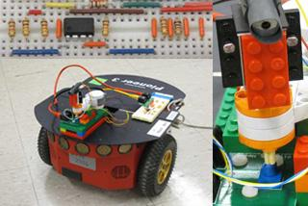
Current System
Pioneer-DX Robot
University Price: $3,995
Lego Motor: $20 (ebay, used)

Slide 4
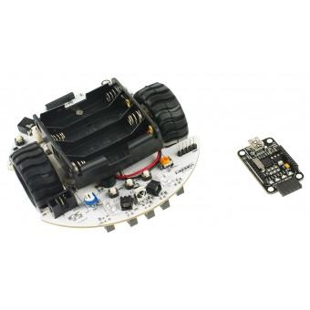
Proposed System
A beefier version of the DFRobot MiniQ 2wd ($79)
Quad encoder instead of photodiode, or non-IR encoder
Sharp IR instead of IR 38 kHz
(possibly) Better gearmotors
Lipo instead of 4xAA
Est. $150 in quantity 1
Wireless (est. +$70)

Slide 5
Deliverables: Month 1
Evaluate and compare:
CPUs, drive systems, odometry systems, obstacle distance sensors
1st iteration robot outputting accurate distance readings

Slide 6
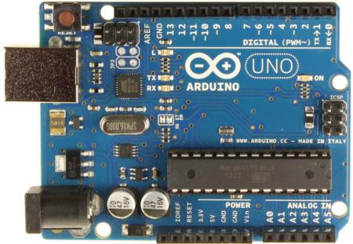
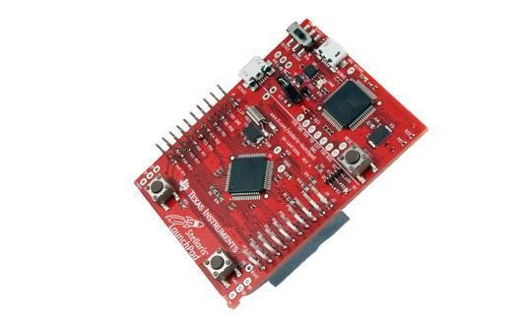
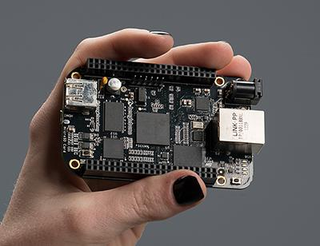
CPUs
We chose Arduino.
Arduino: Uno, $25
clones for $10
sufficient I/O for our purposes
free, easy-to-use open source programming toolchain (all OSes)
Stellaris ARM: $10, but discontinued product line after one month
Tiva ARM Replacement: $14
Beaglebone Black: $45, overkill, expensive

Slide 7
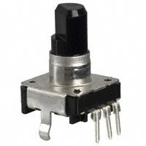
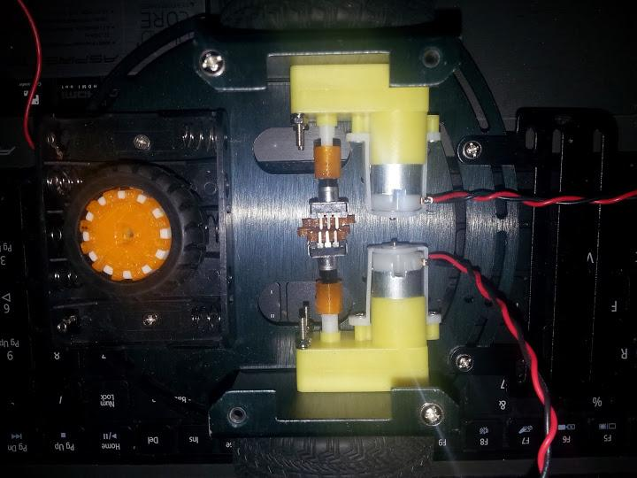
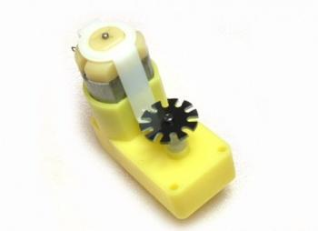
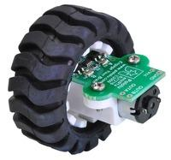
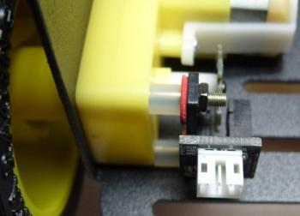
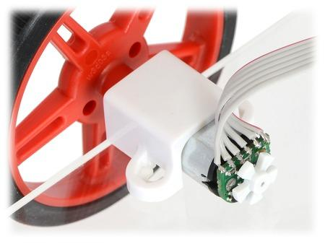
Odometry Systems
Rotary Encoders
Enclosed optical ($.64)
IR break beam ($2.90)
wheel-mounted (low res)
2wd, 4wd kit bots
motor-mounted

Slide 8
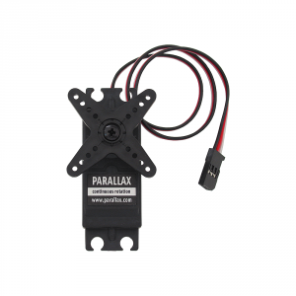
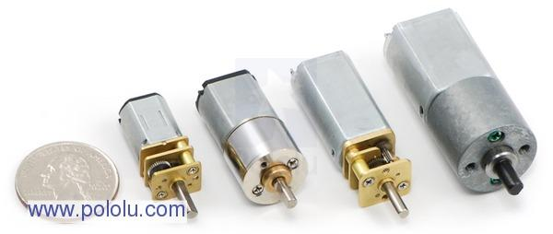
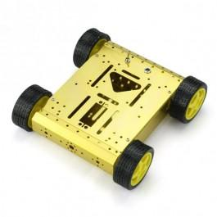
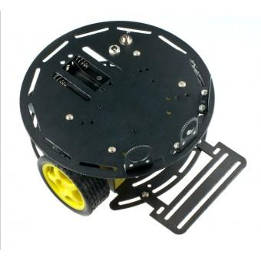
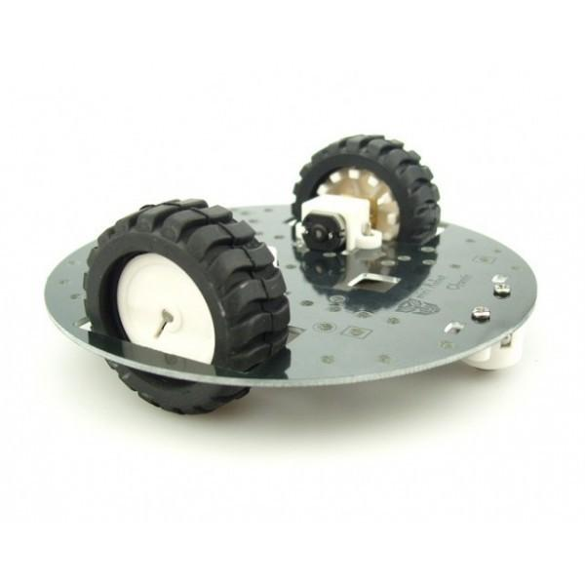
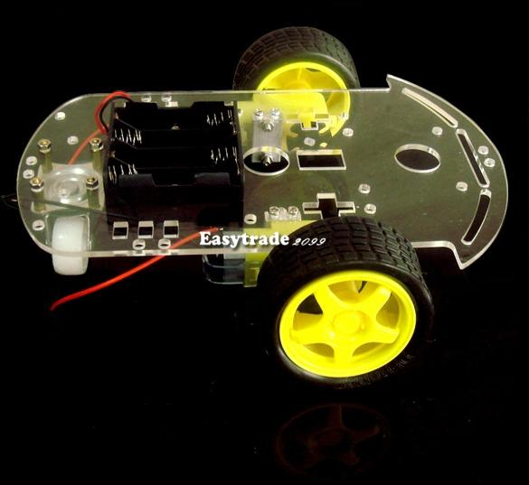
Drive/Chassis
Continuous rotation servos
Gearmotors
Sainsmart 4wd
DFRobot 2wd miniq
DFRobot Turtle
Ebay

Slide 9
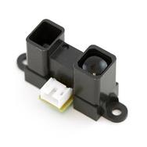
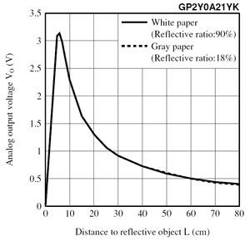
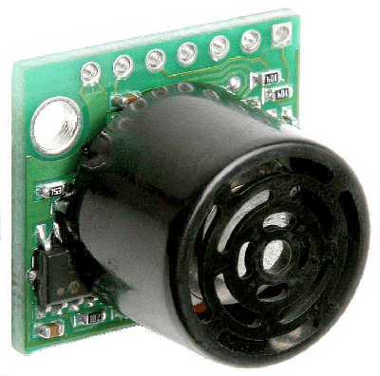
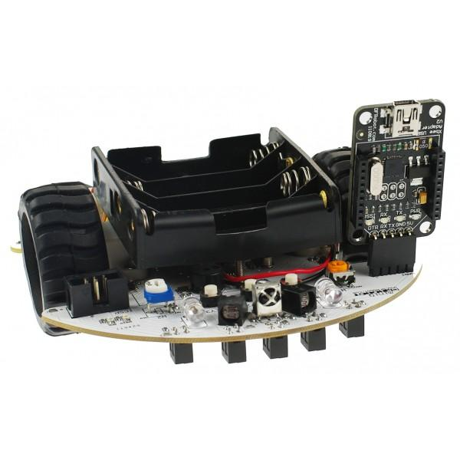
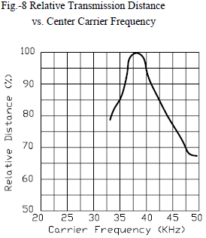
Obstacle Distance Readings
Sonar - expensive ($25)
Infrared
38 kHz - MiniQ ($8)
Designed for proximity, not analog sensing
photodiodes ($8)
Sharp ($15)
Photoresistor
not fast enough to do modulation

Slide 10
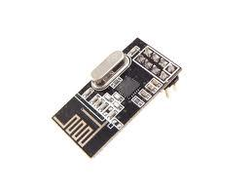
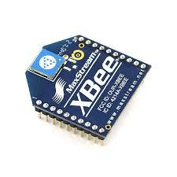
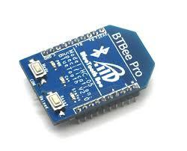
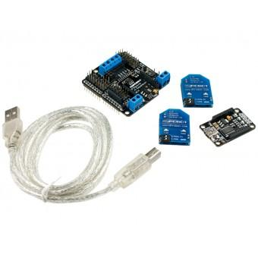
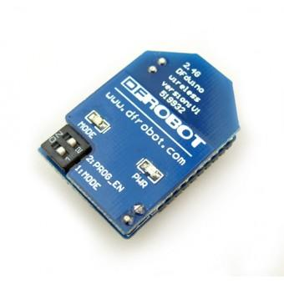
Wireless Systems
We found these to be generally unreliable.
nRF (no program upload, $10)
Xbee ($70 min.)
BTBee ($60)
DFrobot (usb ready program upload, $70)

Slide 11
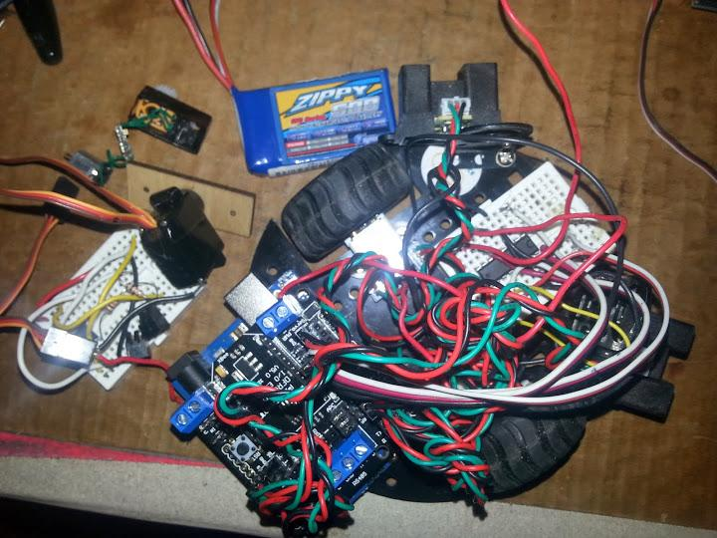
Status
Build robot platform for under $150
Interface with SOAR
Transmit distance readings
Move forward and backward
Todo: move at specific velocity (important for labs?)

Slide 12
Status
Created servo head
Does not operate at 5V system voltage or 7.4V battery voltage with lab circuit (results in ±2.5V)
Todo: charge pump or boost converter?

Slide 13
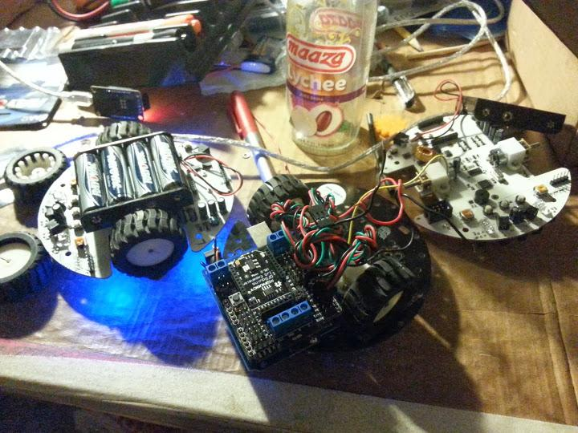
Todo
Fix IR encoder dependent on voltage issues
Encoder on motor/optical?
Rotational: Gyro
Do we need more accurate elapsed position?
Reliable wireless program uploading and data transmission
Out of scope:
Turn into manufacturable robot

Slide 14
Proposed System
Chassis (w/ 2 wheels, motors, 1 castor) | $34.30
encoders x2 | $5.80
ball castors x1 | $1.90
IR sensors GP2Y0A21YK x2 | $30.00
Romeo board | $39.90
Lipo | $5.69
USB cable | $2.50
Sharp IR mounts | $10.00
standoffs | $3.20
Head
Servo | $10.00
Metal servo mounts? | $5.00
Total $148.29

