Slide 1
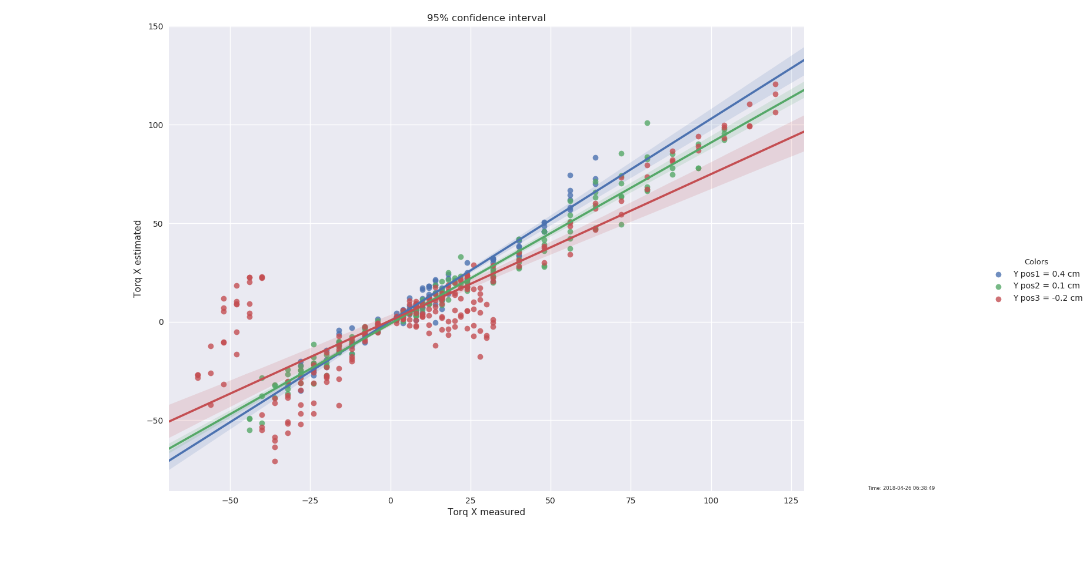
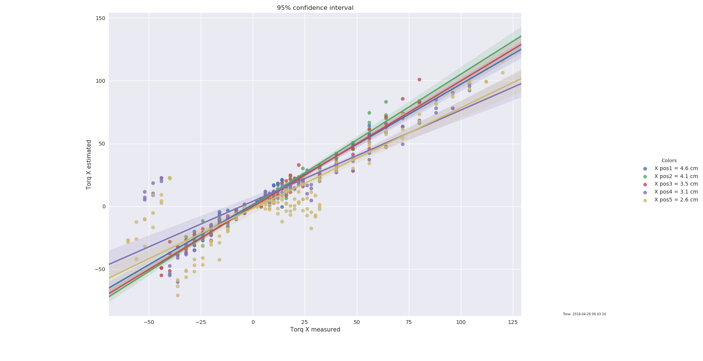
Outliers
Outliers appear to be from last two X position (2.6, 3.1 cm), on the off-center (-0.2cm) y axis
Probably not setup issue, as these are positions 12 & 15 in dataset, interleaved chronologically with other points that fit well
Note: In future should make sure X and Y have non-overlapping colorsets

Slide 2
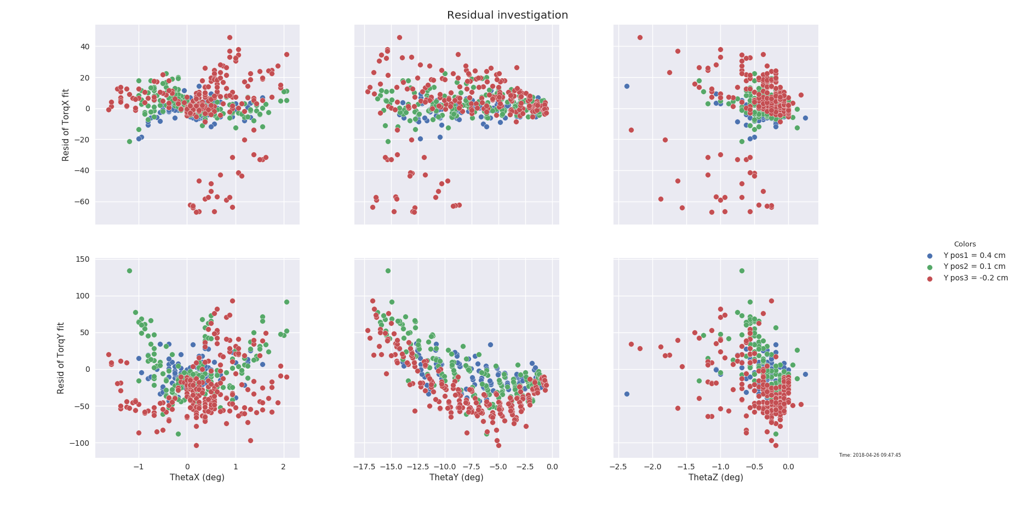
Linear fit
ThetaY appears to have a linear residuals

Slide 3
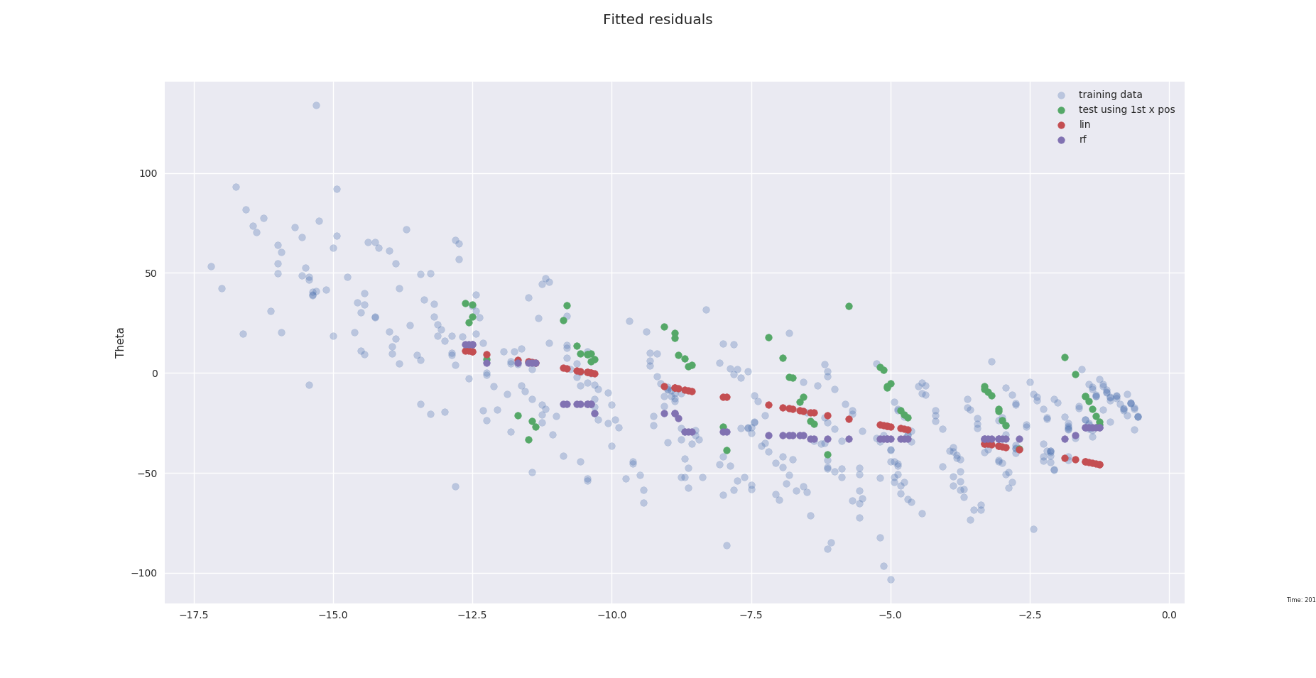
Extrapolation on residuals
Removed 1st x position from dataset for training
Lin rmse on test: 23.332
RF test rmse: 26.894

Slide 4
Linear fit, corrected with residuals
K estimate, bylinear regression (no y intercept)
Torque = K * Theta
Residual
  RMSE Lin K, no resid: 36.63
Residual prediction using Theta
Corrected Torque Estimate
  RMSE Lin K, Lin resid 26.65
  RMSE Lin K, RF resid 22.56
  resid

