Slide 1
Simulating cavity filter temperature drift in CST Microwave Studio
Novak Petrovic
npetrovic@gmail.com

Slide 2
Presentation Outline
Role of CST Microwave Studio (MWS)
  Conventional solutions
  HTS solutions
  Ceramic solutions
Practical Problem and Current Work
  Definition
  CST MWS solution
Q&A and further discussion on (any) topic

Slide 3
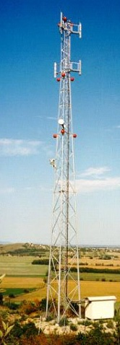
Market overview
Cellular wireless infrastructure
Spectrum re-farming (U900)
Interference mitigation (Custom)
Co-siting & co-location (Sharing)
Low noise solutions
LTE – filtering & range extension

Slide 4
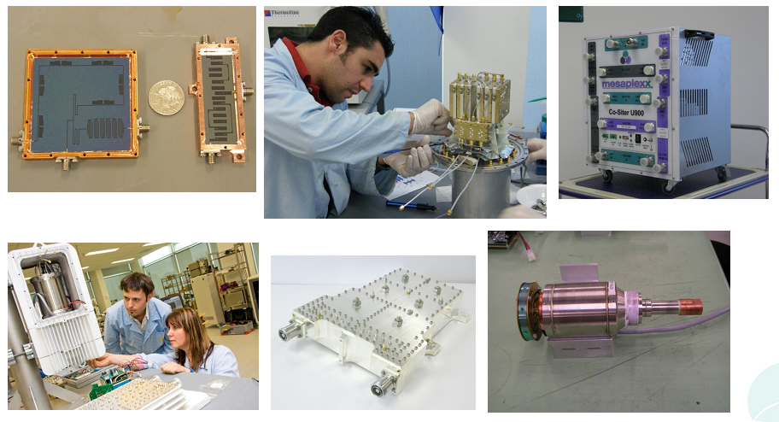
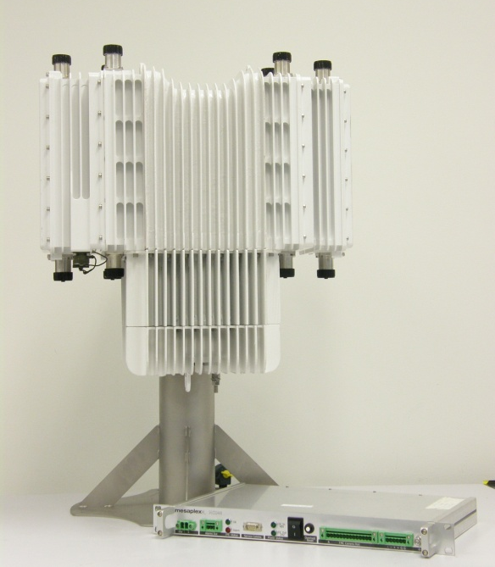
HTS solutions

Slide 5
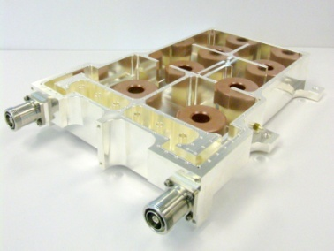
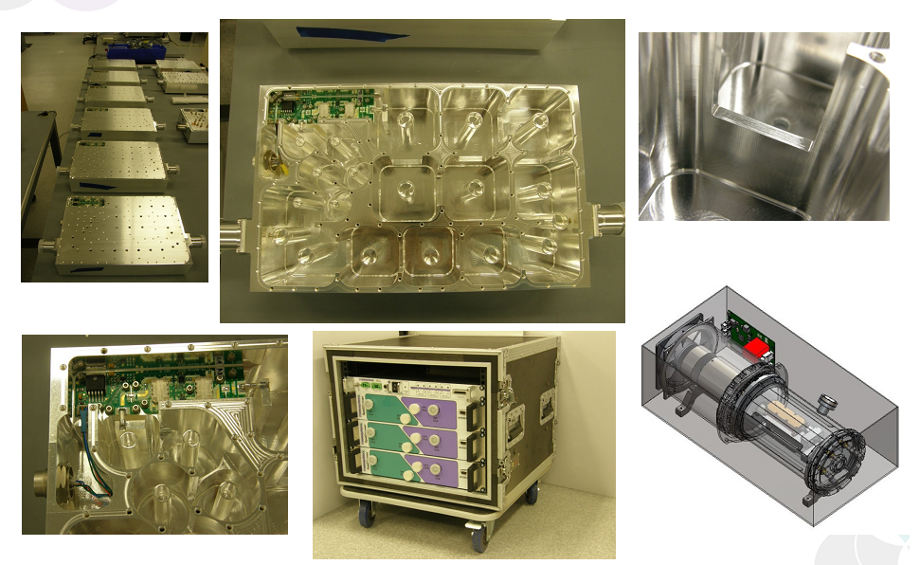
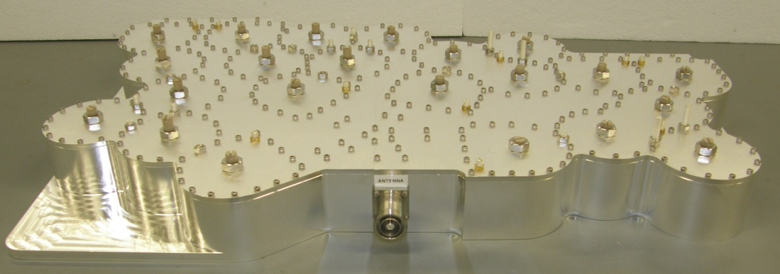
Conventional solutions

Slide 6
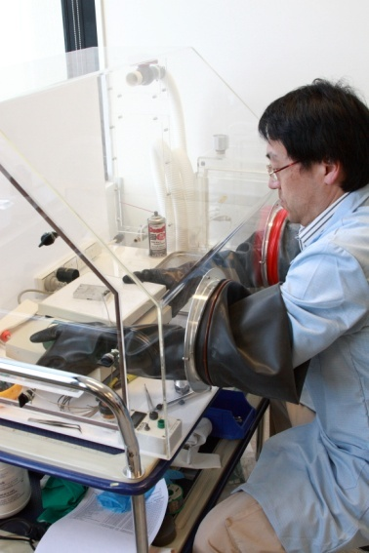
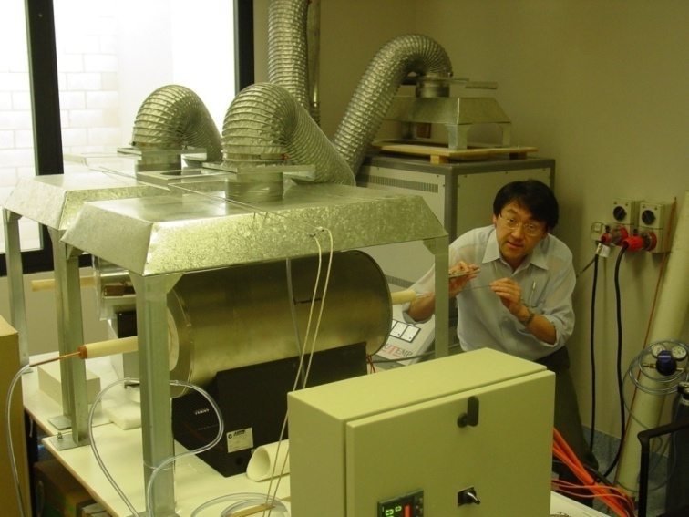
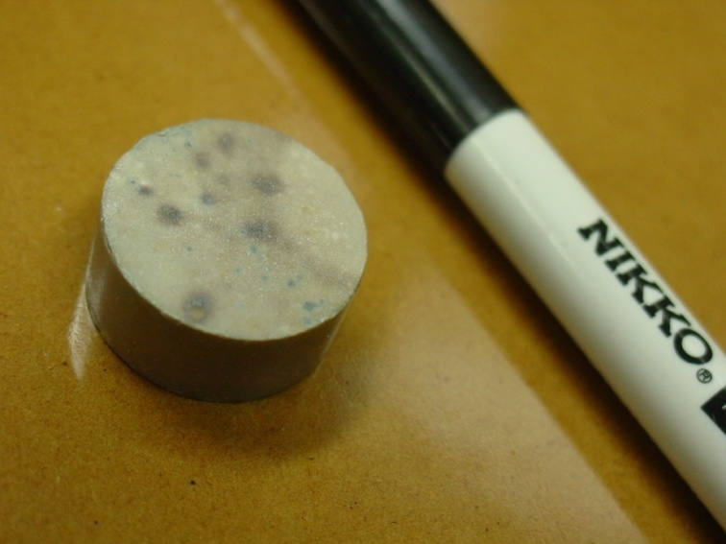
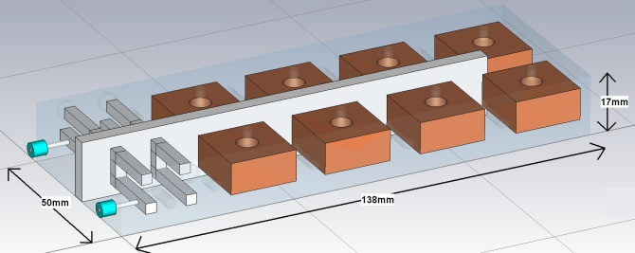
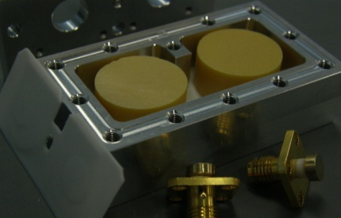
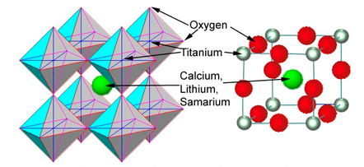
Materials solutions
Novel ceramic materials

Slide 7
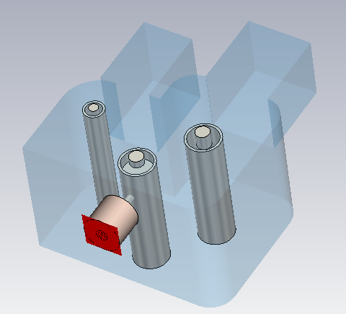
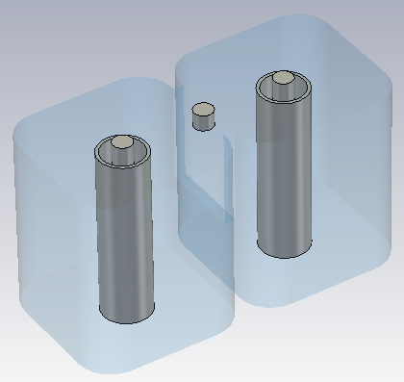
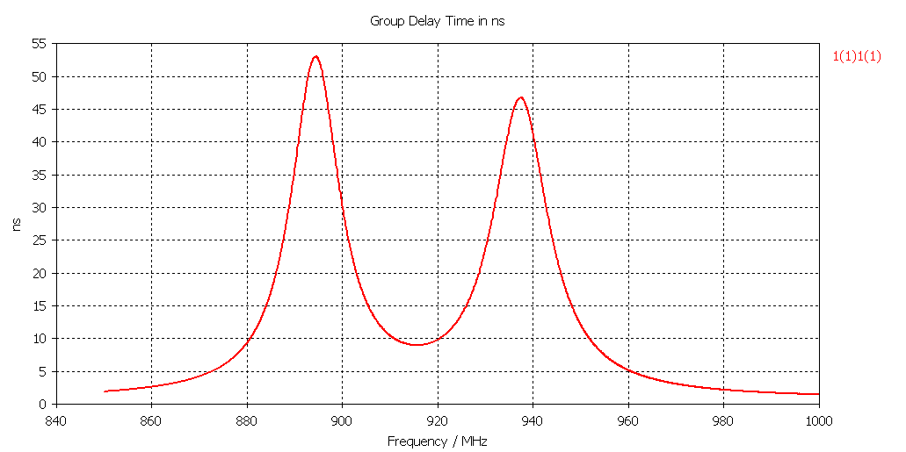
Application of CST MWS
Metallic cavity (combline) filters fully designed in CST MWS.
First design usually works.

Slide 8
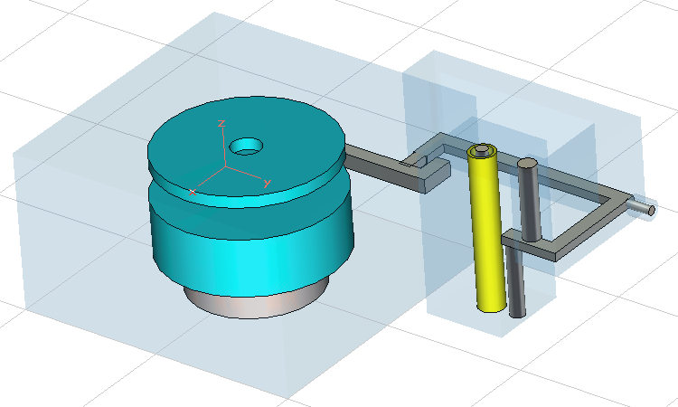
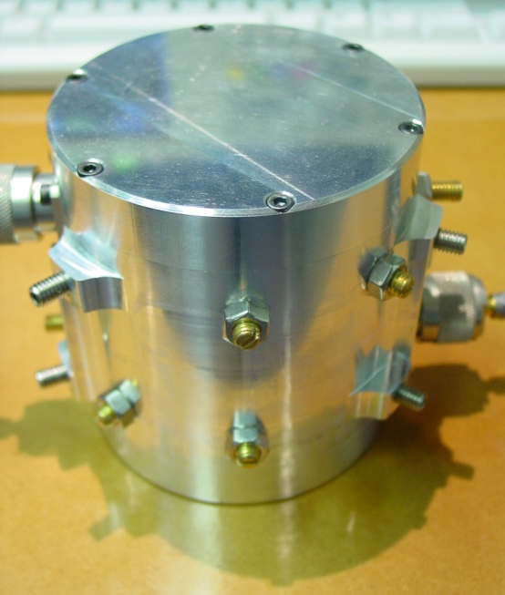
Application of CST MWS
Dielectric resonator filters are also designed in CST MWS

Slide 9
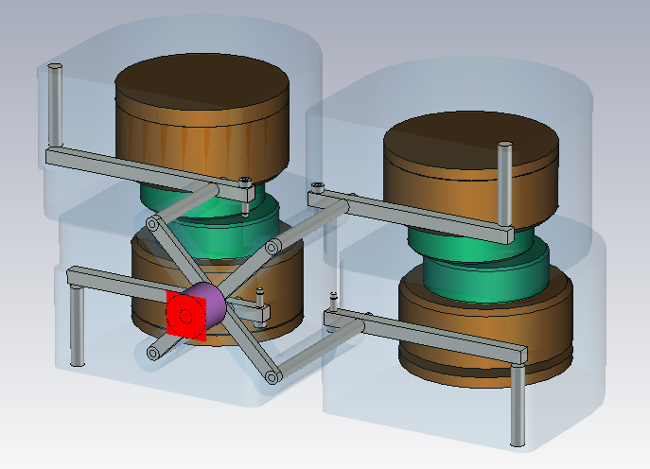
Application of CST MWS
More complicated
structures are
increasingly simulated
“Supercomputer”
Integration with SolidWorks
Have dealt with situations where lumped element and
transmission line approach breaks down in a practical
application

Slide 10
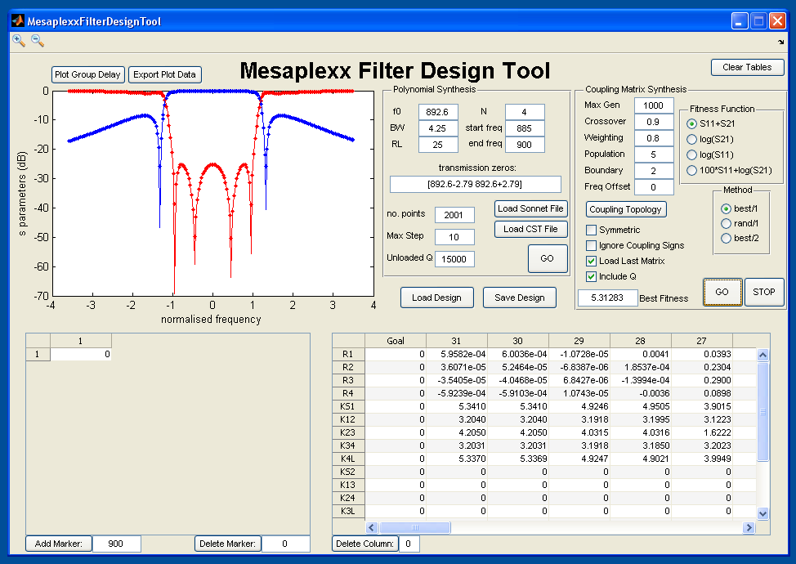
Design and Characterisation
Coupling matrix
optimisation
Design
Tuning
Characterisation

Slide 11
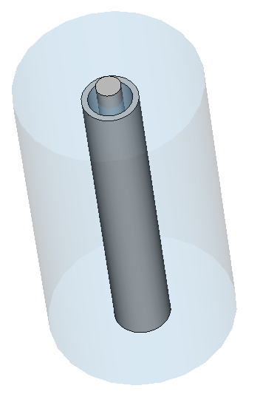
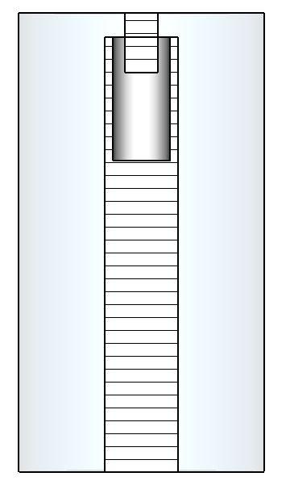
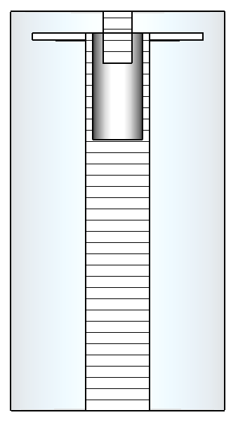
Problem 1
Frequency drift due to dimensional and/or material change?

Slide 12
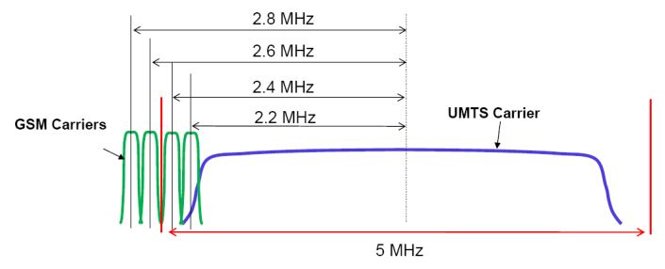
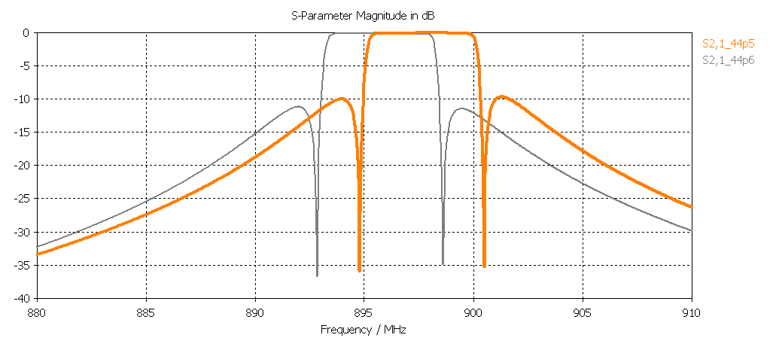
Change in performance

Slide 13
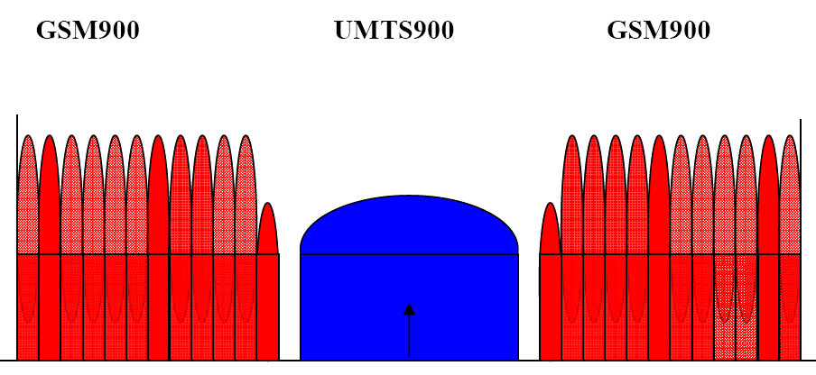

Change in performance
Keep the drift to
less than 1 GSM ch

Slide 14
Current approach
Resonance condition:
Cross-section impedance
function of cavity and
resonator dimensions.
Resonator length

Slide 15
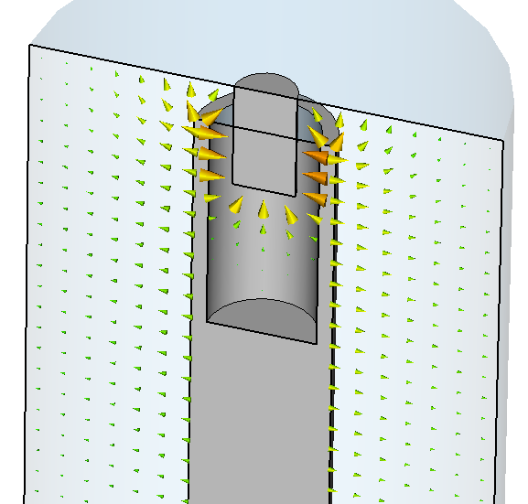
Approximating capacitance
A combination of calculation,
approximation, and empirical
estimation. Not always easy
To get right.

Slide 16
Temperature expansion
Thermal expansion coefficient:
Linear:
Vol:
Area:
αV ≈ 3αL
isotropic
materials
αA ≈ 2αL
isotropic
materials
αL << 1
small ΔT

Slide 17
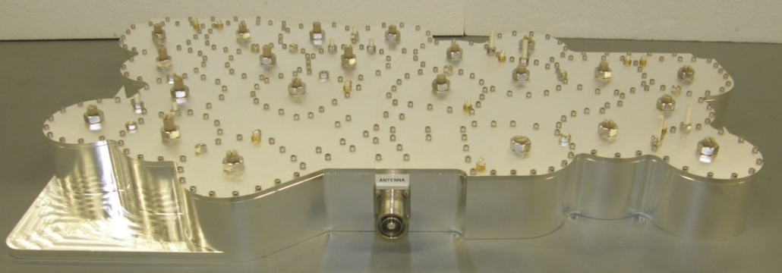
Typical values
Material | Linear CTE ∙ 10^-6/˚C
Rubber | 77
Lead | 29
Aluminium | 23
Brass | 19
Copper | 17
Gold | 14
Steel | 11 – 13
Platinum | 9
Silicon | 3
Invar | 1.2
< 20 kg !!
Damage to machine
when impurities are added

Slide 18
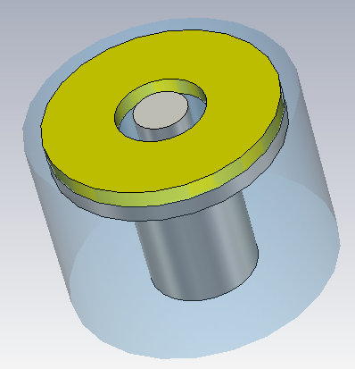
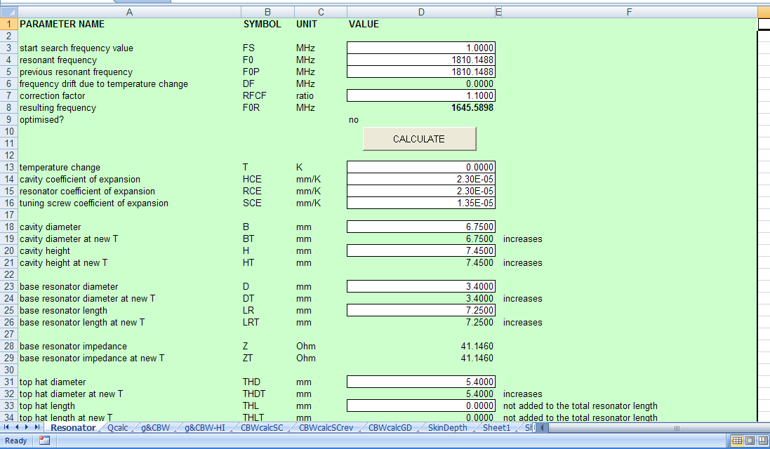
Automation of current approach

Slide 19
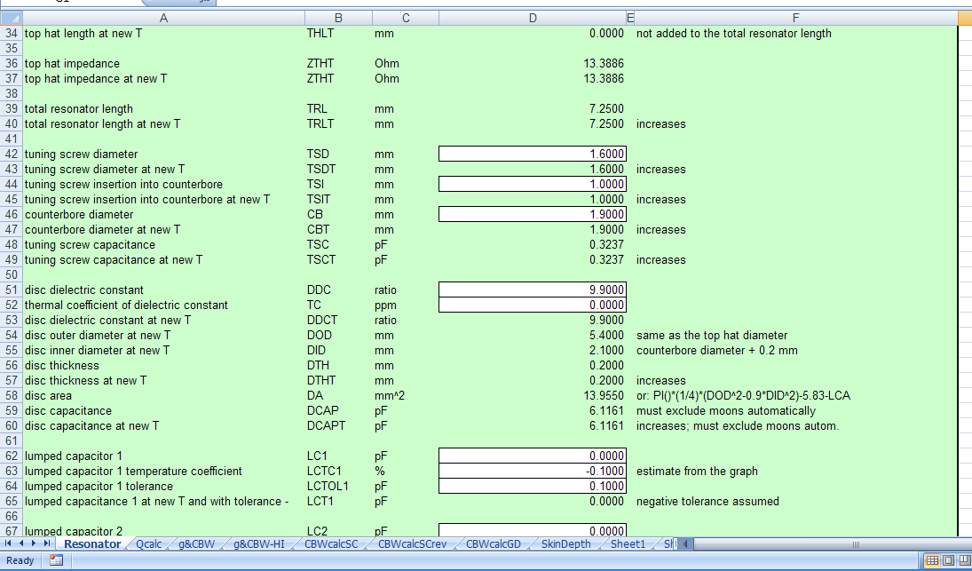
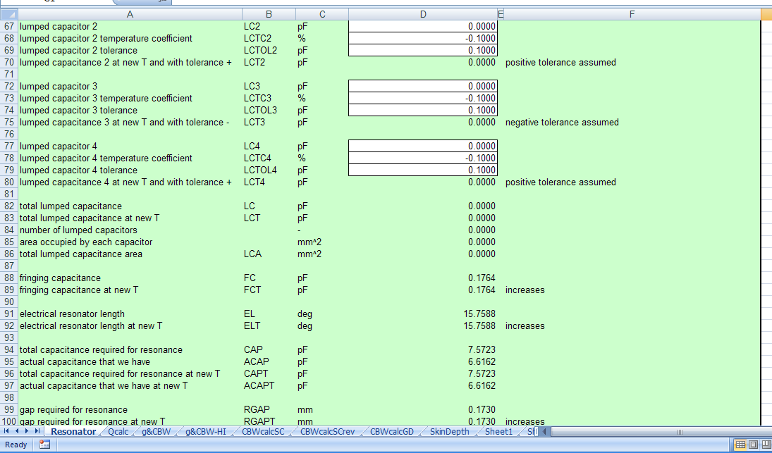
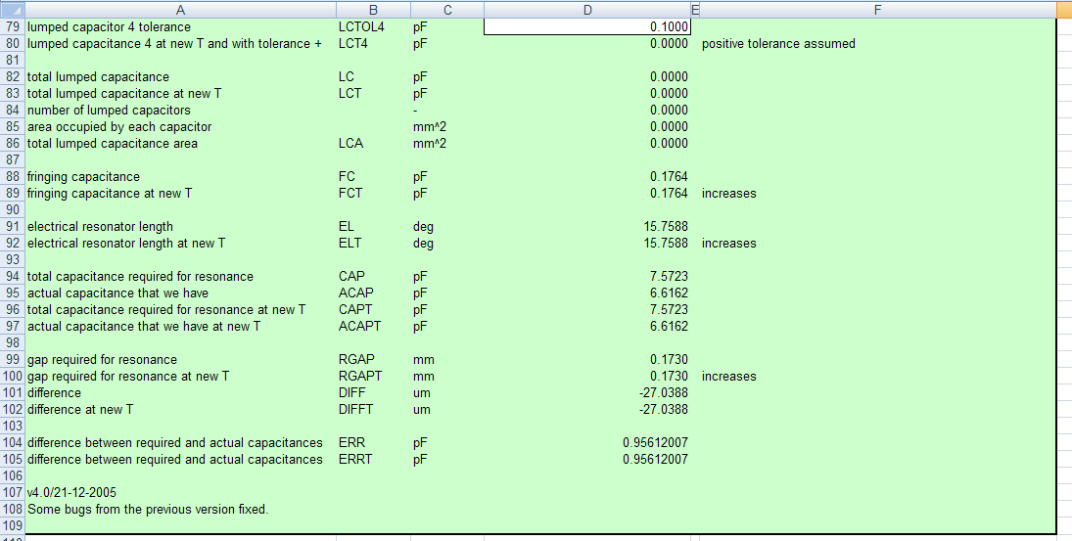
Automation of current approach
Only works for
“static” analytic cases

Slide 20
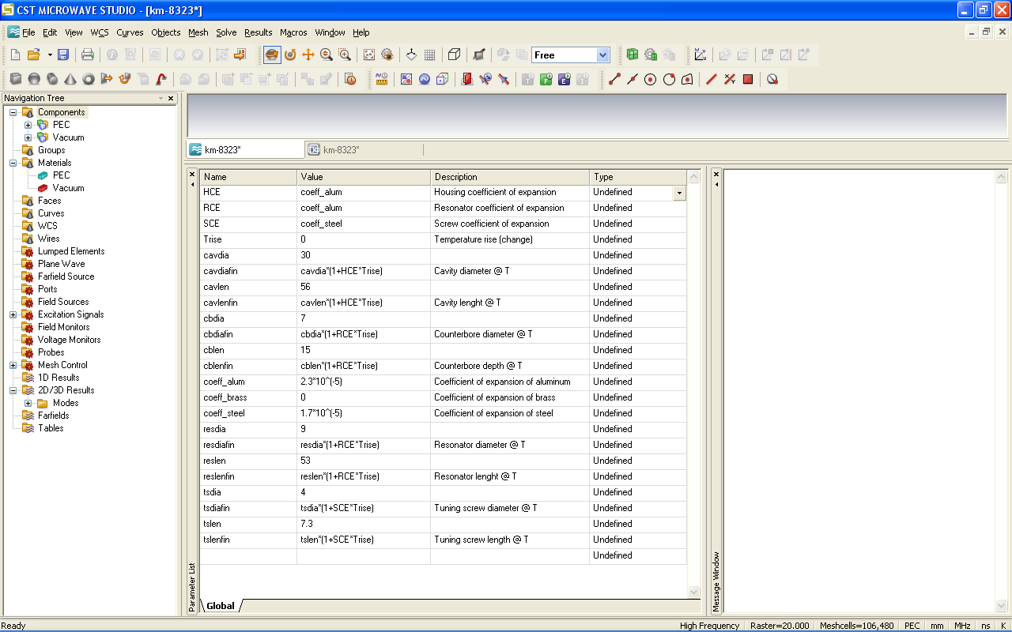
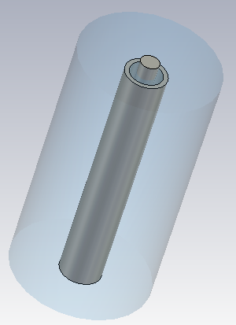
CST MWS solution
Formulate parameters
as a function
of temperature

Slide 21
CST MWS solution

Slide 22
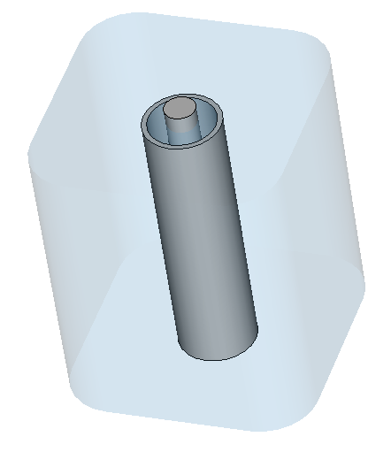
Practical case
Spreadsheet calculation: -0.762 MHz drift, -20.2 ppm/˚C
CST MWS: -0.9 MHz drift, -23.8 ppm/˚C

Slide 23
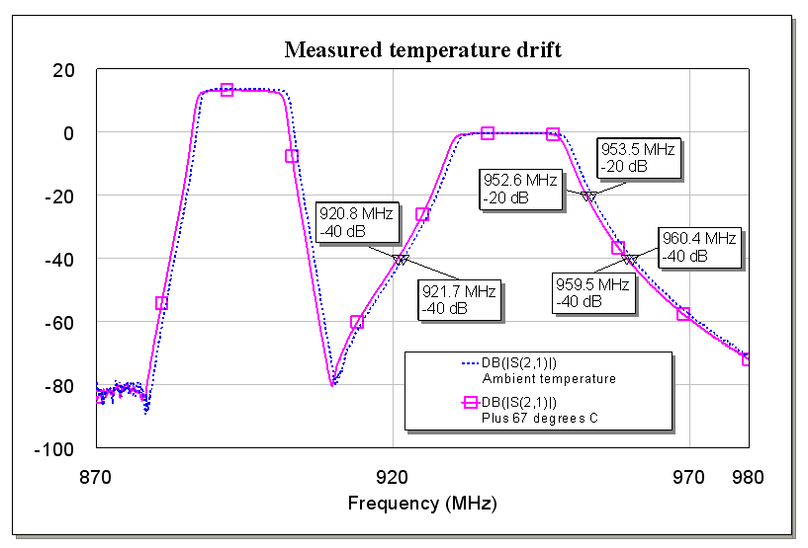
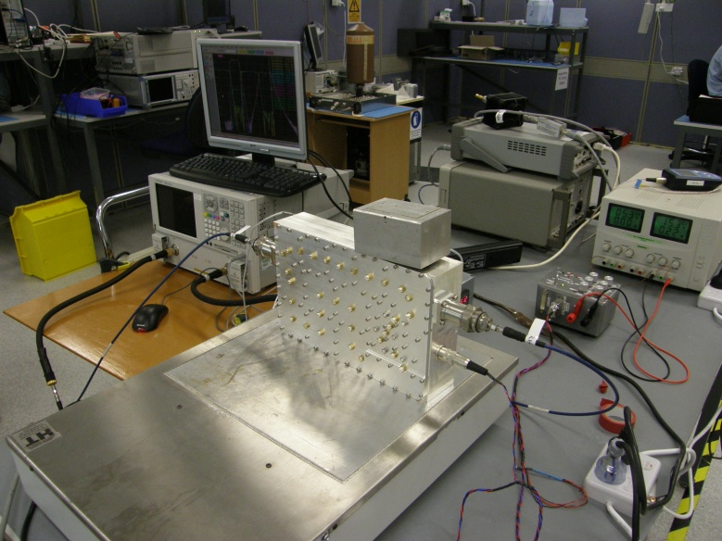
Measured results
Total temperature drift of -0.9 MHz was measured
(+40 ˚C temperature change, rate of -0.023 ˚C/MHz)
CST MWS works

Slide 24
Accuracy
Criterion: Establish logical convergence (experiments),
by examining change in error, and referenced to mesh.
45 LPW: 269,500 meshcells, f1 = 946.9 MHz f2 = 946.0 MHz
35 LPW: 141,120 meshcells, f1 = 946.4 MHz f2 = 945.5 MHz
25 LPW: 54,400 meshcells, f1 = 941.7 MHz f2 = 940.8 MHz
15 LPW: 17,248 meshcells, f1 = 934.5 MHz f2 = 933.6 MHz
Also confirmed convergence on basic coaxial case.

Slide 25
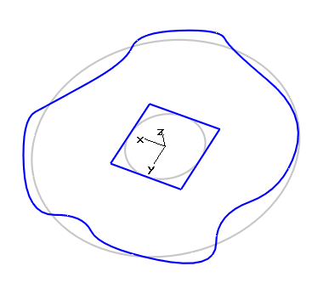
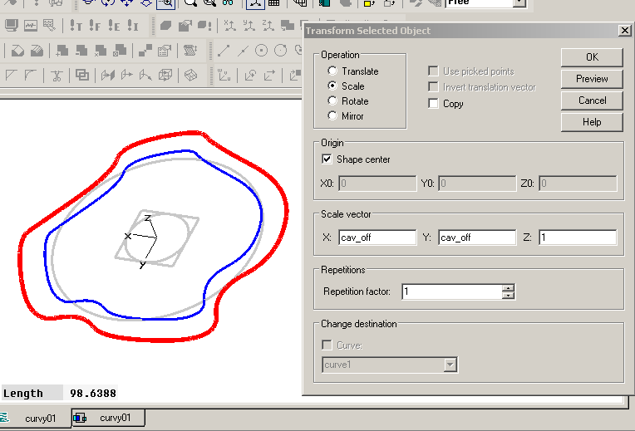
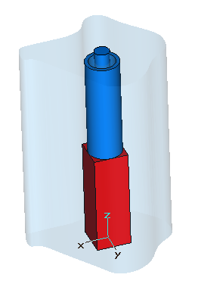
Extension to arbitrary shapes
αA ≈ 2αL
isotropic
materials

Slide 26
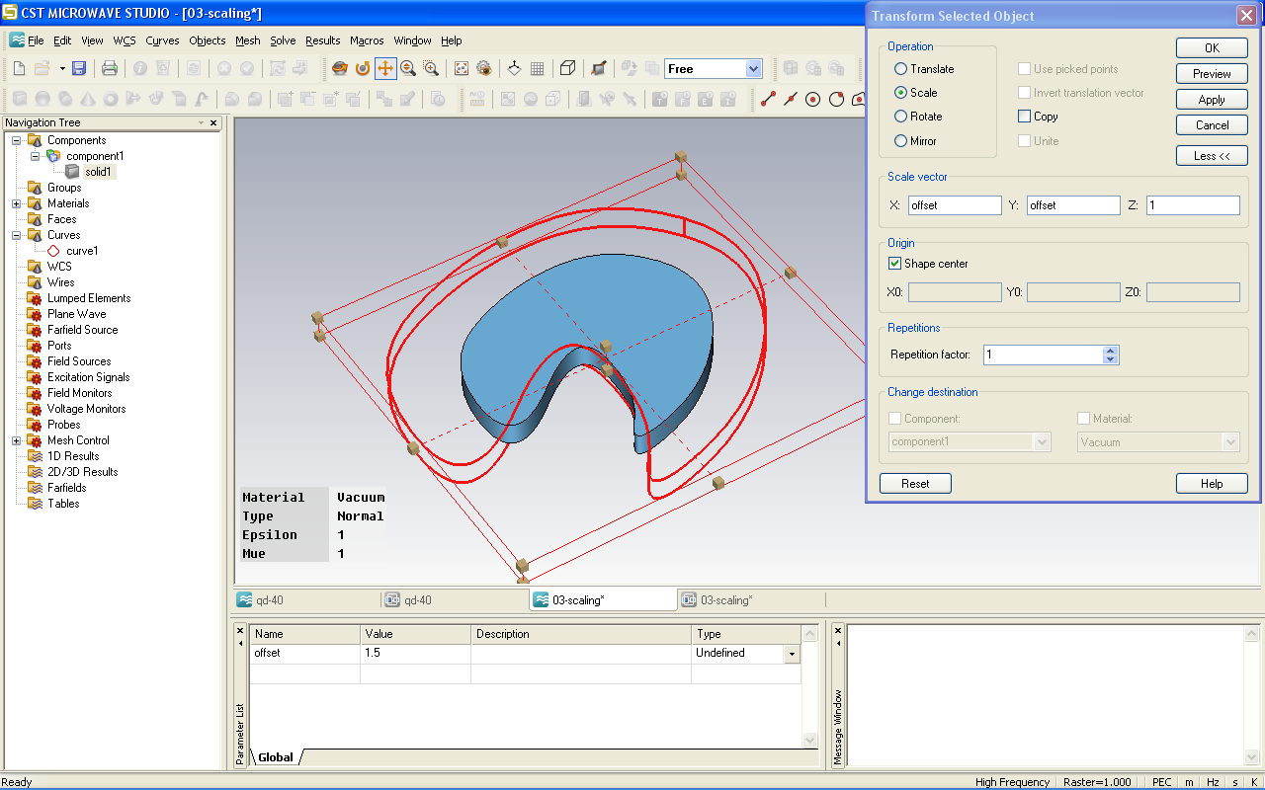
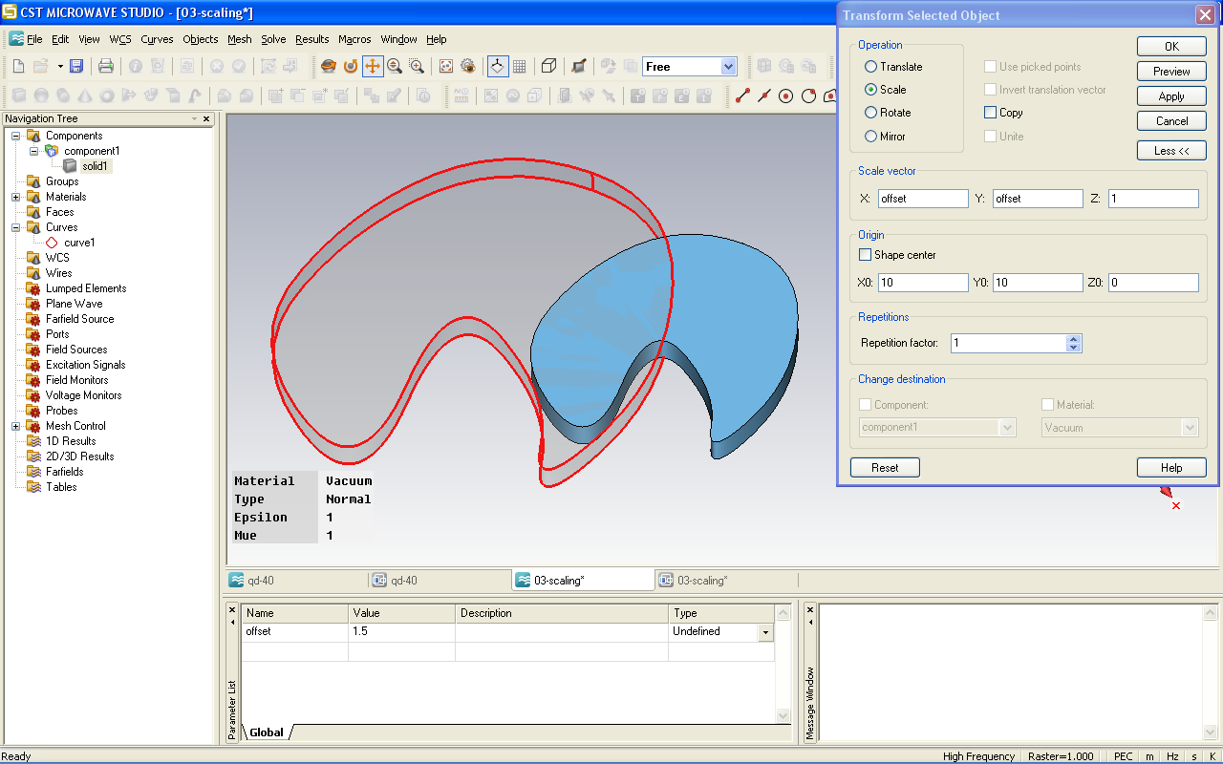
Scaling check
Area of scaled objects
does check out.
Reference objects to cavity
(or fixing screw location)

Slide 27
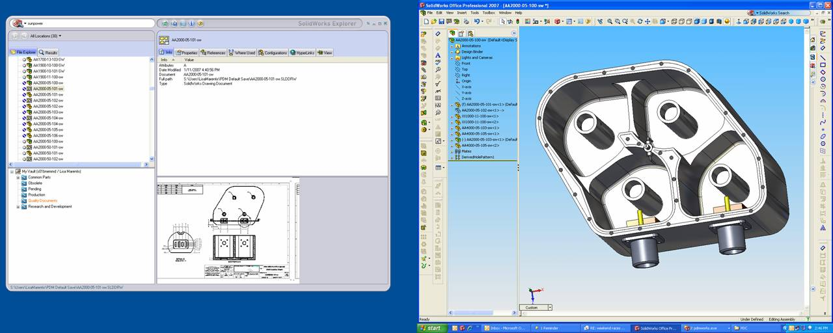
Other possibilities
All other features
Optimisation (literature)
Entire filter with low mesh

Slide 28
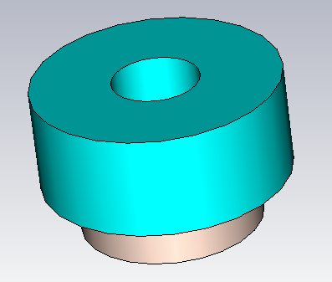
Problem 2
Current work: Design ceramic filter
  Calculate temperature drift and compensate
Previous methodology applied
However, a lot more CST MWS simulations

Slide 29
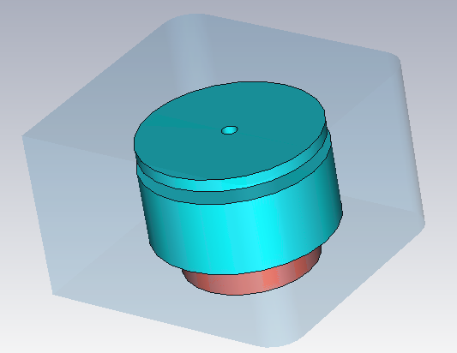
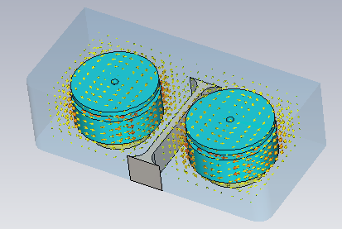
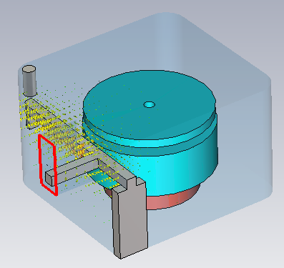
General design notes
Simulations have to be more
precise than for combline resonators

Slide 30
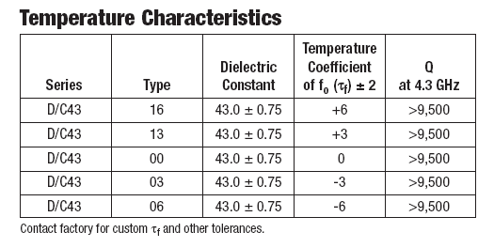
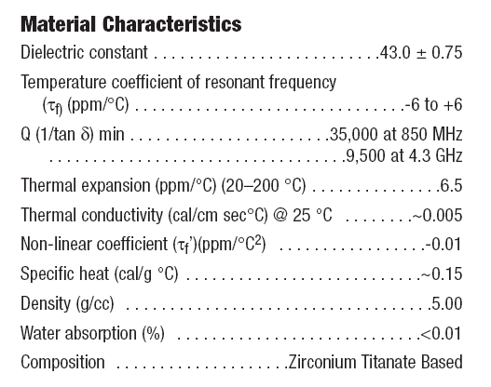
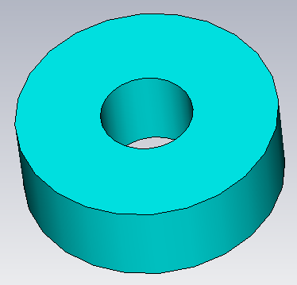

Manufacturer info
τf

Slide 31


Standard cavity: temperature
D = 0.5’’
H = 0.2’’
L = 1.05’’
C = 1.5’’
f0 ≈ 4 GHz

Slide 32
Composite coefficient
Dielectric constant
Cavity
Resonator (dimensions)

Slide 33
Extract τε
Consider:
dielectric const. change
resonator dim. change
cavity dim. change
f0 at amb = 3959.39 MHz
f0 at amb + 60˚ C = function of τεr (change of ε with T)
Change of τεr until the overall quoted τf is obtained

Slide 34
Accuracy
Case | f0 at amb MHz | f0 at amb +60 deg C | τf ppm/deg C | Δf MHz
40 LPW 606,528 | 3953.604 | 3953.658 | 0.23 | 0.054
30 LPW 262,236 | 3956.217 | 3956.277 | 0.25 | 0.06
20 LPW 75,816 | 3962.602 | 3962.675 | 0.31 | 0.073
15 LPW 30,400 | 3972.118 | 3972.207 | 0.37 | 0.089
Used τε = -15.3 ppm/deg C to get to approx τf = 0 ppm/deg C

Slide 35


Conversion
Change τε, calc f0 at
amb & temp, calc τf

Slide 36

Extract τε: check

Slide 37

Drift of the design
Representative cavity vs filter
MWS
f0 @ 0 ˚C = 913.15 MHz
f0 @ 60 ˚C = 913.67 MHz
Sweep τε until design stabilises

Slide 38

Sweep desired τε
Change until f0 @ 0 ˚C and f0 @ 60 ˚C are the same
Work out required τε so dopants can be selected

Slide 39
Convert back to τf in std cavity
MWS
f0 @ amb = 913.15 MHz
f0 @ amb + 60 ˚C = 913.23 MHz
ORDER !

Slide 40


Standard cavity: frequency

Slide 41
Summary
Work out tau_epsilon from specs
Work out expected design drift
Work out required tau_epsilon
Translate to tau_f in standard cavity
Translate to standard cavity frequency
Order
Keep working...

Slide 42

Keep working...
Entire filter,
all parametrised...
Spurious coupling
(coupling sign)
Temperature drift
Verification

Slide 43

Tune and measure
Tuned with the aid of Mesaplexx Filter Design Tool

Slide 44


Tuning
Extract coupling matrix
by comparing to model
Note difference to desired,
change (screws) manually,
5 – 50 times (?)

Slide 45

Accuracy
SPW = 4, MIN = 4
Tetrahedrons: 41,872
Adaptation: None
Accuracy = 1e-4
delta S = 0.01
~ 7 min
SPW = 6, MIN = 6
Tetrahedrons: 156,411
Adaptation: 1 @ 897.7 MHz
Accuracy = 1e-6
delta S = 0.01 (both)
~ 31 min

Slide 46

Drift illustration

Slide 47
Relevance
Turn-around time (+ other suppliers)
Qualification of custom-made ceramics
  Q, εr, τε (the difficult trio)
  nonlinear coefficients, complex ε
  cryogenic temperatures (contraction!)
Tight specification (GSM channels)
New tuners, dual-mode filters, ...

Slide 48



Unexpected twists
Dielectric supports contribute as well!

Slide 49


Parameter extraction
Extraction of material properties by numerical simulation.

Slide 50
Future work
Power handling in comblines
  Line integral to calculate voltage
Thermal runaway in ceramic filters
  Power handling
Printed filters
Lumped element extraction
More macros

Slide 51
Thank you!

