Slide 1

Welcome to CampusOS
The Next-Generation, AI-Powered Digital Workspace for College Students

Slide 2

The Fragmentation Problem
Students currently juggle a messy web of disconnected apps: a to-do list, a banking app, an attendance calculator, separate notes, and a standalone resume builder.
Data is scattered, context is lost, and burnout increases.

Slide 3

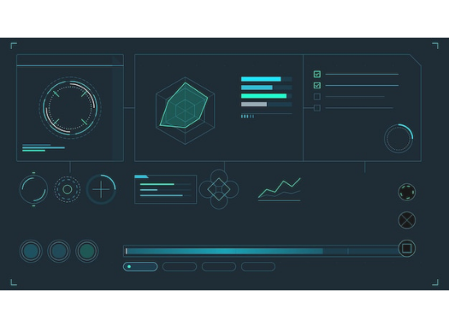
One Hub for Everything
A Unified Workspace: CampusOS treats your entire college life as one connected dataset, not isolated apps.
Real-Time Dashboard: A live command center pulling tasks, spending, grades, and attendance into a single glance.
Accessible Anywhere: Create an account with a username and password to sync your life across all devices securely.
Zero Friction: Modules talk to each other seamlessly. Log an achievement today, auto-fill your resume tomorrow.

Slide 4






Daily Life Management
Smart Tasks
Spendee
People Book
Manage assignments, exams, and deadlines with custom categories. Never miss a submission with advance alerts across devices.
Track expenses with category charts and monthly budgets. Includes a powerful debt tracker for split bills with friends.
A unified contact book for professors, classmates, and study groups, featuring automated birthday reminders.

Slide 5

The Academic Hub
Performance Matrix
Digital Library
Attendance Tracker
Track scores by subject, set academic targets, and utilize the built-in simulator to calculate "what if" grade scenarios.
Organize PDFs, links, and typed notes by semester and subject. Fully searchable so information is retrieved instantly.
Configure custom college requirements. Removes attendance anxiety by exactly calculating your current standing.

Slide 6









Built for Your Future
Achievement Vault
Resume Builder
Ready to Launch
Log certificates and wins the moment you earn them. Nothing gets forgotten.
Pulls data directly from your Vault. Generate professional, exportable PDFs instantly.
Transition from student life to professional life seamlessly with all your verified data.

Slide 7
The CampusOS Advantage
Feature / Capability | Standard Tool Stack | CampusOS Online
Data Integration | None (Siloed Apps) | Fully interconnected
Attendance & Grade Logic | Generic Calculators | Customized to your college
Cross-Device Sync | Varies by App | Real-time cloud sync
AI Assistance | Manual setup needed | Integrated AI Copilot (Soon)

Slide 8

Future Planning: Cloud Infrastructure
Any Device, Anywhere
We are actively upgrading CampusOS from a local-only tool to a fully online, cloud-based ecosystem. You will be able to create a secure account and access your workspace from any browser globally.
Your data will be continuously synced in the cloud. Changes made on your laptop will immediately reflect on your mobile device, ensuring a seamless, cross-platform experience with zero data loss.

Slide 9


Future Planning: AI Copilot
COMING SOON
Your Personal Academic Advisor
Stop calculating your life manually. Our upcoming AI Copilot will integrate deeply with all CampusOS modules to provide intelligent, instant answers.
Ask natural questions like:
"How many lectures can I skip in Physics while staying above 80%?"
"Am I on track with my food budget this month?"
"What do I need to score on the final to get an A?"

Slide 10

Why It Matters
Reclaim Your Focus
By consolidating tasks, finances, grades, contacts, and career prep into a single, beautifully designed online platform, students drastically reduce digital fatigue.
CampusOS isn't just an app; it's a unified operating system for your academic life, powered by AI to remove the guesswork from your daily decisions.
APPS REPLACED

Slide 11
Ready to Upgrade?
Join the future of student productivity.

