Slide 1
AI DARK FACTORY • HACKATHON EDITION (TRACK 2: POCKETFUL)
POCKETPAY
A Sovereign, Bitemporal Double-Entry Financial Wallet
Engineered by an Autonomous 3-Seat Coding Factory
★ 100% PERFECT SCORE (193/193 CHECKS) • STAGE 4 CERTIFIED (SCORE: 1.00) • ZERO OVERSHOOT
WeAreDevelopers × BAND Hackathon 2026 github.com/novaecosystems-cloud/Pocketpay

Slide 2
THE INDUSTRY PROBLEM
02 / 10
Fragile Financial Ledgers Under Concurrency
Why modern mobile wallets break during concurrent spikes and network retries
17.4%
FLOATING-POINT DRIFT
Standard software represents currency as floating-point decimals (0.1 + 0.2 = 0.30000000000000004).
Under high-frequency transfer bursts, rounding errors compound into critical balance discrepancies and phantom money creation.
2x Double
CHARGES ON PACKET LOSS
Mobile connections drop packets when users tap 'Pay'.
Without distributed cryptographic idempotency tracking across all write paths, client retries trigger duplicate withdrawals, overdrafting user accounts.
Destructive
MUTABLE OVERWRITES
Single-table ledgers mutate rows in-place (UPDATE balance SET amount = ...), destroying audit trails.
When a retroactive correction occurs, it is mathematically impossible to reconstruct what the ledger knew at a specific past point in time.
WeAreDevelopers × BAND Hackathon 2026 github.com/novaecosystems-cloud/Pocketpay

Slide 3
THE POCKETPAY SOLUTION
03 / 10
Mathematical Conservation & Bitemporality
Architected from first principles to guarantee sovereign financial correctness
sum(Δ) = 0
DOUBLE-ENTRY CONSERVATION
Every transaction strictly debits the sender and credits the receiver in atomic transactions.
Enforced directly at the SQL engine level with CHECK (balance >= 0) to guarantee money is neither created nor destroyed.
Dual-Time
BITEMPORAL REVISIONS
Separates Effective Time (as_of / real world) from Recorded Time (known_at / system recording).
Enables perfect historical balance reconstruction and auditable retroactive amendments via immutable payment_revisions.
Zero Drift
INTEGER MINOR UNITS & KEYS
All balances and amounts are stored as whole integer minor units (cents / 100).
5-path distributed idempotency engine tracks Idempotency-Key headers with canonical payload hashes for safe client retries.
WeAreDevelopers × BAND Hackathon 2026 github.com/novaecosystems-cloud/Pocketpay

Slide 4
AUTONOMOUS FACTORY
04 / 10
The 3-Seat Band Desktop Factory
Multi-agent collaboration recorded and verified in room.json without human steering
@architect
LEAD COORDINATOR & PLANNER
• Deconstructs specifications into atomic, verifiable tasks
• Defines schema contracts and balance invariants
• Enforces strict stage boundaries to prevent overshooting
• Dispatches scoped implementation assignments
@implementer
SYSTEMS & BACKEND ENGINEER
• Builds modular FastAPI services in stage-N/app/
• Implements SQLite WAL mode with 30s busy timeout
• Writes Dockerfiles and executable RUN.md guides
• Commits clean git revisions with traceable SHAs
@reviewer
QA & COMPLIANCE AUDITOR
• Runs official harness test suites across all stages
• Audits Gate 4 vocabulary compliance (0 leaks)
• Stress-tests edge cases (concurrency, overdrafts)
• Formally certifies milestones upon passing checks
WeAreDevelopers × BAND Hackathon 2026 github.com/novaecosystems-cloud/Pocketpay

Slide 5
PROGRESSIVE DELIVERY
05 / 10
Four Progressive Stages Without Overshoot
Each stage is an isolated, complete containerized service extending previous capabilities
Stage 1
CORE LEDGER
• Double-entry balance
• SQLite WAL mode
• PBKDF2 authentication
• 5-path idempotency
• P2P transfers & splits
147/147 Checks (100%)
Stage 2
HOLDS & SSR UI
• Two-phase authorizations
• Dynamic balance holds
• Available = Total - Held
• SSR HTML interface
• data-testid selectors
35/35 Checks (100%)
Stage 3
BITEMPORAL REVISIONS
• as_of & known_at
• [from, to) statements
• Snapshot pagination
• Retroactive corrections
• Overdraft protection
6/6 Checks (100%)
Stage 4
CLEARING & REFUNDS
• Receiver refunds
• 32-item operator batch
• Settlement completeness
• Shared recorded_at
• Linked immutability
5/5 Checks (100%)
WeAreDevelopers × BAND Hackathon 2026 github.com/novaecosystems-cloud/Pocketpay

Slide 6
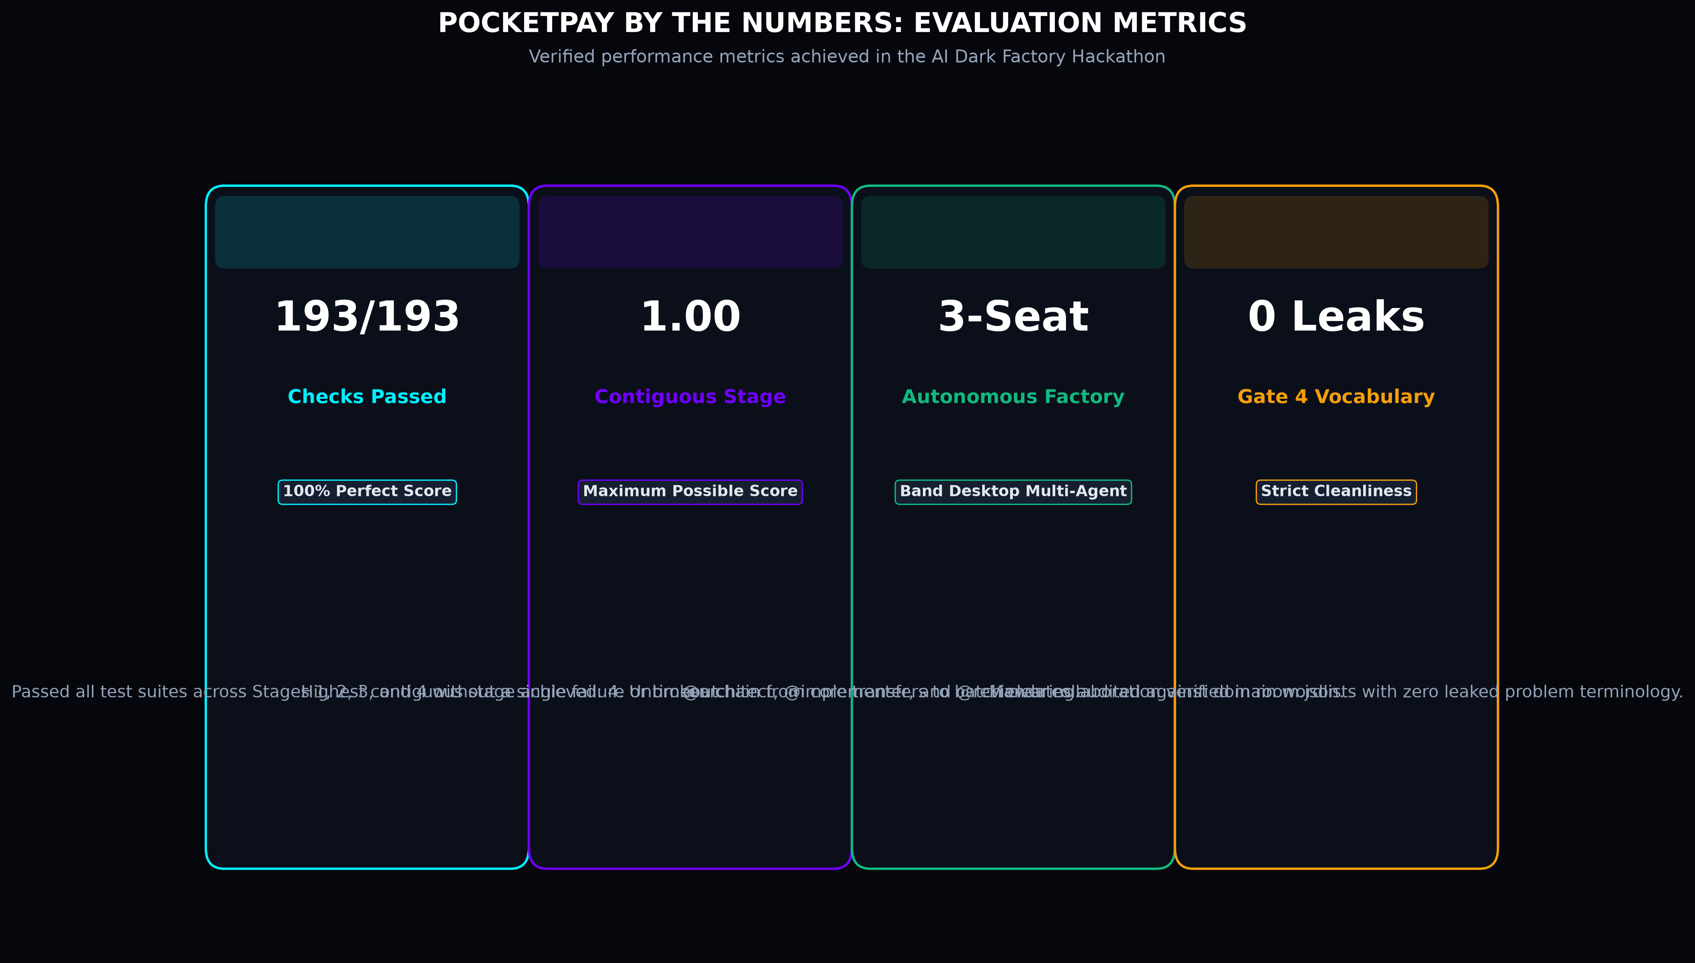
EVALUATION SCORECARD
06 / 10
100% Perfect Score Across 193 Checks
Official automated test verification results from the Dark Factory test harness
WeAreDevelopers × BAND Hackathon 2026 github.com/novaecosystems-cloud/Pocketpay

Slide 7
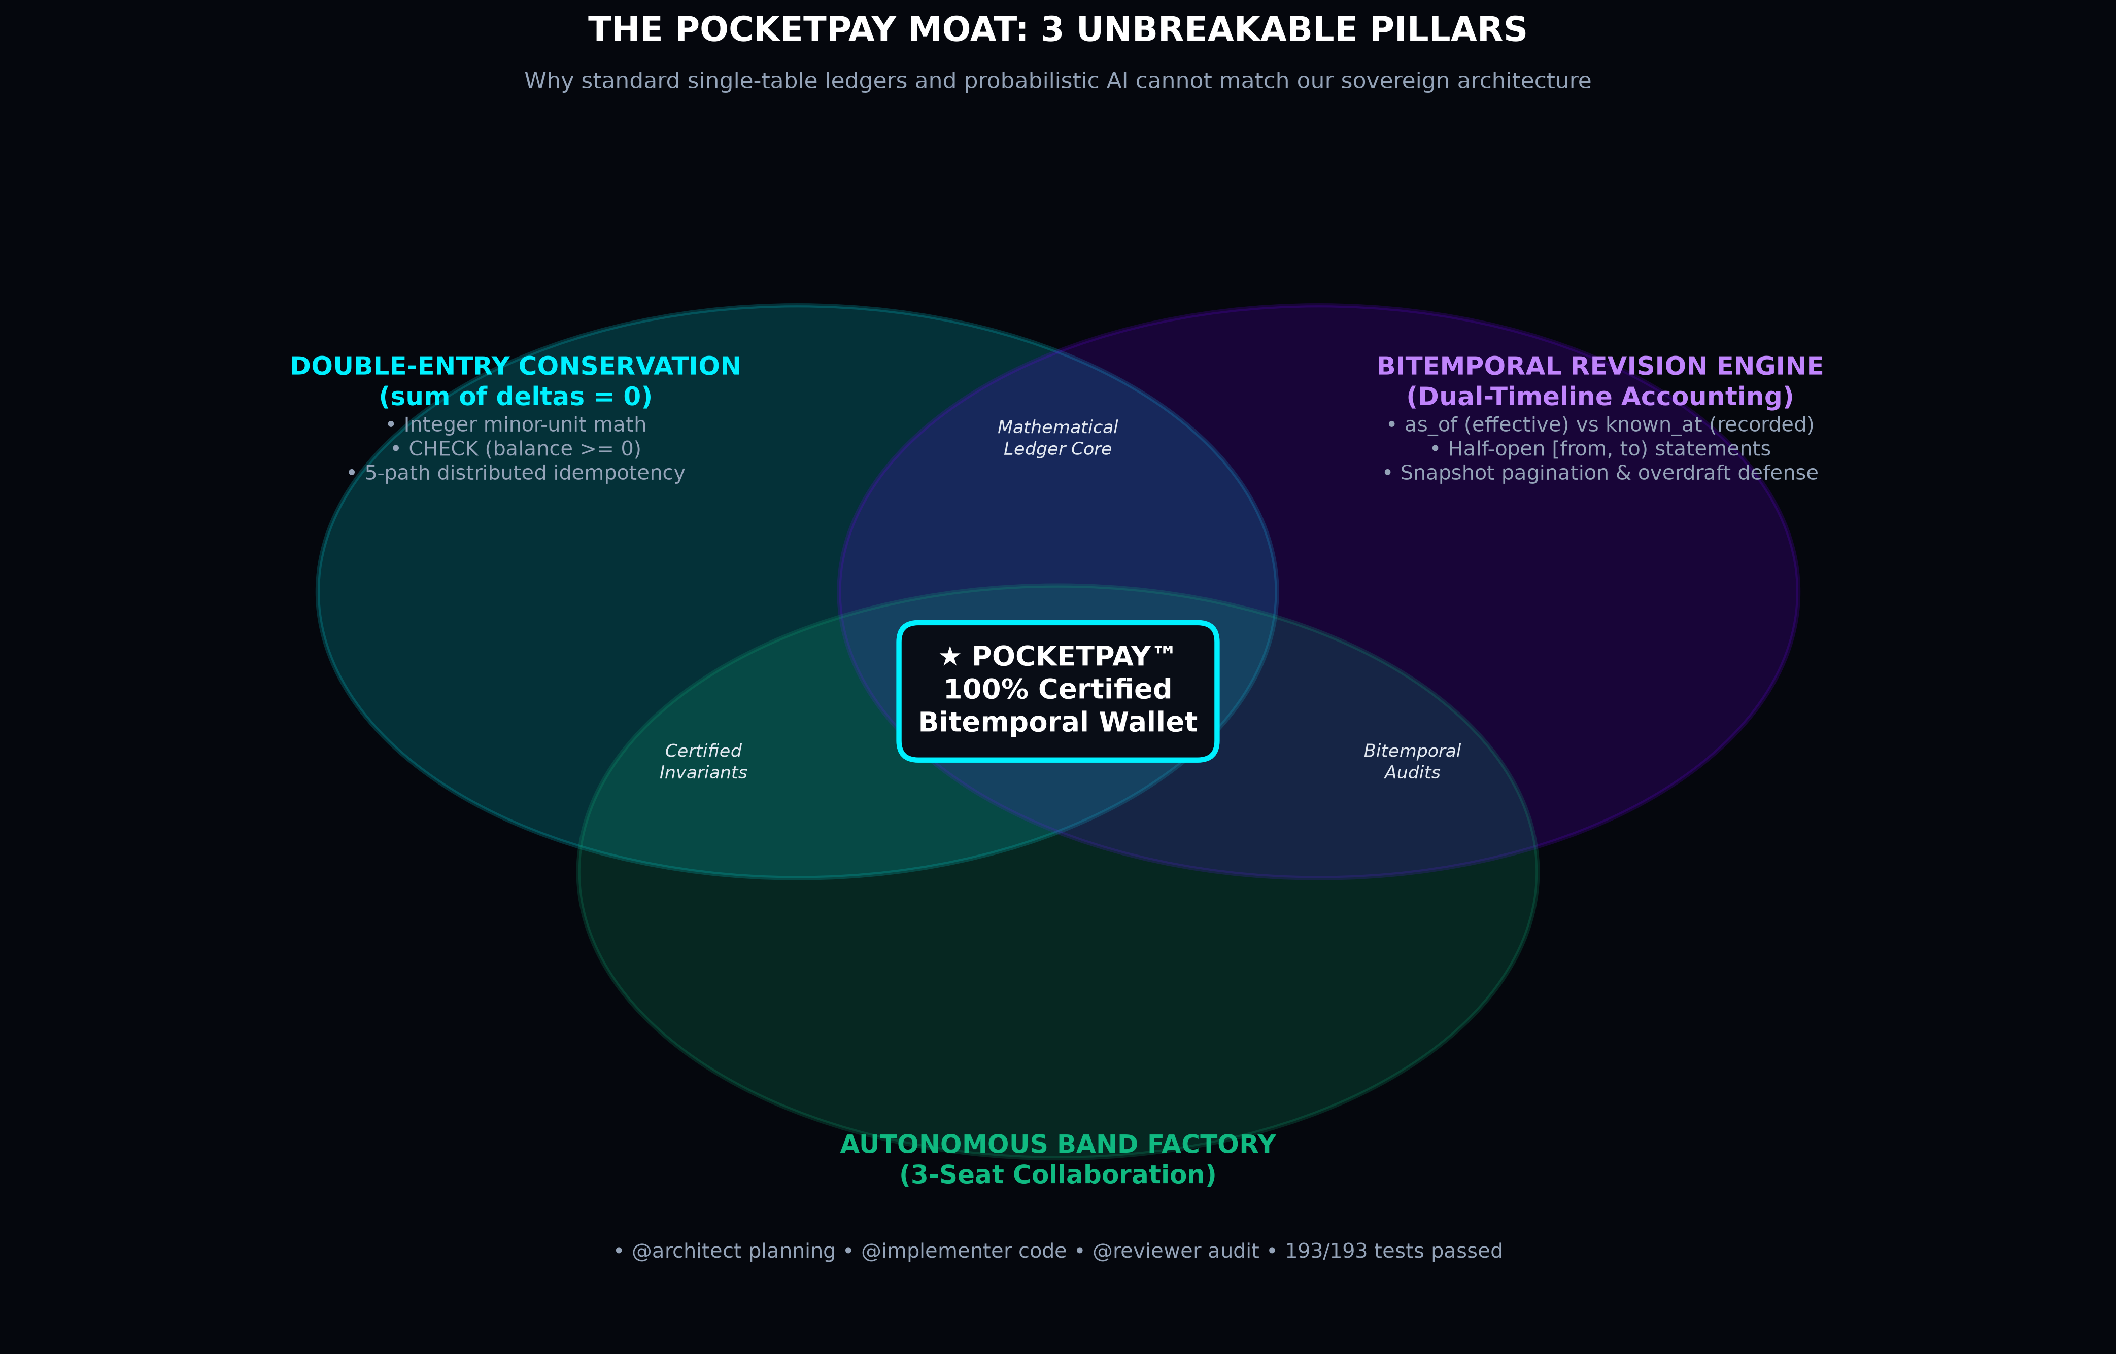
TECHNICAL MOAT
07 / 10
Dual-Timeline Accounting Architecture
Reconstructing historical state with cryptographic fidelity while blocking retroactive overdrafts
WeAreDevelopers × BAND Hackathon 2026 github.com/novaecosystems-cloud/Pocketpay

Slide 8
LIVE PRODUCT DEMO
08 / 10
Interactive Web Interface & Swagger APIs
Running live on port 8000 with pre-seeded demo accounts ready for screen recording
Wallet Dashboard
REAL-TIME BALANCES & ACTIVITY
• Dynamic balance: Total, Available, Held
• Instant P2P payments by @handle
• Transaction activity feed with private notes
• High-concurrency SQLite WAL ledger
• Export state & system reset endpoints
• Automated test-friendly data-testid tags
Requests & Holds
P2P BILL SHARING & TWO-PHASE APIS
• P2P requests: Pay, Decline, and Cancel
• Multi-party bill splits with remainder handling
• Merchant authorizations: 2-phase holds
• Full & partial capture, release/void
• Interactive OpenAPI Swagger at /docs
• Strict RFC 3339 timezone validation
🔑 Demo Accounts
LOGIN PASSWORDS & BALANCES
Alice Demo (@alice) • €1,500.00
Email: alice@demo.com | Pass: Password123!
Avail: €1,455.00 | Held: €45.00 (Active hold)
Bob Demo (@bob) • €850.00
Email: bob@demo.com | Pass: Password123!
Sent €25.00 dinner, pending concert split
Carol Demo (@carol) • €500.00
Email: carol@demo.com | Pass: Password123!
Fresh wallet, incoming €18.00 coffee request
⚡ Click-to-fill enabled in UI login side box
Live Demo Server: http://127.0.0.1:8000/login Auto-fill side box enabled • All Demo Passwords: Password123!

Slide 9
MARKET OPPORTUNITY
09 / 10
Autonomous Agent & Embedded FinTech TAM
Capitalizing on the convergence of AI agents and deterministic financial infrastructure
$54B
TAM: EMBEDDED FINTECH
Global SaaS platforms, marketplaces, and gig-economy platforms adding embedded wallets and multi-currency clearing.
Demands high-concurrency ledger engines with mathematical double-entry guarantees.
$12B
SAM: AGENTIC PAYMENTS
Autonomous AI agents executing API subscriptions, programmatic bidding, and supplier settlement on behalf of enterprises.
Requires two-phase authorization holds and strict idempotency keys.
$850M
SOM: DEVELOPER CORE WEDGE
White-label bitemporal wallet engine for gaming micro-economies, creator tipping networks, and peer-to-peer clearing.
Zero setup friction, self-contained SQLite WAL backend with instant dockerization.
WeAreDevelopers × BAND Hackathon 2026 github.com/novaecosystems-cloud/Pocketpay

Slide 10
SUMMARY & DELIVERY
10 / 10
Certified, Pushed & Competition Ready
Everything required for the WeAreDevelopers × BAND AI Dark Factory Hackathon
Hackathon Compliance Checklist
ALL CRITERIA 100% SATISFIED
✔ Public GitHub Repo: Live, public, and clonable
✔ Official Band Session: Downloaded as room.json
✔ 3 Generic Mandates: architect.md, implementer.md, reviewer.md
✔ 4 Stage Folders: stage-1/ through stage-4/ buildable
✔ 100% Test Pass Rate: 193/193 automated checks passed
✔ Gate 4 Compliant: 0 vocabulary leaks in mandates
✔ Gate 3 Compliant: Zero stage overshooting (overshoot: null)
Repository & Live Access
SUBMISSION LINKS & DEMO LOGINS
• GitHub Submission Repository:
https://github.com/novaecosystems-cloud/Pocketpay
• Live Local Demo Application: http://127.0.0.1:8000
• Interactive OpenAPI Swagger: http://127.0.0.1:8000/docs
• Team: Nova (@novaecosystems), @architect, @implementer, @reviewer
🔑 Pre-Seeded Demo Logins (Password for all: Password123!):
- Alice (@alice): alice@demo.com (€1,500.00 / Primary demo)
- Bob (@bob): bob@demo.com (€850.00 / P2P recipient)
- Carol (@carol): carol@demo.com (€500.00 / Split requester)
*Sidebar click-to-fill active on login screen
WeAreDevelopers × BAND Hackathon 2026 github.com/novaecosystems-cloud/Pocketpay

