Slide 1
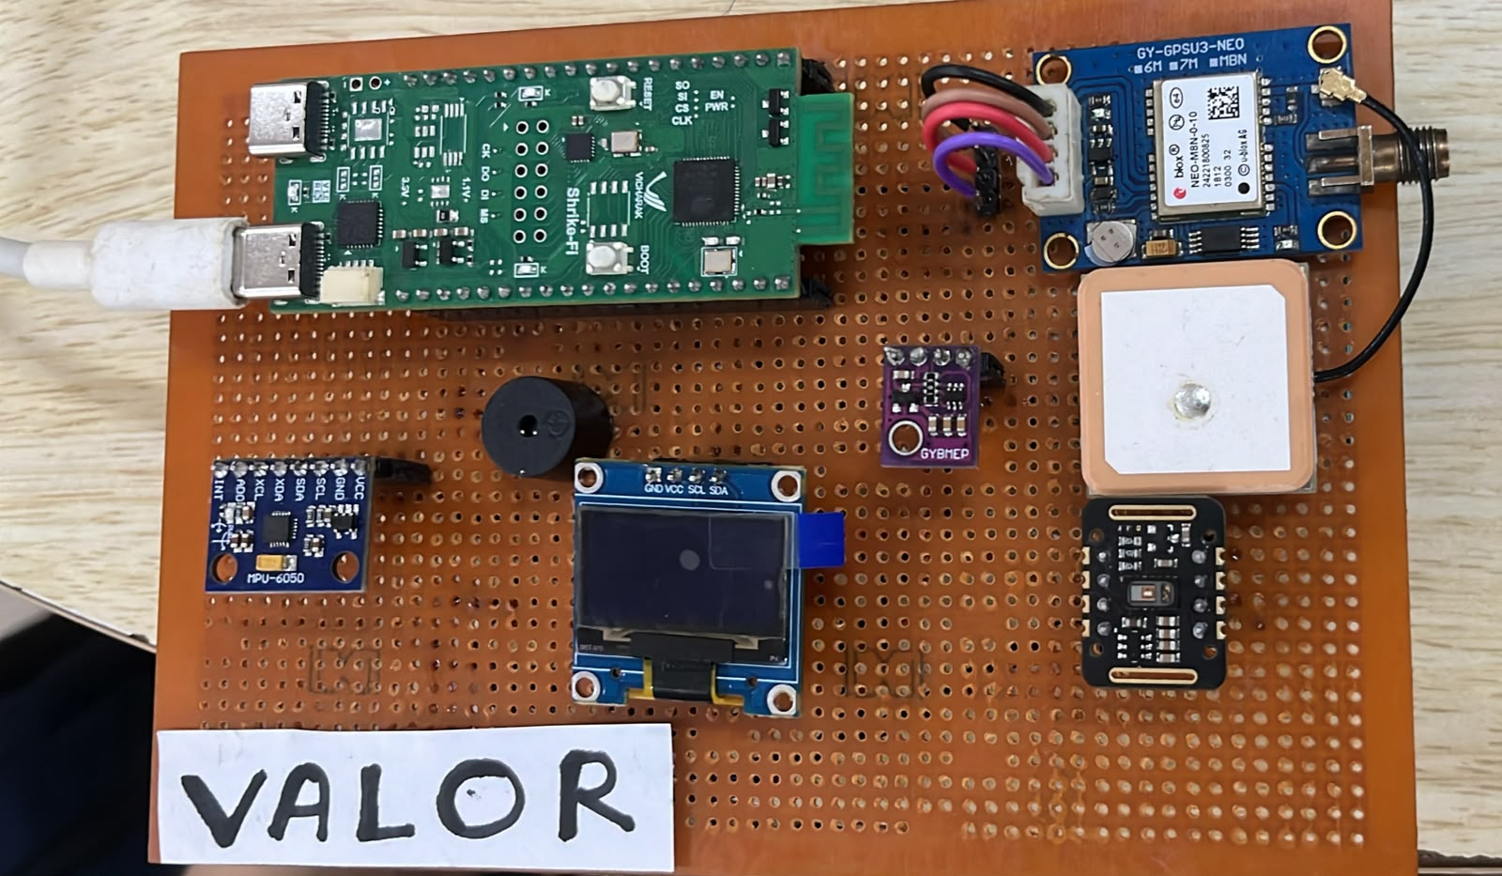
SIH26181 TEAM CHIPSTERS MEDTECH TRACK
VALOR
Vital and Atmospheric Logic
for Offline Rescue
A local health and exposure monitor
for disaster response
ShrikeFi prototype board
Current bench build
FIRST-ROUND HACKATHON SUBMISSION
Notes:
Project name, team, track and identifier follow the provided VALOR Explainer Deck. Prototype photo: docs/images/hardware/valor_zeropcb.jpeg. The image shows the current bench board, not a finished wearable enclosure.

Slide 2
Vitals need exposure context
A person's pulse sits inside a changing environment. VALOR combines both views on the device for a local first-pass assessment.
PERSON
Heart rate, SpO₂, beat intervals, breathing estimate
LOCAL TRIAGE
LOCAL OUTPUTS
Signal checks
Clinical rules
Hazard rules
OLED, LED, buzzer
and a nearby phone page
SURROUNDINGS
Ambient heat and humidity, PM₂.₅, pressure trend, motion
The first-pass sensing and decision path does not depend on an internet connection.
Notes:
System intent and local processing are described in docs/MASTER_PROJECT_GUIDE.md and docs/SHRIKEFI_LINK_PROTOCOL.md. The diagram is an editable summary of local sensor fusion and outputs.

Slide 3
System architecture
SENSORS
LOCAL OUTPUTS
MAX30102
128 × 64 OLED
Red and IR optical PPG
ESP32-S3
Vitals and alert state
BME280
Ambient temperature, RH, pressure
Core 0 PPG capture and pulse analytics
Core 1 clinical and hazard assessment
FreeRTOS tasks share local device state
LED and buzzer
At-device alert cues
PMS5003
Particulate matter, UART
ESP32 SoftAP
MPU6050
Phone status page and history
Motion and fall cues
USB serial
GNSS
Detailed desktop dashboard
Outdoor position
ForgeFPGA SLG47910
50 MHz filter and beat timer
8-bit mode-0 SPI
Sensor buses: I²C / UART. FPGA link: 8-bit mode-0 SPI.
Notes:
Source: docs/SHRIKEFI_LINK_PROTOCOL.md, docs/SHRIKEFI_HARDWARE_CONNECTIONS.md, and firmware/shrikefi/main_shrikefi.c. The MCU samples MAX30102 data, sends the IR path to ForgeFPGA over mode-0 SPI, and receives beat/IBI data. Red/IR ratio processing for SpO₂ stays on the MCU. The dashboard interfaces are distinct: a compact local SoftAP page and a richer USB serial desktop page.

Slide 4
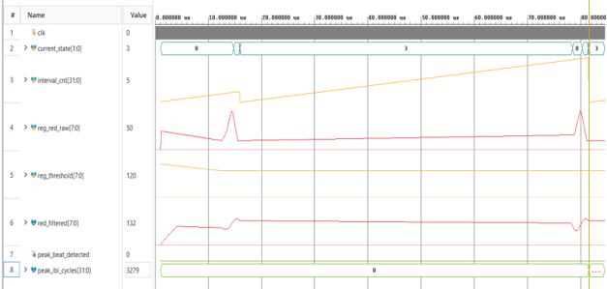
FPGA beat timing
IR sample
8-tap average
Peak detector
IBI capture
SPI return
MAX30102 via ESP32
Running-sum filter
Crest rule, 250 ms refractory
32-bit count at 50 MHz
0xC3 plus 32-bit interval
RTL simulation trace
20 ns
Counter tick at 50 MHz. This is timer resolution, not beat accuracy.
Red optical samples stay on the ESP32-S3 for SpO₂ ratio processing. Firmware checks IBI plausibility before publishing pulse metrics.
Notes:
Source: hardware/shrikefi/forgefpga_ppg_top.v, hardware/common/moving_average_8tap.v, hardware/common/ppg_peak_detector.v, and docs/SHRIKEFI_LINK_PROTOCOL.md. The waveform is an RTL simulation image (docs/images/forgefpga_waveform.png), not a human measurement. The 50 MHz counter has a 20 ns tick; firmware validates intervals and signal quality before publication.

Slide 5
Rules and TinyML in the risk path
The model is an advisory path. Deterministic rules retain the hard safety thresholds.
DETERMINISTIC RULES
ON-DEVICE SIGNALS
mNEWS2 subset for HR, SpO₂ and RR
Environmental thresholds and fall logic
Hard overrides
Person
FUSED TRIAGE
HR, SpO₂, RR, RMSSD
Clinical and hazard outputs
combined locally. The model may
raise an environmental tier.
Exposure
TINYML ADVISORY
Ambient temperature and RH, PM₂.₅, pressure trend, motion
Layer sizes 6-24-16-3
619 bytes of INT8 weights
88.39% synthetic-teacher agreement
BME280 temperature is ambient, not body temperature. Teacher agreement on synthetic data is not clinical accuracy.
Notes:
Source: firmware/core/clinical_vitals_engine.c, firmware/core/disaster_risk_engine.c, firmware/core/nn_risk_model_int8.h, and docs/reports/AI_MODEL_AUDIT_2026-10-20.md. The deployed INT8 model has 619 bytes of parameter storage and 88.39% agreement with its synthetic rule teacher on a held-out synthetic validation set. This is not clinical performance. The device does not have a fitted body-temperature sensor; BME280 measures ambient air.

Slide 6
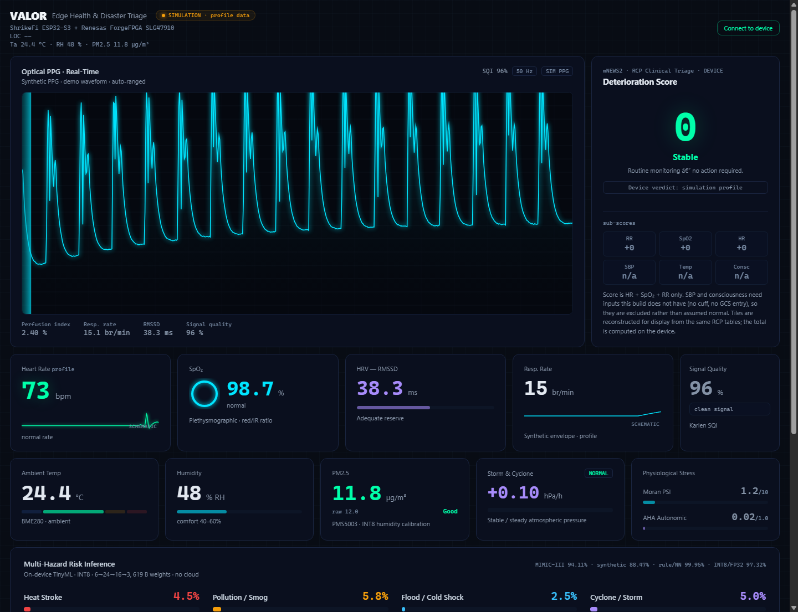
Offline access on the ESP32-S3
ON THE DEVICE
OLED, LED and buzzer provide local alert cues.
PHONE NEARBY
ESP32 SoftAP serves a compact status page and history.
DESKTOP VIEW
A richer dashboard can connect over USB serial.
NETWORK PATH
No cloud or external CDN is required for local status.
Desktop dashboard preview. This screenshot uses a simulation profile.
Notes:
Source: firmware/shrikefi/web_status.c, firmware/shrikefi/dashboard/README.md, and docs/DEMO_RUNBOOK.md. The phone SoftAP page is embedded in firmware and served locally; the richer dashboard screenshot is the separate USB Web Serial page and is explicitly in simulation mode. The SoftAP is open and lacks authentication; the final slide records that field-use boundary.

Slide 7
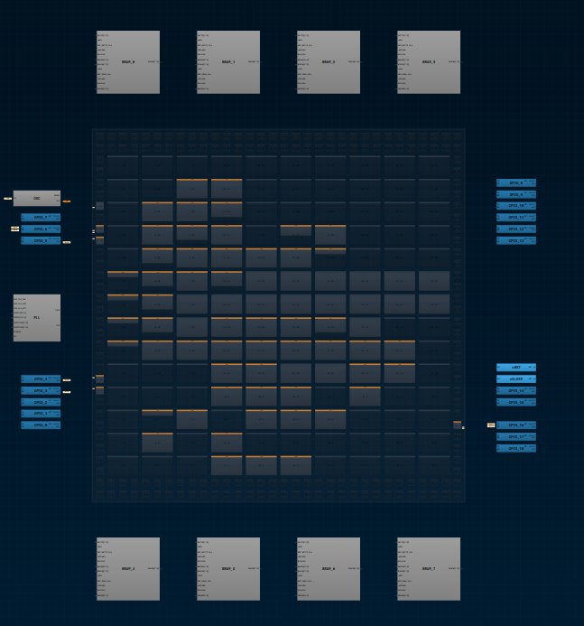
Measured implementation evidence
ACTIVE BUILD · RENESAS FORGEFPGA
515 / 1,120
LUT5 resources in the current fitter report
303 flip-flops; 105 of 140 CLBs used
WNS +7.316 ns at 50 MHz; TNS = 0
Reported achievable frequency: 78.85 MHz
PRESERVED REFERENCE · XILINX ZYNQ-7000
185 LUT, 16 LUTRAM, 266 FF, 0 DSP48, 0 BRAM
ForgeFPGA placement view
WNS +5.603 ns · WHS +0.184 ns · Fmax 69.45 MHz · 6/6 tests
Separate devices and tool flows; utilization figures are not directly comparable.
Notes:
Current ForgeFPGA values: hardware/shrikefi/synthesis_evidence/resource_utilization_spi_link.log and timing_summary_spi_link_50mhz.log (post-route, 50 MHz constraint). Zynq numbers and 6/6 tests: repository AGENTS.md verified baseline and hardware/zynq/tb_ppg_system.v. The ForgeFPGA and Zynq figures describe separate targets and must not be combined or compared as if they used the same LUT architecture.

Slide 8
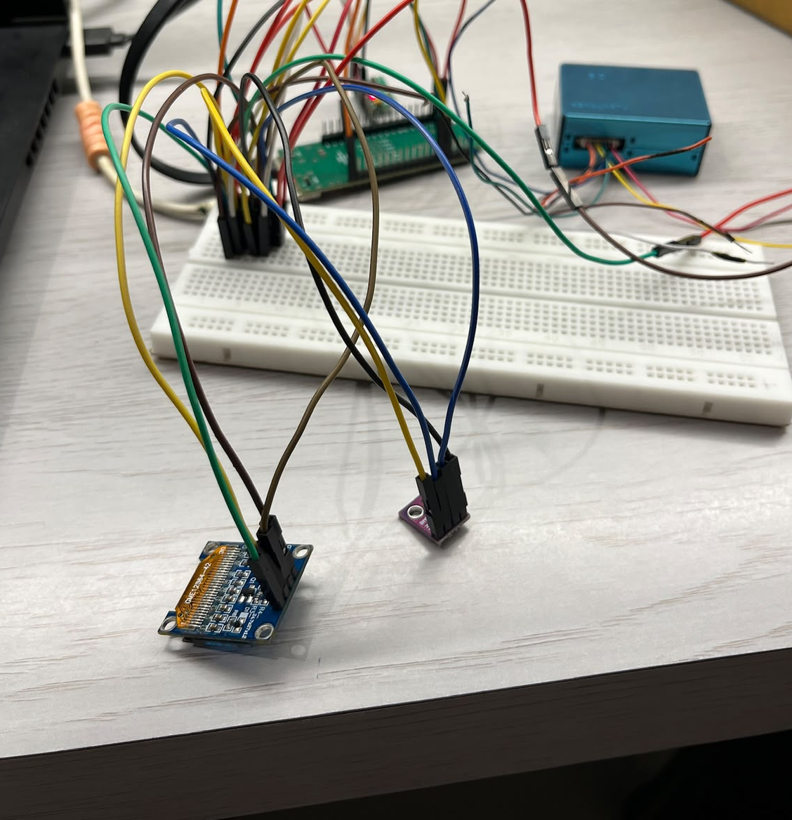
Prototype status and validation gaps
CURRENT BUILD
ESP32-S3 and ForgeFPGA with optical PPG, environmental sensors, motion sensing, GNSS and OLED.
VALIDATION BOUNDARIES
This is an engineering prototype. The BME280 measures ambient air; body temperature is not instrumented. The model was compared with a synthetic teacher, not clinical outcomes.
NEXT ENGINEERING WORK
Build and test an enclosure, validate sensors and power under field conditions, and add access control before exposing sensitive data over the open SoftAP.
Bench prototype shown
Notes:
Source: docs/DEMO_RUNBOOK.md, firmware/shrikefi/dashboard/README.md, firmware/core/skin_estimate.c, and the current sensor path. The prototype photo is docs/images/hardware/valor_breadboard.jpeg. The embedded SoftAP is open and unauthenticated. Body temperature is not instrumented by the current clinical scoring path; the BME280 reports ambient air. No clinical efficacy or human-subject validation claim is made.

