Slide 1
VALOR
SMART INDIA HACKATHON 2026 · SIH26181 · MEDTECH AND ASSISTIVE WEARABLE
Vital and Atmospheric Logic for Offline Rescue
An FPGA-accelerated health companion and disaster monitor that keeps working when the network does not.
ESP32-S3 + ForgeFPGA
Fully offline
Early warning, not diagnosis

Slide 2



When networks fail, wearables go silent
Disasters cut the cloud
Body and environment are split
Noisy pulse signals cause false alarms
Towers and internet fail in floods, cyclones and quakes. Consumer wearables rely on a phone or cloud, so they go quiet when people need them most.
Heat, smoke and storms make a person's condition worse, yet health apps and weather tools are separate products that never read each other.
Motion artifacts corrupt pulse signals. A rescue tool must gate bad data and delay escalation, or people stop trusting it.
VALOR is built for the case where nothing is connected: it fuses body and environment signals on the wrist, runs everything on the device, and warns early.

Slide 3



VALOR: one wrist device, fully offline
Sense the body and the air, decide on the device, alert the wearer and the rescuer.
SENSE
DECIDE
ALERT
Pulse and SpO₂ (MAX30102)
Temperature, humidity, pressure (BME280)
Dust and smoke (PMS5003)
Motion and falls (MPU6050)
Position (GNSS module)
FPGA beat detection in hardware
619-byte INT8 neural network
mNEWS2 and hazard rules
Hard rules always override the network
OLED emergency card
Buzzer and FPGA-driven heartbeat LED
Offline Wi-Fi dashboard for rescuers
10 s cancel window against false alarms

Slide 4
System architecture: two brains, one wearable
MAX30102
I2C
ESP32-S3 · FreeRTOS
ForgeFPGA SLG47910V
Pulse PPG · die temperature
50 MHz fixed clock · pure logic
Core 0 · priority 5
100 Hz sensor read
SPI to FPGA, interval burst
SpO₂ from red / IR ratio
8-tap moving average
MPU6050
I2C
SPI
Motion · fall detection
1 MHz
Peak detector FSM
BME280
I2C
LED stretcher → blue LED
Temp · humidity · pressure
Core 1 · 1 Hz fusion
Signal quality · HRV · mNEWS2
TinyML risk network
SOS and fall state machines
PM and GNSS parsing
Wi-Fi hotspot and web server
PMS5003 (5 V)
UART
I2C
OLED 128×64
Emergency card
PM1 / PM2.5 / PM10 particles
GPIO
Buzzer
Sounds when SOS is active
GNSS module
UART
Wi-Fi
Wi-Fi dashboard
Satellite position
Offline hotspot · 192.168.4.1

Slide 5
One heartbeat, end to end
1
ESP32
2
ESP32
3
SPI
4
FPGA
Sample
Condition
Send
Detect
MAX30102 captures an IR sample every 10 ms
Core 0 removes the baseline and scales to 8 bits
The sample goes to the FPGA over SPI
FPGA runs the 8-tap filter and the peak detector
5
FPGA
6
SPI
7
ESP32
8
ESP32
Timestamp
Return
Validate
Analyse
On a beat it latches a 32-bit cycle count and pulses the LED for 50 ms
Beat flag and a 5-byte interval burst come back on SPI
Core 0 converts cycles to ms and keeps only 30 to 250 BPM
Core 1 computes HR, HRV, SpO₂, respiration and risk at 1 Hz
IBI (ms) = cycles ÷ 50,000 at 50 MHz, one cycle is 20 ns HR (BPM) = 60,000 ÷ IBI (ms)

Slide 6
Beat detection runs in FPGA hardware
ARMED
RISING
PEAK_FOUND
REFRACTORY
state code 00
state code 01
state code 10
state code 11
Waits for a rising crossing of level 120
Tracks the highest sample (the crest)
One clock: beat flag, latch interval, start timer
Ignores the dicrotic notch for 250 ms
12.5 M cycles (250 ms) pass and a new sample arrives
25%
240 BPM
20 ns
fall below the crest confirms a peak
maximum rate, set by the 250 ms blanking
hardware timestamp resolution at 50 MHz
Registered Moore machine · 2-bit binary encoding · 2-flop synchronizer on SPI inputs · detects a pulse shape, not a bit pattern

Slide 7
On-device AI, overridden by hard rules
Inputs, scaled 0–1
Hidden · 24 neurons
Hidden · 16 neurons
Outputs, 0–1
Heart rate
Heat risk
RMSSD (HRV)
SpO₂
Pollution risk
Temperature
Humidity
Flood / cold-exposure risk
PM2.5
8 of 24 drawn
6 of 16 drawn
overrides
Trained on synthetic data
INT8, 619 bytes of flash
Hard rules always win
Rule-derived vitals, not patients. INT8 matches its teacher at 88.39%.
Float math on dequantized weights. 211 of 619 values carry signal.
SpO₂ ≤ 88%, HR ≥ 150, mNEWS2 ≥ 7 or pressure fall ≤ −2.0 hPa/hr force CRITICAL.

Slide 8

Clinical and disaster rules
Hazard | Signal used | Tiers
Cyclone | Pressure fall rate (180-minute least squares) | ≤ −0.5 moderate · ≤ −1.0 high · ≤ −2.0 critical hPa/hr
Heat | NOAA Rothfusz heat index plus HR and HRV | ≥ 35 caution · 40 moderate · 45 high · 54 critical °C
Smoke | PM2.5 (EPA-corrected) plus SpO₂ and HR | ≥ 35 caution · 75 moderate · 150 high · 300 critical µg/m³
Vitals | mNEWS2 from pulse, SpO₂ and respiration | 0–4 low · 5–6 medium · ≥ 7 high; any single parameter scoring 3 is a red flag
Hybrid safety envelope
Cross-domain guards
Pressure trend, not value
The network gives smooth risk scores. Fixed rules give hard limits that always win.
A heat alert is suppressed in cold air, because the Rothfusz formula only holds in warm, humid conditions.
Absolute pressure depends on altitude. A fast fall signals an approaching storm anywhere.

Slide 9



Emergency response: fall detection and SOS
Fall detection (IMU, 40 Hz)
MONITORING
FREE_FALL
IMPACT
INACTIVITY
CONFIRMED
Normal motion
Acceleration below 0.60 g
Above 2.50 g within 800 ms, rotation ≥ 80°/s
Still for 1.5 s
Arms the 10 s SOS countdown
SOS state machine (ESP32 firmware)
IDLE
ARMED
ACTIVE
CANCELLED
Normal monitoring
15 s timer for vitals, 10 s for a fall
OLED card, buzzer and web banner
Latched so it does not re-trigger
Cancel on purpose
Rescuer dashboard
Honest status
Hold the button for 5 s or tap cancel on the dashboard. A bump cannot cancel a real emergency.
Open hotspot VALOR-xxxx at 192.168.4.1. No router, no app, no internet.
Fall detection is prototype level: 16 unit tests and one bench drop trial.

Slide 10
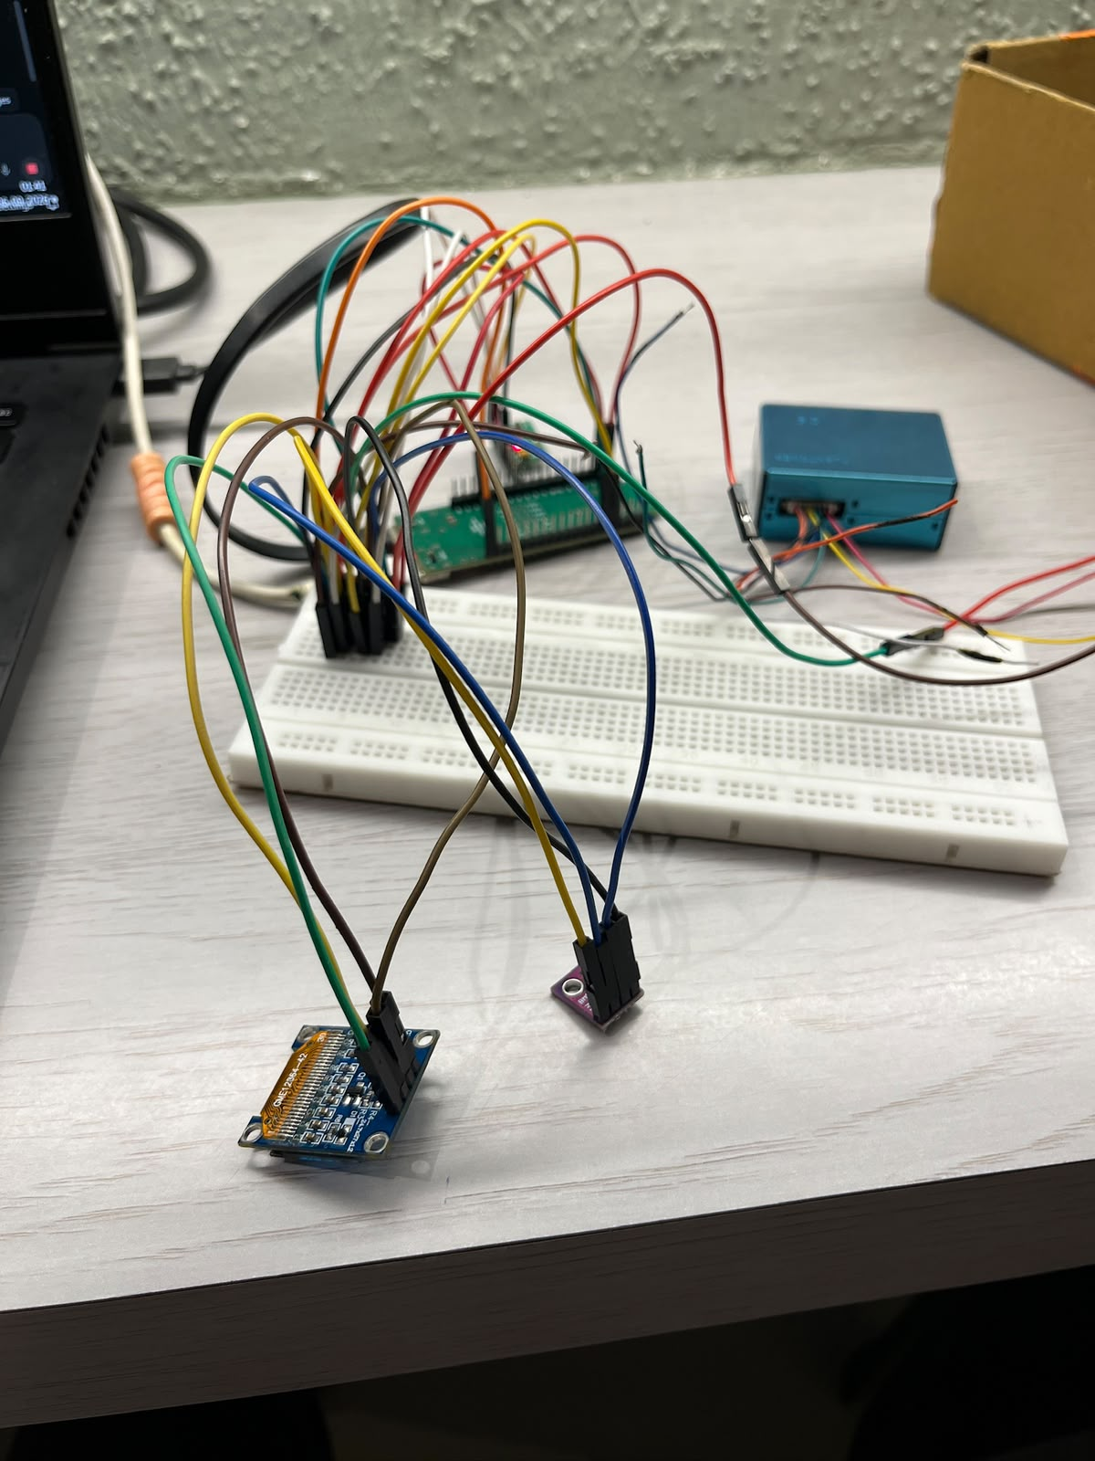
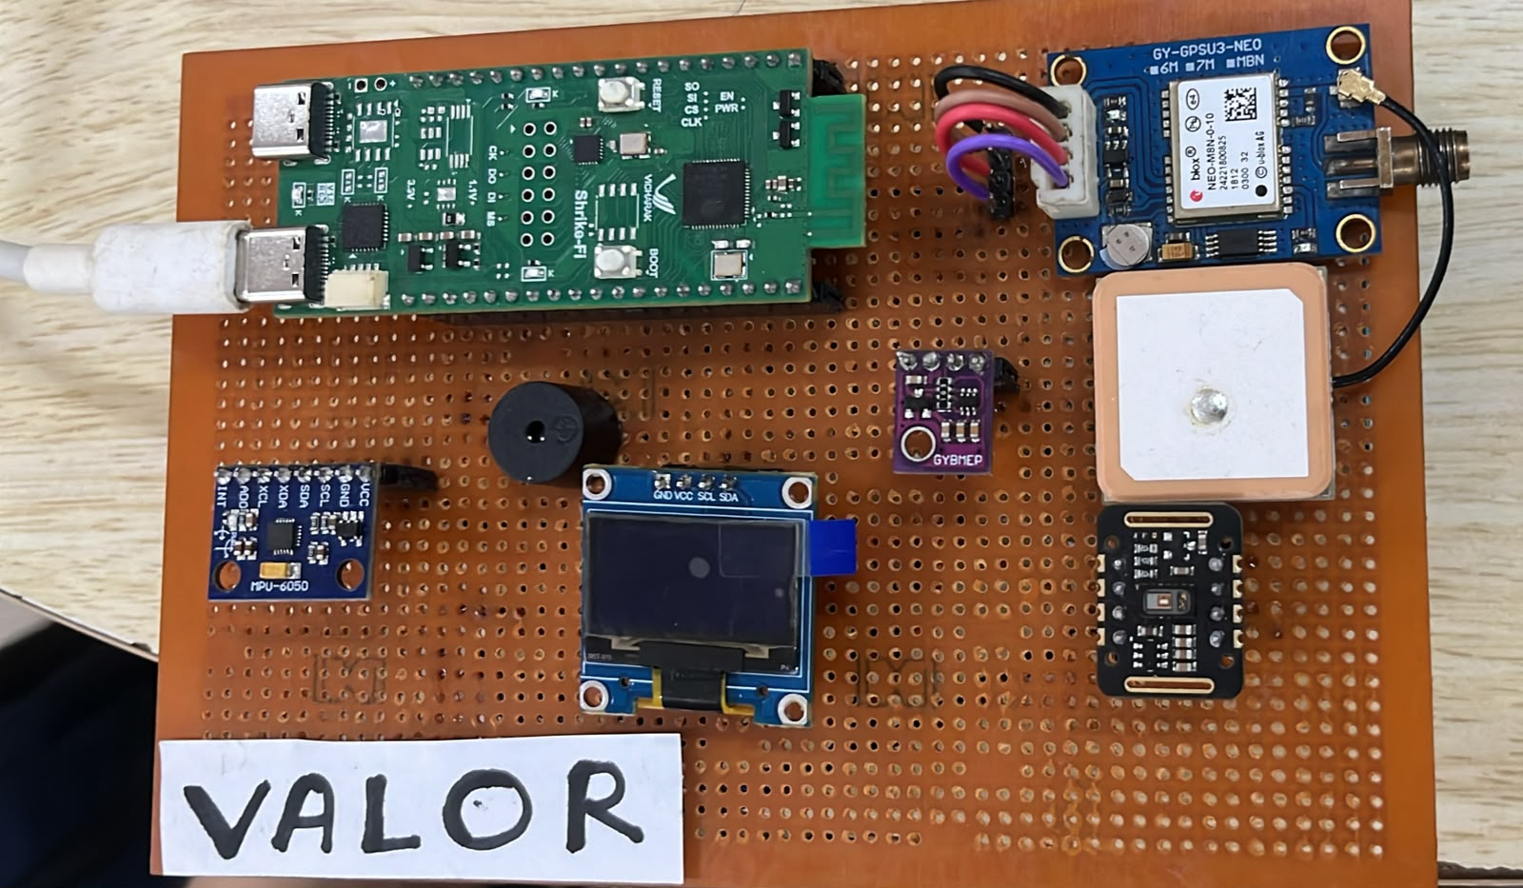
Working prototype
I2C
MAX30102, BME280, MPU6050, OLED
UART
PMS5003 and GNSS at 9600 baud
SPI
ESP32 to FPGA, 1 MHz
Stage 1: breadboard bench build
Stage 2: soldered board with ShrikeFi, GNSS, IMU, OLED, buzzer and sensors

Slide 11
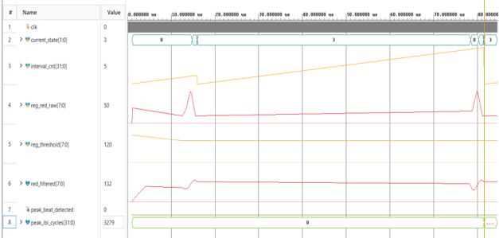
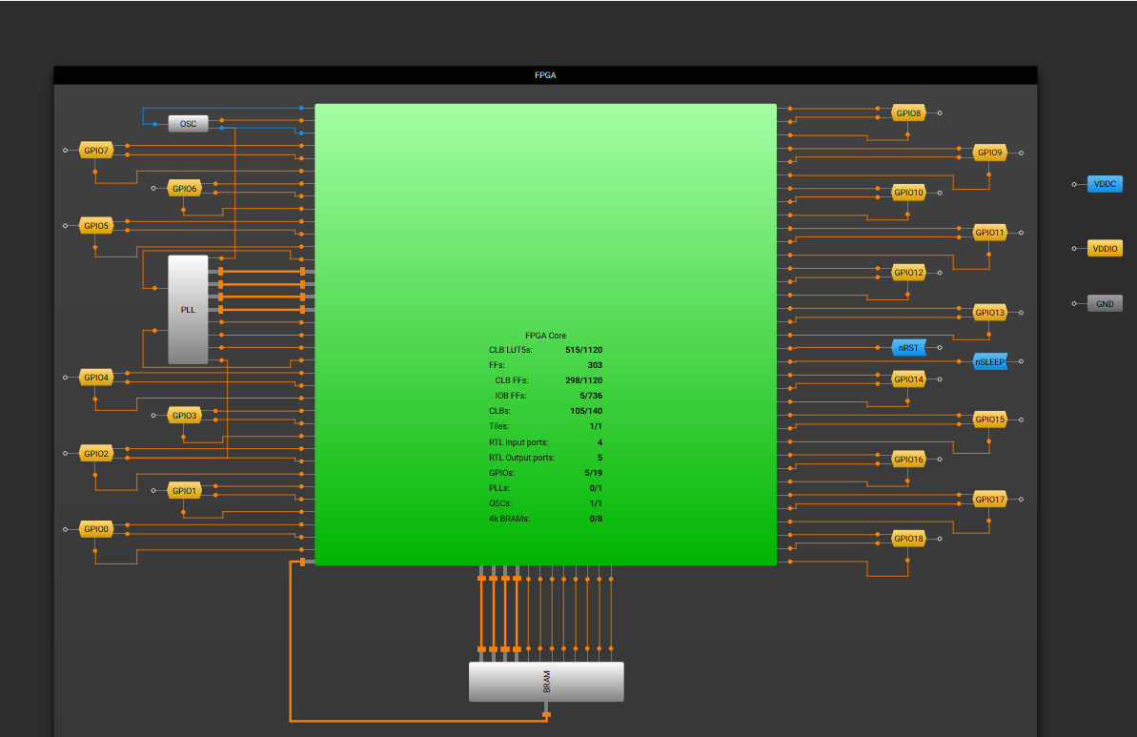
Hardware validation on ForgeFPGA
Compressed-time testbench: two beats 3279 cycles × 20 ns ≈ 66 µs apart. Real beats are about 0.8 s apart.
FPGA core utilisation from the vendor tool: 515 of 1,120 LUT5 and 105 of 140 CLBs.
13 / 13
6 / 6
+7.316 ns
515 LUT5
ShrikeFi self-checking checks pass
Zynq-7000 reference checks pass
worst slack, Fmax 78.85 MHz
105 of 140 CLBs, the real limit

Slide 12
AI benchmark: honest numbers
Synthetic training
The network is distilled from our rule engine on rule-derived vitals, not patients. INT8 agrees with its teacher at 88.39% (FP32 88.47%).
Real ICU benchmark
The MIMIC-III check compares the whole triage pipeline with an algorithmic rule on real heart rate and SpO₂. The HRV column is synthetic.
Why rules always win
Sensitivity is 58.18%: the network misses about 42% of rule-defined critical cases. Deterministic limits override it. VALOR is screening, not diagnosis.

Slide 13
Feasibility and cost
Part | Role | Price
PMS5003 | Dust and smoke (PM1, 2.5, 10) | ₹1,600
NEO-8N | GNSS, satellite position | ₹1,100
ShrikeFi board | ESP32-S3 + ForgeFPGA | ₹900
TMP117 | Skin temp (failed on bench) | ₹400
BME280 | Temp, humidity, pressure | ₹300
OLED 128×64 | Local display | ₹200
MAX30102 | Pulse and SpO₂ sensor | ₹192
MPU6050 | Motion and fall detection | ₹190
Buzzer | SOS alert sound | ₹29
Push button | Cancel input | ₹5
Total |  | ₹4,916
Prototype parts, one of each
₹4,916
ten off-the-shelf parts
Portable design
The same vendor-neutral Verilog runs on a Xilinx Zynq-7000 reference and on the low-cost ForgeFPGA.
Scope
Volume production cost and battery sizing are not costed yet. The prototype is USB-powered.

Slide 14


Impact and roadmap
Rescue teams
Roadmap
Any phone joins the VALOR hotspot and sees vitals and alerts. No router, no app.
Calibrate skin temperature against a reference thermometer
1
2
Retrain the network on field data from wrist devices
People in the hazard
3
Add battery, charging and power management
Early warning for heat, smoke and cyclones, fused with the wearer's own vitals.
4
Reset synchronizer, RISING watchdog and authenticated cancel
Low-cost and portable
5
Multi-trial fall-detection tests
Off-the-shelf parts and vendor-neutral Verilog make it easy to reproduce and scale.
Regulatory path: ISO 13485, IEC 60601-1, clinical trials
6

Slide 15
Research and references
Source | What it provides | How VALOR uses it
Royal College of Physicians, NEWS2 (2017) | UK early-warning score | mNEWS2 from pulse, SpO₂ and respiration; bands 0–4, 5–6, ≥ 7
Karlen et al., Physiological Measurement (2012) | PPG signal quality index | SQI must be ≥ 0.70 before HRV and scores are shown
Rothfusz, NWS Technical Attachment SR 90-23 (1990) | NOAA heat-index regression | Heat tiers, with a cold guard since the formula is valid only when warm and humid
US EPA 24-hour PM2.5 standard; WHO 2021 guideline | Air-quality limits | PM2.5 caution at 35 µg/m³ (EPA standard; WHO guideline is 15)
US EPA / AirGradient PM2.5 correction | Published PMS5003 humidity correction | Replaced our own calibration network; 60 s rolling average with confidence flags
Johnson et al., MIMIC-III, Scientific Data (2016) | Public ICU database | Benchmark of the triage pipeline on 16,387 records
ISO 13485 and IEC 60601-1 | Medical-device standards | Roadmap to a regulated medical-grade product

Slide 16
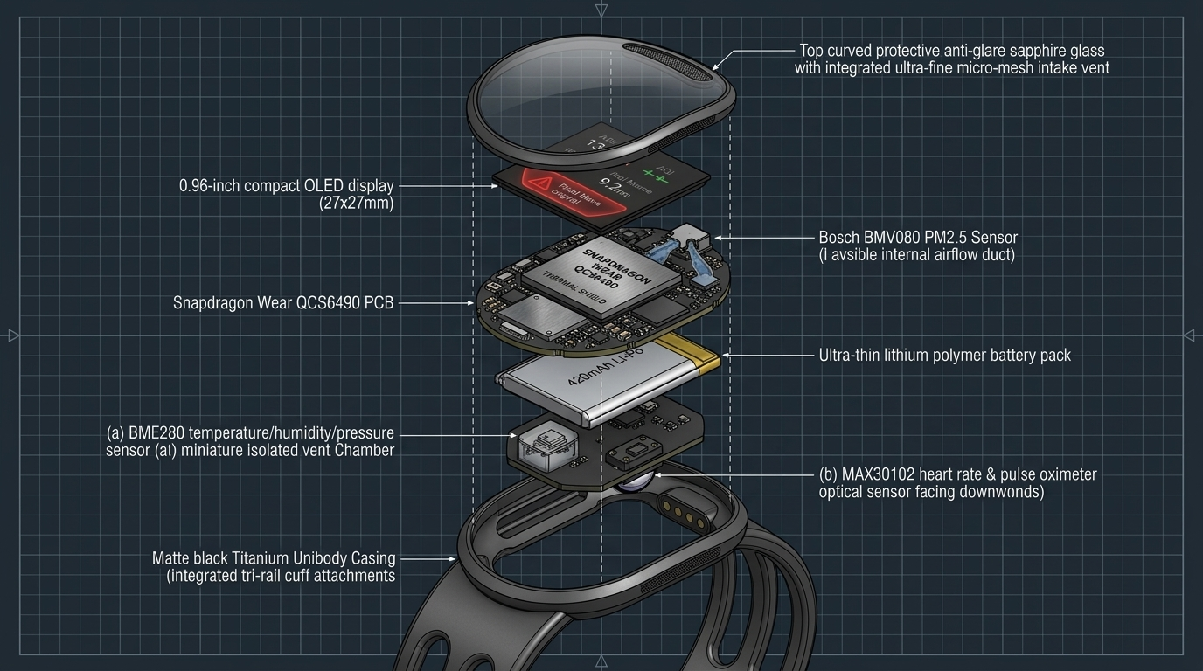



Early warning that works when nothing else does
Offline by design
Own hotspot, own rulebook, own AI
FPGA-timed beat detection
20 ns hardware timestamps, independent of CPU load
Target wrist form factor: concept render, not the built prototype
Rules always win
Deterministic limits over a tiny INT8 network

