Slide 1



SMART INDIA HACKATHON 2026
TITLE PAGE
  Problem Statement ID - 26181
  Problem Statement Title- AI-Powered Personal Health Companion & Edge Disaster Monitor
  Theme- MedTech/BioTech
  PS Category- Hardware
  Team ID- 01
  Team Name - CHIPSTERS

Slide 2
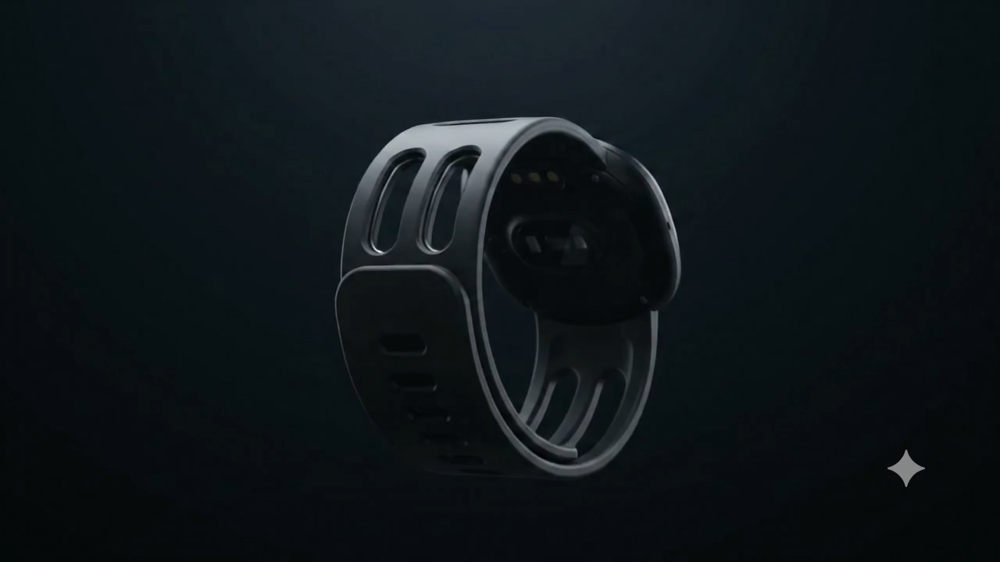
Chipsters
PROBLEM AND SOLUTIONS
❌ The Problem: Why Current Tech Fails in Disasters
Wearables Are Environmentally Blind: Smartwatches only track fitness steps or resting pulse. They have zero awareness if ambient air is toxic (AQI 500+) or if 48°C heat is causing heat exhaustion.
Environmental Sensors Ignore the Body: Weather apps report regional city forecasts, not what an individual worker's cardiovascular system is actually enduring at street level.
Cloud Dependency Trap: Commercial AI health platforms require mobile networks. During severe storms, floods, or grid failures, cell towers collapse and cloud apps die completely.
Software Jitter Destroys HRV: Operating system scheduling delays on standard CPUs jitter by 5-20 ms, severely distorting heart rate variability (HRV) metrics.
✅ The Solution: VALOR→ A Heterogeneous Companion
Biometric & Environmental Fusion: Simultaneously acquires dual-wavelength optical PPG pulses along with hyper-local ambient temperature, humidity, and laser PM2.5 particulate matter on the wrist.
Cycle-Accurate FPGA Silicon: Custom Verilog 8-tap filter and peak-detector FSM runs on 50 MHz hardware with 20 ns resolution, completely bypassing OS scheduling jitter.
Zero-Cloud On-Device TinyML: Deep neural network fits in only 619 bytes of INT8 weights, providing 100% offline continuous triage during infrastructure blackouts.
Early Preventive Warnings: Predicts heat stroke collapse, acute pollution-induced vagal suppression, and cold-water immersion shock 15-20 minutes before medical emergencies.
2
Notes:
2

Slide 3
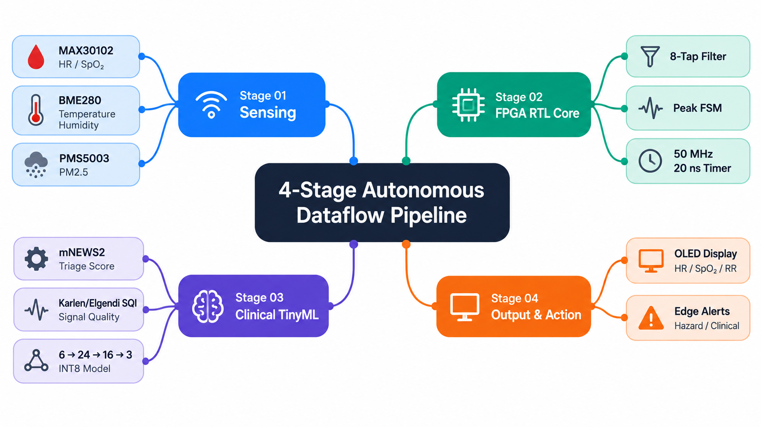
TECHNICAL APPROACH
Chipsters
Notes:
3

Slide 4
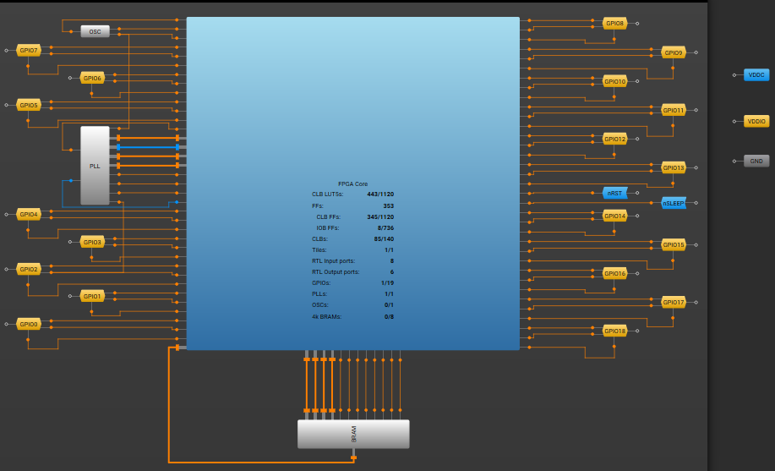
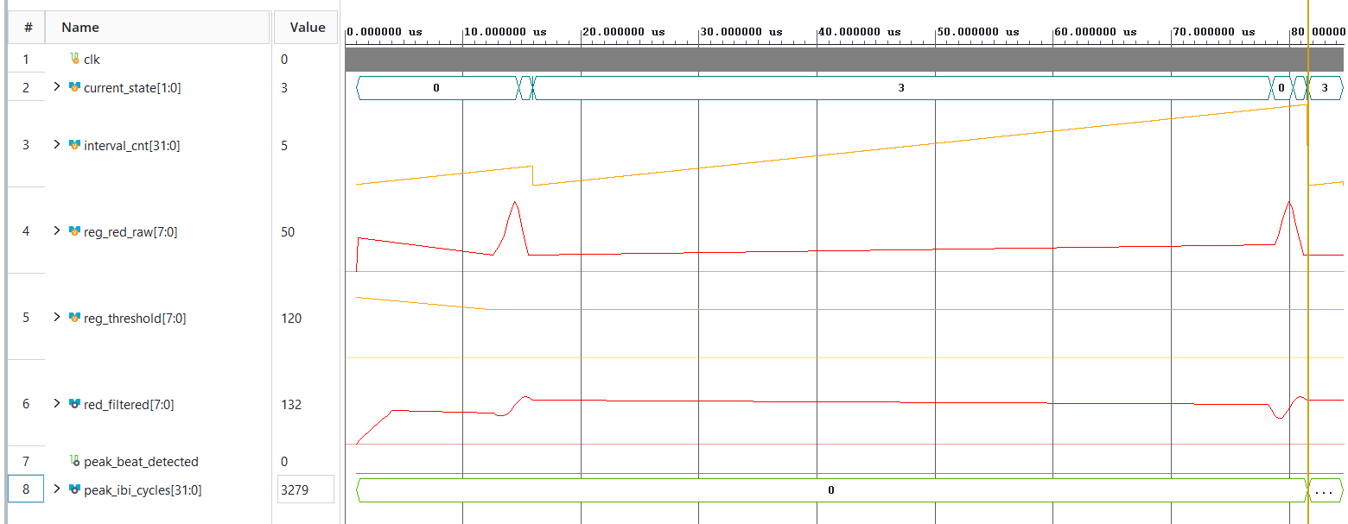
Chipsters
TECHNICAL APPROACH (STAGE-2)
Hardware Synthesis & Resource Utilization (Renesas ForgeFPGA)
Silicon Floorplan and Synthesis Map 0f Renesas forcefpga chip
Waveform of our Project’s core Verilog files

Slide 5

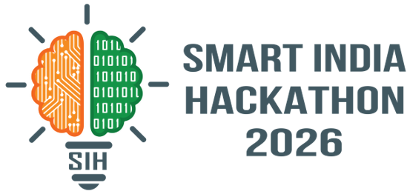

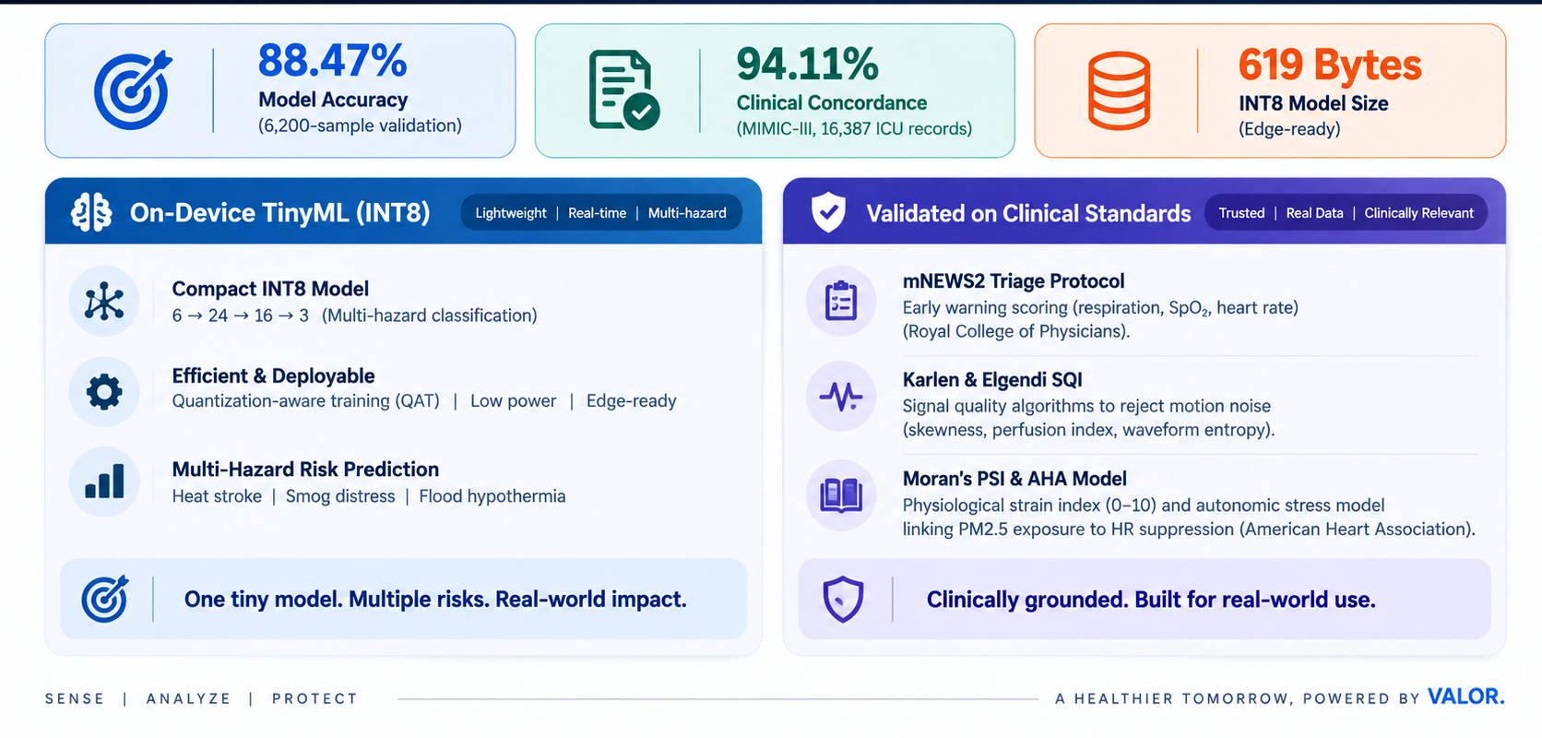
SOFTWARE APPROACH (STAGE-3)
CHIPSTERS

Slide 6
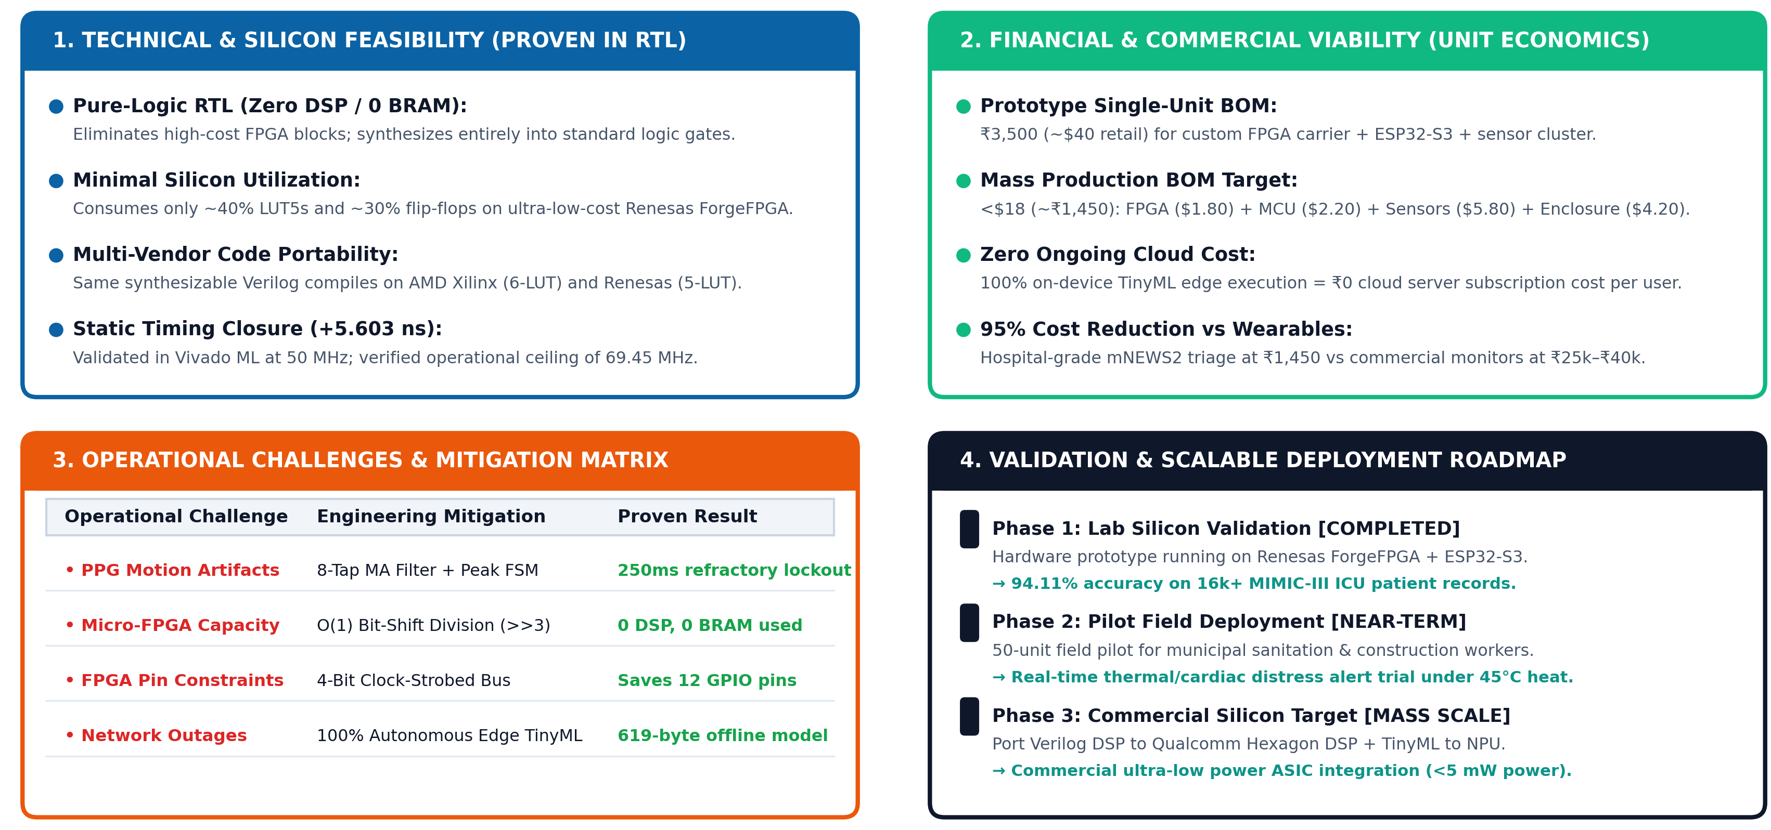
FEASIBILITY AND VIABILITY
Chipsters
Notes:
4

Slide 7
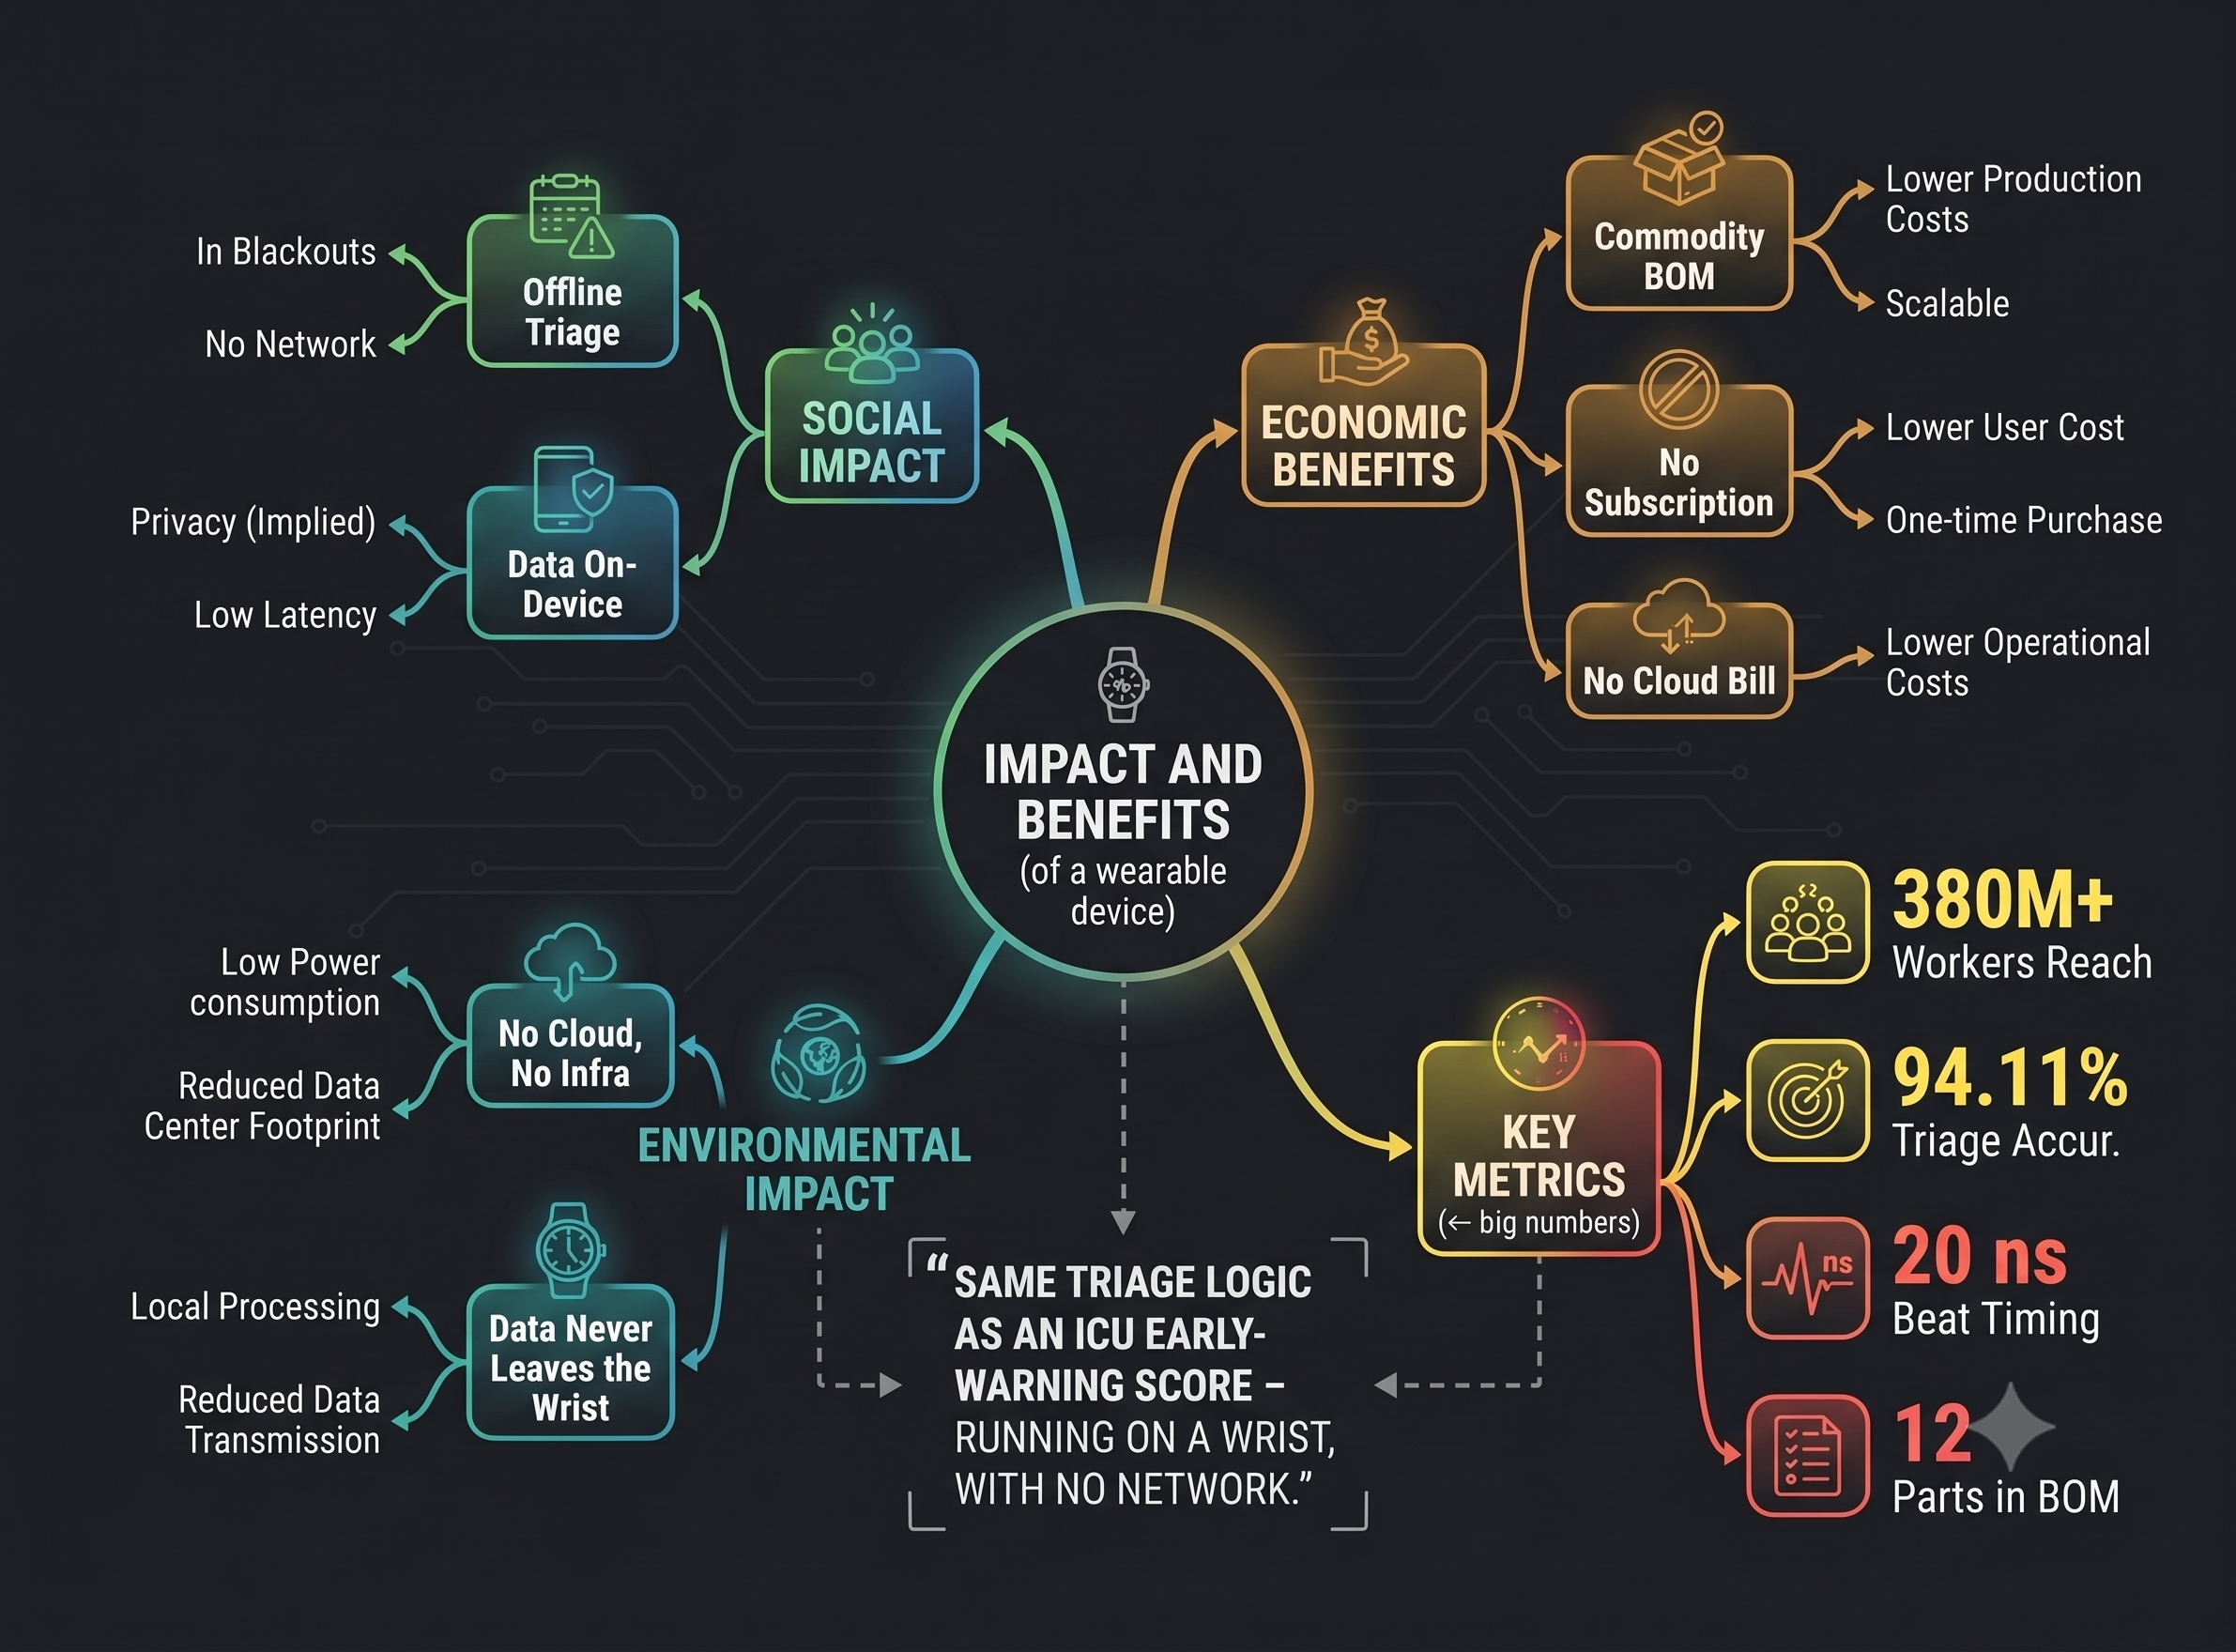
IMPACT AND BENEFITS
Chipsters
☀️ Severe North India Heatwaves (May-June): Protects 380+ million construction laborers, agricultural workers, and delivery personnel from fatal heat exhaustion by issuing warnings 15-20 minutes before collapse.
🌫️ Winter Toxic Smog in Indo-Gangetic Plains: Warns traffic police, elderly individuals, and asthmatic patients when hyper-local PM2.5 triggers dangerous autonomic cardiac vagal suppression.
🌊 Monsoon Flash Floods (Mumbai / Assam): Detects cold-water immersion, hyperventilation, and bradycardia when citizens or rescue teams are stranded during electric grid and mobile network blackouts.
5
Notes:
5

Slide 8
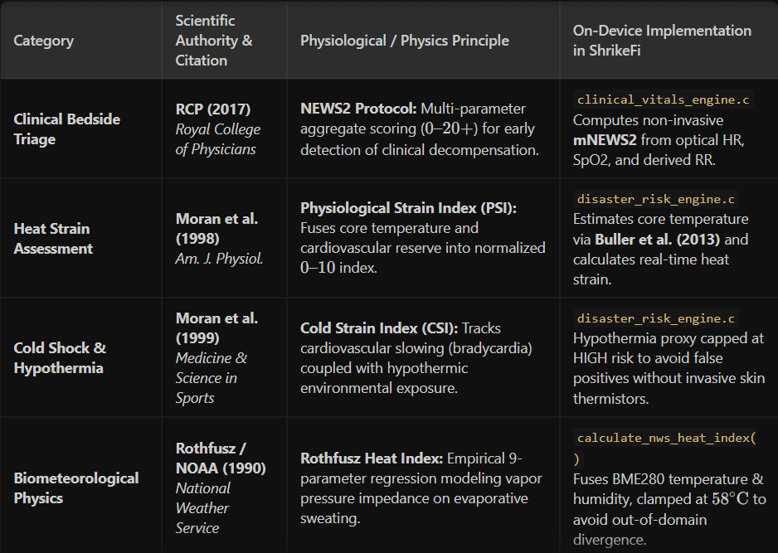
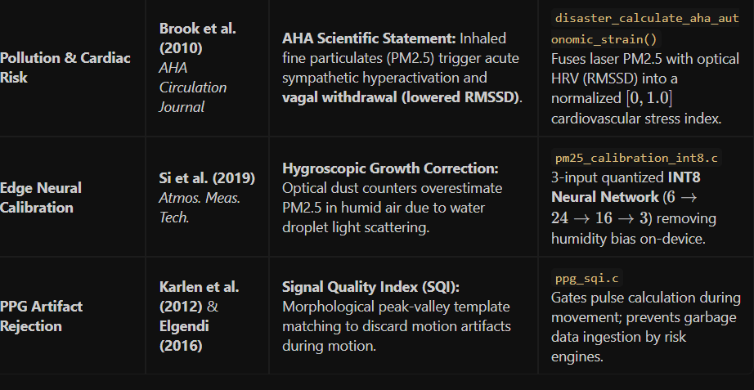
RESEARCH AND REFERENCES
Chipsters
Notes:
6

