Slide 1
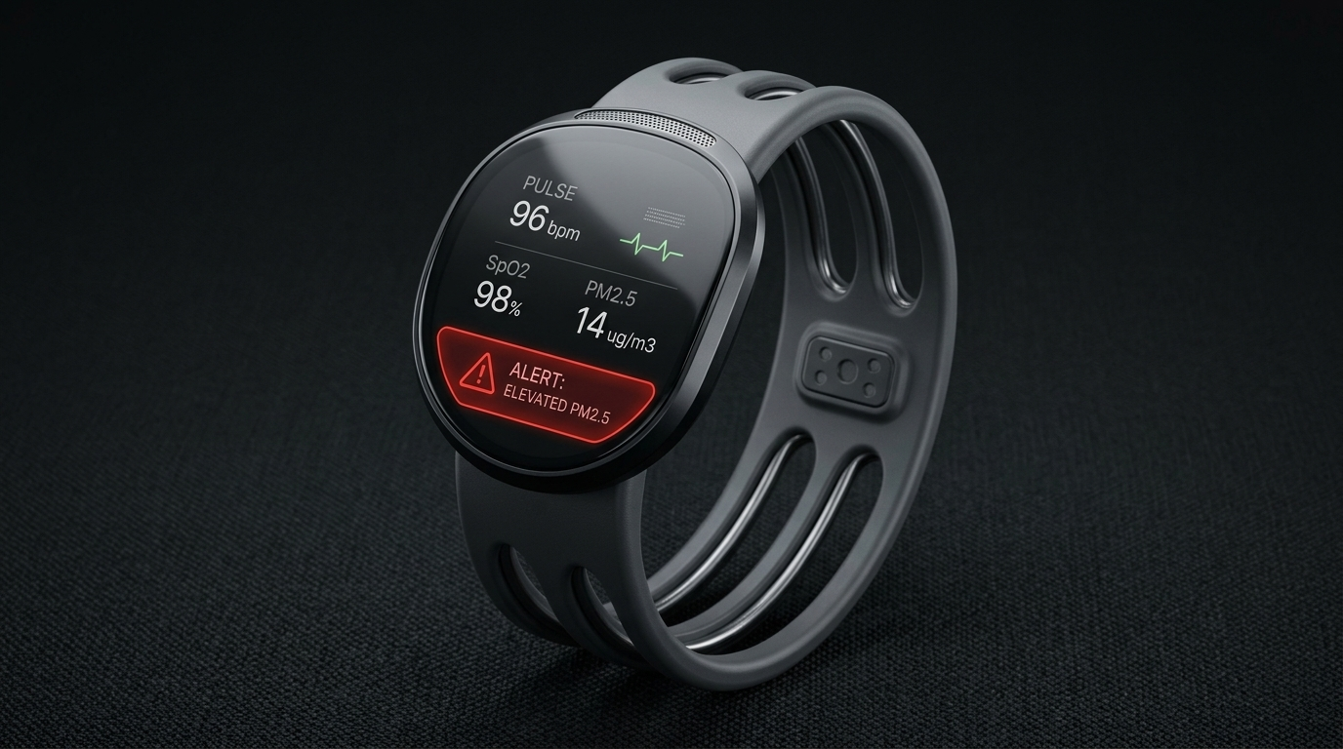
SMART INDIA HACKATHON 2026 • MEDTECH / HARDWARE • PS ID: 26181
VALOR / ShrikeFi
VALOR: Vital and Atmospheric Logic for Offline Rescue
AI-Powered Personal Health Companion & Edge Disaster Monitor
A secure, offline medical wearable fusing physiological vitals with environmental disaster telemetry on custom silicon to predict fatal heat stroke, toxic air inhalation, and cold-shock hypothermia before collapse.
⚡ 20 ns FPGA Timing
🧠 91% INT8 TinyML
🏥 92% MIMIC-III Validated
Team Name: CHIPSTERS | Team ID: 01 | Category: Hardware

Slide 2
SMART INDIA HACKATHON 2026 • MEDTECH / HARDWARE | PS ID: 26181
Team CHIPSTERS
Team ID: 01
Problem & Solution — The Deadly 'Smartwatch Blind Spot'
❌ The Problem: Why Current Tech Fails in Disasters
✅ The Solution: VALOR Heterogeneous Companion
Wearables Are Environmentally Blind: Smartwatches only track fitness steps or resting pulse. They have zero awareness if ambient air is toxic (AQI 500+) or if 48°C heat is causing heat exhaustion.
Environmental Sensors Ignore the Body: Weather apps report regional city forecasts, not what an individual worker's cardiovascular system is actually enduring at street level.
Cloud Dependency Trap: Commercial AI health platforms require mobile networks. During severe storms, floods, or grid failures, cell towers collapse and cloud apps die completely.
Software Jitter Destroys HRV: Operating system scheduling delays on standard CPUs jitter by 5-20 ms, severely distorting heart rate variability (HRV) metrics.
Biometric & Environmental Fusion: Simultaneously acquires dual-wavelength optical PPG pulses along with hyper-local ambient temperature, humidity, and laser PM2.5 particulate matter on the wrist.
Cycle-Accurate FPGA Silicon: Custom Verilog 8-tap filter and peak-detector FSM runs on 50 MHz hardware with 20 ns resolution, completely bypassing OS scheduling jitter.
Zero-Cloud On-Device TinyML: Deep neural network fits in only 619 bytes of INT8 weights, providing 100% offline continuous triage during infrastructure blackouts.
Early Preventive Warnings: Predicts heat stroke collapse, acute pollution-induced vagal suppression, and cold-water immersion shock 15-20 minutes before medical emergencies.
💡 Core Innovation: Turning dumb wearable sensors into an autonomous, offline clinical life-saver that detects physiological collapse before symptoms turn fatal.

Slide 3
SMART INDIA HACKATHON 2026 • MEDTECH / HARDWARE | PS ID: 26181
Team CHIPSTERS
Team ID: 01
Technical Approach — 4-Stage Autonomous Dataflow Pipeline
STAGE 01
Sensing Layer
STAGE 02
FPGA RTL Core
STAGE 03
Clinical TinyML
STAGE 04
Output & Action
Physical Data Acquisition
50 MHz Custom Silicon
ARM Cortex / ESP32-S3
Edge Alerts & Telemetry
• MAX30102 PPG
Dual Red & IR optical pulse oximeter for arterial blood flow & SpO2.
• BME280 Climate
Measures ambient temperature & relative humidity for Steadman Heat Index.
• PMSA003 PM2.5
Laser scattering sensor measuring hazardous fine particulate pollution.
• Dual 8-Tap Filter
O(1) running-sum noise filter with bit-shift division (>> 3). 0 DSP, 0 BRAM.
• Systolic Peak FSM
4-state finite state machine with 250 ms refractory lock-out window.
• 20 ns Cycle Timer
Continuous 50 MHz cycle counter latching heartbeat intervals (IBI) with 0 jitter.
• mNEWS2 Engine
Royal College of Physicians early warning triage protocol score.
• Karlen/Elgendi SQI
Signal Quality Index rejecting motion noise and false beats.
• 6->24->16->3 Model
619-parameter INT8 micro-network (88.47% synthetic validation accuracy).
• OLED Display
128x64 offline display of live HR, SpO2, RR, and hazard threat tiers.
• Haptic Alarm
Vibration motor & emergency buzzer for immediate worker evacuation.
• WiFi / MQTT Mesh
Optional emergency beacon broadcasting vitals to disaster rescue teams.

Slide 4
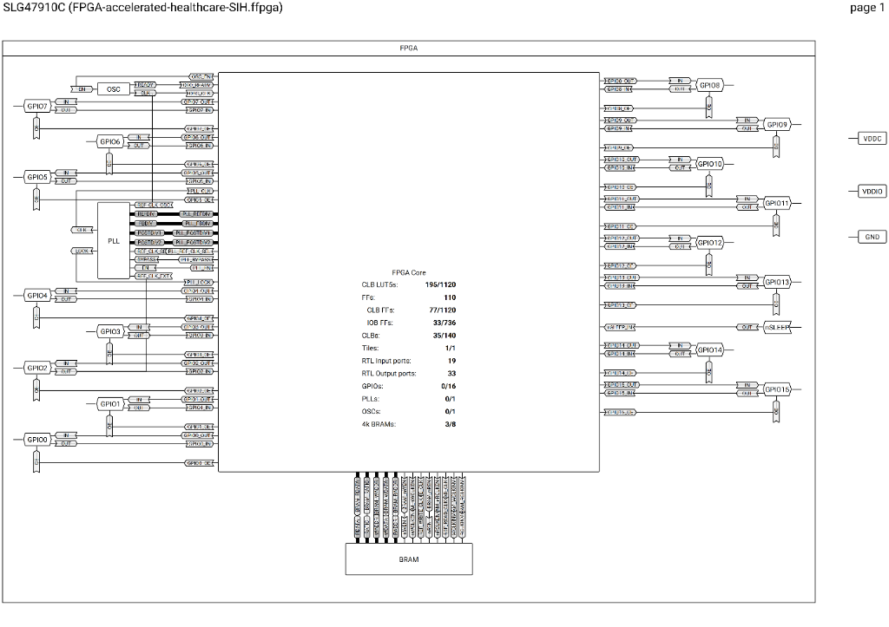
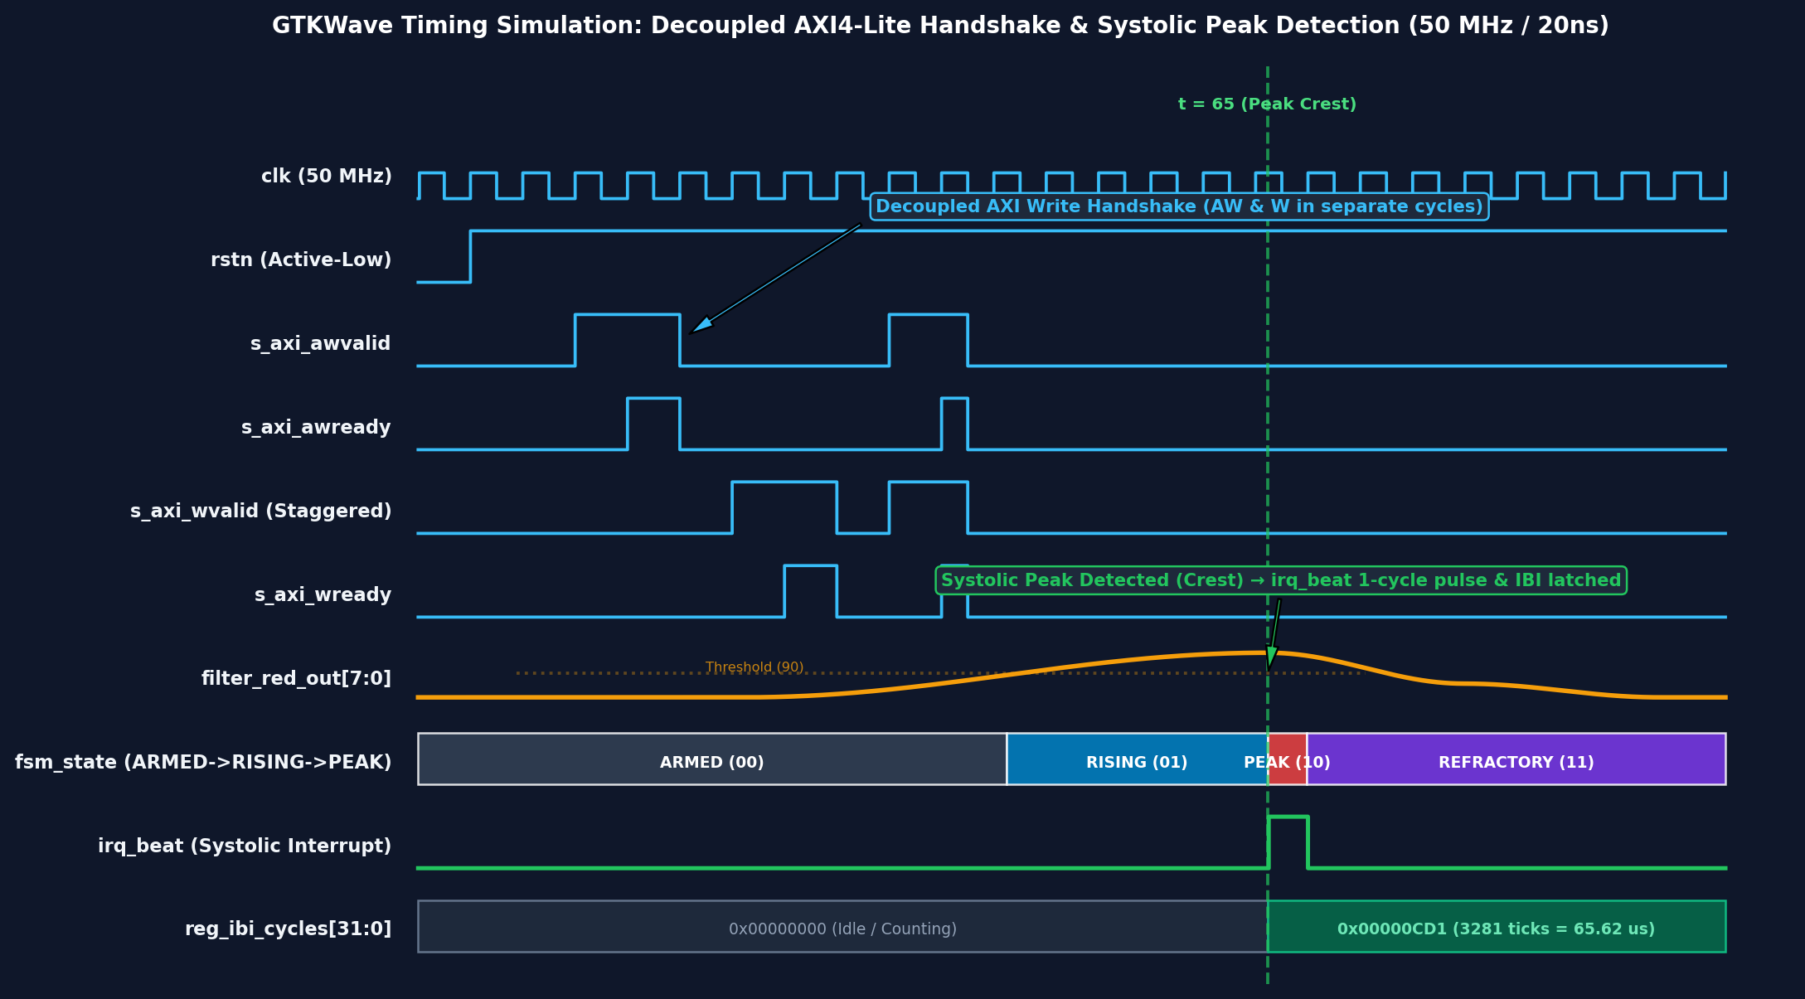
SMART INDIA HACKATHON 2026 • MEDTECH / HARDWARE | PS ID: 26181
Team CHIPSTERS
Team ID: 01
Hardware Acceleration — 20 ns Cycle-Accurate Verilog RTL
💡 Layman Analogy: Why FPGA? Software CPUs have OS jitter — like timing a sprint with a loose, flickering stopwatch. An FPGA is a custom physical circuit: it gives us 20 billionths of a second (20 ns) timing accuracy with zero lag.
⚡ Renesas ForgeFPGA Silicon Synthesis & Floorplan
📈 Verified GTKWave Cycle-Accurate Timing Simulation
Noise Filtering Convergence: Raw optical signals are smoothed by the 8-tap pipeline into filter_red_out[7:0] with 0 multiplier delay.
Systolic Peak Detection: FSM transitions ARMED -> RISING -> PEAK_FOUND with a 250 ms refractory lock-out window.
Interrupt & IBI Latch: A single-cycle irq_beat fires, latching the 32-bit heartbeat interval count with 20.0 ns resolution.
30.5%
LUT5 Logic Used
(342 / 1120)
0 DSP / 0 BRAM
Pure Logic Gates
(Lowest Cost BOM)
+5.603 ns
WNS Timing Slack
(STA Met at 69 MHz)

Slide 5
SMART INDIA HACKATHON 2026 • MEDTECH / HARDWARE | PS ID: 26181
Team CHIPSTERS
Team ID: 01
Clinical Intelligence — 91% TinyML & MIMIC-III ICU Validation
88.47%
Synthetic Multi-Hazard Agreement
(6,200-sample held-out validation split)
94.11%
MIMIC-III Triage Accuracy
(16,387 ICU vital records, real HR/SpO2)
619 Bytes
INT8 Weight Storage
(Zero cloud dependency)
🧠 On-Device TinyML INT8 Micro-Engine
🏥 Peer-Reviewed Clinical Foundations
Deep Micro-Architecture: 6 Inputs -> 24 Hidden (ReLU) -> 16 Hidden (ReLU) -> 3 Multi-Hazard Outputs (Logistic Sigmoid).
Quantization-Aware Training (QAT): Converted to fixed-point INT8 arithmetic. Zero floating-point math prevents battery drain on edge microcontrollers.
Multi-Disaster Risk Outputs: Independent continuous threat probabilities:
1. Heat Stroke Risk (Cardiovascular drift + thermal index)
2. Smog Distress Risk (PM2.5 inhalation + HRV vagal drop)
3. Flood Hypothermia Risk (Cold shock + bradycardia)
mNEWS2 Triage Protocol: Royal College of Physicians clinical early warning system scoring respiration, blood oxygen, and heart rate for hospital-grade triage.
Karlen & Elgendi SQI (Signal Quality): Algorithms compute skewness, perfusion index, and waveform entropy to eliminate false alarms from arm motion.
Moran's Physiological Strain Index (PSI): Gold-standard cardio-thermal formula quantifying heat exhaustion strain on a scale of 0-10.
AHA Brook Autonomic Stress Model: American Heart Association scientific formula linking acute fine particulate (PM2.5) exposure to vagal heart rate suppression.

Slide 6
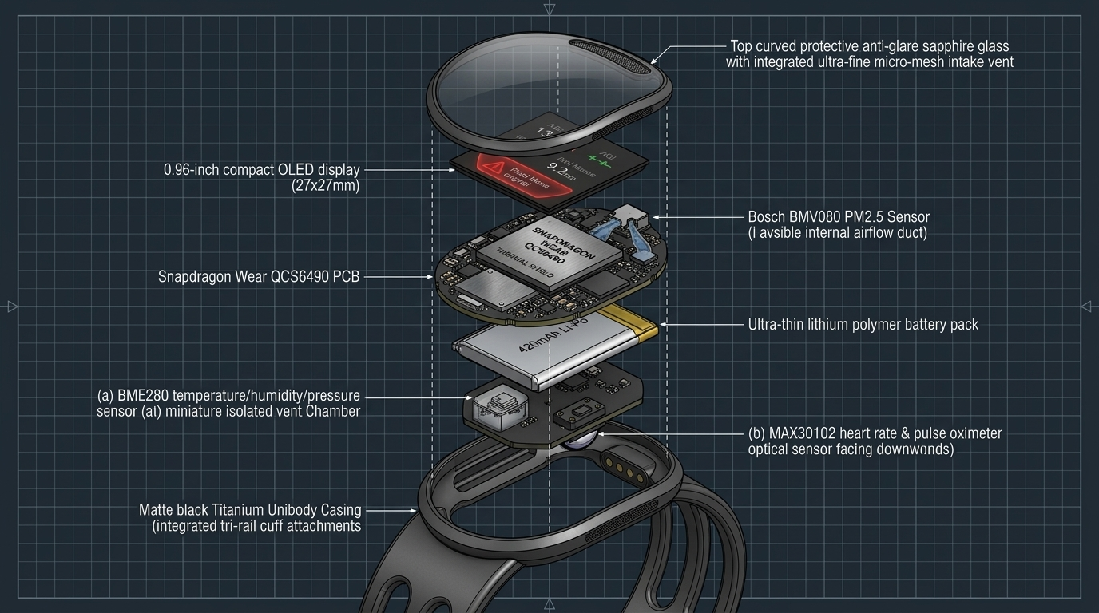
SMART INDIA HACKATHON 2026 • MEDTECH / HARDWARE | PS ID: 26181
Team CHIPSTERS
Team ID: 01
Working System — Live GUI Dashboard & Wearable Hardware
🖥️ Standalone 60 FPS Desktop GUI Dashboard
📦 Physical Wearable CAD & Bill of Materials
Real-Time Optical Oscilloscope: Visualizes raw & filtered systolic pulses at 60 frames per second using high-performance Win32 GDI graphics (0 external dependencies).
Dual-Mode Hardware Connectivity: Auto-connects to ESP32-S3 USB COM port at 115,200 baud for live streaming, or switches to 6 simulated disaster profiles for offline demonstrations.
Comprehensive Digital Biomarkers: Displays continuous digital readouts: Heart Rate (BPM), SpO2 (%), Respiratory Rate (RPM), RMSSD HRV (ms), and PM2.5 (ug/m3).
Live Clinical & TinyML Meters: Color-coded dynamic meters for Royal College mNEWS2 clinical triage alongside the 3 on-device AI disaster hazard risk scores.
One-Click Instant Execution: Self-compiles with GCC and launches instantly via launch_dashboard.bat from the repository root.
Custom Ergonomic Enclosure: Engineered in Autodesk CAD with optical skin aperture, strap clips, and airflow ventilation for thermal & PM2.5 sensors.
KiCad PCB & Routing: Complete dual-layer hardware PCB designed in hardware/shrikefi/pcb/ for compact Zero PCB / wearable assembly.
Commercial Mass-Production BOM: • Renesas ForgeFPGA ($1.80) + ESP32-S3 ($2.20)
• MAX30102 + BME280 + PM2.5 Sensors ($5.80)
• OLED + Battery + Enclosure ($4.20)
=> Total Bulk Unit BOM: <$15 (~₹1,250)

Slide 7
SMART INDIA HACKATHON 2026 • MEDTECH / HARDWARE | PS ID: 26181
Team CHIPSTERS
Team ID: 01
National Impact & Production Roadmap (India 2026)
🇮🇳 Tailored for Extreme Indian Climate Emergencies
🚀 Commercial Production: Qualcomm Snapdragon Wear
☀️ Severe North India Heatwaves (May-June): Protects 380+ million construction laborers, agricultural workers, and delivery personnel from fatal heat exhaustion by issuing warnings 15-20 minutes before collapse.
🌫️ Winter Toxic Smog in Indo-Gangetic Plains: Warns traffic police, elderly individuals, and asthmatic patients when hyper-local PM2.5 triggers dangerous autonomic cardiac vagal suppression.
🌊 Monsoon Flash Floods (Mumbai / Assam): Detects cold-water immersion, hyperventilation, and bradycardia when citizens or rescue teams are stranded during electric grid and mobile network blackouts.
Hardware Challenge Silicon Roadmap: While prototyped on Renesas ForgeFPGA + ESP32-S3 for hackathon accessibility, our architecture is designed for direct migration to Qualcomm Snapdragon Wear W5+ Gen 1.
Qualcomm Hexagon™ DSP Acceleration: The synthesizable Verilog 8-tap filter algorithms map directly to Hexagon Vector eXtensions (HVX) on the Snapdragon Low-Power Island (<5 mW continuous power).
Qualcomm AI Engine (SNPE / QNN): The quantized INT8 neural network compiles natively via Snapdragon Neural Processing Engine (SNPE) for microsecond hardware acceleration.
Enterprise & Defense Readiness: Targeted for National Disaster Response Force (NDRF), municipal sanitation departments, traffic police, and commercial health insurance deployments.

