Slide 1

SMART INDIA HACKATHON 2026
TITLE PAGE
Problem Statement ID – SIH26181
Problem Statement Title- AI-Powered Personal Health Companion & Edge Disaster Monitor
Theme- MedTech / BioTech / HealthTech
PS Category- Hardware
Team ID- 171695
Team Name- CHIPSTERS

Slide 2

Team
Chipsters
IDEA TITLE
VALOR: VITAL AND ATMOSPHERIC LOGIC FOR OFFLINE RESCUE
❖ AI-Powered FPGA accelerated Personal Health Companion & Edge Disaster Monitor
❌ How Current Technology Fails During Disasters
✅ VALOR Proposed Solution & Innovation
• Wearables Are Environmentally Blind: Commercial smartwatches track fitness steps and resting heart rate, but have zero awareness if ambient air is toxic (AQI 400~500+) or if 48°C heat is causing heat exhaustion so it can’t connect the dots between these conditions, especially when outages shut down network towers
• Environmental Sensors Ignore the Body: Weather apps report regional city forecasts, not what an individual worker's cardiovascular system is actually enduring at street level.
• The Cloud Dependency Trap: Cloud AI health platforms require mobile networks. During floods, cyclones, or power grid failures, cellular towers collapse and cloud health apps die completely.
• Software Jitter Destroys HRV: Operating system scheduling delays on standard CPUs jitter by 5-20 ms, severely corrupting heart rate variability (HRV) metrics.
• Detailed Solution Explanation: Simultaneously acquires dual-wavelength optical PPG pulses along with hyper-local ambient temperature, relative humidity, and laser PM2.5 particulate matter on the wrist.
• How It Addresses the Problem: Fuses bodily vitals with environmental stress in real time to calculate cardiac drift and respiratory strain, giving early warning of heat stress and abnormal vital signs before they become emergencies.
• Hardware Innovation (FPGA Silicon): Custom Verilog 8-tap filter and beat detector run in FPGA hardware at 50 MHz, taking time-critical filtering off the OS and removing scheduler jitter, with no DSP multipliers or BRAM.
• Uniqueness & Zero Cloud Dependency: Quantized INT8 neural network fits into only 619 bytes of INT8 weights, so privacy-preserving on-device inference works offline during blackouts.

Slide 3
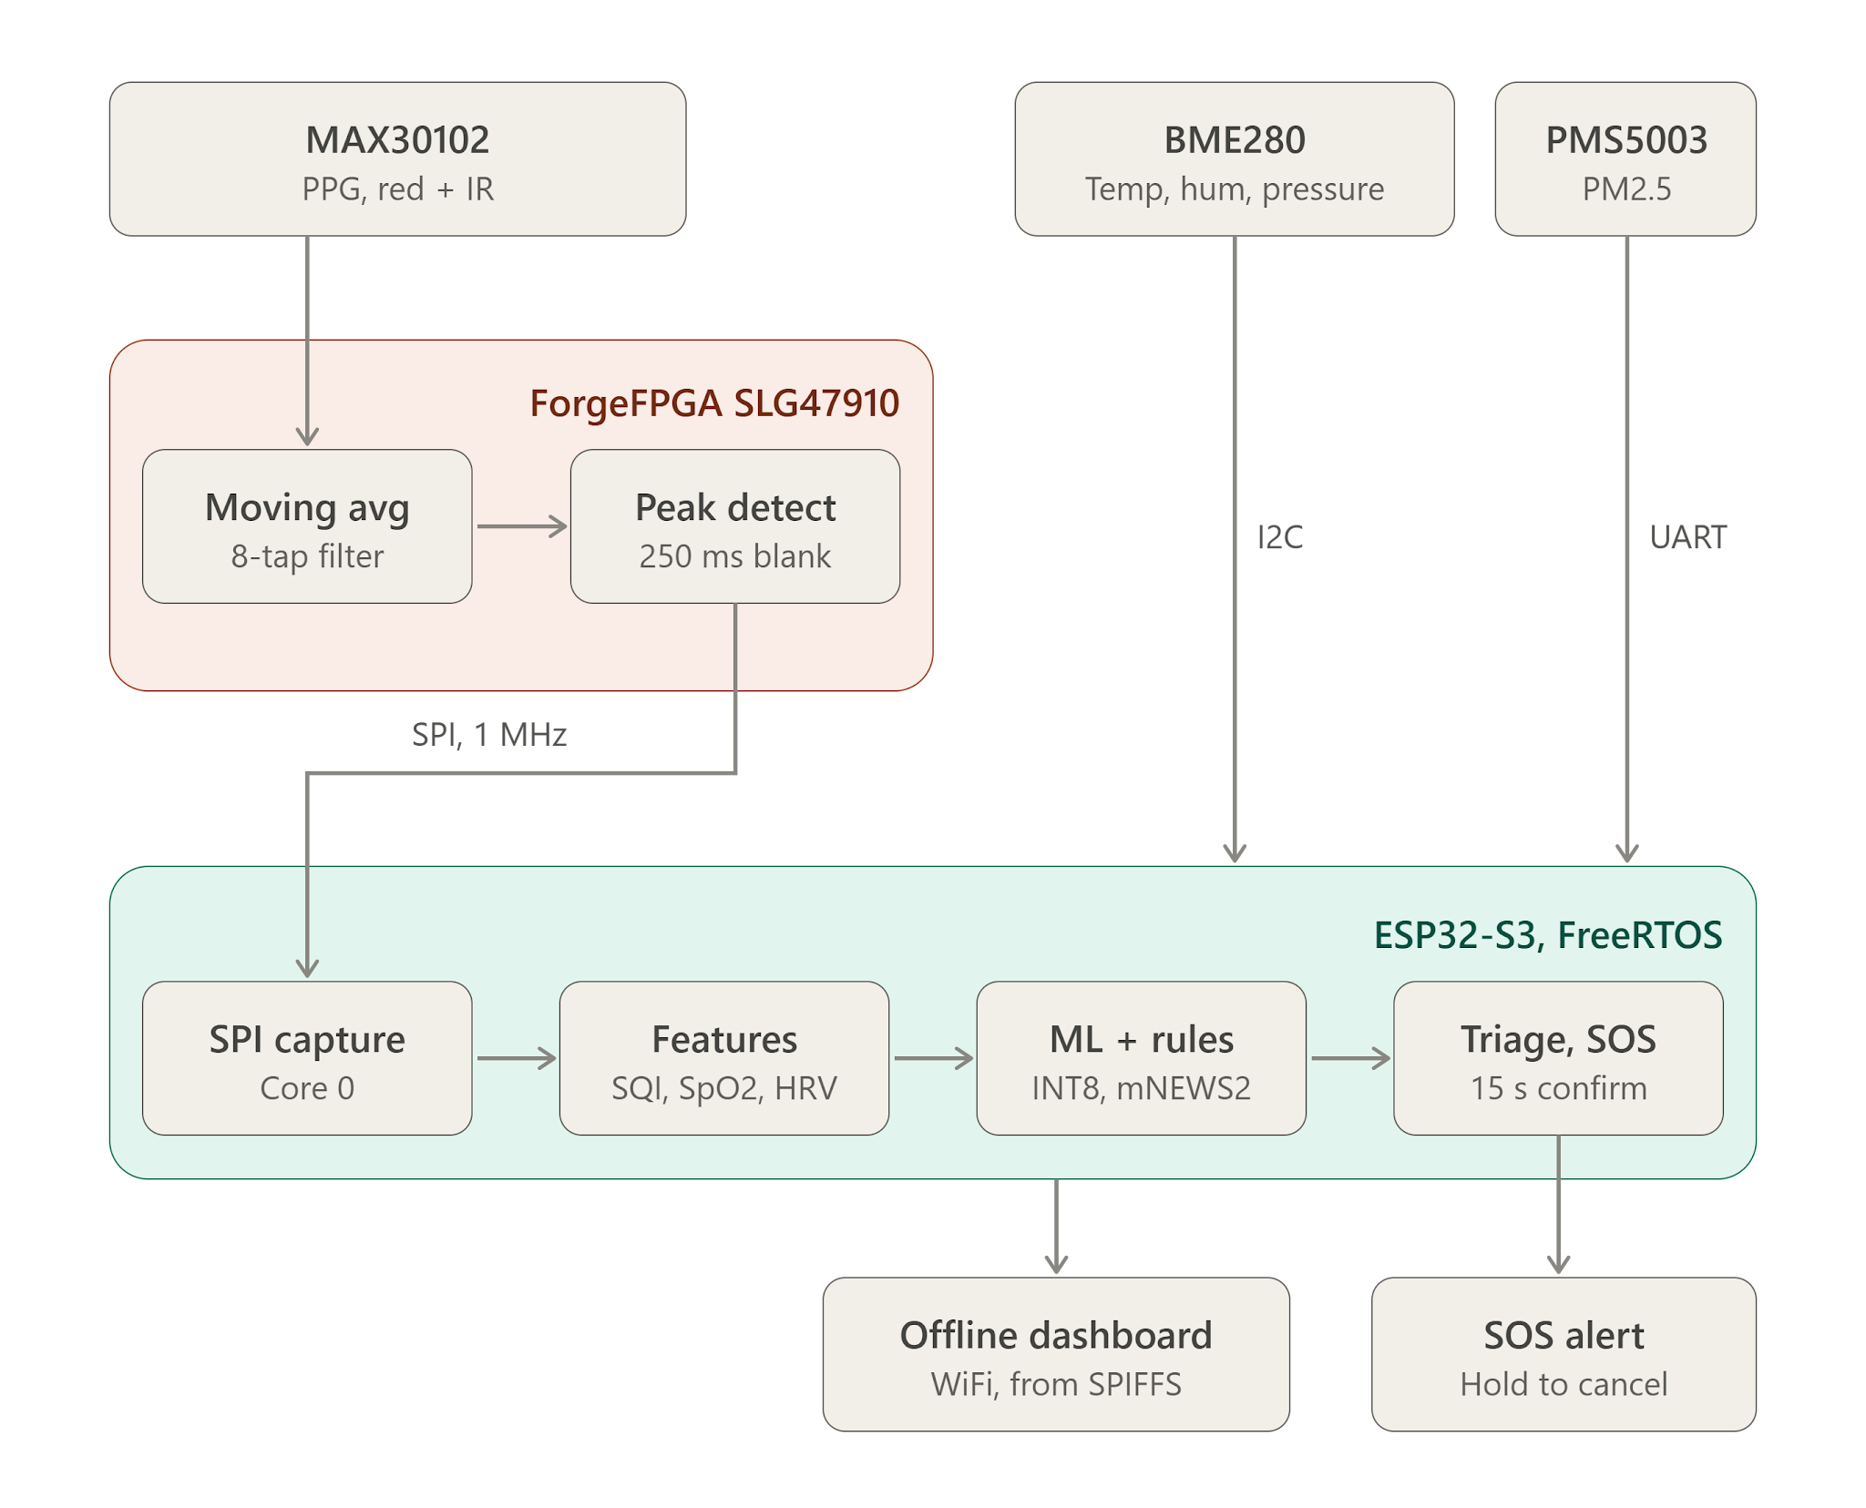
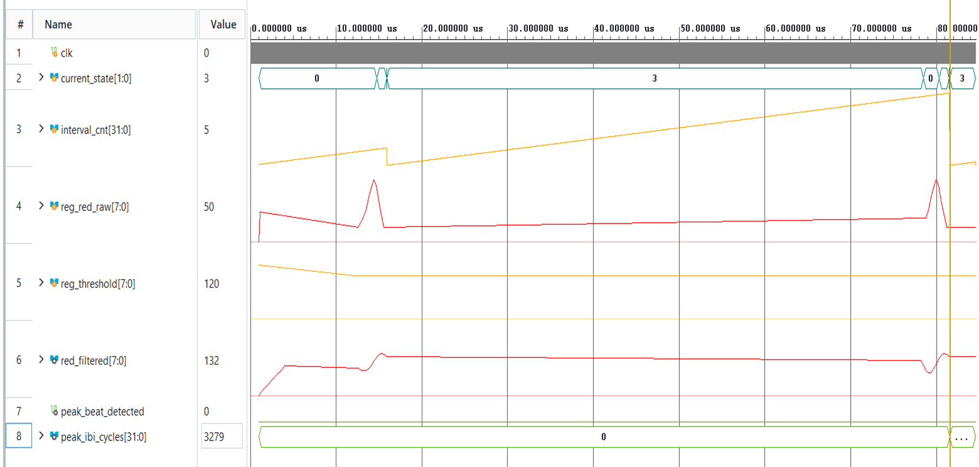
Team
Chipsters
TECHNICAL APPROACH
❖ Architecture, Stack & RTL Verification
⚡ HARDWARE & FIRMWARE FLOW
Survival UI: HTML5 • Vanilla JS • Canvas API • Win32 GDI
Clinical AI / TinyML: PyTorch • QAT INT8 • Scikit-Learn • C99
Firmware / OS: C99 • FreeRTOS • ESP-IDF v5.5.5
Hardware RTL: Verilog-2001 • SystemVerilog • 4-wire SPI
EDA / compilers: Vivado • ForgeFPGA Workshop • Icarus • GCC
RTL SIMULATION: RAW PPG → 8-TAP FILTER → BEAT / IBI
Testbench, compressed time scale. Pulses ~66 µs apart; peak_ibi_cycles = 3279 × 20 ns = 65.6 µs.

Slide 4
Team
Chipsters
FEASIBILITY AND VIABILITY
📊 FEASIBILITY ANALYSIS: SILICON & ECONOMICS
🛡️ RISKS & MITIGATION STRATEGIES
Vendor-Agnostic Verilog RTL
Identical synthesizable core Verilog runs on AMD Xilinx (6-LUT) and Renesas ForgeFPGA (5-LUT) architectures without redesign.
Xilinx + ForgeFPGA
Motion & Optical Noise
Mitigation: 8-tap running-sum filter on FPGA + Karlen SQI algorithm to discard motion-corrupted pulses.
Micro-FPGA Logic Limits
Mitigation: Pure-logic O(1) bit-shift division (>> 3), requiring 0 DSP multipliers and 0 BRAM on ultra-low-cost FPGAs.
Ultra-Low Silicon Footprint
Synthesized on Renesas ForgeFPGA requiring only 364 / 1120 LUTs with 0 Block RAM.
32.5% Utilization
Grid & Cellular Blackouts
Mitigation: 100% on-device offline TinyML (619 bytes INT8 weights) and local SoftAP web status server.
Future Sensors
IMU for falls, activity and sleep; skin-temperature sensor; GPS module for SOS location.
Planned
Clinical Accuracy
Mitigation: Vital-sign triage evaluated offline on 16,387 MIMIC-III ICU records (94.11% accuracy). ICU-grade data; wrist-worn field validation is the next step.
Economic Viability (< $15 / ~₹1,250 Bulk BOM)
12-component commodity bill of materials (ForgeFPGA + ESP32-S3 + 3 sensors + OLED). Zero recurring subscription.
Zero Cloud Fees
Future Features
Roadmap: Fall detection, activity & sleep tracking, caregiver SOS with GPS location; Snapdragon Wear W5+ Gen 1 port.

Slide 5
Team
Chipsters
IMPACT AND BENEFITS
50 MHz
cycle-accurate FPGA
pipeline (20 ns clock)
94.11%
vital-sign triage accuracy,
16,387 MIMIC-III records
619 B
offline INT8 network
(6 → 24 → 16 → 3)
12
components in the
entire wearable BOM
SOCIAL IMPACT
ECONOMIC VIABILITY
ENVIRONMENTAL SUSTAINABILITY
• Offline Triage
Operates reliably during severe cellular network and power grid blackouts.
• Complete Privacy
Sensitive health vitals never leave device; zero cloud dependence & no smartphone required.
• Early Warning & SOS
Heat-stress, air-quality and vitals alerts for vulnerable groups, plus SOS.
• Low-Cost Hardware
Built using 12 off-the-shelf components. Bulk BOM < $15 (~₹1,250) | Fully assembled < ₹2,500.
• Zero Overhead
No cloud server fees, no mobile data plans, and zero recurring subscription costs.
• Scalable Deployment
One edge-AI pipeline for individuals, providers and disaster agencies.
• Zero-Cloud Footprint
Triage runs on the wrist, so it needs no data-center processing or network bandwidth.
• Pure Logic FPGA
Uses 0 DSP blocks and 0 BRAM, keeping the FPGA footprint and power draw low.
• Disaster-Specific Alerts
Heat, pollution and flood risk scores, plus cyclone warning from pressure trend.
🇮🇳 Tailored for Indian Disasters: Protects 380M+ outdoor workers and elderly and rural citizens across North India heatwaves (48°C) • Toxic smog (AQI 400–500+) • Monsoon flash floods & blackouts

Slide 6
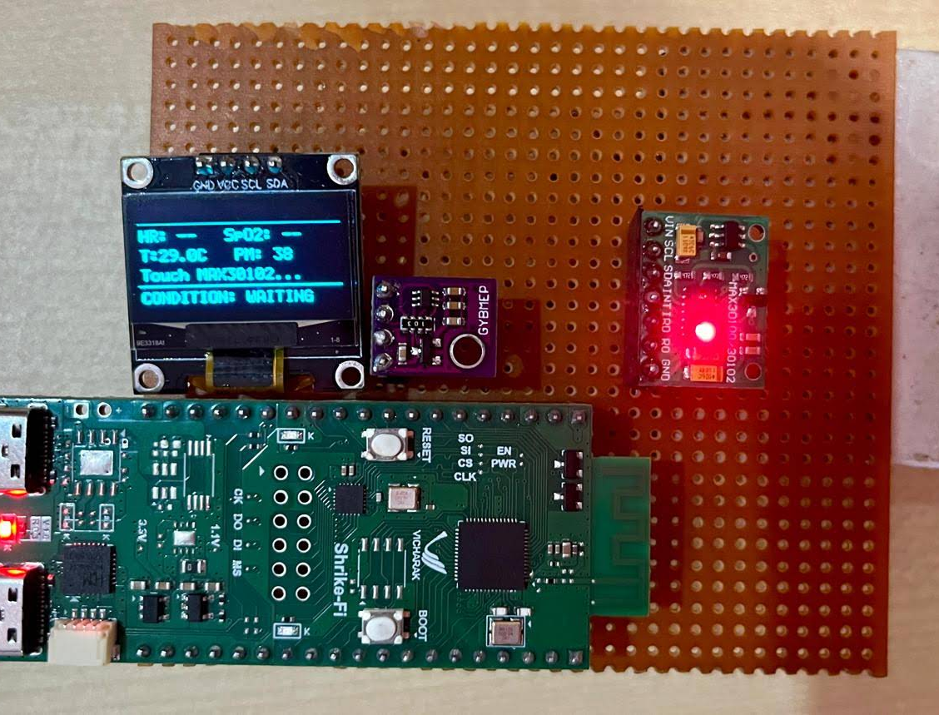
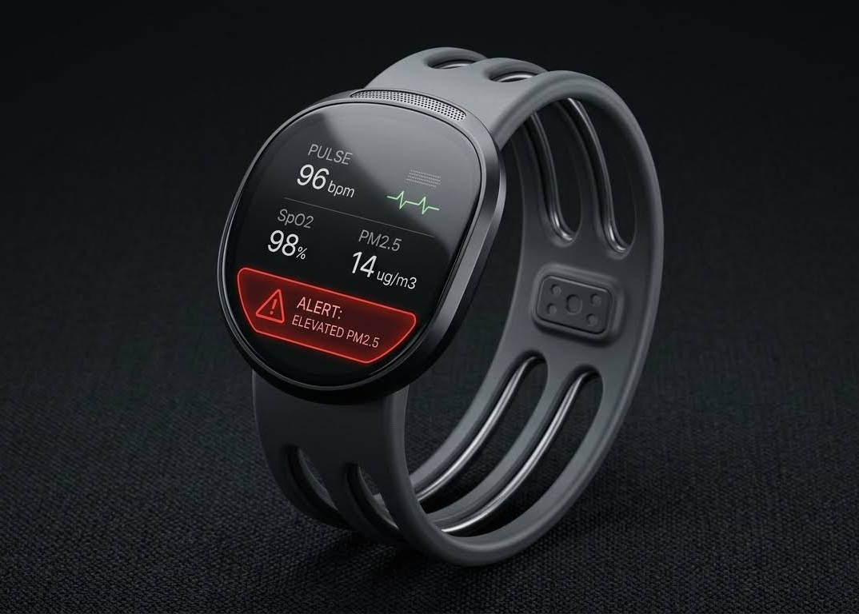
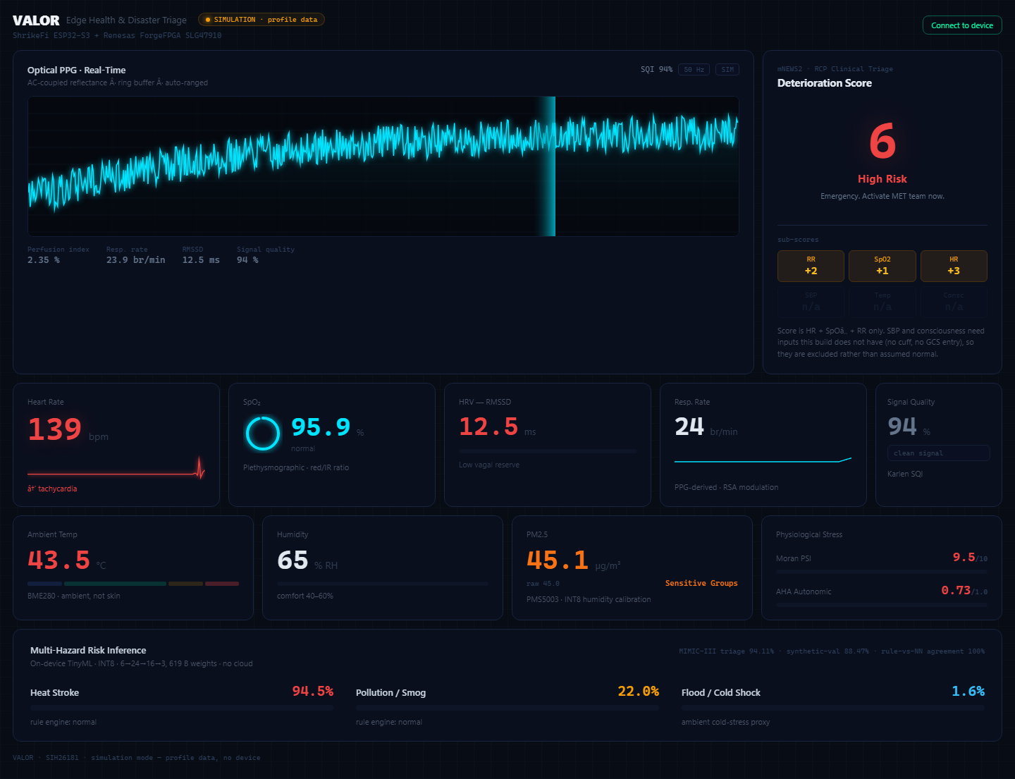
Team
Chipsters
RESEARCH AND REFERENCES
🔬 PROTOTYPE TO FUTURE IDEA OF VALOR WATCH USING SNAPDRAGON SOC
📚 PEER-REVIEWED CLINICAL & ENGINEERING REFERENCES
CLINICAL / TECHNICAL STANDARD (PEER-REVIEWED) | IMPLEMENTED IN WHICH OF OUR CODE FILES
Royal College of Physicians (2017) NEWS2 Acute Severity | clinical_vitals_engine.c
Charlton PH et al. (IEEE 2018) EDR Breathing Rate from PPG | ppg_respiratory_rate.c
Karlen W et al. (Physiol Meas 2012) Signal Quality Index (SQI) | ppg_sqi.c
Moran DS et al. (Am J Physiol 1998) Physiological Strain (PSI) | disaster_risk_engine.c
Brook RD et al. / AHA (Circulation 2010) PM2.5 Cardiac Stress | disaster_risk_engine.c
Johnson AEW et al. (MIMIC-III 2016) 16,387 ICU Records | data/mimic/ (Host Evaluator)
Si M et al. (Atmos Meas Tech 2019) ML Particulate Calibrator | pm25_calibration_int8.c
Steadman RG (J Appl Meteorol 1979) Sultriness & Heat Index | disaster_risk_engine.c
SPI Mode 0 Protocol Specification | forgefpga_ppg_top.v
PHYSICAL PROTOTYPE
TARGET WATCH FORM FACTOR
Live 60 FPS Disaster Dashboard
• 100% Offline SPIFFS Web Server
• Real-time optical systolic trace
• RSA breathing wave extraction
• Live mNEWS2 & multi-hazard radar

