Slide 1

Debian File Server
“This isn’t really a whodunnit but how he did it”
--------------------------------------
“This is not a how to do it but how I did it”
A noobs experience

Slide 2
A little about me
I’ve been using Linux for 9 months
  Computational thinking and understanding the machine
  During lockdown
  OneDrive
First distro Linux Mint
Current Arch with Qtile WM

Slide 3

Overview
Hardware
Debian vs Ubuntu vs Other
Rsnapshot
SAMBA
Music / Media Server and other uses
Final thoughts

Slide 4
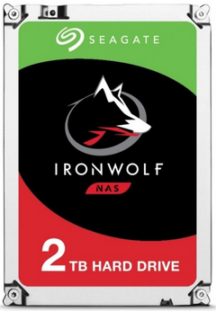
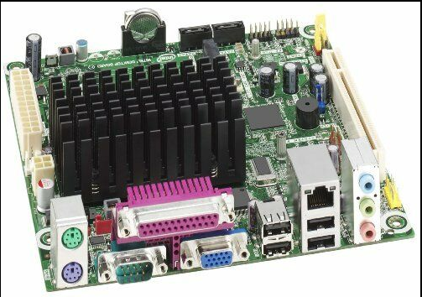
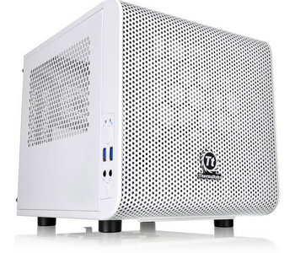
Hardware
Motherboard
Intel D525MW ~ Intel Atom and 1GB DDR3 RAM Motherboard Mini ITX Bundle + VGA
Harddrive
Seagate IronWolf 2TB NAS Hard Drive 3.5" SATA III 6GB's 5900RPM 64MB Cache
Case
Thermaltake Core V1 Snow Mini-ITX Cube Case With Side Window

Slide 5
Debian vs Ubuntu vs Other
Looking at the installers there seemed to be only a couple of differences that affected me.
Ubuntu offered a server install that inlcuded SAMBA
Ubuntu offered automatic security updates
There are of course many differences between Ubuntu server and vanilla Debian but …
Why not CentOS or other?

Slide 6
Backing up
Arch is a rolling release
This gives it a reputation of instability
Back ups allow you keep up to date with the ability to go back to a previous “version” if something breaks
First attempt was to rsync via SAMBA

Slide 7
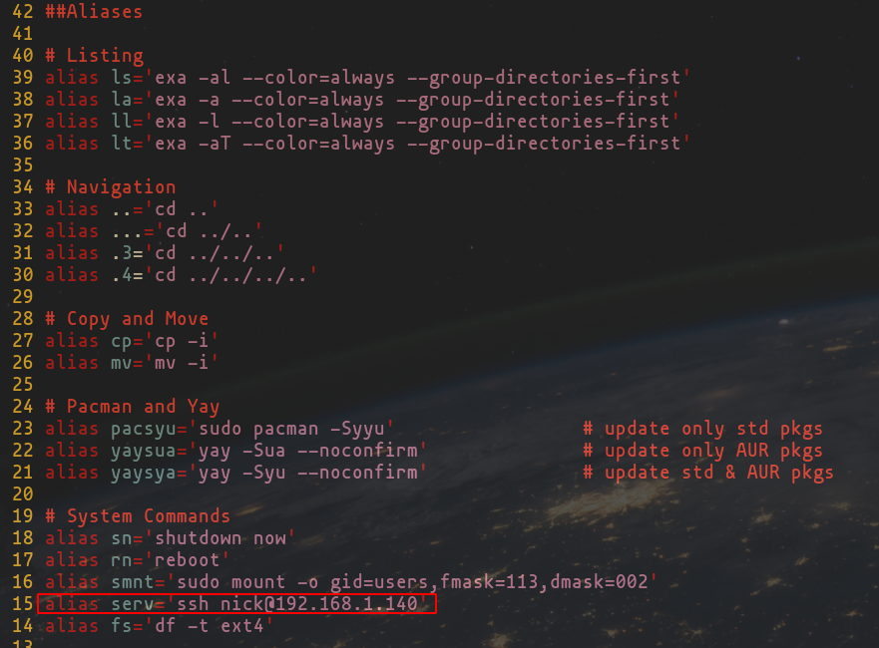
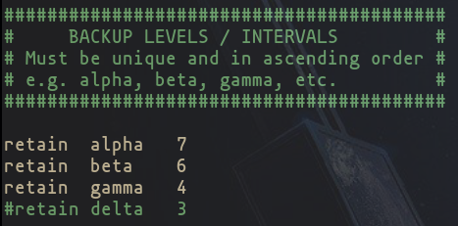
Rsnapshot
Uses rsync via SSH
  Install rsnapshot rysnc and openSSH
  SSH passwordless keys
Rotate files

Slide 8
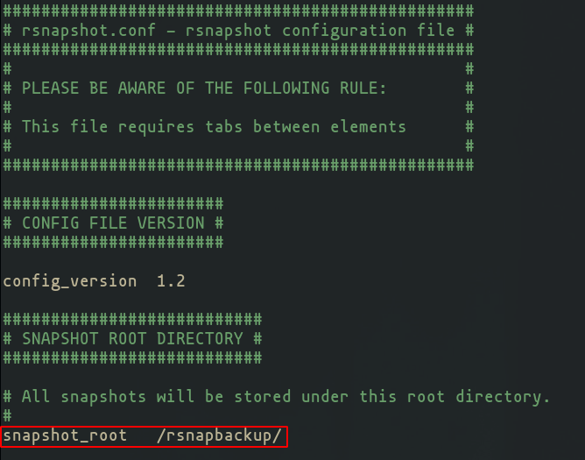
Rsnapshot Setup https://ostechnix.com/setup-backup-server-using-rsnapshot-linux/
On server
  sudo mkdir /rsnapbackup/
  sudo cp /etc/rsnapshot.conf /etc/rsnapshot.conf.bak
  sudo vim /etc/rsnapshot.conf

Slide 9
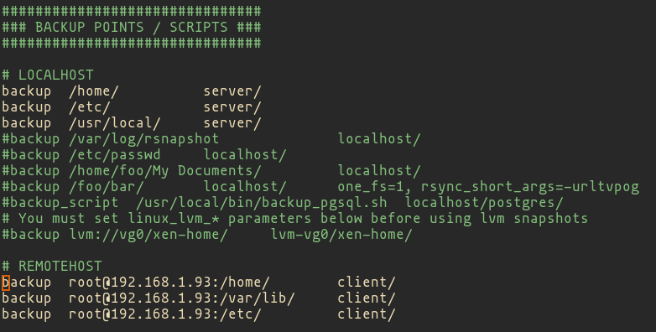
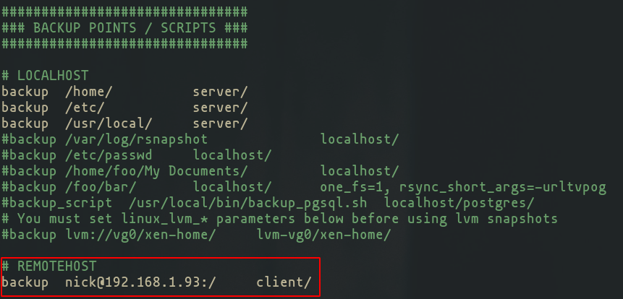
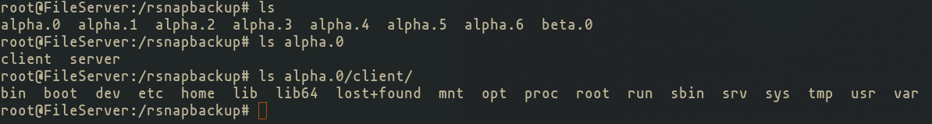

Slide 10
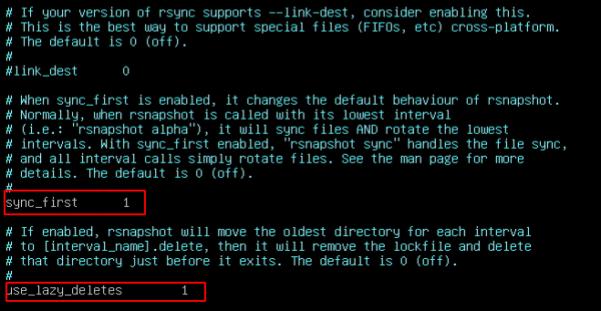
rsnapshot sync && rsnapshot alpha

Slide 11
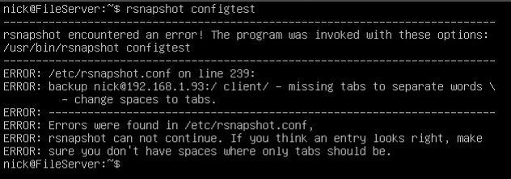

Slide 12
What I wanted...
For my laptop to tell my server to start the backup
The first few tries
  Kept being asked for passwords
  Sudo
  SSH keys
Start from the end and work back

Slide 13
Thinking backwards (mostly)...
Server: script that called rsnapshot
  Then to ssh into my laptop update a log file and send-notify completion
Laptop: script that ssh’d into my server and called the rsnapshot script
  Check the log file and check if it should proceed
  Call script from autostart.sh

Slide 14
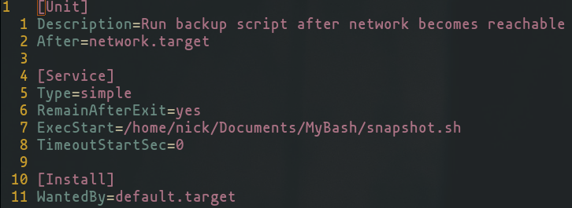
A more linear explanation
In the end calling the script from autostart.sh worked but caused other issues.
Made a systemd .service file
  https://www.golinuxcloud.com/run-script-at-startup-boot-without-cron-linux/

Slide 15
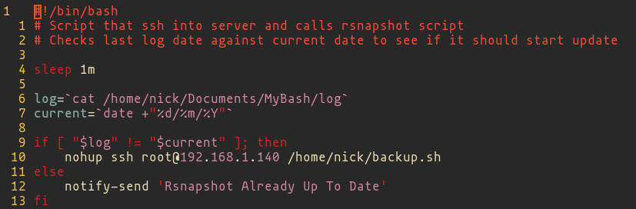
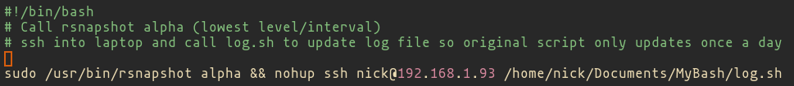
Laptop:
snapshot.service calls snapshot.sh
snapshot.sh checks log and if not todays calls backup.sh on server
Server:
backup.sh calls rnsapshot alpha
Then calls log.sh on laptop
Laptop:
log.sh calls updates log (text file) with todays date
Then sends notification that it is complete

Slide 16
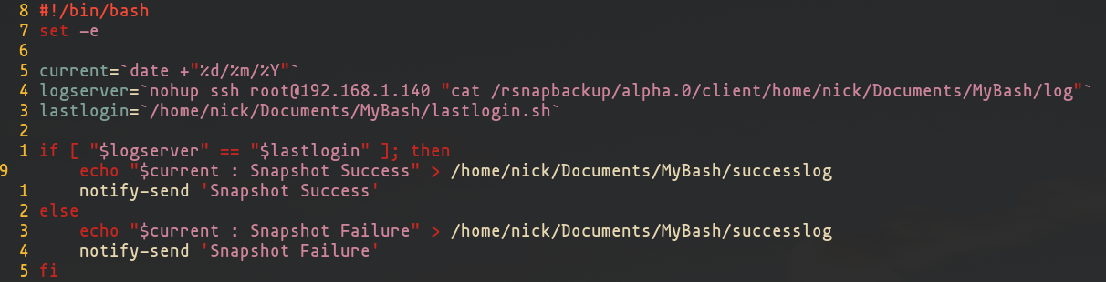
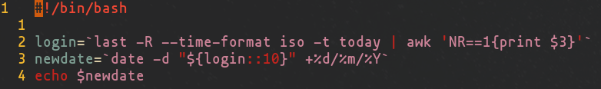
Rsnapshot && issue
I originally had an issue with Rsnapshot not giving the correct exit code. This is why I changed to backing up as root and of specific folders.

Slide 17
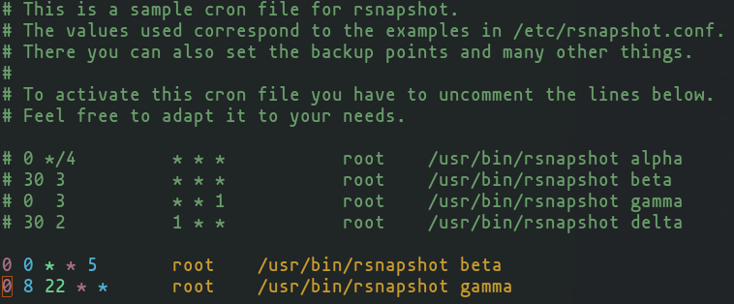
Crontab on server https://ostechnix.com/setup-backup-server-using-rsnapshot-linux/
sudo vim /etc/cron.d/rsnapshot

Slide 18
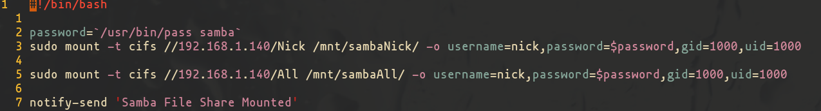
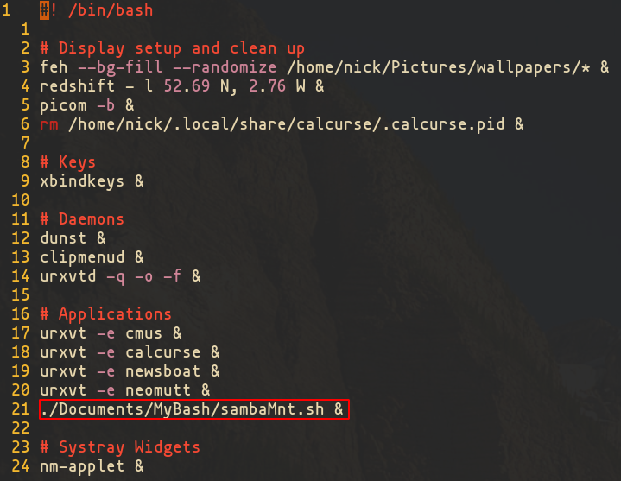
SAMBA
Mainly a way for a windows machine to “backup” individual files
You can have it mounted by fstab

Slide 19
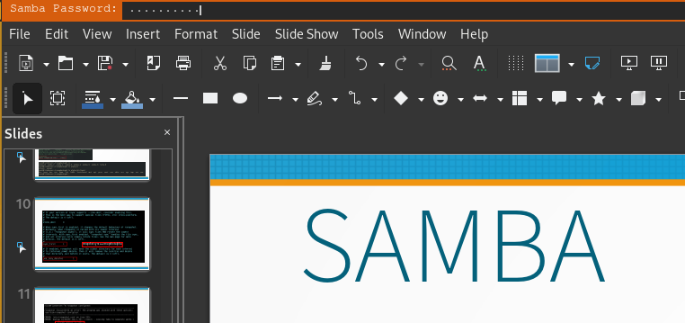
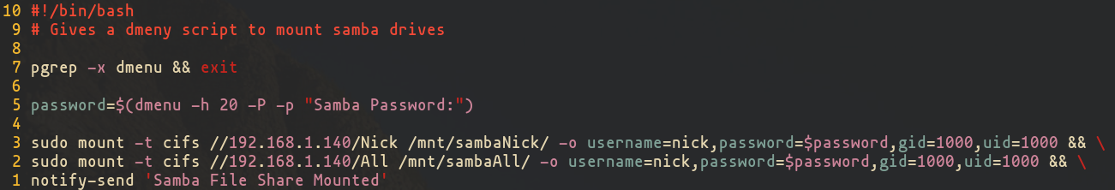
SAMBA
If you don’t like storing passwords
dmenu
  Password patch needed

Slide 20
Media Server
Plex
Volumio
Camera (Raspberry Pi)

Slide 21
Final Thoughts
I’ve learnt a lot
I don’t think I would have started/finished it without SLUG
Making a presentation on it meant I also had to know how I got it to work and made me acknowledge where it is still not finished.

Slide 22
Any Questions/Suggestions??

