Slide 1
Introducing Linux in A Developing Country
El Salvador
Summer, 2007
Roger Broseus

Slide 2
We will:
Set the scene – important to understanding complexity of problems
  Getting there & the the town
  Economy
Visit the Sta. Marta computer center
Introduction of Linux
  Successes
  Problems
  Resources
  Needs

Slide 3
Setting the Scene
Location of effort:
Santa Marta
El Salvador

Slide 4
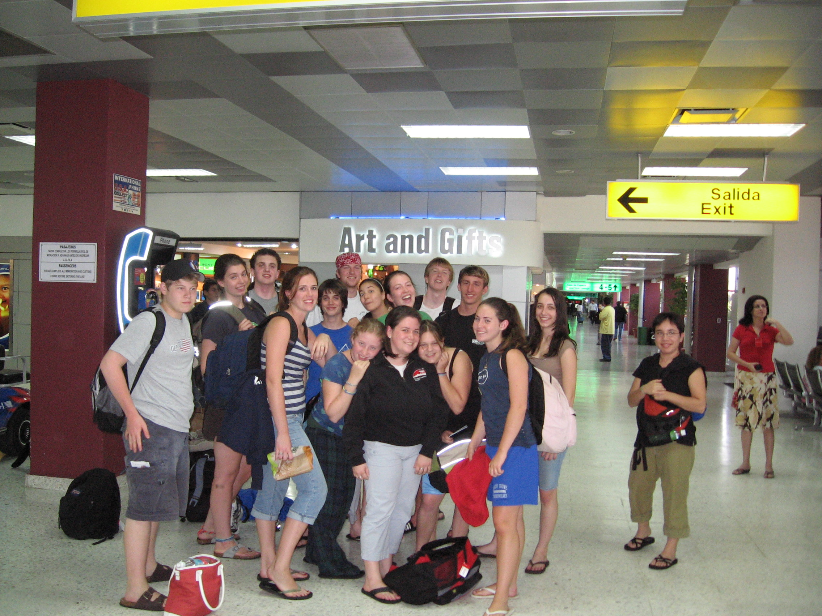
Purposes of Trip: Chaperoning
Opportunity to Introduce Linux

Slide 5
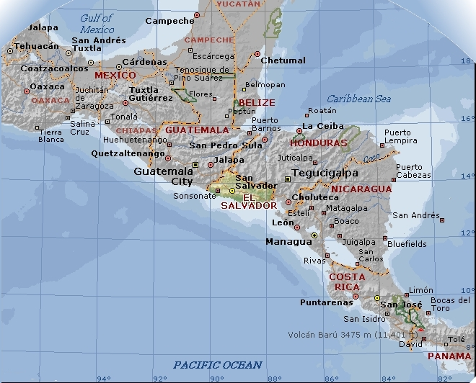

Slide 6
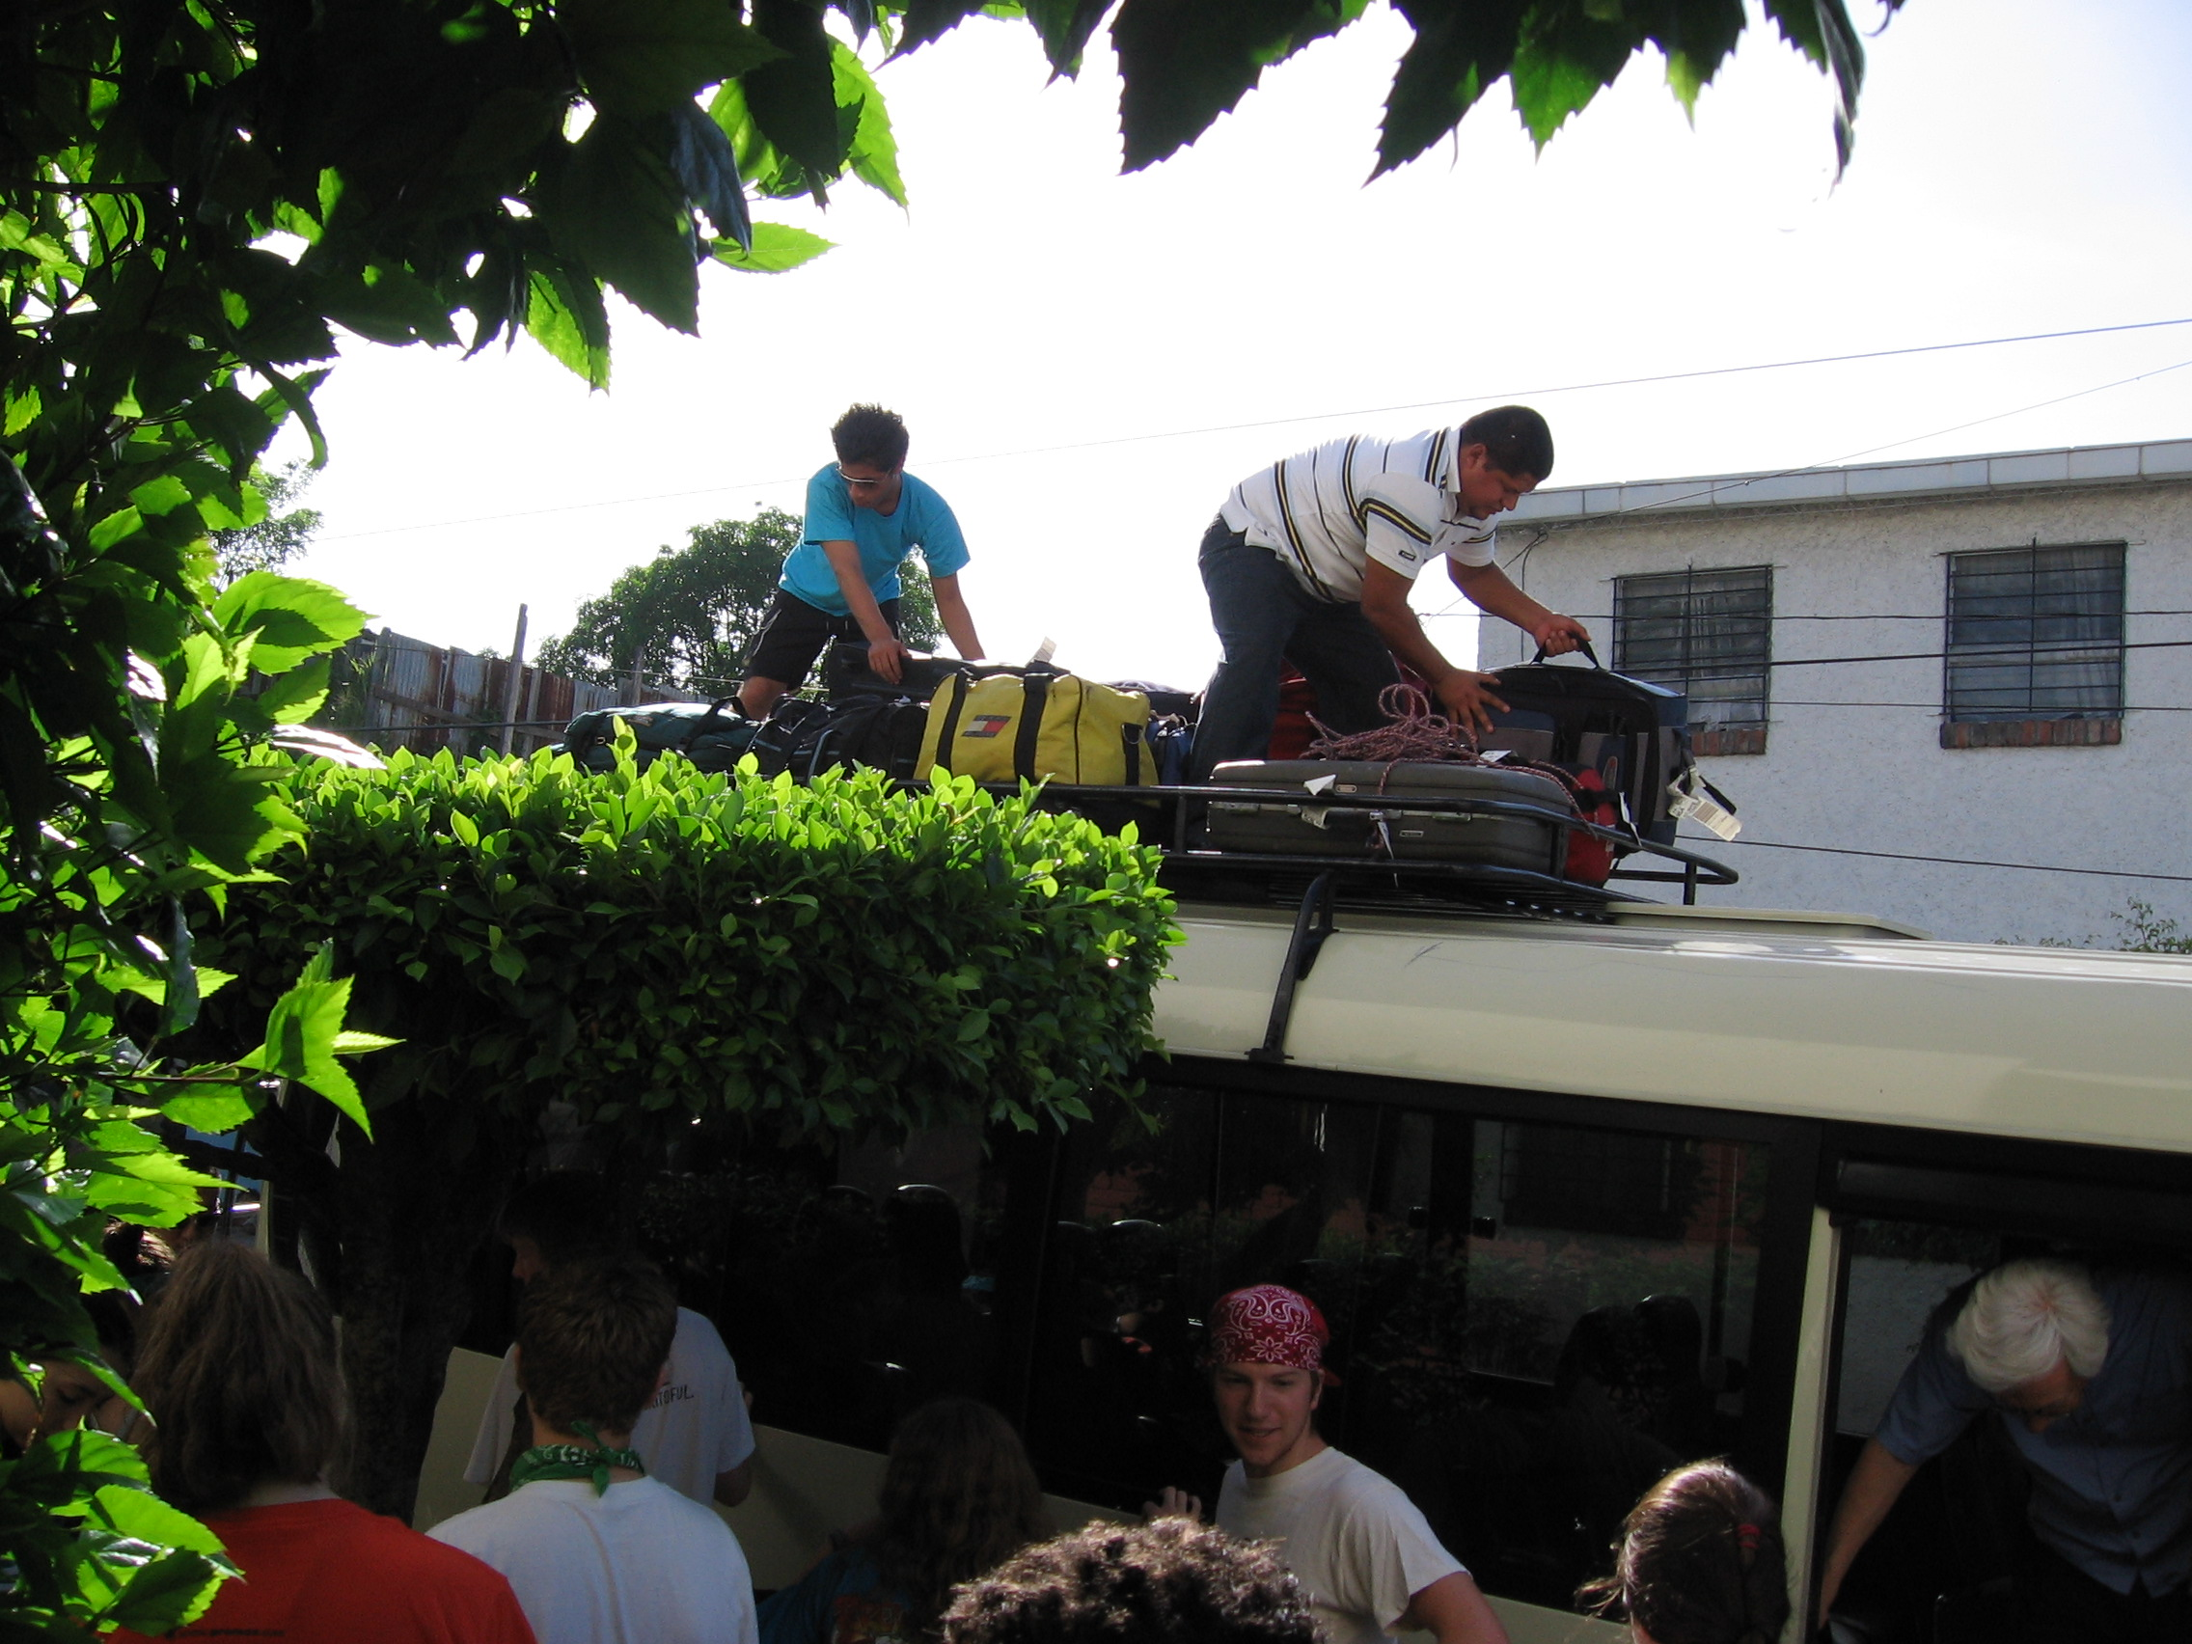
Getting There
PC Transport

Slide 7
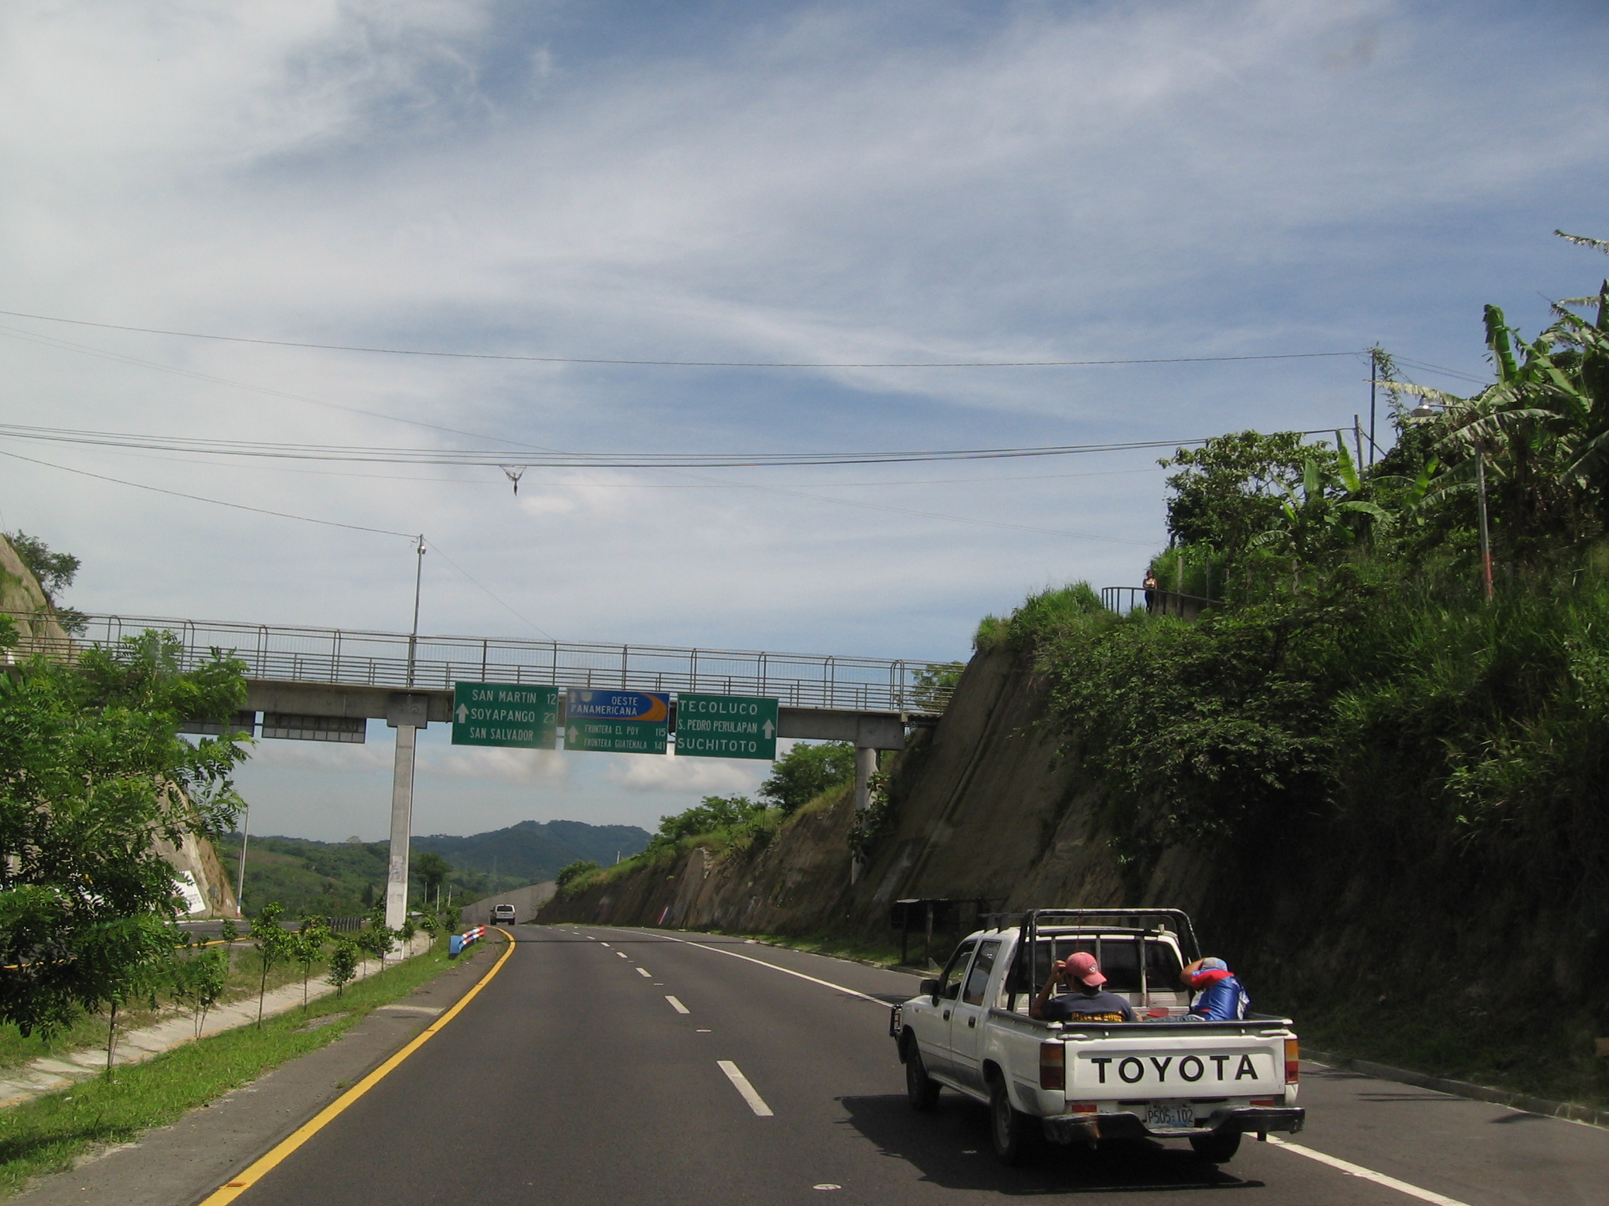

Slide 8
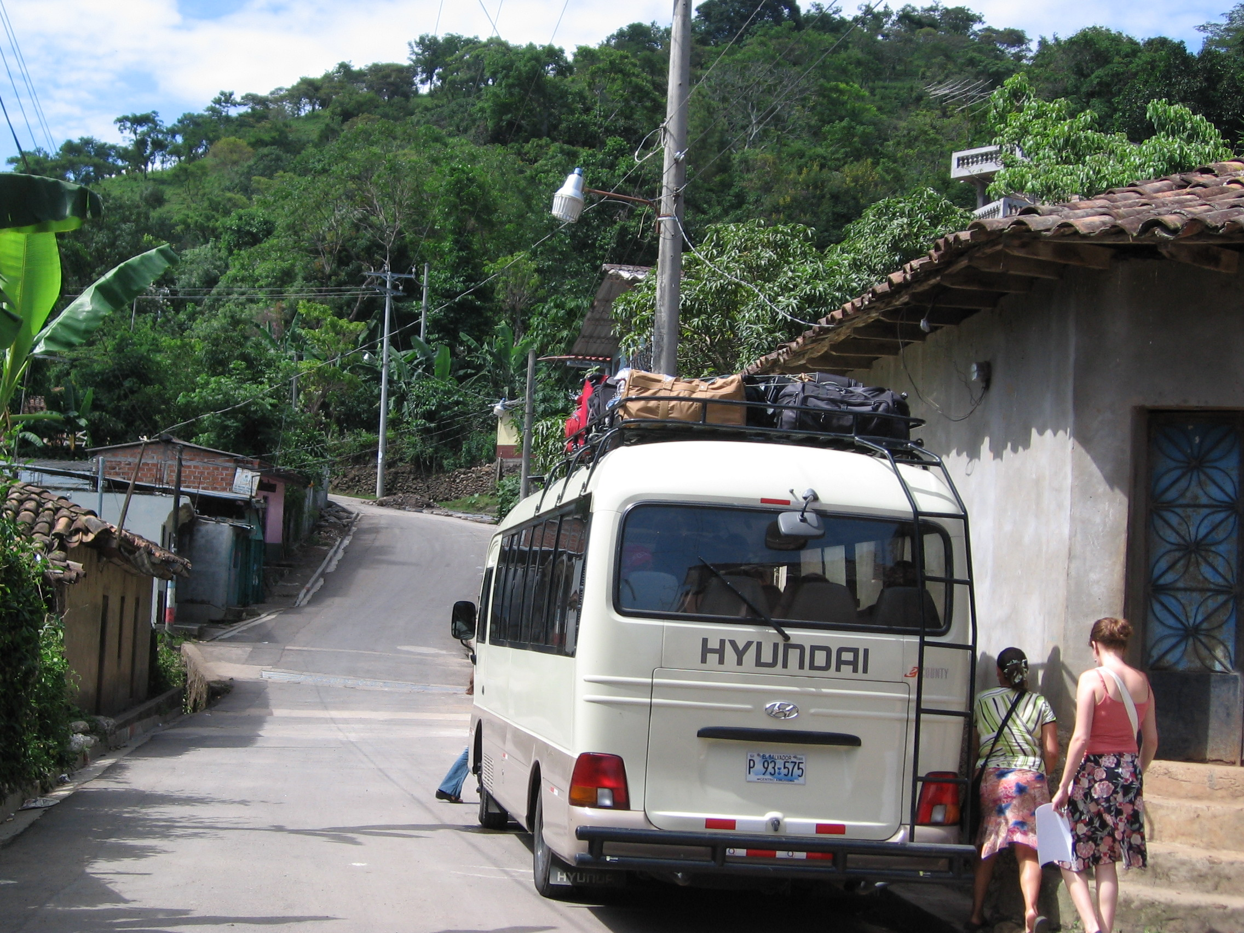

Slide 9
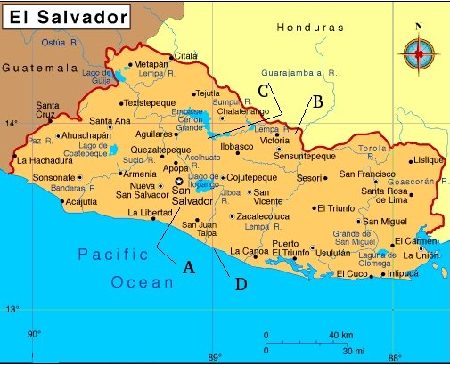
“B” Marks the spot

Slide 10
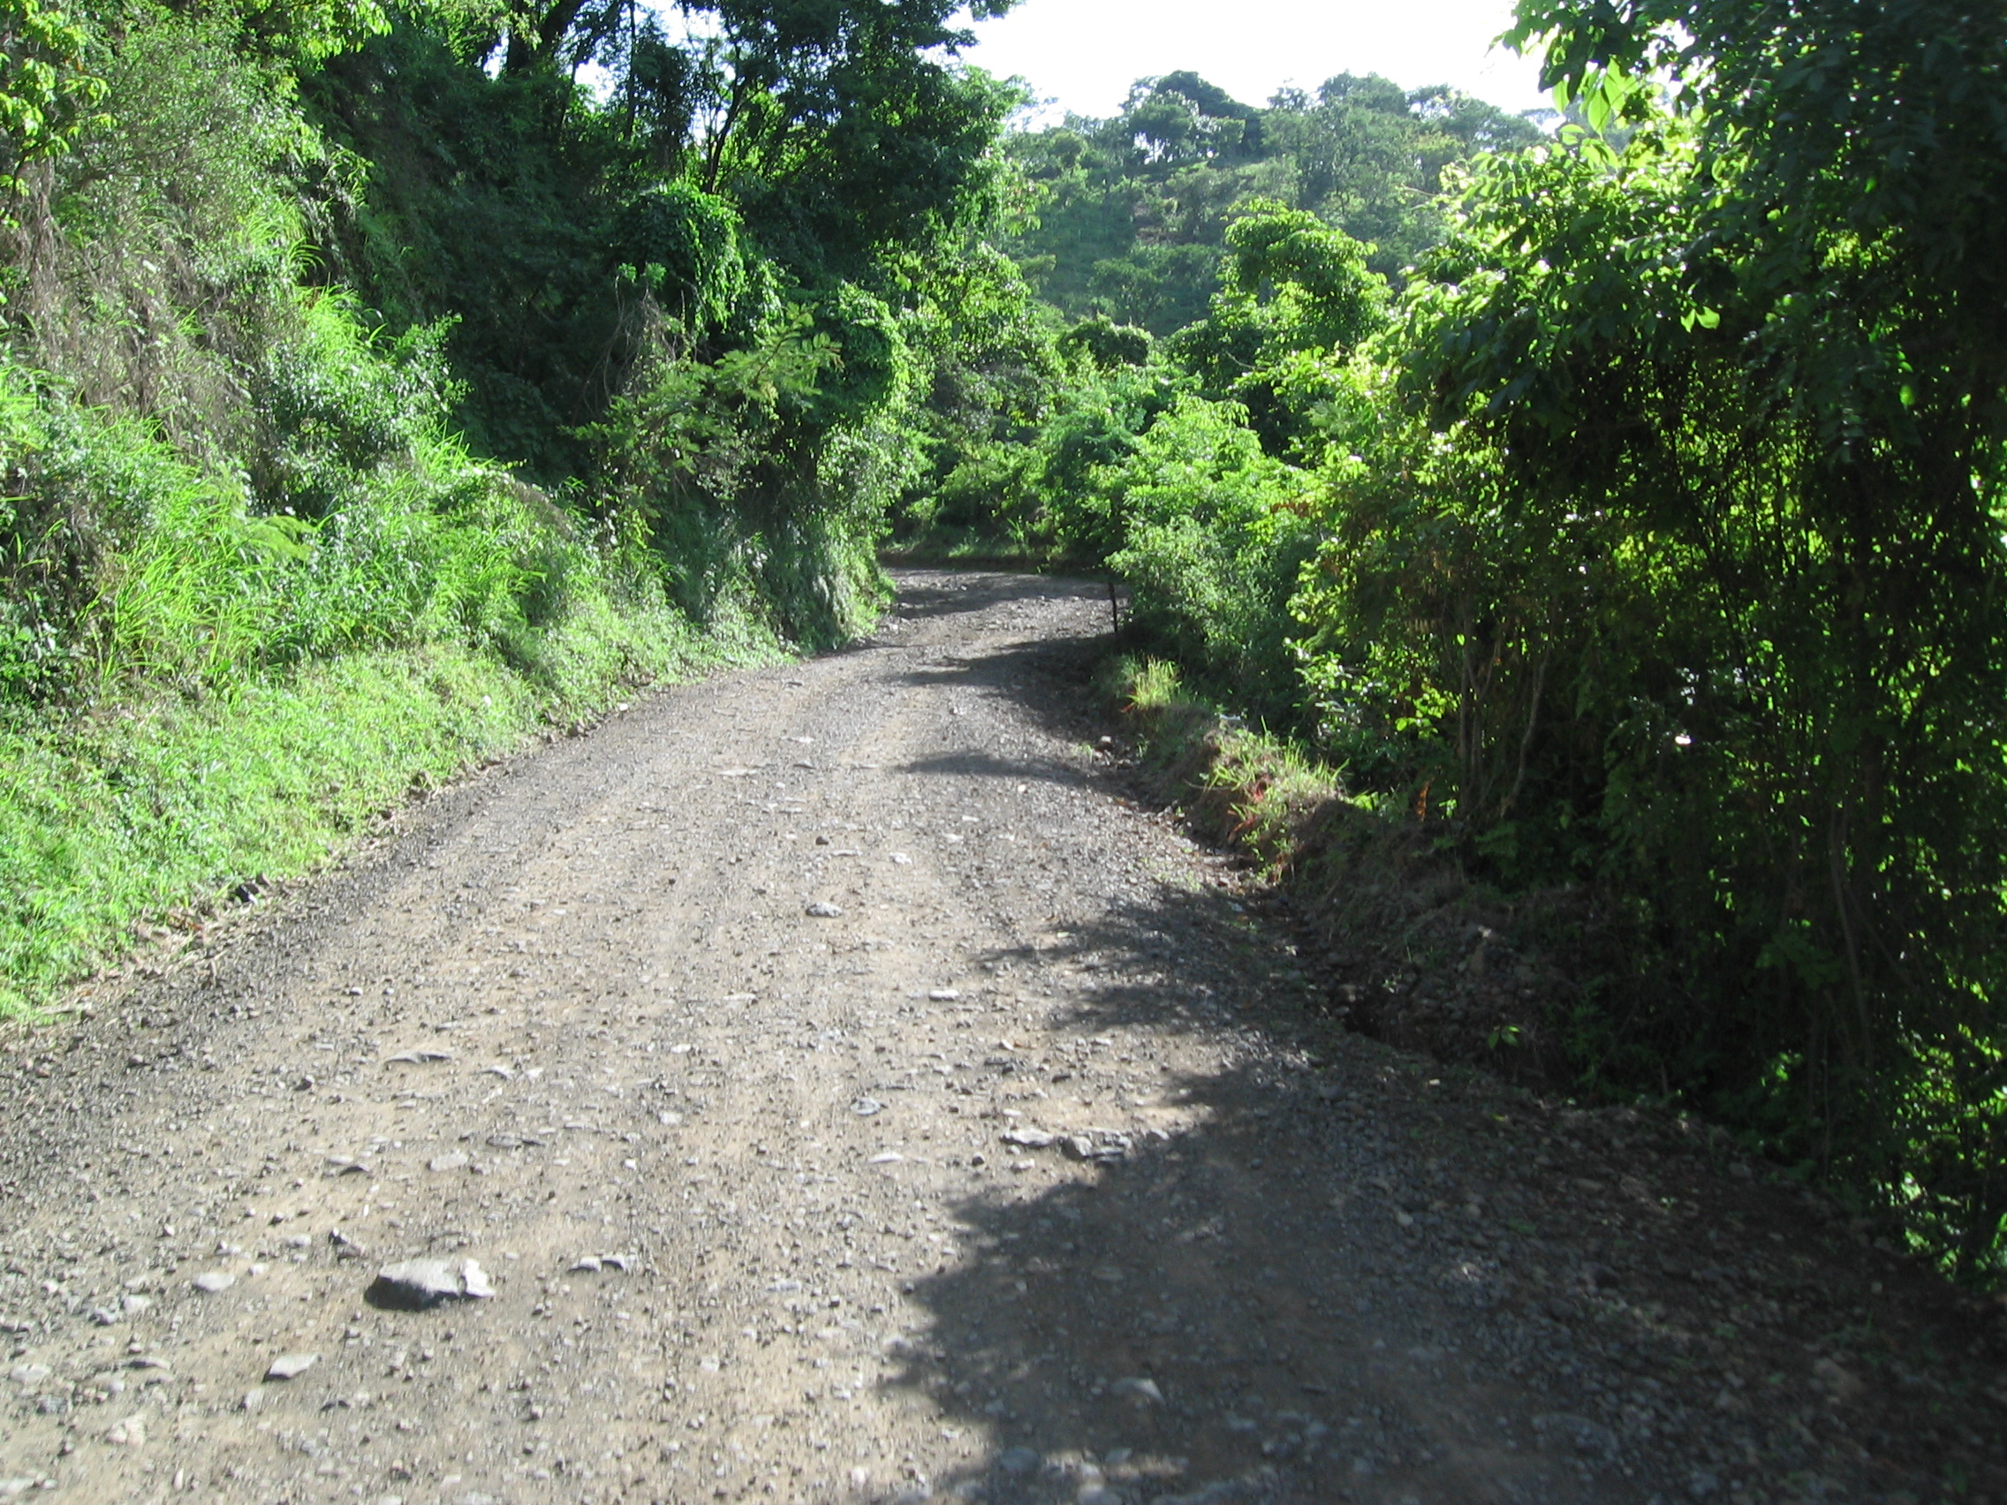

Slide 11
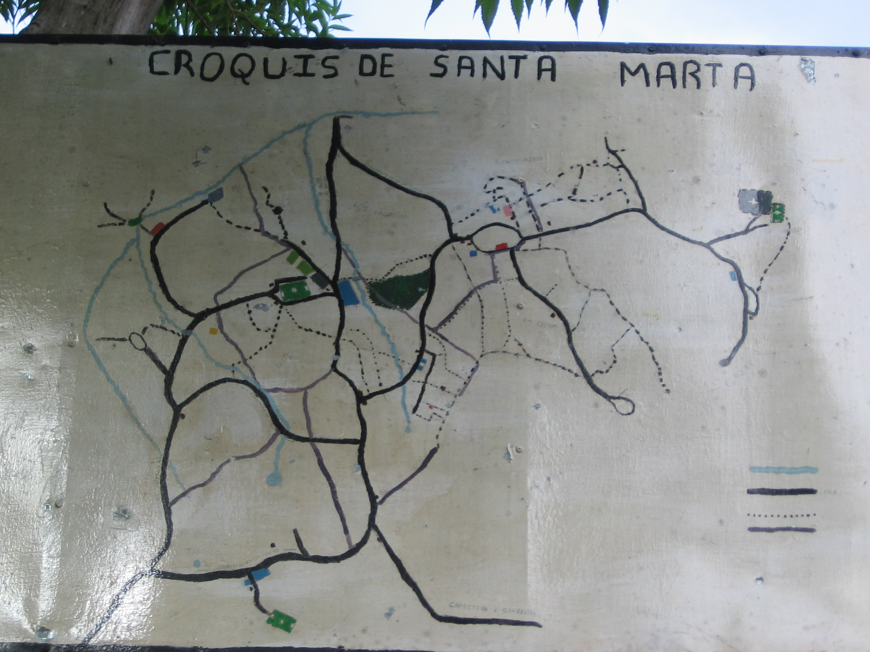

Slide 12

Equivalent of daily, per-capita income ($3)

Slide 13
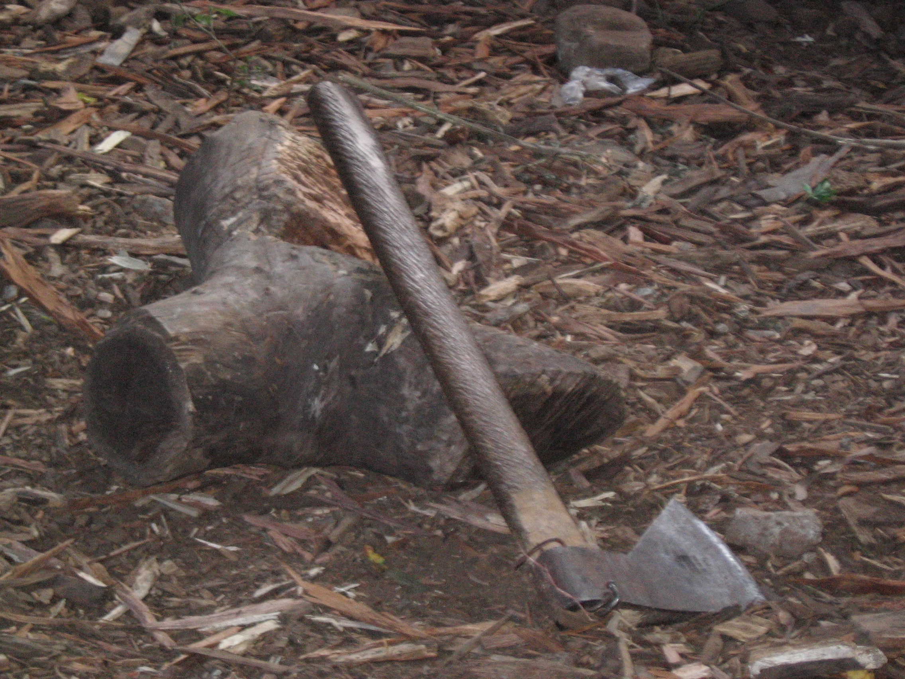

Slide 14
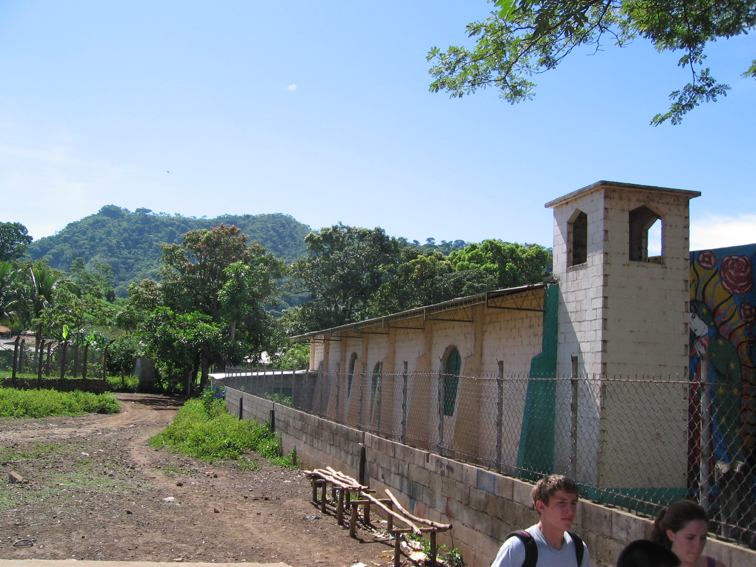
Walking to the Computer Center

Slide 15
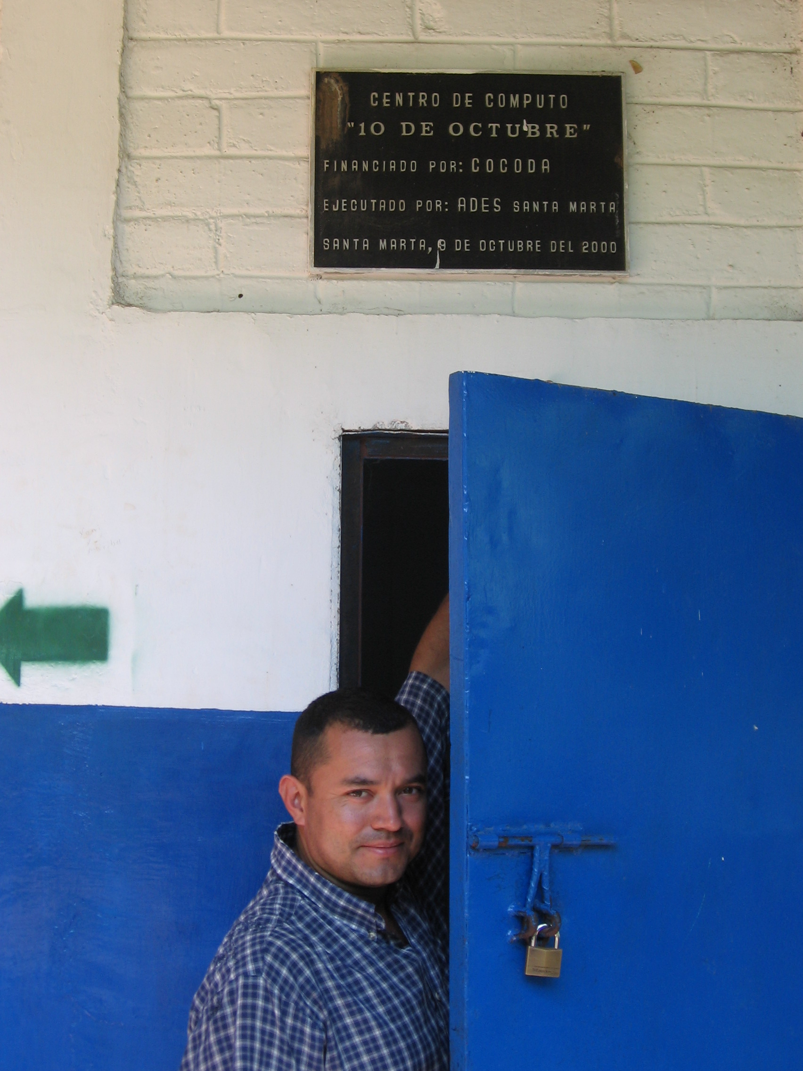

Slide 16
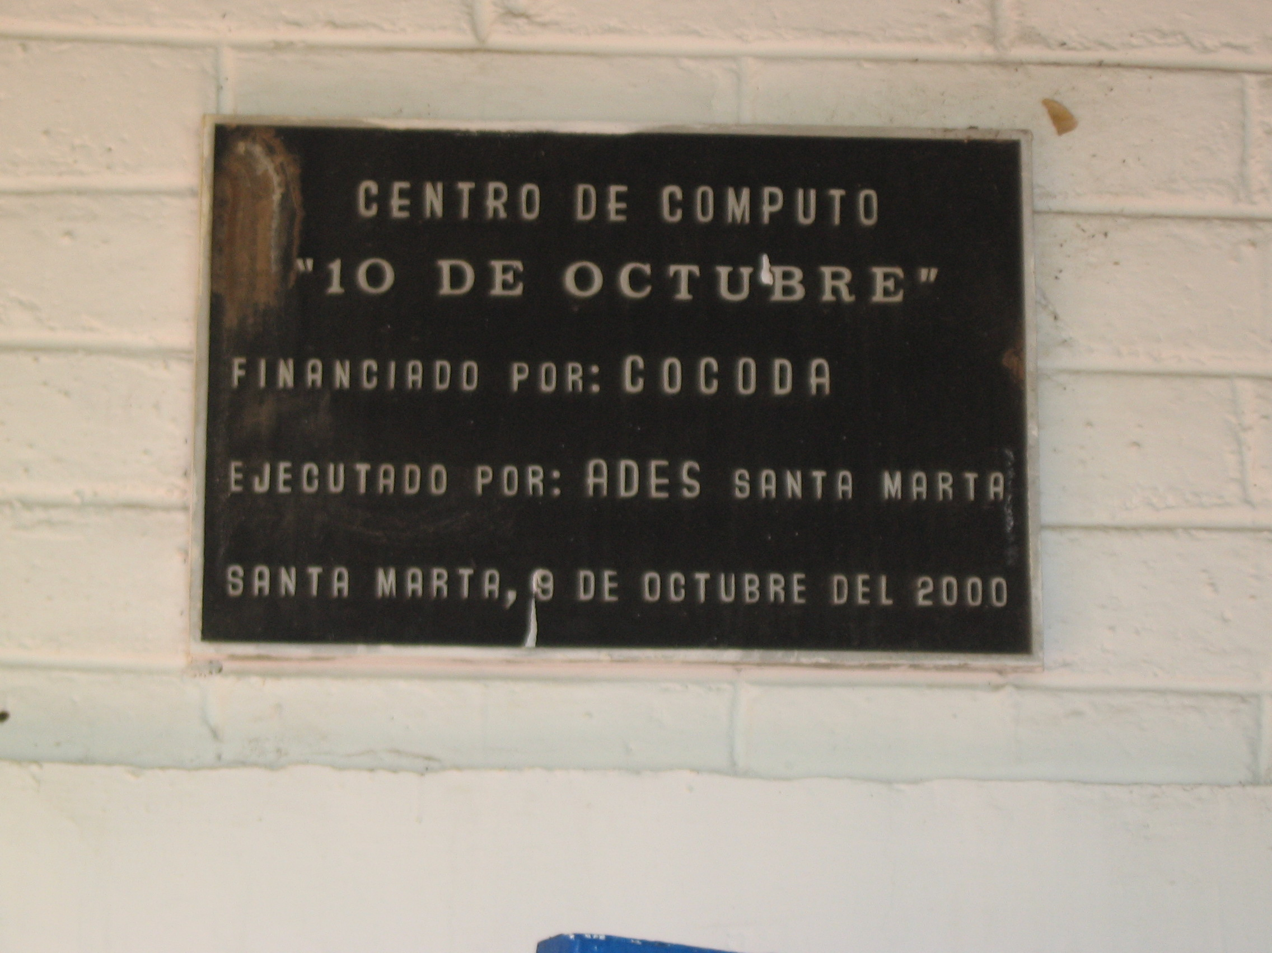

Slide 17
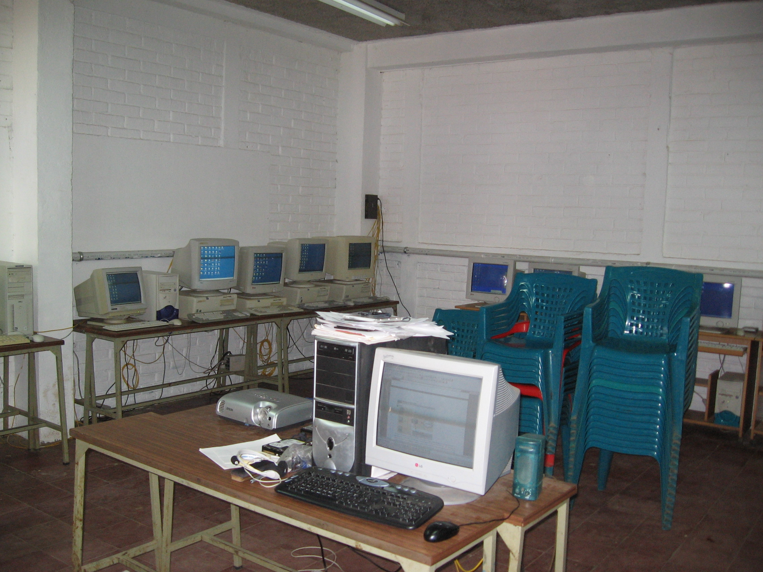

Slide 18
Provisions (Distros, etc.)
Ubuntu
Knoppix
Puppy Linux
DSL (Damn Small Linux
Super Grub
Partition Magic
Wings & Prayers

Slide 19
Problems
Antiquated PCs
Installation Difficulties:
  Partitioner clumsy / hard to use
  Grub not installed
  Could not boot from CD and “see” HD – bios inadequacies (?)
Power outages
Old monitors hard to read
Unreliable /slow internet connection (satellite only)
Communications: difficult at best
  Language barrier
  Unreliable connection

Slide 20
Successes:
Frustration:
Puppy Linux installed / ran well on 15 y.o. Compaq laptop
Ubuntu installed on more recent vintage desk top
Installed first in English
Installed in Spanish – custom variant for Latin America
Aided greatly by Juan-Raf – overcame language barrier
Demo select apps (OO, Firefox, Gimp, etc.)
Students observed using OO day after installation!
No direct word from Sta. Marta - 1 year ago

Slide 21
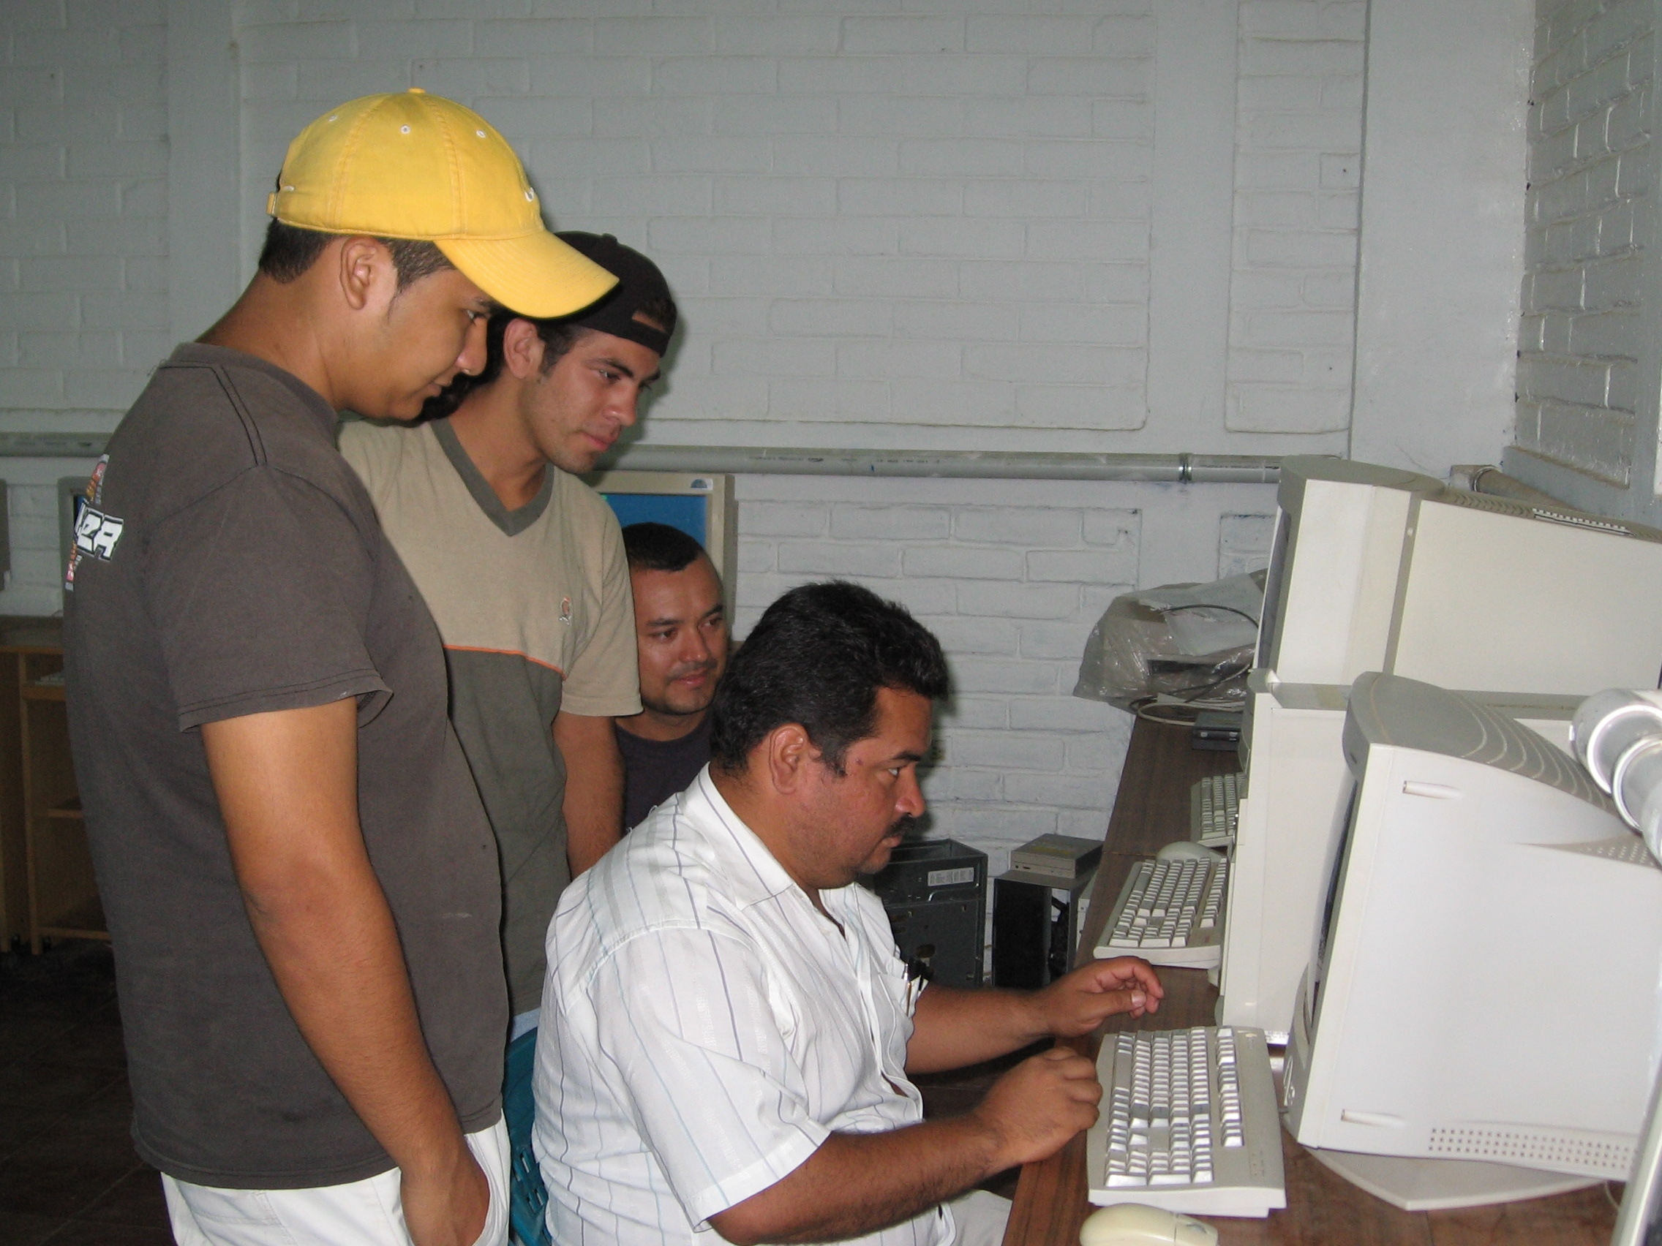

Slide 22

Enthusiastic staff / break-time.
(Smiles follow)

Slide 23
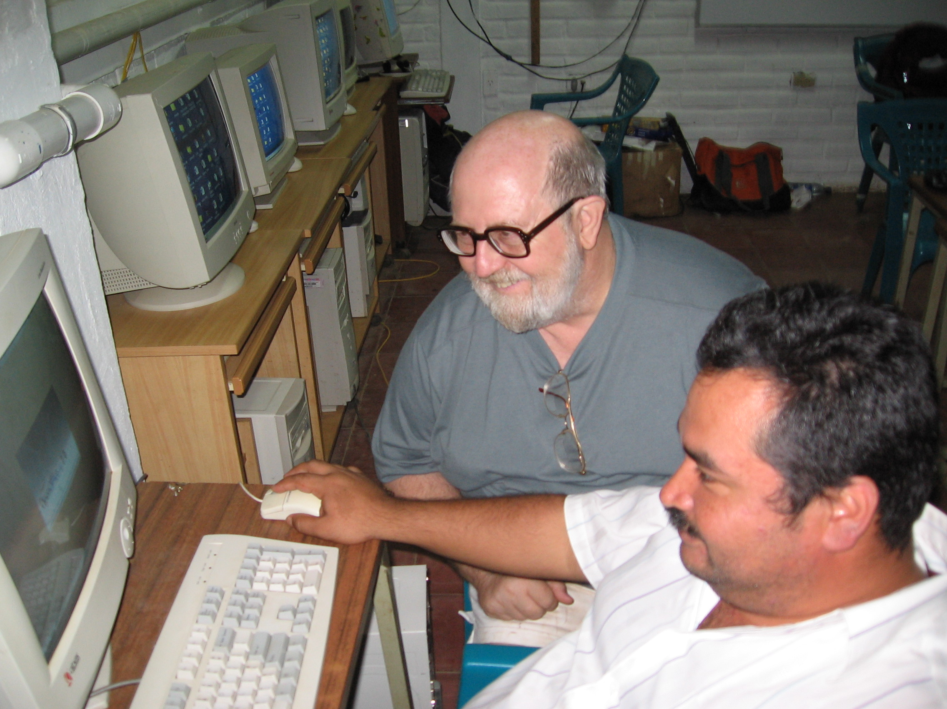

Slide 24
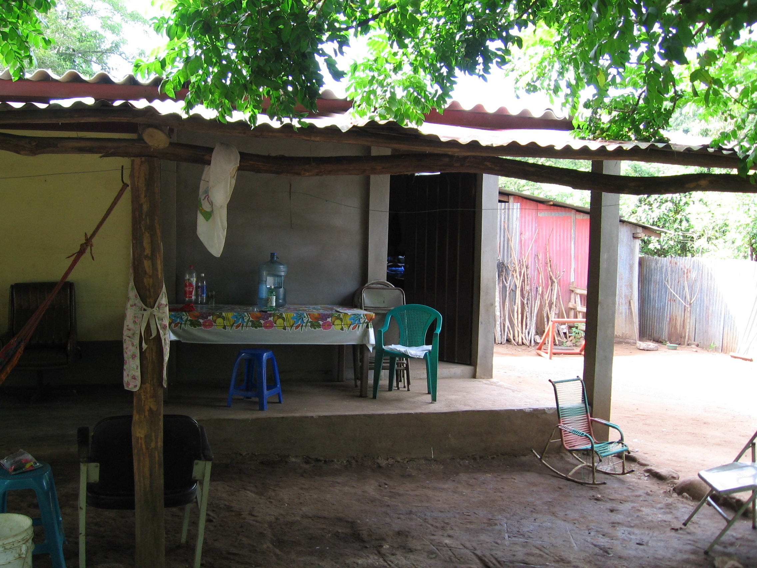

Slide 25


Slide 26
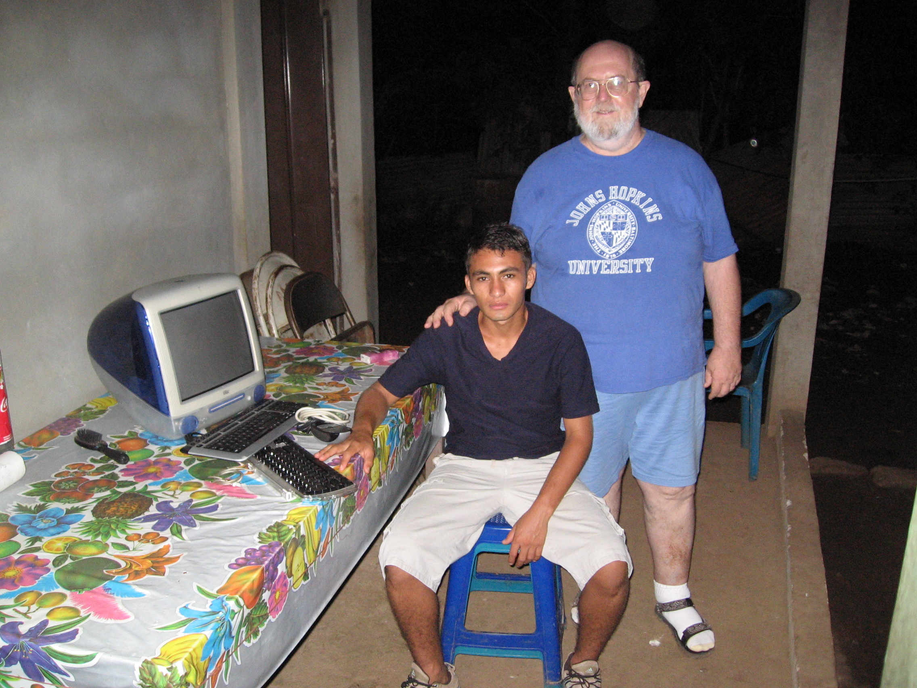

Slide 27
Resources / Needs
Ubuntu LoCos & teams, including international
  http://ubuntuforums.org/forumdisplay.php?f=183
  https://wiki.ubuntu.com/LoCoTeamList
El Salvador Ubuntu mailing list (like NOVALUG)
  https://lists.ubuntu.com/mailman/listinfo/Ubuntu-sv
El Salvador Ubuntu Team (wiki)
  https://wiki.ubuntu.com/ElSalvadorTeam
doc.ubuntu-es
  http://doc.ubuntu-es.org/Portada
Need distro(s) that really work on old machines – finds hardware and installs drivers
  Xubuntu recommended for Pentium III

Slide 28
Resources / Needs
(continued)
Installation/LowMemorySystems – Ubuntu
  https://help.ubuntu.com/community/Installation/LowMemorySystems
Other non-English Resources, Ubuntu
  http://www.ubuntu.com/support/local
Use central server
  Use old PCs as “thin clients”
Transportation of donated equipment hampered
  Theft
  Cost

