Slide 1
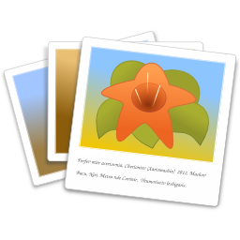



Photographs & Linux
Overview - Intro
First-order management of photos
Many Images – cull / sort with gThumb
Edit photos – The GIMP
Album Creation – jAlbum
Upload – Filezilla
Presentation posted: bronord.com/novalug
Roger Broseus, presenter
NOVALUG Meeting, 12/14/2013

Slide 2
Organize / Sort Images
Managing large number of images
Create a set (copy) of originals
  Recover from mistakes, e.g., accidental deletions
gThumb: convenient for initial culling / sorting- organizing
  Do before editing images

Slide 3
Create Albums – jAlbum
Powerful, feature laden
Final organize re-arrange photos
Annotate with comments visible to viewer on web
Numerous skins
Handles videos
Favorite skins: Turtle & Chameleon
Geo-location: location of photo on Google Maps
Weak smart phone support – but improving

Slide 4
jAlbum (Cont.)
Active user forums w/ answers
Server-side software not required
One month free trial 2 GB on-line storage at jAlbum.net
Free to use / license to get rid of ads (see FAQ)
  jalbum.net
Note: Use Oracle's Java instead of OpenJDK version

Slide 5
jAlbum license Discount
40% for NOVALUG
40% discount code
  novaLug
Valid Dec. 14, to Feb 14, 2014
Courtesy of David Elkholm, jAlbum developer

Slide 6
Album Uploads – Filezilla
Fast – multiple upload “threads”
Nice GUI
Site manager – set i.p., etc., forget
Secure connections – SFTP
Selectively upload only new files
If uploading jAlbum – all files in
  /MyAlbums/<album name>/album

Slide 7
The GIMP
GNU
Image
Manipulation
Program
Standard in many Linux distros
Ports to Windows, MAC, and (reportedly) Android
GIMP: $ 0
Photoshop: $ 1k
  Now subscription (~$ 50/mo?)

Slide 8
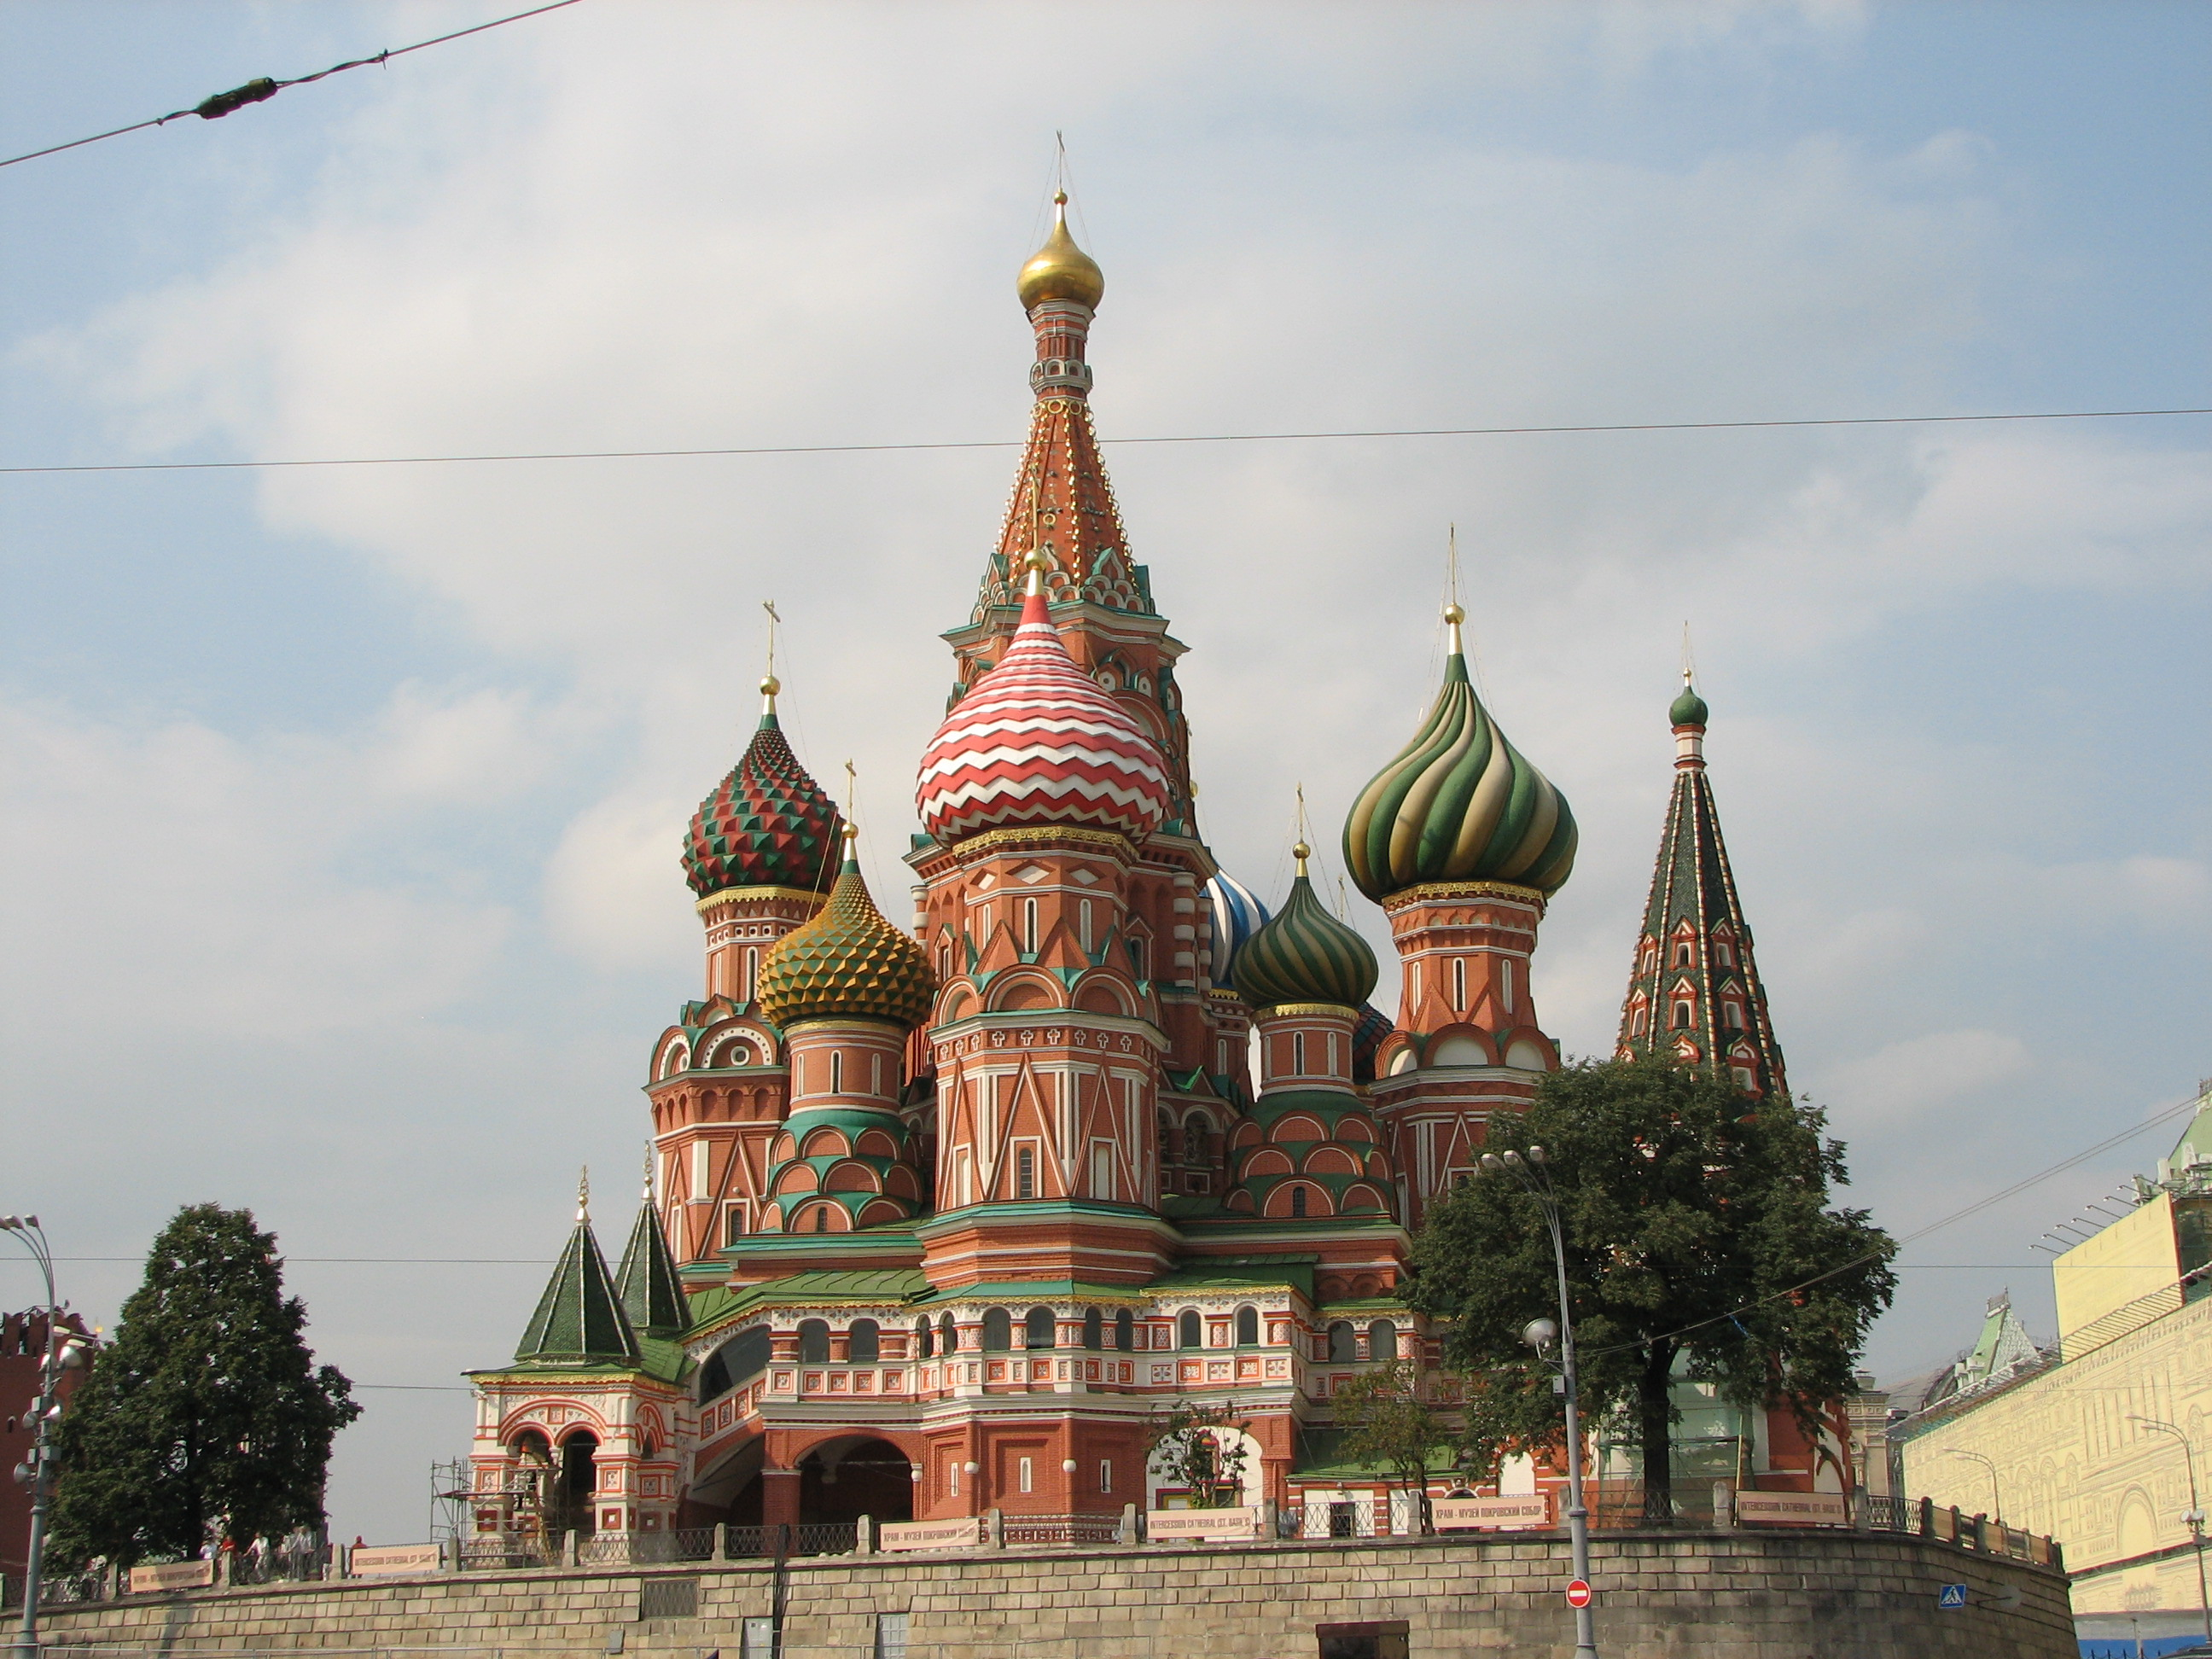
The Power of The GIMP
Wire
Wire
Wire
St. Basil's Cathedral
Moscow
Street
Light

Slide 9
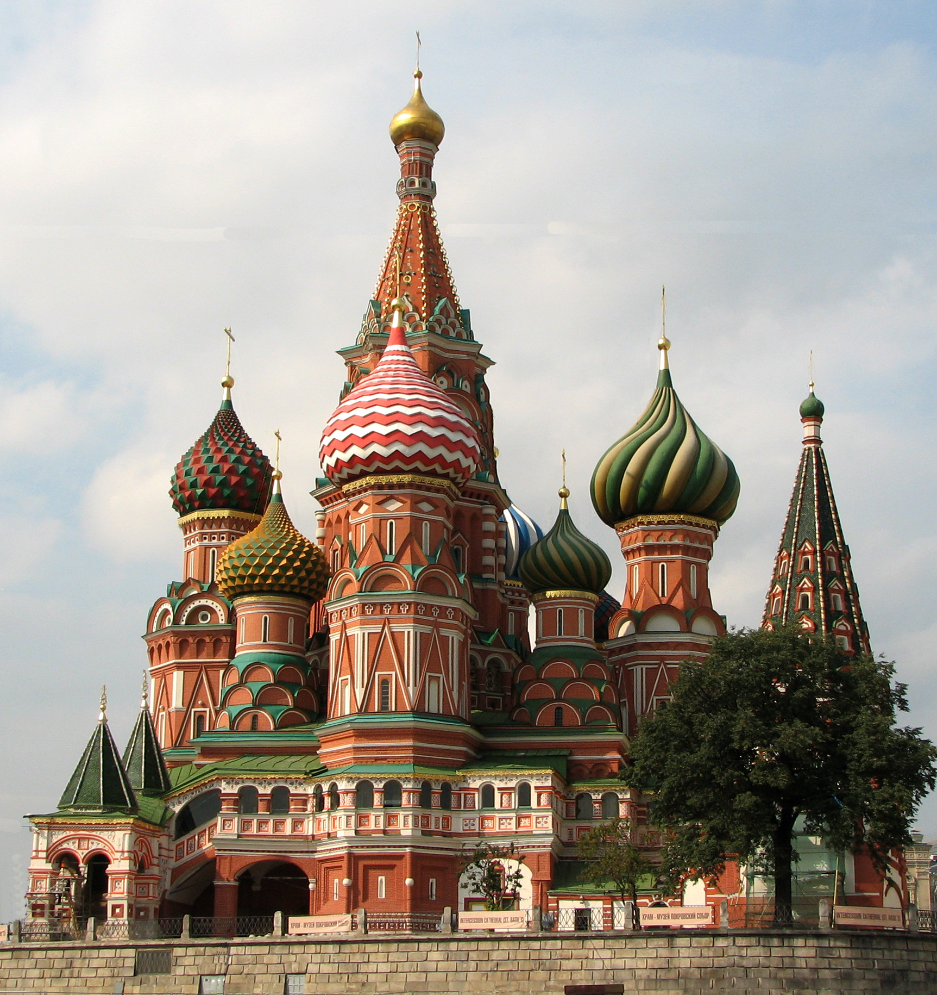
St. Basil's after Edits

Slide 10
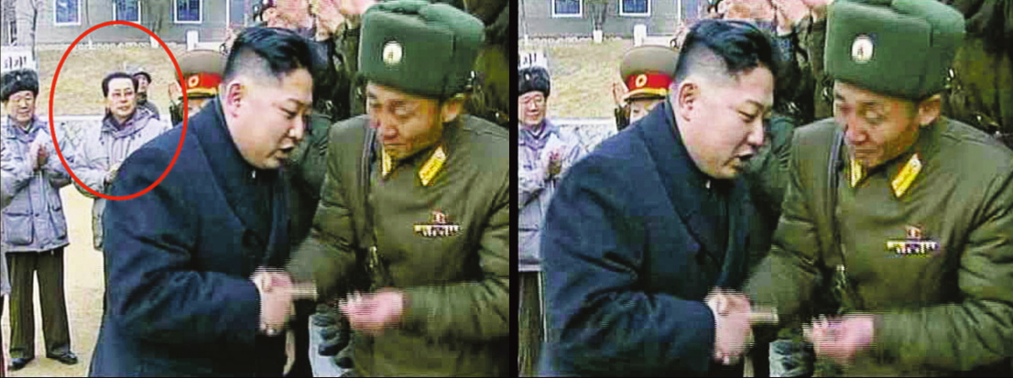
Impossible 1.

Slide 11
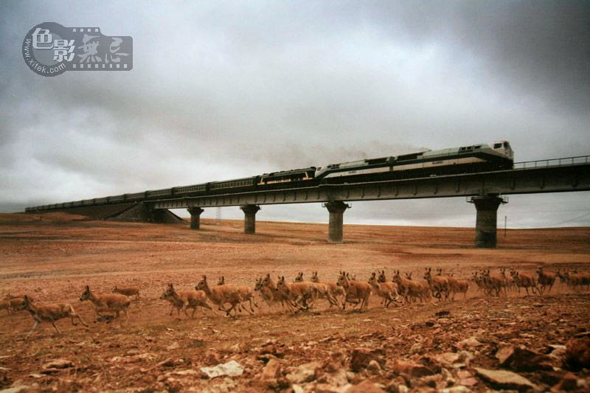
Impossible 2.

Slide 12
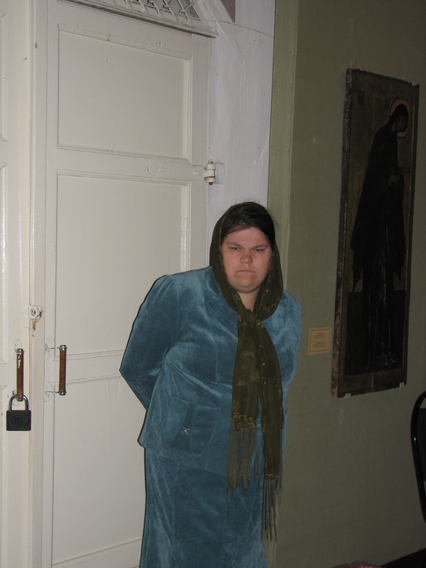
Another Miraculous Change . . .
Lady in Museum Uglich, Russia
(before)

Slide 13
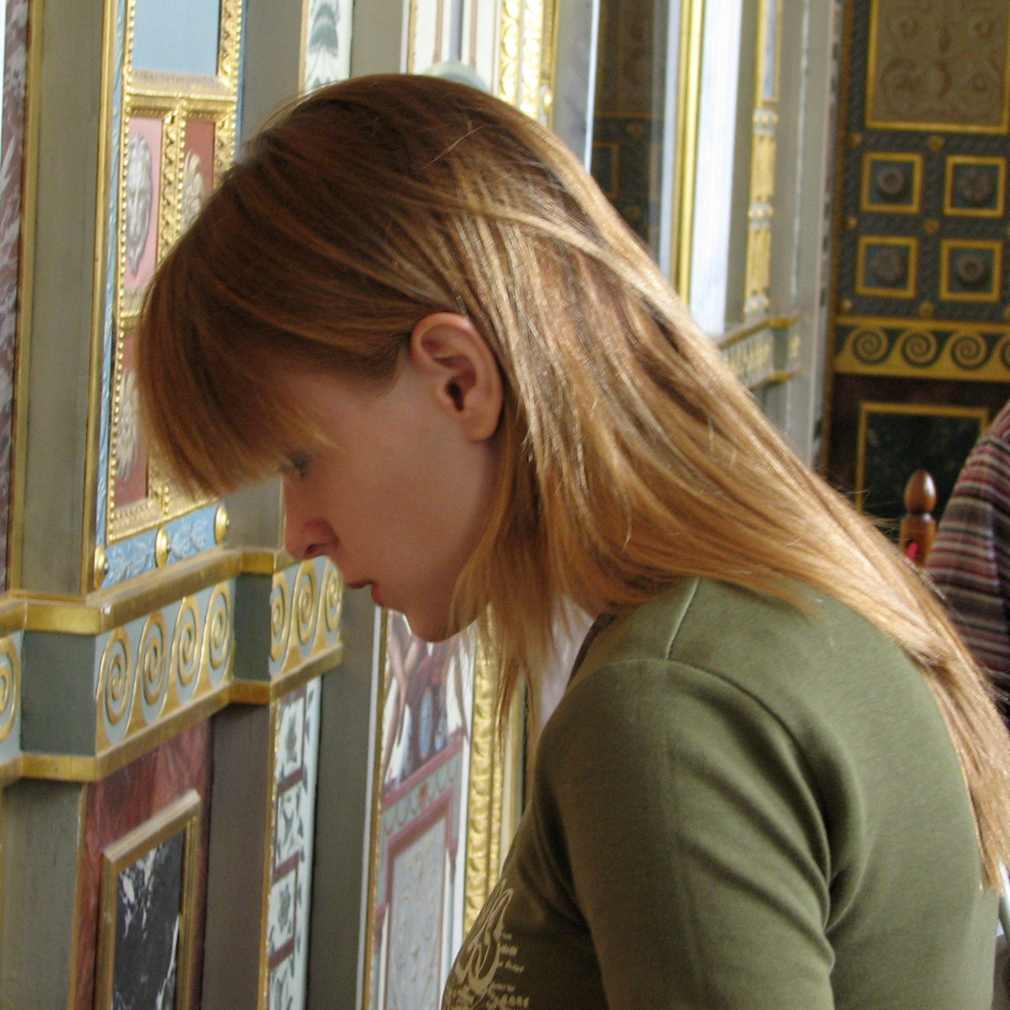
. . . (cont.)
Lady in Museum
(after)

Slide 14
The GIMP
Very powerful photo editor
Pre-installed on many Linux distros
  Ubuntu/Debian, SUSE, Fedora, Mandriva, BSD, Solaris, more
Readily available
  http://www.gimp.org/

Slide 15
GIMP Documentation
Extensive on-line help available
Manual / tutorial
  http://docs.gimp.org/2.8/en/
  Step-by-step procedures illustrated
Grokking the GIMP
  http://gimp-savvy.com/BOOK

Slide 16
Tips / File Formats
Keyboard shortcuts – useful for
  commonly repeated actions
  Quick access to menu items
  Change with: Edit > Keyboard Shortcuts
.xcf files
  GIMP's loss-less file format
  Save intermediate edits / layers
  Lossy formats e.g., .jpg, .gif
    Get image degradation
    Loose intermediate edits, layers merged, no undo

Slide 17
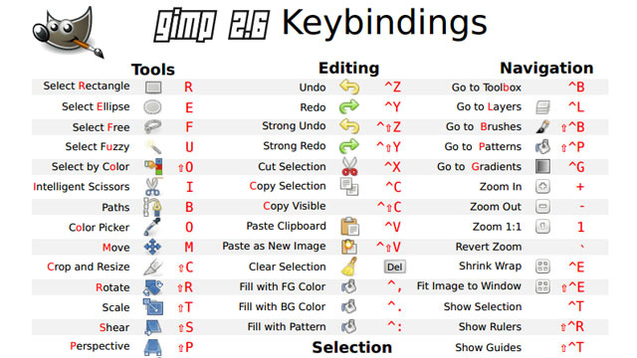
Shortcuts (default)

Slide 18
Tips (Cont.)
Always use sRGB color profile for web (default)
Setting sRGB color profile
  Image > Mode > Assign / Convert to Color Profile, or
  Pick it when if GIMP prompts an image is opened

Slide 19
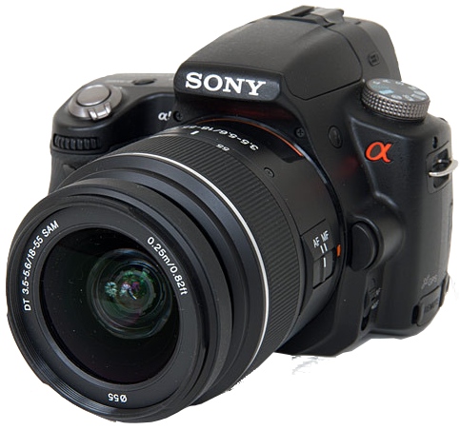
Tips (cont.)
Think ahead
Optimize framing – avoid too tight
  Leaves room for cropping and other image edits
Shoot at high resolution
  Preserves detail / facilitates “digital zooming”
Make sure GPS is locked on satellites
  To insure location of shot is correct
Polarizing filter
  The one filter to have
  Remove haze / glare / reflections

Slide 20
Examples
Example albums:
  http://www.bronord.com/pics
Basics
  Cropping, rotating
  Color level adjustment
  Highlight an area
    Line drawing
    Create vignette

Slide 21
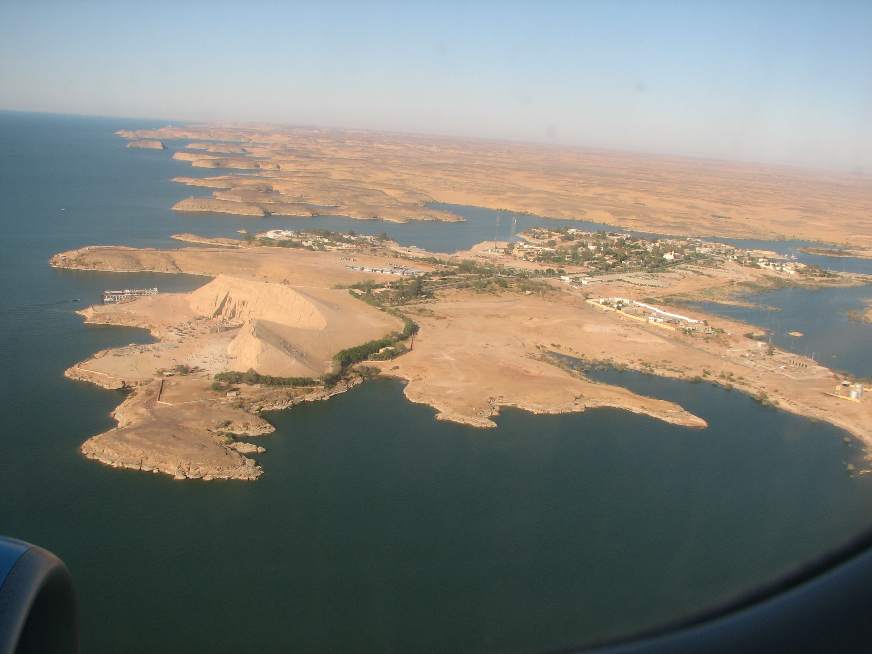
Before Edits
Abu Simbel
(aerial view

Slide 22
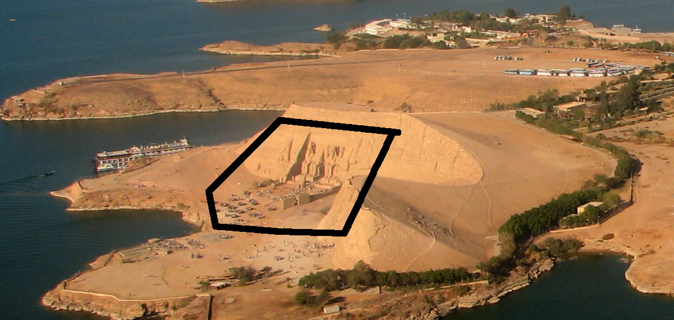
After Edits

Slide 23
After Edits

Slide 24
Using Tools
Open file: File > Open (ctrl-o)
View grid: View > Show Grid
Rotate
  Drag handles / fine tune with “Angle” / Click Rotate to commit)
Crop
  Drag handles to adjust
  <enter> to commit
Adjust color levels: Colors > Levels
Save as .xcf file to retain changes

Slide 25
Geometric Shapes
GIMP is not a “drawing” program
  GIMP: raster graphics – think bit map / pixels
  vs. vector graphics, e.g., Inkscape (recommended)
  Ref: vector vs. raster graphics editors
Construct geometric figures using built-in tools
  Select elliptical area > Edit > Stroke selection > click Stroke to commit
  Brute force: do concentric circle selections and fill thin gap with a color

Slide 26
Red Eye Removal
Zoom-in (shift-+) to area of interest
Select area of concern
Filter > Enhance Red Eye Removal
  Area to be fixed is previewed
  Click OK to commit
Enhancement
  Add highlight – like other eye
  Select, copy, position/move selection, click to commit

Slide 27
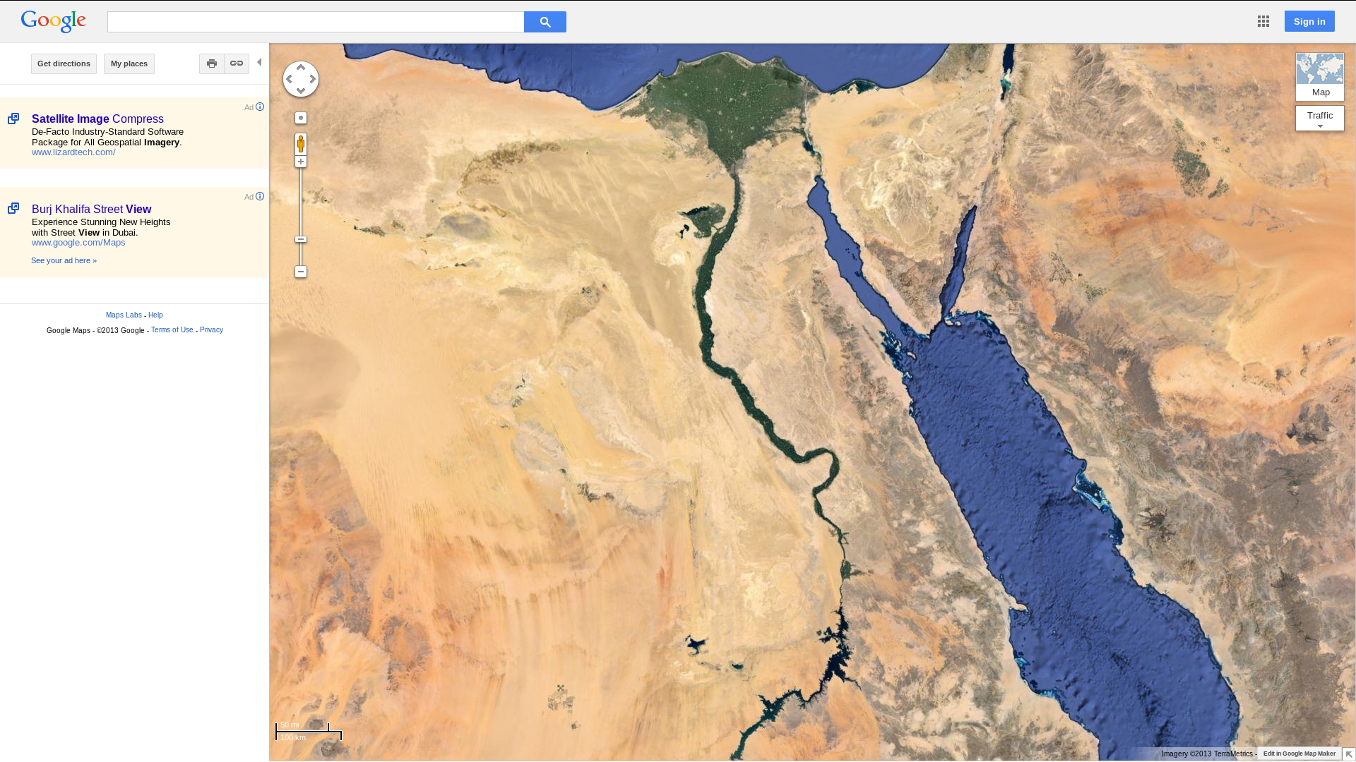
Screen Shots / Layers / Text
Click arrow
to remove
clutter on
Google map

Slide 28
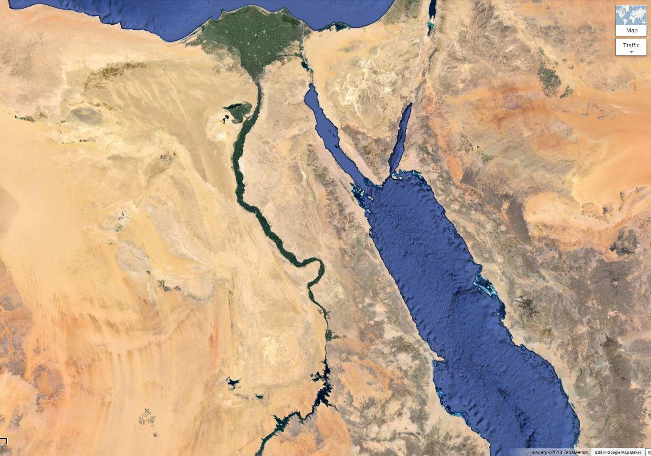

Slide 29
Screen Shot (cont.)
alt-tab to GIMP File > Create > Screenshot
Click on Select region to grab
  Delay 5 seconds – to allow time to switch view
Notice mouse cursor changes to a selection cursor
Drag to select area of interest
  Release and screen shot appears as a new image
Fine-tuning: crop & adjust color levels
  More on levels later
Save the image
  Previously saved as .xcf for use today

Slide 30
Adding Text: the Text Tool
Add text: Text Tool
Position cursor and make a text box (click/drag)
Enter text into GIMP Text Editor Box
Change color of text
  Reveal Text Tool Options
  Click on a Color box
  Pick a color, commit with OK
  Adjust size of text box with corner handles
Change font size
SIZE drop-down
Position text box with 4-headed arrow, commit with Close

Slide 31

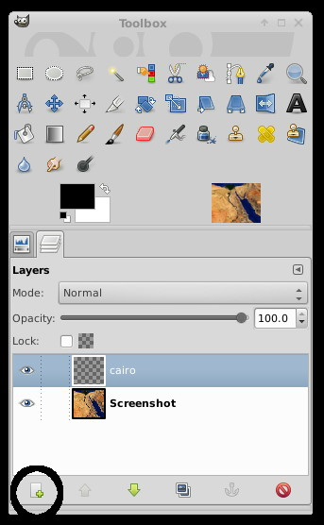
Using Layers
Switch from viewing tool options to viewing Layers
  Click Layers icon to reveal layers
Create a new layer
  Small icon on far bottom left
Select the layer by clicking on it
  Name Layers for future reference
Create /position text on the layer
EYE icons reveal / hide layers

Slide 32
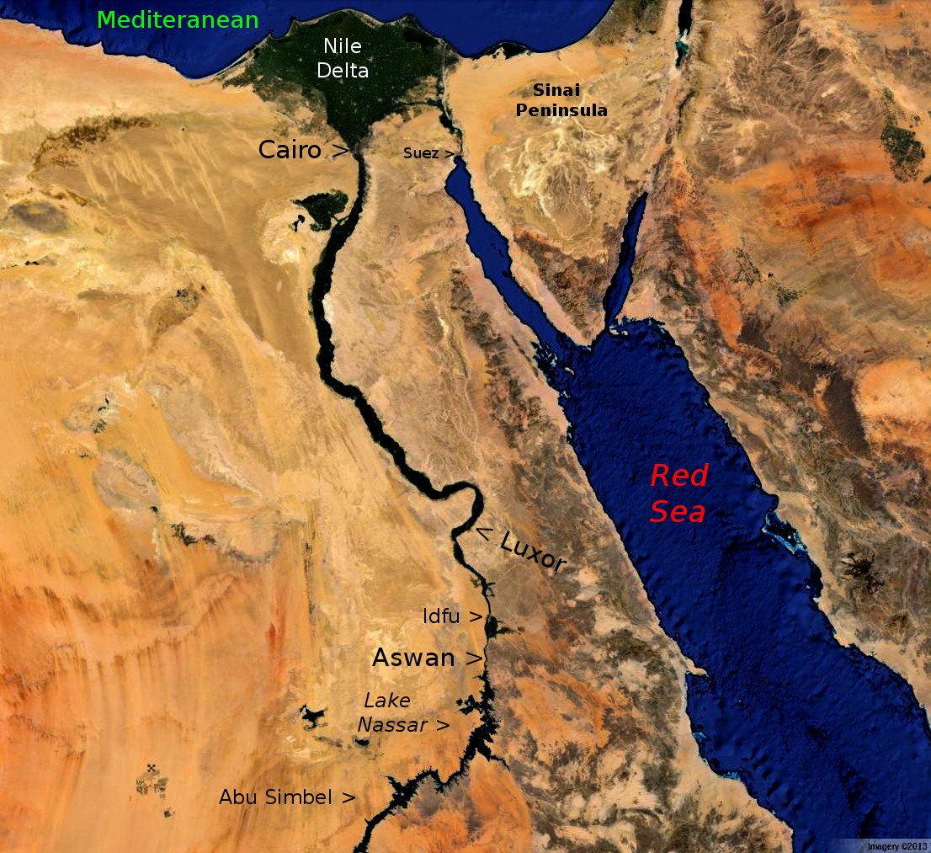

Slide 33
Layers (cont.)
Layers enable many tricks
  e.g., re-use of image
Opening map previouslys saved as .xcf file
Previously added layers retained in .xcf files
Create different versions of image
  Selectively hide / reveal layers
  Save each as, e.g., .jpg files for later use

Slide 34
Exposure / Color Adjustments
Very useful tool – Colors > Levels
Adjust overall lightness / darkness
Compensate for some exposure problems
Improve color balance
Use presets to apply levels to multiple images

Slide 35
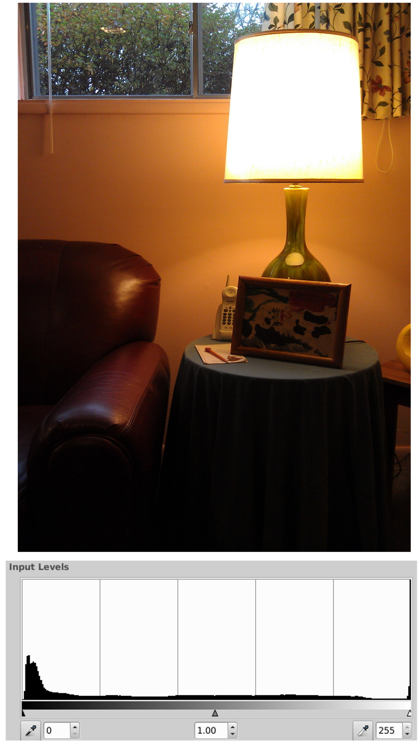
Understanding
Color Levels
Example: image with too broad exposure range

Slide 36
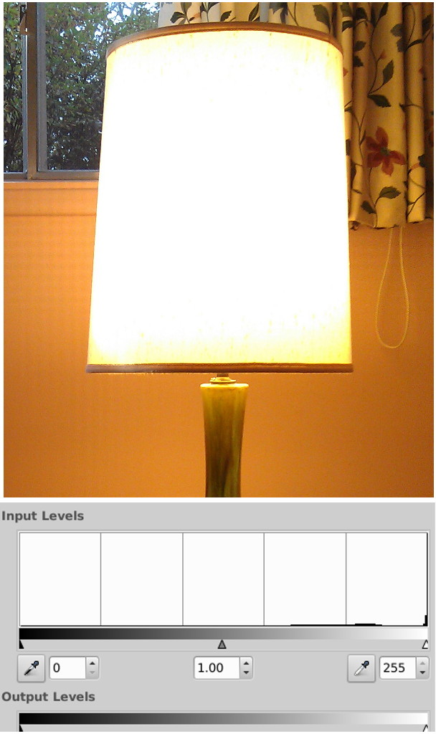
Overexposure
There is little data in the dark and mid-tones

Slide 37
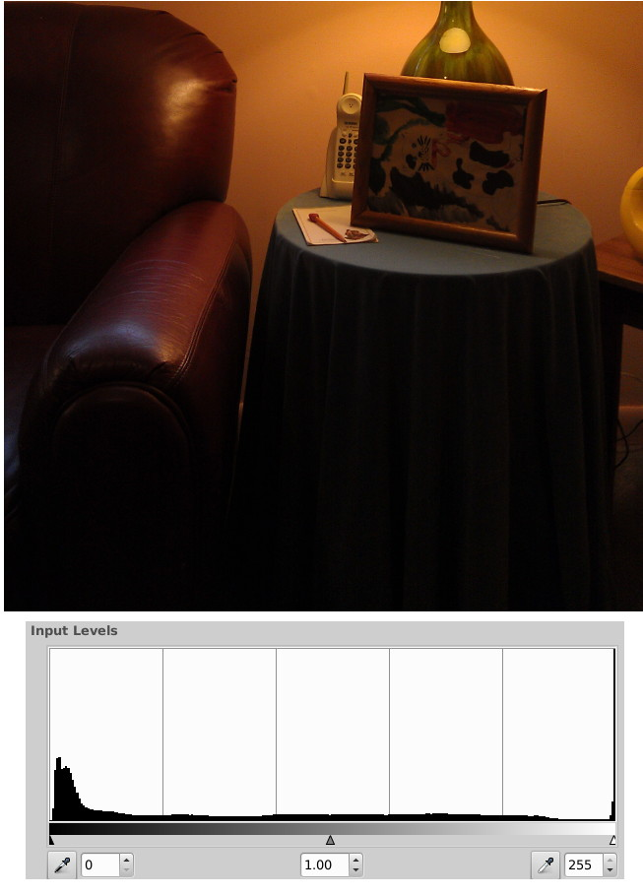
Under-exposed
All of the data is in the dark areas of the image

Slide 38
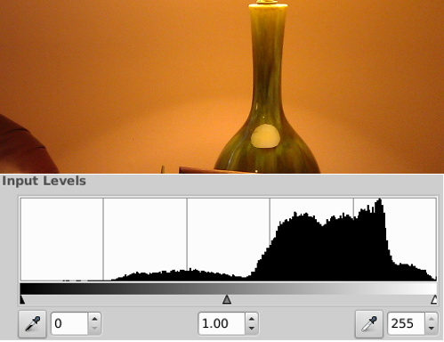
More Correctly Exposed

Slide 39
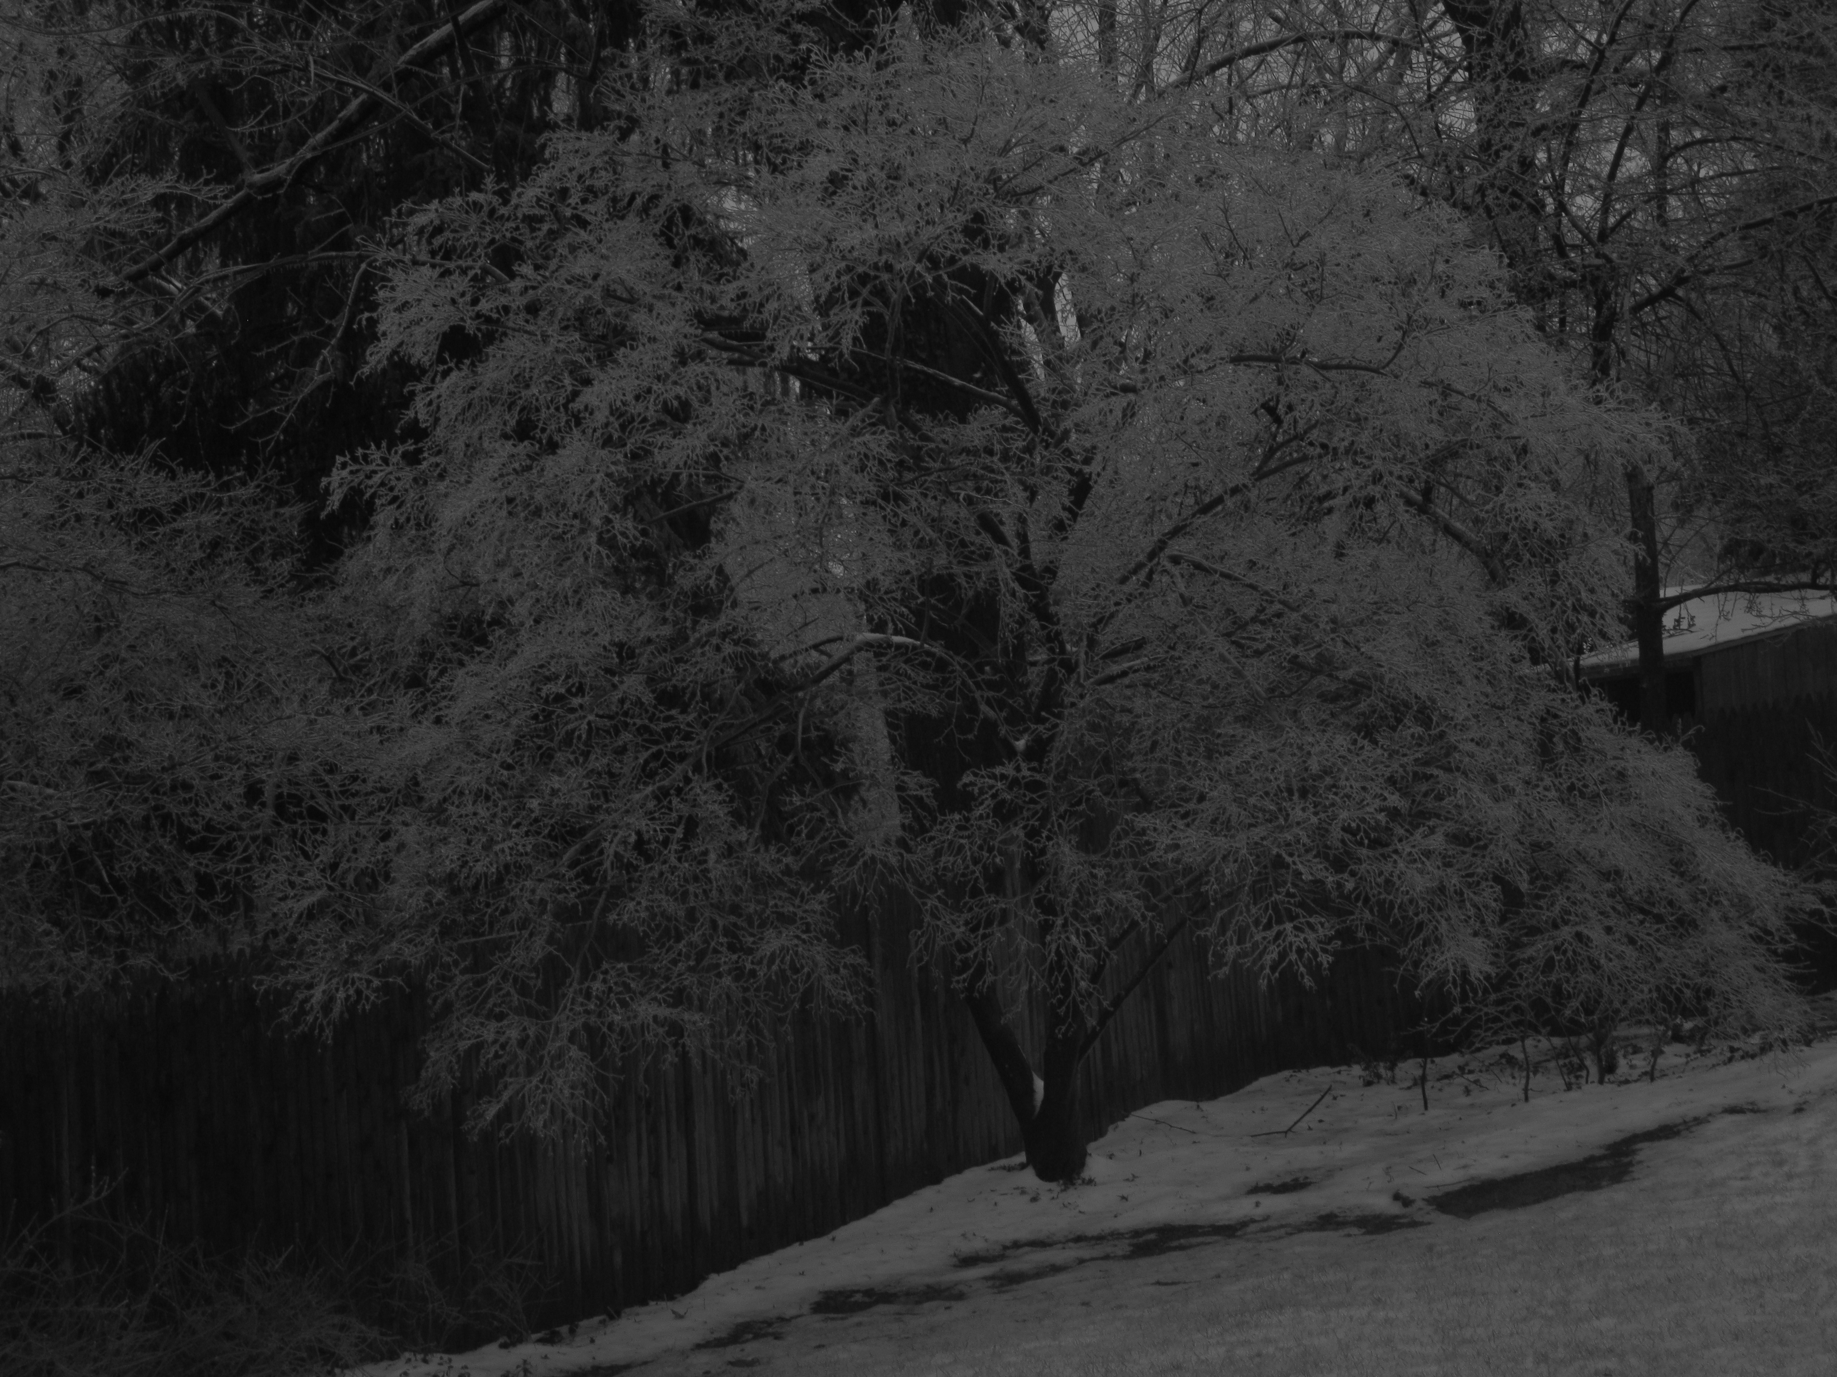
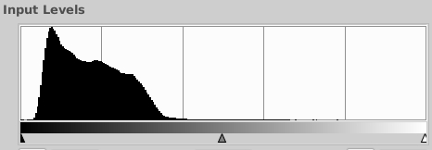
Levels - Under Exposed

Slide 40
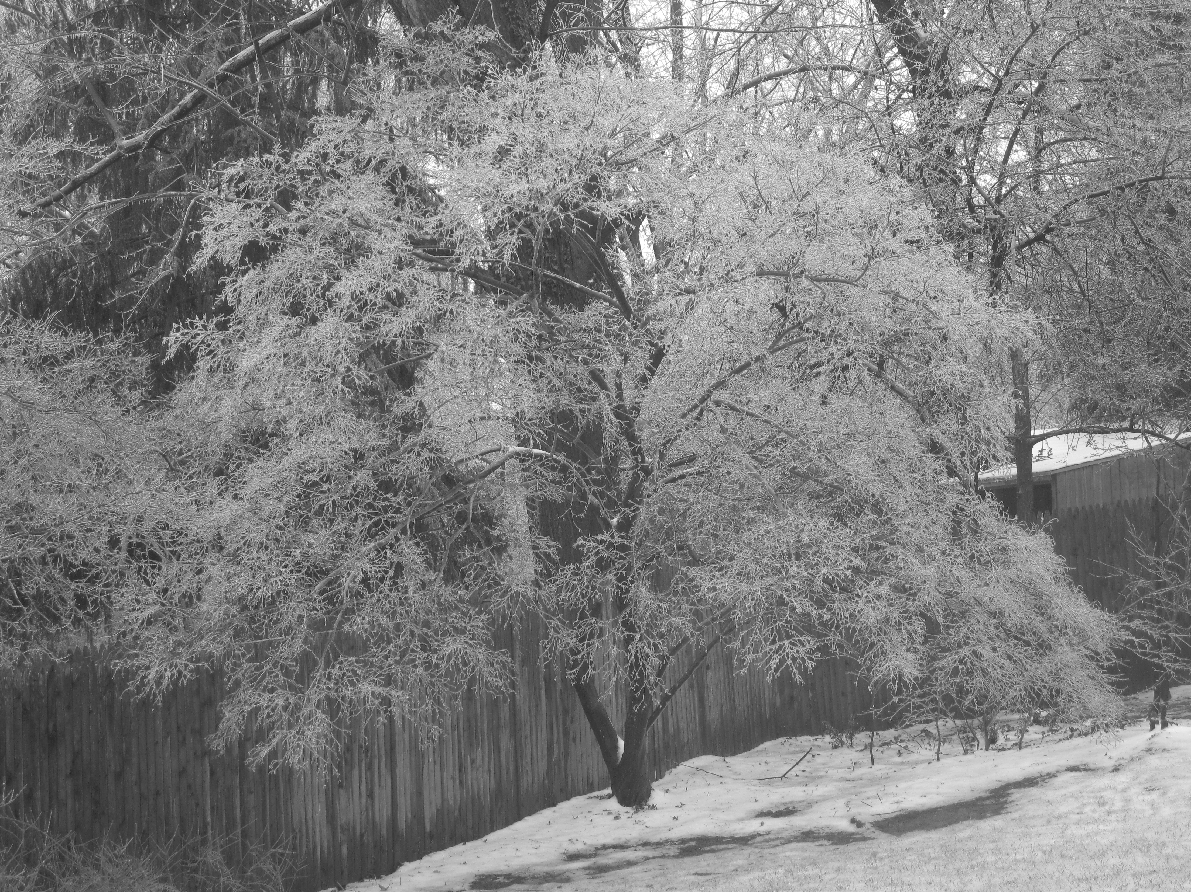
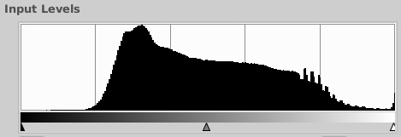
Levels – More Properly Exposed
Notes:
Same tree, somewhat more properly exposed – more info in mid-tones and less in dark areas
But, could improve appearance by using sliders, e.g., in the underexposed image, by moving the lighter-tones to the left.
Used this image to illustrate levels.
Not a satisfying image
Taken on overcast day
Need more sun light to bring out sparkle in ice
How did I get the histograms?
Screen shots of them while displayed in The GIMP
Same for icons used to illustrate tools

Slide 41
Limitations - Level Adjustments
Won't compensate for over-exposure
Extend latitude with High Dynamic Range
  HDR
  RAW
Notes:
Overexposure - “blown out” / white areas
Example: washed-out sky in a forest. If trees are properly exposed, sky over exposed.
Compensate with high dynamic range photography, e.g.,
Take photos of same scene with a range of exposures by bracketing with f/stops and/or exposure time
Digitally combine the shots.
Must use a tripod so frames are congruent
Can do HDR with plug-in
Some advanced cameras now do HDR in-camera!
GIMP can work with RAW images with plug-in
Some cameras shoot / save RAW – no loss through compression, image manipulation – file contains all pixel data collected by image receptor

Slide 42
“Patching”
Zoom-in (shift +)
Use rectangular selection tool
Feather edges / radius 20
Select nearby area, ctrl-c, ctrl-v
Notice dancing ants denote selection and feather area
Move pasted area
  Move tool appears when hover over pasted area
Do a series of paste / moves to repaint
Notes:
Open /patching/peeling.paint.jpg
Maritime monument in St. Petersburg, Russia
Note peeling paint – an eye sore
Selection feather to avoid sharp edges of color differences
Notice dancing ants
Two sets after copy / paste
The area between the two shows where feathering is
Note MOVE tool appears when hover over pasted copy – drag to patch
Do a series of paste / move to gradually re-paint

Slide 43
“Patching” (cont.)
Manipulating pasted selections
Remove power lines from monument
Select area of sky near power lines
Copy / Paste
  Make fine adjustments with move / rotate tools
Notes:
Select a small area near line in sky
Select small areas to avoid color diffs around edges
Copy / paste
Note move tool appears – center over power line
Click on rotate and rotate the pasted selection, OK
Reselect the rectangular selection tool and continue . . .

Slide 44
Free Select Tool
free select tool
  “lasso tool”
  polygonal segments or irregular shapes
Select modes
  Freehand
  Polygonal segments
  Point-to-point
Complete selection by “closing” selection
  Do final click on first selection handle
Notes:
Move quickly to next slide

Slide 45
Demo – Free select (and copy)
Freehand: just drag cursor around area to select
Polygonal: do a series of shift-clicks
Irregular: do a series of clicks
  Allows finer control of selection area
Edit > copy or ctrl-c to copy selection while it's active
Notes:
Open /free.select/vleet.hair.removal.jpg
Demo three modes of free selection
Freehand – show how clicking on first handle completes selection
Ctrl-z to undo
Mention most used shortcuts: ctrl-z, ctrl-c, ctrl-v
Demo straight line segments: click, shift-click, shift-click, etc. until close Ctrl-z
Irregular selection: click, click, click … close and grab it for later use: edit / copy or ctrl-c

Slide 46


Re-using A Selection
+ flip / move tools
Paste selection to new image
Tools can be applied to active selections
Make a mirror image of selection
  Duplicate selection: Edit > Paste (ctrl-v)
  Flip selection (flip tool)
  Position (move tool)
Can also Re-size (scale tool)
Acknowledgement: Veet for Men - Hair Removal Gel Creme
Notes:
Continue with same image
Edit > paste or ctrl-v to copy
Note that tools can be applied to active selections
Demo following steps in slide
Now, reuse elsewhere
Open fellow.xcf
Can re-use previous selections
Show fellow w/o and w/ hair – click on the eye

Slide 47
Perspective Tool
Useful to correct distorted perspective, especially in images with obvious right-angles
Helpers
  Expand window (grab a corner and drag)
  Grid lines: View > Show Grid
Adjust perspective: drag corner handles
Perspective parameter box appears
Commit: click on Transform button
Some of image is lost – null / checkerboard areas
  Illustrates benefit of loosely framed image when shooting
  Crop to finish
Notes:
Open /perspective/parthenon.jpg
Step through points on slide
Parthenon: image is not from Greece! A full-scale replica was built in the “Athens of the South,” Nashville, for the Tennessee Centennial Expo, 1897. It was built of plaster, wood and brick. It deteriorated but was so popular that it was re-constructed in the 1920s.

Slide 48
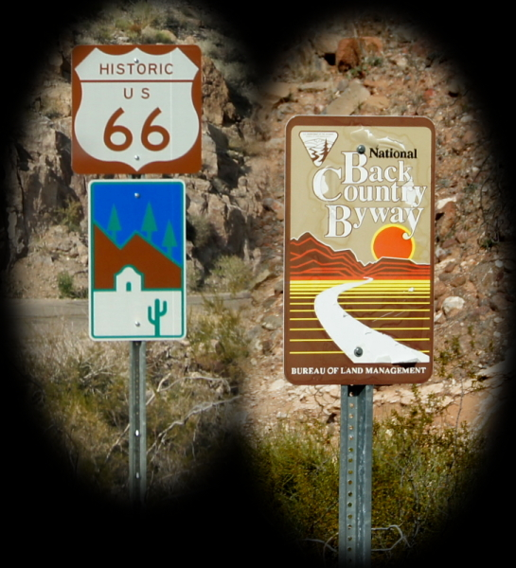
Using Transparencies
Notes:
Use transparencies – illustrate with creation of these vignettes of Rt. 66 signs near Sitgreaves Pass, AZ.
During the era of migration to California, prompted by the dust-bowl period. It is said that drivers were so scared of this section of highway that they hired locals to drive their vehicles through the treacherous pass.

Slide 49
Transparencies – Creation
Open new image: Edit > New (ctrl-n)
Create transparent layer:
  Layer > Transparency > Add Alpha Channel
  Clear background: ctrl-a, ctrl-x
  Waffle-weave background: null / nothing there
Open source for vignette (byway)
Elliptical selection tool
Expand from center
Feather edges max (100)
Copy selection (ctrl-c)
Notes:
Create new image (ctrl-n)
Make it 2000 x 1500 px (I know this from previous work)
Go through steps in slide
Open /transparency/byway.jpg

Slide 50
Transparencies (cont.)
Select and delete white area with Fuzzy Select tool (magic wand with yellow tip)
^x (to cut selection)
Select white background inside of letters:
Multi-select with shift-click using fuzzy select
^x to delete (^z to backup a step)
Save as gif or png

Slide 51
Transparency (cont.)
Switch to transparent image
Paste selection: Edit > Paste
Adjust levels
  Notice the effect is on the selection!
  Use Channel Value > red to cancel out some red
  Commit: OK
Crop: Image > Autocrop
Save as .png or .gif to preserve transparency
File > Save As byway.png
Use such images when desire background to show through
Notes:
Adjust levels to about 35 on left, .85 middle
See excessive / distorted red in background
Adjust remove some red: about 250 on right

Slide 52
Using Transparent Image
Example: vignette on black background
Create new image with black background
Ctrl-n, ctrl-a, Edit > Fill with FG color (black)
Open vignette with transparent background
Copy to black image
ctrl-a, ctrl-c
Switch to black image, paste (ctrl-v), position
Copy in second vignette

Slide 53
Color to Black & White
B&W sometimes better than in color
Severely distorted color balance
Fix by changing to B&W
Example: old photo color distorted due to age

Slide 54
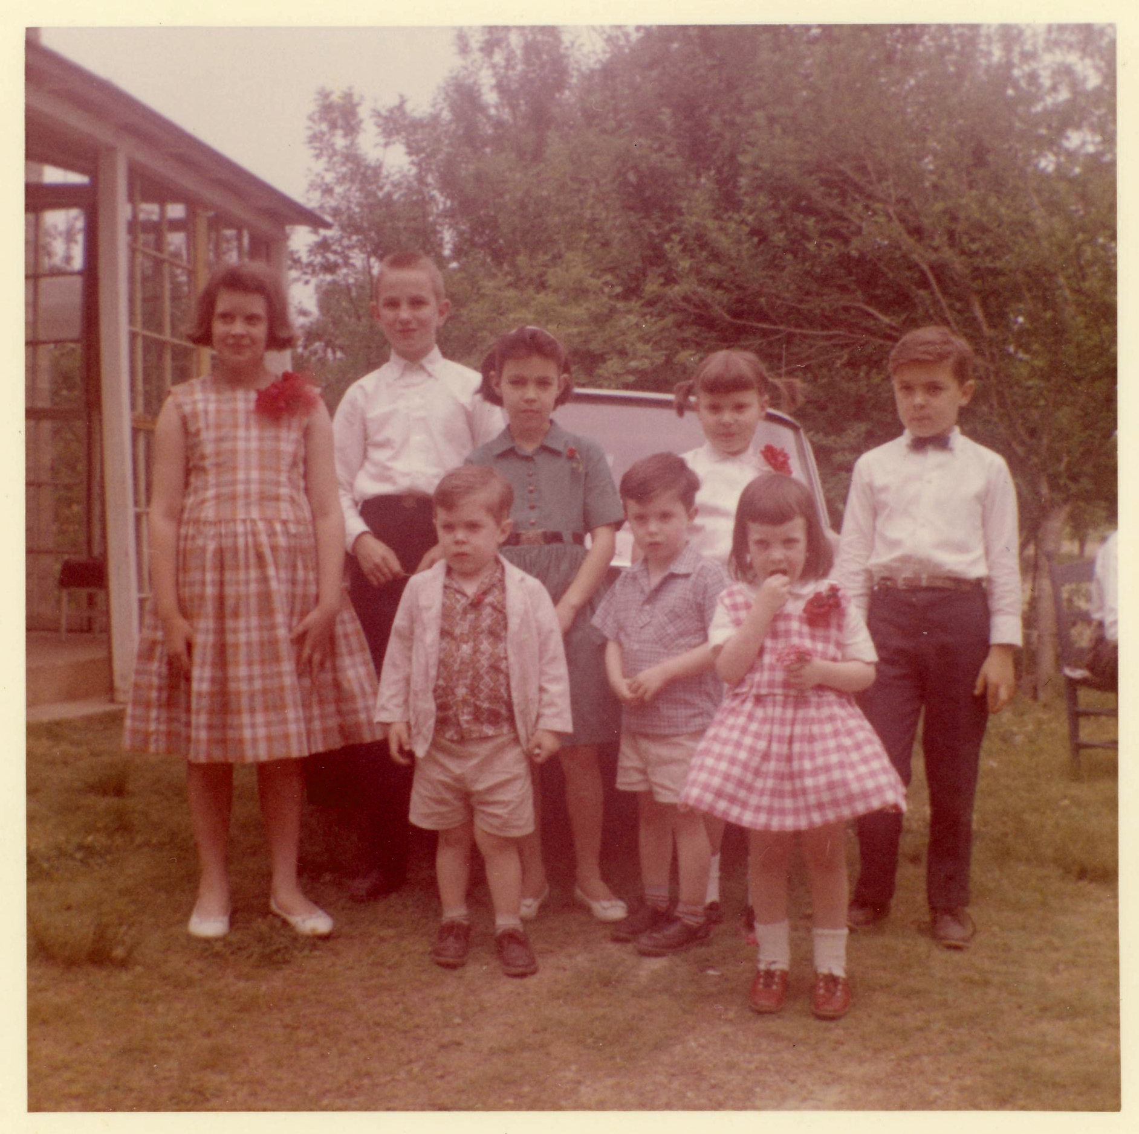
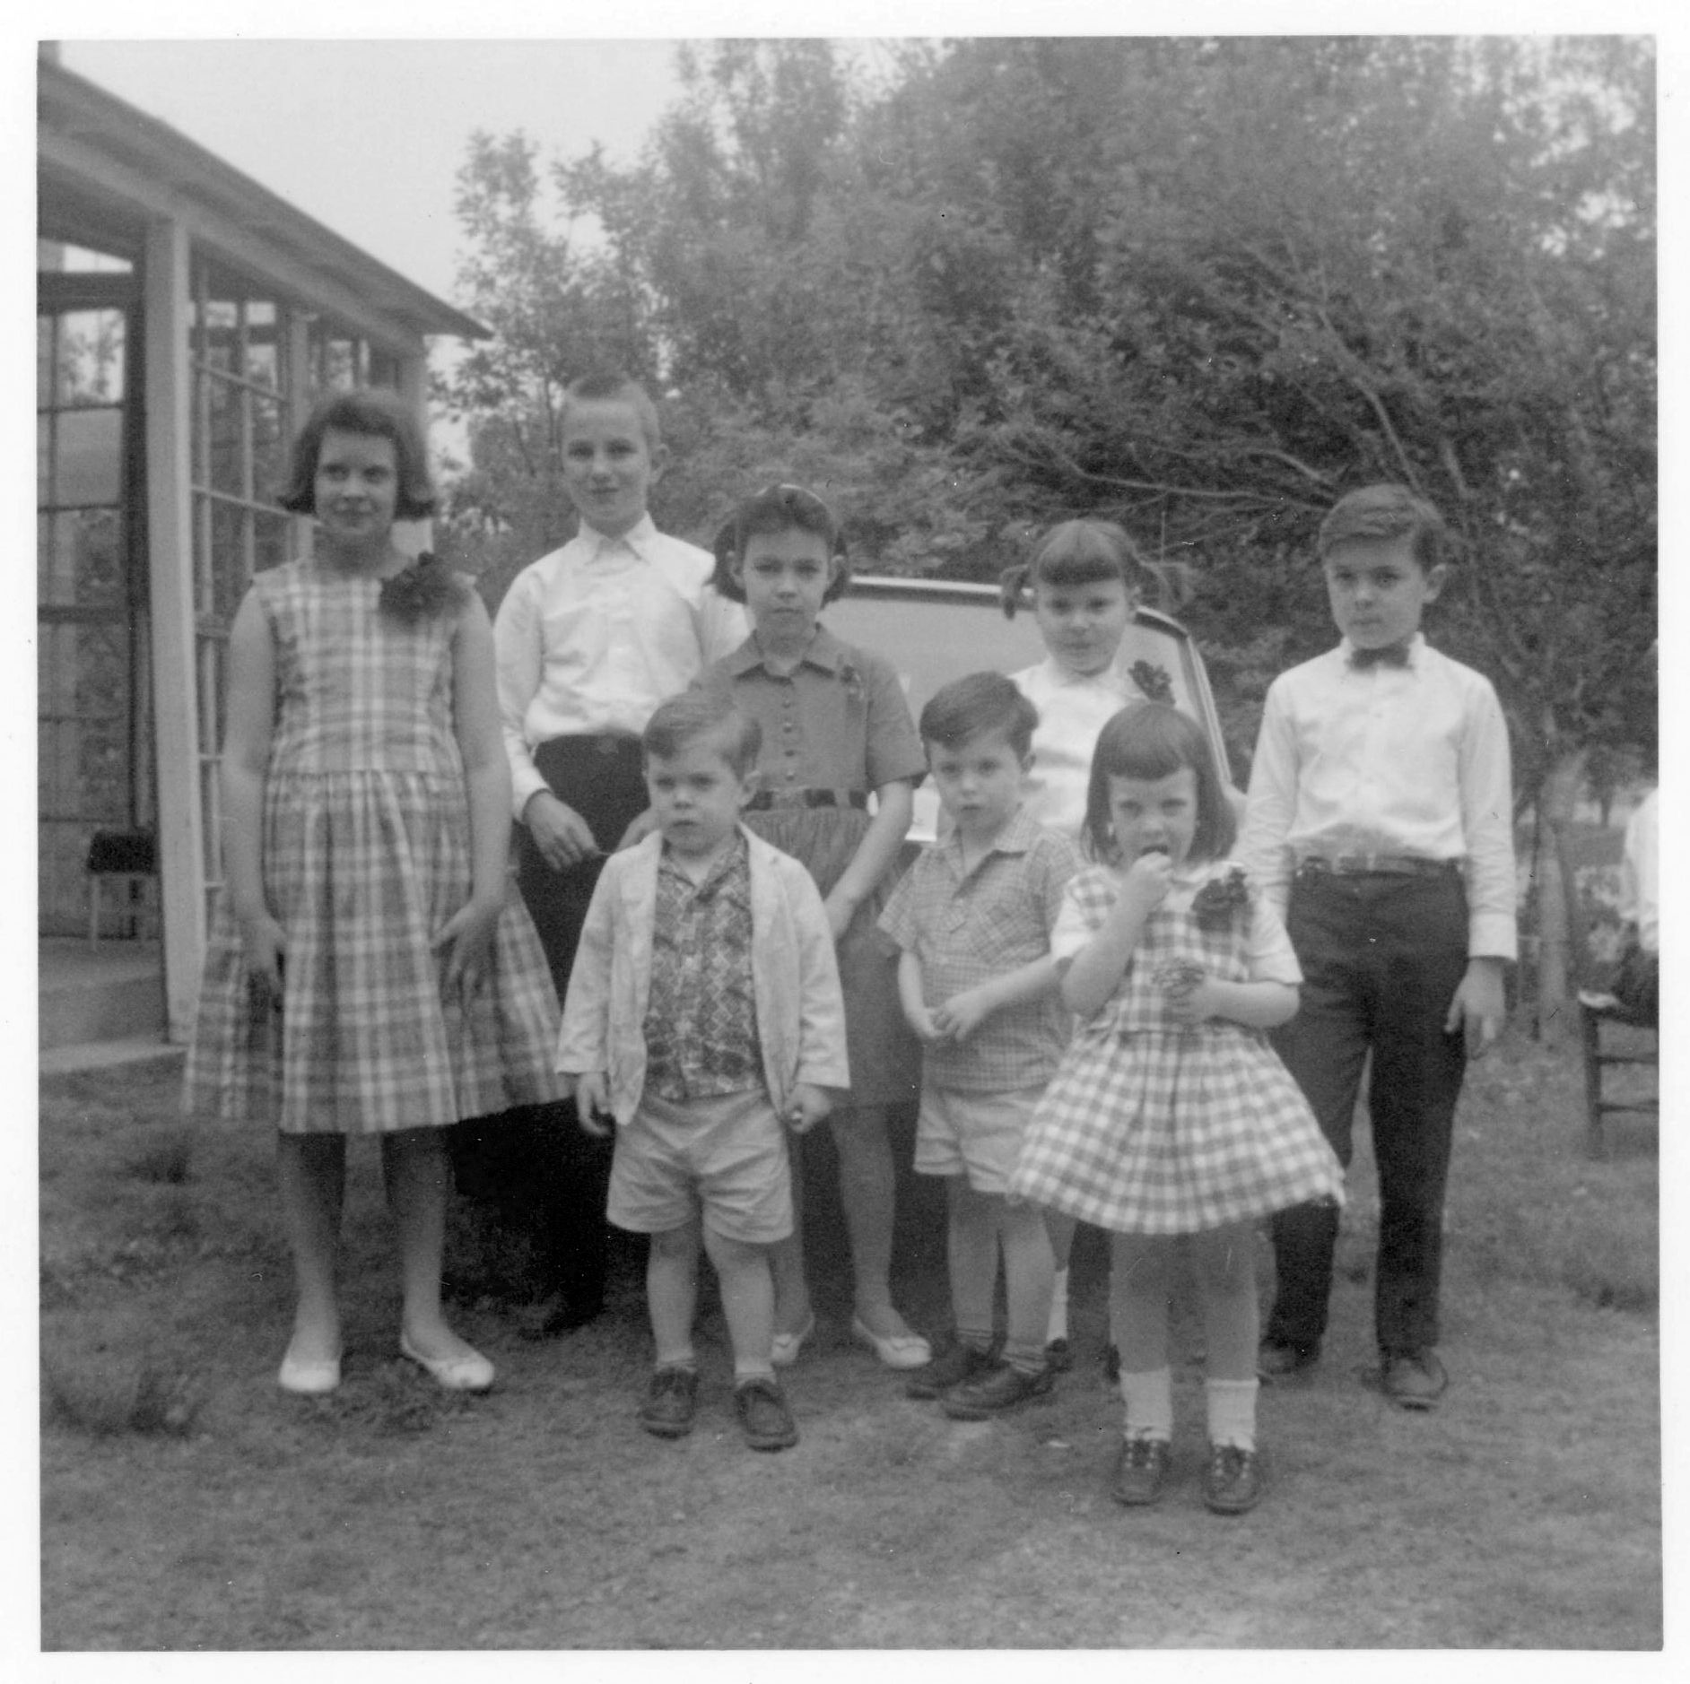
Example – Before and After
Image >
Mode >
Greyscale
Notes:
Bad color balance in old, scanned picture of cousins
I was unable to alter color balance to correct.
Image converted to grayscale looks much better to my eye.
Simple technique: menu steps outlined on slide.
I also tweaked the color levels after conversion to give better contrast between light and dark areas and to lighten mid-tones.
Fuzziness of image is likely due to limitations of old camera and/or focusing – some old cameras were pin-hole cams without focus adjustments.

Slide 55
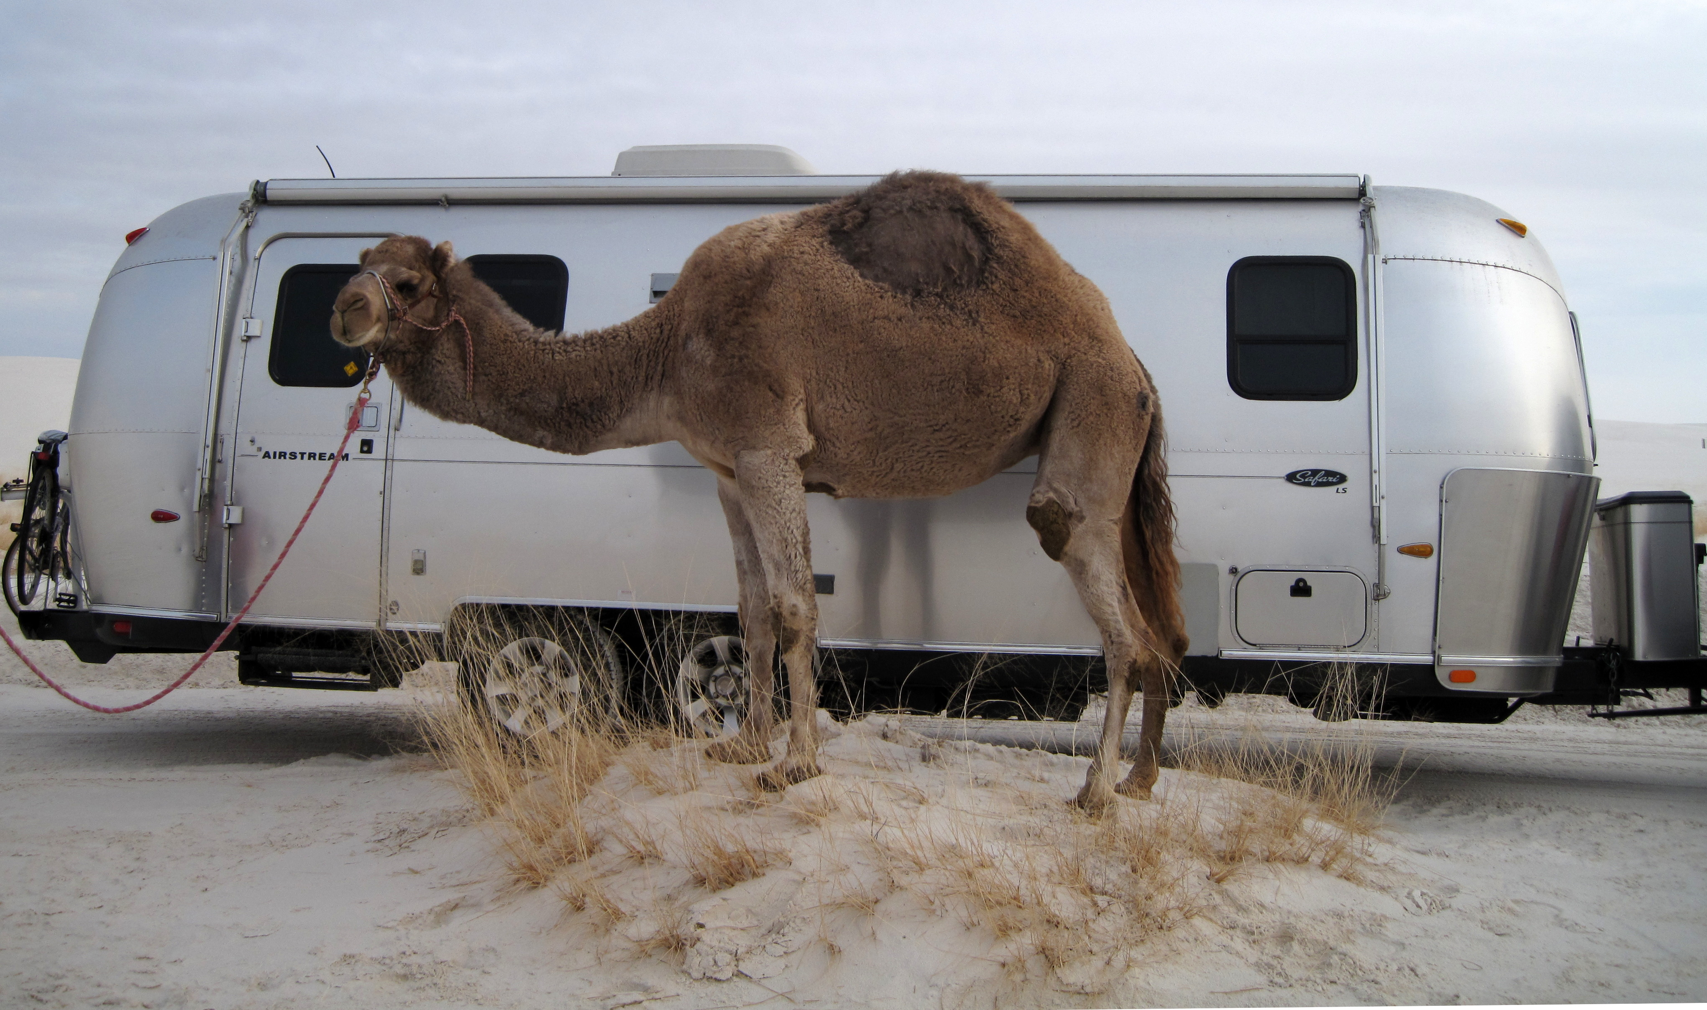
The End - Acknowledgements
Notes:
Acknowledgements:
Jason Kohles for getting copies of handouts
Greg for shepherding NOVALUG
To you for being a good audience.
And, most of all, to my wife, Betty, for her support and for being a marvelous traveling companion.

