Slide 1

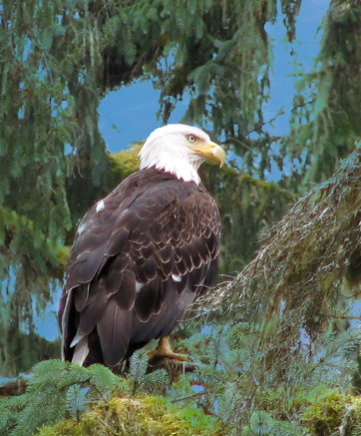
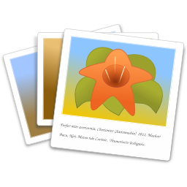



Photographs & Linux
Overview / Intro
https://novalug.org/docs/gimp.odp
First-order management of photos
  Many Images – cull / sort with gThumb
Edit photos – The GIMP
Album Creation – jAlbum
Upload – Filezilla
Presentation:
  Posted: NoVaLUG Presentations
  Composed with open source software
  Hardware: Appendix 8
Roger Broseus
NoVaLUG / Shropshire LUG, 2021.07.12
Slides: https://novalug.org/docs/gimp.odp (43 MB)

Slide 2
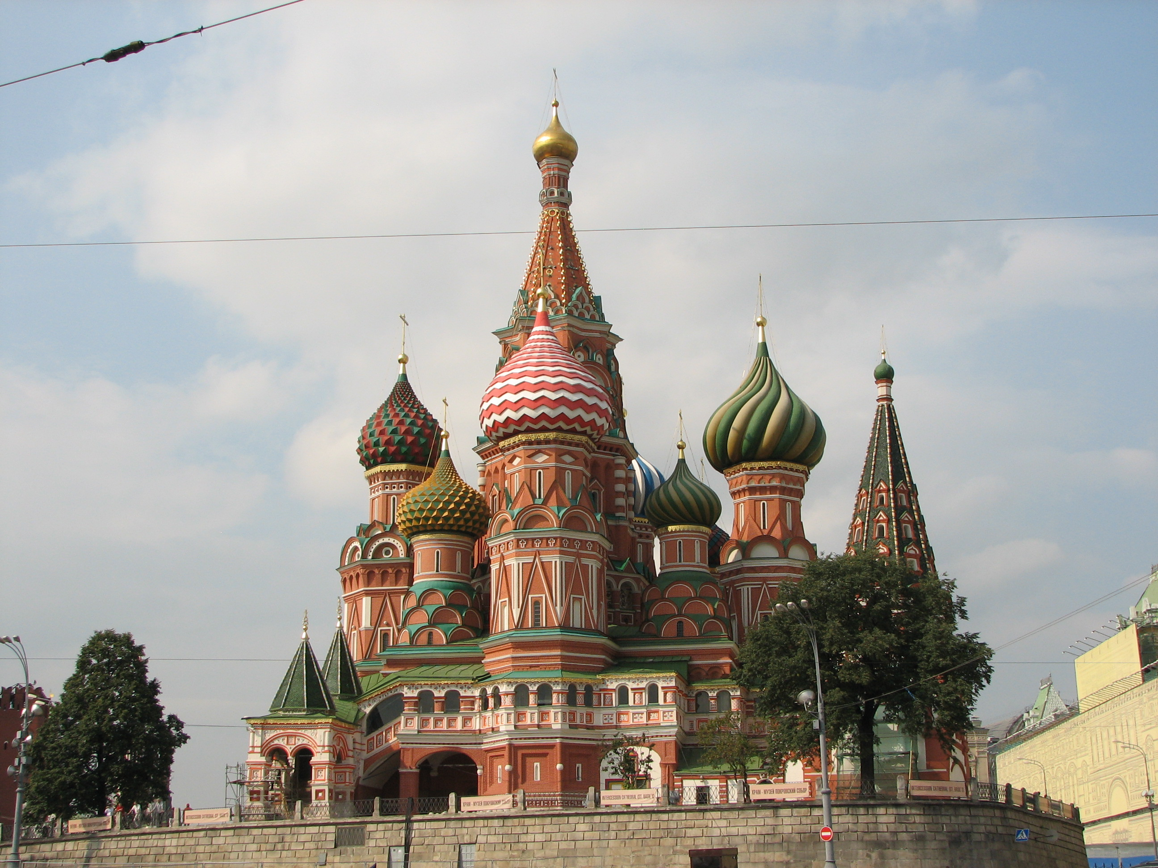
The Power of The GIMP
Wire
Wire
Wire
St. Basil's Cathedral
Moscow
Removed wires, street light
Improvee color balance
Street
Light
St. Basils' Cathedral, Red Square, Moscow

Slide 3
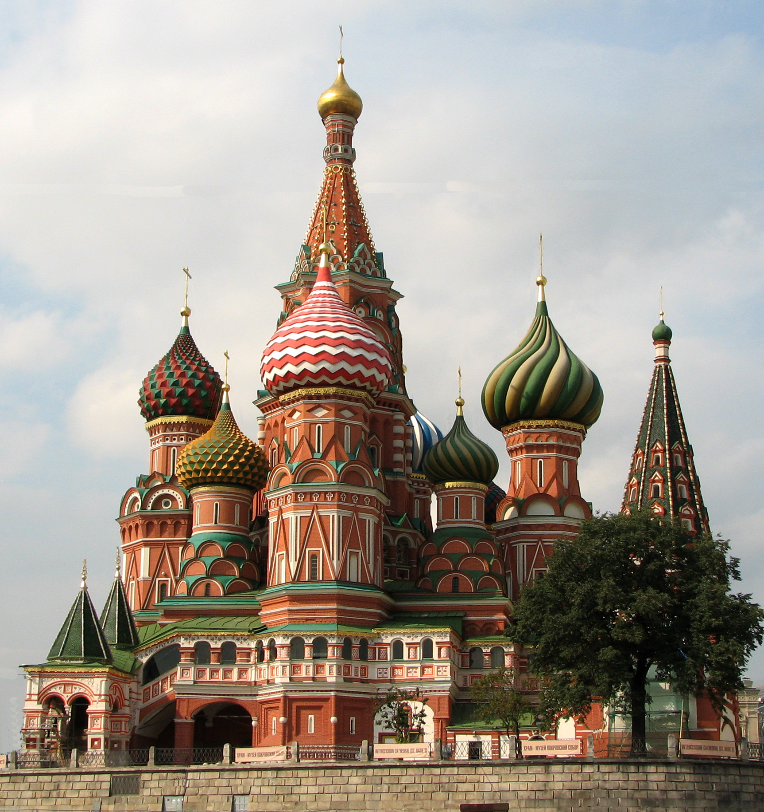
St. Basil's after Edits

Slide 4
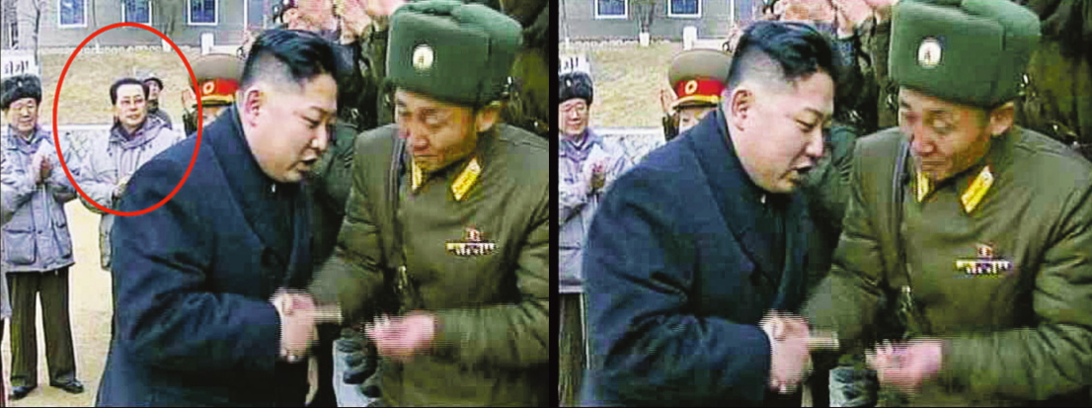
(Really) Fake News 1
N. Korea’s supreme leader, Kim Jong-un, was in the news for purging his uncle – erased from history.
Photo from the front page of the Wall Street Journal

Slide 5
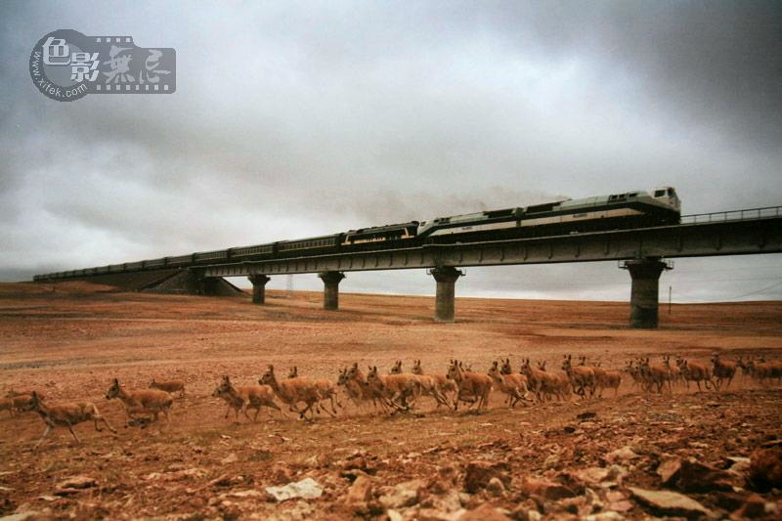
(Really) Fake News 2

Slide 6
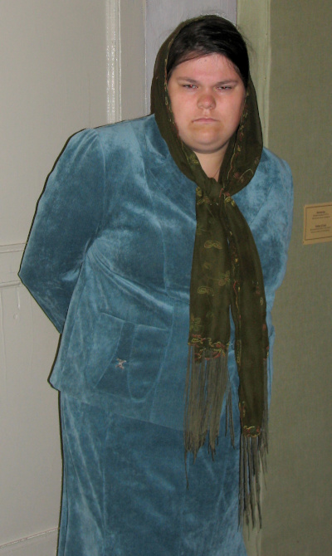
Another Miraculous Change . . .
Lady in Museum Uglich, Russia
(before)

Slide 7
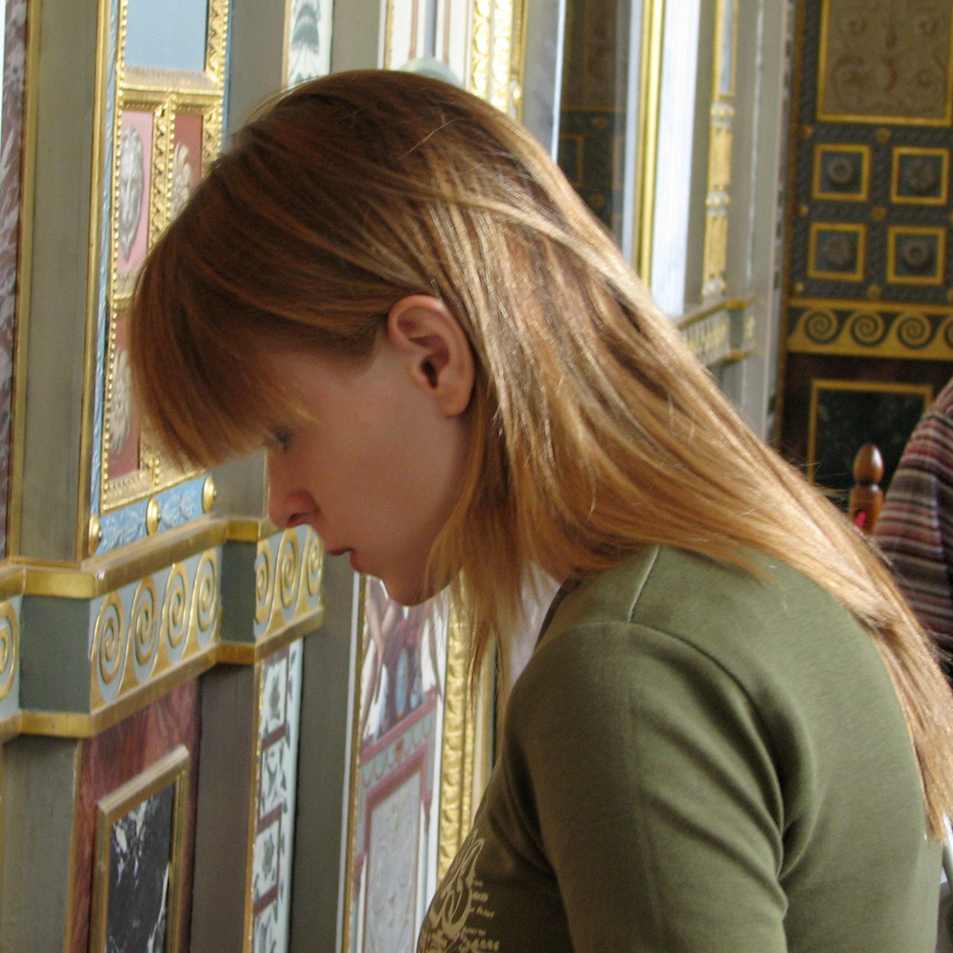
. . . (cont.)
Lady in Museum
(after)

Slide 8
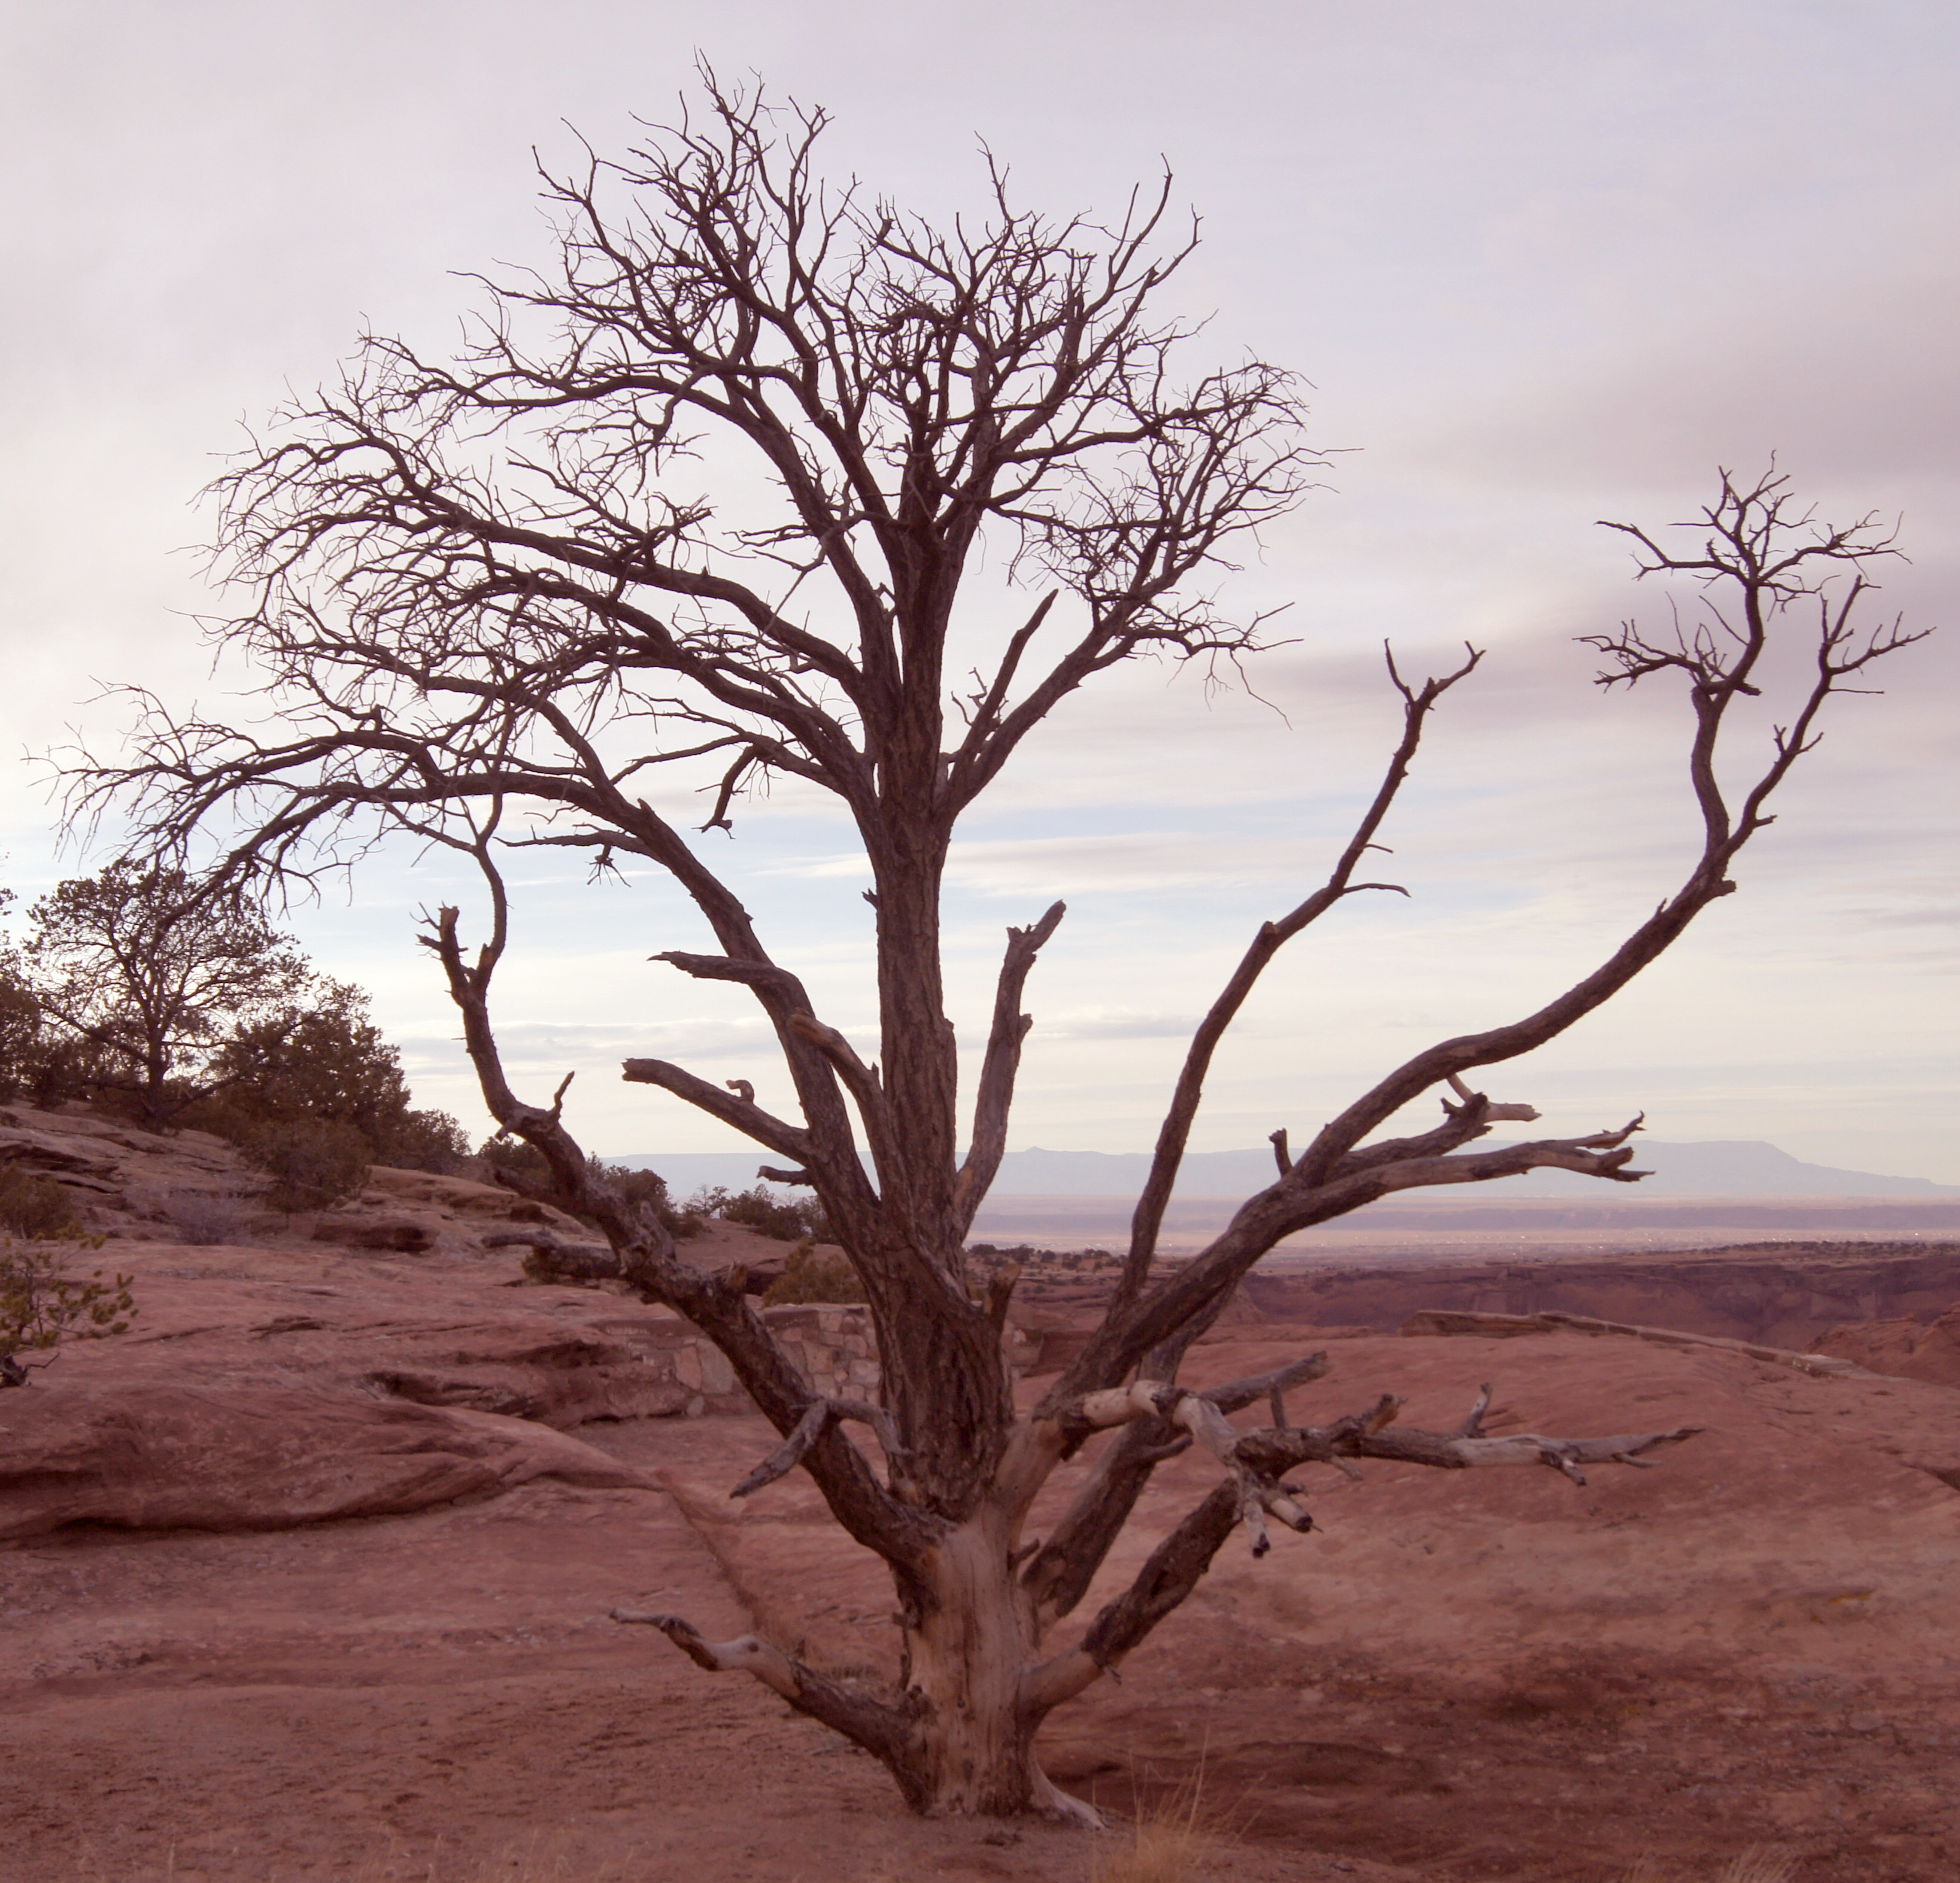
It’s Not Just About Editing (post processing)
Organize / Sort Images
Managing large number of images
Create a set (copy) of originals
  Recover from mistakes, e.g., accidental deletions
Culling / Sorting
Organize / create albums – jAlbum
  Appendix 1. – Description / Discount for NoVaLUG
Alternatives
  gThumb – simple viewer
  DigiKam (KDE app) – it appears to have matured
Filezilla for uploads to web site – Appendix 2.

Slide 9
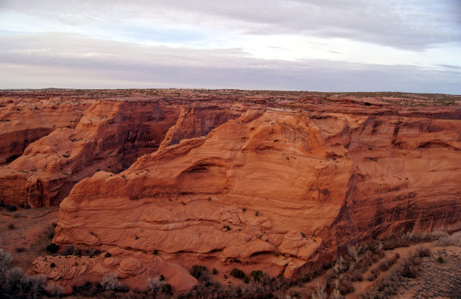
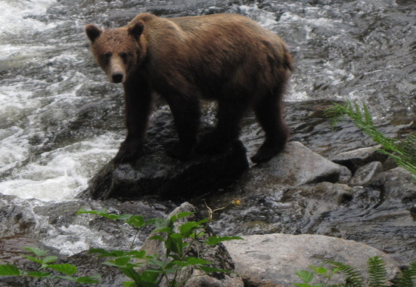
The GIMP
GNU
Image
Manipulation
Program
Standard in many Linux distros
Ports to Windows, MAC, and (reportedly) Android
GIMP: $ 0
Photoshop: $ 1k
  Subscription – $ 20+ / mo, plus for on-line storage
  Cloud dependent for some applications
Notes:
I took a course at Montgomery college on using Photoshop to learn techniques that might enhance my abilities using The GIMP.
After tasting the Koolade, I'm a regular drinker! Photoshop is a powerful program with great features I'm not aware of in The GIMP. Also speeds work flow when dealing with large numbers of images. I use it in a VM with Windows-7.
However, I got a substantial student discount and the subscription model would deter me.
For everyday photo editing, the GIMP is great / powerful.
Ports to Windows, MAC, and, reportedly, Android OS
I used GIMP at work in Windows environment when licensed copy of Photoshop not available.

Slide 10

The GIMP
Very powerful photo editor
Pre-installed on many Linux distros
  Ubuntu/Debian, SUSE, Fedora, BSD systems, Windows, etc.; flatpak, .deb, RPM, even zipped for java-enabled systems
Downloads – http://www.gimp.org/
Active development
  Version 2.10.24 Released 2021-03-29
  Last presentation in 2013 based on Ver. 2.8
Many alternate language versions

Slide 11
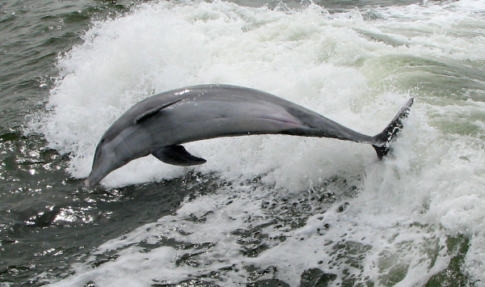
GIMP Documentation
Extensive on-line help available
User Manual / tutorial
  https://docs.gimp.org/2.10/en/
  Step-by-step procedures illustrated
Tutorial
  https://www.gimp.org/tutorials/
Grokking the GIMP (book)
  Google for free versions
YouTube Videos – a plethora

Slide 12
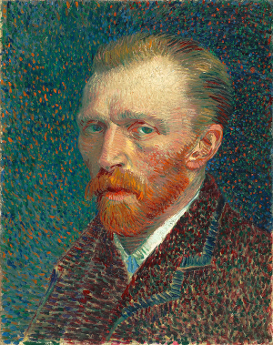

Bitmap vs. Vector Images
GIMP: edit raster graphics file formats (bitmap images, e.g., .jpg, .gif)
Think pixels (digital “pointillism”)
SVG – Scalable Vector Graphics
  XML-based vector image format
  2-D graphics
  Support for interactivity and animation
  Edit with Inkscape – highly regarded drawing application
Vincent van Gogh, Self Portrait, 1887, pointillist.
pixels.surat – zoom to illustrate

Slide 13
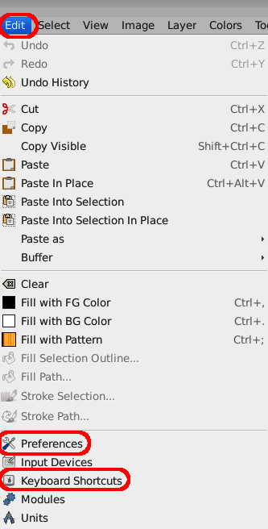
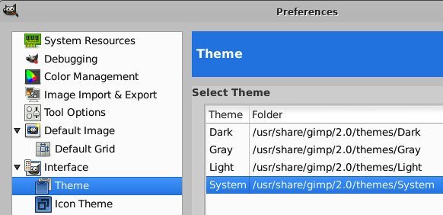
Customize GIMP
GIMP can be highly customized
  Preferences
  Keyboard Shortcuts
Chose System Theme –
  Maximum contrast for presentation
See Appendix 3 for more example Prefs

Slide 14
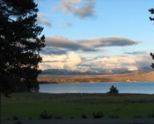
Tips: Keyboard Shortcuts
Keyboard shortcuts – useful for
  commonly repeated actions
  Quick access to menu items
  Change with: Edit > Keyboard Shortcuts
Appendix 4. Default Shotcuts
Next slide – most used shortcuts
Note: commonality across applications, e.g.
  ctrl-c: copy ctrl-v: paste ctrl-x: cut & copy
  ctrl-shift-v: paste w/o formatting

Slide 15
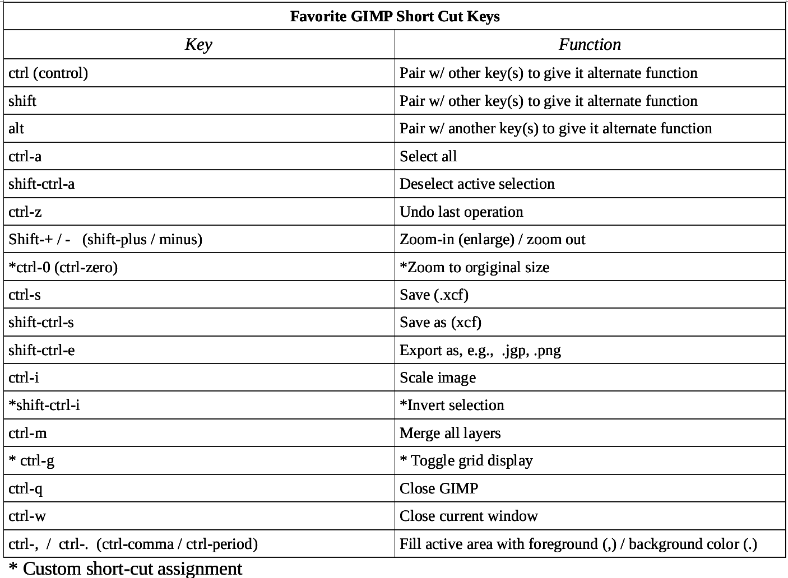
shortcut.favs

Slide 16
Tips: File Types
File formats .xcf files – GIMP's loss-less file format
  Intermediate edits / layers / undo are saved to .xcf
  No side-car files as opposed to other apps, e.g., Pshop
“Lossy” formats – .jpg, .gif
  Lossy image file compression
  Do not save and re save in lossy formats
  Lost: pixels (resolution), intermediate edits (no undo), layers (merged)
  .png – not lossy but no edit / undo data as compared with .xcf
RAW – all of photo data retained – more color “depth”
Edit w/ other apps, e.g., Darktable
  Darktable – links directly into GIMP
  RawTherapee (available as an appimage)

Slide 17
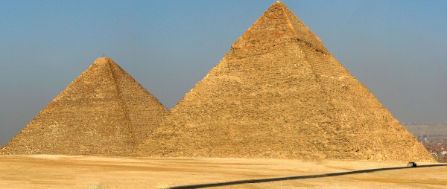
Tips (Cont.)
Always use sRGB color profile for web (default)
Setting sRGB color profile
  Image > Mode > Assign / Convert to Color Profile, or
  Select sRGB if GIMP prompts when image is opened
  See Appendix 5. for choosing colors, hex codes
Color profiles with greater color depth are used for high quality printing, e.g., 16 rather than 8 bit

Slide 18
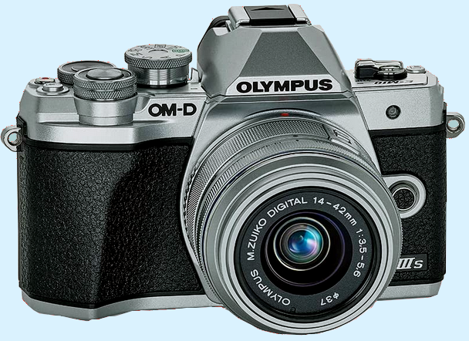
Tips (cont.)
Think ahead
Optimize framing – avoid too tight
  Leaves room for cropping and other image edits
Shoot at high resolution
  Preserves detail / facilitates “digital zooming”
Make sure in-camera GPS is locked onto satellites
  To insure location of shot is correct
Polarizing filter – circular for digital cameras
  The one filter to have
  Remove haze / glare / reflections

Slide 19


Using Tools
Open file: File > Open (ctrl-o)
View grid: View > Show Grid
Rotate
  Drag handles / fine tune with “Angle” / Click Rotate to commit)
Crop
  Icons may differ depending on theme, e.g., crop:
  Drag handles to adjust
  <enter> to commit
Adjust color levels: Colors > Levels
Save as .xcf file to retain changes

Slide 20

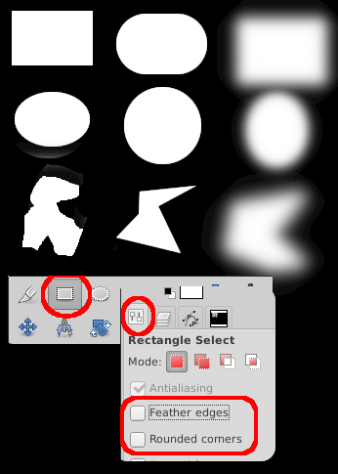

Selection Tool – Options
Rectangular
  Rounded corners
  Feather Edges
Elliptical
  Hold SHIFT to get circle
  Feather edges
“Free” Select / “Lasso”
Selection can be drawn free-hand
  Sucesive shift-clicks for polygon
  Feather edges
Concatenate Shift & select
Crop – trim off edges
Hint – when shooting, frame w/ extra space to allow for adjustments later

Slide 21
Selections
Creating / Co-joining / Excluding
Demo with colored layers
  Top layer: black (w/ white dot for positioning)
  Bottom layer: white
Create a selection, e.g., w/ rectangle select
Add to it with Shift-drag for a chosen tool
  Can be different
Omit an area from a selection with ctrl key
  ctrl-drag a selection tool
Fill selected area with foreground color, black
  ctrl-, (ctrl-comma)
  ctrl-z to reverse change
select joint

Slide 22





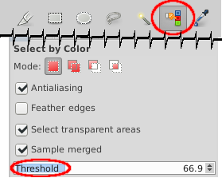
Color Selectors
Color Selection Dialog – change foreground and background colors
  Swap color combo w/ small, overlapping boxes
Color Picker – select (change) foreground color
  Radius option determines how many pixels are selected – Monochrome selection: use very small radius
Fuzzy select tool – select one region by color
Select by Color – select all regions of a color
  Threshold option changes “purity” / monochromacity of color used for fuzzy and select by color
  Practical example: vary amount of non-uniform sky captured. Demo: later.

Slide 23





Move / Arrange / Alter Shape / Measure
Many tools accessed with short-cut Keys
Default short-cuts: Appendix 4.
Move
Rotate
Resize
Perspective alteration
Flip
  Horizontal – click
  Vertical ctrl-click
Measure
  Read angle at bottom of window

Slide 24
Next - Examples - Basics
Screen Capture
Cropping, rotating / selections
Color level adjustment
Highlight an area
  Line drawing
  Create vignette
MORE!

Slide 25
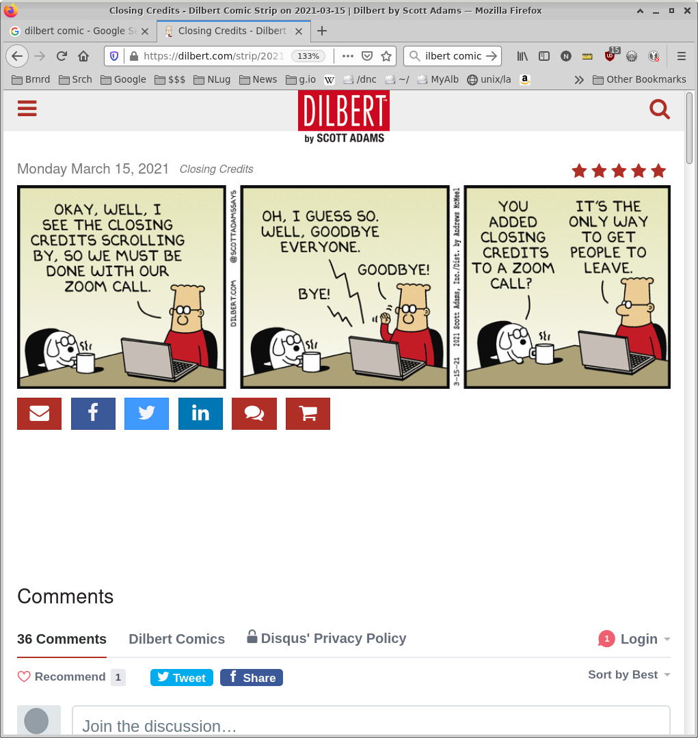
Screen Shots
screen.shot / FF
https://is.gd/xfkWOU

Slide 26
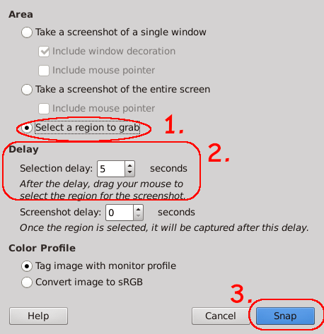
Screen Capture / Crop
Bring object to shoot into view (browser)
Switch focus to GIMP
File > Create > Screen Shot
  Note – scan option is under File menu
  > Select a region to grab
  > Delay 5 sec
  > Click Snap
Crop image
Use handles to change
  Size
  Aspect
Finish
  File > Save-as to keep as xcf
  File Export
Dilbert screen shot
https://is.gd/xfkWOU

Slide 27
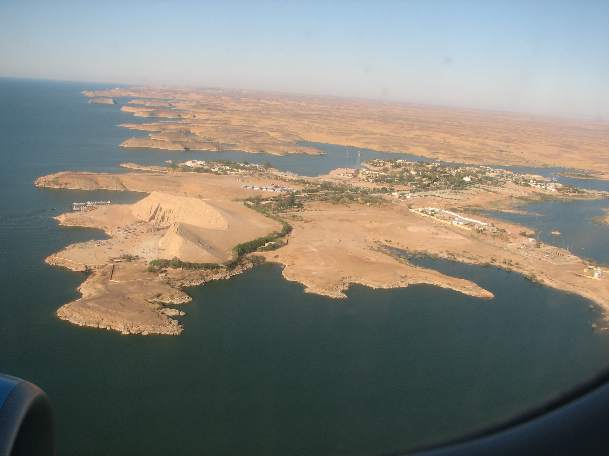
Straighten / Rotate / Crop / Color Levels / Drawing
Abu Simbel
(aerial view
UNESCO site –temples saved from submersion after formation of Lake Nasser by building of the Aswan High Dam.
Temples were massive structures which were cut-up, from solid rock, moved to higher elevation, and pieced back together.
abu.simbel.jpg

Slide 28
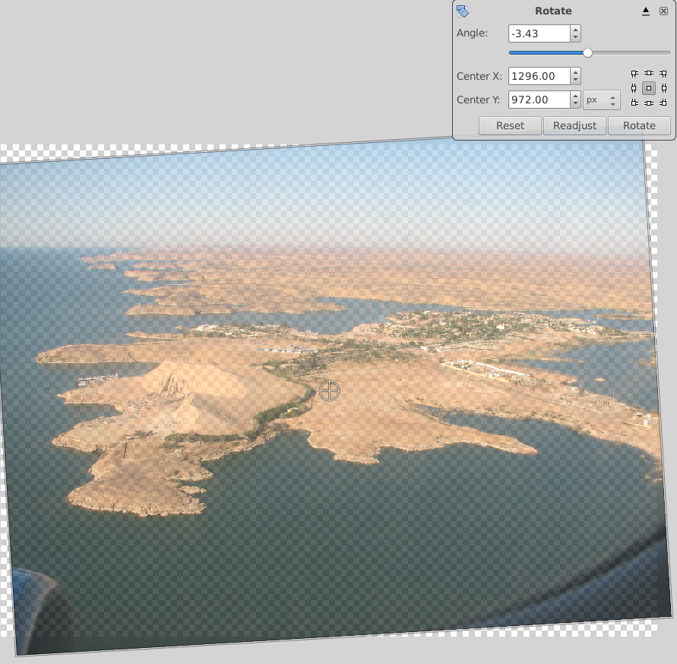
Straighten (Rotate)
Safety: Duplicate layer, blank it
  Work on copy
Use rotate tool – Click to activate
  Cursor changes to rotate tool
Click-drag near image corner
  Image rotates
  See semi-transparent preview
Change angle with drop-down / up arrow
Click Rotate to complete
  Note empty pixels around edges - no data there
Crop
Use corner and edge handles to adjust size
ENTER to complete crop
Problem: hard to align with rotate alone
Grid Lines can help
More precise: use Measure tool
Reverse changes with Undo –
Shortcut ctrl-z
abu.simbel.jpg

Slide 29
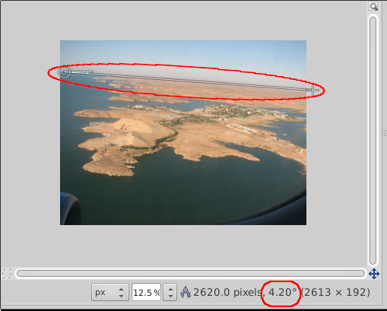

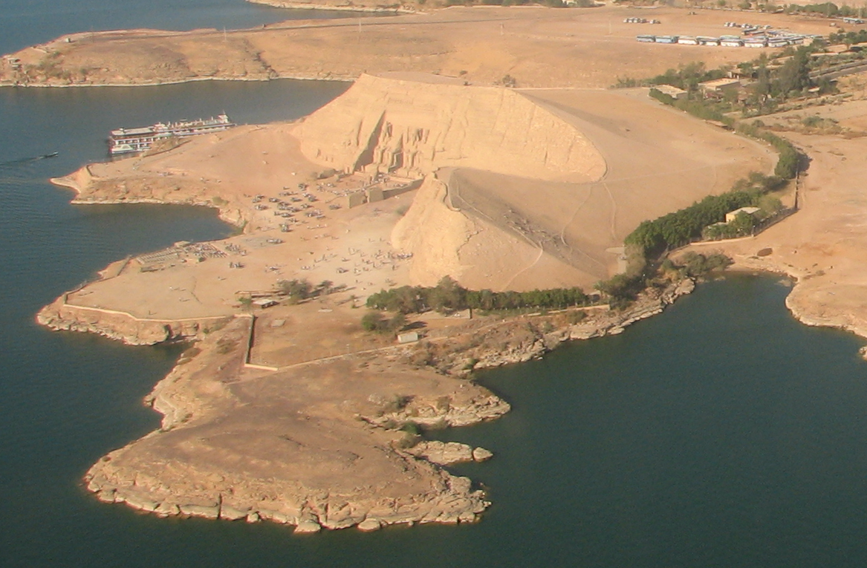
Align –
Measure Tool
Click on Measure tool
Right-click-hold-drag along horizon
See inclination at bottom – 4.2°
Activate Rotate Tool
Left-click on image
Adjust Angle to - 4.2° (minus 4.2°)
TAB to see effect
Click Rotate to accept
CROP to area of interest
  Removes airplane engine, etc.
  ENTER to commit
abu.simbel.cropped.xcf

Slide 30
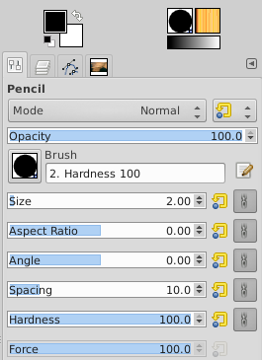


Drawing Lines
Activate Pencil tool
  Opacity: 100 (not semi-transparent)
  Hardness: 100 solid (not feathered)
  Size: adjust with up / down arrows to 3px
  Color: Black
Irregular line: left-click-drag cursor – release
Straight Line
  Move cursor to Start Position, cursor and left-click
    A dot appears
  Position cursor at end point
  ctrl-shift to align in 15° increments
  Left-click to close line
End-point can be beginning of new line segment
abu.simbel.cropped.xcf

Slide 31
Exposure / Color Adjustments
Very useful tool – Colors > Levels (my custom shortcut: ctrl-L)
Adjust overall “lightness” / “darkness”
Compensate for some exposure problems
Improve color balance
Save / Use presets to apply levels to multiple images
Example – histogram for Abu Simbel image
Not in-camera histogram – image histogram rendered by GIMP

Slide 32
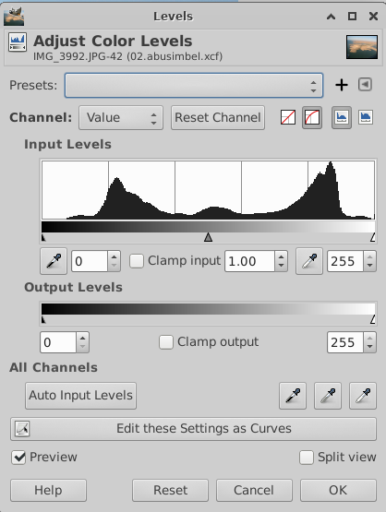

Histograms: Loaded
With Info

Slide 33

Understanding Histograms
Histogram views are built-in to modern digital cameras.
Improve images in post processing using Levels to “manipulate” histogram.”
Horizontal axis:
  Represents the tone of a color
  Far right: pure white
  Far left: pure black
Vertical axis:
  Number of pixels for a given tone
Histogram
(Abu Simbel Image)
IDEAL: Data all in center, tailing off left & right

Slide 34
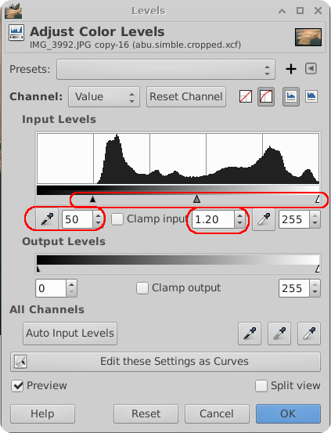
Levels
Color Balance
Menu
  Color > Levels
My Shortcut for a frequently used tool
  ctrl-l (ctrl - el)
Drag arrows to adjust tones:
This example:
  Dark tones: 50
  Mid tones: 1.10
  Light leave at 255
Note options to toggle Preview, reset, cancel
Click OK to commit
More about histograms Appendix 6
abu.simble.levels.demo.xcf

Slide 35
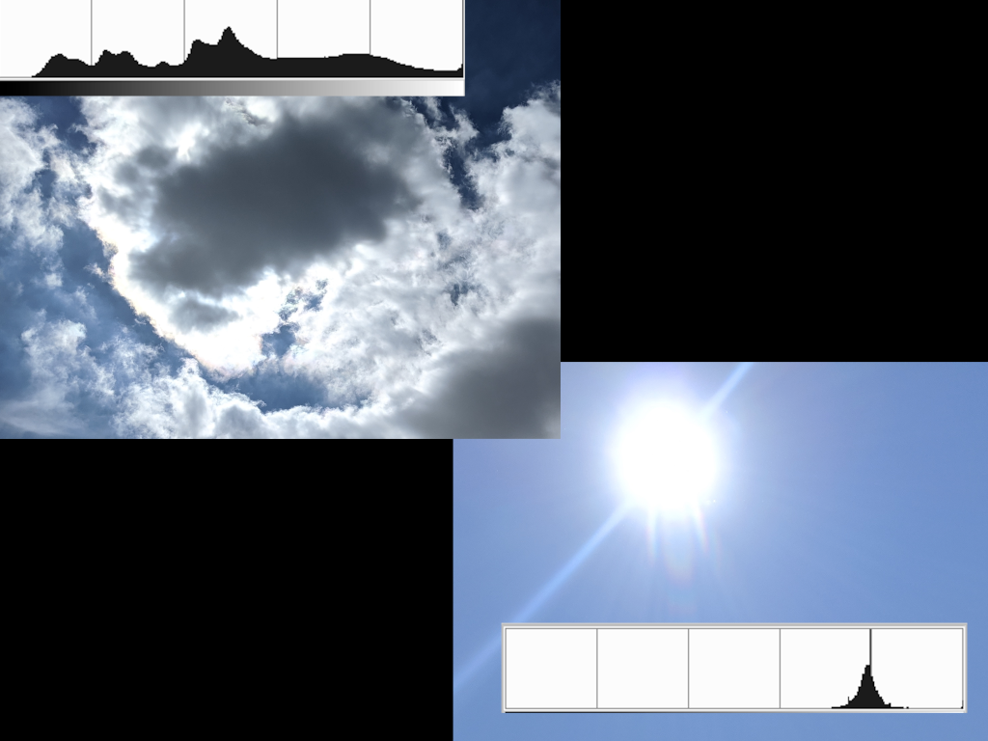
Compare Sky Histograms

Slide 36
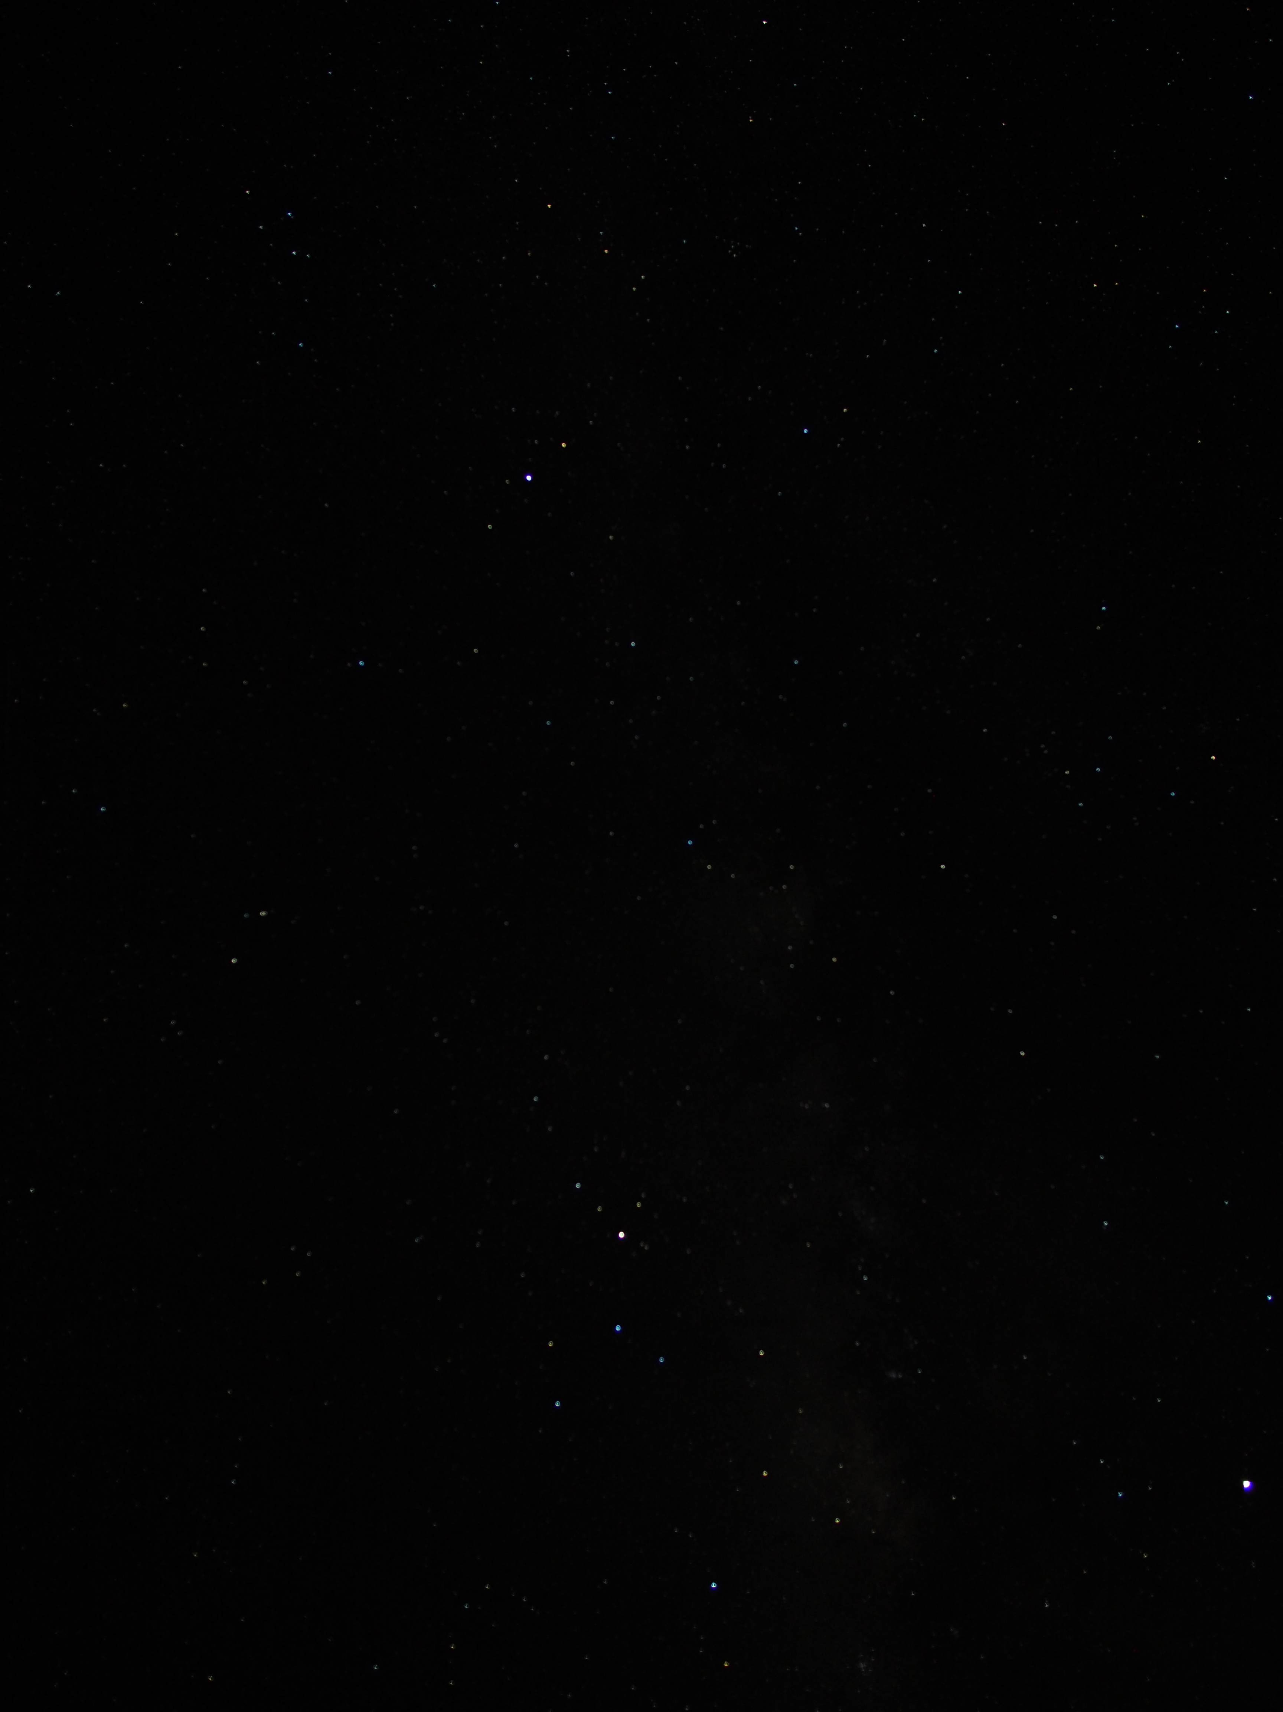
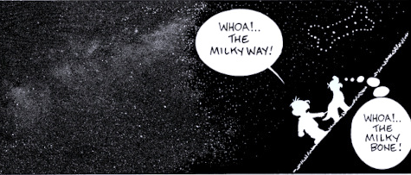
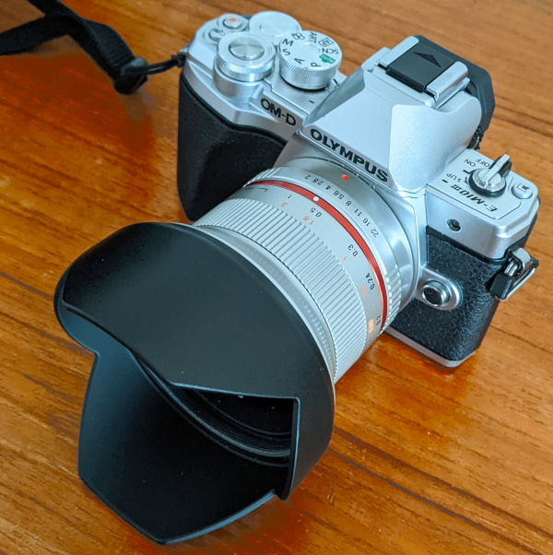
Example – Astro Photography
Wanted:
Got:
(White specs are stars)

Slide 37
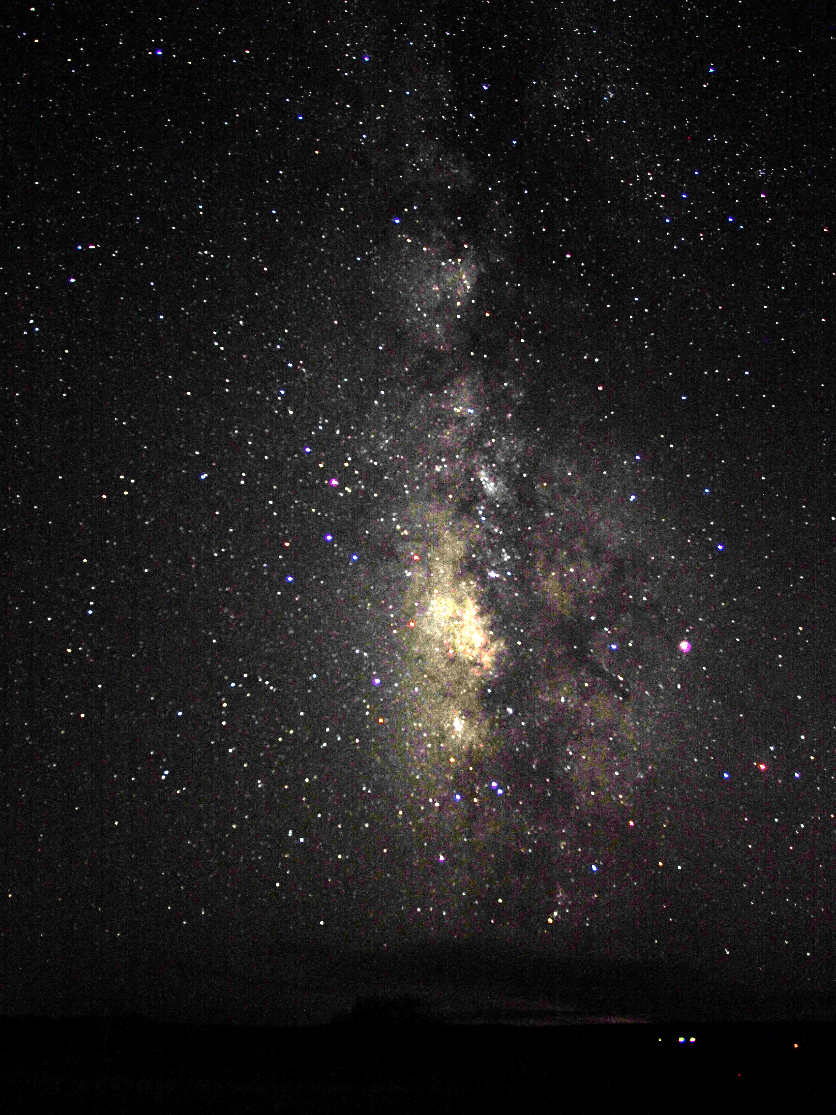
Before & After Level Adjustment
milky.way.level.adjust.xcf

Slide 38
Limitations of Level Adjustments
Won't compensate for:
  Excessive under exposure
  Over exposure (“blown-out” areas of images)
Common issue in landscape photography
HINTS:
  Avoid harsh shadows, extremes of light intensity
  Shoot w/o direct sunlight – mornings / evenings
Modern digital cameras – HDR
  Extend latitude with High Dynamic Range – In Camera!
Post processing of images
  Photo stacking multiple exposure shots, but not easily in The GIMP
  Start post processing with RAW images, switch to GIMP

Slide 39
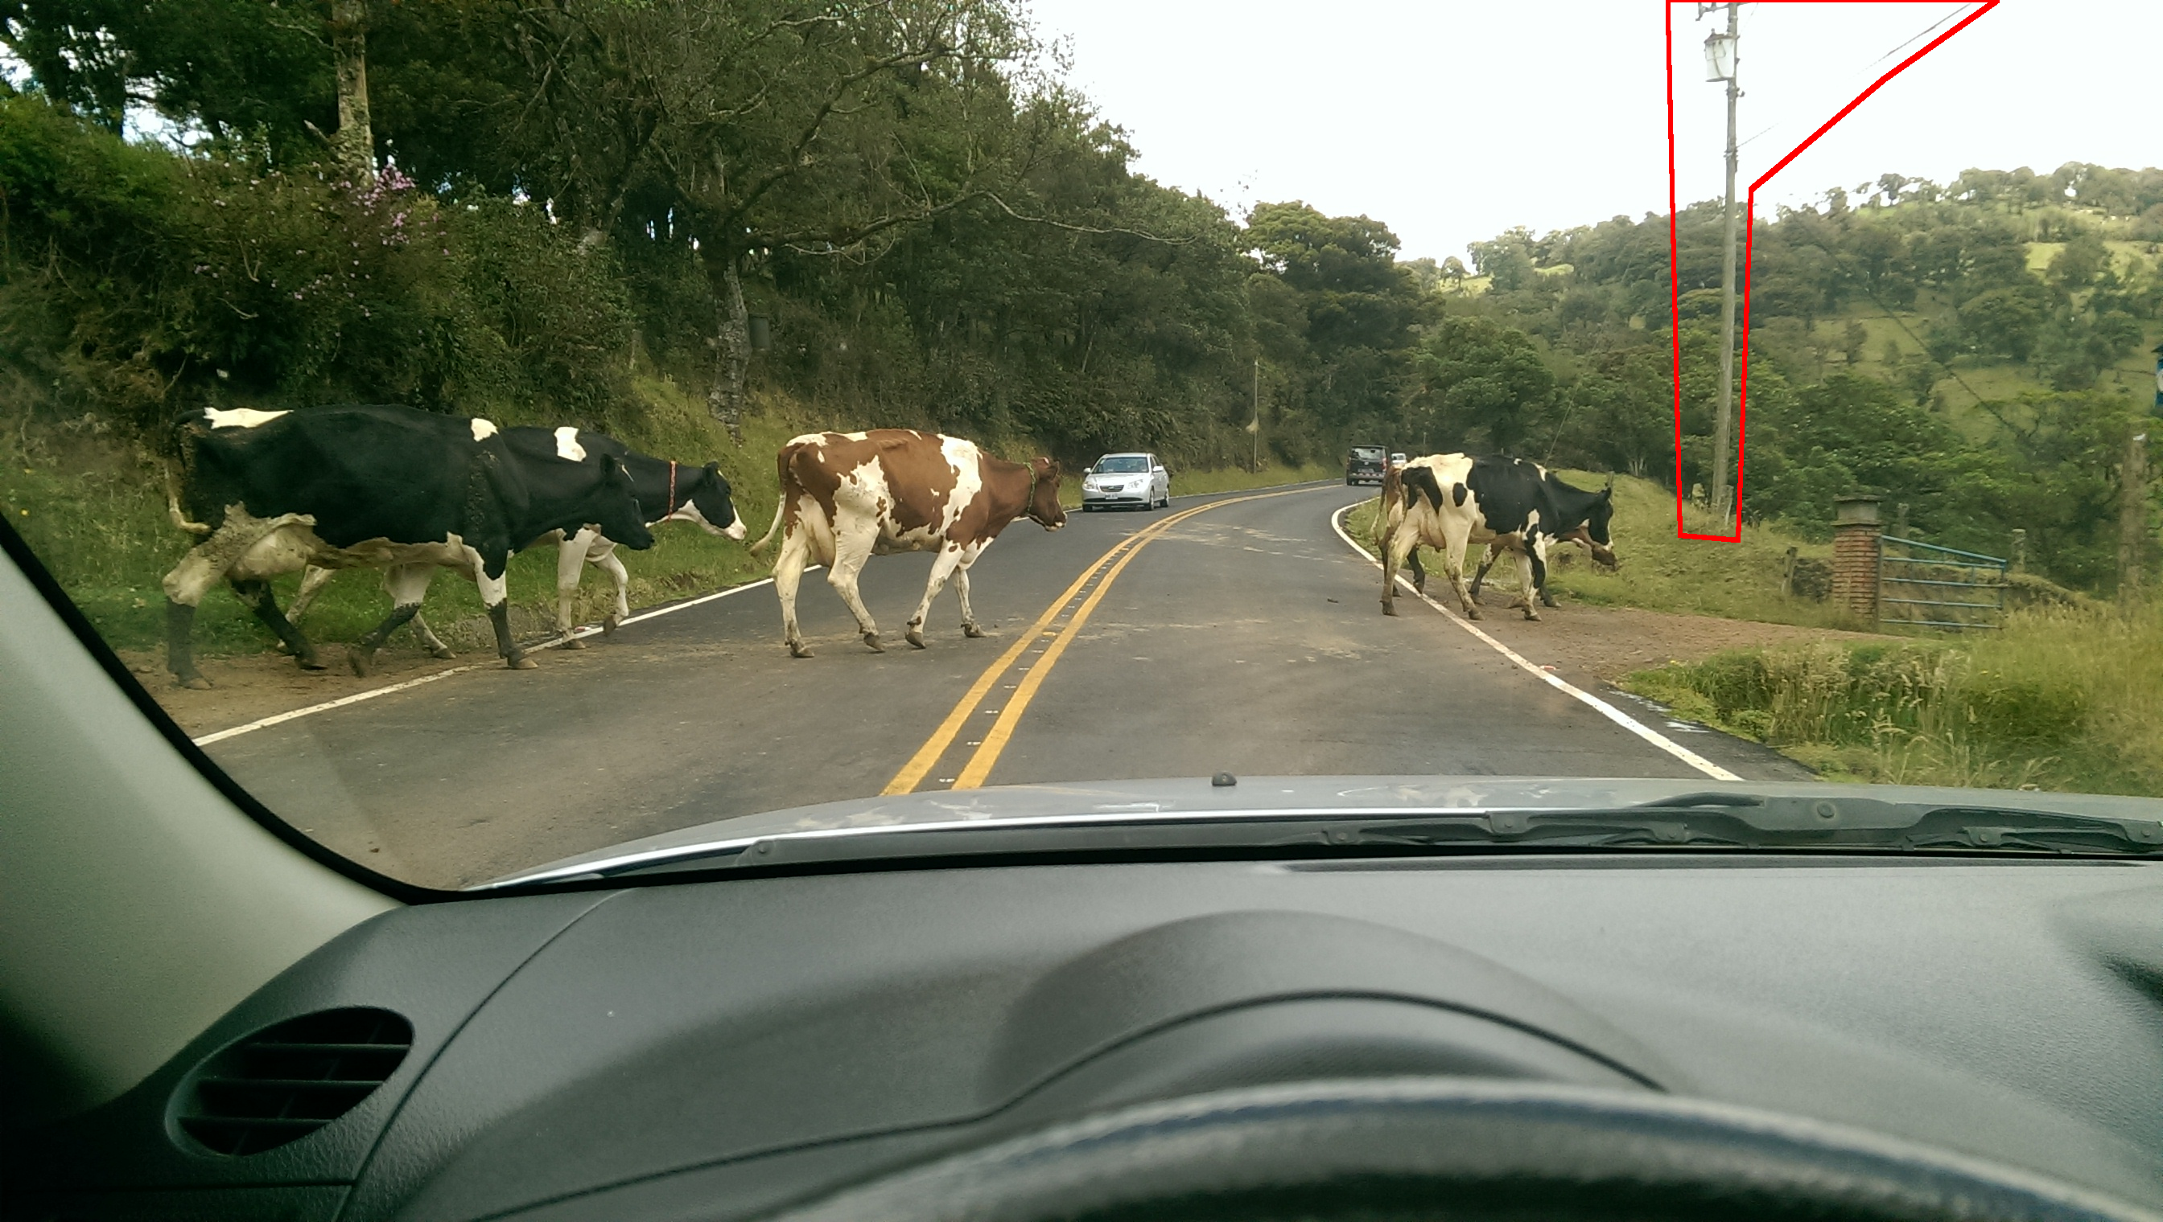

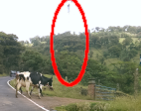
Clone Tool
Backup original – dup layer, blank it – focus visible layer (blue highlight)
Levels (ctrl-l)
Pick white and black points
  Small picker size
  Adjust mid-tones to ~ -1.55
Correct slight blue cast
Value drop-down
Adjust Output Level to ~248
Continue: remove wires and pole
cows.costa.rica.xcf

Slide 40

Clone Tool
Adjust view: Zoom-in shift +
Activate clone tool (icon is like an old rubber stamp)
Adjust properties
  Brush hardness: 2
  feathers edges
  Brush size – slider: ~32 (or use custom +/- wheel)
Select area to clone: ctrl-click just below wire
Left-click to drop cloned area
Position cursor further along wire, left-click
cows.costa.rica.xcf
(cont.)

Slide 41
Clone Tool – Remove Pole (cont.)
Enlarge selection area to ~50 (shift-ctrl +/- wheel)
Left-click near top of pole
  Don’t catch pole in edge of selection area
Center cursor directly to side of clone area, centered on pole
Left-click
Move cursor to bottom / center of pole
left-click
pole disappears
Note also randomness of leaves / soft brush fills-in the pole area
Illustrate with layers on / off
cows.costa.rica.xcf
(cont.)

Slide 42
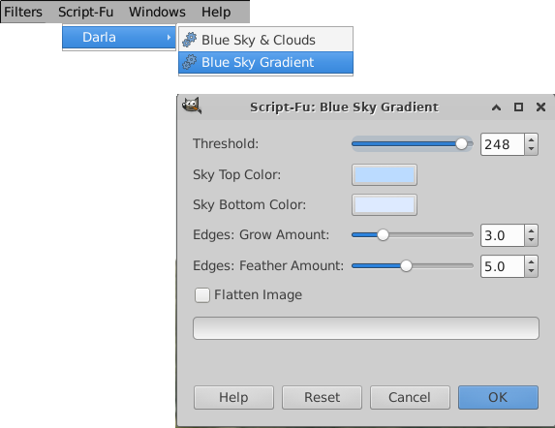
Script-Fu
Sky Replacement
Script-FU > Darla > Blue Sky Gradient
OK, nice blue sky, BUT
  Whiter areas now blue, e.g., spot on cow’s hide, car, etc.
Backing up:
  Undo: ctrl-z, or, delete top layer
Select sky: lasso tool, feather ~10
  Include sky showing thru trees; close selection: click 2x
Repeat script
  Merge layers; Crop; Save-as / Export-as
Obtain / Install info – Darla’s script: Appendix 7
cows.costa.rica.xcf
(cont.)

Slide 43
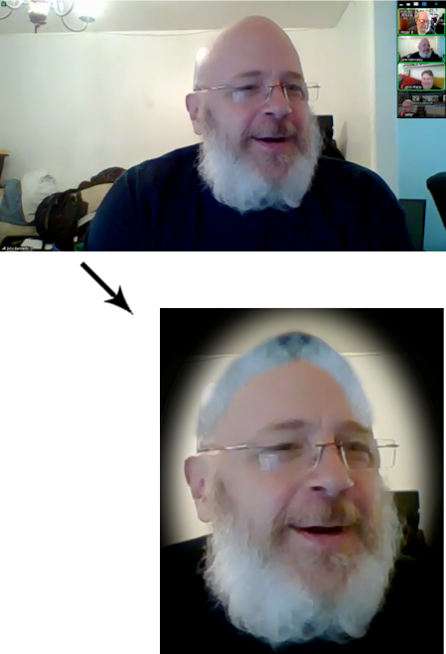
Putting It
All Together
Creating selections
Modify selections
  Tools
  Tool options
Work with Layers
Create a vignette
  (from screen shot of a
  virtual NoVaLUG meeting)

Slide 44
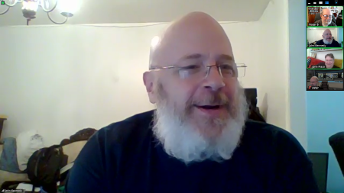

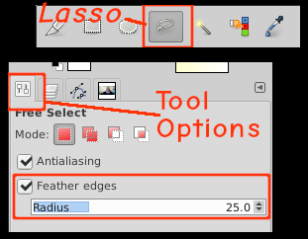

Selection / Modifying
Open image to be edited (a screen shot) Improving the "look" - transplant some hair - Free / lasso - Tool Option > Feather edges (25) - Select some beard w/ lasso - ctrl-c copies selection - ctrl-v pastes | Notice: a new layer appears - right-click on layer > To New Layer - Activate Flip tool - click it ctrl-click inverts selection - Activate move tool - click it - drag selection to reposition - Duplicate layer - Move to position the new layer - Flip the layer horizontally - Adjust position, size Move tool Scale tool Rotate tool
selections.vignette.xcf

Slide 45
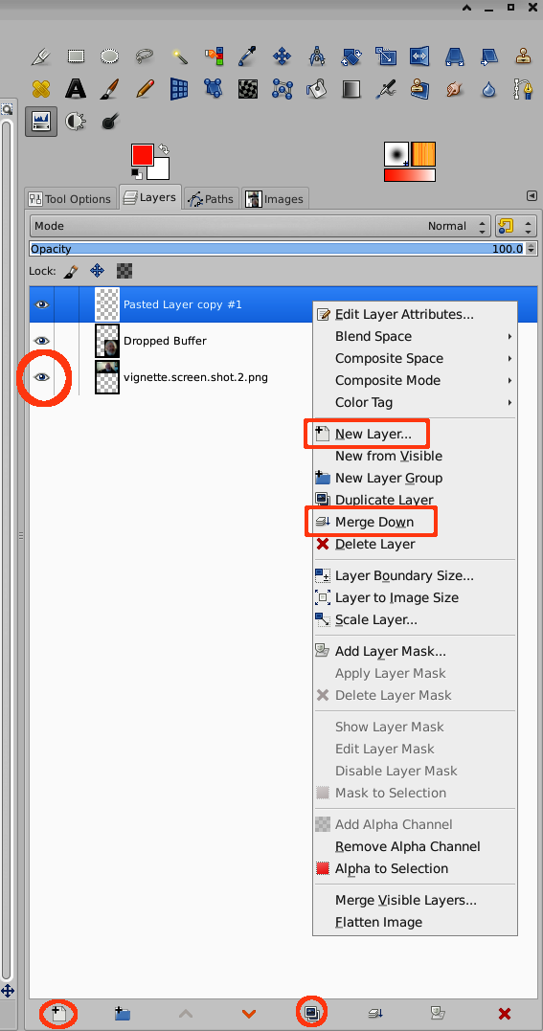
Consolidate the Image
Select the Layers Tab
Highlight the layer to merge down
Right-click-hold on the layer
  Action list appears
Mouse down to Merge Down
Release to activate Merge
Other actions available, e.g.,
  New Layer from visible
  Layer Visibility toggle w/ eye icon

Slide 46

Summary
Flip / Move tools
Paste selection to new image
Other tools can be applied to active selections
Make a mirror image of selection
  Duplicate selection: Edit > Paste (ctrl-v)
  Flip selection (flip tool)
  Position (move tool)
Can also Resize (scale tool)

Slide 47
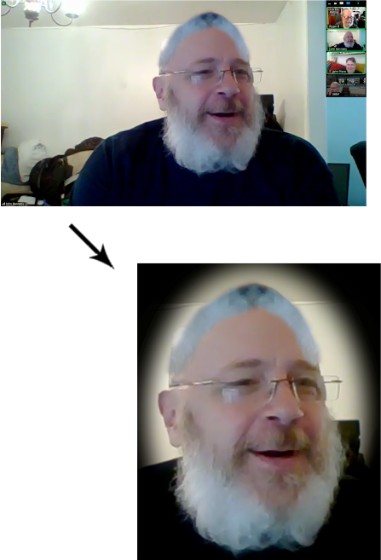

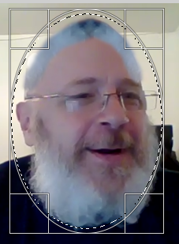
Creating A Vignette
Ellipse Tool
  Tool options > Feather > 100
Create elliptical selection
Invert selection
  Select > Invert
  Notice dancing ants
Color Tool: select black
Fill w/ foreground color
  Edit > Fill w/ FG color (or ctrl-,)
  Unselect: ctrl-shift-a
Finish: crop, save, print, frame
slelections.vignette.xcf
slelections.vignette.xcf

Slide 48
More About Layers
Layers enable many tricks
  e.g., re-use of image
Previously added layers retained in .xcf files
Create different versions of image
  Selectively hide / reveal layers
  Save each as, e.g., .jpg files for later use
Illustration – map labeling to illustrate trip progression

Slide 49
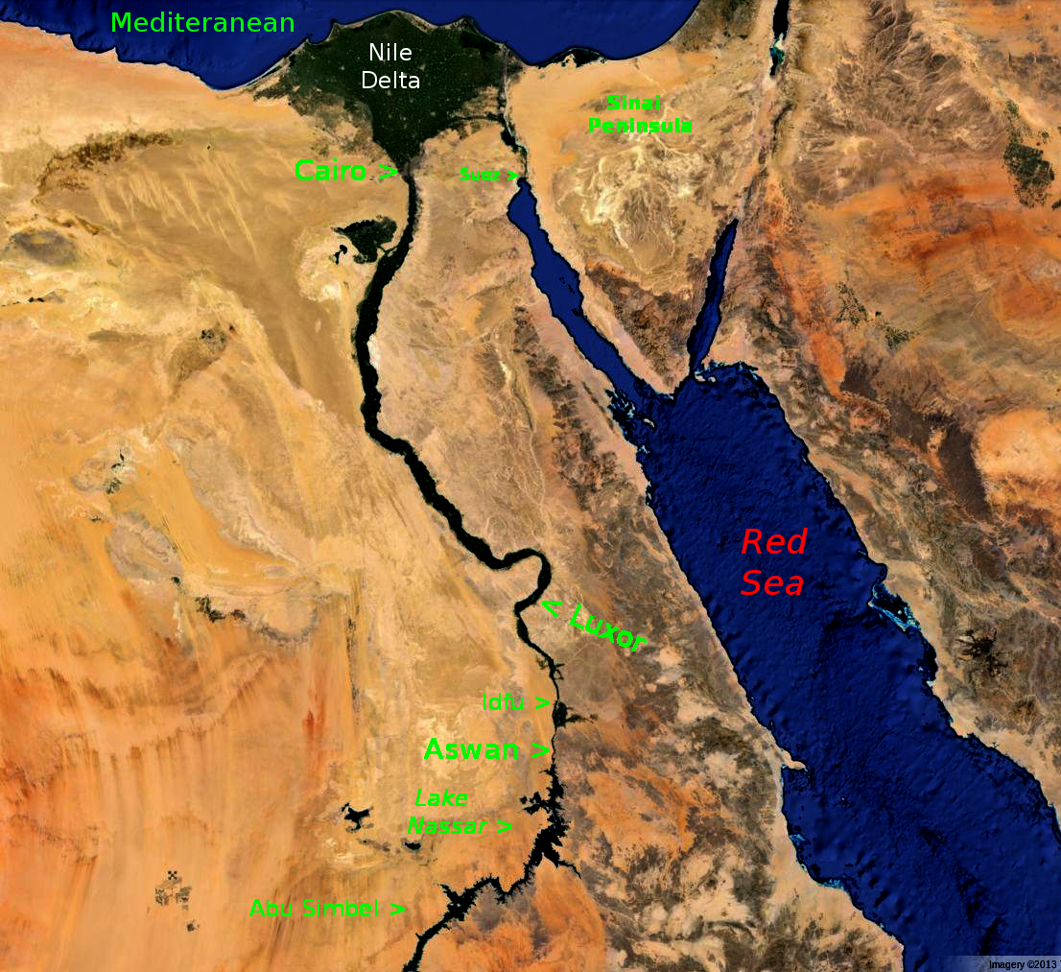
Reuse “Master” Image
map.layers.xcf

Slide 50
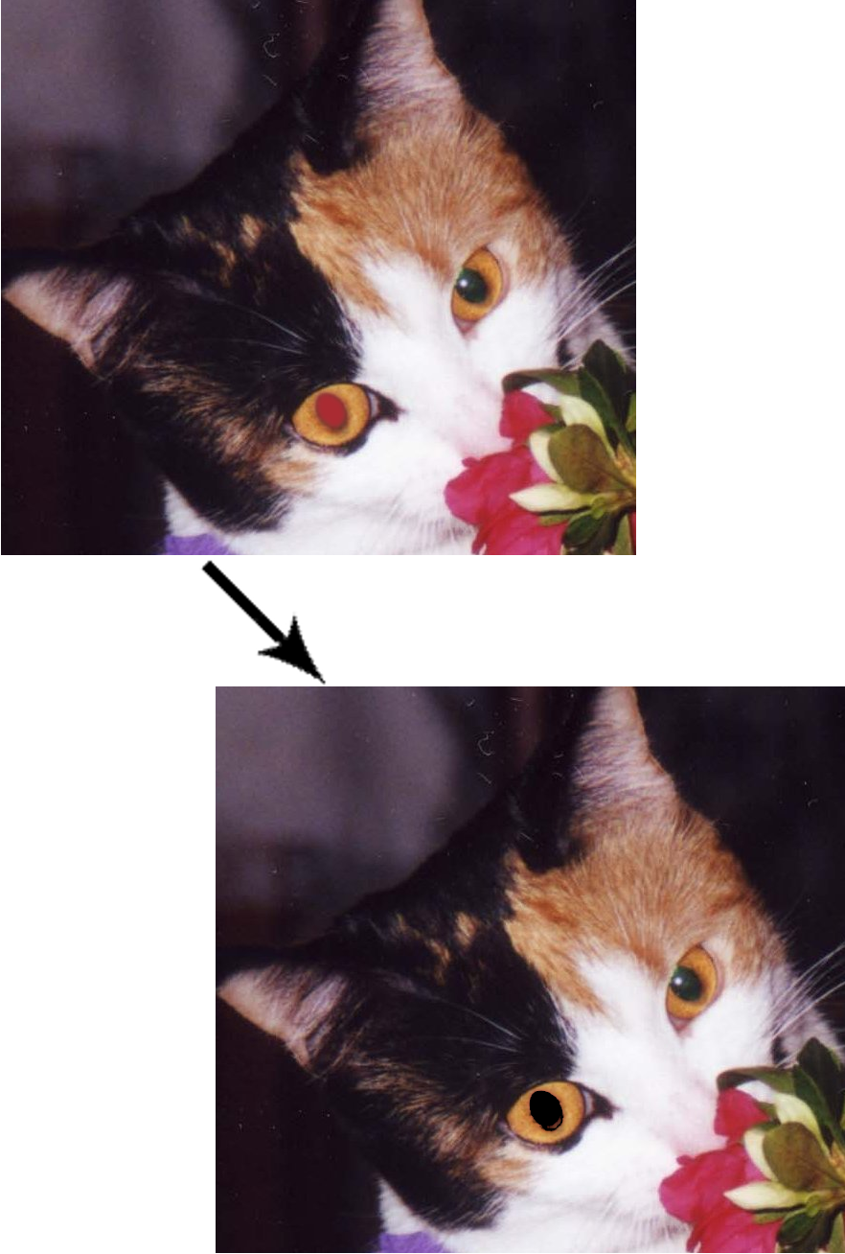
Red Eye Removal
Zoom-in (shift-+) to area of interest
Select pupil w/ Ellipse tool (no feather)
Filter > Enhance Red Eye Removal
  Adjust Threshold
  Click OK to commit (accept defaults)
  Unselect: ctrl-shift-a
Enhancement – Add sparkle, like left eye
red.eyed.cat.xcf

Slide 51
Enhancement (cont.)
Zoom-in / sliders – center eyes in view
Select highlight from left eye
  Ellipse tool, feather 5 (no sharp edges)
Copy / Paste selection: ctrl-c, ctrl-v
Layers: notice floating selection
Position over right eye: move tool
Merge down: ctrl-m
Zoom to original size: ctrl-0 (ctrl-zero)
Done: Save
red.eyed.cat.xcf

Slide 52
Free Select / “Lasso” Tool
Free select tool
  “lasso tool”
  polygonal segments or irregular shapes
Select modes
  Freehand
  Polygonal segments
  Point-to-point
Complete selection by “closing” selection
  Or, do final click on first selection handle

Slide 53
Demo – Free select (and copy)
Freehand: just drag cursor around area to select
Polygonal: do a series of shift-clicks
Irregular: do a series of clicks
  Allows finer control of selection area
Edit > copy or ctrl-c to copy selection while it's active
select.lasso.xcf

Slide 54
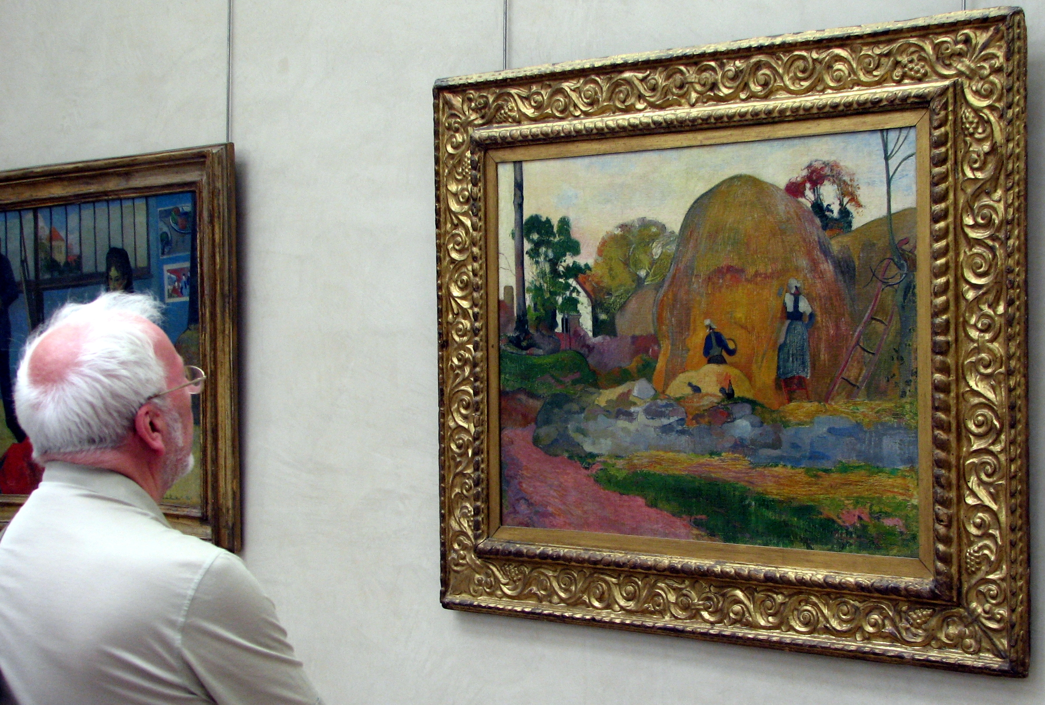
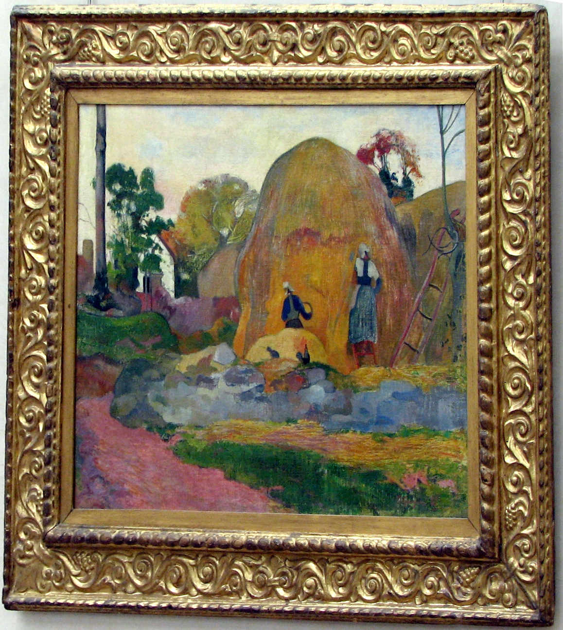
Perspective – Before Changes
Improved Perspective

Slide 55
Perspective Tool
Useful to correct distorted perspective, especially in images with obvious right-angles
Helpers
  Expand window (grab a corner and drag)
  Grid lines: View > Show Grid (my custom: ctrl-g)
Adjust perspective: drag corner handles
  Perspective parameter box appears
Commit: click on Transform button
Some of image is lost – null / checkerboard areas
  Hint: loosely framed image when shooting to allow room for adjustments
  Crop to finish
  Adjust Levels to “brighten” 0 / 1.15 / 225
  File > save-as (xcf to retain edits) or File > export as other format.
perspective.art.xcf

Slide 56
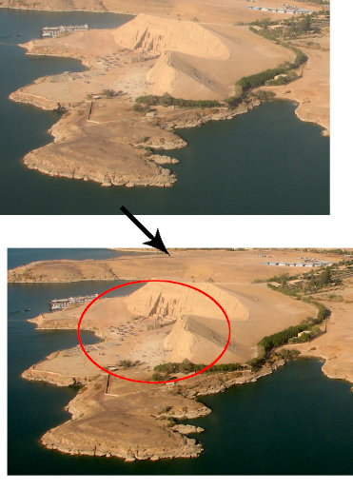

Geometric Shapes
GIMP is not a “drawing” program
GIMP: raster graphics vs. vector graphics (Inkscape)
  Ref: vector vs. raster graphics editors
Construct geometric figures using built-in tools
Example: area of interest – Abu Simbel
Activate Ellipse tool
  Drag cursor, encircle area of interest, change shape
  Shift-drag to create circle
Make it red – Color selector, chose red
Edit > Stroke selection
  Line width: 4
  Click Stroke to commit
Oops: too thin – ctrl-z
  Edit > Stroke selection > Line width 6 > Stroke
  ctrl-shift-a to deselect; save for posterity
Option: Enlarge area of interest: Zoom-in (Shift +); avoid pixelation; crop to area of interest; save-as or export-as.
abu.simbel.cropped.xcf

Slide 57


Other Shapes
Create a Green Square
  New image
  ctrl-n
  Ok
Rectangle select, option Expand from Center
Color: green – by name in HTML box; Enter; OK
Edit > Stroke Selection > Line width: 5; Okay
Unselect: ctrl-shift-a
Use on another image: ctrl-a; change focus to other image; crtl-v
Ovals: Stroke Ellipse selection
Concentric circles – brute force: do concentric circle selections and fill thin gap with a color
Imaginative use of selectors to make interesting shapes
Graphic pens work well with GIMP
Green Square

Slide 58


Shape Creation with Selectors
6-Point Star / Highlighted Text
Create star in steps using rectangular selector and Edit > Stroke – steps illustrated with layers
Trim insides
Text-tool to create WOW (black) in new layer
Select-by-color black text
Change color to red
Stroke selection – Edit > Stroke
  Line width: 1 > Stroke
Finish: ctrl-shift-a; save (preserves .xcf); export as; ctrl-q (quit)
wow.xcf

Slide 59

Five Point Star
Created with a combination of lines radiating from a point at successively increasing 36° angles
Draw point-to-point lines from vertices delineated by intersection of lines with circles
Will briefly illustrate but details are left as an exercise for the “student”
start.five.point.xcf

Slide 60
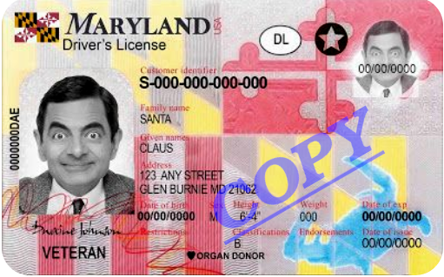



Water Mark
Create new layer
Text Tool
  Click image where text is desired
  Blank image layer
Choose font attributes
  Size: ~ 70 Color: Blue
  Click font attributes
    Bold, Italic, Underline
  Tab to enter text box
watermark.xcf

Slide 61

Water Mark (cont.)
Adjust text box position – drag corners and edges
Adjust Opacity: ~ 60
Change angle – Rotate Tool
  shift-drag rotates in 15° increments
Position with Move Tool
Save-as; export-as; ctrl-q

Slide 62
Color to Black & White
B&W sometimes better than in color
Compensate for severely distorted color balance
Fix by changing to B&W
Example: old photo color distorted due to age

Slide 63


Example – Before and After
Convert with
Image > Mode > Grayscale
Adjust color Levels
Fuzziness: camera limitations
cousins.original.jpg

Slide 64

The End - Acknowledgments

Slide 65
Appendix 1. jAlbum
Create / Organize Albums
Powerful, feature laden
Final organize re-arrange photos
Annotate with comments visible to viewer on web
Numerous skins
Favorite skin: Tiger, ZigZag, Atom (simple, quick)
Responsive design – view on tablets, smart phones
Geo-location: location of photo on Google Maps
Handles videos
Some editing capbilities built-in

Slide 66
App. 1. jAlbum (Cont.)
Active user forums w/ answers
Server side software not required
One month free trial 2 GB on-line storage at jAlbum.net
Free to use / license to get rid of ads (see FAQ)
  jalbum.net
Fast / smart upload tool
  Doesn’t re-load existing images

Slide 67
App. 1. jAlbum (Cont.)
40% discount code
  novalug21
  Valid until 2021.08.10
  A “rare” discount, courtesy of David Elkholm, jAlbum developer

Slide 68
App. 1. jAlbum (Cont.)
Use jAlbum for album creation and cull / sort / order in jAlbum.
Can jump directly to GIMP when set as external editor
Images commonly download from camera arranged by date, usually OK. One can also move images into folders with appropriate names using tools for viewing folders – such as Konqueror or Nemo. Then jump to jAlbum.
Jalbum has options to tag photos, including a “star” rating, helpful when culling.
What method is choosen for various tasks, don’t jump around – interface confusion ensues
Be sure to make a backup copy of originals as a first step.

Slide 69
Appendix 2.
Album Uploads – Filezilla
Fast – multiple upload “threads”
Nice GUI
Site manager – set i.p., etc., forget
Secure connections –
  SFTP
  Public / private key
Selectively upload only new files
If uploading jAlbum – all files in
  /MyAlbums/<album name>/album

Slide 70



Appendix 3
Example Preferences
Toolbox
  Tools to display
  Arrange tools
Default new image
  Size, Resolution
  Color space profile
  My preferred fill: transparent
Policy, File open
  Default for web work
  Convert to sRGB

Slide 71

App. 3 – Prefs (cont.)
Maximize contrast:
  In addition to setting the Interface Theme to “System”
  Also adjust Icon Theme

Slide 72

Example Preferences (cont.)
(Beyond the scope
of this presentation!)

Slide 73

Appendix 4. Shortcuts (default)

Slide 74
Appendix 5. Color Chart Refs
Color charts / color hex codes
Html color chart
  Chart
  Color picker
  Color code theory
  Examples – next slide
Color Picker
Color wheel
  Hex codes for color
  Several color tools

Slide 75

App. 5 (cont.)
Source: https://html-color-codes.info/

Slide 76
App. 6 Understanding Histograms
Camera Histograms reveal underlying data about exposure of a photograph. Understanding of them can extrapolated to editing (Color > Levels)
Over exposure: histogram touches the right edge of the graph for some areas of image.
Under exposure: histogram touches the left edge of the graph for some areas of image.
Photos are composed of pixels. The camera picks up the tone of each of those pixels, regardless of color. Tone / luminosity – bright? Dark?
In a camera, software changes pixels to white, black or different shades of gray, depending on the brightness or darkness of a tone. Normally up to 256 light values – levels – are used to generate the histogram.
  Lastly, the camera's software algorithm counts the number of pixels of each tonality and builds a bar chart – the histogram.

Slide 77
App. 6 Understanding Histograms (cont.)
A camera’s histogram shows all the light values it has capture. It shows the tones that fit within the dynamic range of the camera are distributed.
Between the tone located at the left and right ends of a histogram there are a certain number of stops, which correspond to the dynamic range of a camera.
The aim is to avoid blown out highlights and clipped shadows. Likewise, a GIMP histogram reveals the areas that are over exposed and under exposed.
Adjusting Color Levels in GIMP can bring out data in underexposed areas. Parts of an image that are “blown out” are lost.
A GOOD histogram shows peaks towards the center of the graph from left to right. The majority of the pixels in the image are mid-tones; fewer pixels makeup the shadows and highlights. It's a great histogram.
Ref: photopills.com – Milkway Guide

Slide 78
App. 7. Darla’s Sky Replacement Scripts
Instructions / obtain Darla’s sky scripts
  Blue Sky Gradient
  Blue Sky Clouds
Installation, clouds script
Downloaded script from github
Copied text of scrip, while displayed in browser
Saved as sky.clouds.scm to /home/roger/.cconfig/GIMP/2.10/scripts/
More tips on installing GIMP plugins
  plugins on-line-tech

Slide 79

App. 8 PC Used for this Project
Building the PC

Slide 80

Appendix 9.
My Equipment
Olympus micro four-thirds
  Light weight
  Compact
  Shirt pocket size (almost)
  Highly recommended for travel photograhy
Tripod; Monopod; Filters: star; circular polarized; spare batteries, charger
(Appendix continued – next slides)

Slide 81
App. 9 (cont.)
OM-D E-M10 Mark III, 16 Mega Pixel
Newer, Mark IV: 20 Mega Pixel

Slide 82

App. 9 (cont.)
Lenses: Multiply focal length 2x to get approximate 35mm camera equivalents. The pancake lens (zoom) focal length is 14 – 42mm, ~equivalent to 28 – 50mm focal length for a 35mm camera.
The 40 – 150 zoom lens is ~equivalent to 80 – 300mm.
These are lower priced lenses. “Prime” lenses are higher quality.

