Slide 1
Linux Mobile: history and current state
Matt Panhans April 2025

Slide 2
Why, though?

Slide 3
Why, though?
Looks cool

Slide 4
Why, though?
Looks cool
Environmental sustainability

Slide 5
Why, though?
Looks cool
Environmental sustainability
Privacy
User freedom

Slide 6
Why, though?
Looks cool
Environmental sustainability
Privacy
User freedom
Are two options enough?

Slide 7

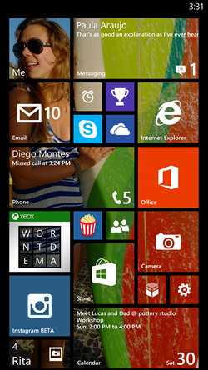
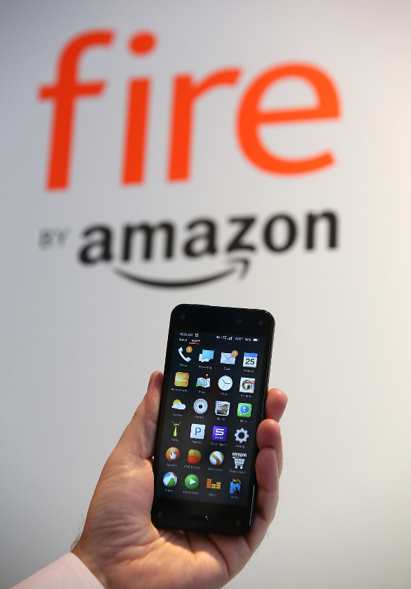

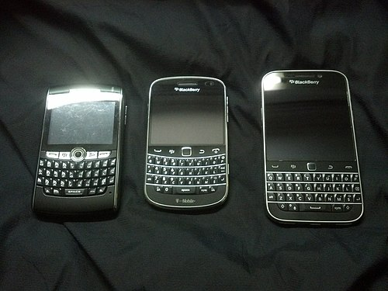
Remember: mobile is hard
2010-2017
1999-2016
2014-2015

Slide 8
Brief Linux Mobile history
2005-2010, Nokia’s Maemo/MeeGo Linux-based OS. Using Debian and GTK/Gnome libraries.
2011-2017, Ubuntu Touch developed by Canonical
In 2017, Ubuntu Touch project terminated by Canonical, and transferred to community development (UBports Foundation)
2013, initial release of Jolla’s Sailfish OS
  Linux-based with closed-source UI
  Jolla Community Phone requires subscription for updates after 1st year
2017, Purism starts crowdfunding for Librem 5 smartphone
2020, Pine64 PinePhone (2020) and PinePhone Pro (2022)
2024, FuriLabs launch the FLX1 running FuriOS (Droidian fork)

Slide 9
Brief Linux Mobile history
2005-2010, Nokia’s Maemo/MeeGo Linux-based OS. Using Debian and GTK/Gnome libraries.
2011-2017, Ubuntu Touch developed by Canonical
In 2017, Ubuntu Touch project terminated by Canonical, and transferred to community development (UBports Foundation)
2013, initial release of Jolla’s Sailfish OS
  Linux-based with closed-source UI
  Jolla Community Phone requires subscription for updates after 1st year
2017, Purism starts crowdfunding for Librem 5 smartphone
2020, Pine64 PinePhone (2020) and PinePhone Pro (2022)
2024, FuriLabs launch the FLX1 running FuriOS (Droidian fork)

Slide 10
Brief Linux Mobile history
2005-2010, Nokia’s Maemo/MeeGo Linux-based OS. Using Debian and GTK/Gnome libraries.
2011-2017, Ubuntu Touch developed by Canonical
In 2017, Ubuntu Touch project terminated by Canonical, and transferred to community development (UBports Foundation)
2013, initial release of Jolla’s Sailfish OS
  Linux-based with closed-source UI
  Jolla Community Phone requires subscription for updates after 1st year
2017, Purism starts crowdfunding for Librem 5 smartphone
2020, Pine64 PinePhone (2020) and PinePhone Pro (2022)
2024, FuriLabs launch the FLX1 running FuriOS (Droidian fork)

Slide 11
Brief Linux Mobile history
2005-2010, Nokia’s Maemo/MeeGo Linux-based OS. Using Debian and GTK/Gnome libraries.
2011-2017, Ubuntu Touch developed by Canonical
In 2017, Ubuntu Touch project terminated by Canonical, and transferred to community development (UBports Foundation)
2013, initial release of Jolla’s Sailfish OS
  Linux-based with closed-source UI
  Jolla Community Phone requires subscription for updates after 1st year
2017, Purism starts crowdfunding for Librem 5 smartphone
2020, Pine64 PinePhone (2020) and PinePhone Pro (2022)
2024, FuriLabs launch the FLX1 running FuriOS (Droidian fork)

Slide 12
Brief Linux Mobile history
2005-2010, Nokia’s Maemo/MeeGo Linux-based OS. Using Debian and GTK/Gnome libraries.
2011-2017, Ubuntu Touch developed by Canonical
In 2017, Ubuntu Touch project terminated by Canonical, and transferred to community development (UBports Foundation)
2013, initial release of Jolla’s Sailfish OS
  Linux-based with closed-source UI
  Jolla Community Phone requires subscription for updates after 1st year
2017, Purism starts crowdfunding for Librem 5 smartphone
2020, Pine64 PinePhone (2020) and PinePhone Pro (2022)
2024, FuriLabs launch the FLX1 running FuriOS (Droidian fork)

Slide 13
Brief Linux Mobile history
2005-2010, Nokia’s Maemo/MeeGo Linux-based OS. Using Debian and GTK/Gnome libraries.
2011-2017, Ubuntu Touch developed by Canonical
In 2017, Ubuntu Touch project terminated by Canonical, and transferred to community development (UBports Foundation)
2013, initial release of Jolla’s Sailfish OS
  Linux-based with closed-source UI
  Jolla Community Phone requires subscription for updates after 1st year
2017, Purism starts crowdfunding for Librem 5 smartphone
2020, Pine64 PinePhone (2020) and PinePhone Pro (2022)
2024, FuriLabs launch the FLX1 running FuriOS (Droidian fork)

Slide 14
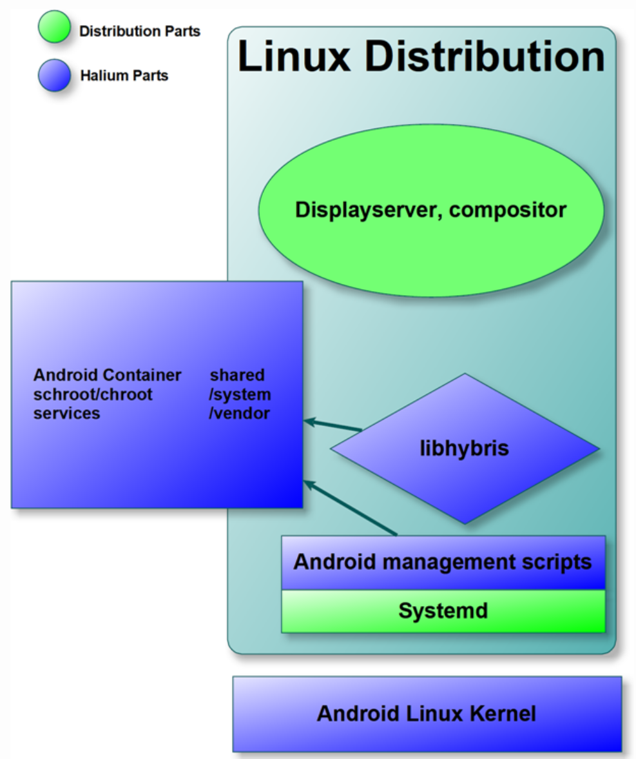
‘Mainline’ vs libhybris/Halium
Halium project: Hardware Abstraction Layer for Linux to run on Android devices
Benefits:
  Camera stack, audio routing, GPS, modem management more readily work by allowing a Linux-based OS to talk to Android interfaces
Costs:
  Relies on Android for security patches and support
  Heavy modification to mainline Linux stack

Slide 15
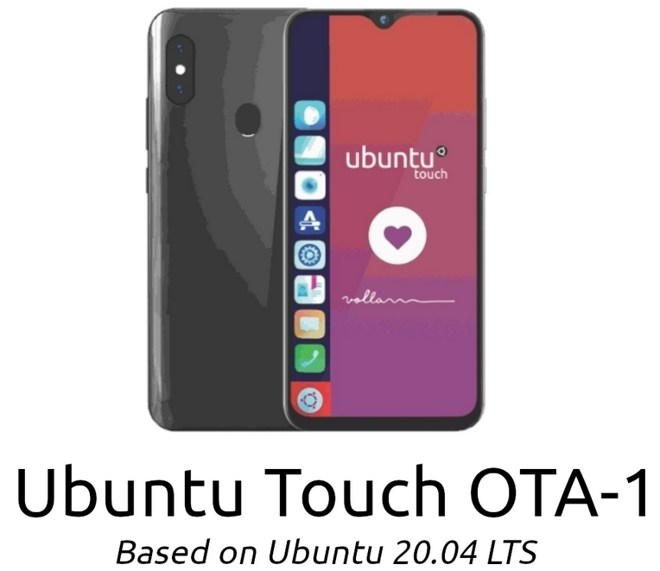
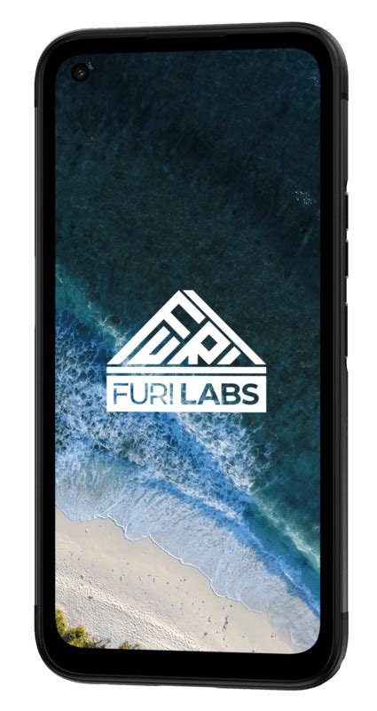


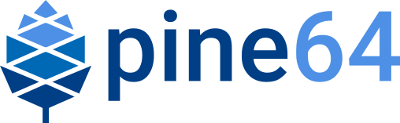

‘Mainline’ vs libhybris/Halium
Mainline libhybris/Halium
Mobian
postmarketOS
PinePhone/Pro
Purism Librem 5
Ubuntu Touch
Droidian
FuriLabs FLX1

Slide 16
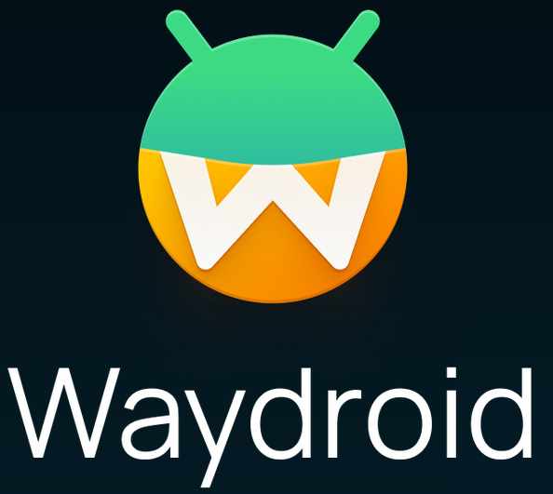
Android in a Linux container
A container-based approach to boot a full Android system on regular GNU/Linux systems.

Slide 17
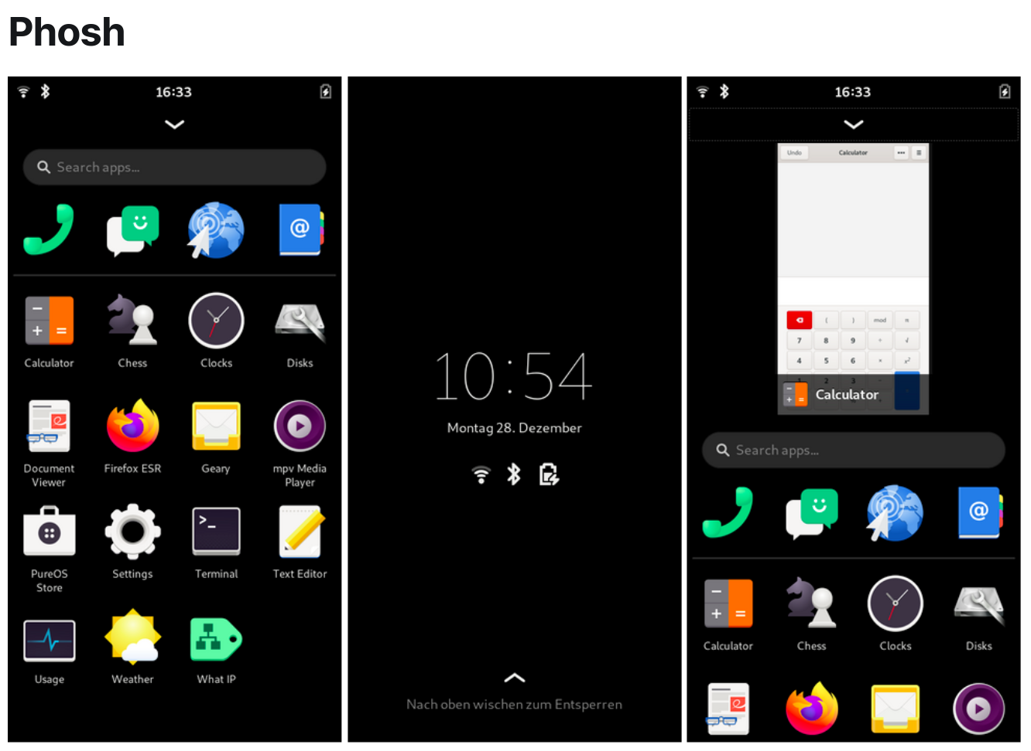
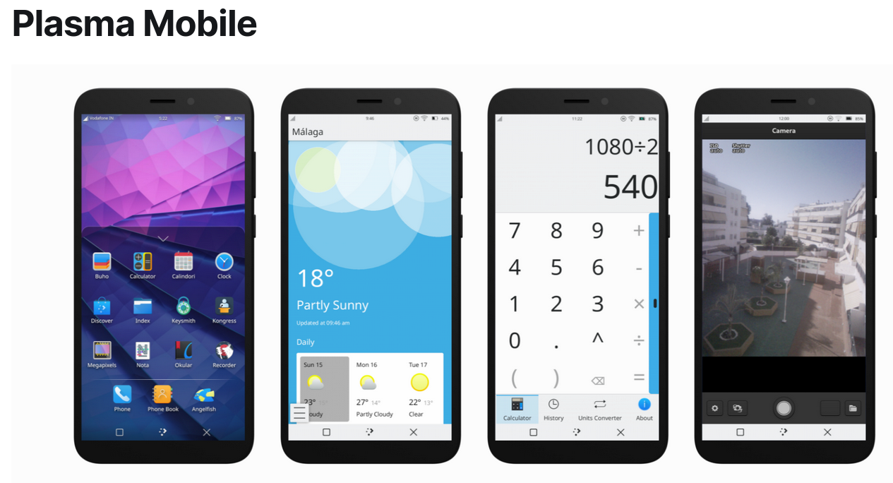
User interfaces

Slide 18
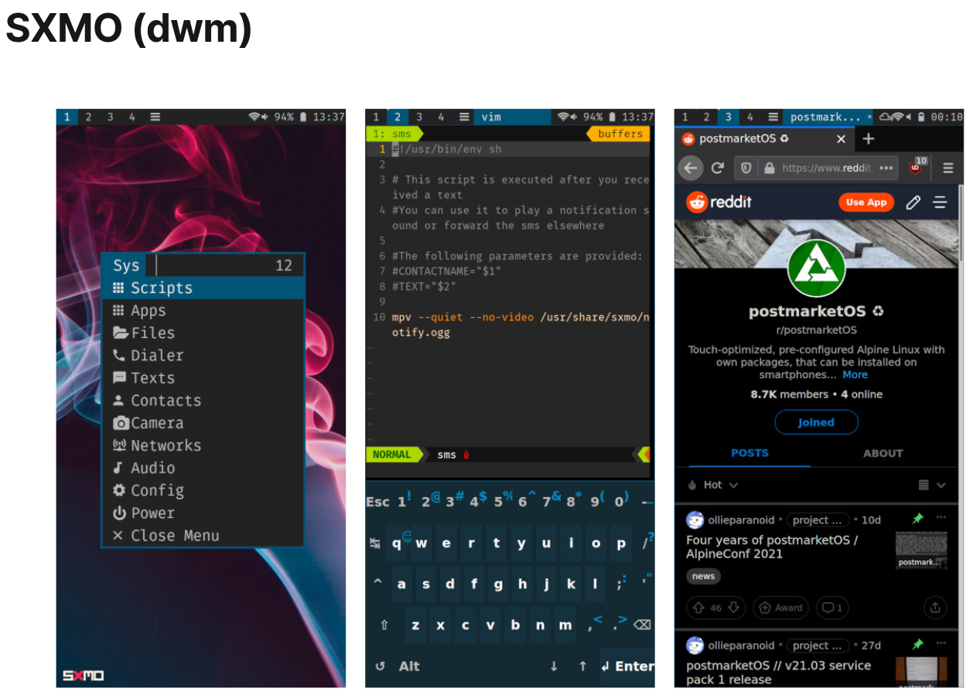
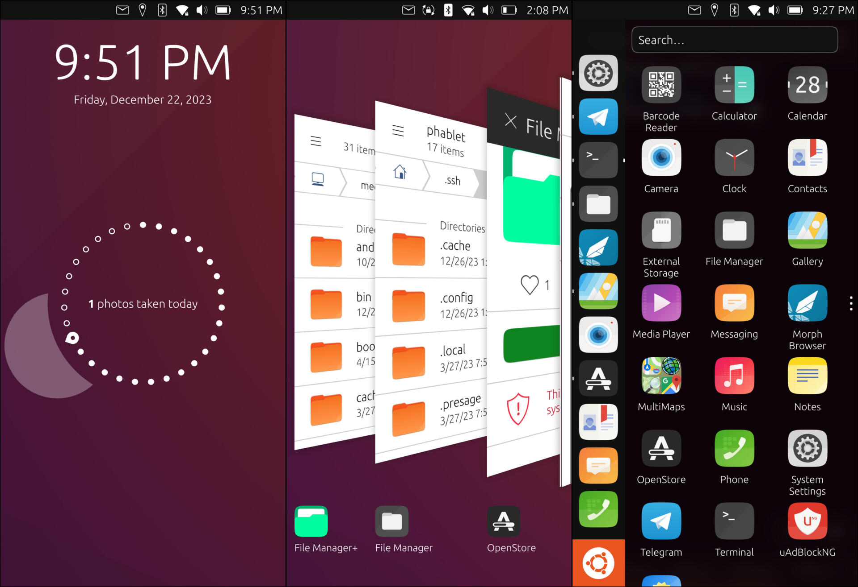
User interfaces
Lomiri (Ubuntu Touch)

Slide 19
Most-compatible devices
OnePlus 6 and 6T
Pixel devices, especially Pixel 3A and 3A XL
Fairphone 4

Slide 20
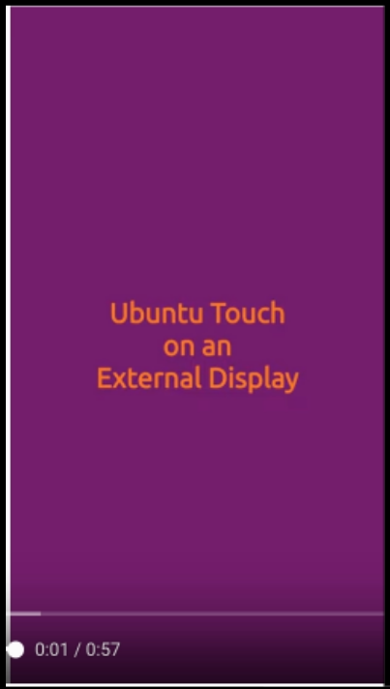
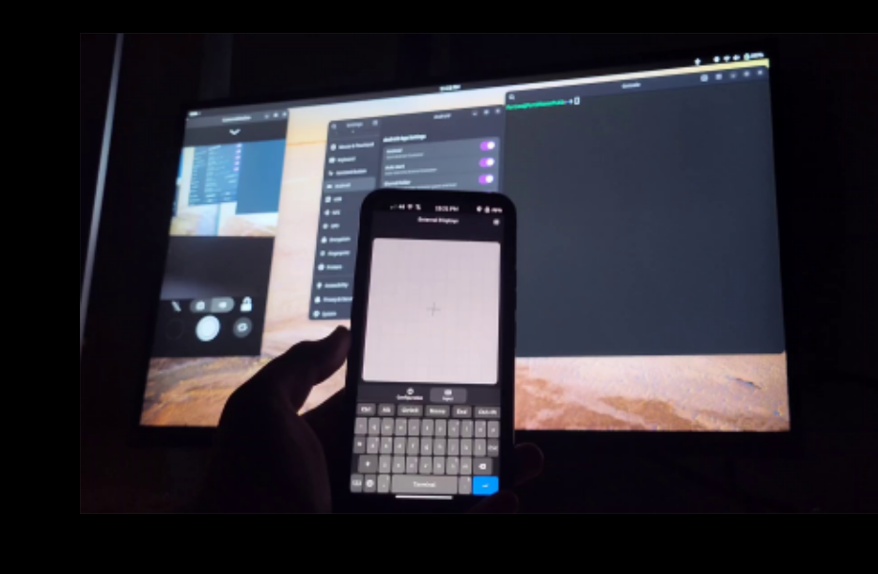
Dreams of convergence
Ubuntu Touch External Display
FLX1 with External Display

