Slide 1

Predicting Queen of Markets - VIX Is it possible to predict the VIX using RNN (LSTM)? Alexander Novak CFDS 3 – Class 2019 Spring
Chartered Financial Data Scientist (CFDS)

Slide 2

Contents

Slide 3
Contents
Motivation
Trading volatility (VIX)
Predicting „Fear“ of the market

Slide 4

Contents
Motivation - Inspiration

Slide 5
Contents
Motivation – What is the VIX?
1993: Measure the market’s expectation of 30-day volatility implied by at-the-money S&P 100® Index (OEX® Index) option prices
2003: Cboe & Goldman Sachs update VIX ➔ based on S&P500 index
2004: VIX Futures

Slide 6
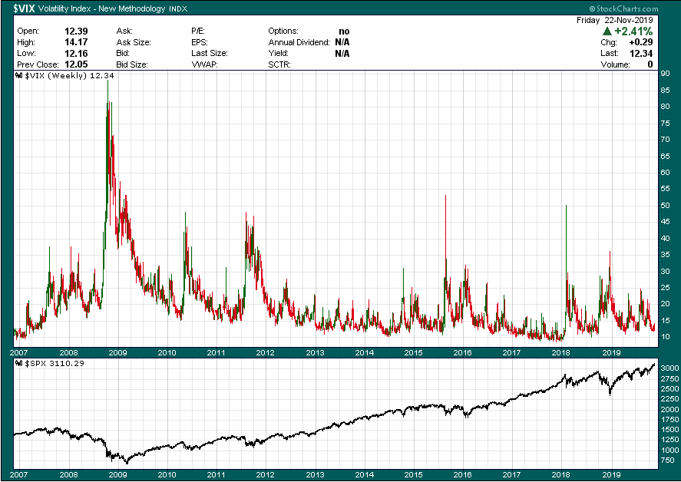
Contents
Motivation - Cboe Volatility Index® (VIX® Index)

Slide 7
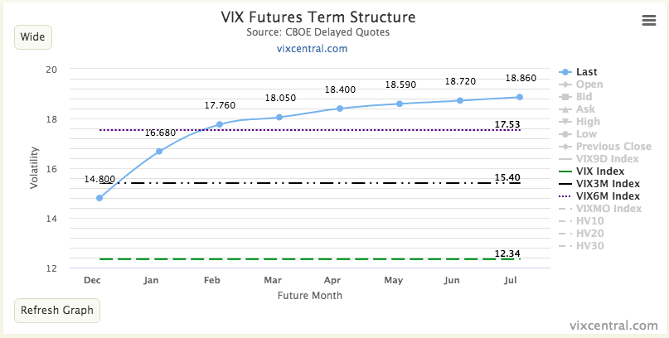
Contents
Motivation – VIX Futures – Forward Curve (healthy)
22.11.2019

Slide 8
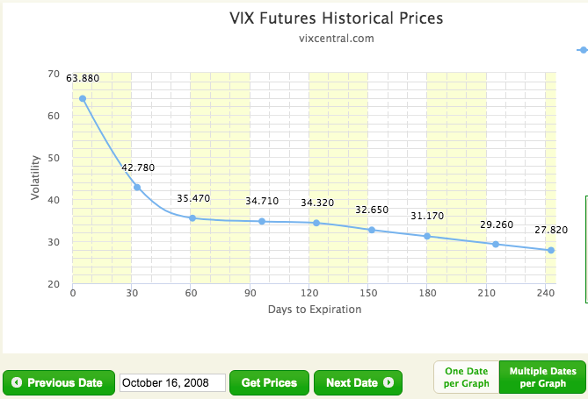
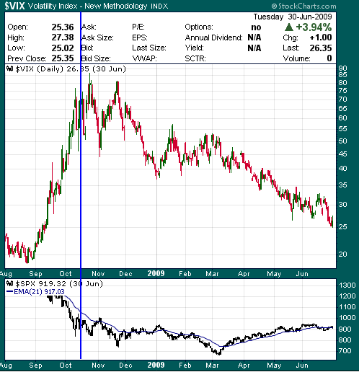
Contents
Motivation – VIX Futures – Forward Curve (unhealthy)

Slide 9
Contents
Problem Description
Is there any LSTM model that is able to predict the VIX?

Slide 10
Contents
Problem Description - Goal
LSTM training framework that produces multiple LSTM models that can be assessed to answer the problem question

Slide 11
Contents
Problem Description
Predicting stock markets – again?

Slide 12

Contents
Problem Description
Predicting stock markets – again?

Slide 13

Contents
Problem Description
Predicting stock markets – again?

Slide 14

Contents
Problem Description
Predicting stock markets – again?

Slide 15
Contents
Problem Description
Univariate timeseries data (commonly used)
Stocks as preferred markets to predict
Different price formation:
Stocks: Prices are based on supply and demand
VIX: calculated by Cboe based on index options
VIX: only in a range (~9 – 85)

Slide 16
Contents
Data

Slide 17
Contents
Data
Advantage 1: structured timeseries data &
Advantage 2: high quality

Slide 18
Contents
Data
Advantage 1: structured timeseries data &
Advantage 2: high quality
Disadvantage 1: Not enough historical data
Disadvantage 2: Expensive for some timeseries data

Slide 19
Contents
Data – Missing Data Imputation
Based on skewness ➔ mean, mode, median
No data deleted

Slide 20
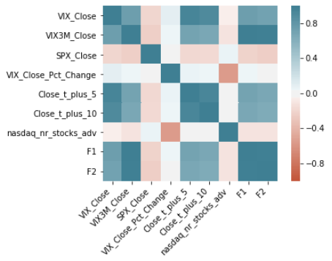
Contents
Data
Volatility Data since 1990
S&P500 Data since 1990
VIX Futures (Contango, Backwardation)
Put/Call Ratio (Cboe)
Advanced/Declined Issues
…

Slide 21
Contents
Data - Sources
Ivolatility.com
Yahoo finance
Quandl
Tradingview.com
Vixcentral.com

Slide 22

Contents
Data – Preparation for ML - Normalization
MinMaxScaler (sklearn)
Doc: “Transforms features by scaling each feature to a given range.”

Slide 23
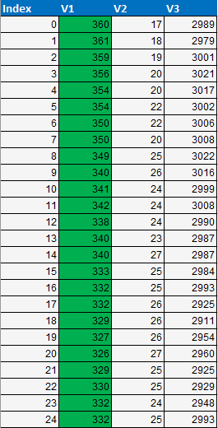
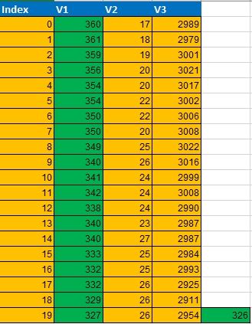
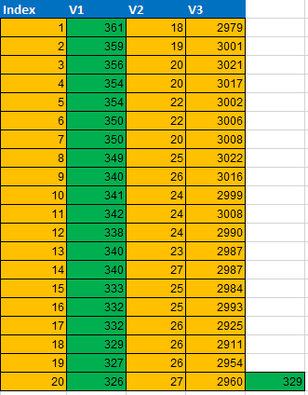
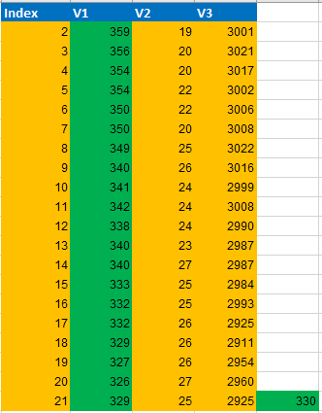
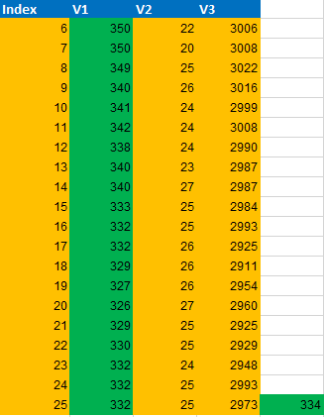
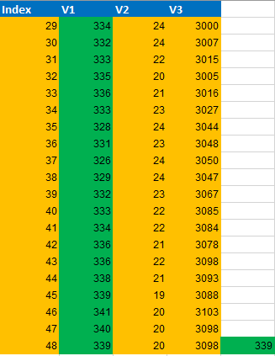
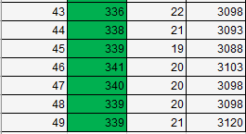
Contents
Data – Preparation for ML – 3d Shape

Slide 24
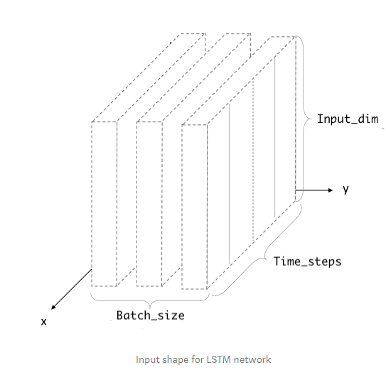
Contents
Data – Preparation for ML – 3d Shape
Source: (Understanding Input and Output shapes in LSTM | Keras)
https://medium.com/@shivajbd/understanding-input-and-output-shape-in-lstm-keras-c501ee95c65e

Slide 25
Contents
Data – Preparation for ML – 3d Shape
Keras TimeSeriesGenerator

Slide 26
Contents
Approach

Slide 27

Contents
Approach
Main goal: LSTM model framework to find the best
LSTM model to predict the VIX.

Slide 28
Contents
Approach – What is “Prediction”?
Simple Value prediction for the next day (5th / 10th / 15th day)
Supervised learning approach
Sequence of values to predict
Binary Prediction (goes up, goes down)
Prediction of % change for the next day (5th / 10th / 15th day)
Using Labels for VIX Ranges (pure supervised learning)

Slide 29

Contents
Approach – Why not classical TS Forecasting?

Slide 30
Contents
Approach – Why not classical TS Forecasting?
Autoregression Models: AR, ARMA, ARIMA, SARIMA
Suitable for linear relationship
Sophisticated, relatively simple and good training performance
Challenge: Stationary vs. non-stationary data

Slide 31
Contents
Approach – LSTM
Suitable for nonlinear TS models
Using multiple TS data vs. single
Train different LSTM models based on various:
TS sequence lengths
combination of features
target data
length of epochs
prediction methods
…

Slide 32
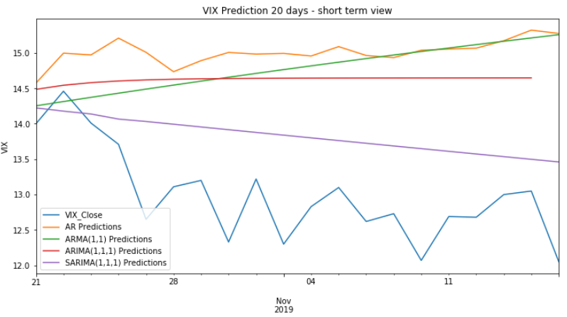
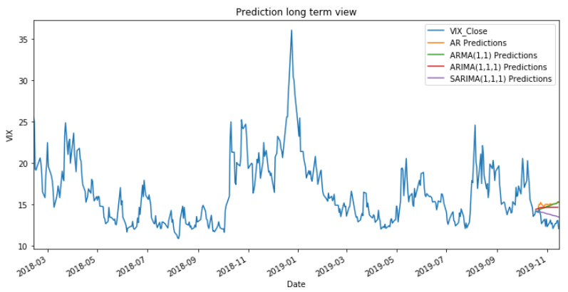
Contents
Results – 4 AR models
AR, ARMA, ARIMA & SARIMA
TS data: VIX Close, since 2005
 | AR(1,1) | ARMA(1,1,1) | ARIMA(1,1,1) | SARIMA(1, 0, 1)x(0, 0, 1, 4)
MSE | 4.58 | 3.96 | 3.09 | 0.94
RMSE | 2.14 | 1.99 | 1.75 | 0.97

Slide 33
Contents
Results – LSTM Training Framework
Load LSTM Designs (json)
Prepare Data (Split, Missing Features …)
Normalize (MinMax Scaler)
TimeSeriesGenerator
Create LSTM models
Save (.h5, Excel)
Evaluate (RMSE, Visualize)
Predict
Fit Models

Slide 34
Contents
Results – LSTM Training Framework - Export
model_name | UNI_T1_VIX_CLOSE_SEQU_10 | UNI_T20_VIX_CLOSE_SEQU_30 | UNI_T1_VIX_DAILY_RETURNS_SEQU_10 | MULTI_T1_VIX_SPX_CLOSE_SEQU_5
nr_features | 1 | 1 | 1 | 2
feature_list | VIX_Close, | Close_t_plus_20, | VIX_Close_Pct_Change, | VIX_Close, SPX_Close,
target | 0 | 0 | 0 | 0
feature_list_scaled | 0, | 0, |  | 0, 1,
nr_epochs | 15000 | 15000 | 3000 | 1500
batch_size | 32 | 32 | 32 | 1
ts_sequ_len | 10 | 30 | 10 | 5
fut_point_time_step | 1 | 20 | 1 | 1
activation_func | tanh | tanh | tanh | tanh
dropout | 0.2 | 0.2 | 0.2 | 0.2
rmse_train | 1.516221579 | 3.636335373 | 0.061979171 | 1117.563703
rmse_test | 1.624169475 | 3.900740448 | 0.094880672 | 2479.061207
training_time | 0.010069444 | 0.004421296 | 0.010104167 | 0.009930556

Slide 35
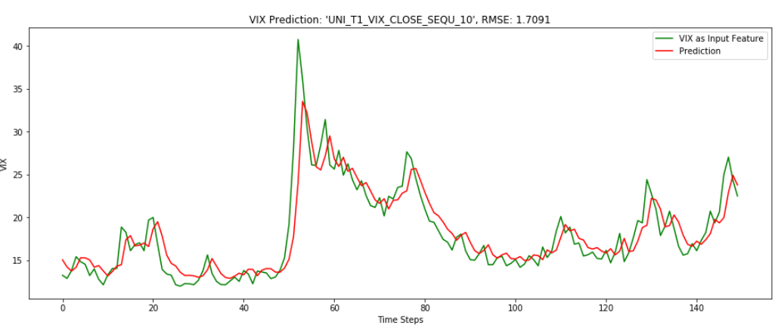
Contents
Results – LSTM models

Slide 36
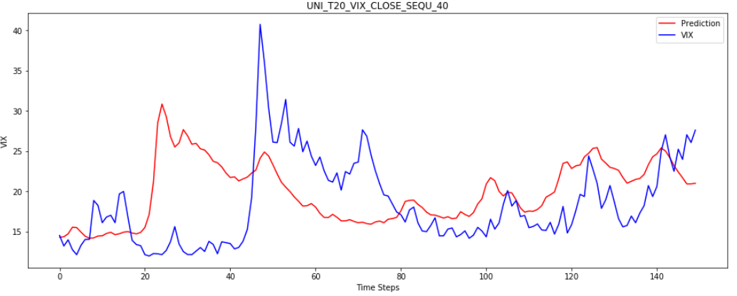
Contents
Results – LSTM models

Slide 37
Contents
Conclusion & Learnings
The more features the worse the RMSE.
The longer the sequence the better the RMSE.
Applying Autoregression is easier and faster
Predicting stock markets (sucessfully ☺) is still a very hard task
Best LSTM model can be used on specific situation (low-vola vs. High vola)

Slide 38
Contents
Conclusion - Outlook
More research on predicting methods
Data & features problem.
Trying out SVM
Implement Backtesting to the LSTM Framework

Slide 39

Contents
Conclusion - Outlook
More research on predicting methods
Data & features problem.
Trying out SVM
Implement Backtesting to the LSTM Framework
➔ The adventure has just started.

Slide 40
Contents
Time for Questions
Predicting Queen of Markets - VIX Is it possible to predict the VIX using RNN (LSTM)? Alexander Novak CFDS 3 – Class 2019 Spring

