Slide 1
Integration Using Outbound Message
Golden Hour
Vinit Jogani

Slide 2
Contents
Integration – Types
Outbound Message
Integration Framework using Outbound Message

Slide 3
Integrations

Slide 4
Integrations in Salesforce
Inbound
REST Based:
  Standard REST API
  Apex REST Service
  Bulk API
SOAP API
  Standard SOAP API
  Apex SOAP Service
Outbound
Apex SOAP Webservice callouts
Apex REST Service callout
Outbound Message
Salesforce Connect
Streaming API

Slide 5
Outbound Message

Slide 6
Introduction
Initiated from Workflow
Uses SOAP endpoint
Generates WSDL in Salesforce to be used to expose endpoint
Messages are sent as notification
Combines up to 100 notifications in one call
Cannot process the response – More like message delivery
Retry for up to 24 hrs in case of failure response

Slide 7
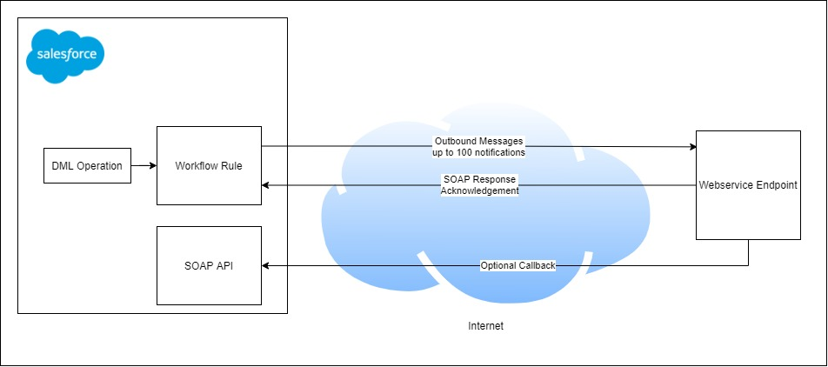
How It Works

Slide 8
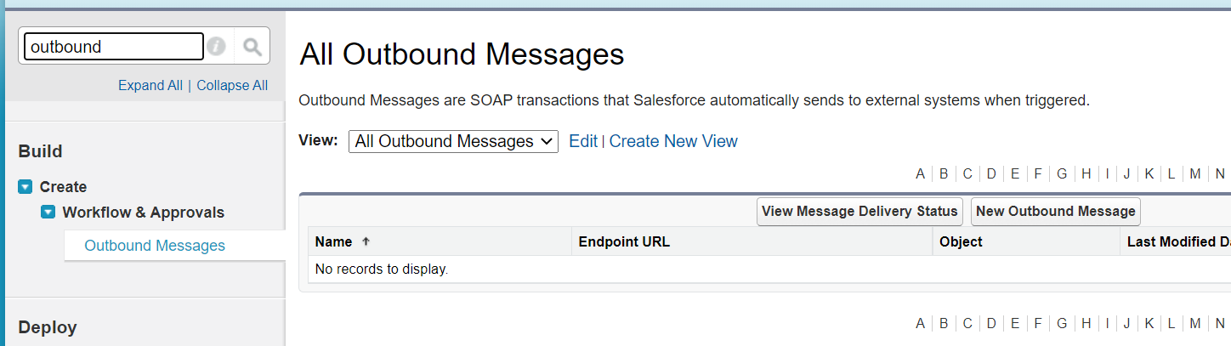
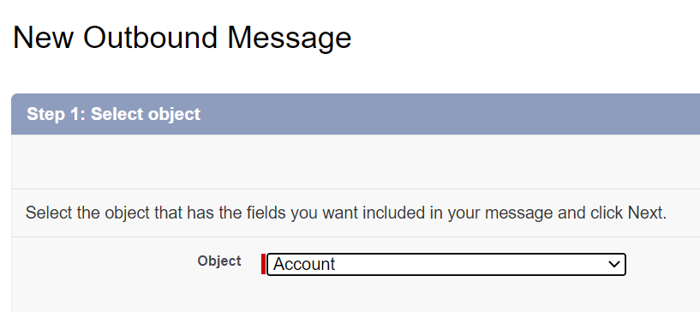
Configuring Outbound Message

Slide 9
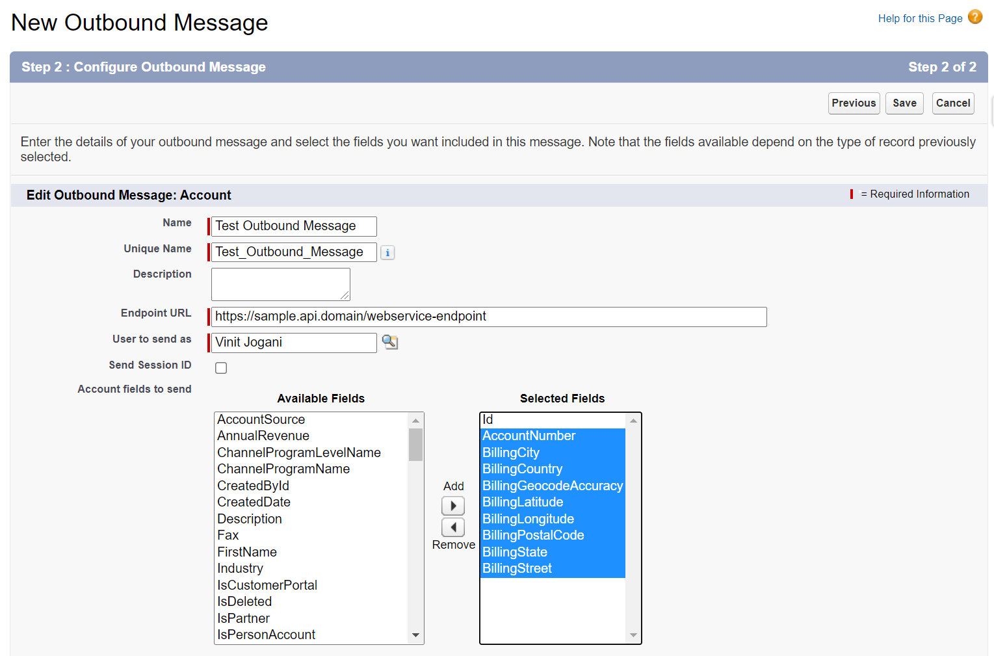
Configuring Outbound Message (Contd.)

Slide 10
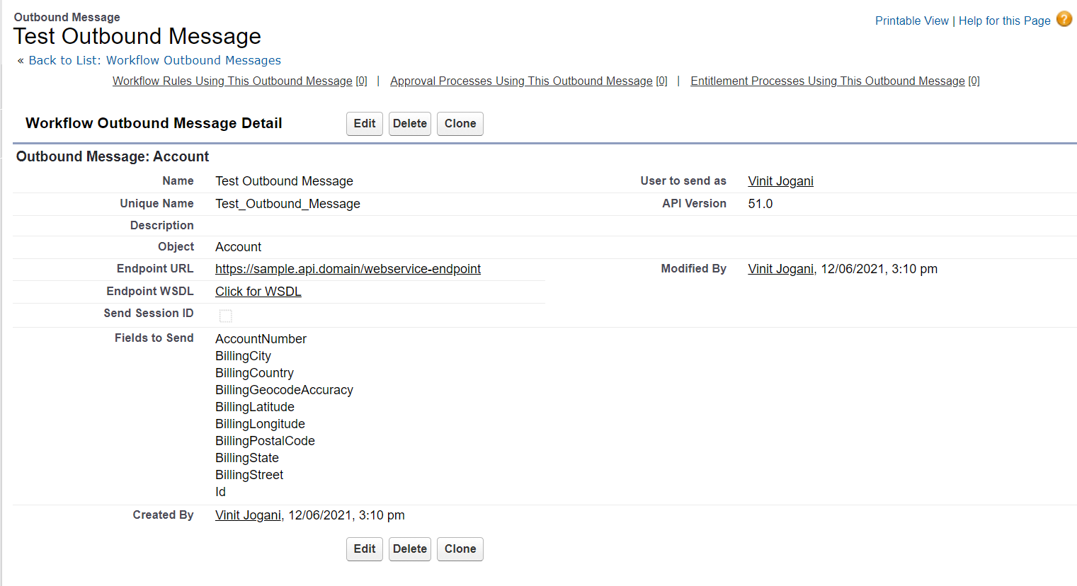
Configuring Outbound Message (Contd.)

Slide 11
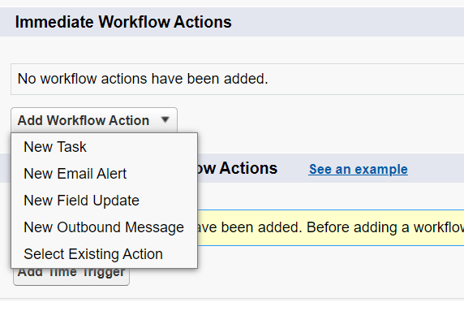
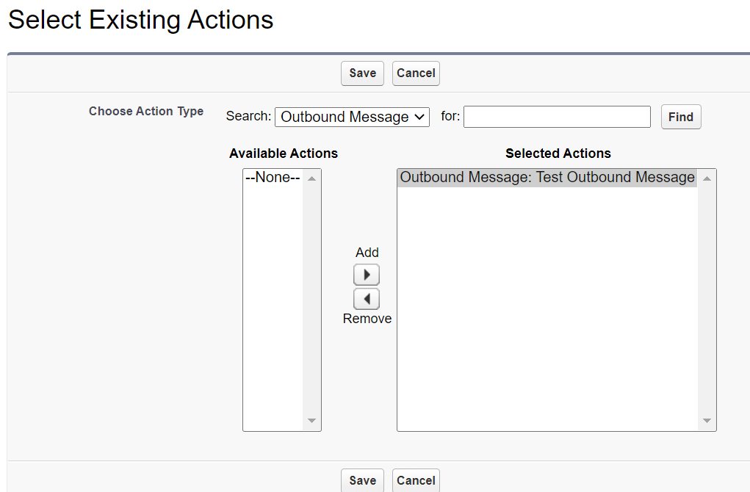
Configuring Outbound Message (Contd.)

Slide 12
Integration Framework using Outbound Message

Slide 13
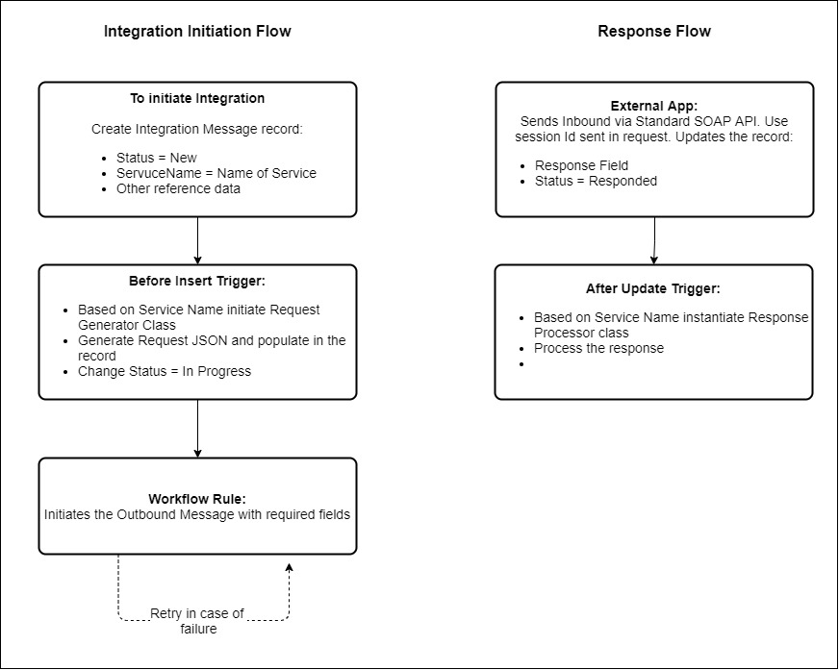
Framework

Slide 14
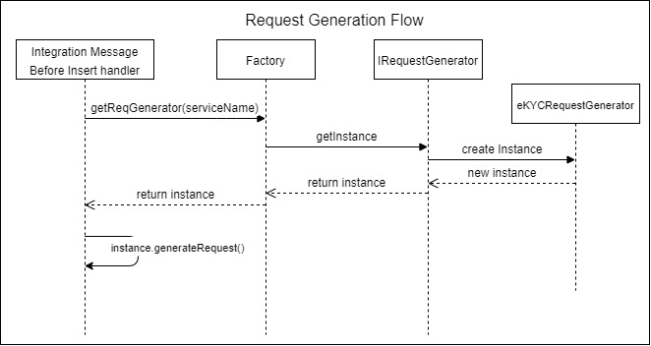
Request Generation

Slide 15
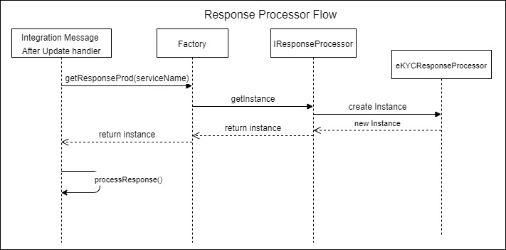
Response Processor

Slide 16
References
https://developer.salesforce.com/docs/atlas.en-us.api.meta/api/sforce_api_om_outboundmessaging_understanding.htm
https://www.apexhours.com/outbound-message-in-salesforce/
https://help.salesforce.com/articleView?id=workflow_rules_new.htm&amp;type=0

Slide 17
Thank You !!!

Slide 18
Use Cases
When we need to sync data to external system once update happens in Salesforce

