Slide 1
novaprova a new generation unit test framework for C programs
www.novaprova.org
Greg Banks <gnb@fastmail.fm>

Slide 2
Overview
Why Did I Write NovaProva?
Design Philosophy & Features
Tutorial + How It Works
Remaining Work
End Matter

Slide 3
Why Did I Write NovaProva?
scratching my own itch!
my day job is the Cyrus IMAP server
  which is written in C (K&R in some places)
  and is large
  and old
  and complex
  and had ZERO buildable tests when I started

Slide 4
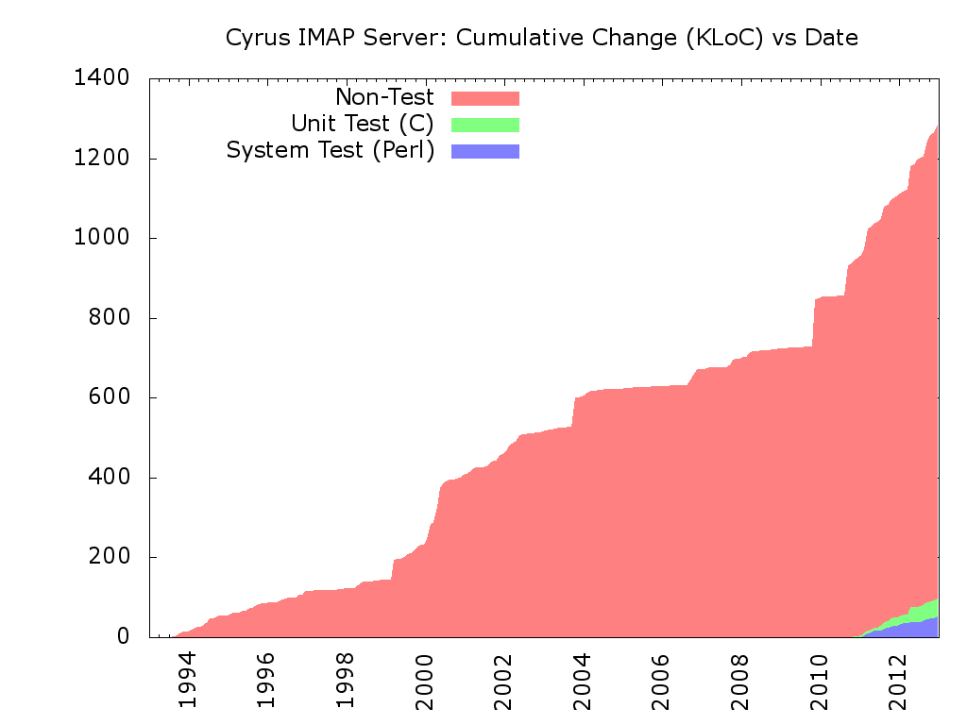
The Cyrus Experience
2.3.16
gnb
Notes:
Jul 1993: first checkins - zero unit tests, zero system tests
... 8779 commits by ~60 people (11 with > 100 commits, 4 with > 1000) ...
Oct 2010: I started working on Cyrus - zero unit tests zero system tests
Nov 2010: I wrote the first unit test

Slide 5
Testing Cyrus
I added system tests using Perl
  http://git.cyrusimap.org/cassandane/
I added unit tests using the CUnit library
  because it's commonly available
  supports C (no C++)
  the first few tests were easy
  but they got harder and harder

Slide 6
Is Cyrus Tested Enough?
code-to-test ratio metric
  easily measurable; just enough meaning
"Code-to-test ratios above 1:2 is a smell, above 1:3 is a stink."
  David H. Hansson, creator of Ruby On Rails
1:0 is too little – no tests at all
sweet spot 1:1 to 1:2
  from the zeitgeist on stackexchange.com

Slide 7
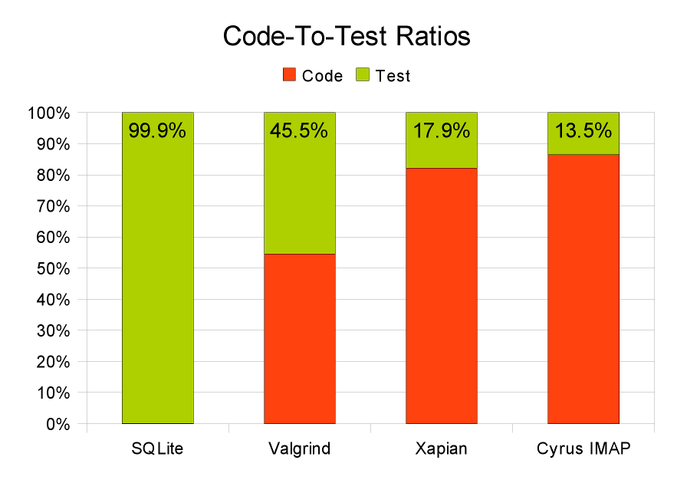
Some Example C projects
worse
sweet
spot
sweet
spot
better

Slide 8
From Which We Can Conclude
the SQLite folks need a hobby
lots of C software is “under” tested
Cyrus is very under tested
why!?
in my experience writing & running more than a few CUnit tests is very hard
need a better CUnit – NovaProva!

Slide 9
Design Philosophy
fully support C as well as C++
  do not rely on C++ features for discovery or reflection
  tests buildable without a C++ compiler
choose power over portability
  portability is important
  but for tests it's better to have good tests on one platform than bad tests on all platforms

Slide 10
Design Philosophy (2)
choose your convenience over my laziness
  I put the work into the framework so you don't have to put it into the tests
  simplify the tedious parts of testing
choose correct over fast
  slow tests are annoying
  but remotely debugging after shipping is much more annoying

Slide 11
Design Philosophy (3)
choose best practice as the default
  maximise test isolation
  maximise failure mode detection
have the courage to do “impossible” things

Slide 12
Features
writing tests is easy
build integration is easy
tests are powerful
test running is reliable
integrating with other tools is easy

Slide 13
Writing Tests Is Easy
test functions are void (void)
  returning normally is a success
use familiar xUnit-like assertion macros
  1st failure terminates the test
  like *_FATAL() semantics in CUnit

Slide 14
Example 01_simple: test
/* mytest.c */
#include <np.h>
#include "mycode.h"
static void test_simple(void)
{
int r;
r = myatoi("42");
NP_ASSERT_EQUAL(r, 42);
}
NovaProva header
Code Under Test header
test function
call Code Under Test
assert correct result

Slide 15
Writing The Main Is Easy
no need to register test functions
  just name your test function test_foobar()
  may be static
fully automatic test discovery at runtime
  uses reflection

Slide 16
Example 01_simple: main
/* testrunner.c */
#include <stdlib.h>
#include <np.h>
int main(int argc, char **argv)
{
int ec = 0;
np_runner_t *runner = np_init();
ec = np_run_tests(runner, NULL);
np_done(runner);
exit(ec);
}
NovaProva header
initialise the library
run all tests
shut down the library

Slide 17
How Does Reflection Work
reflection: a program detects facts about (other parts of) itself
  all modern languages do this
“C can't do reflection”
  there is no standard API
  the compiler doesn't write the info into .o files
yes it does: -g debug information
but, that's not standard!
yes it is: DWARF

Slide 18
How Does Reflection Work (2)
the case for DWARF
  standard – documents at dwarfstd.org
  used with ELF on Linux & Solaris
  used with Mach objects on MacOS
  compilers already generate it
    using -g easier than patching cc
but, it's only for the debugger!
  it's a general purpose format
  describes many artifacts of the compiler's output and maps to source

Slide 19
How Does Reflection Work (3)
so I created a reflection API
provides a high-level API
reads DWARF info
  read /proc/self/exe to find pathname
  call dl_iterate_phdr() to walk the runtime linker's map of objects
  use libbfd to find ELF sections
  use mmap() to map the .debug_* sections
  lazily decode the mmap'd DWARF info

Slide 20
Runtime Test Discovery
once we have reflection, it's fairly easy
walk all functions in all compile_units
  compare against regexp /^test_(.*)$/
  test name is the 1st submatch
  check function has void return & args
  testnode name = CU's pathname + test name
  make a new testnode, creating ancestors
prune common nodes from root
mocks & parameters found the same way

Slide 21
Build Integration Is Easy
just a library, no build-time magic
  fully C-friendly API
  uses C++ internally
  but you don't need to compile or link using C++
easy to drop into your project
  pkg-config .pc file
  PKG_CHECK_MODULES in automake
need to build tests with -g
  but not the Code Under Test

Slide 22
Building Example 01_simple
# Makefile
NOVAPROVA_CFLAGS= $(shell pkg-config --cflags novaprova)
NOVAPROVA_LIBS= $(shell pkg-config --libs novaprova)
CFLAGS= -g $(NOVAPROVA_CFLAGS)
check: testrunner
./testrunner
TEST_SOURCE= mytest.c
TEST_OBJS= $(TEST_SOURCE:.c=.o)
testrunner: testrunner.o $(TEST_OBJS) $(MYCODE_OBJS)
$(LINK.c) -o $@ testrunner.o $(TEST_OBJS) \
$(MYCODE_OBJS) $(NOVAPROVA_LIBS)
pkg-config tells us the right flags
need to build with -g
the check: target builds & runs
very standard link rule for testrunner

Slide 23
Running Tests Is Reliable
runs tests under Valgrind
  detects many failure modes of C code
  turns them into graceful test failures
strong test isolation
  uses UNIX process model
  forks a process per test
  if one test fails, keeps running other tests
  allows for running in parallel
  allows for reliable timeouts

Slide 24
Process Architecture
testrunner

Slide 25
Process Architecture
(Valgrind'ed)
testrunner
execv(/usr/bin/valgrind, argv[])

Slide 26
Process Architecture
(Valgrind'ed)
testrunner
waits for children
fork
fork
(Valgrind'ed)
child 1
. . .
(Valgrind'ed)
child N
runs a test
runs a test

Slide 27
Running Example 01_simple
check: target builds & runs
% make check
./testrunner
[0.000] np: starting valgrind
np: NovaProva Copyright (c) Gregory Banks
np: Built for O/S linux architecture x86
np: running
np: running: "mytest.simple"
PASS mytest.simple
np: 1 run 0 failed
automatically starts Valgrind
By default runs
all tests serially
post-run summary

Slide 28
How NP Valgrinds Itself
Valgrind should be easy & the default, with no build system changes
  Valgrind is a CPU+kernel simulator
  you can't just start Valgrind on a running process
build a Valgrind command line in the library and execv() - easy!
  downside: main() is run twice
  major downside: Valgrind exec loop

Slide 29
How NP Valgrinds Itself (2)
Valgrind has an API you can use
  #include <valgrind/valgrind.h>
  macros that compile to magical NOP instruction sequences
  these do nothing on a real CPU, but Valgrind does special things
predicate RUNNING_ON_VALGRIND
  returns true iff the process is running in Valgrind
  so the library checks that

Slide 30
How NP Valgrinds Itself (3)
to run Valgrind we need argv[]
  original, before any getopt() processing
  to pass down to the 2nd main()
  for maximum convenience and reliability, shouldn't expect main() to pass the correct argv[] down
global variable _dl_argv
  undocumented, undeclared, defined in the runtime linker
  set to main()'s argv[], before main()

Slide 31
Parallel Running
default mode is to run tests serially
optionally can run tests in parallel
call np_set_concurrency() in main
  0 = use all the online CPUs on the machine

Slide 32
Example 02_parallel
int main(int argc, char **argv)
{
…
int concurrency = -1;
np_runner_t *runner;
…
while ((c = getopt(argc, argv, "j:")) >= 0)
{
switch (c)
{
case 'j':
concurrency = atoi(optarg);
…
runner = np_init();
if (concurrency >= 0)
np_set_concurrency(runner, concurrency);
ec = np_run_tests(runner, NULL);
parse -j option

Slide 33
Running Example 02_parallel
./testrunner -j4
…
np: running
np: running: "mytest.000"
np: running: "mytest.001"
np: running: "mytest.002"
np: running: "mytest.003"
Running test 0
Running test 1
Running test 2
Running test 3
Finished test 0
Finished test 1
Finished test 2
Finished test 3
PASS mytest.000
PASS mytest.002
PASS mytest.003
PASS mytest.001
np: 4 run 0 failed
request 4 tests in parallel
runs all tests
in parallel
post-run summary

Slide 34
Using GDB
NP detects when it's running in gdb
  automatically disables test timeout
  automatically disables Valgrind
but you have to set some gdb options, sorry!
  always runs the test in a fork()ed child
  set follow-fork-mode child
  set detach-on-fork off

Slide 35
Debugging Example 01_simple
% cat .gdbinit
set follow-fork-mode child
set detach-on-fork off
% gdb testrunner
(gdb) bre myatoi
Breakpoint 1 at 0x804ad96: file mycode.c, line 21.
(gdb) run
Starting program: …
np: being debugged by gdb
np: disabling Valgrind under debugger
np: NovaProva Copyright (c) Gregory Banks
np: Built for O/S linux architecture x86
np: being debugged by gdb
np: disabling test timeouts under debugger
np: running
np: running: "mytest.simple"
Breakpoint 1, myatoi (s=0x807b1c8 "42") at mycode.c:21
21 int v = 0;
some .gdbinit magic
set a breakpoint
Valgrind is disabled
timeouts are disabled

Slide 36
How NP Detects GDB
sometimes the library needs to know if it's running under GDB
  need to disable test timeouts
  need to avoid running self under Valgrind because gdb & Valgrind don't play together
on Linux, gdb uses ptrace() to attach itself to a process
  a process knows if it's being traced
  /proc/$pid/status shows "TracerPid:"

Slide 37
How NP Detects GDB (2)
read /proc/self/status to see if we're ptraced
  downside: other utilities like strace also use ptrace()
we also use /proc/$pid/cmdline to discover the tracer's argv[0]
  and compare this to a whitelist of debugger executables
  yes there is /proc/$pid/exe symlink, but it's not always readable

Slide 38
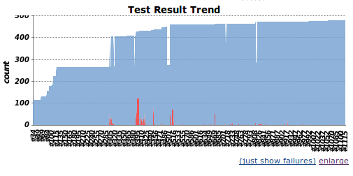
Using Jenkins CI
Jenkins reads, tracks & displays test results
  in jUnit XML format
http://ci.cyrusimap.org/

Slide 39
Using Jenkins CI (2)
NP optionally emits jUnit XML report
call np_set_output_format() in main
  an XML file is written for each suite
  to reports/TEST-$suite.xml

Slide 40
Example 03_jenkins
int main(int argc, char **argv)
{
int ec = 0;
const char *output_format = 0;
np_runner_t *runner;
…
while ((c = getopt(argc, argv, "f:")) >= 0)
{
switch (c)
{
case 'f':
output_format = optarg;
break;
…
runner = np_init();
if (output_format)
np_set_output_format(runner, output_format);
name of the
output format
parse the -f option

Slide 41
Running Example 03_jenkins
Use the -f option
% mkdir reports
% ./testrunner -f junit
[0.000] np: starting valgrind
np: NovaProva Copyright (c) Gregory Banks
np: Built for O/S linux architecture x86
% ls reports/
TEST-mytest.xml
% xmllint --format reports/TEST-mytest.xml
<?xml version="1.0" encoding="UTF-8"?>
<testsuite name="mytest" failures="0" tests="1" hostname="…" timestamp="2013-01-28T12:15:39" errors="0" time="0.882">
<properties/>
<testcase name="simple" classname="simple" time="0.882"/>
<system-out/>
<system-err/>
</testsuite>
no post-run
summary
instead a new XML file
this doesn't work yet

Slide 42
Fixtures & N/A
supports a Not Applicable test result
  so a test can decide that preconditions aren't met
  counted separately from passes and failures
supports fixtures
  set_up function is called before every test
  tear_down function is called after every test
  discovered at runtime using reflection
  will be fixed in 1.2, sorry

Slide 43
Example 04_fixtures
just call a function set_up
static int set_up(void)
{
fprintf(stderr, "Setting up fixtures\n");
return 0;
}
static int tear_down(void)
{
fprintf(stderr, "Tearing down fixtures\n");
return 0;
}
and tear_down

Slide 44
Running Example 04_fixtures
set_up runs before test
np: running
np: running: "mytest.one"
Setting up fixtures
Running test_one
Finished test_one
Tearing down fixtures
PASS mytest.one
np: running: "mytest.two"
Setting up fixtures
Running test_two
Finished test_two
Tearing down fixtures
PASS mytest.two
np: 2 run 0 failed
tear_down runs after test
each test

Slide 45
Tests Are A Tree
xUnit implementations have a 2-level organisation
  test – the smallest runnable element
  suite – group of tests
software just isn't that simple anymore
NP uses an arbitrary depth tree of testnodes
  single root testnode
  each testnode has a full pathname
  separated by '.'

Slide 46
Tests Are A Tree (2)
testnodes may have any of
  a runnable test function
  child testnodes
  fixture functions & other resources
    apply to the node & all descendants
tree is built automatically at runtime
  test functions → leaf nodes
  C source filenames → nodes above that
  directory path name → nodes above those
  redundant path down from / pruned

Slide 47
Tests Are A Tree (3)
tests are named in a way which naturally reflects your source code organisation
unique test names, no effort
flexible scoping/containment mechanism

Slide 48
Example 05_tree
/* startrek/tng/federation/enterprise.c */
static void test_torpedoes(void)
{
fprintf(stderr, "Testing photon torpedoes\n");
}
/* startrek/tng/klingons/neghvar.c */
static void test_disruptors(void)
{
fprintf(stderr, "Testing disruptors\n");
}
/* starwars/episode4/rebels/xwing.c */
static void test_lasers(void)
{
fprintf(stderr, "Testing laser cannon\n");
}

Slide 49
Running Example 05_tree
directory path name
function
np: running
np: running: "05_tree.startrek.tng.federation.enterprise.torpedoes"
Testing photon torpedoes
PASS 05_tree.startrek.tng.federation.enterprise.torpedoes
np: running: "05_tree.startrek.tng.klingons.neghvar.disruptors"
Testing disruptors
PASS 05_tree.startrek.tng.klingons.neghvar.disruptors
np: running: "05_tree.starwars.episode4.rebels.xwing.lasers"
Testing laser cannon
PASS 05_tree.starwars.episode4.rebels.xwing.lasers
np: 3 run 0 failed
.c filename

Slide 50
Function Mocking
mocking a function = arrange for Code under Test to call a special test function instead of some normal part of CuT
dynamic: inserted at runtime not link time
  uses a breakpoint-like mechanism
  when running under gdb need to do handle SIGSEGV nostop noprint
mocks may be setup declaratively
  name a function mock_foo() & it mocks foo()

Slide 51
Example 06_mock: CuT
int myatoi(const char *s)
{
int v = 0;
for ( ; *s ; s++)
{
v *= 10;
v += mychar2int(*s);
}
return v;
}
int mychar2int(int c)
{
return (c - '0');
}
this function
calls
this one

Slide 52
Example 06_mock: Test
static void test_simple(void)
{
int r;
r = myatoi("42");
NP_ASSERT_EQUAL(r, 42);
}
int mock_mychar2int(int c)
{
fprintf(stderr, "Mocked mychar2int('%c') called\n", c);
return (c - '0');
}
test calls myatoi
which calls
mychar2int
this mocks
mychar2int

Slide 53
Running Example 06_mock
./testrunner
[0.000] np: starting valgrind
np: NovaProva Copyright (c) Gregory Banks
np: Built for O/S linux architecture x86
np: running
np: running: "mytest.simple"
Mocked mychar2int('4') called
Mocked mychar2int('2') called
PASS mytest.simple
np: 1 run 0 failed
the mock is
called instead

Slide 54
More On Function Mocking
mocks may be added at runtime
  by name or by function pointer
  from tests or fixtures
  so you can mock for only part of a test
mocks may be attached to any testnode
  automatically installed before any test below that node starts
  automatically removed afterward

Slide 55
Intercepts = Mocks++
more general than function mocks
OO interface – only available from C++
before() virtual function
  called before the real function
  may change parameters
  may redirect to another function (mocks!)
after() virtual function
  called after real function returns
  may change return value

Slide 56
How Intercepts Work
a 1-process adaption of how GDB does breakpoints
less general
  only works on function entry
  doesn't handle recursive functions
  not very good with threads either

Slide 57
How Intercepts Work (2)
process
intercepts have an install step
track and refcount installed intercepts by address
on first install...
.text
r-x
target
function

Slide 58
Installing An Intercept
process
mprotect() → PROT_WRITE
track and refcount pages
install a SIGSEGV handler
overwrite the 1st byte of the function
0xf4 = HLT
.text
r-x
rwx
target
function

Slide 59
Calling An Intercepted Function
process
the function is called
CPU traps on HLT
kernel delivers SIGSEGV
signal handler is not a normal function!
  extra stuff on the stack
  signals blocked
  return → magic
.text
signal
handler
r-x
rwx

Slide 60
Signal Handler
signal handlers get a ucontext_t struct
  containing the machine register state
  modifiable by the handler!
check insn at EIP is HLT
  SIGSEGV can also come from bugs!
stash a copy of the ucontext_t
set EIP in the ucontext_t to a trampoline
return from signal handler
libc+kernel “resumes” to our trampoline

Slide 61
Intercept Trampoline
now out of signal handler context
  stack has the args for the target function
  but running the trampoline
set up a fake stack frame
call the intercept's before()
call the target function with fake frame
  or another function entirely
call the intercept's after()
clean up & return to target's caller

Slide 62
Complications With Intercepts
GDB
  need to not use INT3 insn / SIGTRAP
Valgrind
  need to use INT3 / SIGTRAP
X86_64 ABI
  32b relies on 1st insn being PUSHL %EBP
the Procedure Linkage Table
floating point state

Slide 63
Parameterised Tests
when you want to run the same test several times with a different parameter
macro NP_PARAMETER
  declares a static string variable
  and all its possible values
attached to any node in the test tree
discovered at runtime using reflection
tests under that node are run once for each parameter value combination

Slide 64
Example 07_parameter
NP_PARAMETER(pastry, "donut,bearclaw,danish");
static void test_munchies(void)
{
fprintf(stderr, "I'd love a %s\n", pastry);
}
defines a static variable
and all its values
just use the variable as a char*

Slide 65
Example 07_parameter
np: running
np: running: "mytest.munchies[pastry=donut]"
I'd love a donut
PASS mytest.munchies[pastry=donut]
np: running: "mytest.munchies[pastry=bearclaw]"
I'd love a bearclaw
PASS mytest.munchies[pastry=bearclaw]
np: running: "mytest.munchies[pastry=danish]"
I'd love a danish
PASS mytest.munchies[pastry=danish]
np: 3 run 0 failed

Slide 66
Example 13_twoparams
NP_PARAMETER(pastry, "donut,bearclaw,danish");
NP_PARAMETER(beverage, "tea,coffee");
static void test_munchies(void)
{
fprintf(stderr,
"I'd love a %s with my %s\n",
pastry, beverage);
}

Slide 67
Example 13_twoparams
np: running: "mytest.munchies[pastry=donut][beverage=tea]"
I'd love a donut with my tea
PASS mytest.munchies[pastry=donut][beverage=tea]
np: running: "mytest.munchies[pastry=bearclaw][beverage=tea]"
I'd love a bearclaw with my tea
PASS mytest.munchies[pastry=bearclaw][beverage=tea]
np: running: "mytest.munchies[pastry=danish][beverage=tea]"
I'd love a danish with my tea
PASS mytest.munchies[pastry=danish][beverage=tea]
np: running: "mytest.munchies[pastry=donut][beverage=coffee]"
I'd love a donut with my coffee
PASS mytest.munchies[pastry=donut][beverage=coffee]
np: running: "mytest.munchies[pastry=bearclaw][beverage=coffee]"
I'd love a bearclaw with my coffee
PASS mytest.munchies[pastry=bearclaw][beverage=coffee]
np: running: "mytest.munchies[pastry=danish][beverage=coffee]"
I'd love a danish with my coffee
PASS mytest.munchies[pastry=danish][beverage=coffee]
np: 6 run 0 failed

Slide 68
Memory Access Violations
e.g. following a null pointer
Valgrind notices first and emits a useful analysis
  stack trace
  line numbers
  fault address
  info about where the fault address points
child process dies with SIGSEGV or SIGBUS
test runner process reaps it & fails the test

Slide 69
Example 08_segv
np: running: "mytest.segv"
About to follow a NULL pointer
==32587== Invalid write of size 1
==32587== at 0x804AD40: test_segv (mytest.c:22)
…
==32587== by 0x804DEF6: np_run_tests (runner.cxx:665)
==32587== by 0x804ACF6: main (testrunner.c:31)
==32587== Address 0x0 is not stack'd, malloc'd or (recently) free'd
==32587== Process terminating with default action of signal 11 (SIGSEGV)
==32587== Access not within mapped region at address 0x0
EVENT SIGNAL child process 32587 died on signal 11
FAIL mytest.crash_and_burn
np: 1 run 1 failed
Valgrind report
test fails gracefully

Slide 70
Other Memory Issues
buffer overruns, use of uninitialised variables
  discovered by Valgrind, as they happen
  which emits its usual helpful analysis
memory leaks
  discovered by Valgrind, explicit leak check after each test completes
test process queries Valgrind
  unsuppressed errors → the test has failed

Slide 71
Example 09_memleak
Valgrind report
np: running: "mytest.memleak"
About to do leak 32 bytes from malloc()
Test ends
==779== 32 bytes in 1 blocks are definitely lost in loss record 9 of 54
==779== at 0x4026FDE: malloc …
==779== by 0x804AD46: test_memleak (mytest.c:23)
…
==779== by 0x804DEFA: np_run_tests (runner.cxx:665)
==779== by 0x804ACF6: main (testrunner.c:31)
EVENT VALGRIND 32 bytes of memory leaked
FAIL mytest.memleak
np: 1 run 1 failed
test fails

Slide 72
Code Under Test Calls exit()
NP library defines an exit()
  yuck, should use dynamic function intercept
calling exit() during a test
  prints a stack trace
  fails the test
calling exit() outside a test
  calls _exit()

Slide 73
Example 10_exit
np: running: "mytest.exit"
About to call exit(37)
EVENT EXIT exit(37)
at 0x8056522: np::spiegel::describe_stacktrace
by 0x804BD9C: np::event_t::with_stack
by 0x804B0CE: exit
by 0x804AD42: test_exit
by 0x80561F0: np::spiegel::function_t::invoke
by 0x804C3A5: np::runner_t::run_function
by 0x804D28A: np::runner_t::run_test_code
by 0x804D4F7: np::runner_t::begin_job
by 0x804DD9A: np::runner_t::run_tests
by 0x804DEF2: np_run_tests
by 0x804ACF2: main
FAIL mytest.exit
np: 1 run 1 failed
stacktrace from NovaProva
test fails gracefully

Slide 74
Code Under Test Emits Syslogs
dynamic function intercept on syslog()
  installed before each test
  uninstalled after each test
test may register regexps for expected syslogs
unexpected syslogs fail the test

Slide 75
Running Example 11_syslog
np: running: "mytest.unexpected"
EVENT SLMATCH err: This message shouldn't happen
at 0x8059B22: np::spiegel::describe_stacktrace
by 0x804DD9C: np::event_t::with_stack
by 0x804B9FC: np::mock_syslog
by 0x807A519: np::spiegel::platform::intercept_tramp
by 0x804B009: test_unexpected
by 0x80597F0: np::spiegel::function_t::invoke
by 0x804FB99: np::runner_t::run_function
by 0x8050A7E: np::runner_t::run_test_code
by 0x8050CEB: np::runner_t::begin_job
by 0x805158E: np::runner_t::run_tests
by 0x80516E6: np_run_tests
by 0x804AFC3: main
FAIL mytest.unexpected
stack trace
test fails

Slide 76
Example 11_syslog (2)
Have to tell NP that a
syslog might happen
static void test_expected(void)
{
np_syslog_ignore("entirely expected");
syslog(LOG_ERR, "This message was entirely expected");
}

Slide 77
Running Example 11_syslog (2)
np: running: "mytest.expected"
EVENT SYSLOG err: This message was entirely expected
at 0x8059B22: np::spiegel::describe_stacktrace
by 0x804DD9C: np::event_t::with_stack
by 0x804BABA: np::mock_syslog
by 0x807A519: np::spiegel::platform::intercept_tramp
by 0x804B031: test_expected
by 0x80597F0: np::spiegel::function_t::invoke
by 0x804FB99: np::runner_t::run_function
by 0x8050A7E: np::runner_t::run_test_code
by 0x8050CEB: np::runner_t::begin_job
by 0x805158E: np::runner_t::run_tests
by 0x80516E6: np_run_tests
by 0x804AFC3: main
PASS mytest.expected
stack trace
but test passes

Slide 78
Slow & Looping Tests
per-test timeout
  test fails if the timeout fires
default timeout 30 sec
  3 x when running under Valgrind
  disabled when running under gdb
implemented in the testrunner process
  child killed with SIGTERM

Slide 79
Example 12_timeout
np: running: "mytest.slow"
Test runs for 100 seconds
Have been running for 0 sec
Have been running for 10 sec
Have been running for 20 sec
Have been running for 30 sec
Have been running for 40 sec
Have been running for 50 sec
Have been running for 60 sec
Have been running for 70 sec
Have been running for 80 sec
EVENT TIMEOUT Child process 2294 timed out, killing
EVENT SIGNAL child process 2294 died on signal 15
FAIL mytest.slow
np: 1 run 1 failed
test times out
after 90 sec
runner kills
child process
test fails gracefully

Slide 80
Choosing A Project Name Is Hard
CUnit has an obvious name
  Unit testing for C
  but … dangerous
it took me 2 months to name NovaProva
  .org domain not taken
  name didn't sound silly
  sounded vaguely appropriate
NovaProva ~= “new test” in Italian

Slide 81
Remaining Work
provide an API or a default main() routine to automatically parse a set of default command line options, e.g. --list, to simplify building a testrunner
class/hashtag concept for test functions
  a syntax for specifying these on the command line
  how to attach these to test functions in any kind of natural and reliable way?

Slide 82
Remaining Work (2)
failpoints – a way of automatically failing and terminating a test if a given function is called, like exit()
improve the syntax for specifying tests on the command line to
  be more flexible e.g. like CSS or XPATH
  allow specifying values for test parameters
do a better job of running tests in parallel
.deb and .rpm packages

Slide 83
Remaining Work (3)
port to OS X & Solaris.
an API for time warping
an API for timezone manipulation
an API for locale manipulation
detect file descriptor leaks
detect environment variable leaks
discovery of tests written in C++
handle C++ exceptions

Slide 84
Remaining Work (4)
enable mocking an entire C++ class
handle C++ namespaces better in the reflection API
support Objective C
improve the reflection API
  calling functions,
  creating/destroying object instances,
  getting and setting struct data members.

Slide 85
Thanks
Opera Software
  for letting me open source NovaProva
Cosimo Streppone
  for being Italian
Andrew Wansink
  for putting me onto CUnit
Previous LCA conferences
  for giving me testing religion

Slide 86
Where To Get It
www.novaprova.org
working on binary packages (OBS)
That's all folks!

