Slide 1

Novated leases and novel ways to finance EVs
Chang Yang Yew
AEVA WA Electrikhana
14/03/2026

Slide 2
Who Am I?
Medical doctor — anaesthetist
Lifelong maths geek — mathematical olympiads
Qualified biostatistician — I think in distributions and probability, not point estimates
Personal finance enthusiast — I model scenarios before I make decisions
Creator of novatedlease.guide — independent, non-commercial, no commissions.

Slide 3
The OG Rules of Thumb
You may have heard these from your uncle or internet strangers:
“Cash is king”
“You will never save money by buying a new car”
“Novated leasing is a scam — most benefit goes to leasing companies”
“Only worth it if top tax bracket and drive a lot”
“Never finance a depreciating asset”
These heuristics were mostly true for a long time. But people stopped re-examining them when the underlying conditions changed.

Slide 4
How I Ended Up Down the Rabbit Hole
I had always liked EVs
Rental for road trips in 2021–22: smooth, fast, quiet
Financially an extra $30-50k upfront cost over ICE: Hard to justify.
Late 2022: FBT exemption for eligible EVs and PHEVs
Out of curiosity, I ran the numbers again.
My situation at the time
Four-year-old Mazda 6 worth ~$25,000
Tesla Model 3: $70k base, $80k Long Range, $90k+ Performance
On the surface? Absurd. Every mantra screamed “terrible idea.”

Slide 5
The Mind-Blowing Discovery
EV with cash vs EV via FBT-exempt novated lease:
The novated lease was approximately $46,000 cheaper over 5 years — for my circumstances i.e. top tax bracket.
No, that is not a typo.
Keep the $25k Mazda 6 vs switch to an $81k Tesla:
Difference in net worth over time: roughly neutral over 5 years.
I checked repeatedly. Shared with sceptics. The conclusion held.
The FBT exemption fundamentally overturns many of the old rules of thumb.

Slide 6
Further Discoveries
After this discovery, I also learned about the traps. Two things became clear:
Many people dismiss EV novated leases for the wrong reasons
Based on outdated rules of thumb, not current conditions.
Many people enter novated leases for the wrong reasons
Based on misleading sales pitches, not a clear understanding of costs and risks
I built a few spreadsheets. Then an online calculator. Then the website.
Goal: explain how novated leases work, where benefits come from, where risks are, and who should consider them.

Slide 7

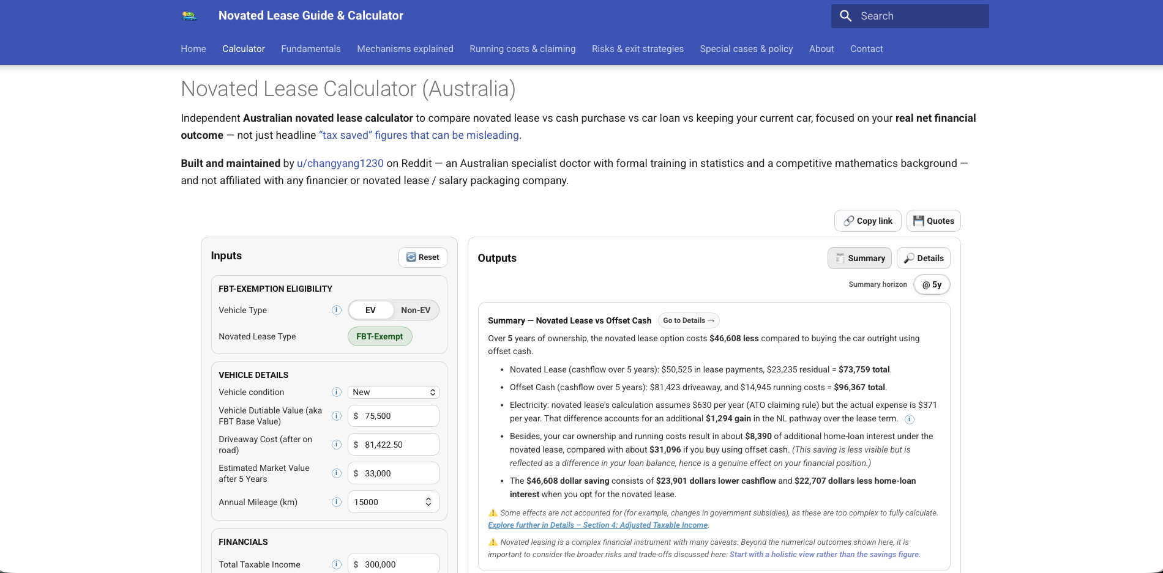
https://novatedlease.guide

Slide 8
Three ways Australians buy EVs
Cash / Offset
Car loan
Novated lease
+/- Business use deduction

Slide 9
Buying with cash or offset
Traditionally “gold standard”
”Cash is king”
”Financing a car is how you stay poor”
Often treated as ‘zero finance cost’ but not true
Opportunity cost
Money spent could lead to more home loan interests.
E.g. $60,000 forked out from offset account: at 5.5% home loan interest, it’s equivalent to $3,300 extra interest per year.

Slide 10
Buying with car loan
Allow people who do not have the upfront cash to still buy a car
Cost: interests.
Paid with post‑tax dollars

Slide 11
What novated lease really is
A salary packaging arrangement that lets you spend pre‑tax income
Normally:
pre-tax income → tax withheld → post-tax money → spend on car
Novated Lease:
pre-tax income → some spent on car → tax withheld on the remainder → post-tax money
Net effect: a discount equal to your marginal tax rate plus the Medicare levy:
30% tax bracket → 32% effective discount
37% tax bracket → 39% effective discount
45% tax bracket → 47% effective discount

Slide 12
History of Novated Lease
Has been a thing for many decades but never prominent
Historically ruined by Fringe Benefits Tax
An additional fixed cost each year
Before EV, worked well mostly for high tax bracket ± high mileage + short lease.
EVs under luxury car tax threshold are FBT‑exempt
Totally toppled the financial mottos
EV NL becomes cheaper than cash for many if not most

Slide 13
What calculators emphasise
Most online calculators present big bold “TAX SAVED” to mislead unsophisticated clients.
Quiet on interest, fees, residual
Sometimes the conclusion is opposite. In one case: $21,000 claimed “saving” on a quote is actually $5,000 loss compared to cash purchase.
You need to calculate net saving, not tax saving.
novatedlease.guide (my site)
leasecheck.au
Toyota Fleet Calculator

Slide 14

Caveat 1: Adjusted Taxable Income
Taxable income goes down; however adjusted taxable income often goes up
Affects HECS, childcare subsidy, Div 293
People who take up EV NL often have worse childcare subsidy etc!

Slide 15
Caveat 2: Reduced borrowing capacity
Like any other loan or liability, your borrowing capacity (e.g. to buy a house) can be significantly reduced when you have a lease.
The impact is often disproportionately higher than car loan of the equivalent car.

Slide 16
Caveat 3: Potentially worse super contribution
Most of the time 12% compulsory super contribution will remain the same after taking up novated lease.
However some employers use your post-novated-lease income in the calculation of the 12% contribution, thereby reducing the contribution.
This could cost you more than $1,000 per year therefore always check with your payroll.

Slide 17
Caveat 4: Risk of losing job / writing off the car
If your lose your job or change to a new job where novated leasing is not supported, you have to pay off the remaining lease at full pos—tax amount.
In many cases the amount you end up paying ends up being worse than what you would have paid if you got the car with cash in the first place.
Similar mechanism if you write off a car and is not adequately insured.

Slide 18
Who it suits best
Higher tax brackets
Stable employment
Have a home loan offset
Have a cash buffer to pay out balloon

Slide 19
Final takeaway
Novated lease is not good or bad
Could save money when everything goes to plan.
But could cost you if things go to plan.
You must weigh up the chances and see if the downside is worth the upside.

