Slide 1


Business Review
{{VILLE_UPPER}}
{{DATE_MERCREDI}}

Slide 2

Summary.
01
Check List W-1
02
General Highlights
03
Acquisition Funnel
04
Sold Out Rates
05
06
Action Plan
Top Funnel

Slide 3
Check List actions W-1.
{{VILLE_UPPER}} {{ANNEE}}
Actions | Done by Lotchi | Done by Fever | Ongoing

Slide 4
General Highlights

Slide 5
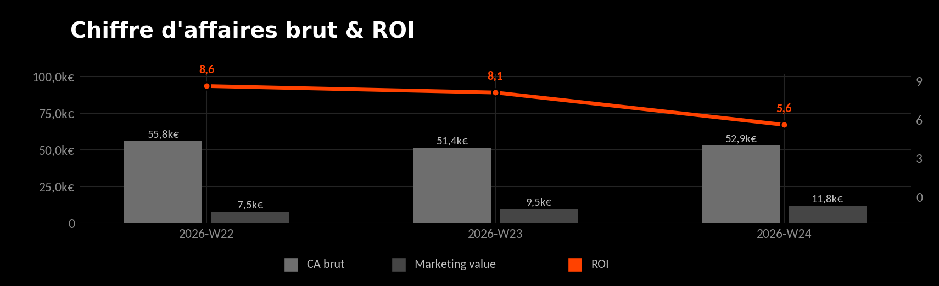
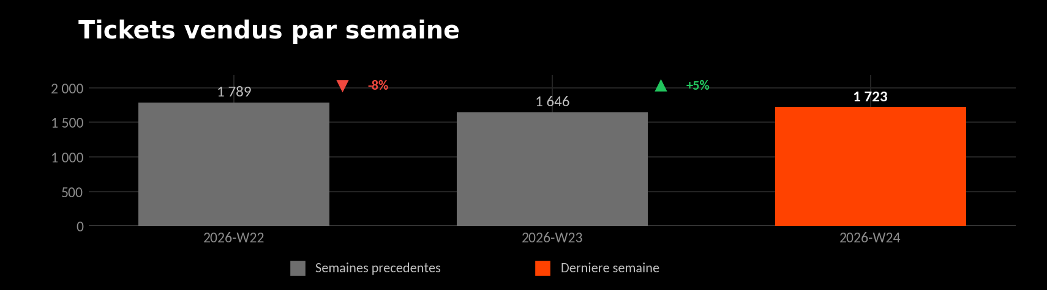
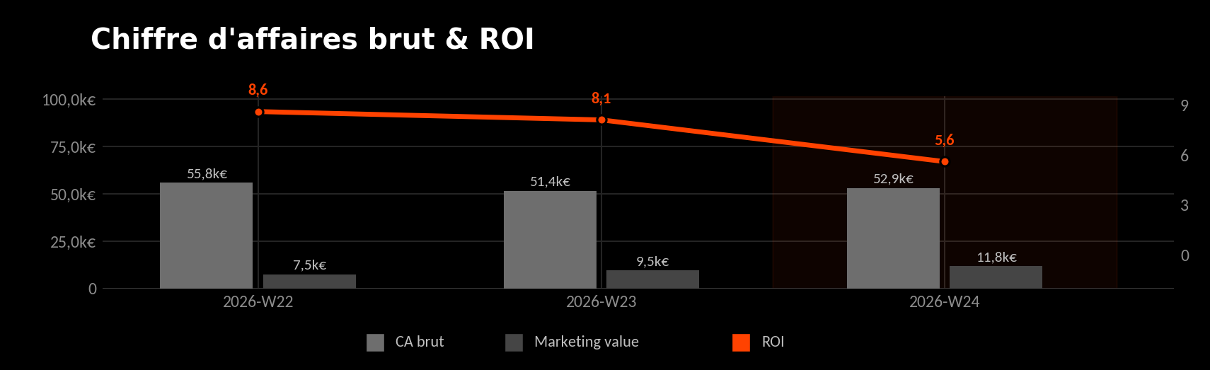
General Highlights.
{{VILLE_UPPER}} {{ANNEE}}
Key Metric | Action Plan

Slide 6
Acquisition Funnel

Slide 7
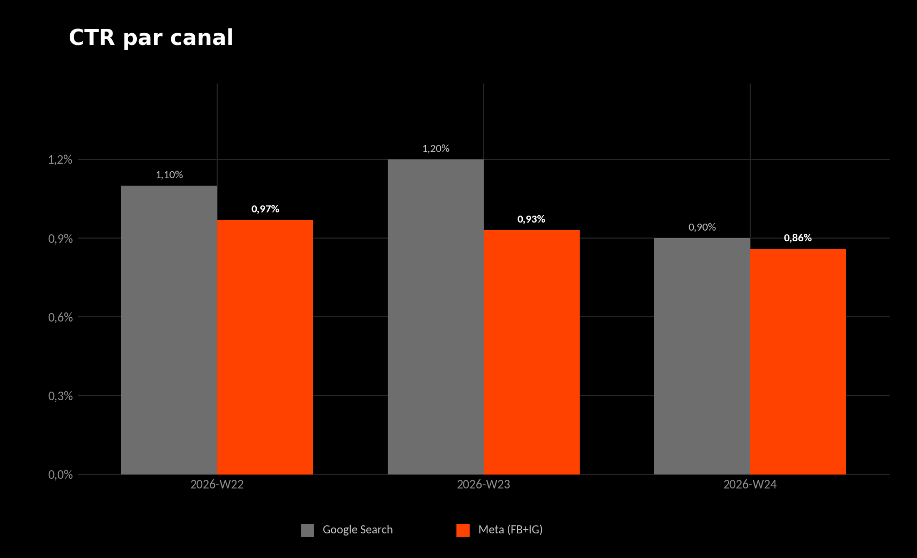
Top Funnel: Meta Ads.
{{VILLE_UPPER}} {{ANNEE}}
Key Metric | Action Plan

Slide 8
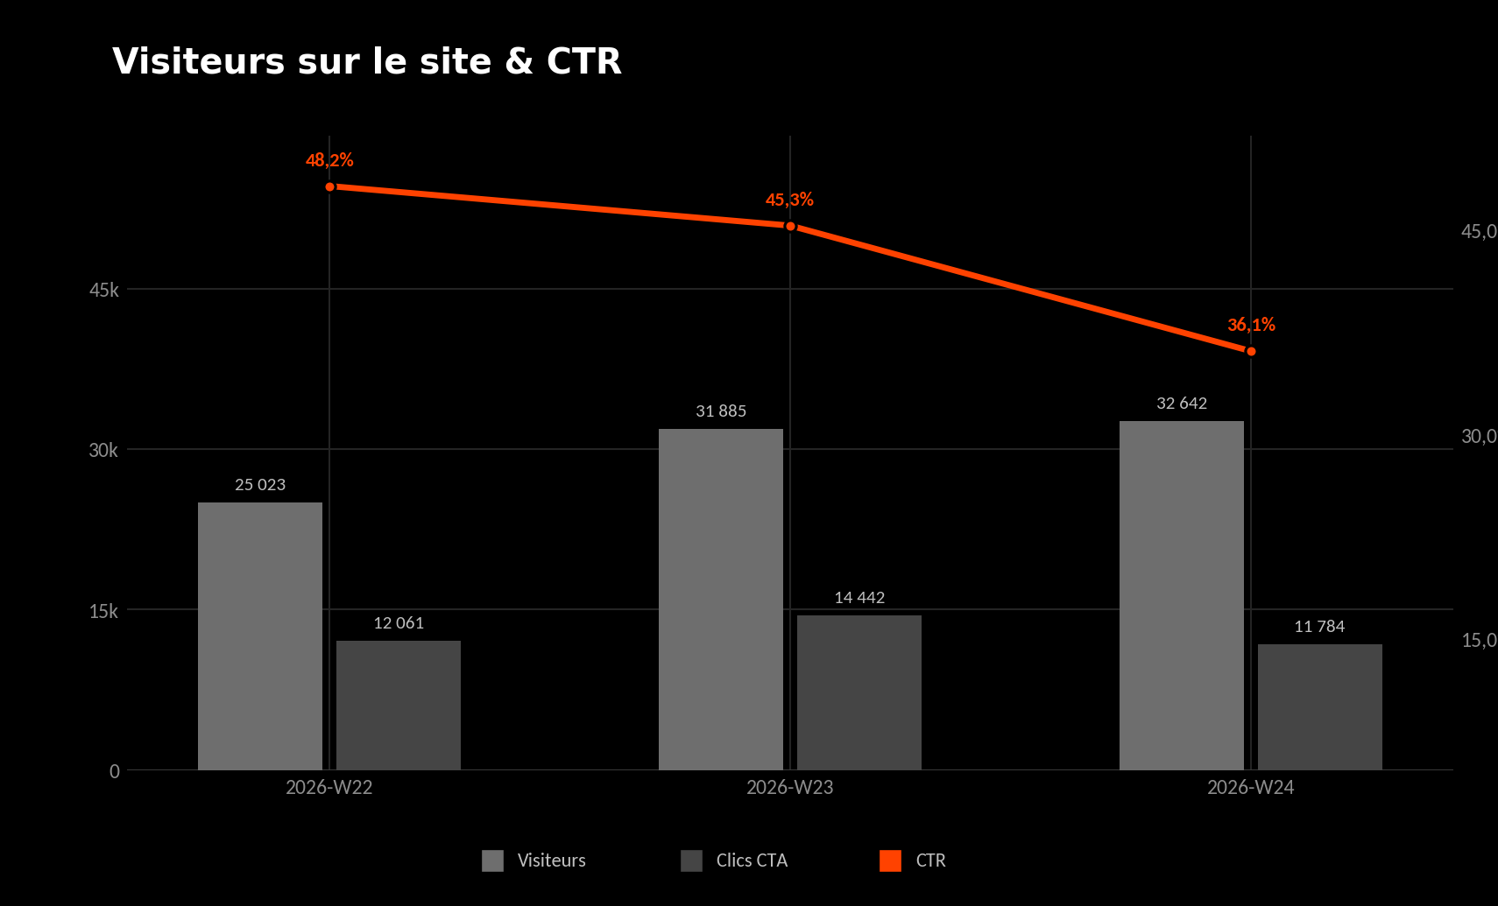
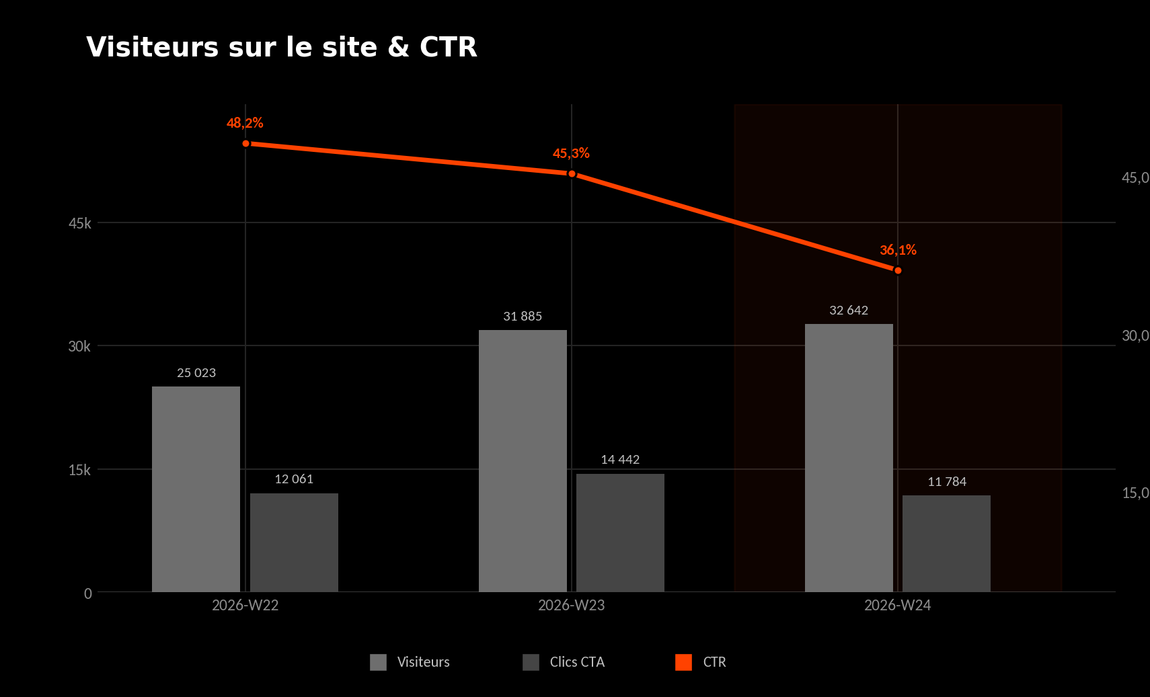
Mid Funnel: Landing page.
{{VILLE_UPPER}} {{ANNEE}}
Key Metric | Action Plan

Slide 9
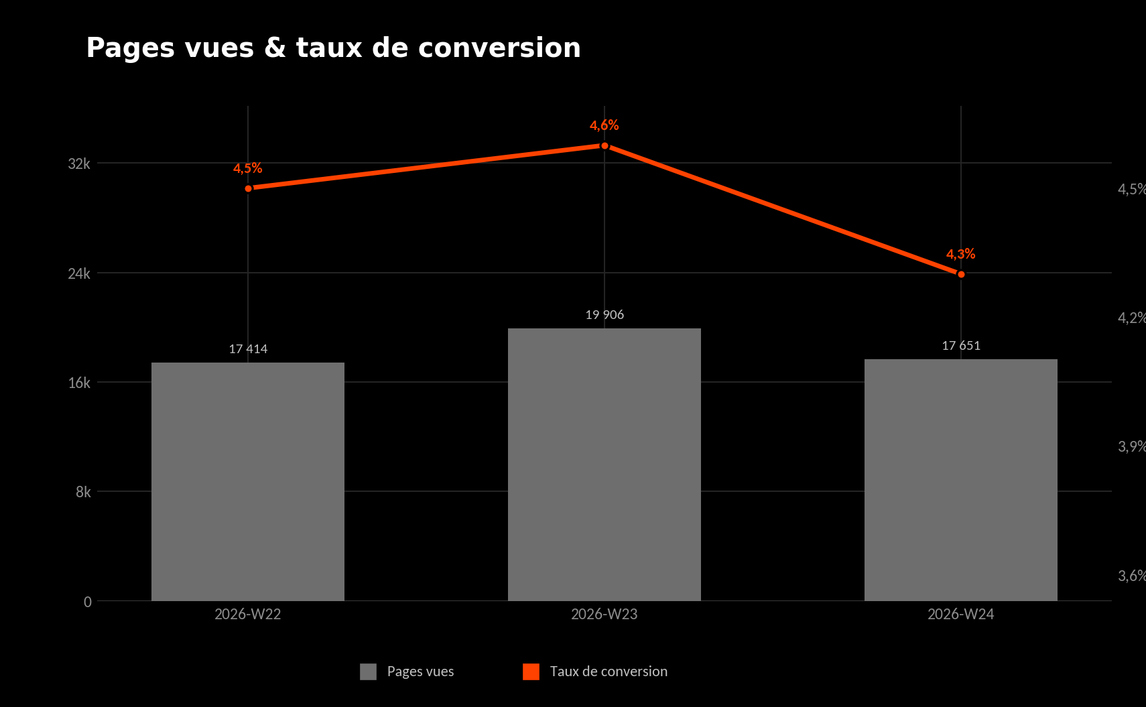
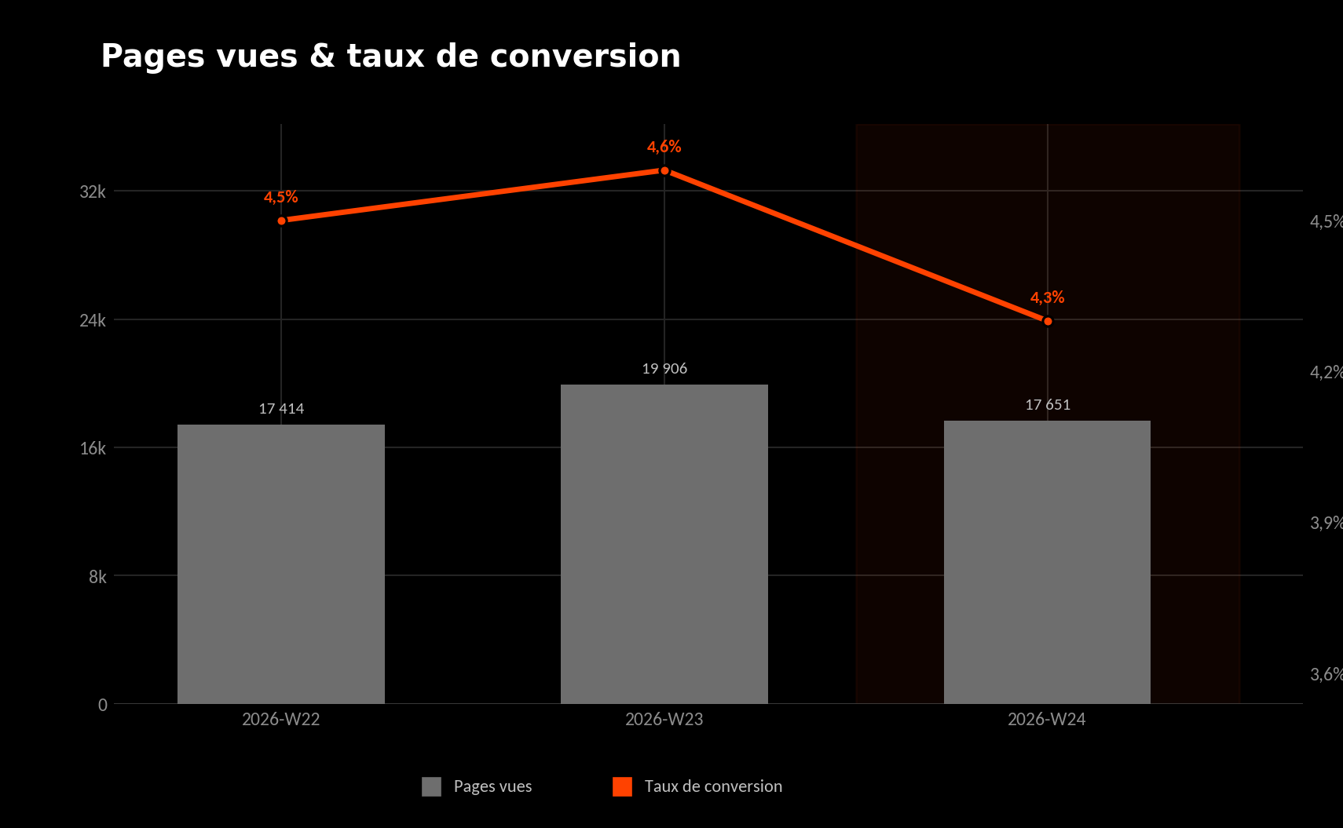
Low Funnel: Product Page.
{{VILLE_UPPER}} {{ANNEE}}
Key Metric | Action Plan

Slide 10
Sold out rates

Slide 11
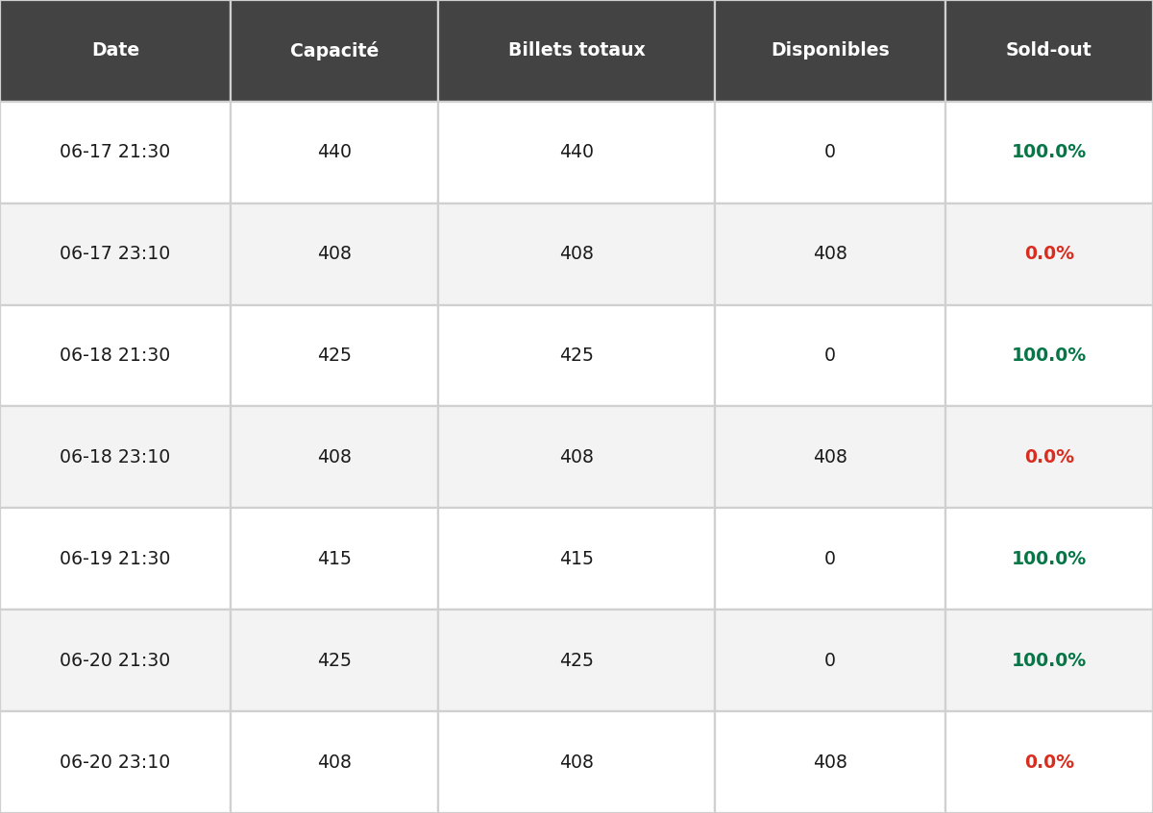
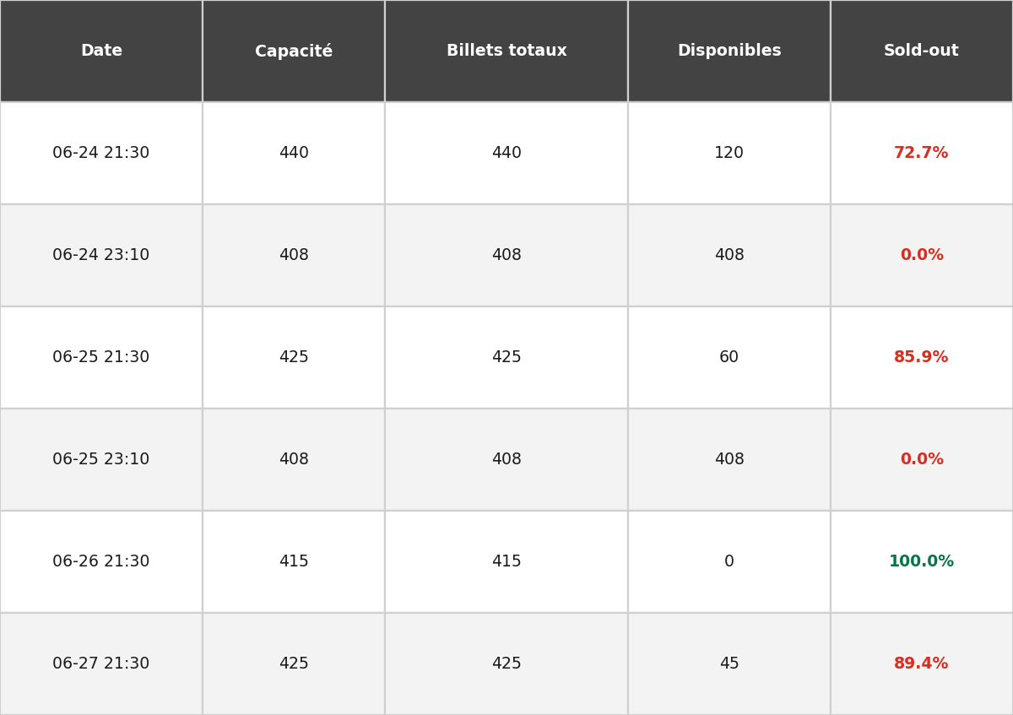
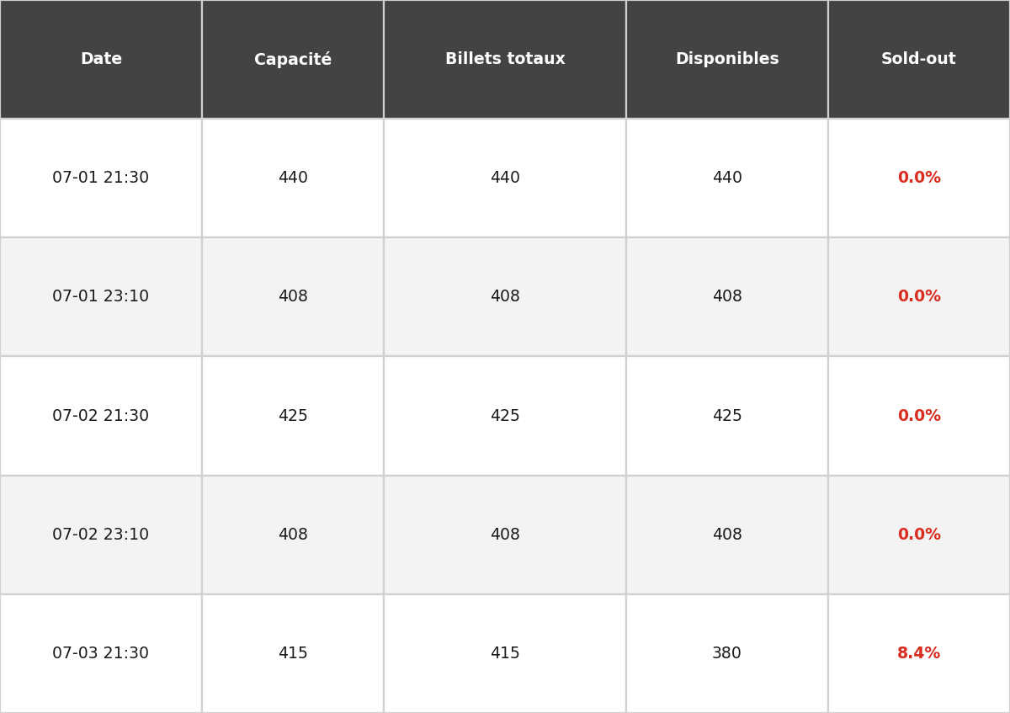
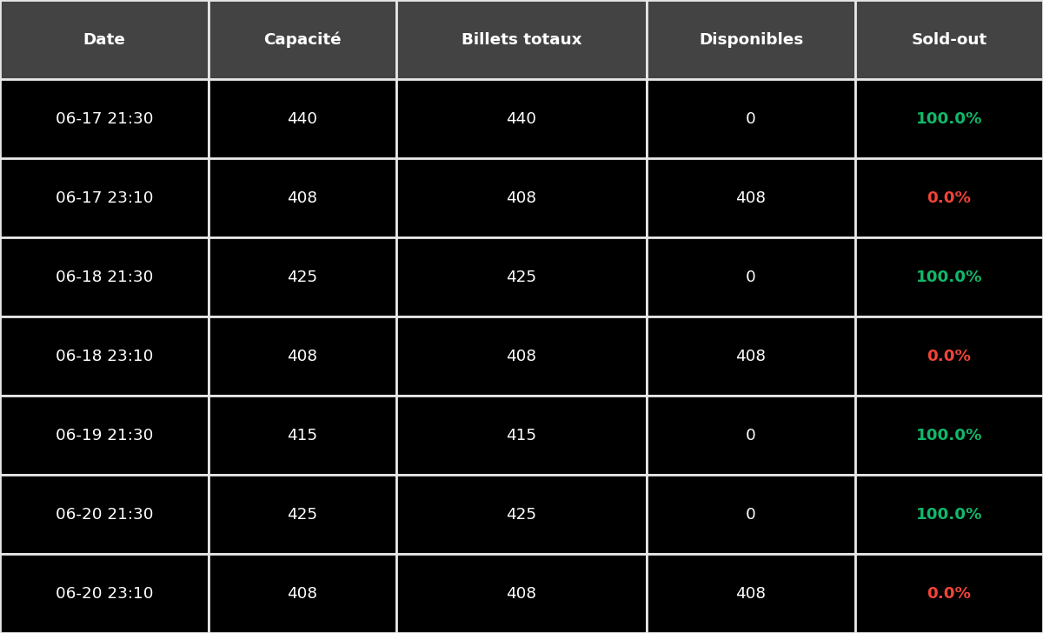
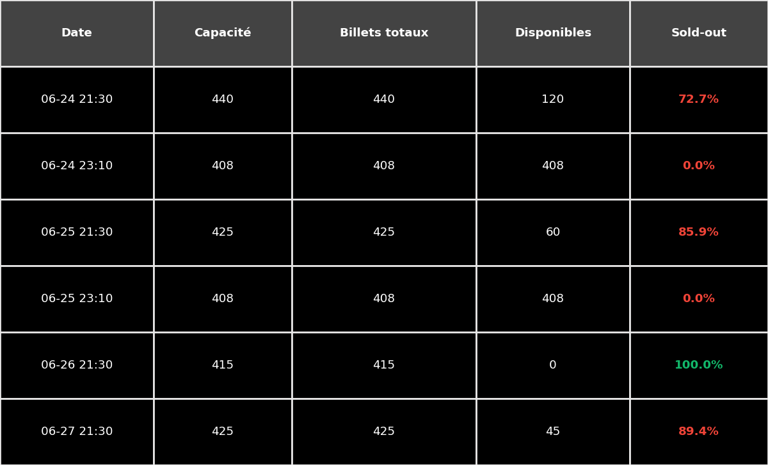
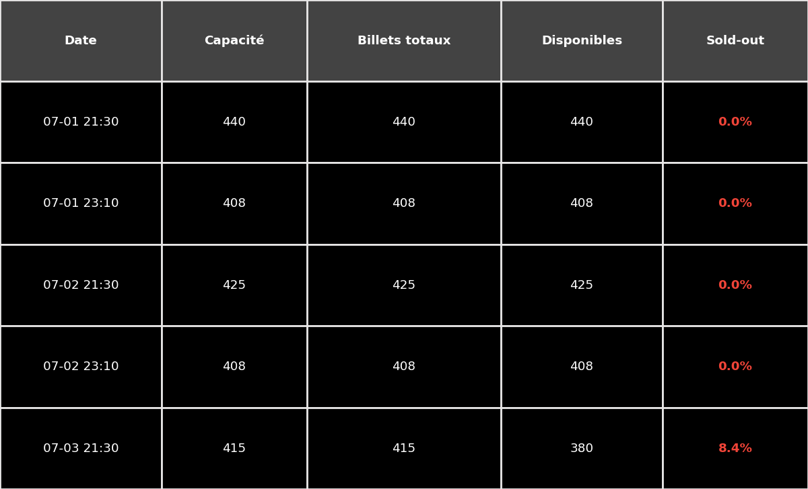
Sold out rates.
{{VILLE_UPPER}} {{ANNEE}}
W-1
Current week
W+1
Key Metric | Action Plan

Slide 12
Top Funnel

Slide 13
Top funnel: Big Picture.
{{VILLE_UPPER}} {{ANNEE}}
CTR | W-3 | Evol | W-2 | Evol | W-1 | Bench
Meta
Google
CPM | W-3 | Evol | W-2 | Evol | W-1 | Bench
Meta
Google
Key Metric | Action Plan

Slide 14
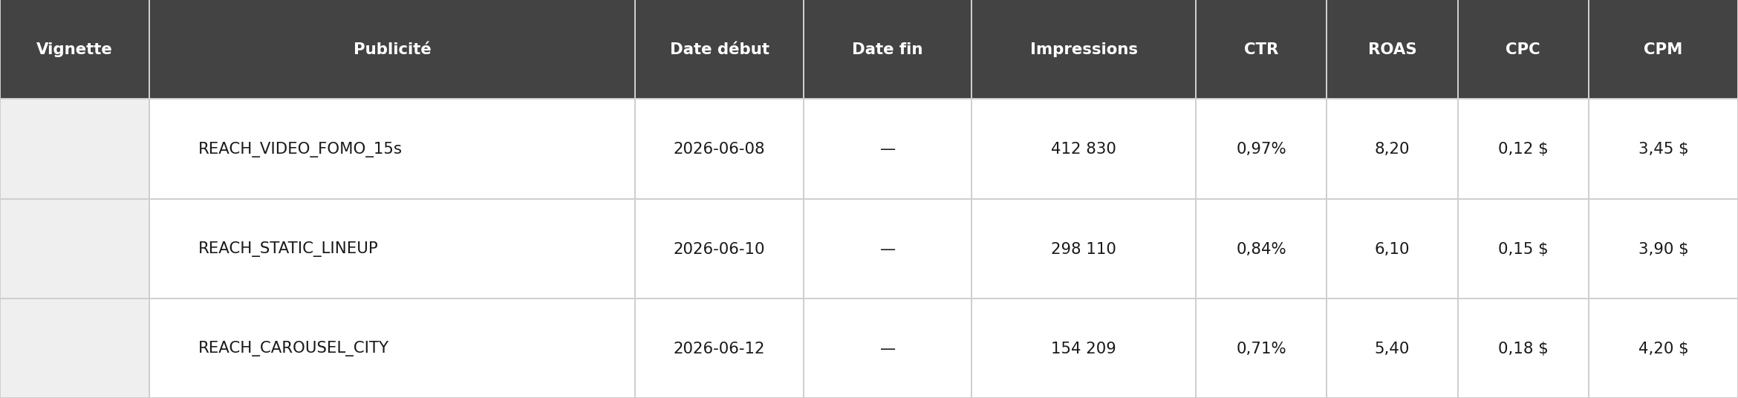
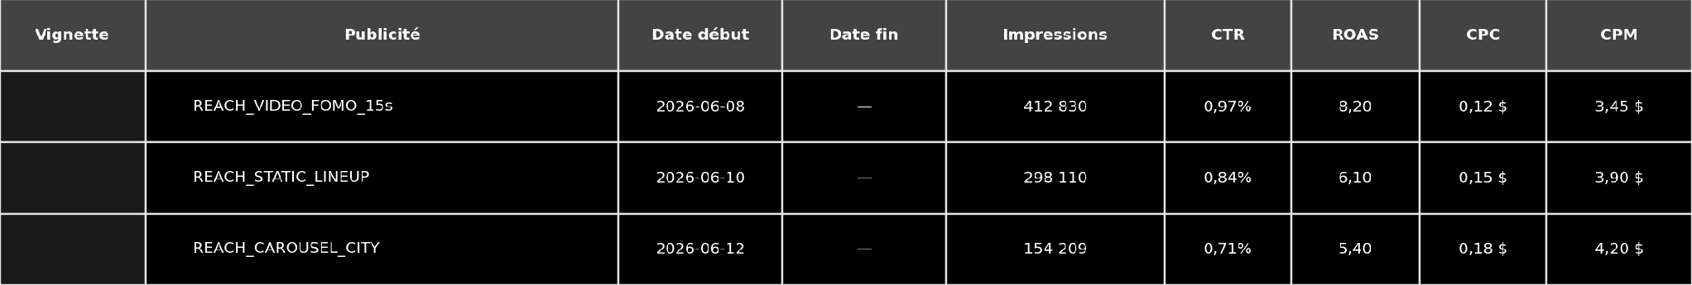
Campaign review: REACH.
{{VILLE_UPPER}} {{ANNEE}}
IMP W-2 | IMP W-1 | CTR W-2 | CTR W-1 | ROAS W-2 | ROAS W-1 | CPM W-2 | CPM W-1
Campaign | CTRs | Comments and recommendations
AD/FOMO

Slide 15
Campaign review: UGC.
{{VILLE_UPPER}} {{ANNEE}}
IMP W-2 | IMP W-1 | CTR W-2 | CTR W-1 | ROAS W-2 | ROAS W-1 | CPM W-2 | CPM W-1
Campaign | CTRs | ROAS | Comments and recommendations
UGC

Slide 16
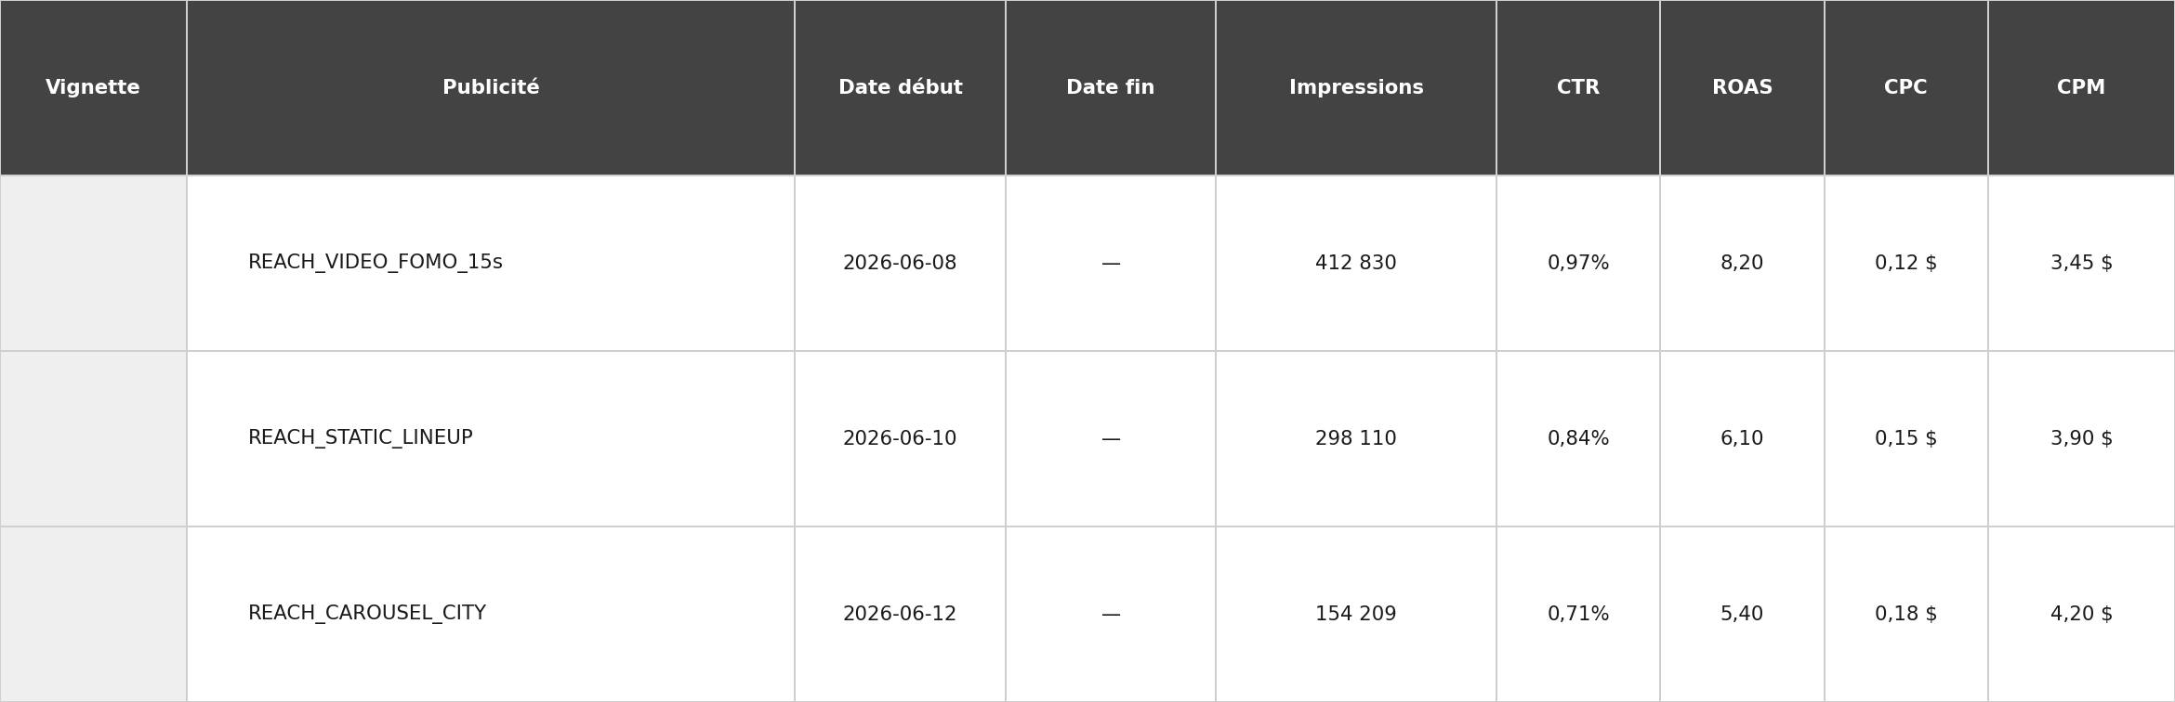
Campaign review: ADE.
{{VILLE_UPPER}} {{ANNEE}}
Campaign | CTRs | ROAS | Comments and recommendations
ADE

Slide 17
Campaign review: RMKT.
{{VILLE_UPPER}} {{ANNEE}}
Campaign | CTRs | ROAS | Comments and recommendations
RMKT

Slide 18
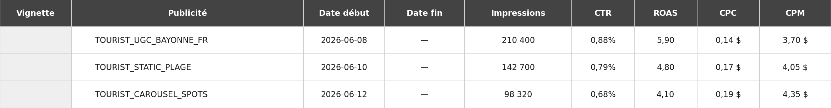
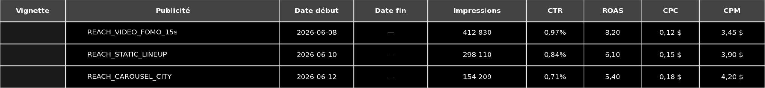
Campaign review: TOURIST FR & EN.
{{VILLE_UPPER}} {{ANNEE}}
Campaign | CTRs | ROAS | Comments and recommendations
TOURIST FR
Campaign | CTRs | ROAS | Comments and recommendations
TOURIST EN

Slide 19
Action Plan

Slide 20
To do for next week.
{{VILLE_UPPER}} {{ANNEE}}
Actions | To be done by Lotchi | To be done by Fever | Deadline

Slide 21
Merci

