Slide 1
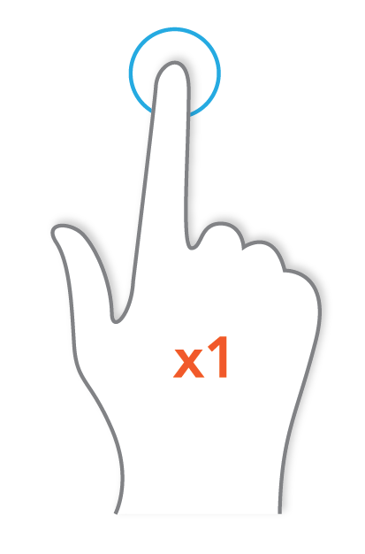
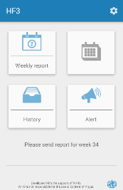
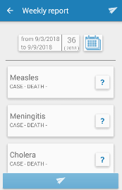

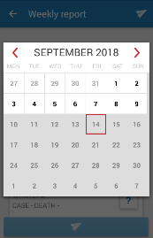
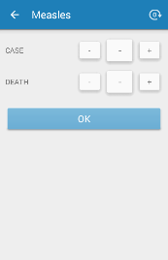
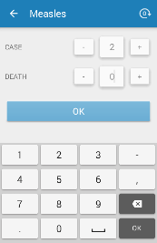
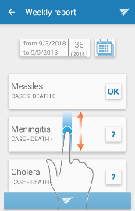
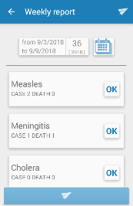
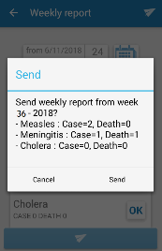
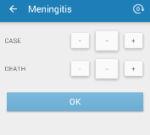
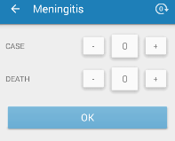
HEALTHCARE FACILITY - ARGUS
Send weekly aggregated reports
and alerts of unexpected events
Country logo + heading ministry
Objective
Reporting weekly the number of cases and deaths for epidemic prone diseases allows to:
Early detect an outbreak.
Take adequate control measures.
For each disease, each week:
From the register, fill in the weekly reporting form for epidemic prone diseases.
If no case or death was observed during the previous week, indicate zero (0) for the number of cases or deaths for this disease.
Using the weekly reporting form, send every Monday before noon the total number of cases and deaths from the previous week with Argus.
Report weekly using Argus on the mobile phone
1. If the mobile phone is off, turn it on.
3. Tap on “Weekly report”.
4. Check the dates of the week you want to report.
If the proposed dates are incorrect, tap on the calendar.
2. Tap the app logo.
5. Tap on any day of the week you want to report.
6. Tap on each disease to report
7. For each disease, tap on – and + to enter the number of cases and deaths.
8. Once the number of cases and deaths have been entered, tap OK.
9. Tap on the next disease to enter its number of cases and deaths.
To display other diseases, slide your finger on the screen.
10. Once all diseases are marked as “OK”, tap the button at the bottom of the screen to send the report.
11. Check the week number and the information to be reported. Tap on “send” to send the report (tap “cancel” to correct it).
Tip: tap on the symbol at the top right corner of the screen to put 0 for all values of a disease.
In addition to weekly reporting, for any severe or unexpected health event*, call your supervisor immediately and use the alert function on Argus (see procedure at the back).
* For example:
- Case of a disease requiring immediate reporting and investigation (e.g. acute flaccid paralysis, haemorrhagic fever).
- Cluster of cases for a given disease or syndrome.
- Any other severe event of unknown aetiology.

Slide 2
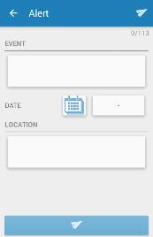
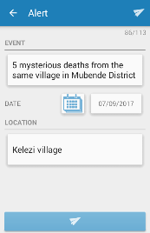
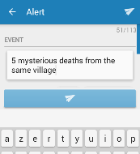
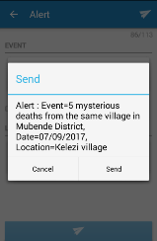
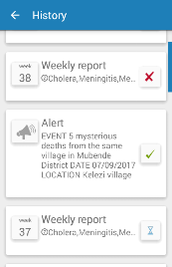
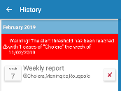
HEALTHCARE FACILITY - ARGUS
Send weekly aggregated reports
and alerts of unexpected events
Country logo + heading ministry
Send an alert using Argus
2. Tap the box below “EVENT”
and describe what has occurred.
3. Tap the calendar icon and select the date of the event.
1 . Tap on “Alert”.
4. Tap the box below “LOCATION” and enter the location of the event.
5. When all the information has been entered, tap the button at the bottom of the screen to send the alert.
6. Check the information entered. Tap “Send” to send the alert (tap “Cancel” to correct it).
Check that your reports and alerts are well received
2. The list of sent reports and alerts is displayed in chronological order. To see the details of a report, tap on the report.
The reception status is displayed as:
Red cross: report or alert not received. To send it again tap on the red cross. If an alert presents a red cross, call your supervisor.
Green tick: report or alert received.
Blue hourglass: delivery in progress (it can take up to 2h).
1 . Tap on
“History”.
3. Tap on the arrow at the top left of the screen to return to the homepage.
If a threshold for a disease is reached, a warning message is displayed. Check that the reported numbers are correct:
if they are: contact your supervisor;
if they aren’t: send a corrected report.
Common issues and solutions:
The phone does not turn on: plug the phone, let it charge for 10 min, try to turn it on again.
The message “No network available” is displayed: check the mobile phone signal at the top of the screen; if there is no signal: send the report later or from a different location. If there is a signal: it is likely that there is no credit left, contact your supervisor.
The message “Your phone number isn’t declared in the system” is displayed: contact your supervisor.
The message “Complete all required fields” is displayed: there is missing information for at least one disease, complete the report.
You have sent a report or an alert containing errors: send a new report or alert to replace the previous one.
Despite multiple attempts to send the report, a red cross still appears in the history screen: contact your supervisor.
The message “Maximum character number exceeded” is displayed before sending an alert: there are too many characters in the alert, you need to remove some text. The number of authorized characters appears on the top right corner of the alert screen.
A red cross is displayed for an alert in the history screen: contact your supervisor.
Other issues: contact your supervisor.
Healthcare facility:
Name and phone number of supervisor:
Argus web platform can be accessed on the following link:
Username:
Password:

