Slide 1
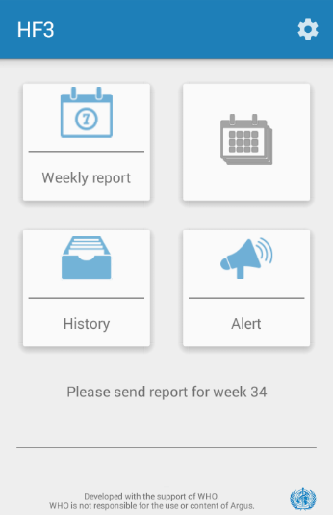
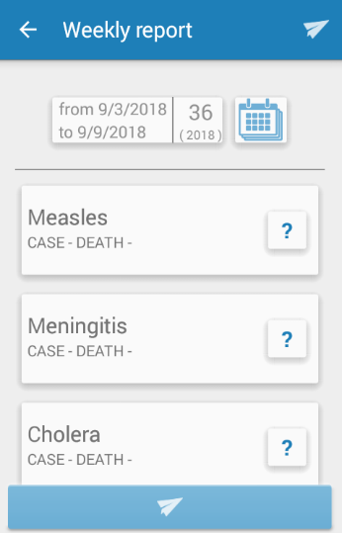
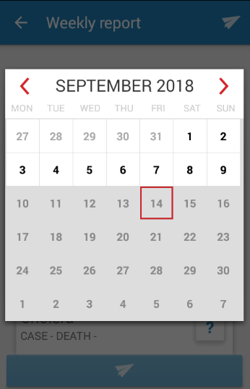
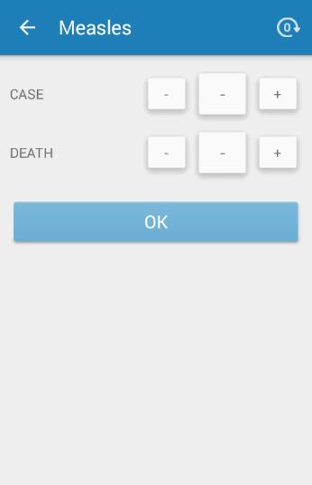
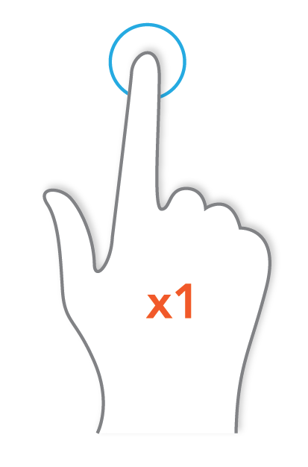

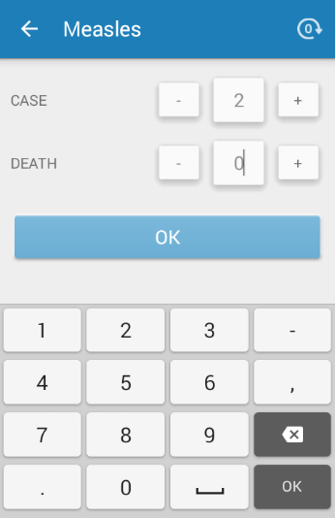
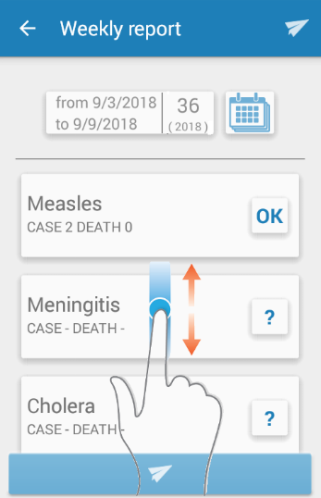
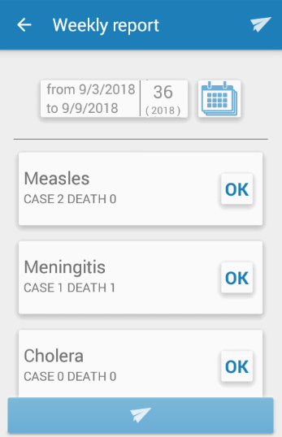
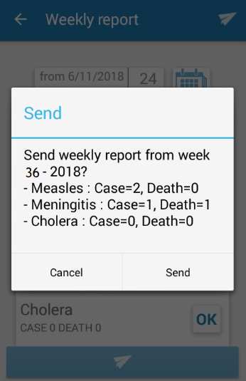
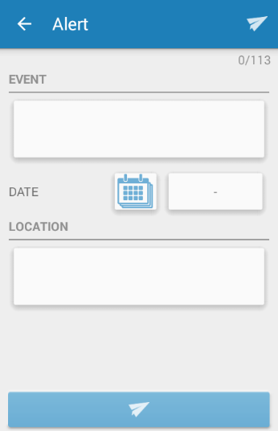
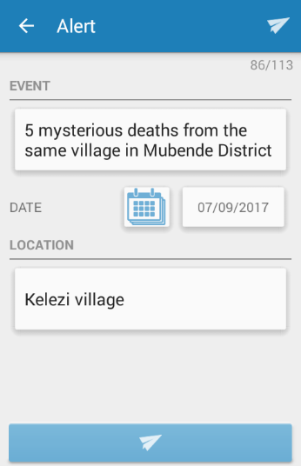
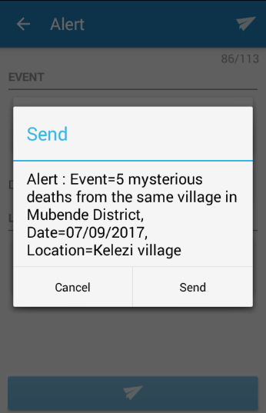
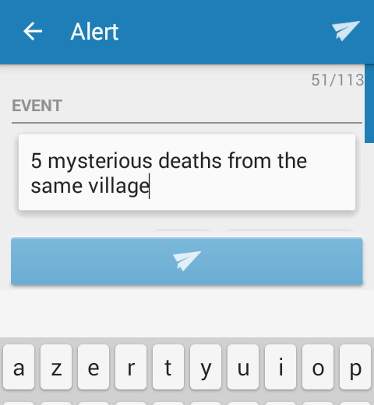
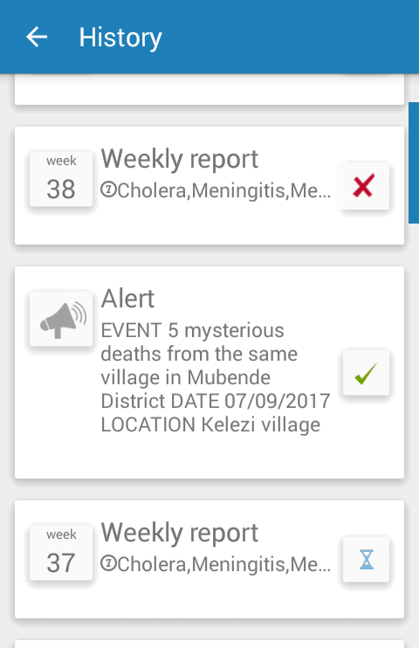
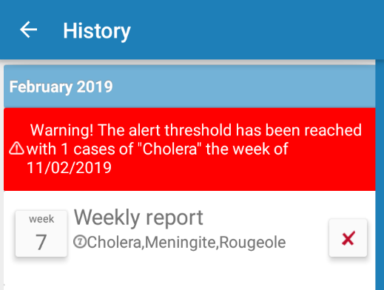
HEALTHCARE FACILITY - ARGUS
Send weekly aggregated reports
and alerts of unexpected events
Country logo + heading ministry
Report weekly using Argus on the mobile phone
7. For each disease, tap on – and + to enter the number of cases and deaths.
1. If the mobile phone is off, turn it on.
3. Tap on “Weekly report”.
4. Check the dates of the week you want to report.
If the proposed dates are incorrect, tap on the calendar.
2. Tap the app logo.
5. Tap on any day of the week you want to report.
6. Tap on each disease to report.
8. Once the number of cases and deaths have been entered, tap OK.
9. Tap on the next disease to enter its number of cases and deaths.
To display other diseases, slide your finger on the screen.
10. Once all diseases are marked as “OK”, tap the button at the bottom of the screen to send the report.
11. Check the week number and the information to be reported.
Tap on “send” to send the report (tap ‘cancel’ to correct it).
Send an alert using Argus
6. Check the information entered.
Tap “Send” to send the alert (tap “Cancel” to correct it).
2. Tap the box below “EVENT”
and describe what has occurred.
3. Tap the calendar icon and select the date of the event.
4. Tap the box below “LOCATION” and enter the location of the event.
5. When all the information has been entered, tap the button at the bottom of the screen to send the alert.
1 . Tap on “Alert”.
Check that your reports and alerts are well received
If a threshold for a disease is reached, a warning message is displayed. Check that the reported numbers are correct:
if they are: contact your supervisor;
if they aren’t: send a corrected report.
2. The list of sent reports and alerts is displayed in chronological order. To see the details of a report, tap on the report.
The reception status is displayed as:
Red cross: report or alert not received. To send it again tap on the red cross. If an alert presents a red cross, call your supervisor.
Green tick: report or alert received.
Blue hourglass: delivery in progress (it can take up to 2h).
3. Press the arrow at the top left of the screen to return to the homepage.
1 . Tap on
“History”.

