Slide 1
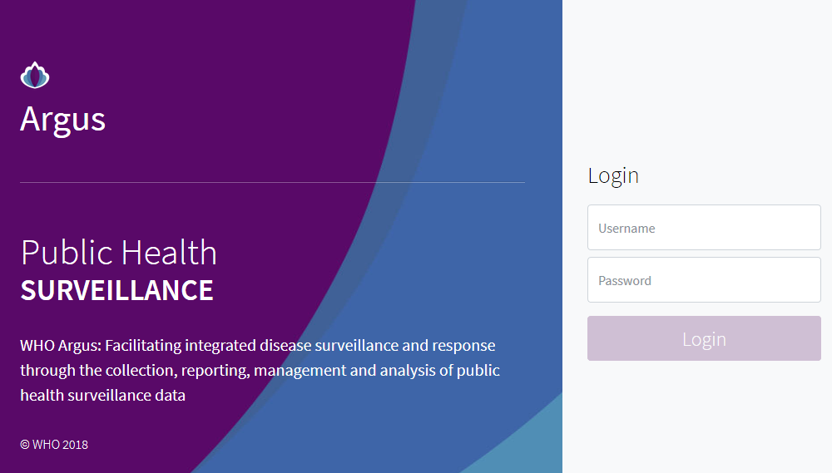
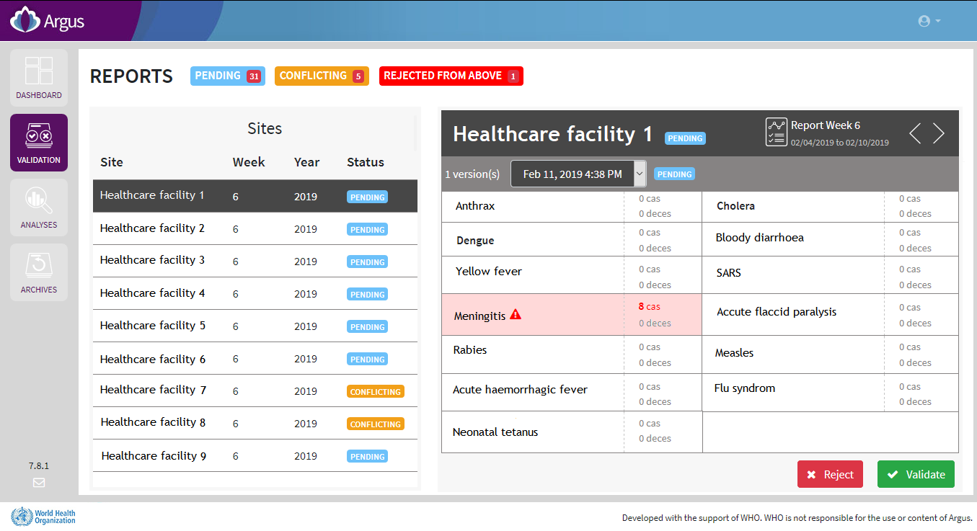
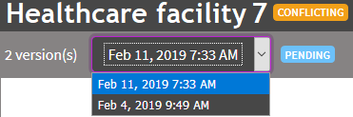
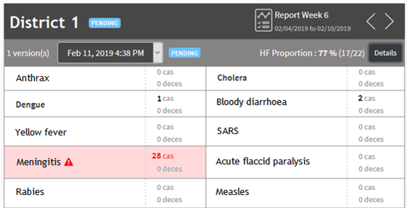
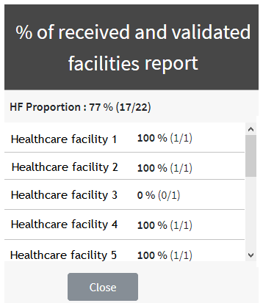
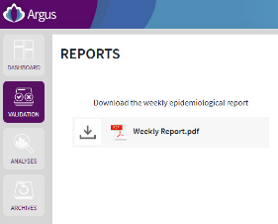
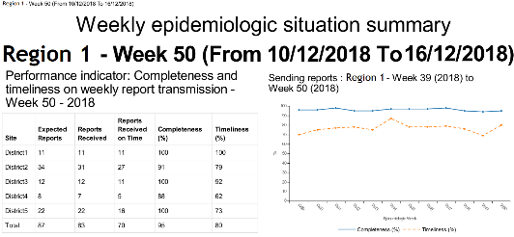
INTERMEDIATE AND CENTRAL LEVELS
Use the Argus web platform
Country logo + heading ministry
Objective
Reporting weekly the number of cases and deaths for epidemic prone diseases allows to:
Early detect an outbreak.
Take adequate control measures.
As the surveillance officer at the intermediate or central level, you are in charge of:
Validate or reject weekly reports from your area.
Review the data to check if there is any epidemiological threat requiring a rapid response.
Access and navigate the Argus web platform
1. Open a web browser and go to:
http://IP_ADDRESS/argus
2. Enter your username and password and click on “Login”
There are four main pages:
DASHBOARD: to access an overview of the administrative and epidemiological situation in the country.
VALIDATION: to validate or reject weekly reports from your below level.
ANALYSES: to download the weekly epidemiological summary and perform custom analyses.
ARCHIVES: to browse weekly reports.
Validate or reject the weekly reports
Once you log in to the platform, you will see all the reports needing to be validated or rejected.
In case of a “conflicting” report, several versions exist. You need to validate or reject the most recent version.
Thresholds have been defined for diseases and conditions under weekly surveillance. If a threshold is reached, the disease is highlighted. You need to perform urgently an assessment of the situation.
Press the button to validate or reject a report.
If you are the surveillance officer at an upper level (e.g. regional level), you will validate or reject aggregated reports from the level below (e.g. district level).
For aggregated reports, you can see how many facility reports they represent.
Download your weekly epidemiological summary
Once you have validated or rejected all your reports, you will be asked to download the epidemiological situation summary for your area. Download it and check if there is an epidemiological threat requiring a rapid response.

Slide 2
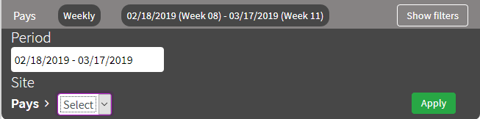
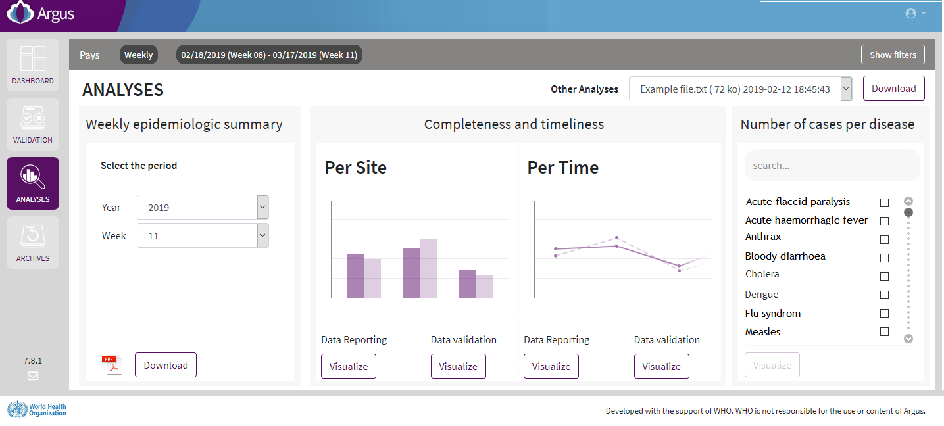
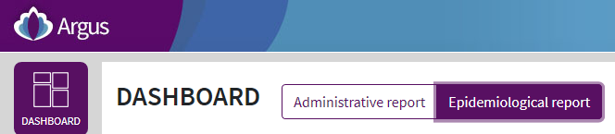
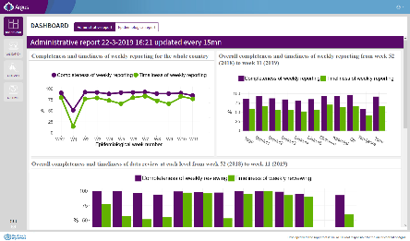
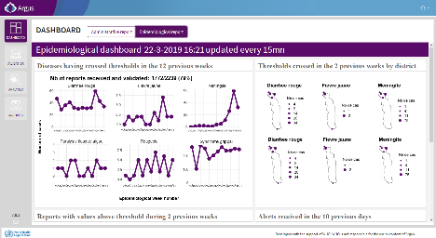

INTERMEDIATE AND CENTRAL LEVELS
Use the Argus web platform
Country logo + heading ministry
Perform and export custom analyses
Select the area and period of interest
Click on the “Show filters” button.
Select the appropriate period.
Select the appropriate site.
Click on the “Apply” button.
To download a specific weekly epidemiological summary:
1. Select the site of interest with the “Show filters” button.
2. Select the week and year of interest in the weekly epidemiologic summary area.
To choose the analysis to be performed click on the “Visualize” button.
For the number of cases, choose first the disease of interest.
Access administrative and epidemiological dashboards
Two dashboards present an overview of the administrative and epidemiological situation in the country. Click on the button “Administrative report” or “Epidemiological report” to see them.
Browse validated and rejected weekly reports
Select the area and period of interest as mentioned above using the “Show filters” button.
Common issues and solutions:
Impossible to connect to the platform: check your internet access, check your username and password, check that your keyboard is not locked in capital letters.
A report is incomplete and can’t be validated: wait for the report to be fully received (up to 2 hours); call the healthcare facility to send back the report by pressing the red cross in the history page of the Argus mobile phone.
Impossible to perform an action: each user has a different set of permission, check with the administrator your permissions.
A report was received but its data are not taken into account in the analyses: data from a report is only taken into consideration in the analyses once the report has been validated.
Other issue: contact your technical support.
Name and phone number for technical support:
Argus web platform can be accessed on the following link:
Username:
Password:

