Slide 1
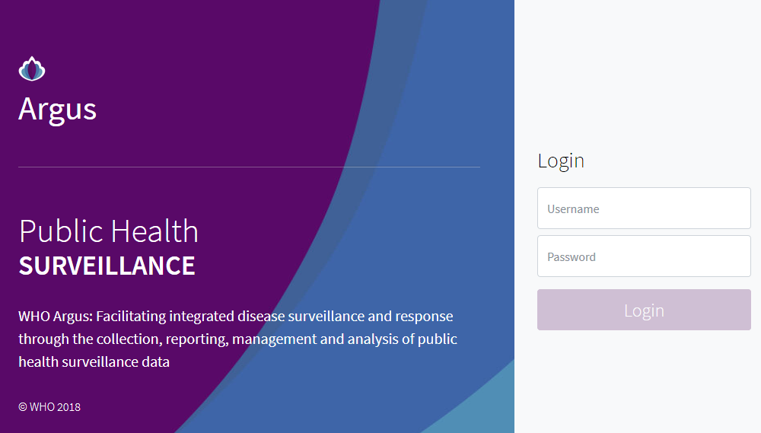
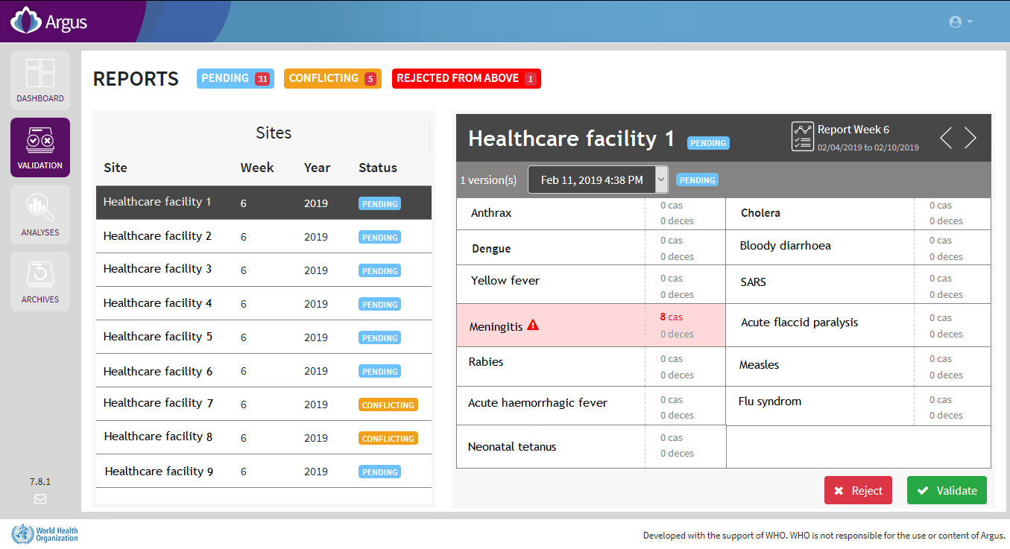
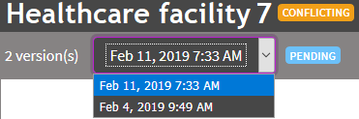
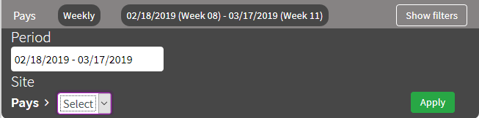
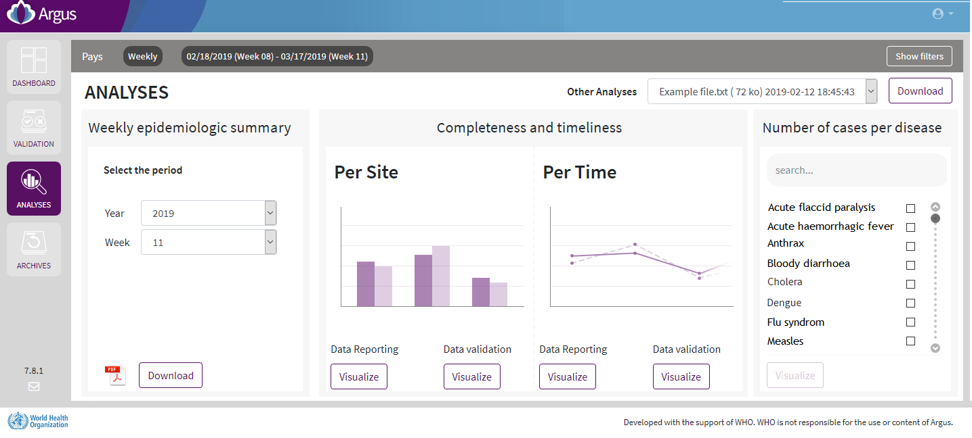
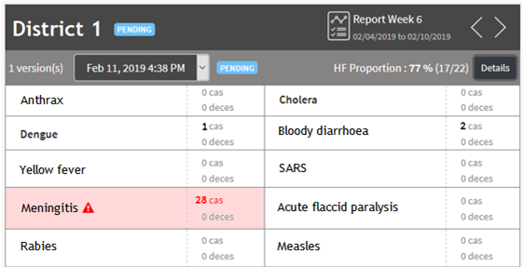
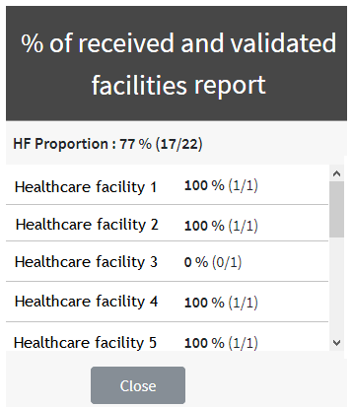

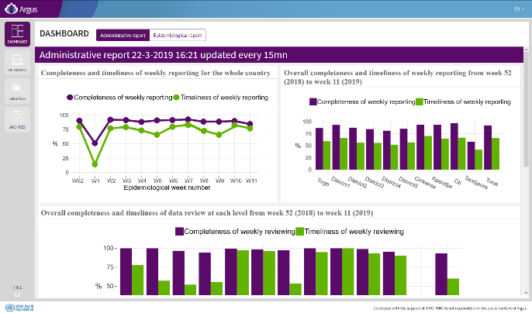
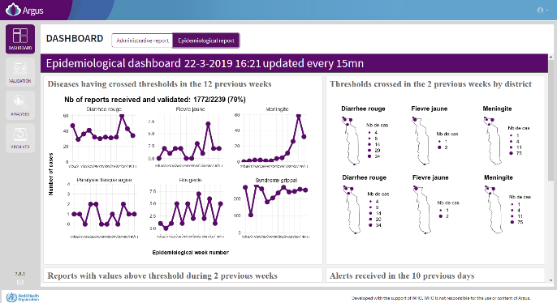
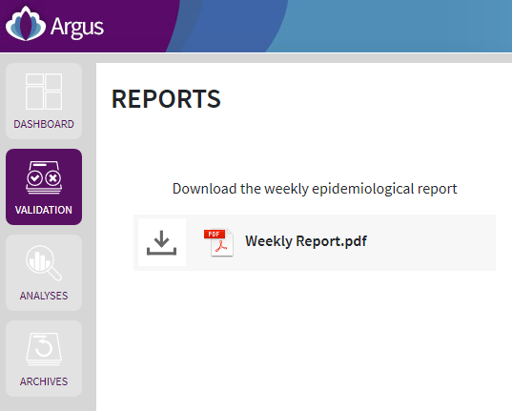
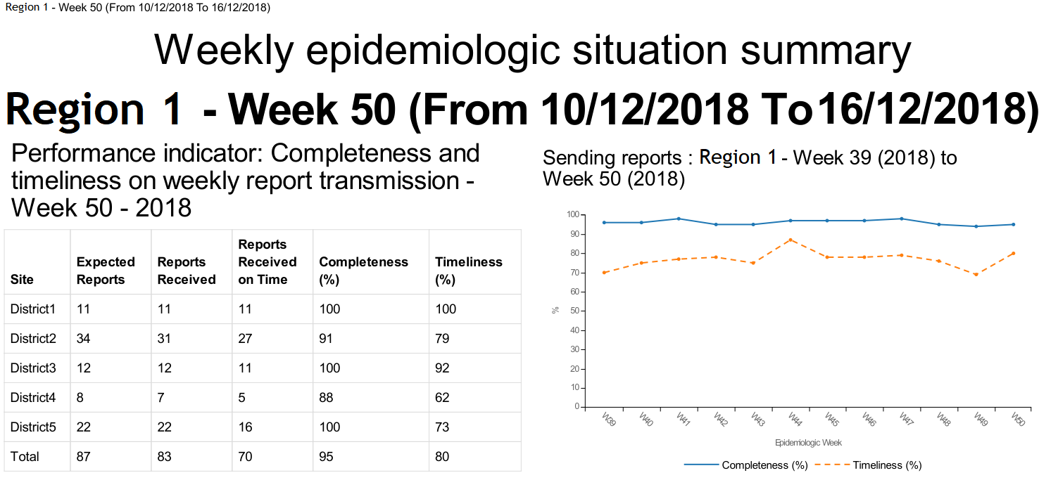

INTERMEDIATE AND CENTRAL LEVELS
Use the Argus web platform
Country logo + heading ministry
Access and navigate
Validate or reject the weekly reports
1. Open a web browser and go to:
http://IP_ADDRESS/argus
Once you log in to the platform, you will see all the reports needing to be validated or rejected.
2. Enter your username and password and click on “Login”
In case of a “conflicting” report, several versions exist. You need to validate or reject the most recent version.
Perform and export custom analyses
Select the area and period of interest
Click on the “Show filters” button.
Select the appropriate period.
Select the appropriate site.
Click on the “Apply” button.
Thresholds have been defined for diseases and conditions under weekly surveillance. If a threshold is reached, the disease is highlighted. You need to perform urgently an assessment of the situation.
To download a specific weekly epidemiological summary:
1. Select the site of interest with the “Show filters” button.
2. Select the week and year of interest in the weekly epidemiologic summary area.
Press the button to validate or reject a report.
To choose the analysis to be performed click on the “Visualize” button.
For the number of cases, choose first the disease of interest.
If you are the surveillance officer at an upper level (e.g. regional level), you will validate or reject aggregated reports from the level below (e.g. district level).
For aggregated reports, you can see how many facility reports they represent.
Access dashboards
Two dashboards present an overview of the administrative and epidemiological situation in the country.
Click on the button “Administrative report” or “Epidemiological report” to see them.
Download your weekly epidemiological summary
Once you have validated or rejected all your reports, you will be asked to download the epidemiological situation summary for your area. Download it and check if there is an epidemiological threat requiring a rapid response.
Browse archives
Select the area and period of interest as mentioned above for custom analyses using the “Show filters” button.

