Slide 1
Capstone 1
Inventory Management System User Interface
Nancy Golden
TEKsystems Fullstack Bootcamp
Instructor: Amir Yunas
Cohort 1 June 13, 2020

Slide 2
1. Understanding the Problem
Create an inventory management user interface for Kiwi Photography
Project time Frame: June 5, 2020 – June 12, 2020

Slide 3
Minimum Viable Product
“You’re selling the vision and delivering the minimum feature set to visionaries, not everyone.” – Steve Blank
The App must be created using the React.js framework.
A Product Page View that displays Products along with the following details: Product Name, Serial Number, Price. Manufacturer, Category/Tag
A Shopping Cart View that allows for Purchase Functionality
Search Functionality by Product Name
Allow customers to purchase multiple quantities of the same item
Must have at least 10 items in the inventory

Slide 4
2. Planning the Solution
Interview client, define expectations, and obtain items from customer needed to implement solution:
1) Logo in header: Kiwi Photography (supplied by customer)
2) Color Scheme and Layout: Customer Approved
3) Obtain Pictures from customer and uploaded customer pictures into folder on my personal website so they would be readily available to link to.
4) Picture details to be displayed: Customer Approved
5) Set realistic and achievable goals: Prioritize client requests and identify areas of difficulty that will need to be addressed while keeping in mind current level of technical expertise, resources available and time frame

Slide 5
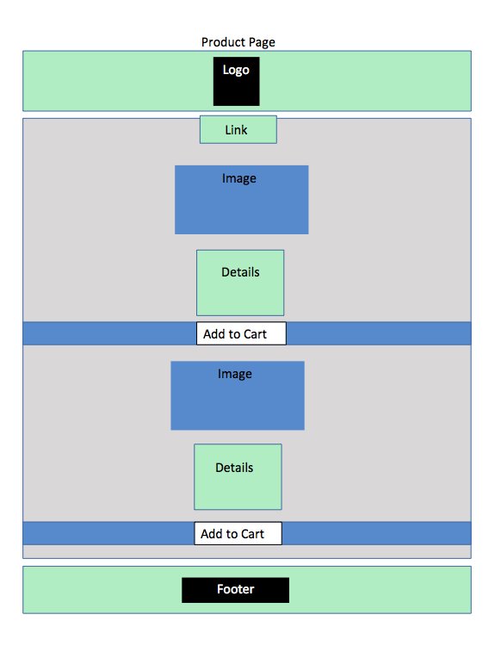
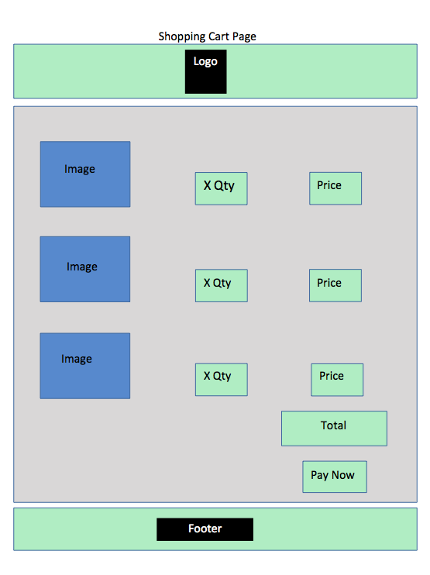
Preliminary Planning
Create wireframes: Page Layouts

Slide 6
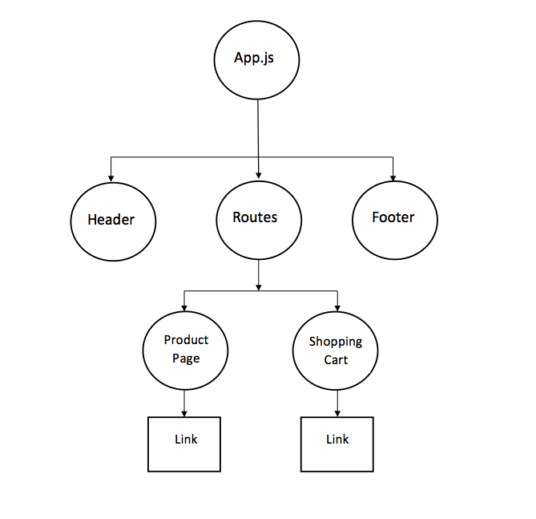
Preliminary Planning
Component Tree:

Slide 7
Preliminary Planning
Projected Daily Goals:
Day One: Review Capstone Documentation provided by instructor. Define problem and begin to plan how to solve it. Complete Step One and Two of UPER
Day Two: Create Data File from Customer Requirements. Brainstorm Framework/Structure with components needed for layout and to fulfill MVP
Day Three: Work on coding separate components, identify problem areas and prioritize time according to what can be accomplished while waiting on resources needed to accomplish tasks in the queue.
Day Four – Six: Continue coding and participating in student collaboration
Day Seven: Address and Resolve any Coding Issues. Complete Documentation. Prepare slides from notes and practice presentation.

Slide 8
Tools/Resources Available
Collaboration with other students
Support Sessions led by TEKAcademy Faculty
Help Channel and Resources Channel on Slack
Extensive Online Documentation Including Reactjs.org, Stack Overflow, Udemy and You Tube tutorials
Previous TEKAcademy exercises that can be related to current task

Slide 9
3. Executing the Plan
The process for implementing my plan was very fluid, making adjustments as needed. For example, I initially created a component structure and began coding, but after collaborating with more experienced students, I found that I needed to discard my original structure. My learning curve for the software coding required was my biggest blocker. I prioritized my coding time (what I worked on) according to:
A. MVP
B. Current technical ability and how much research required to implement the task
C. Length of time of blocker (which leads to D.)
D. Availability of support and other students for collaboration
Thank you to everyone at TEKAcademy and our cohort – the spirit of collaboration and everyone’s desire to help each other succeed was amazing!

Slide 10
4. Reflection / Refactor
I love people and I love technology and what has been so amazing about this Capstone experience is that I got to have both! I got to collaborate with amazing people – we all come from different backgrounds and experience levels – we all bring different gifts to the table and we shored up each other’s weaknesses and leveraged each other’s strengths. We celebrated each others successes and commiserated and encouraged when someone was struggling.
Measurable outcomes
Tangible:
Was the criteria set forth in the assignment met? The web page meets the basic criteria for the assignment.
My friend is very happy at the prospect of receiving her free website ☺

Slide 11
4. Reflection / Refactor Continued
Intangible:
It was a tremendous learning opportunity that also has me very excited about future learning and growth. I made some wonderful relationships and got to learn more about my classmates through this experience.
“If you don’t know it’s simply awful, if you do know, it’s awfully simple.” I will never forget this experience. It was challenging, exhausting, exhilarating, frustrating, exciting. I also found that I had reserves within me that I didn’t know existed when it came time to make a choice of persevering or giving up. The right answer always is: If I don’t know, I can find out.
What would I do different? Not so much different but I will definitely continue to learn, continue to grow, and continue to develop relationships so that we can help each other to succeed. I know that the code I wrote this week is not the code I will be able to write next week, the week after, or two years from now. Having a flexible mindset and learning from my mistakes is a lifelong characteristic I will try my best to cultivate. I will not settle for ordinary but in regards to my rather ordinary-looking website I have much to celebrate regarding the learning, the investment by other students and TEK Academy faculty that brought me to a place I could never have imagined a scant four weeks ago.

