Slide 1

Capstone 2
Java Based Terminal Game
Nancy Golden
TEKsystems Fullstack Bootcamp
Instructor: Amir Yunas
Cohort 1 July 14, 2020

Slide 2

1. Understanding the Problem
Create a terminal based, 2D game written in Java
Project time Frame: July 7, 2020 – July 13, 2020
Created by Allan Alcorn for Atari, Pong is a table tennis game featuring simple two-dimensional graphics. The game was originally released in 1972. This special TEKcamp version was created in response to the need for a 4 Player version.
Customer: Eric and Denise Kliskey

Slide 3
Minimum Viable Product
“You’re selling the vision and delivering the minimum feature set to visionaries, not everyone.” – Steve Blank
The Game must be functional and playable by a user
Instructions for how to play the game must be built into the game and incorporated into a separate file
Required elements include Java classes adhering to the four pillars of Object Oriented Programming: encapsulation, inheritance, abstraction, and polymorphism
Each game object must be modeled using a Java class
Implement at least one interface, one Abstract class, one lambda expression, and one stream
Have an organized and logical approach with at least one package
Have some type of error handling for bad user input

Slide 4
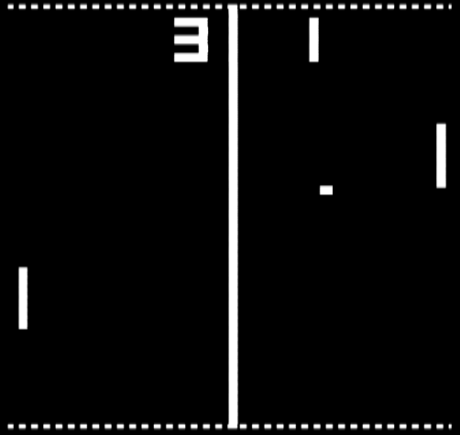
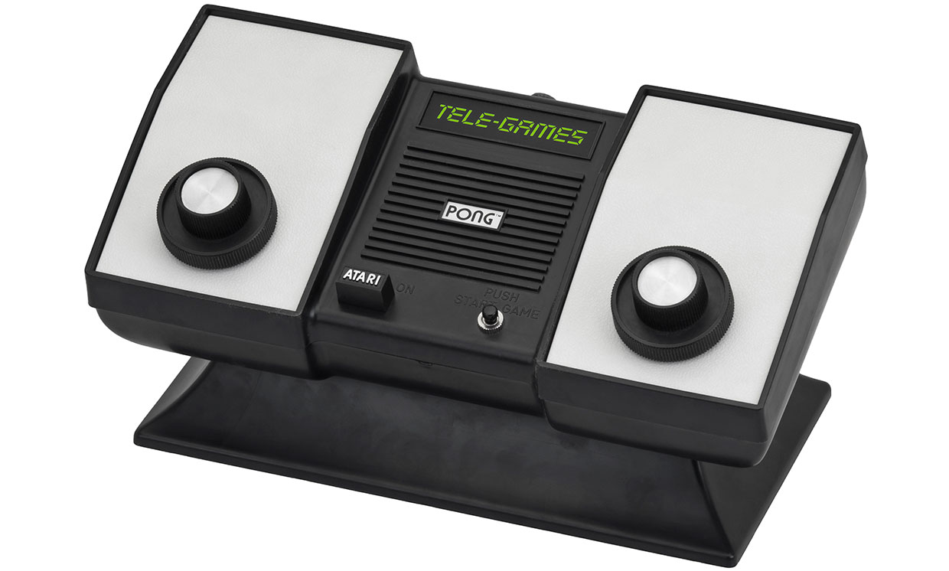
Inspiration: Why I chose Pong

Slide 5
Customer Features Wish List
Current Features:
2 or 4 Player Mode
Player Names display on the GUI
The Score displays on the GUI and increments in real time
The TEKcamp logo is displayed on the GUI and in dialogue boxes
Future Upgrades:
Allow player to select levels of difficulty (paddle size, paddle speed, ball size, ball speed)
Create a player library that includes their picture so if name matches, import picture to GUI also.
Keystroke that allows individual player to toggle between paddle sizes independently.

Slide 6
Challenges as the Developer
How can I complete my capstone successfully with my current skill and experience level?
How can I implement the core requirements into my project?
How can I prioritize my time so that I can maximize my productivity while meeting my other commitments?
Where do I get the information I will need to complete my tasks?
It’s not just about me – How can I help my teammates to be successful by offering assistance with their soft skills?

Slide 7
2. Planning the Solution
Interview client, define expectations, and obtain items needed to implement solution:
TEKcamp Logo for GUI (supplied by classmate Abigail Swigert)
Color Scheme and Layout: Customer Approved
Review Features Wish List with customer and prioritize items
GUI details to be displayed: Customer Approved
Set realistic and achievable goals: Prioritize client requests and identify areas of difficulty that will need to be addressed while keeping in mind current level of technical expertise, resources available and time frame
Define specific times to provide soft skill training for teammates and incorporate into my schedule / provide a PowerPoint in the help channel on presentation tips that students can view in their own time

Slide 8
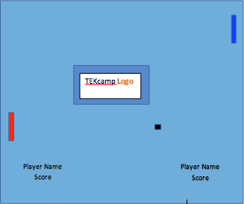
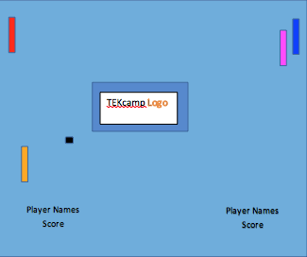
Preliminary Planning: Wireframes
Two Player Four Player

Slide 9
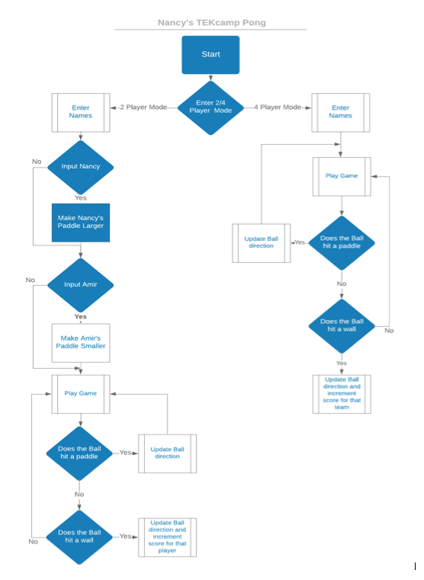
Preliminary Planning
Program Flowchart:

Slide 10
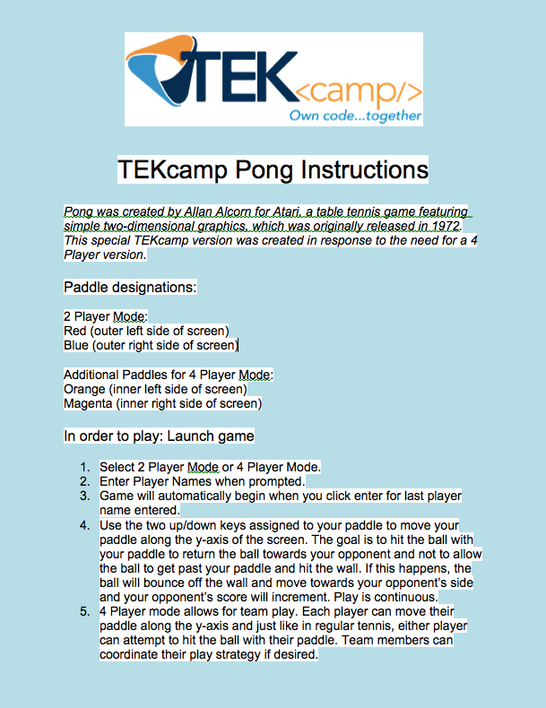
Game Instructions

Slide 11
Preliminary Planning
Projected Daily Goals:
Day One: Review Capstone Documentation provided by instructor. Research games and examine existing code to understand how to implement functionality. Locate resources to aid in creating game. Finalize game selection.
Day Two: Define problem and begin to plan how to solve it. Complete Step One and Two of UPER. Work on OOP documentation per capstone requirements.
Day Three: Review Feature List from Customer Requirements. Brainstorm Structure with Classes/Objects needed to fulfill MVP. Continue to work on OOP documentation. Research pong code and try to understand how it works. Identify trouble areas and research.
Day Four: Begin coding basic structure. identify problem areas and prioritize time according to what can be accomplished while waiting on resources needed to accomplish tasks in the queue. Research what is needed to accomplish Features Wish List
Day Five – Six: Continue coding and work on coding items from Features Wish List in order of priority. Work on refactoring and debugging.
Day Seven: Address and Resolve any Coding Issues. Complete Documentation. Prepare slides from notes and practice presentation.

Slide 12
Tools/Resources Available
Collaboration with other students/friends
Support Sessions led by TEKacademy Faculty
Help Channel and Resources Channel on TEKacademy Slack
Extensive Online Documentation including many Online Blog Articles by SW Developers, Stack Overflow, Geeks for Geeks, javadocs, and Udemy and You Tube tutorials
Previous TEKAcademy exercises that can be related to current task

Slide 13
3. Executing the Plan
The process for implementing my plan was very fluid, making adjustments as needed. I needed to study a lot of code and spend time with my friend who is a java developer – he patiently explained concepts that would help me understand and implement my code. My learning curve for the software coding required was my biggest blocker. I prioritized my coding time (what I worked on) according to:
A. MVP
B. Current technical ability and how much research required to implement the task
C. Length of time of blocker (which leads to D.)
D. Availability of support and other students for collaboration
Thank you to everyone at TEKAcademy and our cohort – just as in Capstone 1, the responsiveness of the TEKacademy faculty, the spirit of collaboration among students, and everyone’s desire to help each other succeed was amazing! I especially appreciate the folks from TEKsystems who offered their time and knowledge freely, well-past normal working hours, to anyone who needed help.

Slide 14
3. Executing the Plan
I did my project in stages, with my first goal being to accomplish basic functionality. I then worked on the customer features list which was a lot of fun. It took much research and I am amazed at the classes and methods that are available in java and what you can do with them once you are aware they exist. I learned about inheritance and spent a lot of time playing with methods from different classes, especially the Graphics class, and JFrames, and learning about modal dialogue boxes. I created three classes: Paddle, Ball, and GameDriver and learned about threads and how to create and execute threads. I could go on and on...
It seems to me that java is extremely powerful in its functionality and very challenging because it is so strongly typed but that the more you use it, the more intuitive it will become. I big part of my success as a test engineer for a semiconductor manufacturer was not that I knew how to do everything, but that I knew how to get the information I needed to accomplish my task. I believe that is a successful strategy for any endeavor – and part of the fun of the task is learning new things. I had a lot of help in understanding concepts for this project and I am grateful for all of the resources that were available – human and google.

Slide 15
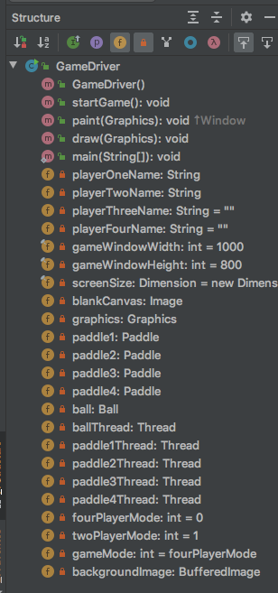
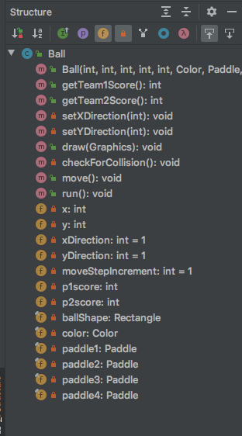
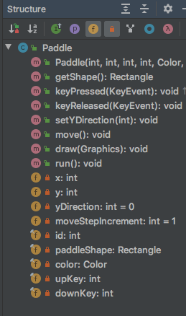
Program Structure
Class GameDriver
Class Ball
Class Paddle

Slide 16
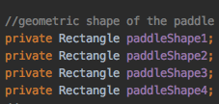
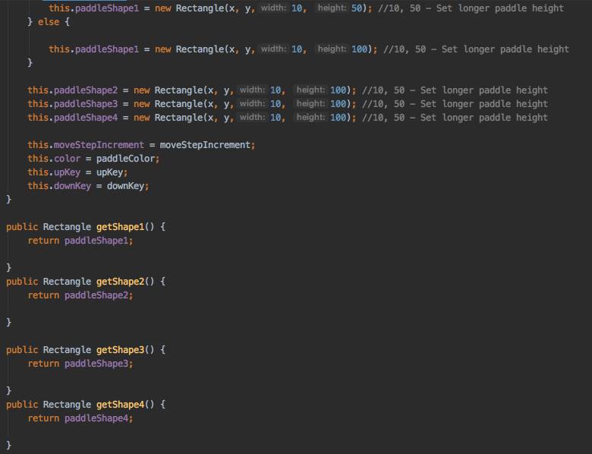
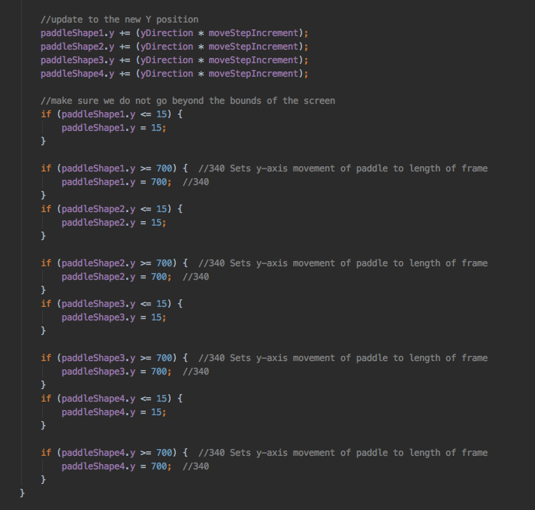
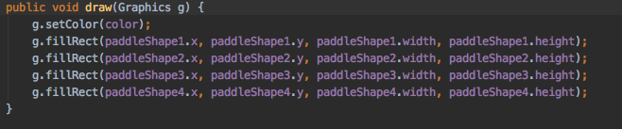
Code examples: Initial Code WHEN I DECIDED TO ADD THE ABILITY TO ADJUST THE length of the paddle

Slide 17
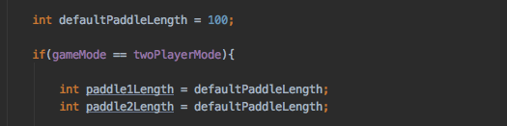
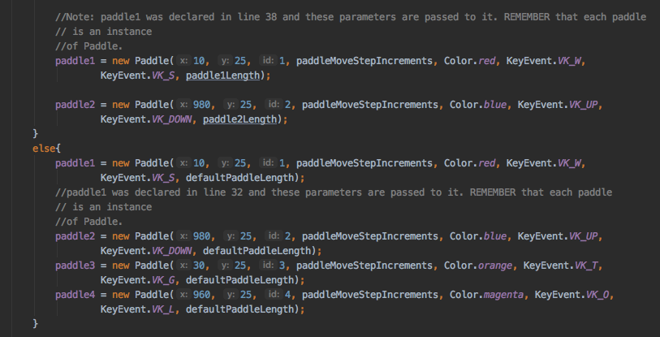
Refactored to implement S.O.L.I.D. Principle of Single responsibility
Cohesive:
Class Paddle does
does one thing – it’s
a paddle
Customizable

Slide 18
MY SOLUTION TO CODING AND EVERYTHING IN LIFE: You don’t need to know everything, you just need to know how to find out what you need to know...
I struggled for many hours studying examples, trying to code this game and implement the items on my Features Wish List and knew I needed help. I needed to understand how to instantiate a class better – how to create new objects from the ”blueprint” to implement the functionality I needed. I decided to ask a friend who is a java developer to help me understand the important concepts I needed to know to get the code to work. My Daddy always said, “If you don’t know it’s simply awful and if you do know it’s awfully simple.” He understood my desire to write the code myself with some needed guidance. We met via Zoom and reviewed the code together, discussing the importance of OOP concepts and program structure. When I got stuck he provided some direction. I am thrilled to say that through our collaboration I was able to complete the capstone and I learned so much along the way! None of us are an island - we are better together!
Special Thanks to my friend, Jamil, for his patience with all of my questions, his great explanations, and for his guidance as I worked on the code.

Slide 19
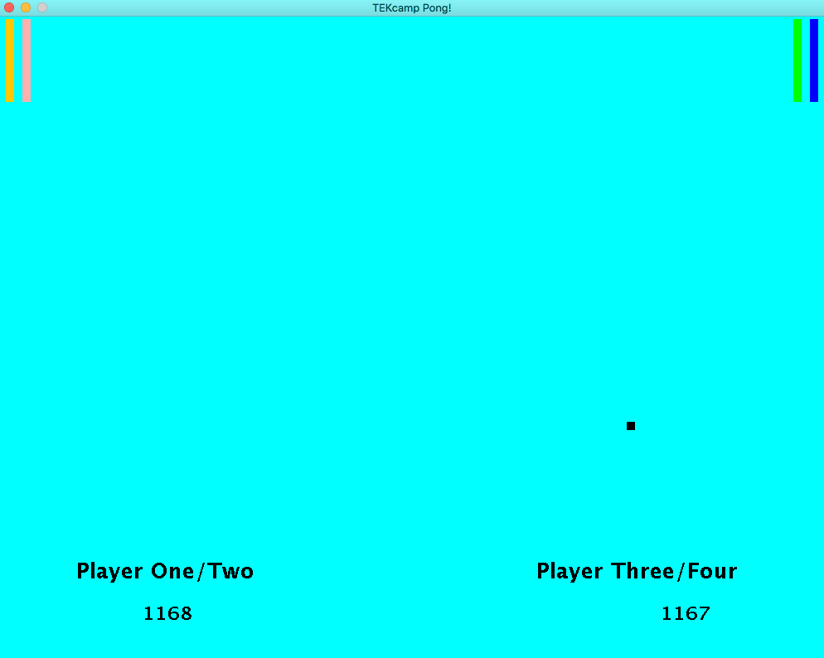
Testing Phase
I drafted my husband and we had a lot of fun testing out the game. We made sure the dialogue boxes functioned correctly and that the string text began passed to the dialogue box and on the GUI was uniform with no misspellings. We played around with optimum paddle sizes and colors, the size of the ball and ball speed.
We also needed to test the score keeping, and we let the program run to see if it would crash and if the score would continue to increment. The figure below is from an earlier reiteration of the code. Testing also helped me to determine what I needed to do to improve the code.

Slide 20
4. Reflection / Refactor
Capstone 2 has been a great learning opportunity. The intensity of the boot camp doesn’t permit students the luxury of repetition on learning concepts and to say these past weeks have been challenging is an understatement. But there is a lot to be said regarding being challenged. It is through challenges that we learn to find our strength, to dig deeper than we have in the past, and to persevere even when it hurts. It is also an opportunity to reach out and support and encourage those around us. I love people and I love technology and I got to deepen some relationships and begin new ones while beginning to learn a very fun new language. It has been an incredible experience.
Measurable outcomes
Tangible:
Was the criteria set forth in the assignment met? The 2D terminal game Pong meets the basic criteria for the assignment.
The Kliskey family is very happy at having a pong computer game that all four of their children can play simultaneously ☺

Slide 21
4. Reflection / Refactor Continued
Intangible:
It was a tremendous learning opportunity that also has me very excited about future learning and growth. The relationships I have already formed in TEKcamp deepened and I made some new wonderful relationships as well.
I have to say it again because it is so true...“If you don’t know it’s simply awful, if you do know, it’s awfully simple.” I will never forget this experience. It was challenging, exhausting, exhilarating, frustrating, exciting. I also found that I had reserves within me that I didn’t know existed when it came time to make a choice of persevering or giving up. The right answer always is: If I don’t know, I can find out.
What would I do different? Not so much different but I will definitely continue to learn, continue to grow, and continue to develop relationships so that we can help each other to succeed. I know that the code I wrote this week is not the code I will be able to write next week, the week after, or two years from now. Having a flexible mindset and learning from my mistakes is a lifelong characteristic I will try my best to cultivate. I will not settle for ordinary but in regards to my rather ordinary-looking 2D game, I have much to celebrate regarding the learning, the investment by other students and TEK Academy faculty and friends that brought me to a place I could never have imagined a scant nine weeks ago.

Slide 22
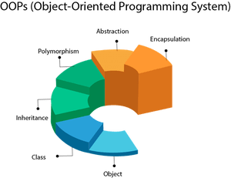
Object Oriented programming
A programming paradigm that leverages classes and objects and utilizes four programming principles (pillars): encapsulation, inheritance, abstraction and polymorphism.
picture credit:
francescolelli.info

Slide 23
EnCapsulation
Encapsulation is the idea that we want to keep data private. We use the principle of encapsulation so that users will be unable to access and modify the code. By using encapsulation, we can provide security to the application and prevent misuse.
The access modifier private declares a field or member variable as private and will only be able to be accessed within the class, unless public getter methods (a getter is a method that reads the value of a variable) are present in the class.
Example from program: This makes it so that no one can modify the size of the GUI window.
From the GameDriver class:
//window size variables:
privare final int gameWindowWidth = 1000; //private encapsulates this variable so it is only available in the GameDriver class
private final int gameWindowHeight = 800; //final prevents the field from being changed
private final Dimension screenSize = new Dimension (gameWindowWidth, gameWindowHeight); //creates a new instance of Dimension called screenSize with gameWindowWidth and gameWindowHeight as its parameters. Dimension is a class from java.awt

Slide 24
inheritance
Inheritance is the concept that we can take the functionality that is available in an already existing class and extend it to a new class. This allows us to reuse code, thereby reducing the amount of code needing to be written to achieve a desired outcome.
This is a very powerful concept in OOP because it allows us to access the properties of an existing class and implement them quickly and easily.
Example from program: This uses Jframe functionality to build the window of the GUI.
Public class Gamedriver extends JFrame {
Code that initializes JFrame:
this.setTitle(“TEKcamp Pong!”);
this.setSize(screenSize);
this.setResizable(false);
this.setVisible(true);
this.setBackground(Color.CYAN);
setDefaultCloseOperation(JFrame.EXIT_ON_CLOSE);

Slide 25
abstraction
Abstraction is another useful concept in OOP. When we use abstracting we are achieving three useful outcomes: simplifying, generalizing, and conceptualizing. By using a google map example:
By simplifying we are hiding the details. We don’t show everything on the map. By generalizing we are creating a class that can be used over and over again. In our map example, blue lines represent rivers. We can use the concept of blue lines for rivers over and over again. We can conceptualize a location on the map by placing a red dot in its location. Obviously the red dot is a representation, not reality.
In this example, Bike is an abstract class that contains only one abstract method ride. Its implementation is provided by the Trek class.
abstract class Bike{
abstract void ride();
}
class Trek extends Bike{
void run(){System.out.println("riding safely");}
public static void main(String args[]){
Bike obj = new Trek();
obj.run();
}
}

Slide 26
polymorphism
Polymorphism is a useful concept in that it allows us to reuse code – we can reuse methods of an existing class when we create a new class. When a method in a subclass has the same name, same parameters or signature, and same return type(or sub-type) as a method in its super-class, then the method in the subclass is said to override the method in the super-class.
Example from Program: This is the method required for the Runnable interface that is being implemented by the Ball class.
@Override
public void run() { //method from the Thread class
try{
while(true) { //always true: infinite loop – keeps game going by continually calling this method
move();
Thread.sleep(50); //50 milliseconds to allow for computer multitasking
}
} catch (exception e) {
System.err.println(e.getMessage()); when an exception occurs, prints error message to console
}
}
}

