Slide 1
Inventory & Warehouse Management System
Python based MySQL Project
By- Nisit Kumar Mohanty
Email- mnisitkumar@gmail.com
Github- https://github.com/november17mike

Slide 2
Overview
This project implements a warehouse inventory tracking system with a MySQL backend and a Python frontend to manage stock levels across multiple warehouses, suppliers, and products.
It shows a prototypical approach to the real life logical way of warehouse management.

Slide 3
Tools Used:
Python (frontend)
MySQL (backend)
SQLAlchemy
Faker
Matplotlib
Seaborn

Slide 4
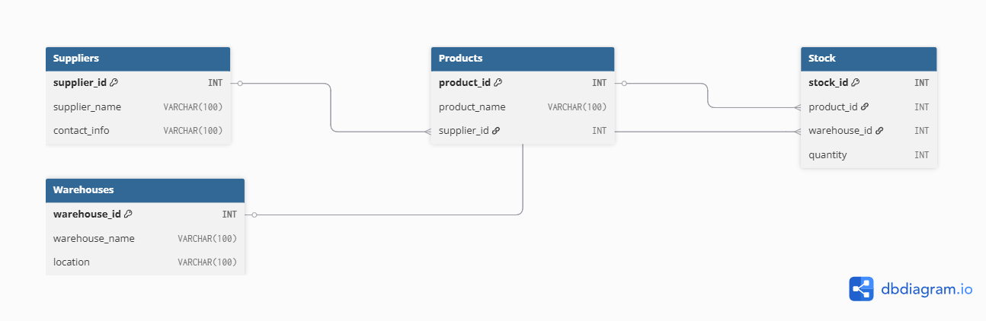
Database Schema
Tables:
1. Products
2. Warehouses
3. Suppliers
4. Stock

Slide 5
Features & Functionalities
Shows current stock alerts
Stock distribution per warehouse (Pie Chart)
Stock count per product in warehouse (Bar Chart)
Transfer stock between warehouses
Alert if stock < 100 units
Provides a menu-driven interface

Slide 6
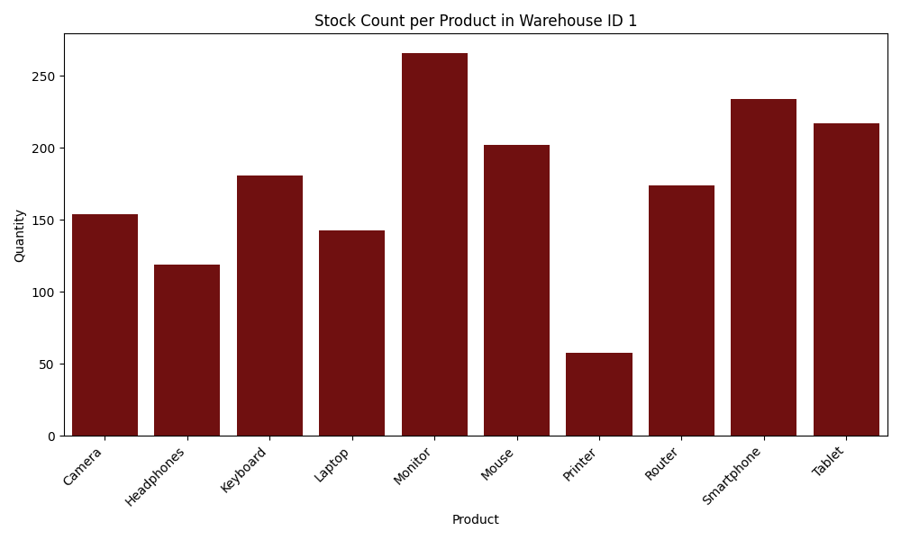
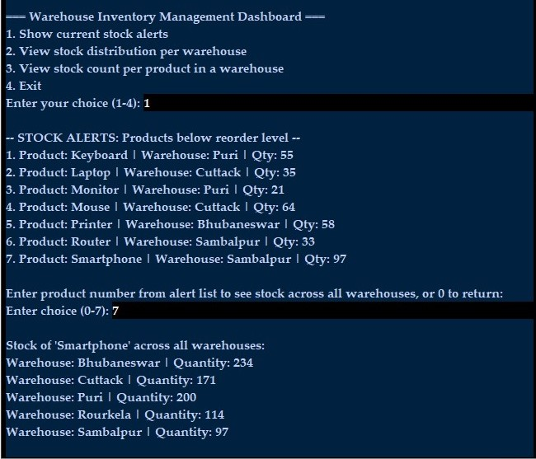
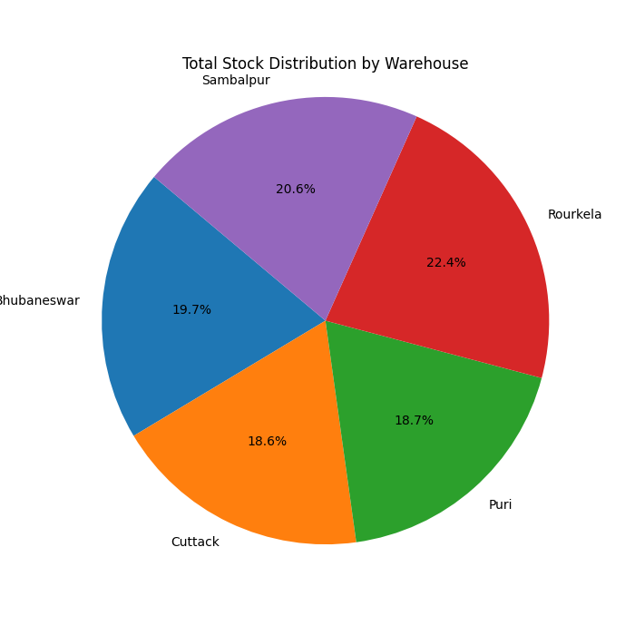
Sample Visualizations:

Slide 7
Future Improvements
Real-time stock updates and alerts
Web frontend using Flask
Export reports to PDF/Excel
Integration with retail sales dashboard
Advanced analytics and forecasting

