Slide 1

UPSCALE · WORKING-PACKAGE UPDATE · SWITZERLAND VEGETATION PILOT
Two routes to a national
vegetation-condition product
Copernicus Sentinel-2 L2A and swissEO S2-SR compared for July 2024
Normand Overney · ITES, ETH Zürich · 08.09.2026 · TerraVault pilot, UPSCALE project
ITES · UPSCALE · Working Package 4
08.09.2026
Notes:
One month, one country, two independent processing routes. The pilot asked whether both give the same national picture and what each costs to run. Short answer: they agree nationally, and swissEO is about 2.2x faster end to end.

Slide 2
What was compared
Two independently produced July 2024 products, standardised to the same Swiss cutline, the same physical reflectance definition and the same four index equations.
Sentinel-2 / Copernicus L2A
swissEO S2-SR
65 scenes
520 downloaded band and mask assets
16 products
every published same-orbit mosaic for July 2024
≤ 20 % cloud
mean catalogue cloud of accepted scenes 11.64 %
43.2 % masked
mean source-reported percent_masked
SCL + CLD
invalid SCL classes dropped, CLD ≤ 30 %
Published masks
cloud, cloud-shadow and terrain-shadow bands
Local archive
starts from downloaded L2A assets
Remote COGs
read live from the swisstopo STAC API
Identical downstream contract — applied after each route reaches physical surface reflectance
Switzerland national cutline · July 2024 · EPSG:2056 · 20 m · 17,423 × 11,034 px · Float32 COG, nodata −9999 · NDVI, GNDVI, NDRE and NDWI from one shared set of equations
A third route, native FORCE BOA/QAI, was run for July 2024 but excluded from this comparison — see the appendix.
ITES · UPSCALE · Working Package 4
08.09.2026
2
Notes:
Same boundary, same grid, same equations. What differs is upstream: 65 locally downloaded scenes versus 16 published orbit mosaics, and two different quality-mask definitions. The 11.6 % and the 43.2 % are not the same quantity and must not be compared directly.

Slide 3
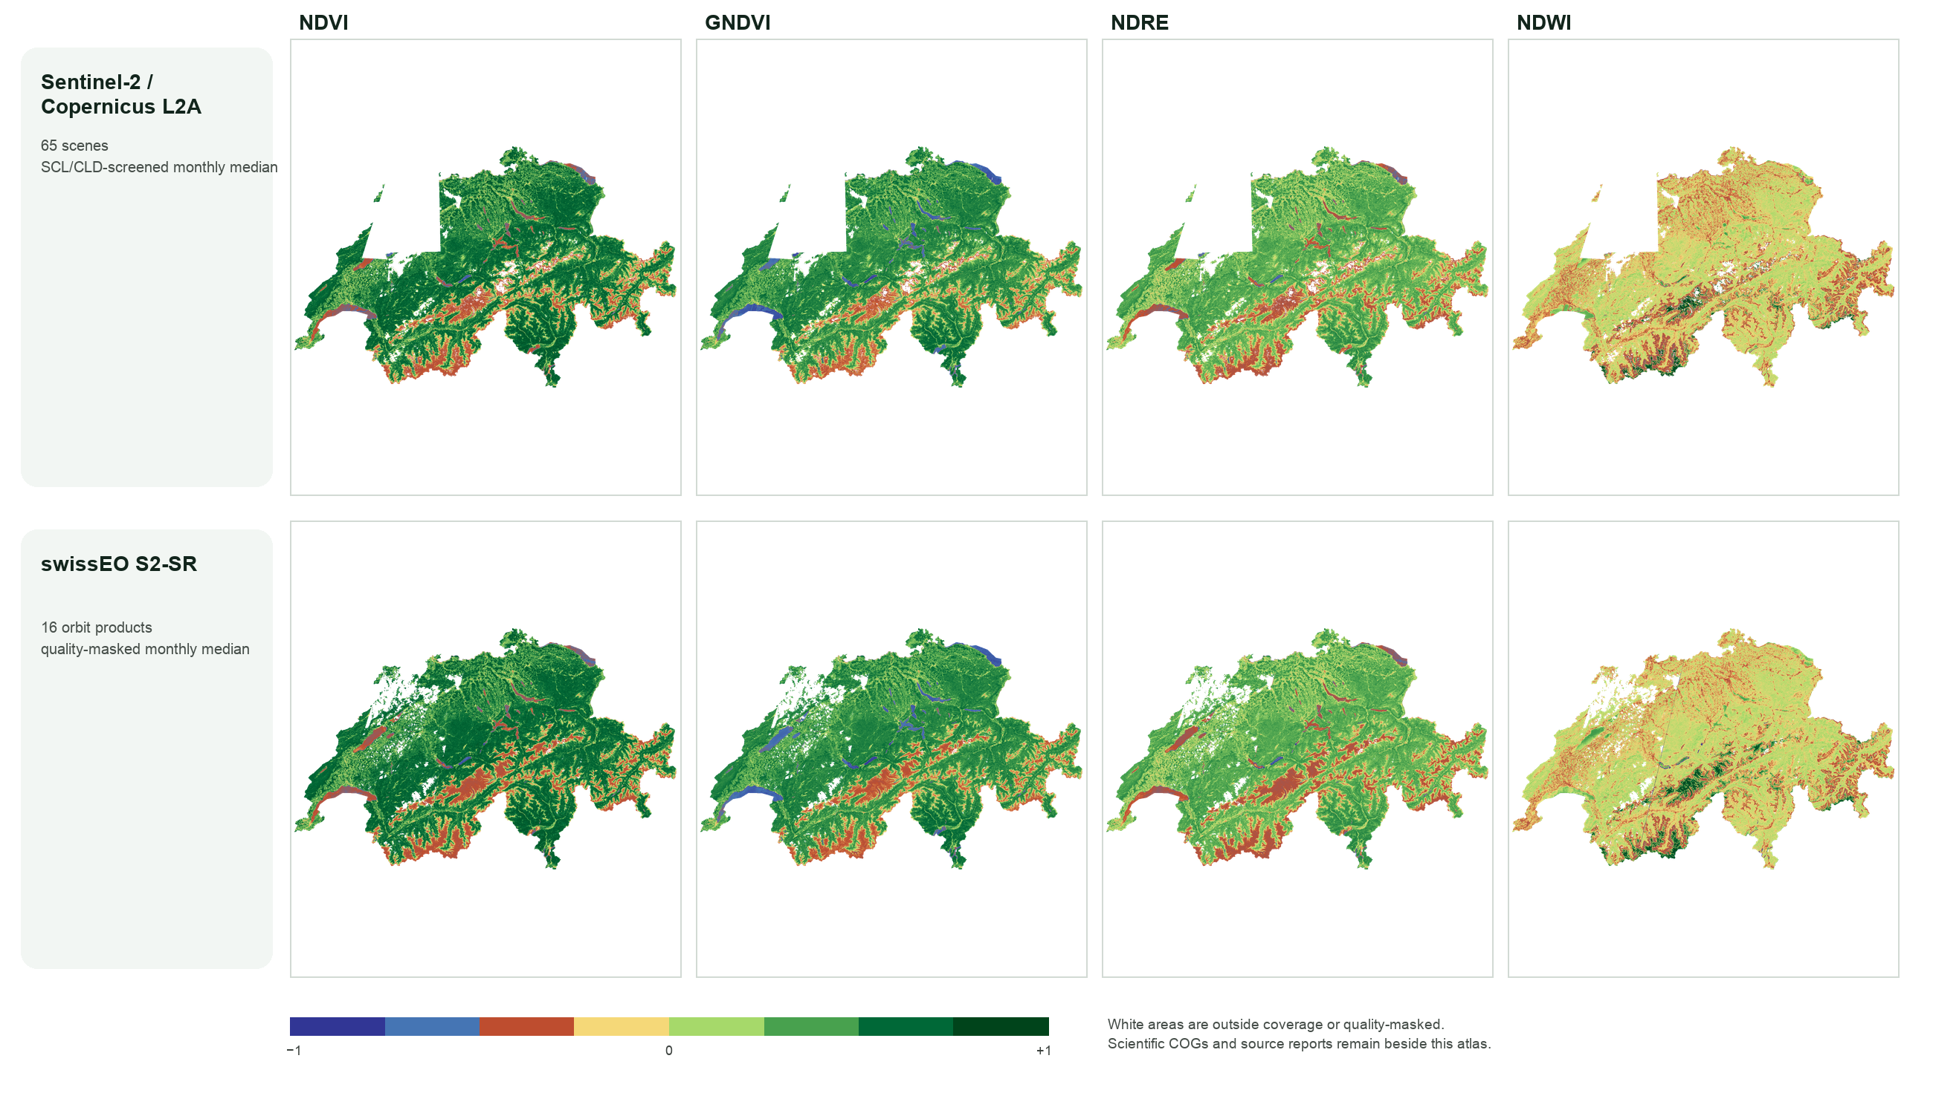


Both routes give the same national picture
Same spatial pattern
Strong positive vegetation signal across the lowlands and forested regions, lower values in the high Alps.
Water clearly separated
Lakes and rivers sit at the negative end of the NDVI, GNDVI and NDRE scales in both products.
Gaps differ
Copernicus shows one rectangular gap in the west/northwest; swissEO's gaps are more fragmented.
All eight panels share the Swiss cutline, the 20 m grid and one fixed −1 to +1 colour scale.
ITES · UPSCALE · Working Package 4
08.09.2026
3
Notes:
The headline result. Eight panels, four indices, two sources, one colour scale. The agreement is qualitative and national. The white areas are the interesting part and the next slide is about them.

Slide 4
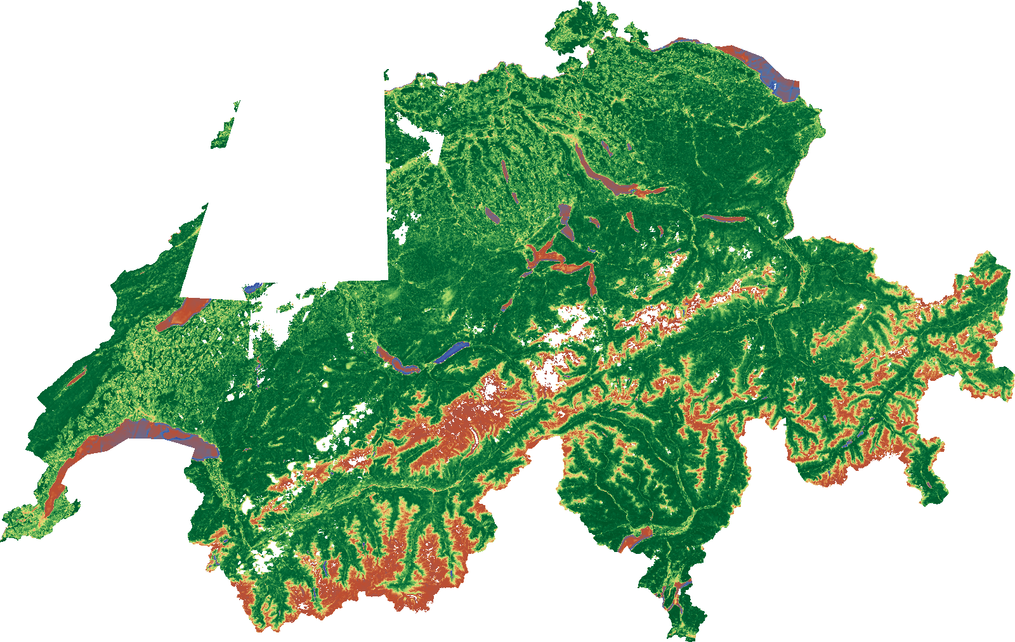
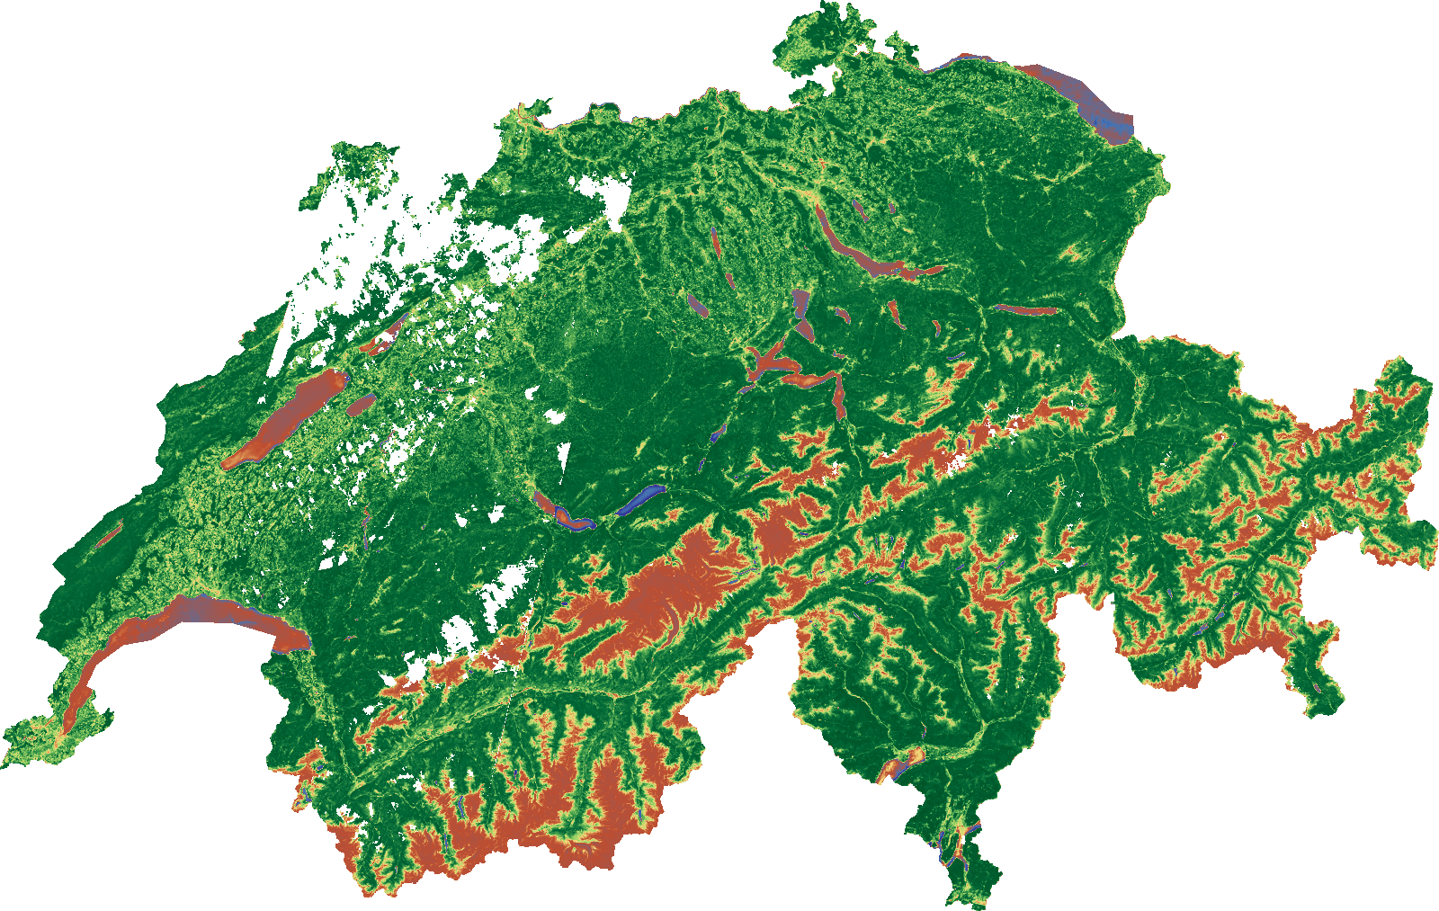
Where they differ is coverage, not vegetation
NDVI, JULY 2024 — SAME SCALE, SAME CUTLINE
Copernicus Sentinel-2 L2A
swissEO S2-SR
Read the white areas as masking, not as vegetation change
Cloud, cloud shadow, terrain shadow, snow, nodata and source-orbit coverage all remove pixels. The two routes use different quality masks, so their gaps are expected to differ. A formal cross-source coverage percentage was not computed for this lightweight atlas.
ITES · UPSCALE · Working Package 4
08.09.2026
4
Notes:
The rectangular notch in the Copernicus panel is a coverage artefact of the accepted scene set, not a dead zone. This is the caveat to repeat if anyone reads the atlas as a change map.

Slide 5
What each route cost to run
MEASURED ON THE SAME MACHINE AND MONTH
Stage | Copernicus L2A | swissEO S2-SR
Input units | 65 scenes | 16 orbit mosaics
Monthly mosaic | 136.6 min | 65.5 min
Four vegetation indices | 2.5 min | 5.7 min
Complete monthly command | 156.3 min | 71.3 min
2.2×
longer for the complete Copernicus monthly command
COPERNICUS INDEX STATISTICS
mean std. dev.
NDVI
0.616
0.309
GNDVI
0.543
0.305
An operational benchmark, not a speed test.
NDRE
0.446
0.231
The routes start from different upstream products, so input counts, retrieval scope and mask definitions differ. The Copernicus figure excludes the earlier L2A download phase; the swissEO figure includes network transfer from remote COGs.
NDWI
0.235
0.196
ITES · UPSCALE · Working Package 4
08.09.2026
5
Notes:
swissEO wins end to end because it starts from already-assembled mosaics; Copernicus is faster at the index stage. Both numbers are real measurements but they are not a controlled comparison of algorithms.

Slide 6


Where the pilot stands
All four scientific COGs were inspected after publication. COG layout, DEFLATE compression, internal cubic overviews, Float32 pixels, EPSG:2056, 20 m on the 17,423 × 11,034 grid, nodata −9999 on every band, and index values bounded to −1…+1 for valid pixels.
Both routes are usable
swissEO is the cheaper route
They agree on the national vegetation pattern for July 2024.
About 2.2× faster end to end and needs no local L2A archive.
Copernicus keeps mask control
One gap remains
Full control of the screening policy, and a faster index stage.
No quantified cross-source coverage or agreement statistic yet.
Next: quantify cross-source coverage and difference statistics, extend beyond July 2024, and decide whether FORCE is revisited under a storage preflight.
swissEO attribution required on any reuse: © swisstopo, Contains modified Copernicus Sentinel data 2024.
ITES · UPSCALE · Working Package 4
08.09.2026
6
Notes:
Validation is done and clean. The open item is a number for how much the two products actually agree, pixel by pixel — that is the natural next task.

Slide 7
SUMMARY
Two routes, one consistent national picture
Copernicus L2A and swissEO S2-SR agree on Switzerland's July 2024 vegetation condition. Their differences are coverage and masking, not vegetation. swissEO is the cheaper monthly route; Copernicus keeps full control of the mask.
65 scenes vs 16 mosaics
20 m · EPSG:2056
2.2× faster end to end
4 validated COGs
Full report, manifests and logs remain on the upscale share. · Normand Overney · ITES, ETH Zürich
ITES · UPSCALE · Working Package 4
08.09.2026
Notes:
Close on the finding, not the machinery. Offer to walk through the FORCE appendix if anyone asks why there are only two sources.

Slide 8
Appendix — where the composites and images live
Mounted root
/Volumes/upscale/working_package_4/terravault/ SMB share ites-formdata.ethz.ch/upscale
Monthly composite rasters — the high-resolution product
Report images — previews rendered from those rasters
data/copernicus-monthly/year=2024/month=07/
reports/switzerland-monthly-2024/
switzerland_copernicus_l2a_2024_07_20m_reflectance.tif
2.3 GB
comparison-atlas-copernicus-vs-swisseo-2024-07.png
2600×1600
switzerland_copernicus_l2a_2024_07_20m_indices.tif
1.6 GB
sources/sentinel-copernicus/year=2024/month=07/
switzerland_copernicus_l2a_2024_07_20m.manifest.json
51 KB
ndvi.png gndvi.png ndre.png ndwi.png
1600×1013
data/swisseo-monthly/year=2024/month=07/
sources/swisseo/year=2024/month=07/
switzerland_swisseo_s2_sr_2024_07_20m_reflectance.tif
1.9 GB
ndvi.png gndvi.png ndre.png ndwi.png
1600×1013
switzerland_swisseo_s2_sr_2024_07_20m_indices.tif
1.7 GB
switzerland_swisseo_s2_sr_2024_07_20m.manifest.json
5.9 KB
sources/*/year=2024/month=07/
data/roi/
summary.json
per-source stats
switzerland-boundary.geojson
4.3 MB
logs/
copernicus-*-2024-07.log swisseo-2024-07.log
run logs
Reflectance rasters carry B03, B04, B05, B08, B8A and B11; index rasters carry NDVI, GNDVI, NDRE and NDWI. Every path needs the upscale share mounted.
ITES · UPSCALE · Working Package 4
08.09.2026
8
Notes:
Atlas SHA-256: 887540f7ede7d5859ee0c70107480cc13fa4dfac6780c9c416900700db9e6343. The .tif files are the scientific product at 20 m — those are what to open in QGIS or GDAL. The PNGs in the reports tree are previews rendered from them, not the data. Everything needs the upscale share mounted at /Volumes/upscale. The manifests carry the processing contract and provenance.

Slide 9
Appendix — FORCE was run, then excluded
FORCE was genuinely executed for July 2024. Level-2 processing completed; the monthly national aggregation did not.
What completed
Native ARM64 FORCE processed all 83 Sentinel-2 L1C tile-scenes to Level-2, giving 83 BOA/QAI scene mosaics and 1,403 FORCE 30 km tiles. One corrupt B12 JP2 was re-fetched from the public AWS archive, validated and reprocessed.
Where it stopped
The monthly aggregation screened all 83 scenes, then materialised a six-band Float32 raster per scene and computed the median over the full 51,000 × 45,000-pixel union grid before clipping to Switzerland. It failed with “No space left on device”.
129 GB
247 GB
> 58 GB
> 434 GB
Level-2 BOA/QAI inputs
83 screened temporary rasters
union-grid median at failure
workspace observed near failure
Run started 02.09.2026 21:38 CEST and failed 03.09.2026 14:34 CEST — a July-only run; the cost came from full-grid intermediates.
ITES · UPSCALE · Working Package 4
08.09.2026
9
Notes:
Important for credibility: FORCE was not skipped, it was run and it broke on storage, for an identifiable implementation reason rather than a fundamental one.

Slide 10
Appendix — FORCE: decision and conditions for a revisit
FORCE was excluded from the pilot because the extra compute and storage were not justified for a two-source comparison.
What was kept and what was removed
The generated FORCE datasets were deleted from the local workspace and the upscale share. They are not recoverable in place but can be regenerated from source data. FORCE source code and configuration remain in the repository, and the images terravault/force:3.10.04-arm64-native and terravault/force:3.10.04-arm64 were retained.
THREE CHANGES REQUIRED BEFORE FORCE IS RUN AGAIN
1
2
3
Clip before materialising
Bounded median
Storage preflight
Clip every scene to the Swiss target extent before writing any full raster.
Replace the full-grid median with a bounded or streaming computation.
Refuse to start unless a projected peak-storage check passes.
ITES · UPSCALE · Working Package 4
08.09.2026
10
Notes:
The exclusion is reversible and cheap to revisit, provided the aggregation is rewritten to clip first and to refuse to start without a storage preflight.

