Slide 1

Patron Relations
Old Town Historical Society

Slide 2
Learning Objectives
Guide patrons effectively through archive navigation and finding aids
Assist patrons with digital tools and technology resources
Implement accessibility and inclusivity best practices
Apply professional customer service skills in archive settings
Handle challenging patron situations with confidence

Slide 3
Patron Orientation Process
Initial Consultation:
Discuss research goals and topics
Collection Assessment:
Identify relevant holdings
Finding Aid Review:
Walk through relevant finding aids
Material Retrieval:
Explain request procedures
Research Space Tour:
Orient to facilities and policies

Slide 4

Navigation Assistance
Ask open-ended questions to understand research needs
Explain the difference between archives and libraries
Demonstrate how to interpret finding aids
Provide realistic timelines for material retrieval
Offer alternative collections when primary
sources aren't available
Notes:
Photo credit: Stock image from PowerPoint

Slide 5

Finding Aids and Research Tools
Finding aids are the roadmap to archival collections
Collection Overview: Scope, dates, and significance
Biographical/Historical Note: Context about the creator
Series Descriptions: How materials are organized
Container Lists: Box-by-box, folder-by-folder inventory
Notes:
Photo credit: Stock image from PowerPoint

Slide 6
Digital Catalog Systems
Catalog Search Techniques:
Boolean operators, field searching, filters
Database Navigation:
Moving between records, saving searches
Digital Collections:
Accessing online materials and metadata
Cross-Platform Searching:
Using multiple databases effectively

Slide 7
Patron Technology Support
Basic Computer Skills:
File management, printing, saving
Digital Camera/Scanner Use:
Reproducing archival materials
Online Research:
Database searching, digital collections
Equipment Troubleshooting:
Basic technical support

Slide 8
Digital Preservation Awareness
Why some materials may not be available digitally
Copyright and use restrictions
Quality standards for digital reproduction
Long-term preservation considerations

Slide 9
Implementing Technology Training
Provide hands-on practice with all patron-facing systems
Create quick reference guides for common tasks
Establish protocols for technical difficulties
Maintain updated equipment and software

Slide 10
Understanding Accessibility Needs
Physical Disabilities:
Mobility challenges, wheelchair access
Visual Impairments:
Magnification needs, screen readers
Hearing Impairments:
Communication accommodations
Cognitive Differences:
Processing time, instruction clarity
Temporary Limitations:
Injuries, medical conditions

Slide 11
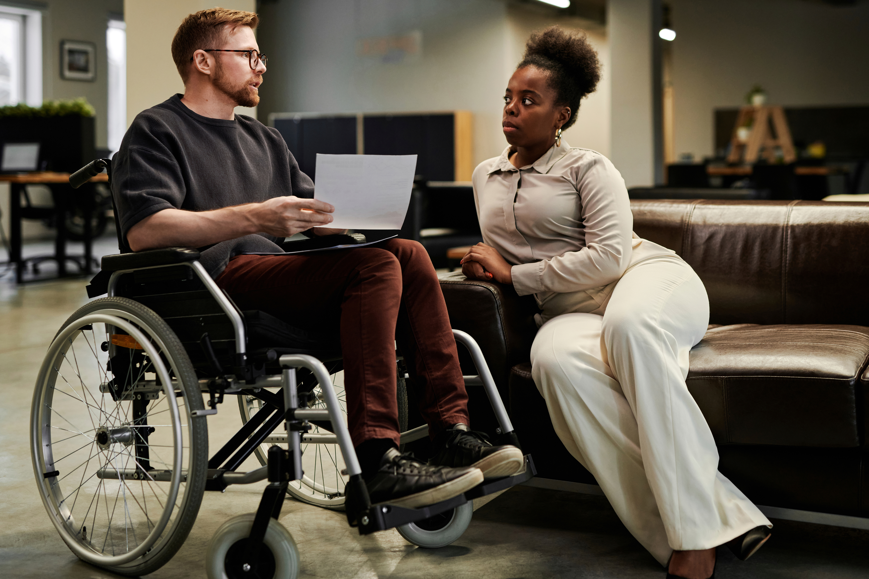
Physical Accessibility
Ensure research spaces accommodate:
Wheelchair access to all public areas
Adjustable tables and seating
Adequate lighting and magnification tools
Clear pathways and signage
Accessible restrooms and facilities
Notes:
Photo credit: Stock image from PowerPoint

Slide 12

Digital Accessibility
Online resources should include:
Screen reader compatibility
Keyboard navigation options
Alternative text for images
Captioned videos and audio
Multiple format options
Notes:
Photo credit: Stock image from PowerPoint

Slide 13
Inclusive Service Approaches
Use person-first language
Ask before providing assistance
Respect assistive devices and personal space
Offer multiple communication methods
Provide extra time when needed
Create welcoming, non-judgmental environments

Slide 14
Cultural Sensitivity
Historical societies serve diverse communities. Staff should:
Recognize
Recognize potential cultural barriers
Understand
Understand sensitive historical topics
Provide
Provide context for historical materials
Respect
Respect different research approaches
Acknowledge
Acknowledge gaps in historical records

Slide 15
Professional Communication
Active Listening:
Understanding patron needs completely
Clear Communication:
Explaining procedures and limitations
Patience:
Allowing time for questions and learning
Empathy:
Recognizing research frustrations
Professionalism:
Maintaining appropriate boundaries

Slide 16
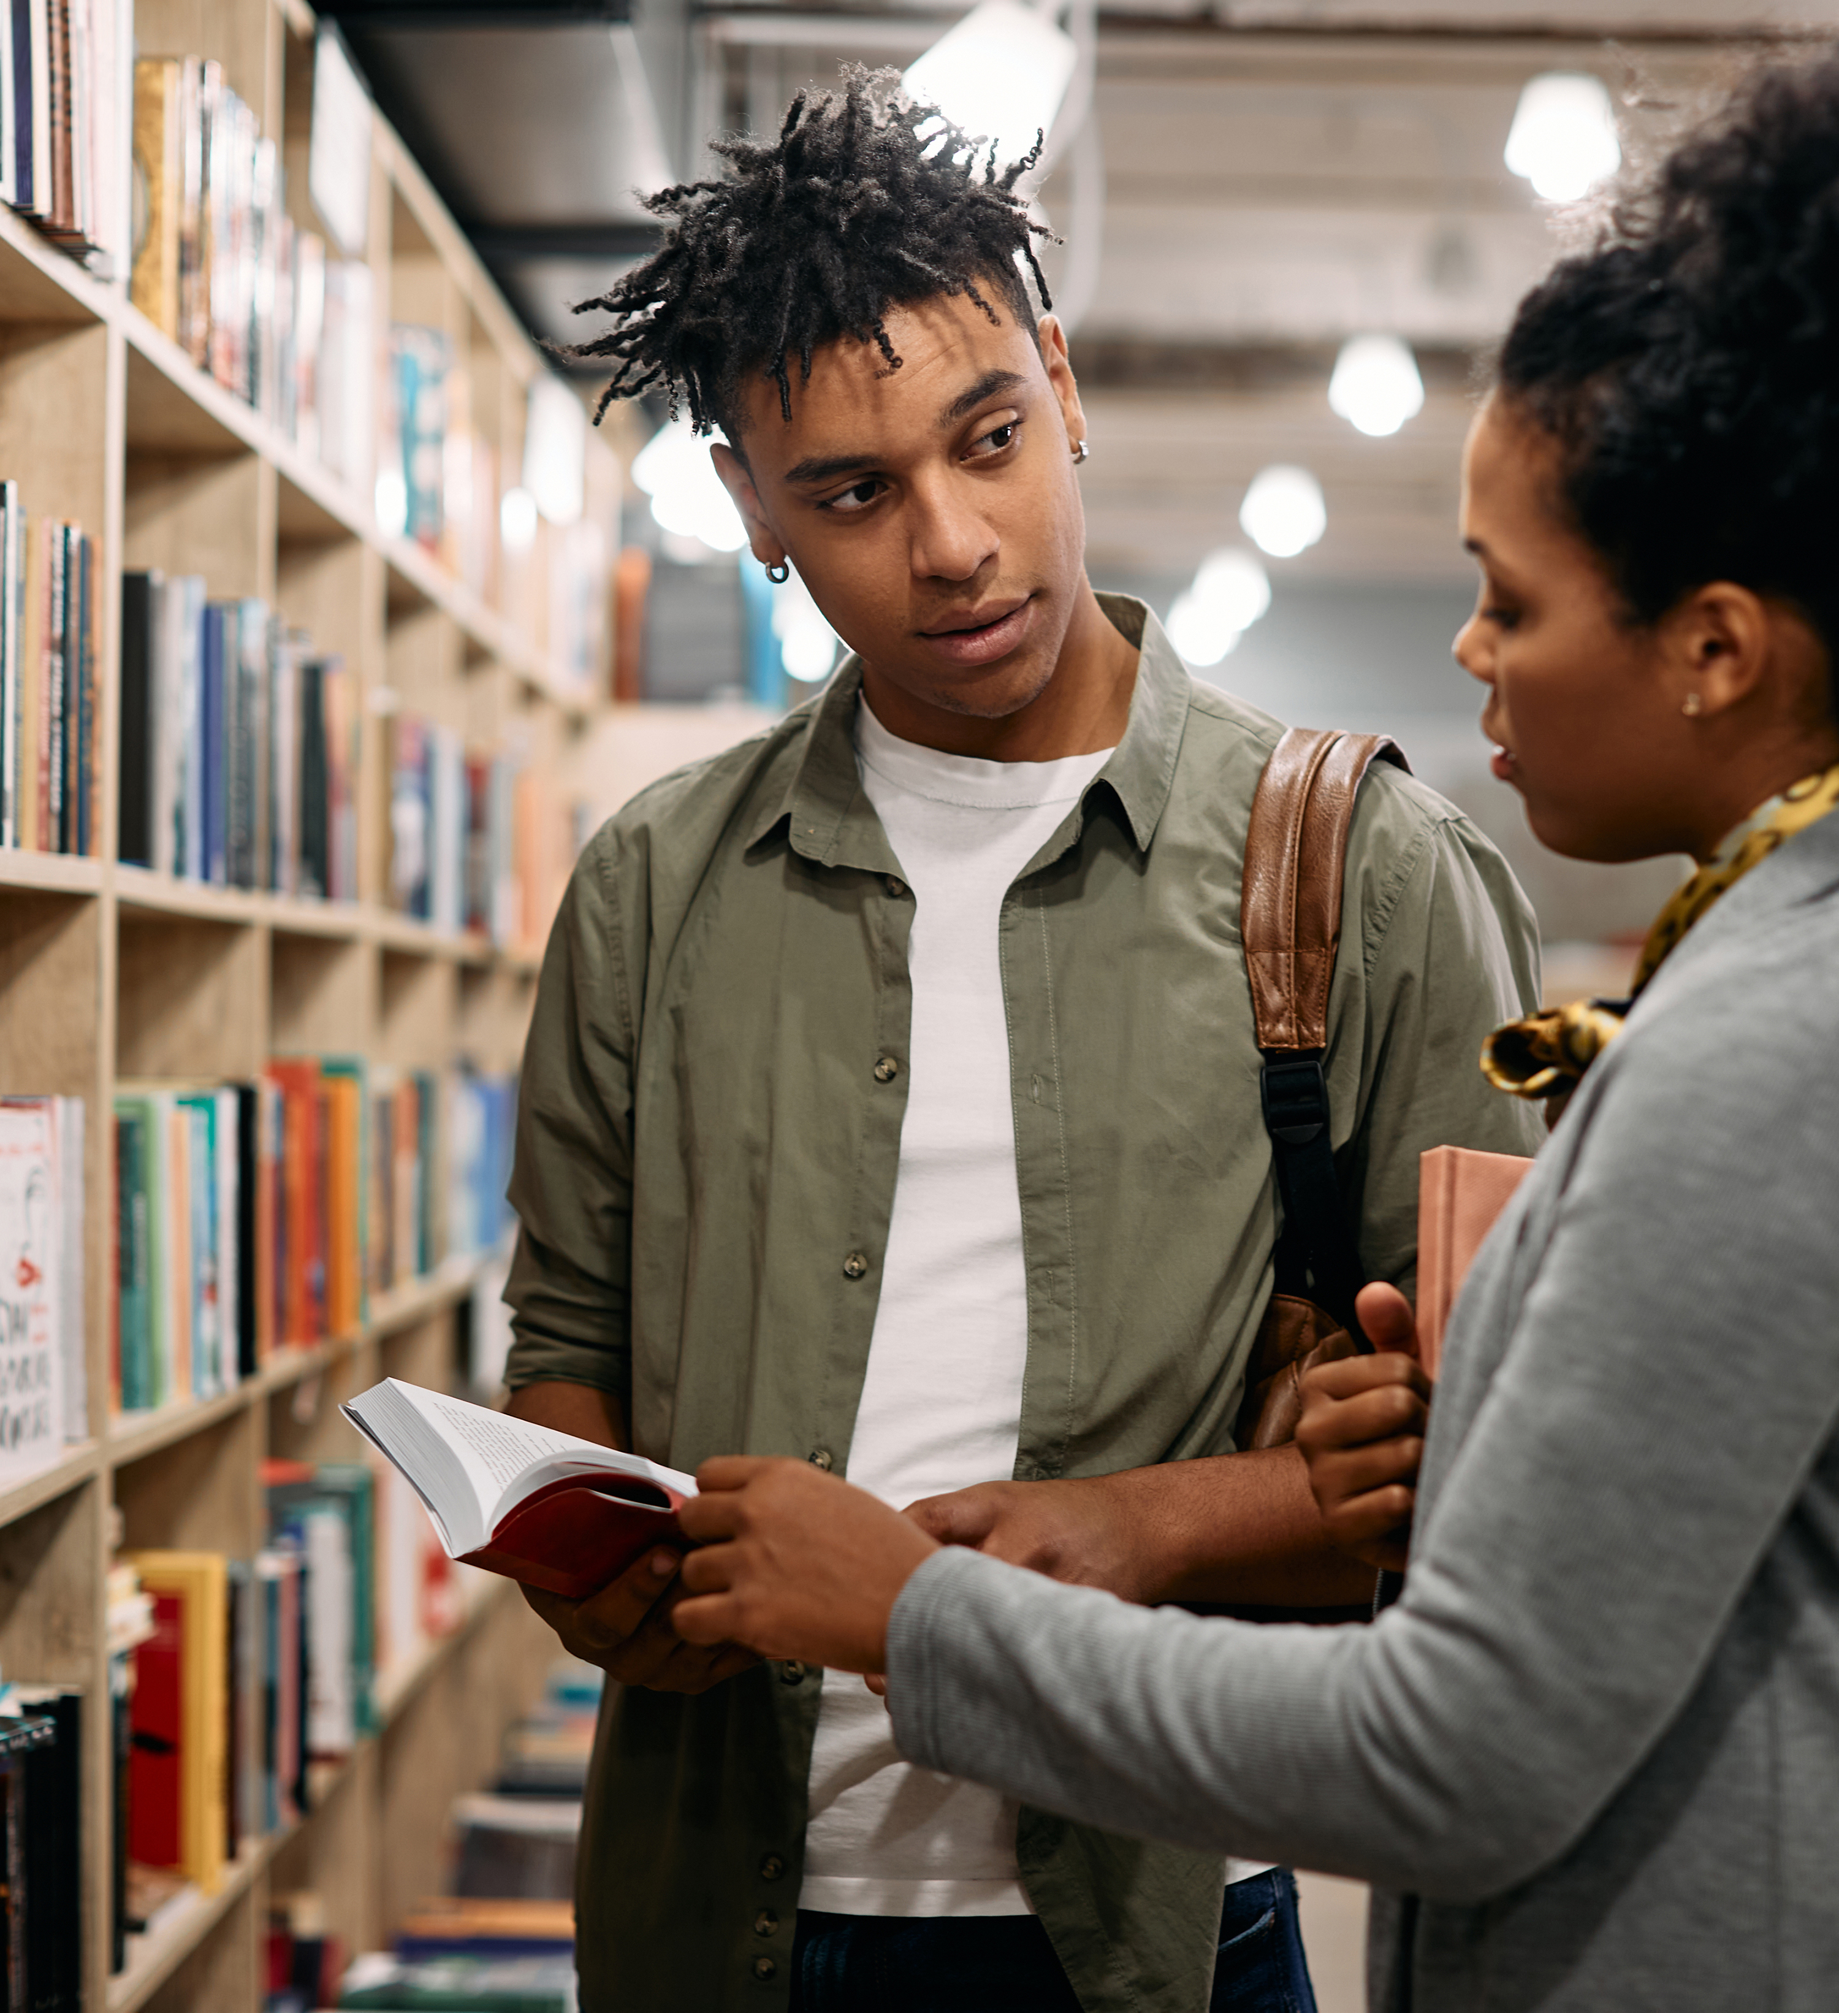
Managing Patron
Expectations
Time Requirements: Research takes longer than expected
Material Availability: Not everything is digitized or accessible
Copyright Restrictions: Limitations on reproduction
Collection Scope: Archives may not have everything patrons need
Processing Times: New acquisitions may not be available immediately
Notes:
Photo credit: Stock image from PowerPoint

Slide 17
Handling Difficult Situations
Unrealistic Demands:
Wanting immediate access to restricted materials
Frustration with Technology:
Difficulty using digital systems
Disagreement with Policies:
Questioning access or reproduction rules
Time Pressure:
Rushed research timelines
Emotional Responses:
Strong reactions to historical materials

Slide 18
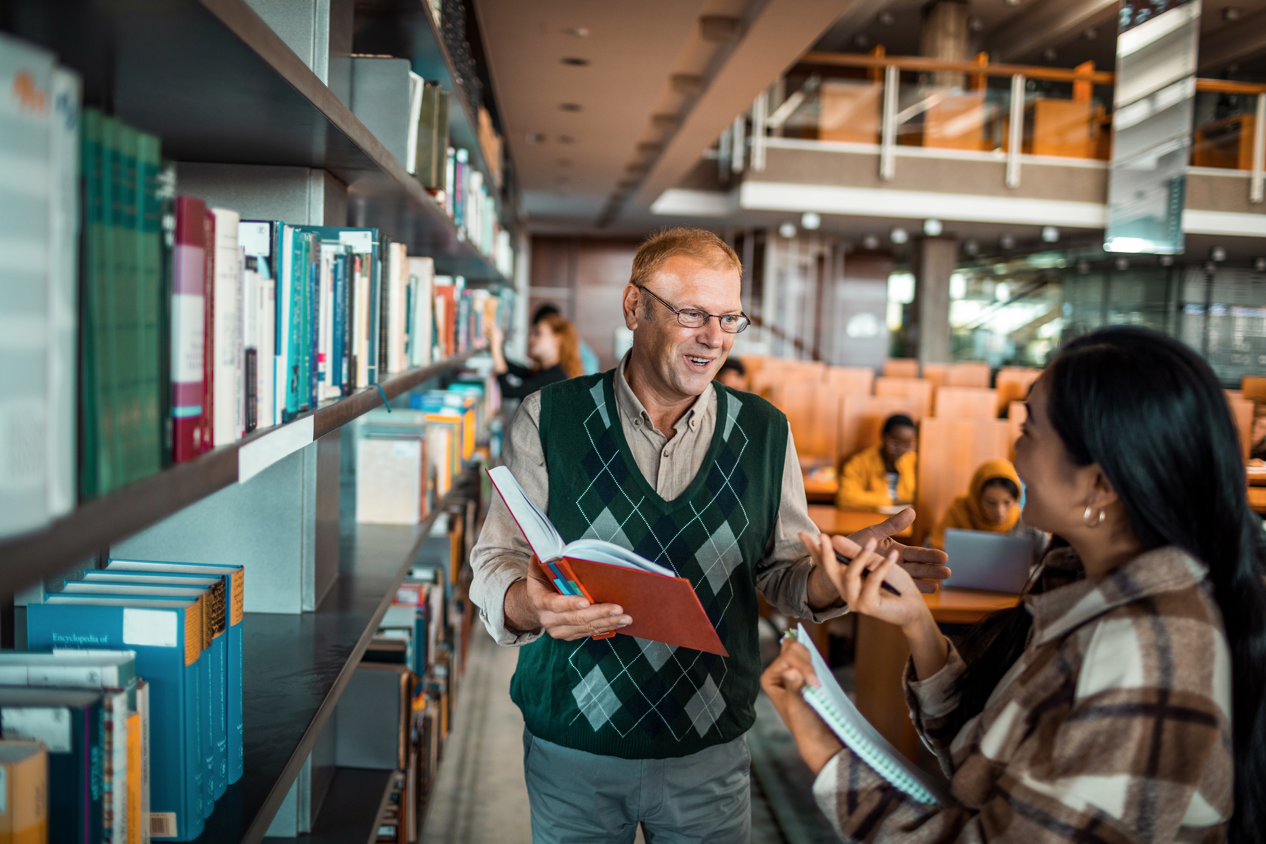
De-escalation Strategies
Remain Calm: Keep your voice steady and professional
Listen Actively: Let patrons express their concerns fully
Acknowledge Feelings: Validate their frustration
Focus on Solutions: Explore alternatives within
policies
Know When to Escalate: Involve supervisors
when necessary

Slide 19
Building Positive Relationships
Consistent Service:
Reliable, professional interactions
Personal Interest:
Showing genuine enthusiasm for their research
Follow-up:
Checking in on research progress
Resource Sharing:
Suggesting additional materials or repositories
Feedback:
Asking for input on services and improvements

Slide 20
Implementation
Staff Development
*Regular Training Sessions: Monthly skill-building workshops
*Peer Mentoring: Pairing experienced staff with new hires
*Professional Development: Attending conferences and workshops
*Cross-Training: Ensuring multiple staff can handle various tasks
*Performance Feedback: Regular evaluation and improvement planning
Policy Development
Create clear, written policies for:
* Patron Relations and orientation
*Material access and handling
*Technology use and support
*Accessibility accommodations
*Customer service standards

Slide 21
Implementation
Quality Assurance
*Patron Feedback: Regular surveys and comment opportunities
*Staff Observations: Periodic evaluation of patron interactions
*Service Metrics: Tracking satisfaction and efficiency
*Continuous Improvement: Regular policy and procedure updates
Emergency Procedures
Staff should be prepared for:
*Medical emergencies in research spaces
*Technology failures during patron visits
*Difficult patron situations requiring intervention
*Natural disasters or building emergencies

Slide 22
Thank You!
"Alone we can do so little;
together we can do so
much."
— Helen Keller

