Slide 1
Named-Entity Recognition for Swedish
Past, Present and Way Ahead...
Dimitrios Kokkinakis

Slide 2
Outline
Looking Back: AVENTINUS, flexers,...
Current Status & Workplan:
  Resources: Lexical, Textual and Algorithmic
  NER on Part-of-Speech Annotated Material
  Way Ahead, Approach and Evaluation Samples
Resource Localization (if required...)
NE Tagset and Guidelines
Survey of the Market for NER: Tools, Projects,...
Problems: Ambiguity, Metonymy, Text Format (Orthography, Source Modality...)...

Slide 3
Looking Back...
NER in the AVENTINUS project (LE4) without lists
No proper evaluation on a large scale
Collection of a few types of resources; e.g. appositives
Method: finite-state grammars ’semantic grammars’; one for each category
Delivered rules (for Swedish NER) that were compiled in a user-required product
See Kokkinakis (2001): svenska.gu.se/~svedk/publics/swe_ner.ps for a grammar used for identifying ”Transportation Means”

Slide 4
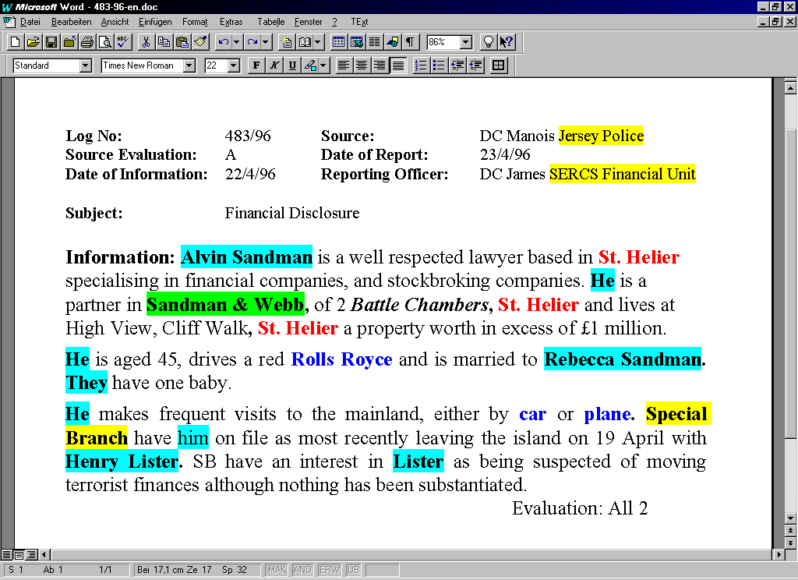
Snapshots from AVE₁
Police report from Europol

Slide 5
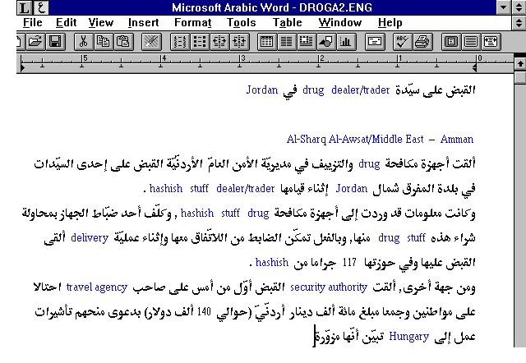
Snapshots from AVE₂

Slide 6
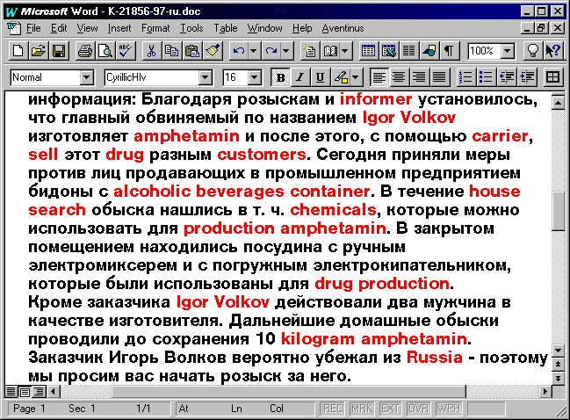
Snapshots from AVE₃

Slide 7
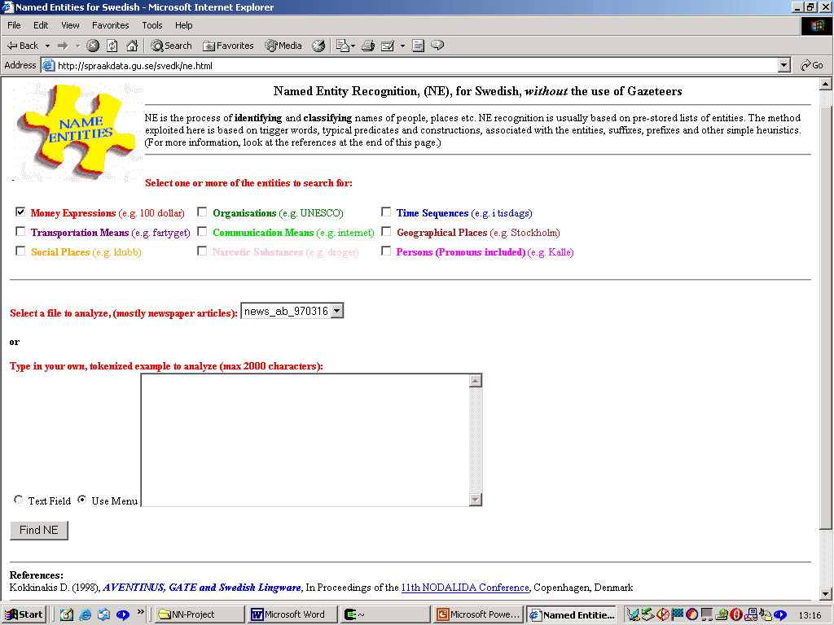
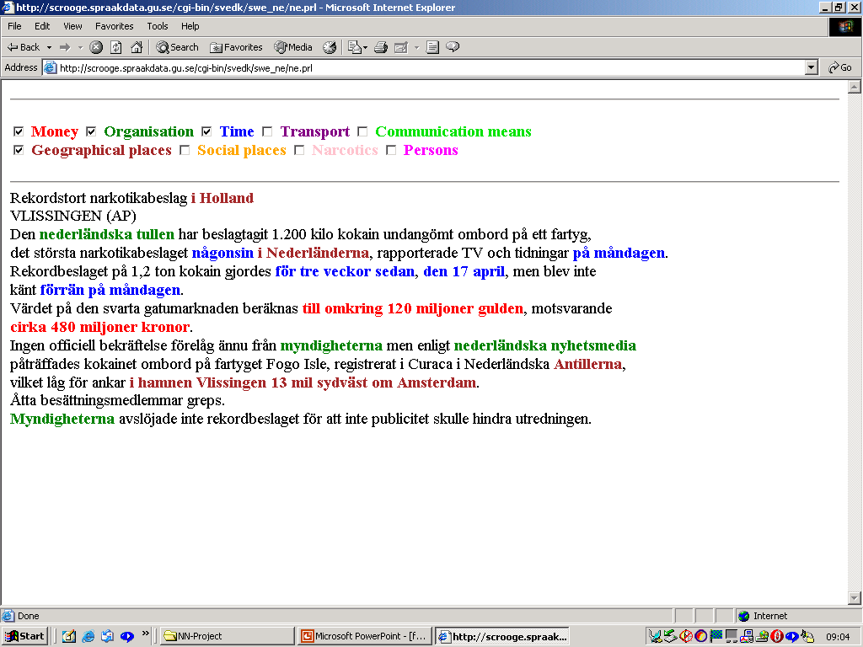
Swe-NER without Lists
How long can we go without lists?
......see the flexers example

Slide 8
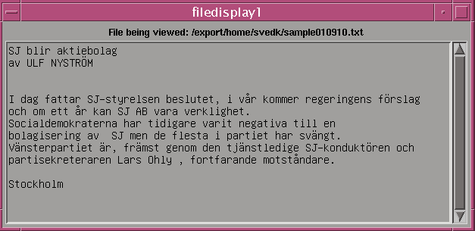
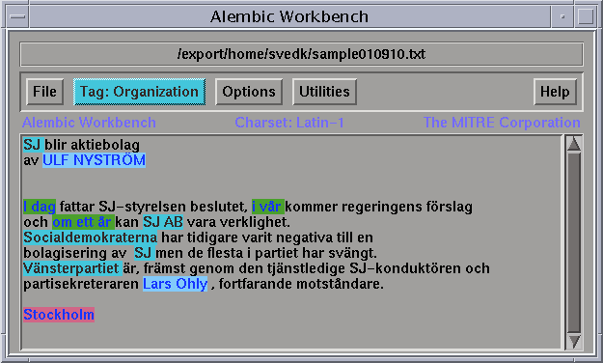
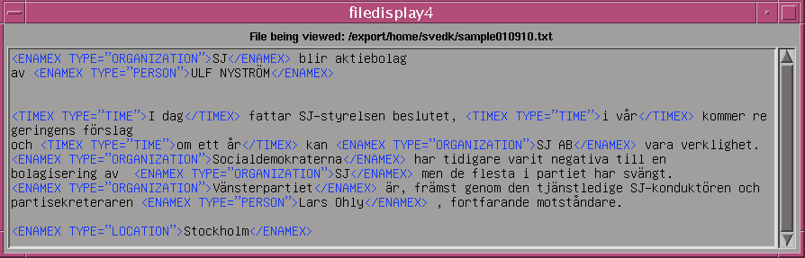
Swe-NER Evaluation Sample in AWB
See also SUC2

Slide 9
In the framework of...
my PhD, a collection of 35 documents was manually tagged; newspaper articles (30) & reports from a popular science periodical (5)
ENTITY | #AMOUNT | DOCUMENTS | 35
Persons | 419 (≈84f) | TOKENS | 20,927
Locations | 569 (≈89f) | PROPER NOUNS | 1,422
Organizations | 272 (≈83f)
Temporal | 504 (≈89f)
Monetary | 80 (≈97f)

Slide 10
Status & Workplan
  Resources
    Lexical, Textual and Algorithmic
  NER on Part-of-Speech Annotated Material
  Way Ahead, Approach and Evaluation Samples

Slide 11
Evidence
McDonald (1996):
Internal evidence: is taken from within the sequence of words that comprise the name, such as the content of lists of proper names (gazetteers), abbreviations and acronyms (Ltd, Inc., Gmbh)
External evidence: provided by the context in which a name appears – the characteristic properties or events in a syntactic relation (verbs, adjectives) with a proper noun can be used to provide confirming or criterial evidence for a name’s category – an important type of complementary information since internal evidence can never be complete...

Slide 12
Lexical Resources (1) (Internal Evidence)
Name Lists (Gazeteers)
Single names
Org/commerc.: 1,500
Person First: 70,000
Person Last: 5,000
Cities non-Swe.:2,200
Org/no-comm: 200
Provinces: 70
Airports: 10
Cities Swe.: 1,600
Countries: 230
Events: 10
...
Multiword names
Organizations (profit): 1,200
Organizations (non-profit): 60
Locations: 40

Slide 13
Lexical Resources (2) (Internal Evidence)
Designators, affixes, and trigger words
Titles, premodifiers, appositions...
e.g. organizations
e.g. persons
Design.& Triggers: bolaget X, föreningen X, institutet X, organisationen X, stiftelsen X, förbundet X,…
X Agency, X Biotech, X Chemical, X Consultancy ,…
Affixes:+kollegium,+verket,...
PostMods: Jr, Junior,…
PreTitles: VD, Dr, sir,…
Nationality: belgaren,
brasilianaren, dansken,…
Occupation: amiral,
kriminolog, psykolog,...

Slide 14
Lexical Resources (External Evidence)
the Volvo/Saab case (can be generalized)
a typical, frequent and fairly difficult example
For instance:
  ...Saab 9000...
  ...mellanklassbilar som Volvo,...
  ...att köra Volvo i en Volvostad som...
  ... i en stor svart Volvo och blinkade...
  ...tjuven försvinner i en stulen Saab
  ...tappat kontrollen över sin Volvo
  Volvo steg med 12 kronor
  Saab backade med 1 peocent
  ...gick Volvo ned med 10 kronor...
  .......
object: car
object: share
organization
...ignore infrequent cases and details →

Slide 15
Flexers Example
Sense1: object, the product (vehicle)
Morphology: number (singular/plural), case (nominative/genitive), definiteness
Samples: Volvon är billigare, singular, e.g. en svart Volvo ...
Corpus Analysis/Usage:
1. Saab/Volvo NUM
2. Saab/Volvo NUM?
(coupé|turbo|dieselcabriolet|corvette|transporter|cc|...)
3. (GENITIVE/POSS-PRN/ARTCL) ADJ/PRTCPL* Saab/Volvo NUM?
4. (GENITIVE/POSS-PRN/ARTCL)? ADJ/PRTCPL+ Saab/Volvo NUM?
5. bilar som Saab/Volvo
6. typen/kör/*köra Saab/Volvo
no rule without exception:
[Saab/Volvo TimeExpression; När Volvo 1994...]
>9 out of 10 cases

Slide 16
Flexers Example
Sense2: object, the share
Morphology: number (singular/plural), case (nominative/genitive), definiteness
Samples: Volvon har gått upp med...
Corpus Analysis/Usage:
1. Saab/Volvo AUX? VERB(steg/stig*/backa*)
2. Saab/Volvo AUX? VERB(öka*/minska*)? med NUM procent
3. Saab/Volvo gick (tillbaka kraftigt|mot strömmen|upp|ned)
4. Saab/Volvo NUM procent
Rest of cases? Sense3 the building <not found>
Rest of cases? Sense4 the organization

Slide 17
Flexers Example
CAR_TYPE (Saab|Volvo|Ford|...)/NP...
VERB (stiga|stiger|stigit|steg|backa[^/ ]+|...)/(VMISA|VMU0A|...)
AUX_VERB [^/ ]+/(VTISA|VTU0A|...)
MC [0-9][0-9]?[0-9]?/MC|[0-9][0-9]?[.,][0-9][0-9]?/MC
SPACE [ \t]+
{CAR_TYPE}{SPACE}({AUX_VERB}{SPACE})?{VERB}(”med/S ”{MC}{SPACE}procent)? {tag-as-sense2;}
{CAR_TYPE}{SPACE}{MC}{SPACE}procent {tag-as-sense2;}
{CAR_TYPE}{SPACE}gick{SPACE}(”tillbaka/ kraftigt”|”mot/S strömm”|”upp/”|”ned/”) {tag-as-sense2;}

Slide 18
SUC-2
The second version of SUC has been semi-automatically?? annotated with ”NAMES”
15131 PERSON
8771 PLACE
6309 INST
1887 WORK
638 PRODUCT
540 OTHER
364 ANIMAL
280 MYTH
245 EVENT
242 FORMULA
...årsmöte i <NAME TYPE=OTHER>
Kristiansborgskyrkan</NAME>…
Här har <NAME TYPE=ANIMAL>Nalle
</NAME> frukosterat...
...ber <NAME TYPE=MYTH>Herren
</NAME> välsigna vår...
...till nitrat ( <DISTINCT TYPE=FORMULA>
NO3-</DISTINCT> ) och därefter...

Slide 19
POS Taggers & Tagset
NER is a complex of different tasks; POS tagging is a basic
task which can aid the detection of entities
Three off-the-shelf POS taggers have been downloaded and are currently under development with our new tagset
TreeTagger: HMM + Decision Trees
TnT: Viterbi (HMM)
Brills: Transformation-based

Slide 20
POS Taggers & Tagset
The NER will be/is applied on part-of-speech annotated material. The relevant tags for marking proper nouns (as found in the training corpus-SUC2):
NPNSND | ...i Europa/NPNSND har inte...
NPNSGD | ...för Litauens/NPNSGD parlament där...
NPUSND | ...berättar Torgny/NPUSND Lindgren/...
NPUSGD | ...är Mona Eliassons/NPUSGD recept...
NP*SND | Ulf Norrman vann H-43/NP*SND...
XF | …vunnit en Grand/XF Slam/XF...
Y | ...ÖB/Y under kriget i Libanon...

Slide 21
Explore JAPE&GATE2
Java Annotation Pattern Engine (JAPE) Grammar
  Set of rules
    LHS regular expression over annotations
    RHS annotations to be added
    Priority
    Left and Right context around the pattern
  Rules are compiled in a FST over annotations

Slide 22
JAPE Rules
Rule: Location1
Priority: 25
(
({Lookup.majorType==loc_key,Lookup.minorType==pre}{SpaceToken})?
{Lookup.majorType==location}({SpaceToken}
{Lookup.majorType==loc_key,Lookup.minorType==post})?
)
:locName --> :locName.Location={kind=”location”,rule=”Location1”}
China
sea
location

Slide 23
Plan for (the rest of) 2002
January-April: inventory of existing L&A resources;
re-training of pos-taggers with språkdatas tagset;
localization, ’completion’& structuring of L-resources;
provision of (draft) guidelines for the NER task; working with ’WORK&ART’ and ’EVENTS’;
May-September: implementations; porting of old scripts to the current state-of-affairs; SUC2 with ML?; developing a Swedish JAPE module in GATE2
October: evaluation
November: new web-interface and GATE2 integration
December: wrapping-upp

Slide 24
Annotation Guidelines
First draft specifications for the creation of simple guidelines for the NER work as applied on Swedish data have been written
Ideas from MUC, ACE and own experience
The guidelines are expected to evolve during the course of the project, refined and extended
The purpose of the guidelines is to try and impose some consistency measures for annotation and evaluation, and giving the potential future users of the system a clearer picture of what the recognition components can offer
Pragmatic rather than theoretic...

Slide 25
Guidelines cont’d
Named Entity Recognition (NER) consists of a number of subtasks, corresponding to a number of XML tag elements
The only insertions allowed during tagging are tags enclosed in angled brackets. No extra white space or carriage returns are to be inserted
The markup will have the form of the entity type and attribute information:
<ELEMENT-NAME ATTR-NAME="ATTR-VALUE">a text-string</ELEMENT-NAME>
Six (+1) categories will be recognized ➔➔➔

Slide 26
“PLACE” NAMES
<ENAMEX TYPE=”G-PLC”>; Description: a (natural) geographically/geologically or astronomically defined location, with physical extent; such as bodies of water, rivers, mountains, geological formations, islands, continents, stars, galaxies, …
<ENAMEX TYPE=”P-PLC”>; Description: (geo-political entities) politically defined geographical regions; nations, states, cities, villages, provinces, regions, other populated urban areas …); e.g., the capital city is used to refer to the nation’s government e.g. USA attackerade X;
<ENAMEX TYPE=”F-PLC”>; Description: facility entities which are (permanent) man-made artefacts falling under the domains of architecture, transportation infrastructure and civil engineering; such as streets, parks, stadiums, airports, ports, museums, tunnels, bridges,…

Slide 27
“PERSON” NAMES
<ENAMEX TYPE=”H-PRS”>; Description: person entities are
limited to humans, fictional human characters appearing in TV,
movies etc.; christian, family names, nicknames, group names, tribes,…
<ENAMEX TYPE=”O-PRS”>; Description: Saints, gods, names of animals and pets,…
e.g. Herren, Gud, Athena, Ior,...

Slide 28
“ORGANIZATION” NAMES
<ENAMEX TYPE=”C-ORG”>; Description: organization entities are divided into two categories; the first is limited to commercial corporations, multinational organizations, tv-channels,…(both multiword and single word entities)
<ENAMEX TYPE=”G-ORG”>; Description: organization entities of the second groups are limited to governmental and non-profit organizations such as political parties, governmental bodies at any level of importance, political groups, non-profit organizations, unions, universities, embassies, army… (sport teams, music groups, stock exchanges, orchestras, churches,...)?

Slide 29
“EVENT” NAMES
<ENAMEX TYPE=”EVN”>; Description: Historical, sports, festivals, races, War and Peace events (Battles), conferences, Christmas, holidays
e.g. formel-1, andra världskriget, Julitrav, VM, OS, Mittmässan, elitserien, ...
Open category; orthography might not be enough...

Slide 30
“WORK/ART” NAMES
<ENAMEX TYPE=”WRK”>; Description: This is one of the most difficult categories since a work or art name is usually comprised by tokens that are seldom proper nouns. Titles of books, films, songs, artwork, paintings, tv-programs, magazines, newspapers, …
e.g. X sjöng “Barnens visa”
Ett fotografi med titeln Galna turister visar en gatumarknad i Brasilien
Open category; long chains; orthography is not enough...

Slide 31
“OBJECT” NAMES
<ENAMEX TYPE=”OBJ”>; Description: ships, machines, artefacts, products, diseases/prizes named after people, boats, …
e.g. fartyget Miriam, Alzheimers sjukdom

Slide 32
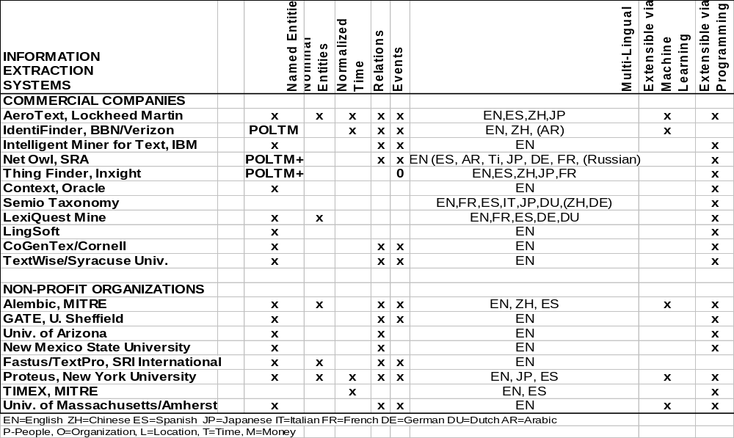
Tool Comparison-1 (IE)
INFORMATION
EXTRACTION
SYSTEMS
Screenshot taken fr. Mark Maybury

Slide 33
Entity Extraction Tools – Commercial Vendors 020204
AeroText - Lockheed Martin's AeroText & trade;
  www.lockheedmartin.com/factsheets/product589.html
BBN's Identifinder: www.bbn.com/speech/identifinder.html
IBM's Intelligent Miner for Text
  www-4.ibm.com/software/data/iminer/fortext/index.html
SRA NetOwl: www.netowl.com
Inxight's ThingFinder
  www.inxight.com/products/thing_finder/
Semio taxonomies: www.semio.com
Context: technet.oracle.com/products/oracle7/context/tutorial/
LexiQuest Mine: www.lexiquest.com
Lingsoft: www.lingsoft.fi
CoGenTex: www.cogentex.com
TextWise: www.textwise.com & www.infonortics.com/searchengines/boston1999/arnold/sld001.htm

Slide 34
Entity Extraction Tools – Non-Profit Organizations
MITRE’s Alembic extraction system and Alembic Workbench annotation tool: www.mitre.org/technology/nlp
Univ. of Sheffield’s GATE: gate.ac.uk
Univ. of Arizona: ai.bpa.arizona.edu
New Mexico State University (Tabula Rasa system): http://crl.nmsu.edu/Research/Projects/tr/index.html
SRI Internationals Fastus/TextPro:
  www.ai.sri.com/~appelt/fastus.html
  www.ai.sri.com/~appelt/TextPro (not free since Jan 2002!)
New York University’s Proteus
  www.cs.nyu.edu/cs/projects/proteus/
University of Massachusetts (Badger and Crystal):
  www-nlp.cs.umass.edu/

Slide 35
Name Analysis Software
Language Analysis Systems Inc.’s (Herndon, VA)
“Name Reference Library” www.las-inc.com & www.onomastix.com/
Supports analysis of Arabic, Hispanic, Chinese, Thai, Russian, Korean, and Indonesian names; others in future versions...
Product Features:
  Identifying the cultural classification of a person name
  Given a name, provides common variants on that name, e.g., “Abd Al Rahman” or “Abdurrahman” or ...
  Implied gender
  Identifies title, affixes, qualifiers, e.g.,
  "Bin," means "son of" as in Osama Bin Laden
  List top countries where name occurs
Cost: $3,535 a copy and a $990 annual fee !

Slide 36
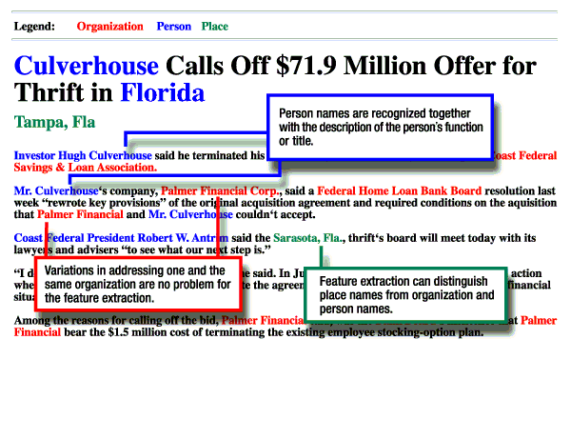
Example 1: IBM’s Intelligent Miner
See: www-4.ibm.com/software/data/iminer/fortext/index.html

Slide 37
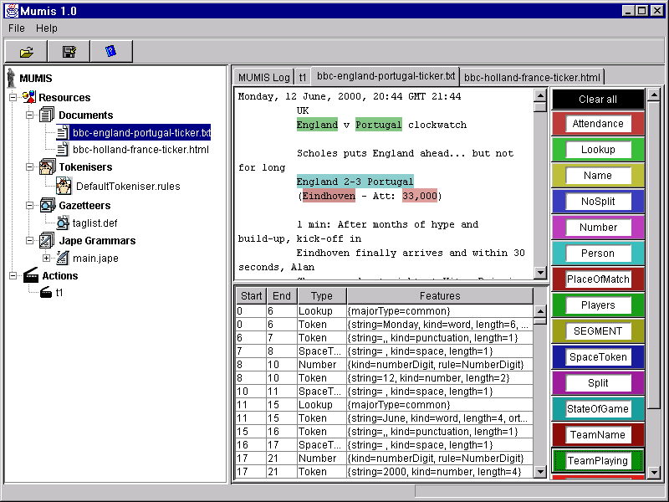
Example 2: GATE2

Slide 38
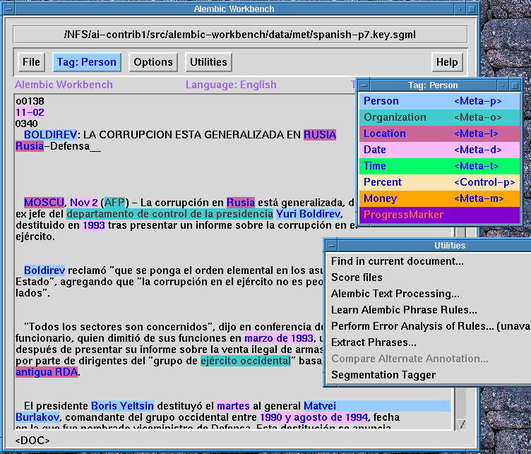
Example 3: AWB

Slide 39
Some Relevant Projects
ACE: Automated Content Extraction
(www.nist.gov/speech/tests/ace)
NIST: National Institure of Standards and Technologies
(http://www.itl.nist.gov/iaui/894.02/related_projects/muc/index.html); +evaluation tools
TIDES: Translingual Information Detection Extraction and Summarization; DARPA; multilingual name extraction (www.darpa.mil/ito/research/tides)
MUSE: A MUlti-Source Entity finder (http://www.dcs.shef.ac.uk/~hamish/muse.html)
Identifying Named Entities in Speech (HUB)
Other...

Slide 40
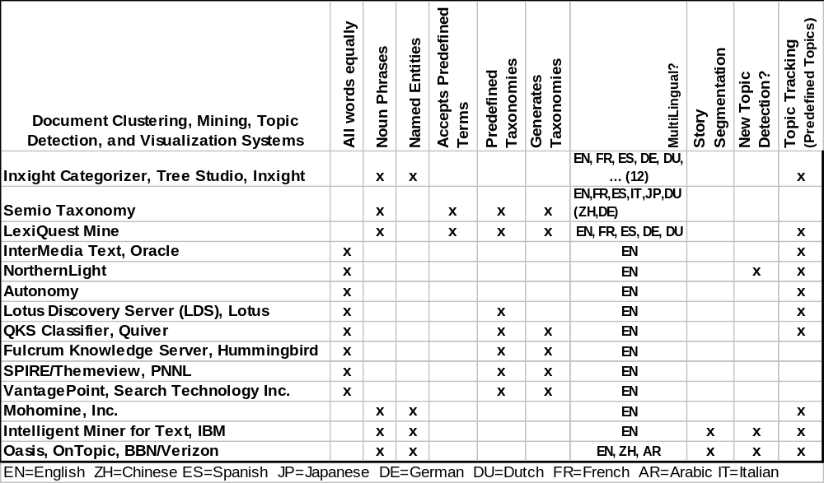
Tool Comparison-2 (DC,TM...)
Document Clustering, Mining, Topic Detection, and Visualization Systems
Screenshot taken fr. Mark Maybury

Slide 41
Evaluation
Evaluation consists of (at least) three parts:
  Entity Detection (of the string that names an entity): <ENAMEX>Fjärran Östern</ENAMEX>
  Attribute Recognition/Classification (of the entity); <ENAMEX TYPE=“LOCATION”>Fjärran Östern</ENAMEX>
  Extent Recognition (measure the ability of a system to correctly determine an entity’s extent partial correctness):
  Fjärran <ENAMEX TYPE=“LOCATION”>Östern</ENAMEX>

Slide 42
Evaluation cont’d
Systems exist that identify names ~90-95% accurately in newswire texts (in several languages)
Metrics: Vary from test case to test case; the “simplest” definitions are:
  Precision = #CorrectReturned/#TotalReturned
  Recall = #CorrectReturned/#CorrectPossible
Quite high figures in P&R can be found in the litterature based exclusively on these simpler metrics...
Almost non-existent discussion on metonymy or other difficult cases makes the results suspect?!

Slide 43
Evaluation cont’d
Guidelines for more rigid evaluation criteria have been imposed by the MUC; e.g.
  Precision = Correct + ( 0.5 * Partially Correct )
  Actual
  Correct: two single fills are considered identical
  Partially Correct: two single fills are not identical, but partial credit should still be given
  Actual = Correct + Incorrect + Partially Correct + Spurious
  Spurious: a response object has no key object aligned with it
  Recall = Correct + ( 0.5 * Partially Correct )
  Possible
See: http://www.itl.nist.gov/iaui/894.02/related_projects/muc/
muc_sw/muc_sw_manual.html

Slide 44
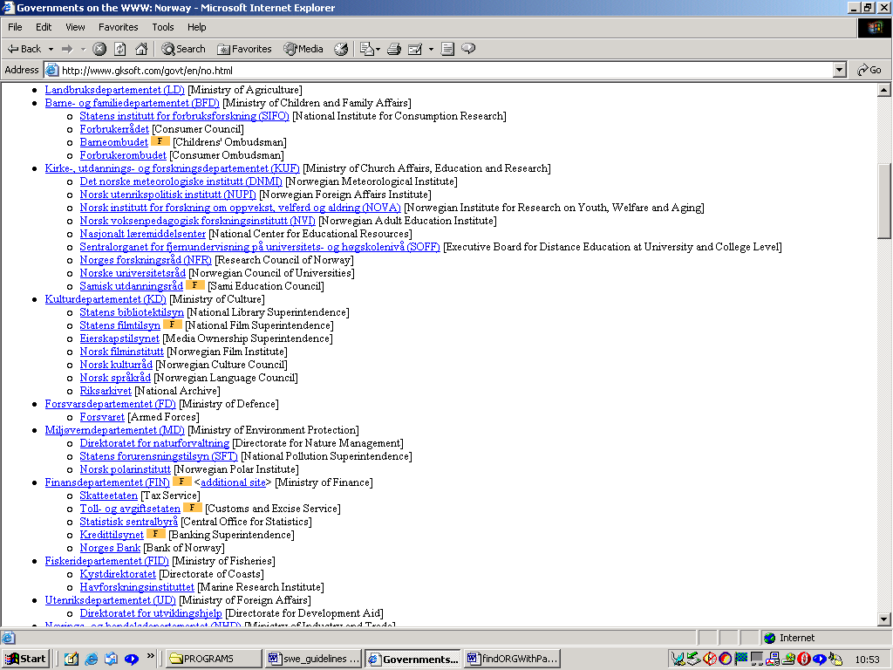
Resource Localization (Organizations: Govermental)
181 govermental
orgs for Norway
See: http://www.gksoft.com/govt/

Slide 45
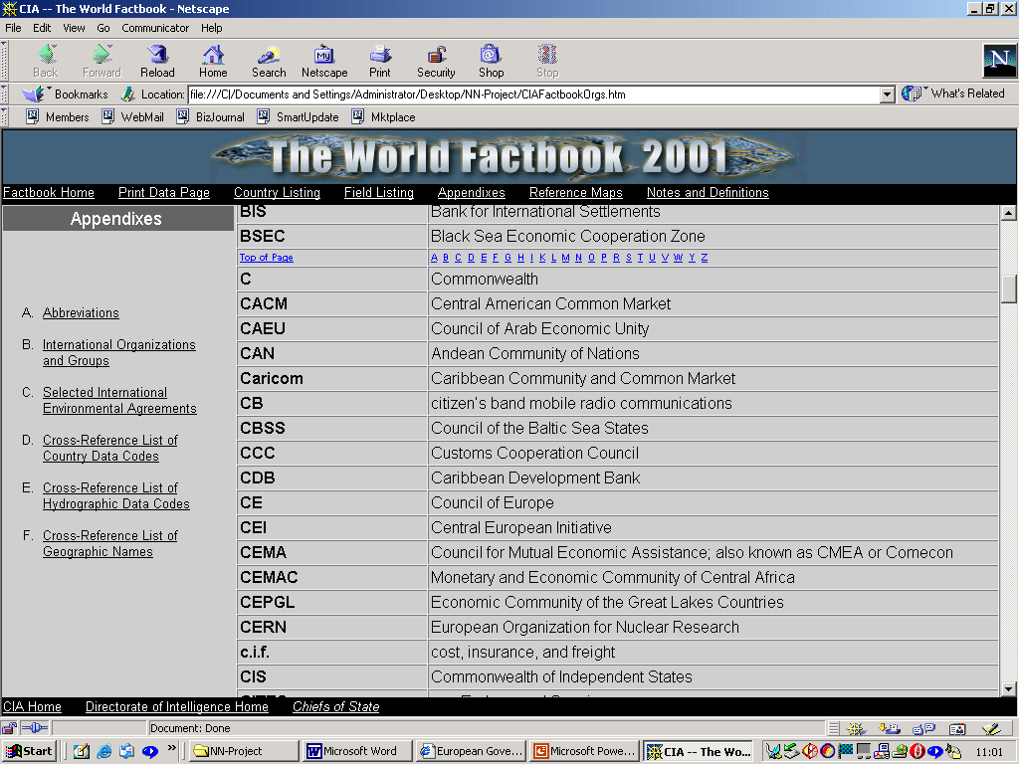
Resource Localization (Organizations: Govermental)
See: http://www.odci.gov/cia/publications/factbook/index.html

Slide 46
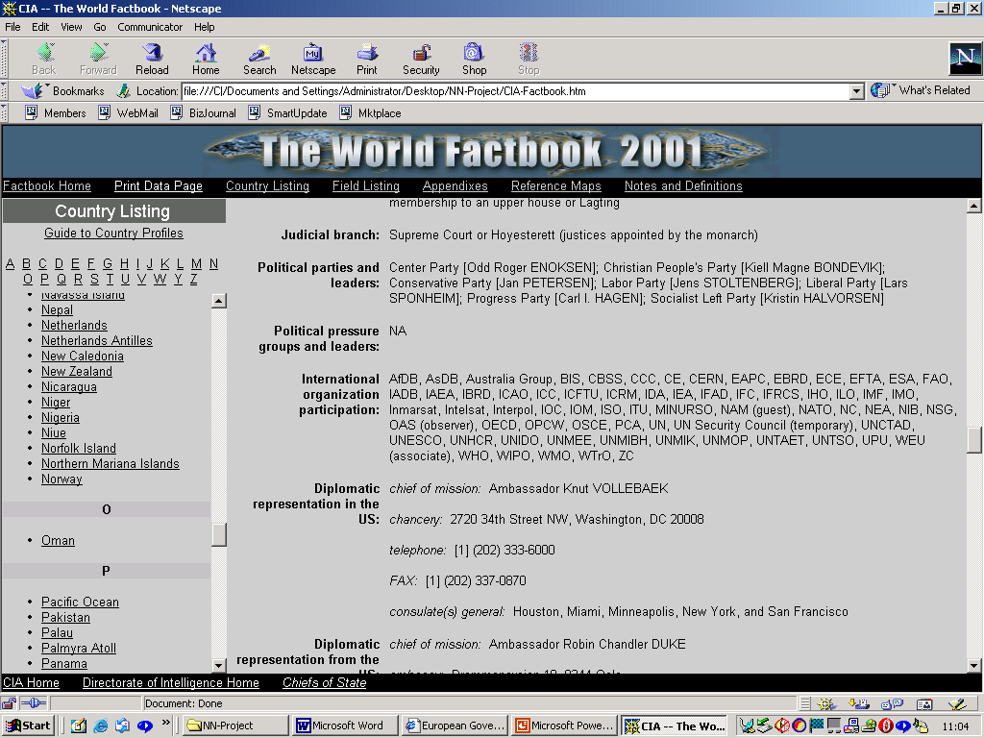
Resource Localization (Organizations: Govermental)
See: http://www.odci.gov/cia/publications/factbook/index.html

Slide 47
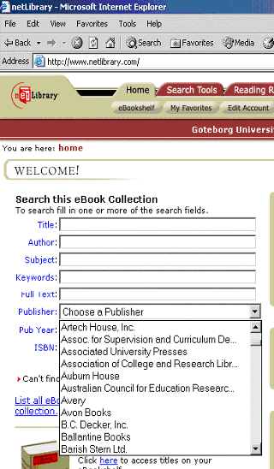
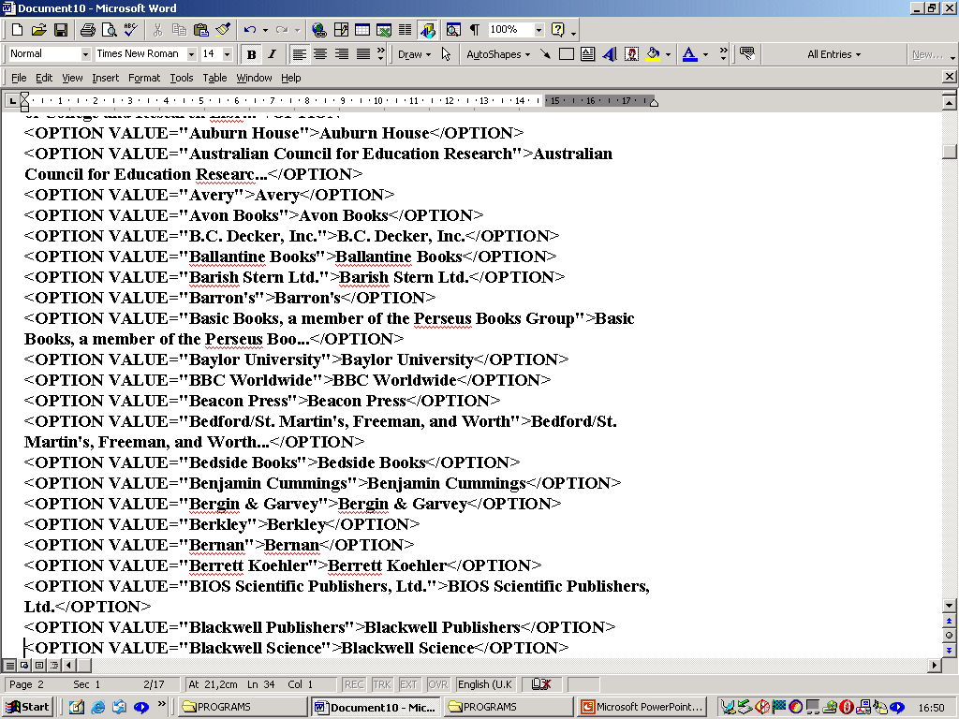
Resource Localization (Organizations: Publishers)
500 publ.
See: http://www.netlibrary.com

Slide 48
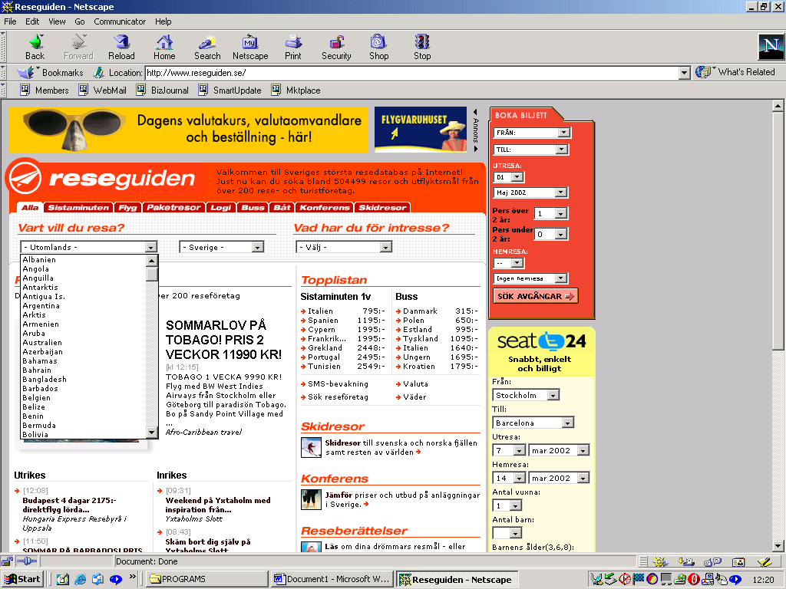
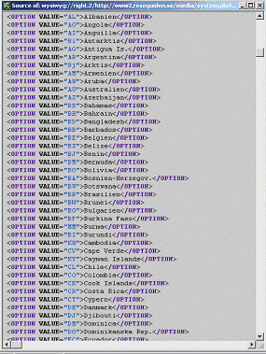
Resource Localization (Locations: Countries)
184 countries
See: http://www.reseguide.se

Slide 49
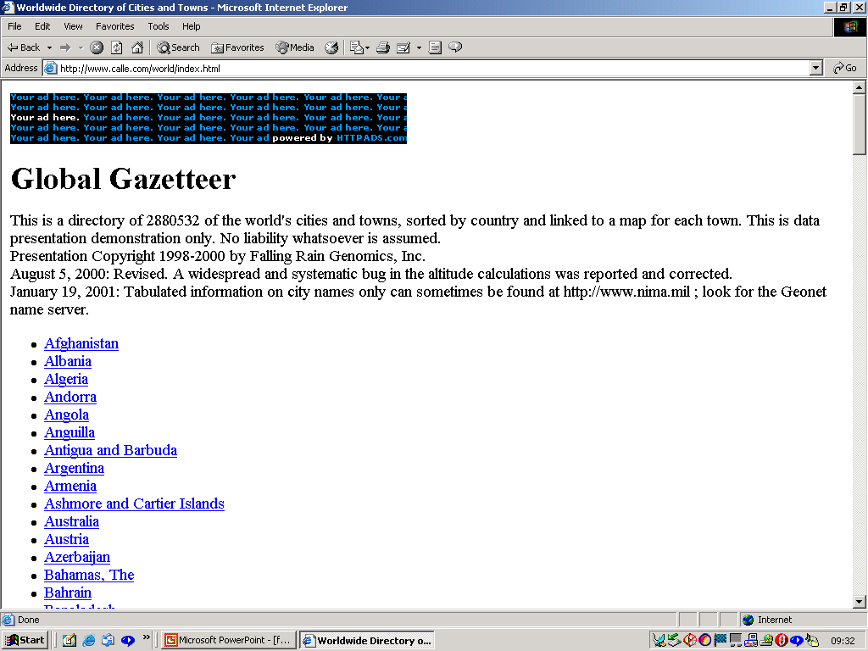
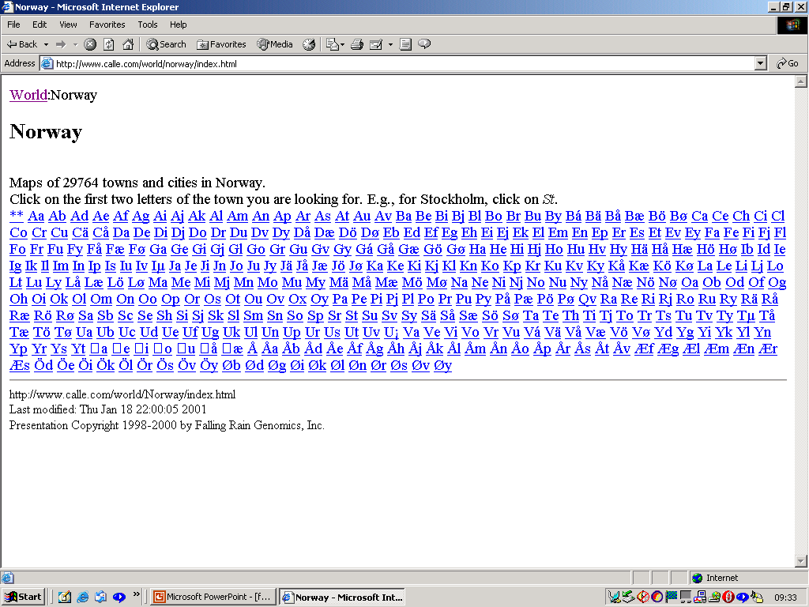
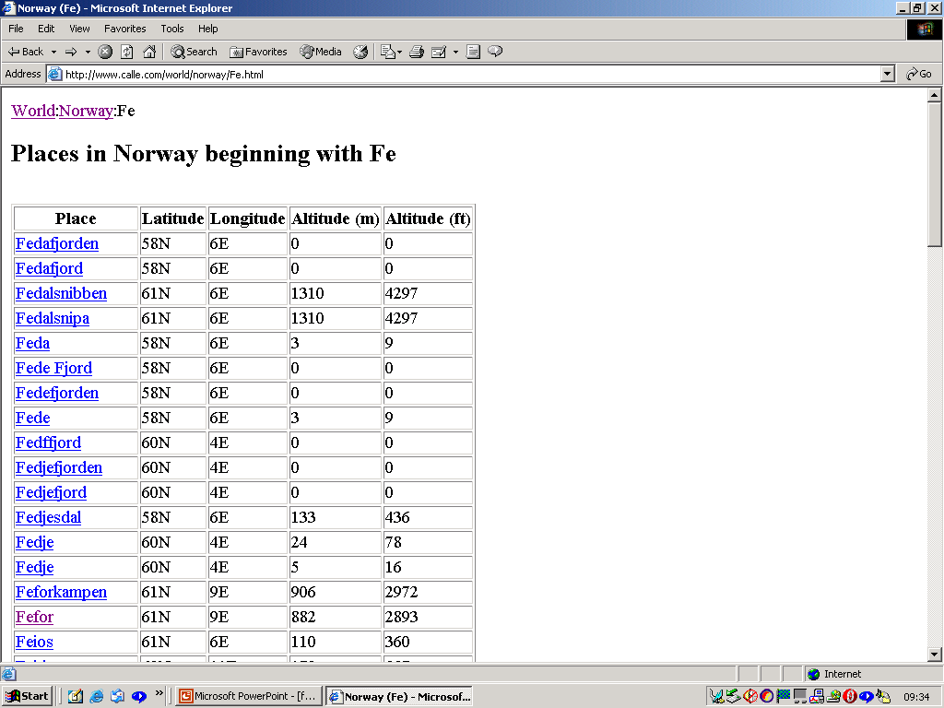
Resource Localization (Locations: Cities)
www.calle.com

Slide 50
Problems: Metonymy
a speaker uses a reference to one entity to refer to another entity – or entities – related to it; ALL words are metonyms?!
(In ACE) Classic metonymies and composites
Reference to two entities, one explicit
and one indirect reference; commonly this
is the case of capital city names standing in
for national goverments
Apply to GPEs, typically having a goverment, a populate, a geographic location and an abstract notion of statehood

Slide 51
Problems: DCA?
The DCA approach might not work for some of the NE categories that are long and mentioned only once; particularly EVENTS, ARTWORK, …
In these cases context sensitive grammars might be the alternative; They work fairly well for novel entities and rules can be created by hand or learned via machine learning or statistical algorithms
example....

Slide 52
Rules that capture local patterns that characterize entities, from instances of annotated training data or semi-automatic analysis of corpora:
  XXX köpte YYY:
    XXX and YYY are with very high probability organizations
    EMI köpte Virgin_Music_Group
    Grundin köpte Hornline
    Moyne köpte Trustor
    Optiroc köpte Stråbruken
    Pandox köpte Park_Avenue_Hotel
    SF köpte Europafilm
    Stagecoach köpte Swebus
    Trelleborg köpte Intertrade

Slide 53
DCA more problems...
<Dagens Indutri 020306 s.18>
Fords VD och delägare Bill Ford stal showen från Volvo PV när bilsalongen i Genève... Ford köpte Volvo Personvagnar 1999....På Fords egen presskonferens betonade Bill Ford att Volvo...
<Dagens Indutri 020306 s.22>
Indutri- och finansmannen Carl Bennet, via sitt bolag Carl Bennet AB, börsnoterade...Carl Bennet framhåller att...

Slide 54
Some Final Remarks
A challenge with NER is creating a stable definition
of what an entity is and creating a taxonomy of entities
to map to...
Having done that it becomes simpler to solve
metonymy and other ambiguity problems...
Problems remain; where shall we draw the entity boundaries?
Text format...
Shall we just go for it or try and rationalize the entity types?
time will show...

