Slide 1

100%
Mastering the Art: Choosing Between CTEs and Nested Methods for Optimal Query Performance
Easy Tips for converting
CTE’s
Nested
Total success!

Slide 2

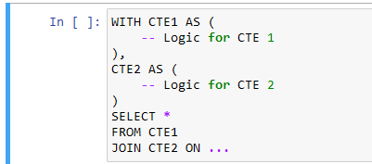
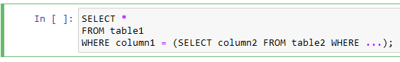
CTE’s Method
Nested Method
When the Query is Too Complex: Use CTEs when the main query is too complex and can be broken down into smaller, more readable parts.
When the Query is Simple: If the query you are constructing is relatively simple and does not require intricate division, nested queries can be effective.
Recursion: When dealing with recursive or hierarchical data, CTEs can be used with the recursive feature using UNION ALL.
Existence Check: When you only need to perform an existence check on data or perform a simple operation based on the result of a subquery.

Slide 3
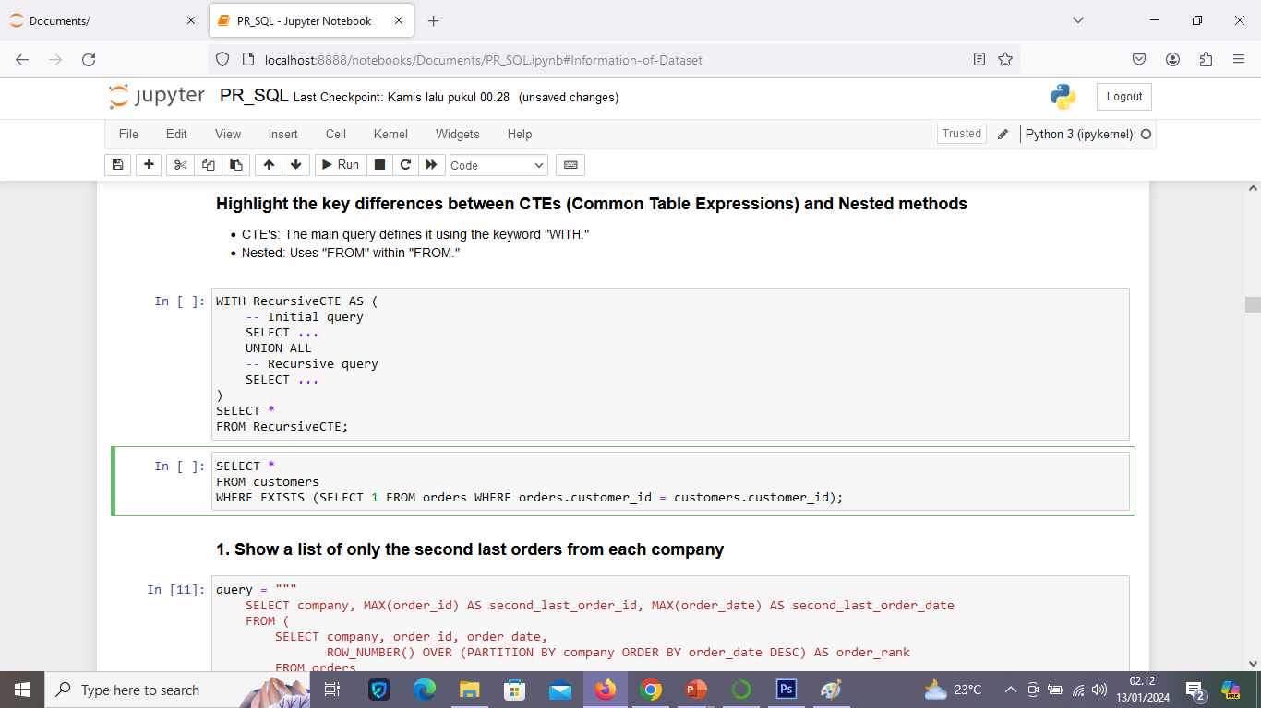
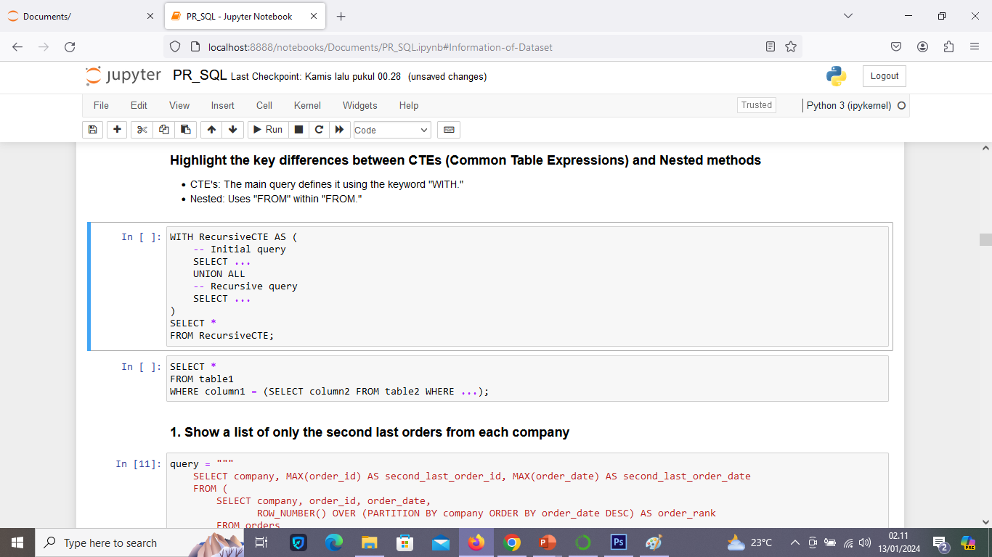
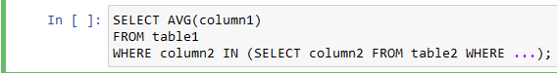
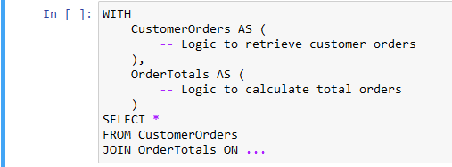
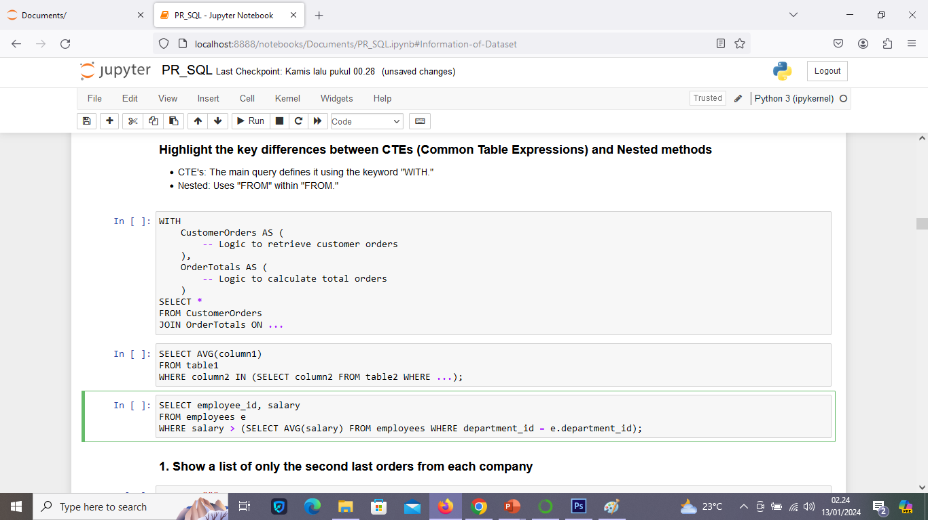
CTE’s Method
Nested Method
Simple Aggregation or Comparison: If you only need simple aggregation results or comparisons with the result of a subquery.
Separating Business Logic: Use CTEs to separate and organize business logic into manageable sections.
Correlated Subqueries: When the subquery needs to refer to columns from the outer query. Correlated subqueries typically use a nested approach.

Slide 4
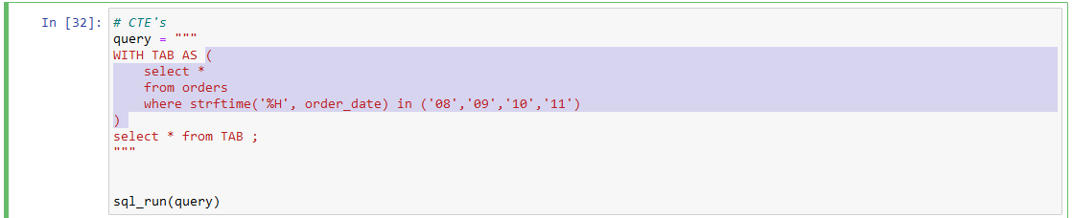
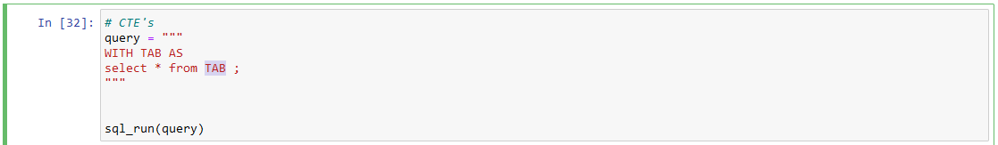
Easy Tips for converting
CTE’s
Nested
1. Drag the code within the brackets and then cut it
2. Drag the text "TAB"

Slide 5
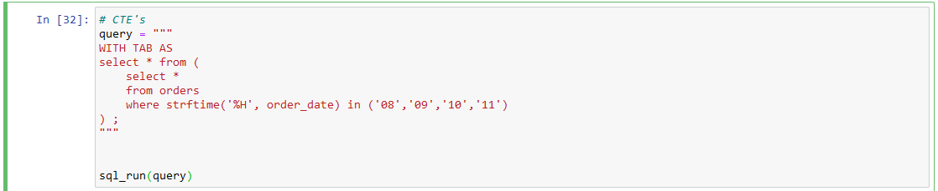
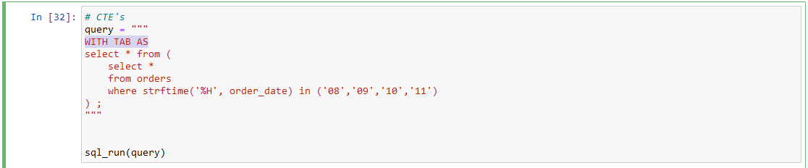
Easy Tips for converting
CTE’s
Nested
3. Then paste it at the TAB location or after the word "from"
4. Delete the text "WITH TAB AS"

Slide 6
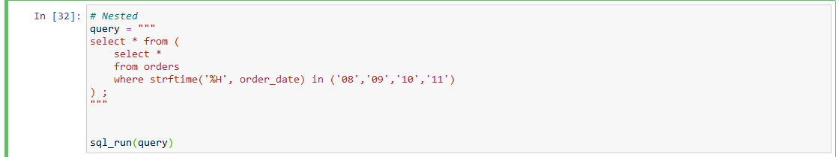
Easy Tips for converting
CTE’s
Nested
5. The CTE's method has been successfully transformed into Nested
Highlight the key differences between CTE's (Common Table Expressions) and Nested methods
CTE's: The main query defines it using the keyword "WITH.“
Nested: Uses "FROM" within "FROM."

Slide 7


The complete query code can be found in the notebook that I shared on my GitHub.
https://www.linkedin.com/in/novia-wulandari-1247a2228/
https://github.com/noviawulandar1

