Slide 1
  Glocal 2.0
  Blogs, CVs and Jobs
  in Macedonia

Slide 2
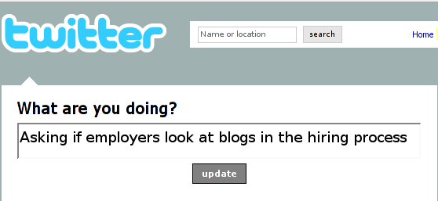

Slide 3
Often Probably Maybe What?! Who cares... I don't know NO Not really Not sure Sometimes Rarely Yes

Slide 4
Often Probably Maybe What?! Who cares... I don't know NO Not really Not sure Sometimes Rarely Yes

Slide 5
  six companies
  (4 HR, 2 telecom)

Slide 6
  small sample

Slide 7
  <one>

Slide 8
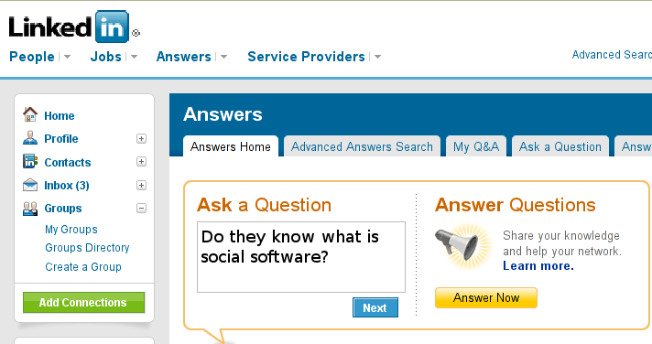

Slide 9
  the brands, not the term

Slide 10
  face to face
  &
  technology

Slide 11
  <two>

Slide 12
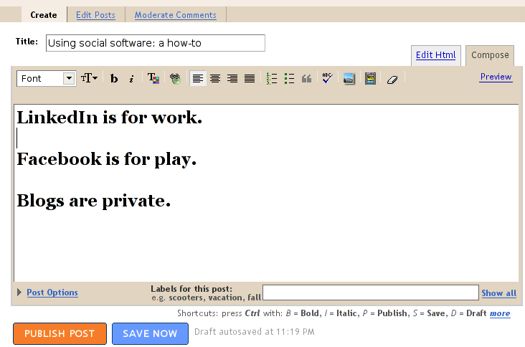

Slide 13
  blog from work

Slide 14
  reading for entertainment

Slide 15
  <three>

Slide 16
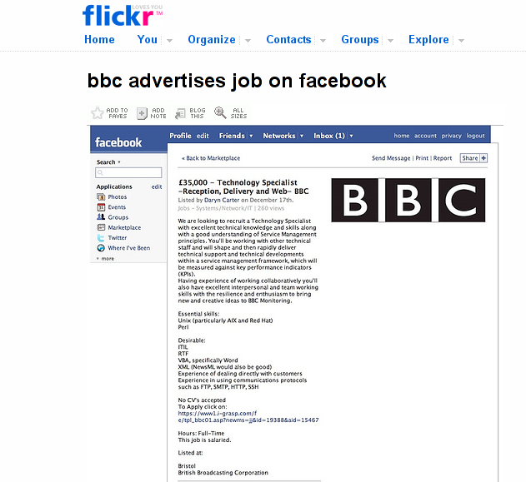

Slide 17
  local sites

Slide 18
  exploring LinkedIn

Slide 19
  <four>

Slide 20
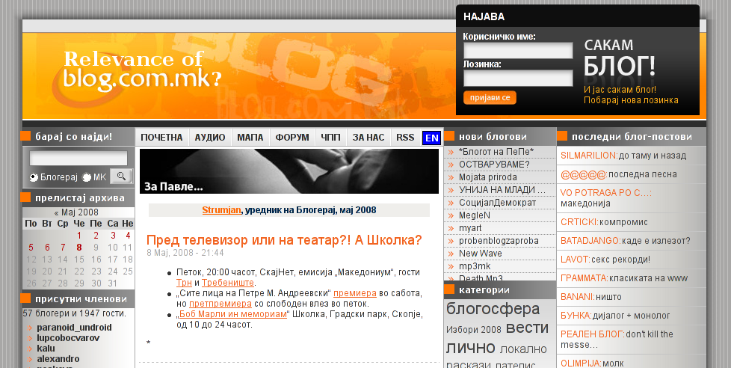

Slide 21
  conflict of interests

Slide 22
  time consuming

Slide 23
  anonymity, misrepresentation,
  public image

Slide 24
  nondiscrimination policy
  vs
  headhunting

Slide 25
  <five>

Slide 26
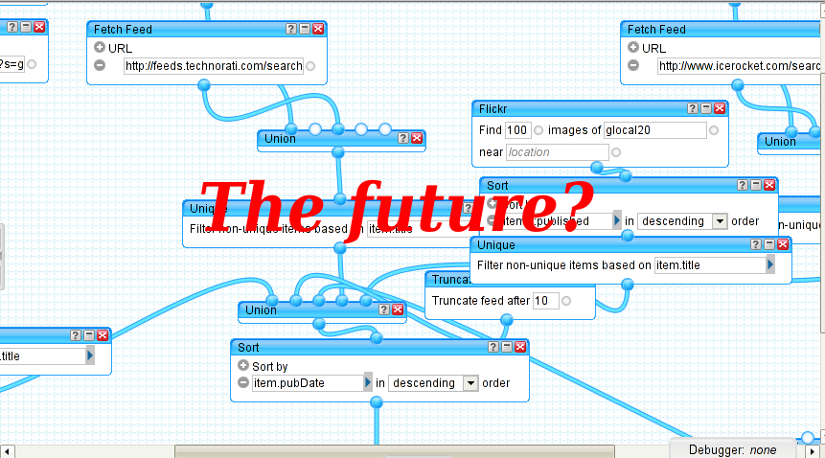

Slide 27
  cool,
  copyright,
  control

Slide 28
  maturity

Slide 30
  <godin>
  Great people shouldn't have a resume.
  Here's why: A resume is an excuse to reject you. Once you send me your resume, I can say, "oh, they're missing this or they're missing that," and boom, you're out.
  </godin>
  http://sethgodin.typepad.com/seths_blog/2008/03/why-bother-havi.html

